Slide 1
GSICS-EP-19 debrief 19th GSICS Executive Panel, Bangalore, India, 1-2 June 2018

Slide 2
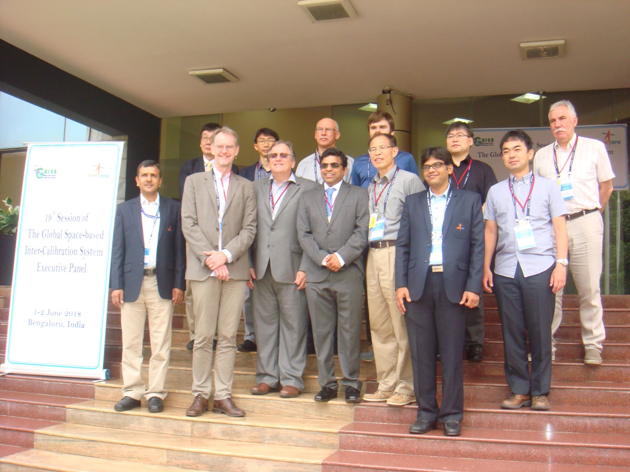
GSICS-EP-19
CGMS-46-GSICS, Bangalore, India, 1-2 June 2018

Slide 3
GSICS EP Approvals/Agreements on GDWG Activities
GDWG Chairing
Chair: M.Takahashi (JMA)
Vice-Chair: A.K. Mitra (IMD) and P. Miu (EUM)
Minor updates of GDWG ToR
Removal of strong expected skill for GDWG members
GDWG Fact Sheet (developed at GSICS-EP-18)
As one of GSICS official documents
Action ID format for EP meetings
Same as those for GRWG/GDWG/GCC
GSICS Wiki migration and new WMO GSICS Portal website
WMO/NOAA-GDWG to keep communication
Instrument Event Logging (next slide)

Slide 4
Instruments Event Logging
Achievements and problems on Event Logging activity
White paper submitted to CGMS-45 (2017)
Progress on creating “Landing Pages” to be linked from WMO OSCAR/Space
CMA/EUM/JMA/KMA: done, NOAA: ongoing, other agencies: encouraged to do
Difficulties in achieving final goal: adopting nomenclature/standards
Developing/implementing tools/software: not a scope of updated GDWG ToR
Additional resources (e.g. technical/database experts) are needed
Proposal to take the further tasks back to CGMS
Discussions at CGMS-46 (WG IV: Global data dissemination)
Implementation of GSICS monitoring/incident management capabilities in WDQMS (WIGOS Data Quality Monitoring System) will be discussed (action to WMO)
Purpose of WDQMS: to monitor/evaluate observational availability/quality/timeliness for all WIGOS observations (GOS, GAW, WHO, GCW) and GCOS

Slide 5
GSICS Annual State of the Observing System
Can we compile a collection of GSICS monitoring results into overarching annual assessment of observing system performance with respect to reference instruments?
GDWG Chair introduced report examples kindly prepared by EUMETSAT, JMA, KMA and NOAA (next slides)
EP appreciated GRWG/GDWG discussions.
Usefulness of scene dependent biases (if exists) and accuracies of reference instruments by Double Difference was pointed out.
Discussion to be continued in GRWG/GDWG to finalize the template (hopefully by the end of 2018).

Slide 6
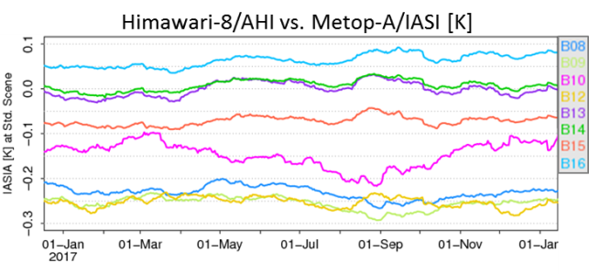
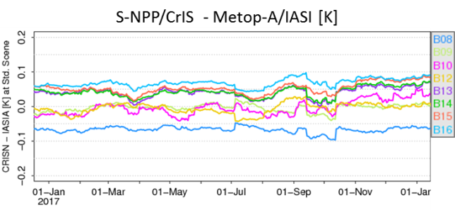
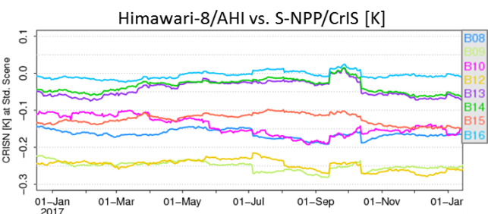
Calibration Performance: Himawari-8/AHI Infrared Bands
Summary Statistics of Himawari-8/AHI IR Calibration Performance in 2017 (All uncertainties are k=1)
 | Channel Name (Central Wavelength in μm) | BAND07 (3.9) | BAND08 (6.2) | BAND09 (6.9) | BAND10 (7.3) | BAND11 (8.6) | BAND12 (9.6) | BAND13 (10.4) | BAND14 (11.2) | BAND15 (12.4) | BAND16 (13.3)
 | Std. Radiance as Tb (K) | 286.0 | 234.6 | 243.9 | 254.6 | 283.8 | 259.5 | 286.2 | 286.1 | 283.8 | 269.7
Metop-A/ IASI | Mean Bias (K) | -0.11 | -0.173 | -0.212 | -0.129 | -0.05 | -0.216 | 0.036 | 0.045 | -0.04 | 0.078
 | Stdv. of Bias (K) | 0.008 | 0.012 | 0.009 | 0.014 | 0.012 | 0.017 | 0.018 | 0.019 | 0.017 | 0.015
S-NPP/ CrIS | Mean Bias (K) | -0.07 | -0.16 | -0.24 | -0.15 | N/A | -0.23 | -0.02 | -0.01 | -0.01 | 0.03
 | Stdv/ of Bias (K) | 0.039 | 0.011 | 0.012 | 0.026 | N/A | 0.013 | 0.013 | 0.012 | 0.010 | 0.005
The statistics are derived from Himawari-8/AHI GSICS Re-Analysis Correction (ATBD)
Standard Radiance: typical scene defined by GSICS for easy inter-comparison of sensors’ inter-calibration biases

Slide 7
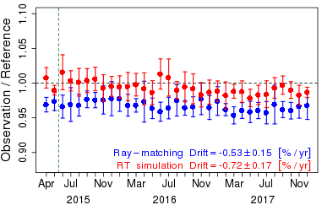
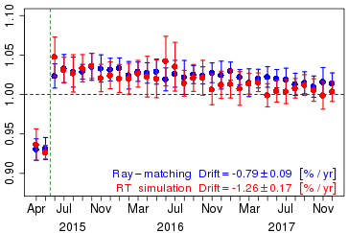
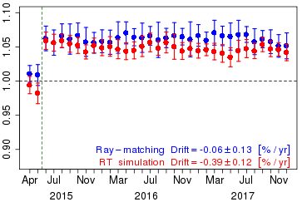
Calibration Performance: Himawari-8/AHI Visible/Near-Infrared Bands
Summary Statistics of Himawari-8/AHI VNIR Calibration Performance (All Uncertainties are k=1)
Channel Name (Central Wavelength in μm) |  | BAND01 (0.47) | BAND02 (0.51) | BAND03 (0.64) | BAND04 (0.86) | BAND05 (1.6) | BAND06 (2.3) | Units
Ray-matching w/ S-NPP/VIIRS | Mean Bias | 2.2 ± 0.8 | +3.1 ± 0.8 | -2.9 ± 0.8 | -0.8 ± 0.7 | -6.3 ± 0.8 | +4.9 ± 0.9 | %
 | Annual Drift | -0.53 ± 0.15 | -0.52 ± 0.12 | -0.79 ± 0.09 | -0.58 ± 0.06 | -0.06 ± 0.13 | -0.18 ± 0.11 | %/yr
Vicarious Cal. using Aqua/MODIS + RTM | Mean Bias | 1.0 ± 1.6 | +1.7 ± 1.8 | -1.9 ± 1.8 | -2.8 ± 1.6 | -4.3 ± 1.0 | +3.5 ± 0.9 | %
 | Annual Drift | -0.72 ± 0.17 | -0.92 ± 0.18 | -1.26 ± 0.17 | -1.20 ± 0.17 | -0.39 ± 0.12 | -0.24 ± 0.19 | %/yr
Mean Bias: monthly average and standard deviation of the daily results in January 2017
Annual Drift: calculated using Mean Bias from July 2015 to December 2017
Ray-matching: Spectral Band Adjustment Factors on NASA Langley website compensates Spectral diff. (ATBD)
Vicarious calibration uses optical parameters retrieved from Aqua/MODIS C6 L1B (Reference)
Trend of the ratio of observation to reference computed using Ray-matching / Vicarious calibration approaches
BAND01 (0.47 μm)
BAND03 (0.64 μm)
BAND05 (1.6 μm)

Slide 8
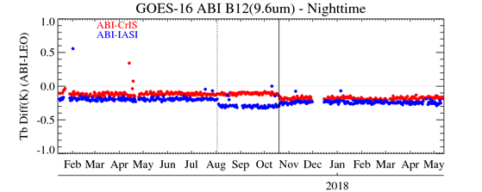
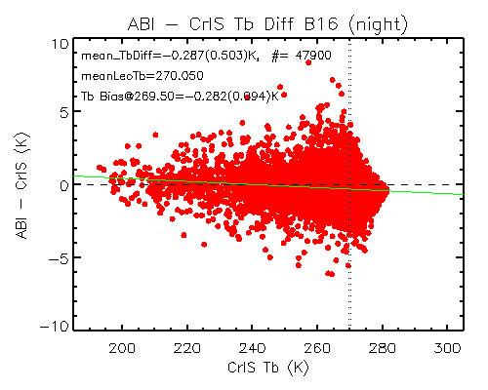
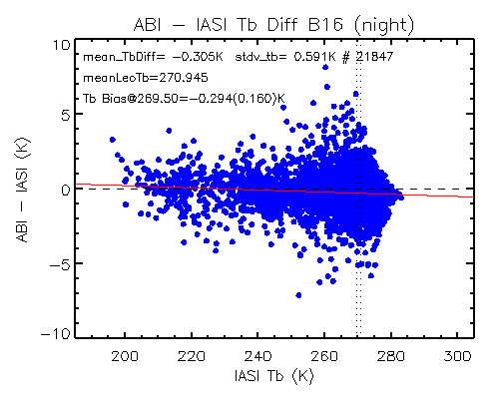
Calibration Performance: GOES16/ABI Infrared Bands
Summary Statistics of GOES-16/ABI IR Calibration Performance in December 2017 (All uncertainties are k=1)
 | Channel Name (Central Wavelength in μm) | BAND07 (3.9) | BAND08 (6.2) | BAND09 (6.9) | BAND10 (7.3) | BAND11 (8.6) | BAND12 (9.6) | BAND13 (10.4) | BAND14 (11.2) | BAND15 (12.4) | BAND16 (13.3)
 | Std. Scene Tb (K) | 286.0 | 234.5 | 244.0 | 254.5 | 284.0 | 259.5 | 286.0 | 286.0 | 283.5 | 269.5
Metop-B/ IASI | Bias at Std. Scene(K) | -0.167 | -0.196 | -0.218 | -0.170 | -0.204 | -0.227 | -0.210 | -0.141 | -0.153 | -0.294
 | Stdv. of Bias (K) | 0.120 | 0.082 | 0.093 | 0.108 | 0.147 | 0.110 | 0.160 | 0.165 | 0.169 | 0.160
S-NPP/ CrIS | Bias at Std. Scene(K) | - | - | -0.259 | -0.202 | - | -0.160 | -0.227 | -0.167 | -0.176 | -0.282
 | Stdv of Bias (K) | - | - | 0.045 | 0.052 | - | 0.047 | 0.073 | 0.073 | 0.073 | 0.094
The uncertainty and statistics are calculated following the GSICS standard GEO-LEO IR inter-calibration algorithm
GOES-16 ABI IR calibration is very stable with mean Tb bias to CrIS/IASI less than 0.3K. No significant scene dependent Tb bias to the reference instruments for all the IR channels
GOES-16 ABI post-launch test started in Jan. 2017 and became operational on 18 December 2017. L1B data are available to the public since after the provisional maturity on 1 June 2017.
Stable reference and monitored instruments can quickly detect and identify calibration events (e.g. Metop-B/IASI and GOES-16 ABI Ground updates) and validate the algorithm (e.g. ABI cal. algorithm update in October 2017)
Time series of GOES-16 ABI daily mean Tb bias to SNPP/CrIS and Metop-B/IASI for ABI B12
Scene dependent Tb bias to SNPP/CrIS for ABI B16
Scene dependent Tb bias to Metop-B/IASI for ABI B16
Metop-B/IASI cal. algorithm update
G16 ABI cal. algorithm update

Slide 9
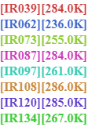
Calibration Performance: Meteosat-8/SEVIRI IR Bands
Summary Statistics of Meteosat-8/SEVIRI IR Calibration Performance in 2017 (All uncertainties are k=1)
Channel Name | IR3.9 | IR6.2 | IR7.3 | IR8.7 | IR9.7 | IR10.8 | IR12.0 | IR13.4
Standard Radiance as Tb (K) | 284 | 236 | 255 | 284 | 261 | 286 | 285 | 267
Mean Bias (K) | +0.57 | -0.16 | +0.38 | +0.01 | -0.08 | +0.04 | +0.01 | +0.35
Standard Deviation of Bias (K) | 0.03 | 0.05 | 0.08 | 0.05 | 0.07 | 0.04 | 0.03 | 0.40
Mean Drift Rate of Bias (K/yr) | -0.07 | -0.10 | -0.22 | -0.04 | -0.14 | -0.05 | -0.05 | +0.35
The statistics are derived from Meteosat-8/SEVIRI Operational GSICS Re-Analysis Correction vs. Metop-A/IASI
Biases defined for Standard Radiance: typical scene for easy inter-comparison of sensors’ inter-calibration biases
Decontaminations introduce calibration jumps – most obvious in the IR13.4 channel due to ice contamination
Time series of Meteosat-8/SEVIRI Tb biases w.r.t. Metop-A/IASI at standard radiance

Slide 10
Calibration Performance: Meteosat-9/SEVIRI IR Bands
Summary Statistics of Meteosat-9/SEVIRI IR Calibration Performance in 2017 (All uncertainties are k=1)
Channel Name | IR3.9 | IR6.2 | IR7.3 | IR8.7 | IR9.7 | IR10.8 | IR12.0 | IR13.4
Standard Radiance as Tb (K) | 284 | 236 | 255 | 284 | 261 | 286 | 285 | 267
Mean Bias (K) | +0.36 | -0.13 | +0.09 | +0.01 | -0.03 | +0.03 | -0.01 | -1.41
Standard Deviation of Bias (K) | 0.08 | 0.12 | 0.15 | 0.11 | 0.18 | 0.11 | 0.13 | 0.16
Mean Drift Rate of Bias (K/yr) | -0.23 | -0.34 | -0.39 | -0.08 | -0.44 | -0.13 | -0.21 | -0.46
The statistics are derived from Meteosat-9/SEVIRI Operational GSICS Re-Analysis Correction vs. Metop-A/IASI
Biases defined for Standard Radiance: typical scene for easy inter-comparison of sensors’ inter-calibration biases
Meteosat-9 operated in Rapid Scan Service during most of this period, which increases the bias uncertainties
Time series of Meteosat-9/SEVIRI Tb biases w.r.t. Metop-A/IASI at standard radiance

Slide 11
Calibration Performance: Meteosat-10/SEVIRI IR Bands
Summary Statistics of Meteosat-10/SEVIRI IR Calibration Performance in 2017 (All uncertainties are k=1)
Channel Name | IR3.9 | IR6.2 | IR7.3 | IR8.7 | IR9.7 | IR10.8 | IR12.0 | IR13.4
Standard Radiance as Tb (K) | 284 | 236 | 255 | 284 | 261 | 286 | 285 | 267
Mean Bias (K) | +0.36 | -0.17 | +0.07 | -0.04 | +0.07 | +0.03 | +0.04 | -1.40
Standard Deviation of Bias (K) | 0.08 | 0.03 | 0.03 | 0.03 | 0.02 | 0.02 | 0.02 | 0.11
Mean Drift Rate of Bias (K/yr) | -0.25 | -0.08 | +0.05 | +0.03 | -0.01 | -0.02 | -0.01 | -0.35
The statistics are derived from Meteosat-10/SEVIRI Operational GSICS Re-Analysis Correction vs. Metop-A/IASI
Biases defined for Standard Radiance: typical scene for easy inter-comparison of sensors’ inter-calibration biases
Decontaminations introduce calibration jumps – most obvious in the IR13.4 channel due to ice contamination
Time series of Meteosat-10/SEVIRI Tb biases w.r.t. Metop-A/IASI at standard radiance

Slide 12
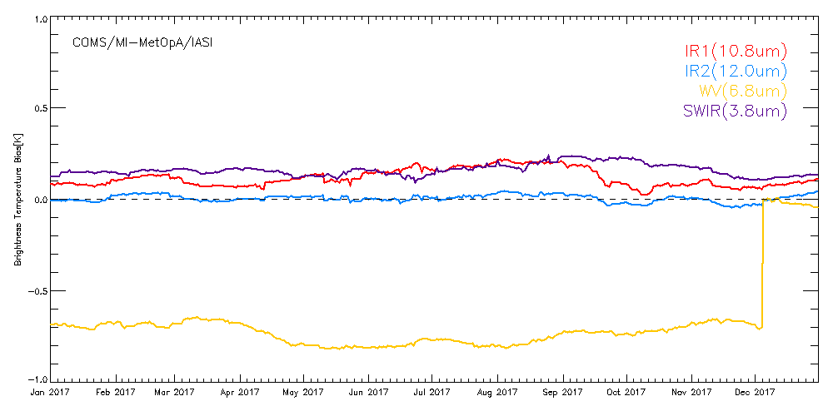
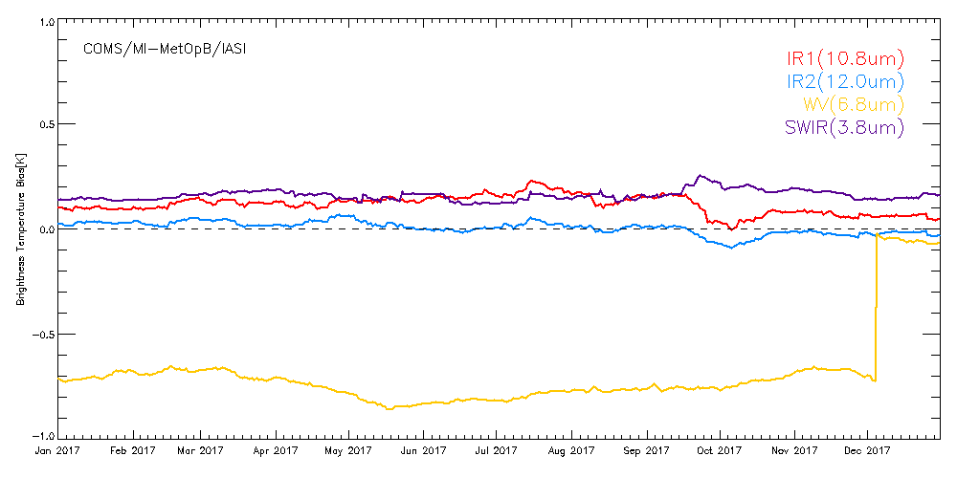
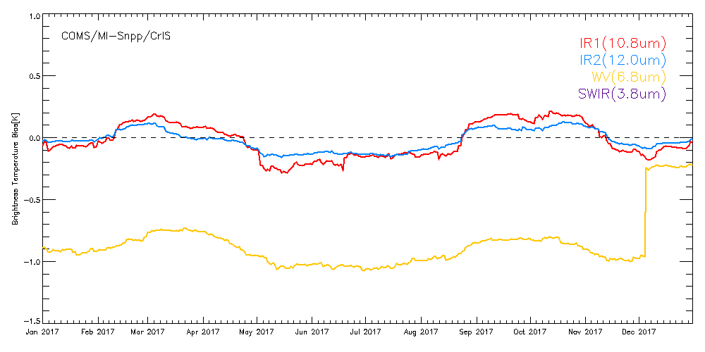
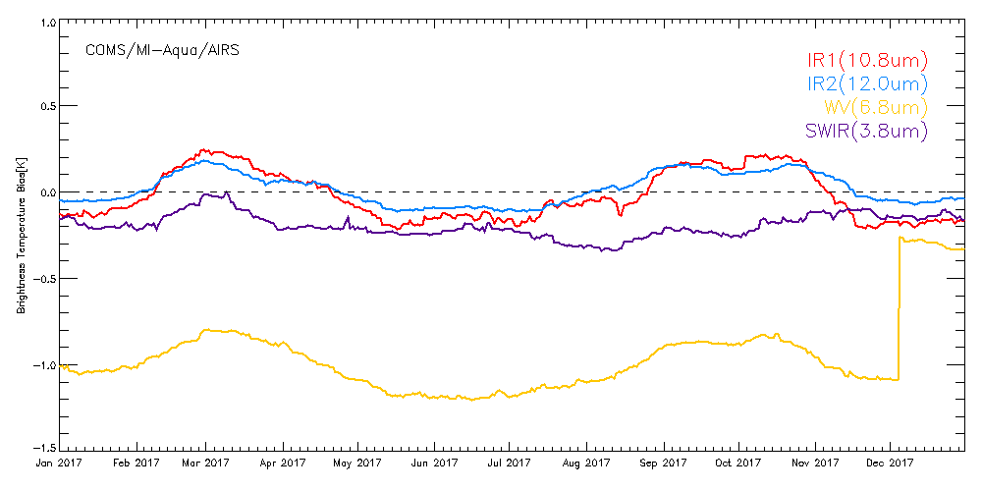
Calibration Performance: COMS/MI Infrared Bands
Summary Statistics of COMS/MI IR Calibration Performance in 2017 (All uncertainties are k=1)
 | MetOp-A/IASI |  |  |  | MetOp-B/IASI
Channel Name | IR3.8 | IR6.8 | IR10.8 | IR12.0 | IR3.8 | IR6.8 | IR10.8 | IR12.0
Std Rad as Tb (K) | 286 | 238 | 286 | 285 | 286 | 238 | 286 | 285
Mean Bias (K) | 0.16 | -0.02 | 0.12 | 0.004 | 0.15 | -0.06 | 0.11 | 0.004
Stdv of Bias (K) | 0.03 | 0.01 | 0.05 | 0.02 | 0.02 | 0.01 | 0.04 | 0.03
Mean Drift Rate of Bias (K/yr) | -0.14 | - | -0.12 | -0.01 | -0.15 | - | -0.14 | -0.04
 | Snpp/CrIS |  |  |  | Aqua/AIRS
Channel Name | IR3.8 | IR6.8 | IR10.8 | IR12.0 | IR3.8 | IR6.8 | IR10.8 | IR12.0
Std Rad as Tb (K) | 286 | 238 | 286 | 285 | 286 | 238 | 286 | 285
Mean Bias (K) | - | -0.23 | -0.03 | -0.02 | -0.19 | -0.30 | -0.02 | 0.02
Stdv of Bias (K) | - | 0.01 | 0.14 | 0.08 | 0.07 | 0.02 | 0.14 | 0.09
Mean Drift Rate of Bias (K/yr) | - | - | +0.03 | +0.03 | +0.19 | - | -0.005 | -0.007
The statistics are derived from COMS/MI Operational GSICS Re-Analysis Correction vs. Metop-A/IASI, Metop-B/IASI, Aqua/AIRS, Snpp/CrIS
Biases defined for Standard Radiance: typical scene for easy inter-comparison of sensors’ inter-calibration biases
Operation of MI with shifted WV SRF of 3.5cm⁻¹ started in 5 December 2017.

Slide 13
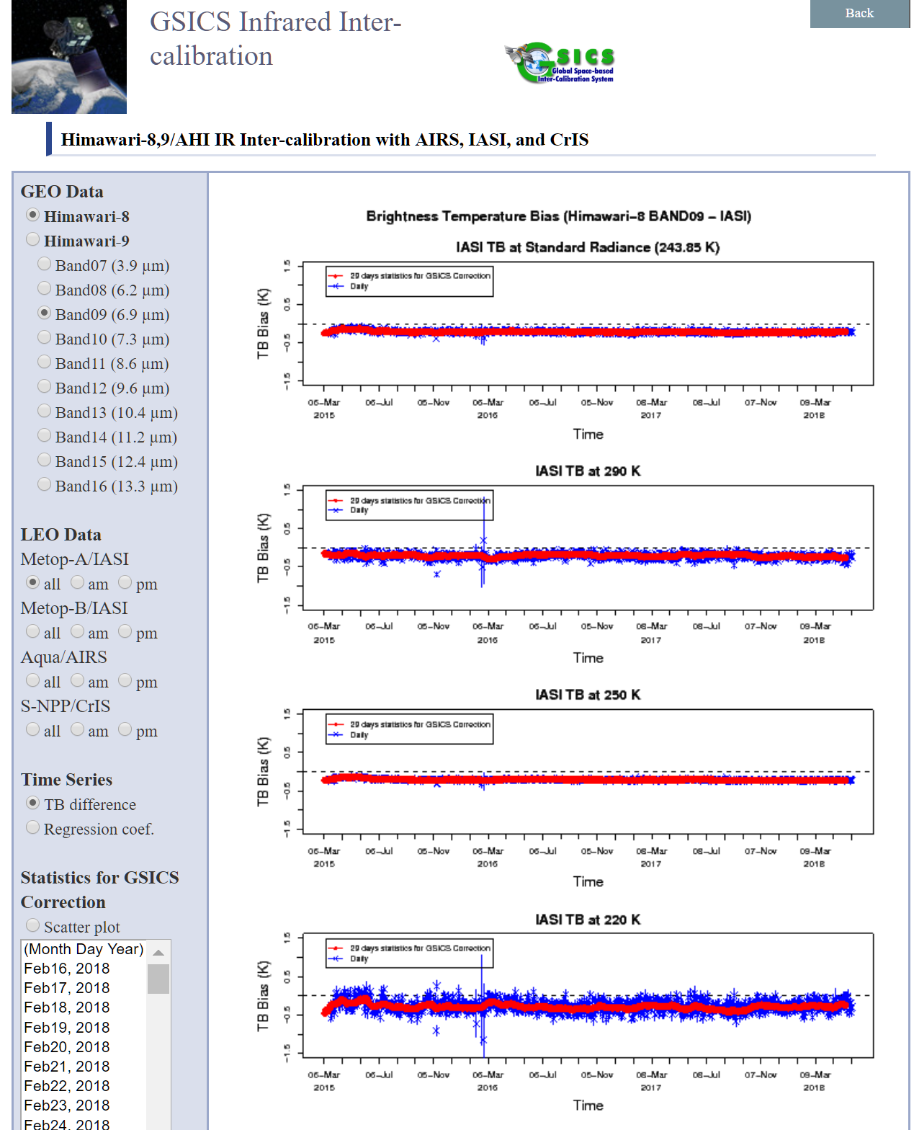
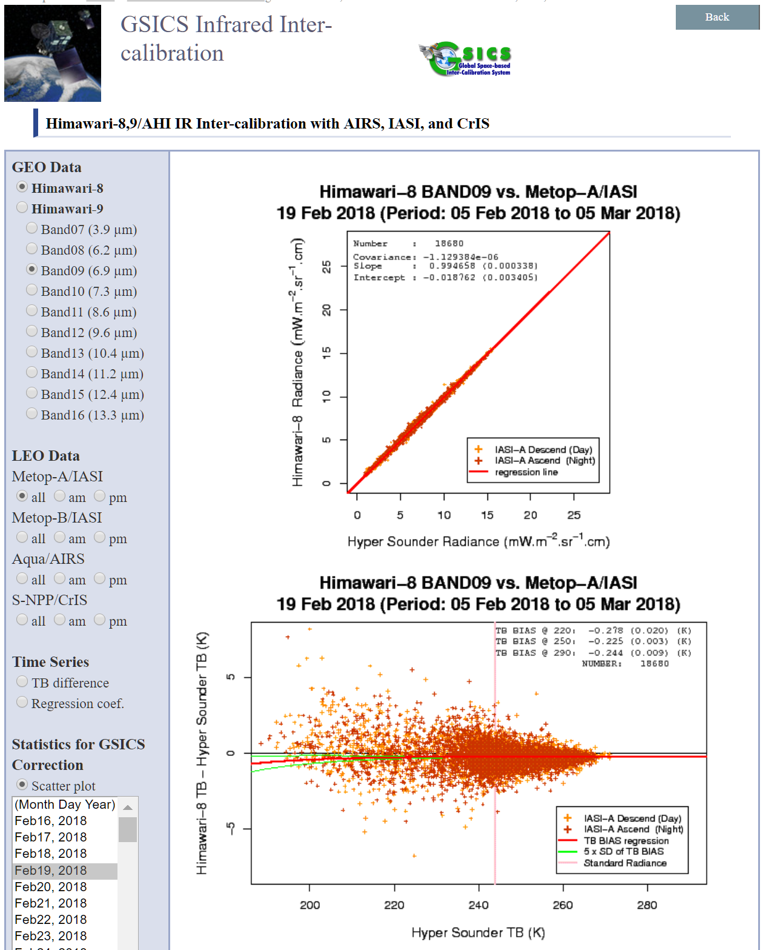
Public Facing Websites

Slide 14
Introduction of information for performance monitoring
GSICS-EP-18.A01 : GRWG to prepare specifications and methodologies for CGMS agency development of operational instrument performance monitoring systems
A.GRWG.2018.10b.1: GRWG Chair to coordinate each agency to provide to define minimum information for performance monitoring “specification and requirements” by 15 May 2018.
Summary
The report is based on ICVS(Integrated Calibration/Validation System) * ICVS monitors over 400 parameters for 28 instrument onboard(NOAA/MetOp/SNPP) Parameters can be categorized into a) Instrument Healthy Status, b) Radiometric and Geometric Calibration data/quality, c) Inter(Vicarious) Calibration, d) Product(lv1b) data/quality and so on Status of Monitoring system CMA: external system(under develop) EUMETSAT: external system(MetOp/IASI, GOME-2,ASCAT) ISRO: could not find the web yet, but maybe internal JMA: Internal(Maybe main)/External system KMA: Internal(main)/External system NOAA: ICVS, GOES calibration system(under develop)
Reference used to collect information for performance monitoring
CMA | EUMETSAT | ISRO | JMA | KMA | NOAA
Monitoring System | Daily report | e-mail | Internal system (+e-mail) | Internal system | ICVS, GOES system (+e-mail)
http://gsics.nsmc.org.cn/portal/en/fycv/ipm.html | http://oiswww.eumetsat.org/epsreports/html/index.php |  | http://www.data.jma.go.jp/mscweb/en/operation/calibration_portal.html | http://nmsc.kma.go.kr/html/homepage/ko/chollian/Quality/selectQuality.do | https://www.star.nesdis.noaa.gov/GOESCal/index.php https://www.star.nesdis.noaa.gov/icvs/

Slide 15
Summary of information for performance monitoring
 |  | Parameters
Engineering | Spacecraft | Status (attitude, velocity, position, etc.)
 | Instrument | Temperature (Detector, Blackbody, Cooler, Radiator, Blackbody, Stage Outgas Htr, Optics, Loop Heat Pipe, Scan Mirror, Motor, Antenna, Optics, Power, FPM, etc.), Voltage (Power), scan rate, SRF, service status, *current(dark, motor, etc.)
Calibration | Calibration | Count and Temperature (Space, blackbody, solar diffuser), Coefficient(Gain, Intercept)
 | Radiometric Cal. Qual. | SNR, NEdT(NEdN), Trend(slope), Consistency, Stability
 | Geometric Cal. Qual. | Bias, stability, residual, band-to-band/pixel-to-pixel co-registration, #(valid) of landmark(or stars), Errors(striping) status
 | Cross/Vicarious/ Model O-B | GEO-LEO Tb Bias, Reflectance Ratio, Desert/DCC/Lunar calibration, O-B Bias
GDWG inputs |  | Implementing user notification function(e.g. alerting via email in case of calibration anomaly) Linking calibration event logging information
Product |  | Level1B data, Image Max/Min/Mean/Median/Invalid, stability
Discussion?
The scope of instrument performance monitoring?
Radiance, Calibration, Engineering, Product, Spacecraft and SRF?
Most agency also provide these information as well: Operational Status, Schedule, Service status, Event log etc
What about including the inter-calibration, comparison with model?
For example, Inter-Calibration, CRTM O-B, DCC Mapping in NOAA, JMA
What about depth? E.g.) Relay Optics, Beamspliter ? or anything else?
The period? E.g.) NRT, x-axis: 3days, 1month, 1year?
Common or specific based on sensor type? E.g.) imager, sounder, scatterometer etc

Slide 16
Current GSICS reference instruments
IR Sub-Group
AIRS on Aqua
IASI on MetOp-A
CrIS on Suomi NPP
D.GIR.2018.4w.1: CrIS accepted as a GSICS reference on the basis of positive answer to all the above questions (see the next slide)
VIS/NIR Sub-Group
MODIS on Aqua in collection 6
VIIRS on SNPP (which version?)
MW Sub-Group
No reference?
UV Sub-Group
No reference?
Need standard criteria and procedures for future follow-on instruments
CrIS on NOAA20 and JPSS-2(future), IASI on MetOp-B and MetOp-C (launched in 2018)
VIIRS on NOAA20 and JPSS-2 (future)

Slide 17
Suggested criteria and Procedures as GSICS References
criteria
Procedures
Its calibration "in family"? (wrt other references) - CrIS agrees with IASI within 0.1K
Its calibration stable? (wrt other references) – demonstrate over ≥1yr
Its data freely available - with sufficient latency?
Does its orbit, scan, dynamic range and spectral sampling provide suitable coverage?
Does this complement those of other references? (overpass times, spectral coverage)
Its processing well documented? (calibration algorithms ATBD)
Its pre-launch characterization well documented? (noise, radiometric, spectral, geometric, error budget)
Does it have a heritage as an inter-calibration reference? or is it operated as part of a committed series of satellites - providing continuity? (e.g., IASI, CrIS, )
Are the operators committed to reprocessing for FCDRs?
Are the operators committed to provide scientific support in its use as a reference? (SDR science team)
Sub-Group chairs ask inputs of the above questions from the instrument Cal/Val team
Information, documents, website, and journal papers
Sub-Group chairs make recommendation based on answers from the above questions
Positive or negative
Research group chair asks inputs from the members and the community based on sub-group chairs’ recommendation
Send the email to GSICS working group list
Sub-Group chairs and research group chair work together (with the help from the instrument Cal/Val team) to address the comments and concerns raised by the GSICS community and members
If consensus can be reached, research group chair makes final recommendation to the EP panel
The EP panel approves the reference instrument

Slide 18
GSICS and OSCAR/Space Database (WMO)
a status on a newly established OSCAR/Space database maintenance scheme approved in CGMS-45 in collaboration with CGMS Members and Observers. (Toshiyuki Kurino of the WMO Secretariat )
OSCAR/Space Science and Technical Advisory Team (O/SSAT) is well organized/functioning with dedicated contributions from the CGMS ISWGs' experts (ITWG, IWWG, IPWG, ICWG, IROWG) and GSICS.
WMO is grateful for the contribution of GSICS to (O/SSAT).
The following topics are under review in O/SSAT;
Definition of the relevant spectral intervals and identification of the relevant instruments;
Identification and flagging of the reference instruments
OSCAR/Space Database System “Bugs and Requirements”
Most up-to-date and relevant information on OSCAR/Space is the User Manual, which is available from;
http://www.wmo.int/pages/prog/sat/documents/OSCAR_User_Manual-2016-09-10.pdf
It is currently linked on the OSCAR homepage: https://www.wmo-sat.info/oscar/

Slide 19
GSICS Reference Documents (WMO)
WMO Secretariat provided information to the group on an expected contribution of GSICS to WMO documents on satellite observation.
WMO Executive Council - Seventieth Session (EC-70), 20-29 June 2018, will approve the updates for “Guide to the WMO Integrated Global Observing System (Guide to WIGOS)” including the link to GSICS document “Guide to GSICS Products and Services” with additional description on GSICS in Chapter 3.3.7. Satellite.
It is also planned to update the WMO Commission for Instruments and Methods of Observation (CIMO) GUIDE PART III: SPACE-BASED OBSERVATIONS.
GRWG is expected to review and update “Chapter 6: Calibration and validation” for emphasizing a possible contribution of GSICS to space-based observation

Slide 20
Hyperspectral intercalibration and reprocessing
The NOAA has reprocessed CrIS Sensor Data Records (SDRs) for continued consistency of SDR products.
The reprocessed data is available on NOAA/NESDIS Cluster.
EUMETSAT also has completed the reprocessing IASI data.
Thus, it is strongly requested for GRWG to analyse the impact of the reprocessed hyperspectral sounders in GEO-LEO intercomparison as these instruments are at the core of GSICS. EP assigned action
KMA to analyse the impact of the reprocessed CrIS (e.g., the double differences of COMS/MI and before/after reprocessed CrIS).

Slide 21
Maturity status of each GSICS product
the maturity status of all non operational products. (GCC Manik Bali )
How can we assign or advance the maturity of products that have ceased being produced?
The EP suggested retaining the existing maturity of such product.
How should we help to advance the maturity of the products that are being produced every day?
EP suggested that GCC provide a GPPA checklist to the authors of the product.
Then follow the guidance of the two actions generated A.GCC.20180601.10 and A.GCC.20180601.11.
Recommendation: Relax the requirement for a User Guide for classical GSICS products.
Recommendation: Relax the requirement for Uncertainty analysis.
This can be complimented by an Impact Report showing the benefit of using Cross-Calibration products. Promotion could weigh whether Input L1B measurements are taken from Operational data processing streams of host agencies.

Slide 22
GSICS for Space Weather
CGMS SWTT Chair, Elsayed Talaat of NOAA, provide a preliminary results on an intercalibration of high-energy electron sensors by NICT, Japan.
The cross-comparison between Himawari-8/SEDA and GOES 15/MAGED showed good correspondence, and the flux level of Himawari-8/SEDA was found to be smaller than that of GOES 15/MAGED
The product of the estimated high-energy electron flux distribution along GEO was obtained using calibrated particle data. It is planned to provide this type of product in near real time using the near-real-time data stream from Himawari, DSCOVR, and GOES.
[CGMS] The SWTT presented Terms of Reference for a Space Weather Coordination Group (SWCG) to CGMS Plenary
[CGMS WG II/5 Action] CGMS members to provide points of contacts for space weather instrument inter-calibration. (Ref. CGMS-46-GSICS-WP-01)

Slide 23
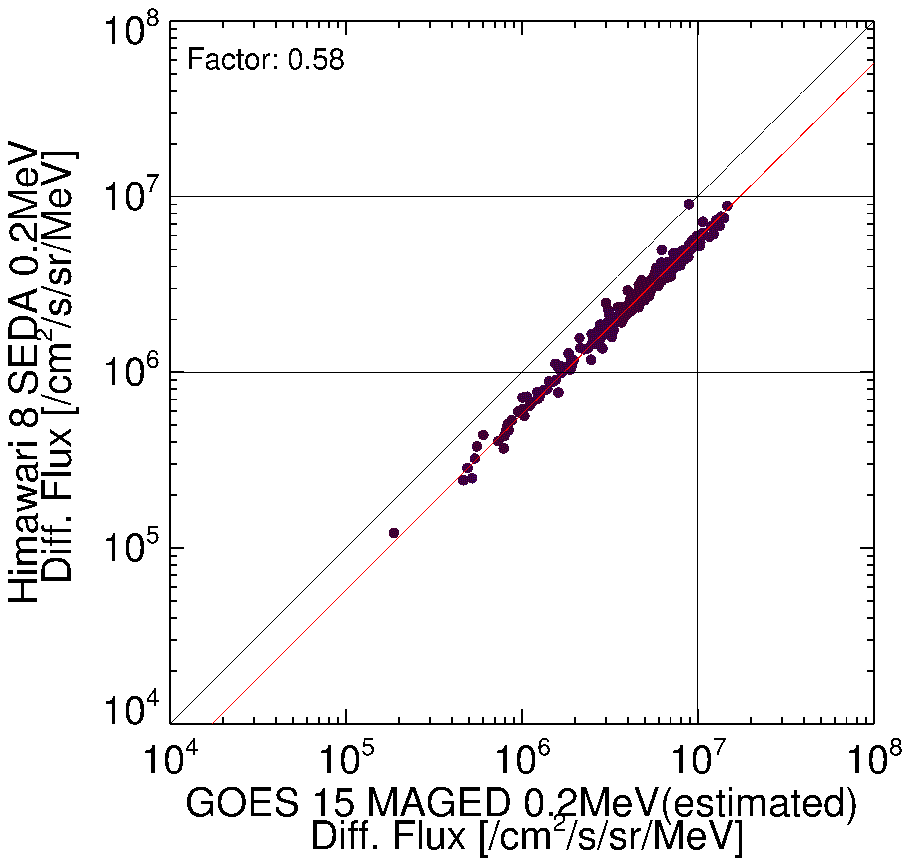
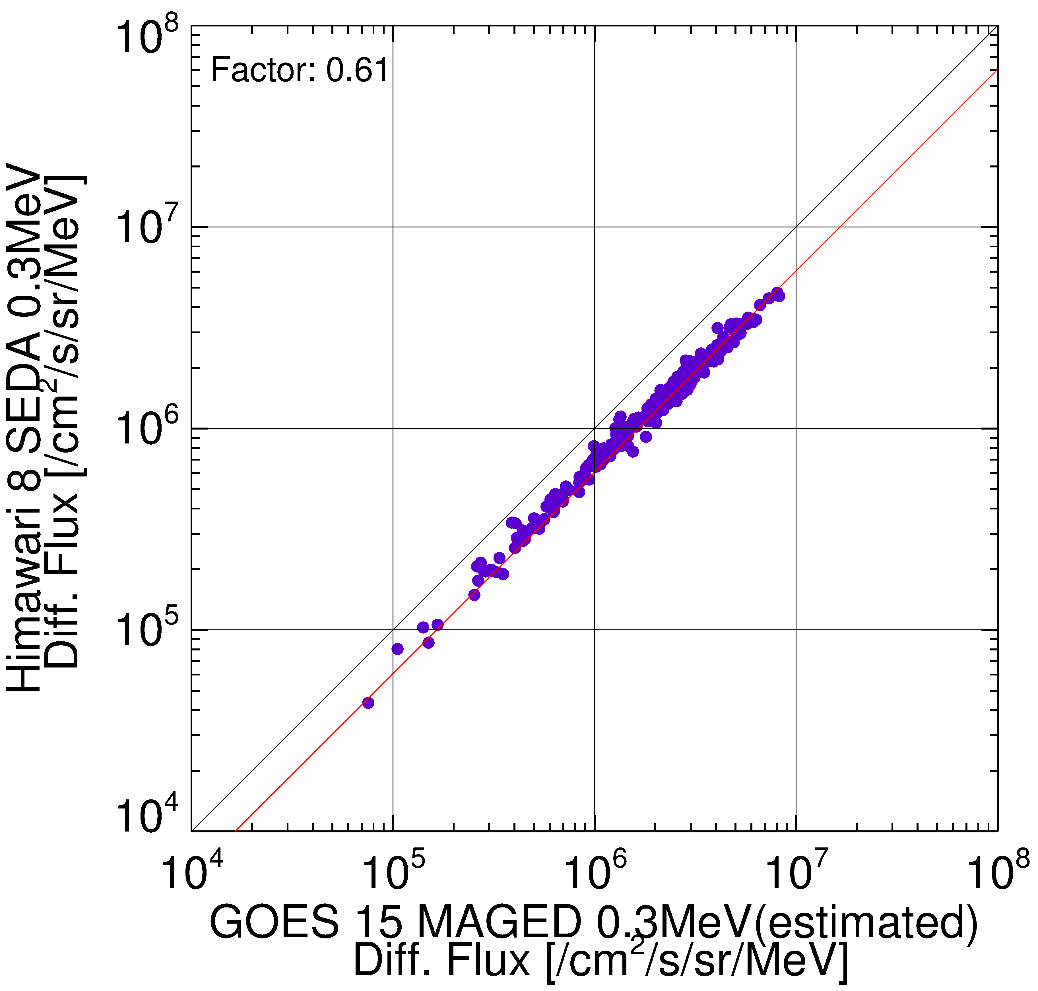
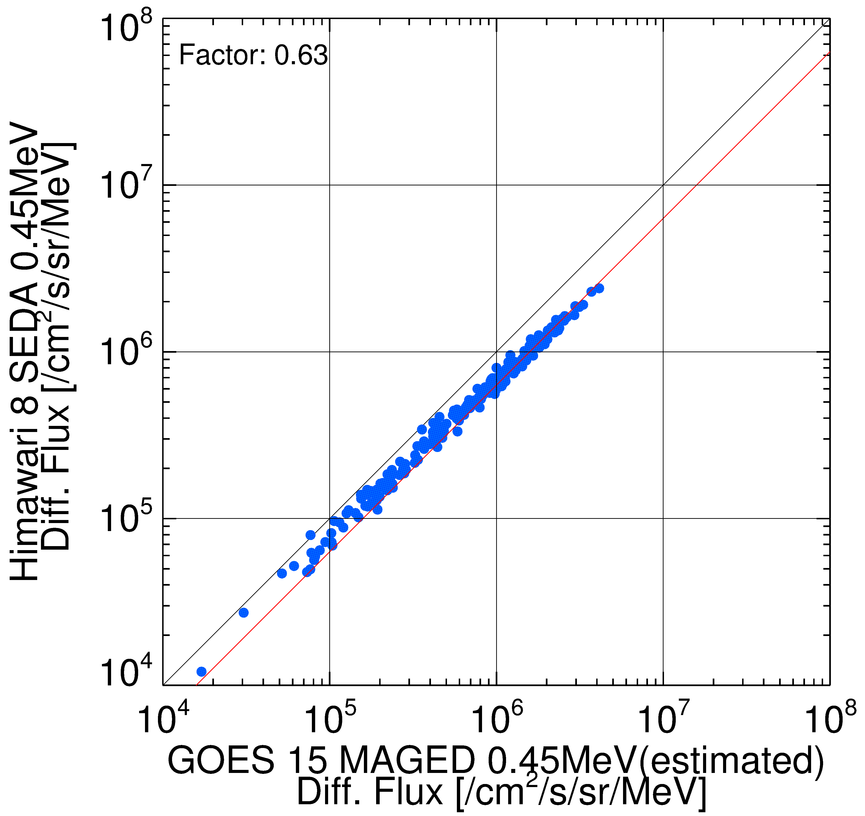
GSICS space weather
Inter-calibration between Himawari-8/SEDA and GOES 15 particle detector
There are good correlations between Himawari-8 and GOES 15 observations in general.
However, the flux level is slightly lower than that observed by GOES 15 in these channels.

Slide 24
Actions from GSICS-EP-19
Reference | Action Description | Actionee | Due date
A.GEP.20180601.1 | EP chair to recommend the nomination of GRWG membership from CNES | EP Chair | EP-20
A.GEP.20180601.6 | EP Chair to request ESA to become full member of GSICS | EP | EP-20
A.GEP.20180601.15 | EP to consider how to involve space weather in sub-group | EP | CGMS-46
A.KMA.20180601.2 | KMA to provide the inter-calibration comparison results of COMS/MI using before and after reprocessed CrIS data | KMA | EP-20
A.ISRO&GCC. 20180601.9 | ISRO to contact GCC to obtain knowledge on reading CrIS data to help them inter-calibrate INSAT with CrIS. | ISRO | EP-20
A.WMO. 20180601.7-1 | WMO to provide information on WMO cloud to NOAA-GDWG. Information sough includes (ability to upload GSICS products onto the WMO Cloud by members, ability to download data, disk space available and redundancy) | WMO | Aug-18
A.NOAA&GDWG. 20180601.7-2 | Following above action, NOAA-GDWG to provide information on Clouds available at NOAA and whether they can be used to host GSICS data from member agencies | NOAA-GDWG | Dec-18
A.GEP&GCC& GRWG&GDWG. 20180601.12 | Encourage submission of papers on GSICS in Joint NOAA EUMETSAT Conference to be organized around Oct 2019 in Boston, USA | EP/GCC/ GRWG/ GDWG | EP-20
A.GPRC.20180601.14 | GSICS Agencies to include CrIS in their GEO-LEO monitoring | GPRC | EP-20

Slide 25
Actions from GSICS-EP-19
Reference | Action Description | Actionee | Due date
A.GRWG.20180601.3 | GRWG to develop a strategy, including the procedure and criteria, on how to handle the long-term drifts of individual instruments identified based on the analyses using GSICS approved approaches. This applies primarily to the VIS/NIR instruments. | GRWG Chair | EP-20
A.GRWG.20180601.5 | GRWG to develop monitoring webpage to demonstrate instrument performance recalibrated after applying the GSICS correction | GRWG | EP-20
A.GRWG. 20180601.16 | GRWG to review and update the GSICS document “Guide to GSICS Products and Services” to be referred in the WMO document “Guide to the WMO Integrated Global Observing System (Guide to WIGOS)” | GRWG | EP-20
A.GRWG. 20180601.17 | GRWG to review and update the WMO CIMO Guide: PART III: SPACE-BASED OBSERVATIONS Chapter 6: Calibration and validation for emphasizing contribution of GSICS to space-based observation | GRWG | Aug-18
A.GCC&GRWG. 20180601.13 | GCC/GRWG to develop consensus on contents of intermediate collocation products to be shared with users | GCC/ GRWG | EP-20
A.GCC&GRWG. 20180601.18 | GCC/GRWG to develop plan for side-events in CGMS Science Working Group meetings | GCC/ GRWG | EP-20
A.GCC.20180601.8 | GCC to contact GRUAN POC in GSICS ( Tony/Ralph/Cheng-Zhi) to submit yearly updates on 3G (GRUAN-GSICS-GNSS) collaboration to EP | GCC | EP-20
A.GCC.20180601.10 | GCC to simplify and stream line GPPA checklist and share it with members to fast track maturity; Start with KMA and JMA. | GCC | EP-20
A.GCC.20180601.11 | GCC to provide recommendations on new processing and science maturity levels for GSICS products and services | GCC | EP-20
A.GCC&ISRO. 20180601.4 | GCC to develop harmonized interface for the instrument performance monitoring website as a baseline for inquiring instrument status. Demo by ISRO | GCC/ISRO | EP-20

Slide 26
Thanks for your attention!

