Slide 1
Calibration of MW Instruments Comparing Radiative Transfer Models
Isaac Moradi (UMD); Ralph Ferraro(NOAA); Mitch Goldberg (NOAA)

Slide 2
PURPOSE
Comparing CRTM and RTTOV using similar atmospheric and surface dataset (Era-5)
Comparing CRTM vs. observations from from ATMS onboard NPP and J01
Comparing RTTOV vs. observations from from ATMS onboard NPP and J01
Using a LBL model to evaluate the accuracy of fast models
Using GRUAN observations to (may be) validate RT models using satellite observations

Slide 3
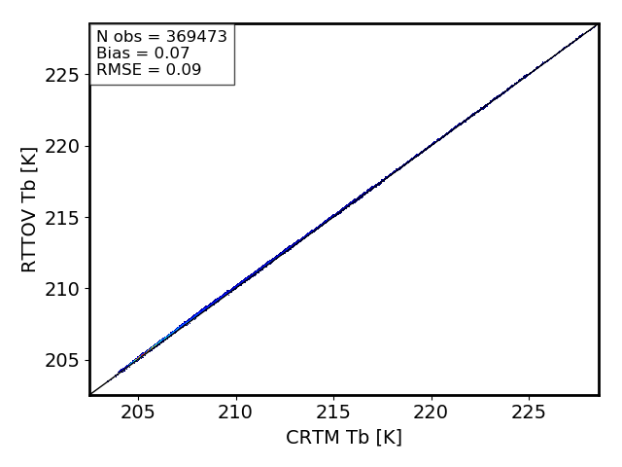
CRTM vs. RTTOV (Temperature Sounding Channel 10)
Left CRTM calculated emissivity – Right RTTOV emissivity

Slide 4
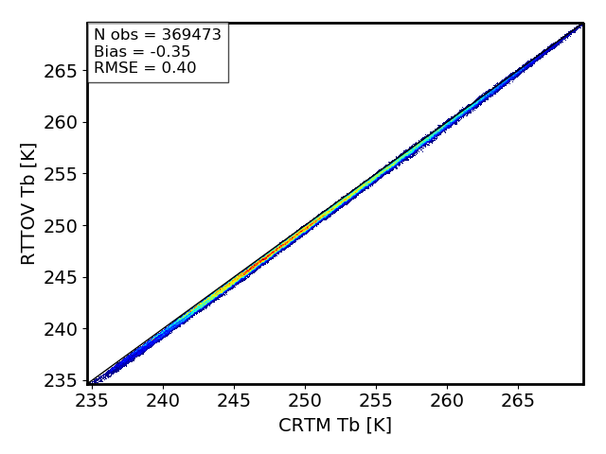
CRTM vs. RTTOV (Humidity Sounding Channel 22)

Slide 5
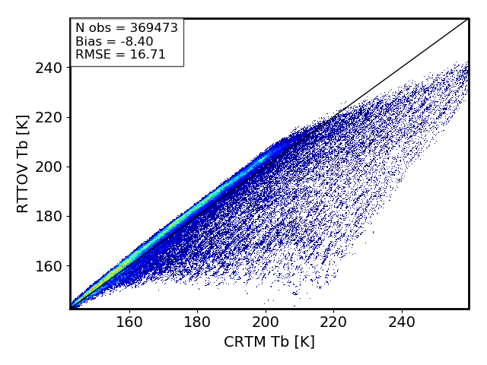
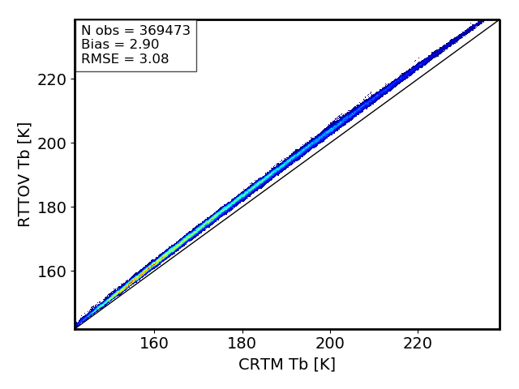
CRTM vs. RTTOV (Window Channel 1)

Slide 6
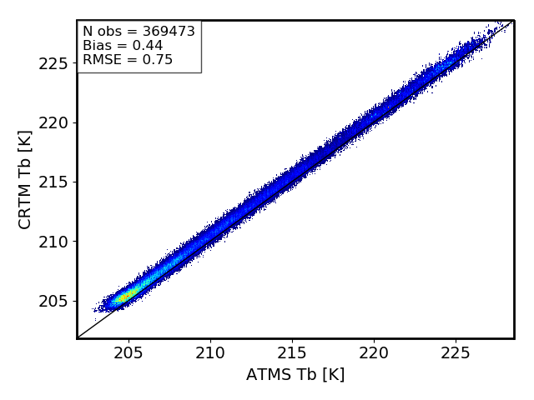
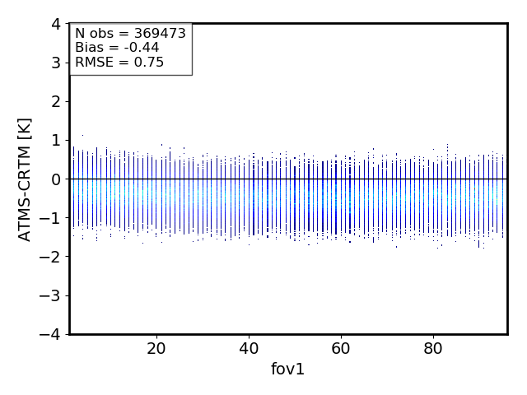
CRTM vs. ATMS (Temperature Sounding Channel 10)

Slide 7
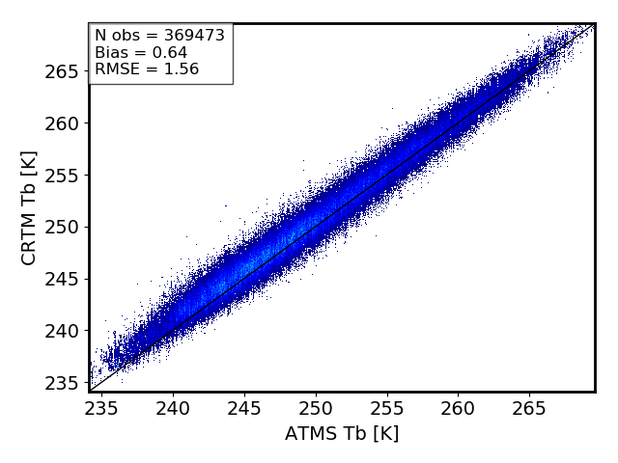
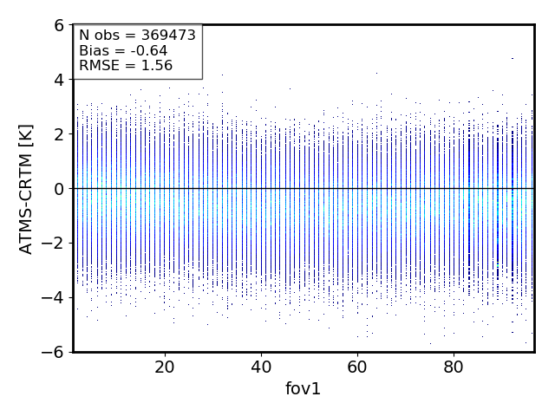
CRTM vs. ATMS (Humidity Sounding Channel 22)

Slide 8
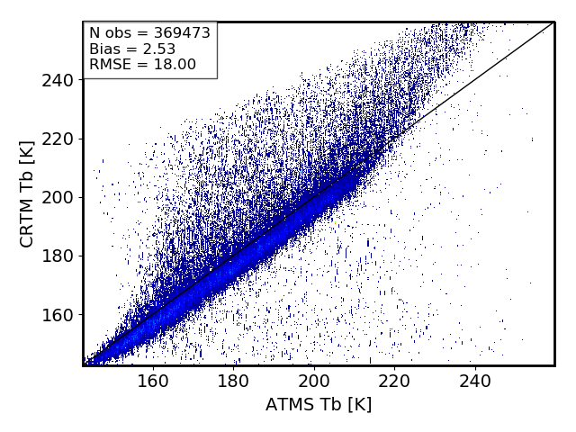
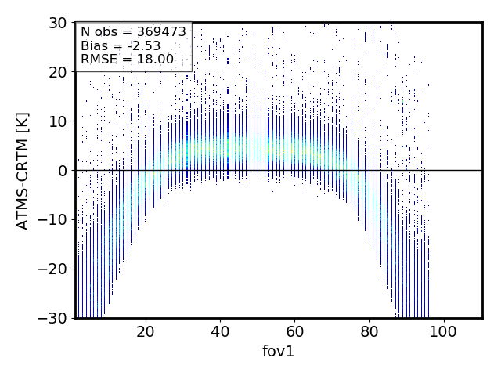
CRTM vs. ATMS (Window Channel 1)

Slide 9
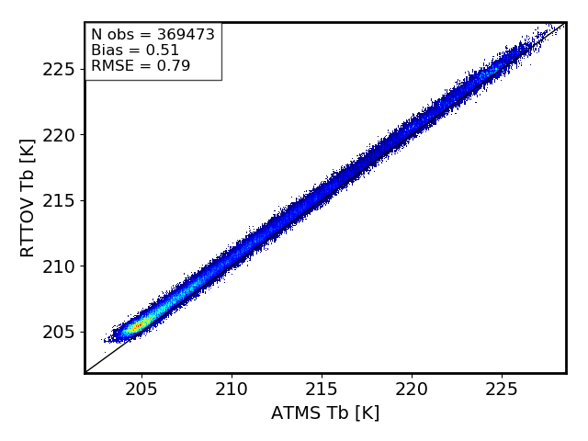
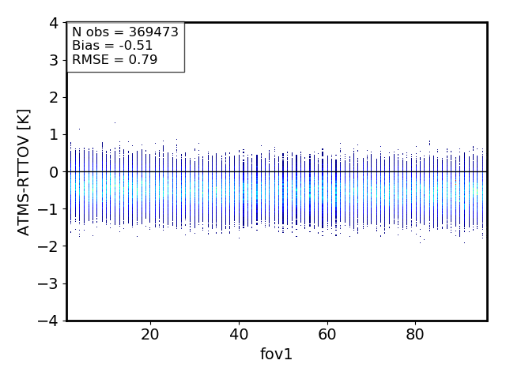
RTTOV vs. ATMS (Temperature Sounding Channel 10)

Slide 10
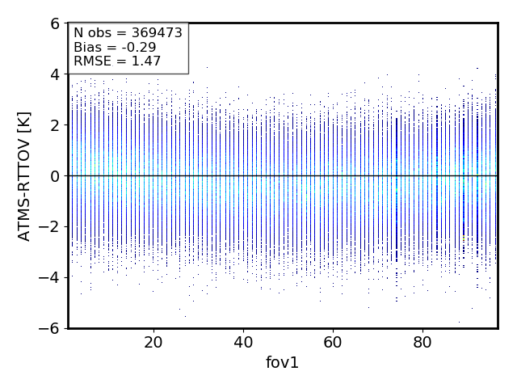
RTTOV vs. ATMS (Humidity Sounding Channel 22)

Slide 11
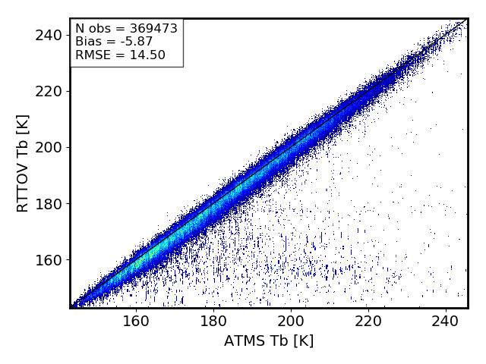
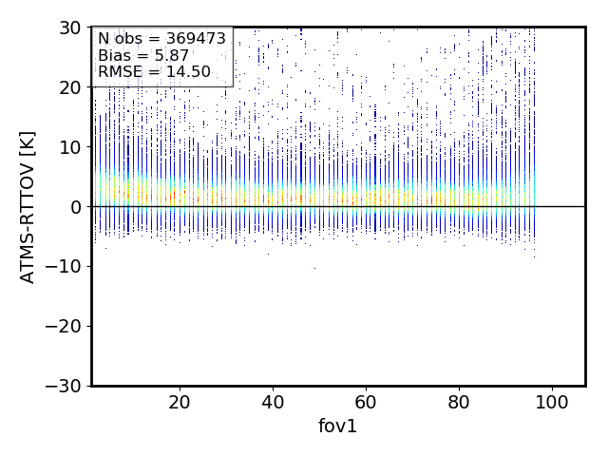
RTTOV vs. ATMS (Window Channel 1)

