Slide 1
Proposed best practices for Simultaneous Nadir Overpass (A Discussion)
Manik Bali¹ Cheng-Zhi Zou² , Viju John, Isaac Moradi, Wenze Yang, Ralph Ferraro,
¹ESSIC/CICS, ²NOAA

Slide 2
Introduction
One of the core goals of GSICS is to monitor in-orbit instruments.
The Simultaneous Nadir Overpass(SNO) method has played a central role in achieving this goal
The SNO method aims at determining the bias between two satellite instruments when they both view same target under similar viewing conditions.
In order to arrive at an agreed criterion for choosing comparing pair of (SNO ) observations, over the past two quarters the GSICS MW subgroup has been collecting from members the SNO criterion they have been using to inter-compare their MW instruments.
Members were asked
What is the criterion for Time difference in observations between comparing instruments
What is the criterion for distance between two observations between comparing instruments
Any other criterion they used.

Slide 3
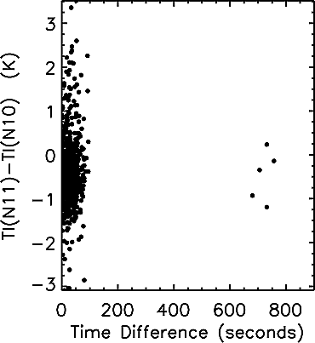
Best Practices: Simultaneous Nadir Overpass
SNO ( Simultaneous Nadir Overpass) Algorithm identifies locations observed by two instruments under similar viewing conditions.
This algorithm is used to monitor In-orbit Microwave Instruments.
Inter-comparing MW instruments reveals biases anomalies and Trends in instruments.
SNO matchups can accurately determine the differences of the offsets as well as the nonlinear coefficients between satellite pairs, thus providing a strong constraint to link calibration coefficients of different satellites together.
MSU channel 2 brightness temperature differences of the nadir pixels between NOAA 10 and 11 versus time window for the SNO matchups. The maximum spatial distance for the SNOs is set to 111 km. Note that when the time difference is larger than about 100 s, only few SNO data pairs can be found. The brightness temperature is computed from the linear calibration algorithm equation (9).( Zou et al 2006)
SNO Code from Cheng-Zhi Zou can be shared in the MW Subgroup

Slide 4
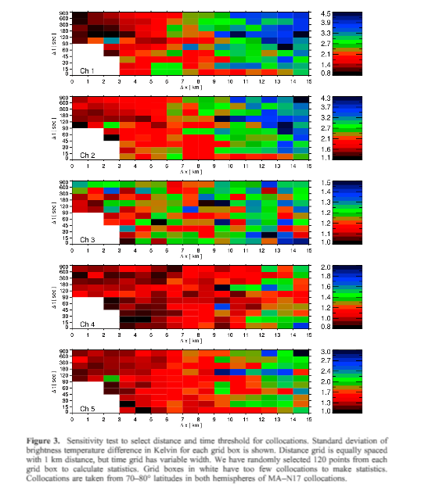
Best Practices: Simultaneous Nadir Overpass
MHS-AMSU intercomparision
Distance < 5 km
Time Difference < 300 s.
These stringent collocation criteria reduce the impact of highly variable surface or atmospheric conditions on the estimated biases.
Results obtained using polar SNOs will not be representative for moist regions, necessitating the use of global collocations for reliable intercalibration.
Reference: John, V. O., G. Holl, S. A. Buehler, B. Candy, R. W. Saunders, and D. E. Parker (2012), Understanding intersatellite biases of microwave humidity sounders using global simultaneous nadir overpasses, J. Geophys. Res., 117, D02305, doi:10.1029/2011JD016349.

Slide 5
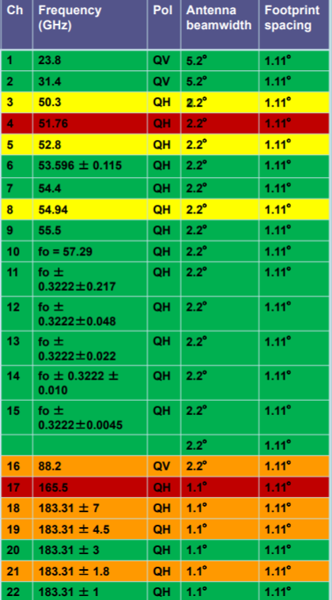
Proposed Best Practices: Simultaneous Nadir Overpass
Window Channels ( 23 GhZ, 31 GhZ, 50 GhZ 89 GhZ. ( by Wenze Yang )
1. within 50~70 km
2. < 50 seconds
3. no
4. dTB <= 10 * NEdT (as homogeneity test)
Oxygen Bands ( 50-58 GhZ) (by Cheng-Zhi Zou)
1. < 111 km
2. < 100 seconds
3. Scan Angle within 1 degree
Homogeneity test ( std < 1)
Scene Selection a key component of SNO
Cloud free scenes are recommended
SNO itself is not sufficient for monitoring MW instrument. It needs to be complemented with other methods

Slide 6
Pre-Launch Best Practices
Proposed Best Practice Matrix for Pre-Launch Characterization
Detector Characteristics (Freq, Side Lobe, Response)
Non Linearity -> What is your instrument’s non linearity
Antenna Pattern Correction-> How do you correct for antenna
NEdT-> What is your measure of noise .. Can we agree on one standard ?
Internal Calibration Targets are Characterized to SI Standards-> What standards do you follow.
How do you characterize the Space View at Pre-Launch
What is your absolute accuracy estimate and does it meet specs
Proposed Action: Members to share pre-launch Matrix information in the Microwave Subgroup

Slide 7
Thank You

