Slide 1
Annual GSICS Calibration Report for {Agency} – action proposal for 2019 GRWG/GDWG Annual Meeting
Masaya Takahashi (JMA)
Dohyeong Kim (KMA)

Slide 2
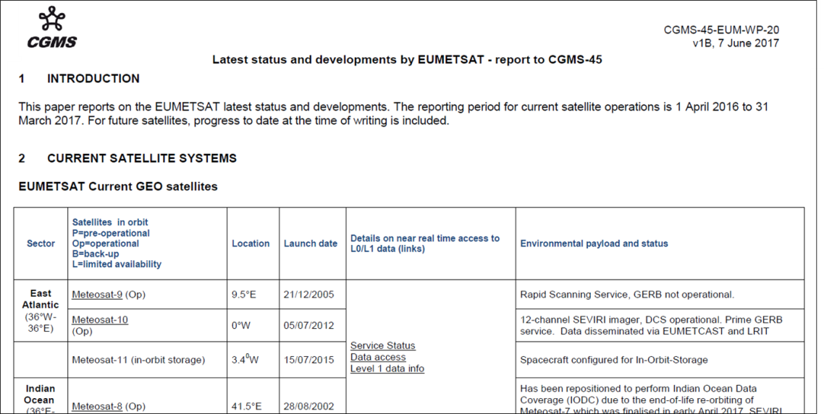
Background (1/2)
CGMS member agencies have been reporting their spacecraft status using the same format (text-format document).
We could also make reports for CGMS on instrument performance based on GSICS inter-calibration approaches.

Slide 3
Background (2/2)
In 2017, GSICS-EP asked GSICS member agencies to provide instrument performance report validated by GSICS inter-calibration methods.
Benefits for both GSICS and satellite data user communities
The draft template: prepared through 2018 Annual Meeting and gsics-dev
Great thanks who contributed to the discussion and provided report examples!
GDWG Chair reported the template (example) at GSICS-EP-19 in June 2018.
EP’s point: information on scene dependent biases (if exists) and accuracies of reference instruments by Double Difference approaches would be useful as well as time series charts on monitored instruments’ biases.
Reference | Action Description | Actionee | Due date
EP-18.A03 | GDWG and GRWG to develop an approach for an Annual GSICS report on the State of the Observing System with respect to Instrument Performance and Inter-comparisons with GSICS Reference Instruments | GDWG and GRWG | EP-19 (Jun 2018)

Slide 4
Concepts of Annual Report – Template as of 2018-10-31
Target audience
Satellite data users + satellite operators (incl. non calibration experts)
Keeping report contents SIMPLE for GSICS members’ minimum efforts
Satellite/Instrument events relevant to calibration: 1 page for agency
Radiometric calibration performance for MONITORED instruments: 1-2 page / instrument
Using GSICS inter-calibration approaches
Detailed information should be referred to Calibration Landing Page
Adopting existing formats as possible
Color chart used on NOAA satellite status webpage
Visualization tools (e.g. GSICS Plotting Tool)
Geometric/spectral calibration and GSICS reference instruments’ performance
To be considered in future (2nd step) even though GSICS-EP asked to show reference instruments’ performance using double difference approach for GEO instruments

Slide 5
Discussion
Proposed action
GSICS member agencies operating geostationary satellites to report their instrument’s radiometric calibration performance and relevant events at Agency Report of 2019 GRWG/GDWG Annual Meeting.
Discussion points for report template
# of slides
1 slide for GEO instruments’ status and calibration-relevant events?
1-2 slides for each instrument?
Stats to be reported
Table: calibration bias/uncertainty for the last year (or snapshot for a certain month of the last year)?
Figure: time series of bias/unc. from operation start to show calibration trends?
Reference instruments’ validation (by double difference)
To be left for future reports by agencies who are responsible for them?

Slide 6
{Year} Annual GSICS Calibration Report
Report Template - Proposal
{Name}
{Agency}

Slide 7
Report Template - Proposal
{Year} Satellite/Instrument Summary
Please add hyperlinks over instrument names which navigate to agency’s Calibration Landing Page
Satellite (status) |  | Location | Launch date | EO instruments (operation start date)
{Satlelite#1} | {Status} | {SSP} | YYYY-MM-DD | {Instrument#1} (YYYY-MM-DD)
{Satellite#2} | {Status} | {SSP} | YYYY-MM-DD | {Instrument#1} (YYYY-MM-DD) | {Instrument#2} (YYYY-MM-DD)
Major calibration relevant events in {Year}
YYYY-MM-DD: XXXXXXXX
YYYY-MM-DD: YYYYYYYY
Legends for satellite/instrument status
Satellite Status
 | Op = Operational RSS = Rapid Scanning Service
 | P = Pre-operational
 | B = Back-up, secondary
 | L = Limited availability
Instrument Status
 |  | Operational (or capable of)
 |  | Operational with limitations (or Standby)
 |  | Operational with Degraded Performance
 |  | Not Operational
 |  | Functional, Turned Off

Slide 8
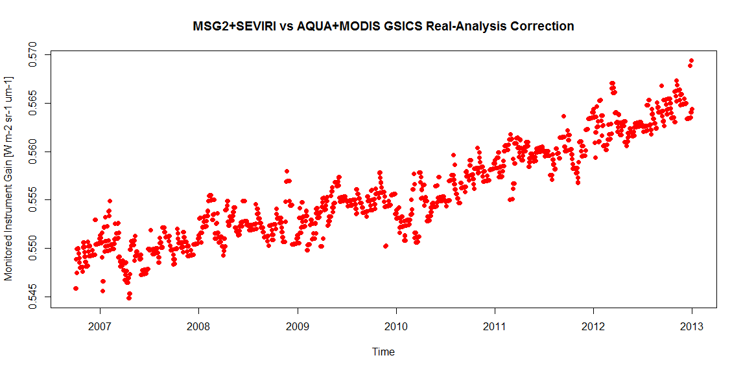
Report Template for VIS/NIR - Proposal
Summary Stats of {Satellite}/{Instrument} VIS/NIR Calibration Performance in {Year}
(All uncertainties are k=1)
Reference: {Satellite}/{Instrument} | Channel Name (μm) | CH XX (XXX) | CH XX (XXX) |  |  |  |  | Units
{Method#1} | Mean Bias (unc.)
 | Annual Drift (unc.)
{Method#2} | Mean Bias (unc.)
 | Annual Drift (unc.)
Stats derived from {Satellite}/{Instrument} GSICS Re-Analysis Correction ( {Link to ATBD} )
{Description on inter-calibration methods#1}
{Description on inter-calibration methods#2}
{Notes on validation results (if any) }
Time series of gains derived for {Satellite}/{Instrument} CH XXX w.r.t. {Reference}
Monitored Instrument Gain
[W/m²/sr/um]

Slide 9
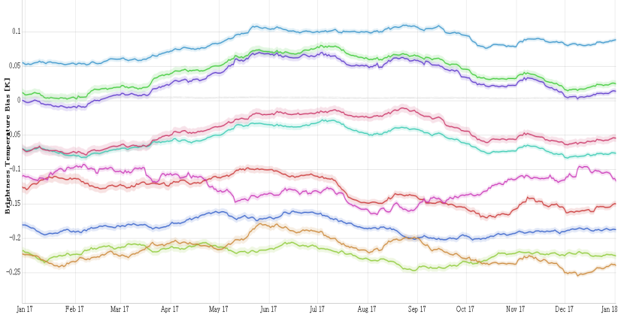
Report Template for IR - Proposal
Summary Stats of {Satellite}/{Instrument} IR Calibration Performance in {Year}
(All uncertainties are k=1)
 | Channel Name (μm) | CH XX (XXX) | CH XX (XXX)
 | Std. Rad. as Tb (K)
{Reference#1} | Mean Bias (K)
 | Stdv. of Bias (K)
{Reference#2} | Mean Bias (K)
 | Stdv. of Bias (K)
Stats derived from {Satellite}/{Instrument} GSICS Re-Analysis Correction ( {Link to ATBD} )
Standard Radiance: typical scene defined by GSICS for easy inter-comparison of sensors’ inter-calibration biases
{Notes on validation results (if any) }
Time series of {Satellite}/{Instrument} Tb biases w.r.t. {Reference} at std. radiance

Slide 10
The following slides are report examples for GEO imagers – thanks for your cooperation
EUMETSAT (Tim Hewison and Sebatien Wagner)
NOAA (Fred Wu and Fangfang Yu)
JMA (Masaya Takahashi, Yusuke Yogo)
KMA (Dohyeong Kim and Minju Gu)
ROSHYDROMET (Alexey Rublev and Alexander Uspensky)

Slide 11
2017 Annual GSICS Calibration Report for EUMETSAT
Example#1
Tim Hewison, Sebastien Wagner
EUMETSAT

Slide 12
Satellite/Instrument Summary - GEO
Satellite (status) |  | Location | Launch date | EO instruments
Meteosat-7 | B | 57 E | 1997-09-02 | MVIRI
Meteosat-8 | Op | 41.5 E | 2002-08-28 | SEVIRI | GERB
Meteosat-9 | RSS | 9.5 E | 2005-12-21 | SEVIRI | GERB
Meteosat-10 | Op | 0.0 E | 2012-07-05 | SEVIRI | GERB
Meteosat-11 | B | 3.4 W | 2015-07-15 | SEVIRI | GERB
Hyperlinks on instrument names navigate to the Calibration Landing Page
Used in CGMS Working Paper
Satellite Status
 | Op = Operational
 | P = Pre-operational
 | B = Back-up, secondary
 | L = Limited availability
Instrument Status
 |  | Operational (or capable of)
 |  | Operational with limitations (or Standby)
 |  | Operational with Degraded Performance
 |  | Not Operational
 |  | Functional, Turned Off
Major calibration relevant events in 2017
2017-02-01 10:00 Meteosat-8 took over from Meteosat-7 as prime spacecraft for IODC Service. Meteosat-7 was disseminated in parallel until
2017-03-31 Meteosat-7 re-orbited
2017-12-06: Correction to geo-referencing offset in the SEVIRI Level 1.5 image
Used on NOAA/OSPO GOES/POES status webpages

Slide 13
Calibration Performance: Meteosat/SEVIRI Visible Bands
Summary Statistics of Meteosat/SEVIRI VIS/NIR Calibration Performance (All Uncertainties are k=1)
Channel Name |  | VIS0.6 | VIS0.8 | NIR1.6 | HRV | Units
Meteosat-8 | Mean Bias (DCC-SSCC) | +13.5 ± 5.6 |  |  |  | %
 | Annual Drift (DCC) | -0.08 ± 0.13 |  |  |  | %/yr
 | Annual Drift (SSCC) | -0.56 ± 0.01 | -0.53 ± 0.03 | -0.03 ± 0.03 | -0.51 ± 0.04 | %/yr
 | Annual Drift (LCS) | -0.54 ± 0.01 | -0.52 ± 0.01 | -0.02 ± 0.02 | -0.53 ± 0.02 | %/yr
Meteosat-10 | Mean Bias (DCC-SSCC) | +10.4 ± 1.4 |  |  |  | %
 | Annual Drift (DCC) | -0.54 ± 0.03 |  |  |  | %/yr
 | Annual Drift (SSCC) | -0.75 ± 0.20 | -0.63 ± 0.14 | -0.02 ± 0.13 | -0.76 ± 0.15 | %/yr
 | Annual Drift (LCS) | -0.88 ± 0.03 | -0.77 ± 0.03 | -0.23 ± 0.10 | -0.99 ± 0.08 | %/yr
Mean Bias: Mean and SD of difference of DCC from operational (SSCC) calibration for all 2017 pentad results
Annual Drift: Mean gain drift and uncertainty calculated from DCC and operational (SSCC) over each satellite life
DCC: Demonstration GSICS Deep Convective Cloud inter-calibration, with respect to Aqua/MODIS
SSCC: SEVIRI Solar Channel Calibration System = vicarious calibration used operationally for SEVIRI
LCS: Lunar Calibration System = based on the GIRO.

Slide 14
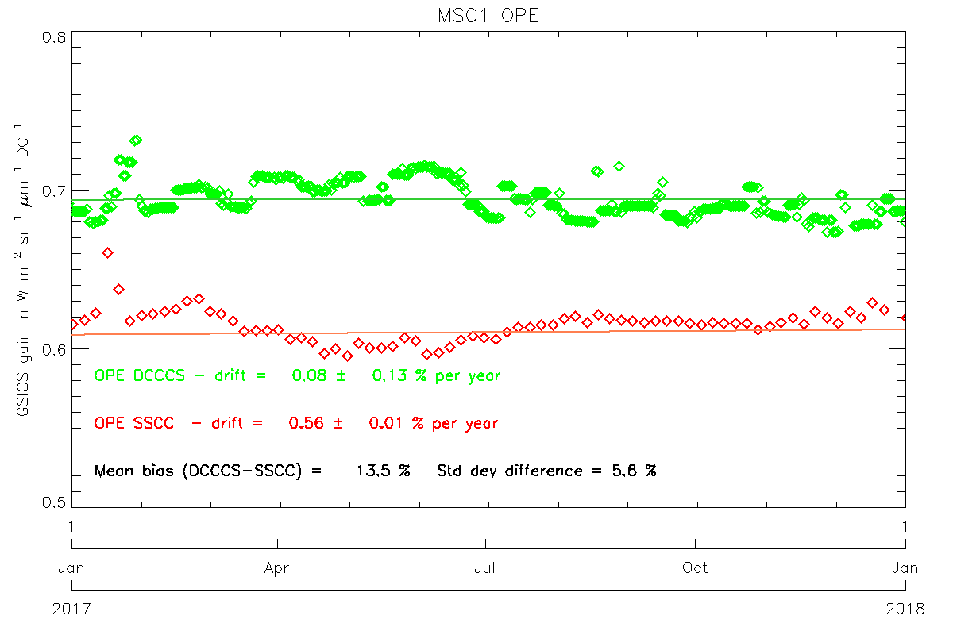
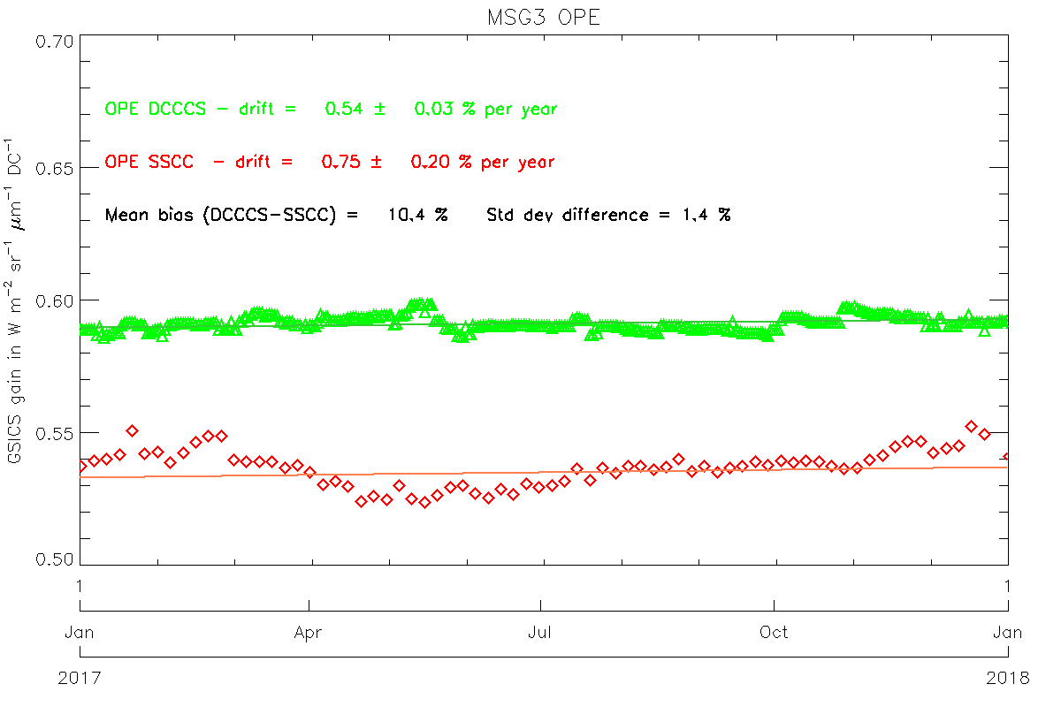
Calibration Performance: Meteosat/SEVIRI Visible Bands
Mean Bias: Mean and SD of difference of DCC from operational (SSCC) calibration for all 2017 pentad results
Annual Drift: Mean gain drift and uncertainty calculated from DCC and operational (SSCC) over each satellite life
DCC: Demonstration GSICS Deep Convective Cloud inter-calibration, with respect to Aqua/MODIS
SSCC: SEVIRI Solar Channel Calibration System = vicarious calibration used operationally for SEVIRI
Time Series of gains derived for Meteosat-8 (MSG1) and -10 (MSG3) VIS0.6 channel SSCC (red), DCC (green).

Slide 15
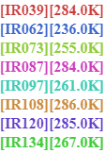
Calibration Performance: Meteosat-8/SEVIRI IR Bands
Summary Statistics of Meteosat-8/SEVIRI IR Calibration Performance in 2017 (All uncertainties are k=1)
Channel Name | IR3.9 | IR6.2 | IR7.3 | IR8.7 | IR9.7 | IR10.8 | IR12.0 | IR13.4
Standard Radiance as Tb (K) | 284 | 236 | 255 | 284 | 261 | 286 | 285 | 267
Mean Bias (K) | +0.57 | -0.16 | +0.38 | +0.01 | -0.08 | +0.04 | +0.01 | +0.35
Standard Deviation of Bias (K) | 0.03 | 0.05 | 0.08 | 0.05 | 0.07 | 0.04 | 0.03 | 0.40
Mean Drift Rate of Bias (K/yr) | -0.07 | -0.10 | -0.22 | -0.04 | -0.14 | -0.05 | -0.05 | +0.35
The statistics are derived from Meteosat-8/SEVIRI Operational GSICS Re-Analysis Correction vs. Metop-A/IASI
Biases defined for Standard Radiance: typical scene for easy inter-comparison of sensors’ inter-calibration biases
Decontaminations introduce calibration jumps – most obvious in the IR13.4 channel due to ice contamination
Time series of Meteosat-8/SEVIRI Tb biases w.r.t. Metop-A/IASI at standard radiance

Slide 16
Calibration Performance: Meteosat-9/SEVIRI IR Bands
Summary Statistics of Meteosat-9/SEVIRI IR Calibration Performance in 2017 (All uncertainties are k=1)
Channel Name | IR3.9 | IR6.2 | IR7.3 | IR8.7 | IR9.7 | IR10.8 | IR12.0 | IR13.4
Standard Radiance as Tb (K) | 284 | 236 | 255 | 284 | 261 | 286 | 285 | 267
Mean Bias (K) | +0.36 | -0.13 | +0.09 | +0.01 | -0.03 | +0.03 | -0.01 | -1.41
Standard Deviation of Bias (K) | 0.08 | 0.12 | 0.15 | 0.11 | 0.18 | 0.11 | 0.13 | 0.16
Mean Drift Rate of Bias (K/yr) | -0.23 | -0.34 | -0.39 | -0.08 | -0.44 | -0.13 | -0.21 | -0.46
The statistics are derived from Meteosat-9/SEVIRI Operational GSICS Re-Analysis Correction vs. Metop-A/IASI
Biases defined for Standard Radiance: typical scene for easy inter-comparison of sensors’ inter-calibration biases
Meteosat-9 operated in Rapid Scan Service during most of this period, which increases the bias uncertainties
Time series of Meteosat-9/SEVIRI Tb biases w.r.t. Metop-A/IASI at standard radiance

Slide 17
2017 Annual GSICS Calibration Report for NOAA
Example#2
Fred Wu, Fangfang Yu
NOAA

Slide 18
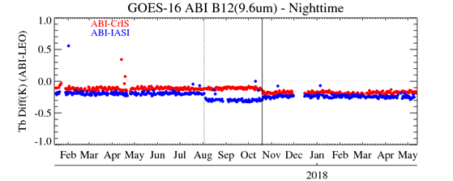
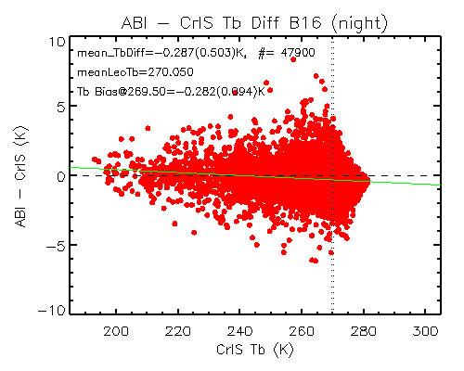
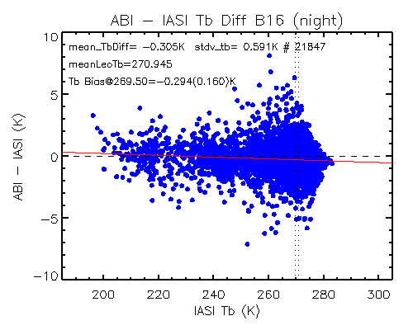
Calibration Performance: GOES16/ABI Infrared Bands
Summary Statistics of GOES-16/ABI IR Calibration Performance in December 2017 (All uncertainties are k=1)
 | Channel Name (Central Wavelength in μm) | BAND07 (3.9) | BAND08 (6.2) | BAND09 (6.9) | BAND10 (7.3) | BAND11 (8.6) | BAND12 (9.6) | BAND13 (10.4) | BAND14 (11.2) | BAND15 (12.4) | BAND16 (13.3)
 | Std. Scene Tb (K) | 286.0 | 234.5 | 244.0 | 254.5 | 284.0 | 259.5 | 286.0 | 286.0 | 283.5 | 269.5
Metop-B/ IASI | Bias at Std. Scene(K) | -0.167 | -0.196 | -0.218 | -0.170 | -0.204 | -0.227 | -0.210 | -0.141 | -0.153 | -0.294
 | Stdv. of Bias (K) | 0.120 | 0.082 | 0.093 | 0.108 | 0.147 | 0.110 | 0.160 | 0.165 | 0.169 | 0.160
S-NPP/ CrIS | Bias at Std. Scene(K) | - | - | -0.259 | -0.202 | - | -0.160 | -0.227 | -0.167 | -0.176 | -0.282
 | Stdv of Bias (K) | - | - | 0.045 | 0.052 | - | 0.047 | 0.073 | 0.073 | 0.073 | 0.094
The uncertainty and statistics are calculated following the GSICS standard GEO-LEO IR inter-calibration algorithm
GOES-16 ABI IR calibration is very stable with mean Tb bias to CrIS/IASI less than 0.3K. No significant scene dependent Tb bias to the reference instruments for all the IR channels
GOES-16 ABI post-launch test started in Jan. 2017 and became operational on 18 December 2017. L1B data are available to the public since after the provisional maturity on 1 June 2017.
Stable reference and monitored instruments can quickly detect and identify calibration events (e.g. Metop-B/IASI and GOES-16 ABI Ground updates) and validate the algorithm (e.g. ABI cal. algorithm update in October 2017)
Time series of GOES-16 ABI daily mean Tb bias to SNPP/CrIS and Metop-B/IASI for ABI B12
Scene dependent Tb bias to SNPP/CrIS for ABI B16
Scene dependent Tb bias to Metop-B/IASI for ABI B16
Metop-B/IASI cal. algorithm update
G16 ABI cal. algorithm update

Slide 19
2017 Annual GSICS Calibration Report for JMA
Example#3
Masaya Takahashi, Yusuke Yogo
Japan Meteorological Agency

Slide 20
Satellite/Instrument Summary - GEO
Satellite (status) |  | Location | Launch date | EO instruments
Himawari-8 | (Op) | 140.7 E | 2014-10-07 | AHI
Himawari-9 | (B) | 140.7 E | 2016-11-02 | AHI
Hyperlinks on instrument names navigate to the Calibration Landing Page
Major calibration relevant events in 2017
2017-03-10: Himawari-9 was put into in-orbit standby as backup Himawari-8
2017-07-25: Disclosure of sensitivity trends (calibration gain) of Himawari-8/AHI VNIR bands
2017-07-25: Updating ground processing system incl. reduction of banding and stripe noise of Himawari-8/AHI VNIR bands
Satellite Status
 | Op = Operational
 | P = Pre-operational
 | B = Back-up, secondary
 | L = Limited availability
Instrument Status
 |  | Operational (or capable of)
 |  | Operational with limitations (or Standby)
 |  | Operational with Degraded Performance
 |  | Not Operational
 |  | Functional, Turned Off

Slide 21
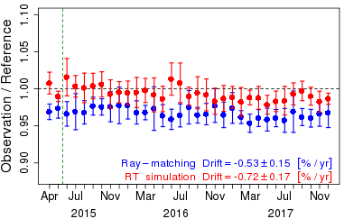
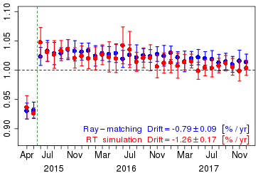
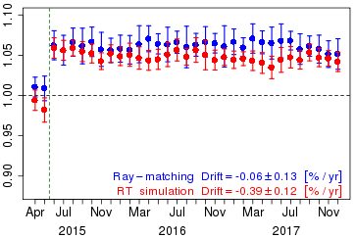
Calibration Performance: Himawari-8/AHI Visible/Near-Infrared Bands
Summary Statistics of Himawari-8/AHI VNIR Calibration Performance (All Uncertainties are k=1)
Channel Name (Central Wavelength in μm) |  | BAND01 (0.47) | BAND02 (0.51) | BAND03 (0.64) | BAND04 (0.86) | BAND05 (1.6) | BAND06 (2.3) | Units
Ray-matching w/ S-NPP/VIIRS | Mean Bias | -2.2 ± 0.8 | -3.1 ± 0.8 | +2.9 ± 0.8 | +0.8 ± 0.7 | +6.3 ± 0.8 | -4.9 ± 0.9 | %
 | Annual Drift | -0.53 ± 0.15 | -0.52 ± 0.12 | -0.79 ± 0.09 | -0.58 ± 0.06 | -0.06 ± 0.13 | -0.18 ± 0.11 | %/yr
Vicarious Cal. using Aqua/MODIS + RTM | Mean Bias | -1.0 ± 1.6 | -1.7 ± 1.8 | +1.9 ± 1.8 | +2.8 ± 1.6 | +4.3 ± 1.0 | -3.5 ± 0.9 | %
 | Annual Drift | -0.72 ± 0.17 | -0.92 ± 0.18 | -1.26 ± 0.17 | -1.20 ± 0.17 | -0.39 ± 0.12 | -0.24 ± 0.19 | %/yr
Mean Bias: monthly average and standard deviation of the daily results in January 2017
Annual Drift: calculated using Mean Bias from July 2015 to December 2017
Ray-matching: Spectral Band Adjustment Factors on NASA Langley website compensates Spectral diff. (ATBD)
Vicarious calibration uses optical parameters retrieved from Aqua/MODIS C6 L1B (Reference)
Trend of the ratio of observation to reference computed using Ray-matching / Vicarious calibration approaches
BAND01 (0.47 μm)
BAND03 (0.64 μm)
BAND05 (1.6 μm)

Slide 22
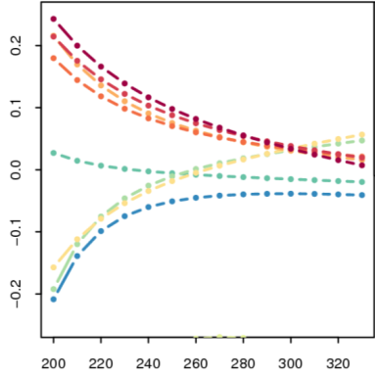
Calibration Performance: Himawari-8/AHI Infrared Bands
Summary Statistics of Himawari-8/AHI IR Calibration Performance in 2017 (All uncertainties are k=1)
 | Channel Name (Central Wavelength in μm) | BAND07 (3.9) | BAND08 (6.2) | BAND09 (6.9) | BAND10 (7.3) | BAND11 (8.6) | BAND12 (9.6) | BAND13 (10.4) | BAND14 (11.2) | BAND15 (12.4) | BAND16 (13.3)
 | Std. Radiance as Tb (K) | 286.0 | 234.6 | 243.9 | 254.6 | 283.8 | 259.5 | 286.2 | 286.1 | 283.8 | 269.7
Metop-A/ IASI | Mean Bias (K) | -0.11 | -0.173 | -0.212 | -0.129 | -0.05 | -0.216 | 0.036 | 0.045 | -0.04 | 0.078
 | Stdv. of Bias (K) | 0.008 | 0.012 | 0.009 | 0.014 | 0.012 | 0.017 | 0.018 | 0.019 | 0.017 | 0.015
S-NPP/ CrIS | Mean Bias (K) | -0.07 | -0.16 | -0.24 | -0.15 | N/A | -0.23 | -0.02 | -0.01 | -0.01 | 0.03
 | Stdv/ of Bias (K) | 0.039 | 0.011 | 0.012 | 0.026 | N/A | 0.013 | 0.013 | 0.012 | 0.010 | 0.005
The statistics are derived from Himawari-8/AHI GSICS Re-Analysis Correction (ATBD)
Standard Radiance: typical scene defined by GSICS for easy inter-comparison of sensors’ inter-calibration biases
Time series of Himawari-8/AHI Tb biases w.r.t. Metop-A/IASI at std. radiance
CrIS – IASI-A in 2017
[K]
(AHI-8 – IASI-A) – (AHI-8 – CrIS)
TB [K]

Slide 23
2017 Annual GSICS Calibration Report for KMA
Example#4
Dohyeong Kim, Minju Gu
Korea Meteorological Administration

Slide 24
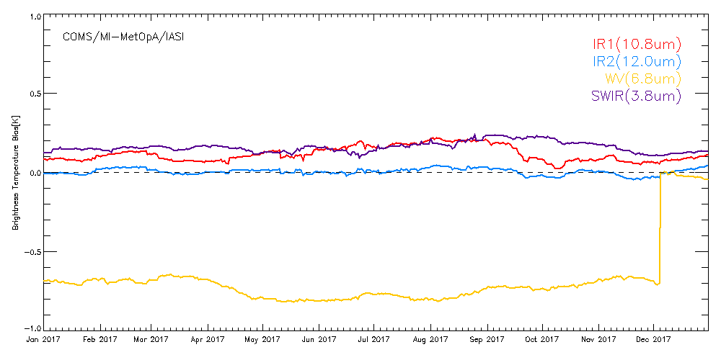
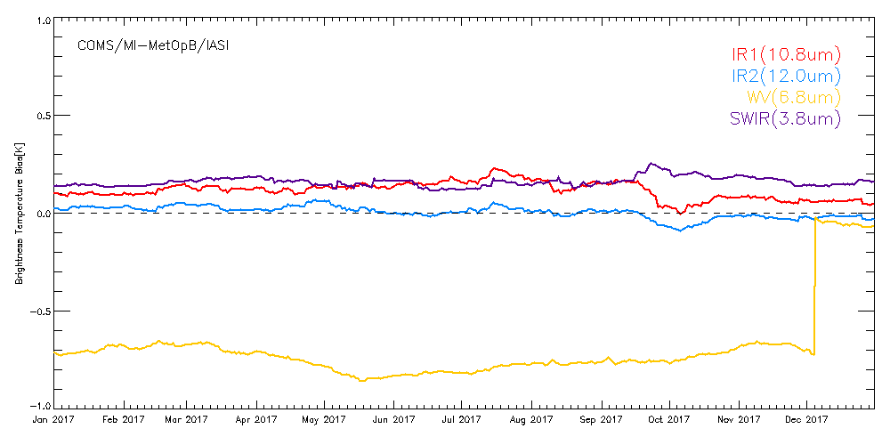
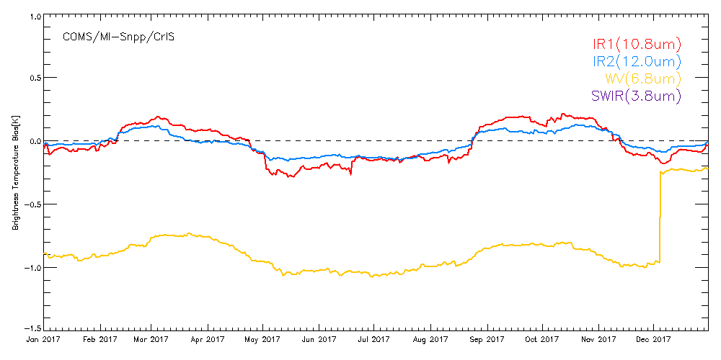
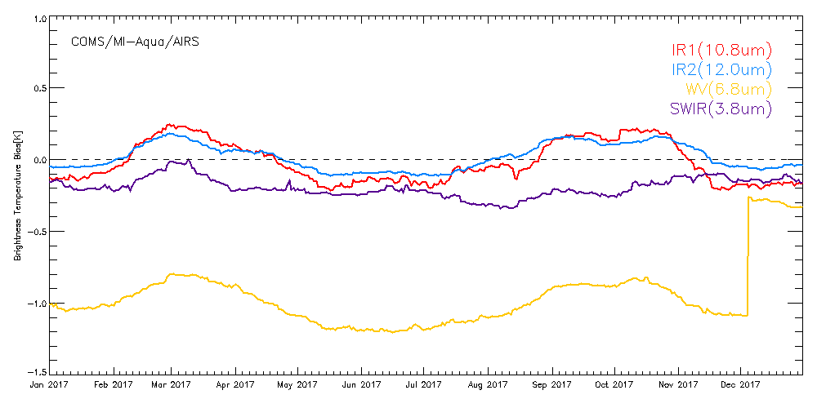
Calibration Performance: COMS/MI Infrared Bands
Summary Statistics of COMS/MI IR Calibration Performance in 2017 (All uncertainties are k=1)
 | MetOp-A/IASI |  |  |  | MetOp-B/IASI
Channel Name | IR3.8 | IR6.8 | IR10.8 | IR12.0 | IR3.8 | IR6.8 | IR10.8 | IR12.0
Std Rad as Tb (K) | 286 | 238 | 286 | 285 | 286 | 238 | 286 | 285
Mean Bias (K) | 0.16 | -0.02 | 0.12 | 0.004 | 0.15 | -0.06 | 0.11 | 0.004
Stdv of Bias (K) | 0.03 | 0.01 | 0.05 | 0.02 | 0.02 | 0.01 | 0.04 | 0.03
Mean Drift Rate of Bias (K/yr) | -0.14 | - | -0.12 | -0.01 | -0.15 | - | -0.14 | -0.04
 | Snpp/CrIS |  |  |  | Aqua/AIRS
Channel Name | IR3.8 | IR6.8 | IR10.8 | IR12.0 | IR3.8 | IR6.8 | IR10.8 | IR12.0
Std Rad as Tb (K) | 286 | 238 | 286 | 285 | 286 | 238 | 286 | 285
Mean Bias (K) | - | -0.23 | -0.03 | -0.02 | -0.19 | -0.30 | -0.02 | 0.02
Stdv of Bias (K) | - | 0.01 | 0.14 | 0.08 | 0.07 | 0.02 | 0.14 | 0.09
Mean Drift Rate of Bias (K/yr) | - | - | +0.03 | +0.03 | +0.19 | - | -0.005 | -0.007
The statistics are derived from COMS/MI Operational GSICS Re-Analysis Correction vs. Metop-A/IASI, Metop-B/IASI, Aqua/AIRS, Snpp/CrIS
Biases defined for Standard Radiance: typical scene for easy inter-comparison of sensors’ inter-calibration biases
Operation of MI with shifted WV SRF of 3.5cm⁻¹ started in 5 December 2017.

Slide 25
2017 Annual GSICS Calibration Report for ROSHHYDROMET
Example#5
Alexey Rublev, Alexander Uspensky
ROSHYDROMET

Slide 26
Satellite/Instrument Summary - GEO
http://planet.rssi.ru
Satellite (status) |  | Location | Launch date | EO instruments
Elektro-L No.2 | (Op) | 76E | 2015-12-11 | MSU-GS
Satellite Status
 | Op = Operational
 | P = Pre-operational
 | B = Back-up, secondary
 | L = Limited availability
Instrument Status
 |  | Operational (or capable of)
 |  | Operational with limitations (or Standby)
 |  | Operational with Degraded Performance
 |  | Not Operational
 |  | Functional, Turned Off
The MSU-GS instrument is functional with limitations (12 μm channel is absent).
Absolute calibration is ongoing.

Slide 27
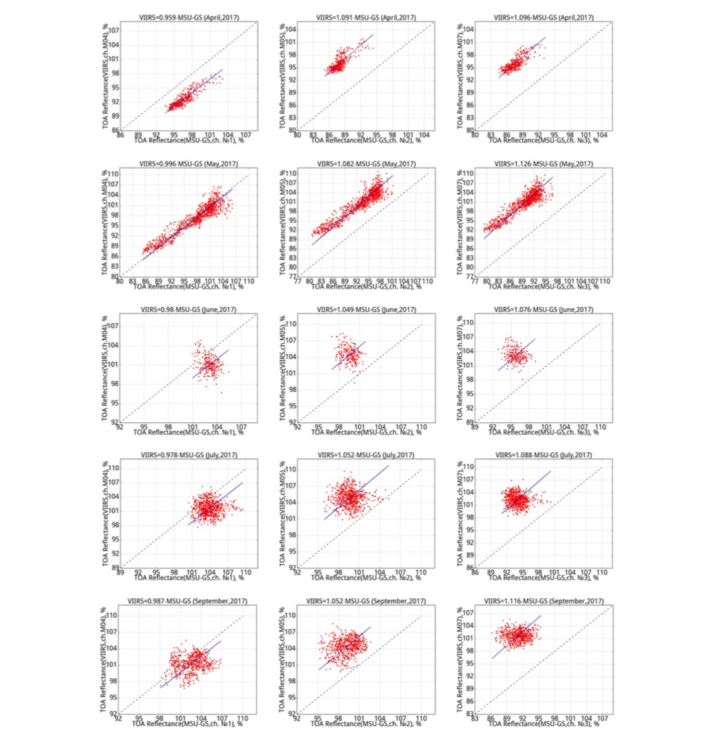
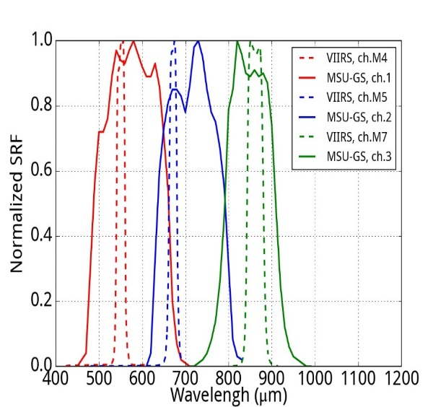
Calibration Performance of MSU-GS: Visible/Near-Infrared Channels
Inter-calibration of MSU-GS shortwaves channels
versus the VIIRS/Suomi NPP
Comparison above
deep convective clouds
over the Indian Ocean
± 20° North/South and East/West of Elektro-L No. 2
sub-satellite point (76 °E)
Calculated SBAF between MSU-GS
and VIIRS ~1.0 for each pair of channels
Month | k1 | Std error* | k2 | Std error | k3 | Std error | Number of cases
April | 0.959 | 0.021 | 1.091 | 0.038 | 1.096 | 0.031 | 384
May | 0.995 | 0.009 | 1.082 | 0.010 | 1.126 | 0.012 | 383
June | 0.980 | 0.095 | 1.049 | 0.091 | 1.076 | 0.076 | 227
July | 0.978 | 0.036 | 1.052 | 0.040 | 1.088 | 0.035 | 651
August | 0.974 | 0.118 | 1.066 | 0.120 | 1.086 | 0.118 | 116
September | 0.987 | 0.035 | 1.052 | 0.037 | 1.116 | 0.030 | 554
Weighted mean | 0.989 | 0.008 | 1.079 | 0.009 | 1.118 | 0.010 | 2315
*Std error – standard regression error

