Slide 1
Preparatory Web meeting for 2019 Annual Meeting in Frascati, Italy
Larry Flynn and Manik Bali
GSICS Coordination Center, NOAA
NOAA GDWG

Slide 2
TABLE OF CONTENT
Proposed topics for GSICS Coordination Center
Actions on GCC
Proposed topics for NOAA-GDWG
Actions on NOAA-GDWG
Proposed topic for GRWSG-UV

Slide 3
Topics-GSICS Coordination Center
Updates on Actions
Updates on New Products and Product Promotion
Review status
Product types (E.g., SRFs)
New Action Tracker
Updates on Action Tracker ( New Parsers)
Product Catalog – New Prototype Product Visualization
GUW
2019 Report on Vladivostok
Instrument and Level 1 Monitoring
OSCAR, Landing Pages, GPRCs, and ICVS
Newsletter-Towards collaboration with contemporary journals
Membership
Upcoming Special Issues
You are Welcome to Suggest topics for GCC

Slide 4
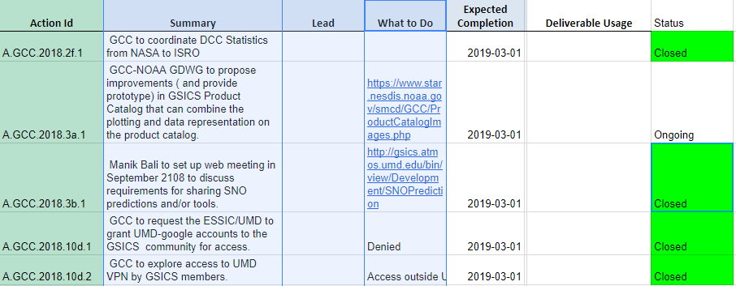
NOAA-GCC Action Status

Slide 5
NOAA-GDWD- Actions Status
A.GDWG.2018.5a.1 | Actions Review | NOAA-GDWG( Bali) to propose updates to the Actions Tracker and GSICS User Messaging (GUM) service such that all GPRCs can use these applications. | NOAA | Open
A.GDWG.2018.8a.2 | Action Tracking | NOAA-GDWG (Manik Bali) to summarize action tracking tool on the Wik | NOAA | Open
A.GDWG.2018.8a.3 | Action Tracking | NOAA-GDWG (Manik Bali) to summarise current status of GSICS Wiki (e.g. server configuration, system requirements) and inform to W | NOAA | Open
A.GDWG.2018.8f.1 | Instrment Performance Monitoring | Ninghai Sun to share their ICVS user manual with the GDWG members when it becomes available. | NOAA | Open

Slide 6
Topics-NOAA-GDWG
Mirroring GSICS Product
New Action Tracker-> Action Tracking on Cloud
Updates on Action Tracker
Access for GSICS on Clouds (AWS, Azure , Google )
Product Monitoring Tool (A.GDWG.20171108.1)
Product Visualization
Updates on GSICS Wiki/THREDDS
Welcome to Suggest topics for NOAA-GDWG

Slide 7
NOAA Suggestions for UV Session
UV Project Reports
Solar
Reflectivity
Initial Residuals
Calibration Best Practices
Sentinel 5P TropOMI
NOAA-20 OMPS
Metop-C GOME-2
GF-5 EMI,
FY-3F OMS-N & OMS-L
UV in GEO Orbits

Slide 8
Thank you

