Slide 1
Characterisation of NWP model biases and uncertainties for improved satellite Cal/Val
Fabien Carminati, Stefano Migliorini, & Bruce Ingleby

Slide 2
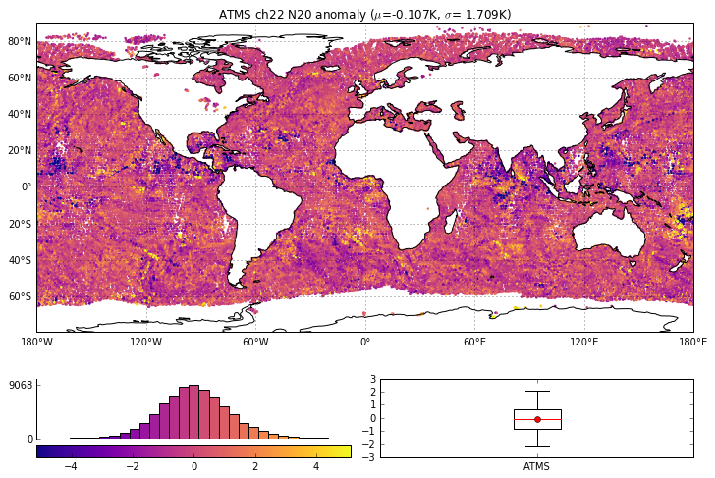
Rationale
NWP short-range forecast uncertainties in brightness temperature space (Loew et al., 2017) :
0.05 to 0.2K at frequencies sensitive to temperature
1 to 2K at frequencies sensitive to humidity
Estimations arise from sensitivity studies
not from uncertainty analyses*
*Stochastic studies – based on ensemble – but only for the random component of model uncertainties (Leutbecher et al., 2017)
Leutbecher et al., Stochastic representations of model uncertainties at ECMWF: state of the art and future vision. Q.J.R.M.S., doi:10.1002/qj.3094, 2017.
Loew et al., Validation practices for satellite based earth observation data across communities, Rev. of Geophysics, doi:10.1002/2017RG000562, 2017.

Slide 3
Rationale
The total uncertainty associated with NWP fields, , can be derived as a function of:
$$u_{NWP}$$
$$u_{NWP}=f(u\left(x_{NWP}\right), u\left(H\right),u\left(Δx\right),u(cloud))$$
Uncertainties in T, P, & q mapped to Tb space:
Estimated from the GRUAN Processor
Uncertainties in RT modelling:
Line-by-line to fast model
Spectroscopic uncertainty
Surface emissivity
Uncertainties due to scale mismatch:
Obs scale ≠ model scale
Natural scale << obs or model scale
Uncertainties due to residual cloud after screening
Objective of this study

Slide 4
Outline
To evaluate NWP uncertainties in radiance space we need to:
Compare simulated brightness temperature from NWP fields and traceable comparator data – here, GRUAN radiosondes
Propagate uncertainties in radiance space (2 options):
Apply the radiative transfer to profiles perturbed by their uncertainties
Use the Jacobians derived by RTTOV

Slide 5
GRUAN processor
Inputs
Attributes
Name-list file
Dummy profiles with GRUAN surf.
Outputs
MODEL_ouput.nc
NWP
Data file
Horizontal
interpolation
Vertical
interpolation
RTTOV
GRUAN_ouput.nc
Conversion
GRUAN
Data file
Coordinates
Merging
Sub-sampling
Dummy profiles ± uncertainties
LEGACY:
CAPABILITY:
OBJECTIVE:
EUMETSAT Numerical Weather Prediction Satellite Application Facilities NWPSAF RTTOV fast radiative transfer model and Radiance Simulator (http://nwpsaf.eu/).
Collocate GRUAN profiles and NWP model fields, simulate top-of-atmosphere brightness temperature at frequencies used by satellite instruments, and propagate uncertainties in the simulation.
Quantify errors and uncertainties in NWP temperature and humidity fields mapped to observation space (brightness temperature).
For details see Carminati et al., 2019
https://www.atmos-meas-tech.net/12/83/2019/amt-12-83-2019.html

Slide 6
Demonstration of capability
ATMS channel | Frequency (GHz) | ΔTb_{ECMWF} (1σ) (K) | ΔTb_{MetOffice} (1σ) (K)
8 | 54.94 | -0.084 (0.094) | -0.002 (0.108)
9 | 55.5 | -0.147 (0.124) | 0.037 (0.126)
10 | 57.29 | -0.321 (0.175) | 0.012 (0.161)
11 | 57.29±0.217 | -0.388 (0.207) | -0.039 (0.197)
12 | 57.29±0.3222±0.048 | -0.337 (0.254) | -0.093 (0.276)
18 | 183.31±7.0 | 0.354 (0.910) | 0.016 (0.829)
19 | 183.31±7.0 | 0.369 (1.129) | -0.085 (1.026)
20 | 183.31±3.0 | 0.337 (1.310) | -0.178 (1.219)
21 | 183.31±1.8 | 0.219 (1.477) | -0.311 (1.420)
22 | 183.31±1.0 | 0.039 (1.613) | -0.460 (1.571)
NWP–GRUAN using ECMWF fields
NWP–GRUAN using Met Office fields
GRUAN uncertainties propagated in radiance space
Difference NWP–GRUAN in radiance space at ATMS frequencies using 587 GRUAN night-time profiles from Lindenberg, Germany, 2016. Vertical bars show the 1σ standard deviation.

Slide 7
Propagation of uncertainty (1)
GRUAN profiles are perturbed by their profiles of total uncertainty assuming it is fully correlated throughout the profile:
Good first approximation, but
Pessimistic assumption (overestimation)
Ignore uncertainties from the NWP model fields and data processing
NWP–GRUAN using ECMWF fields
NWP–GRUAN using Met Office fields
GRUAN uncertainties propagated in radiance space

Slide 8
Propagation of uncertainty (2)
Estimation of covariance of the difference NWP minus GRUAN:
with
where y_{rs} and y_{m} are the radiosonde and model-based simulated brightness temperatures, H the Jacobian, and R, B, and S_{int} the error covariance matrices of GRUAN measurements, the forecast, and the vertical interpolation, respectively.
$$S_{δy}≡cov\left(δy\right)≅HRH^{T}+HWBW^{T}H^{T}+HS_{int}H^{T}$$
$$δy≡y_{m}−y_{rs}\left.≅H_{x^{t}}(Wε_{m}+ε_{int}−ε_{rs}\right)$$
Notes:
R is built as a diagonal matrix accounting for the different sources of uncertainty, i.e. 𝑇, q, and 𝑃 built as the sum of diag. matrices whose diagonals are the square of GRUAN profiles of total uncertainty, and 𝑢_𝑠𝑘𝑖𝑛𝑇, 𝑢_𝑇2𝑚, 𝑢_𝑞2𝑚, and 𝑢_𝑃2𝑚 the uncertainties associated with the surface parameters set to 0.3K, 0.3K, 0.04 RH, and 0.1hPa, resp.
S_{int} is shown to be a function of B the forecast covariance matrix and W the interpolation matrix.
x^{t} is the true profile of the fine grid, epsilon gruan, nwp, and int are the errors associated with the radiosonde and the model fields and the interpolation

Slide 9
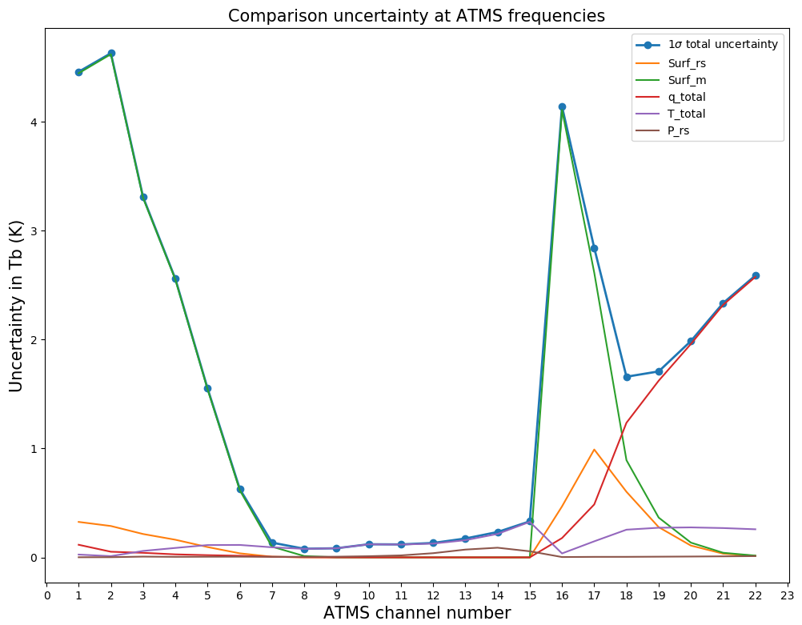
Propagation of uncertainty (2)
In practice, we estimate the $S_{δy}$ for each parameter:
$$S_{δy}=S_{surf}^{rs}+S_{surf}^{m}+S_{T}+S_{q}+S_{P}$$
with
$$S_{T}=S_{T}^{rs}+S_{T}^{m} \text{+} S_{T}^{int}$$
$$S_{q}=S_{q}^{rs}+S_{q}^{m} \text{+} S_{q}^{int}$$
$$S_{P}=S_{P}^{rs}$$
and the uncertainties are calculated as:
uncertainty = $\sqrt{diag(\overline{S})}$

Slide 10
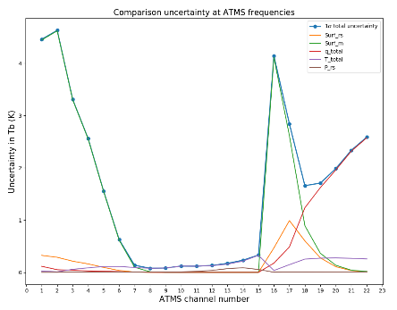
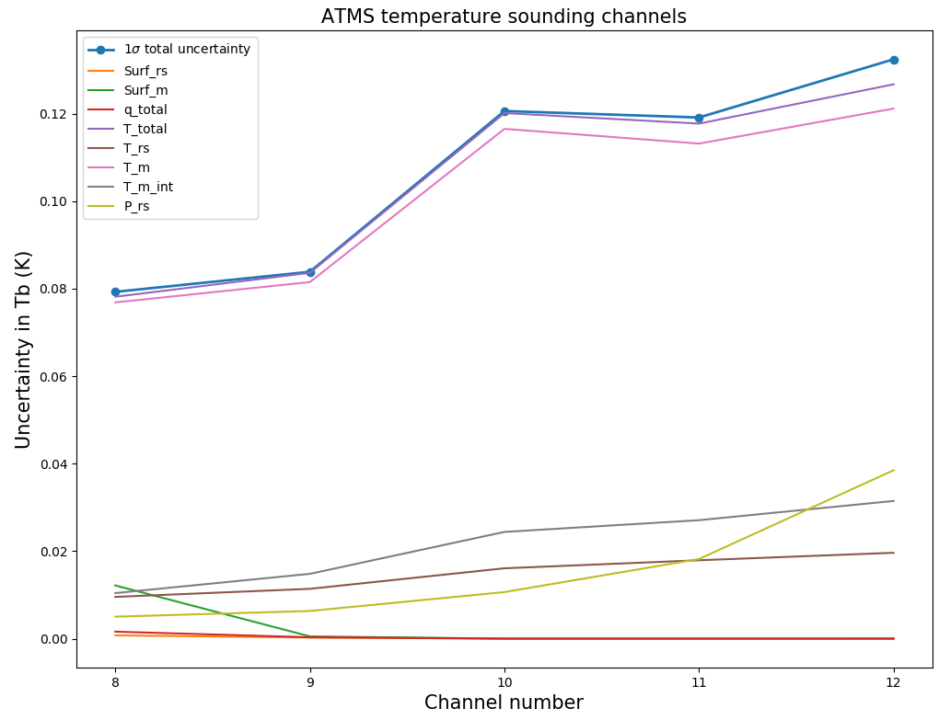
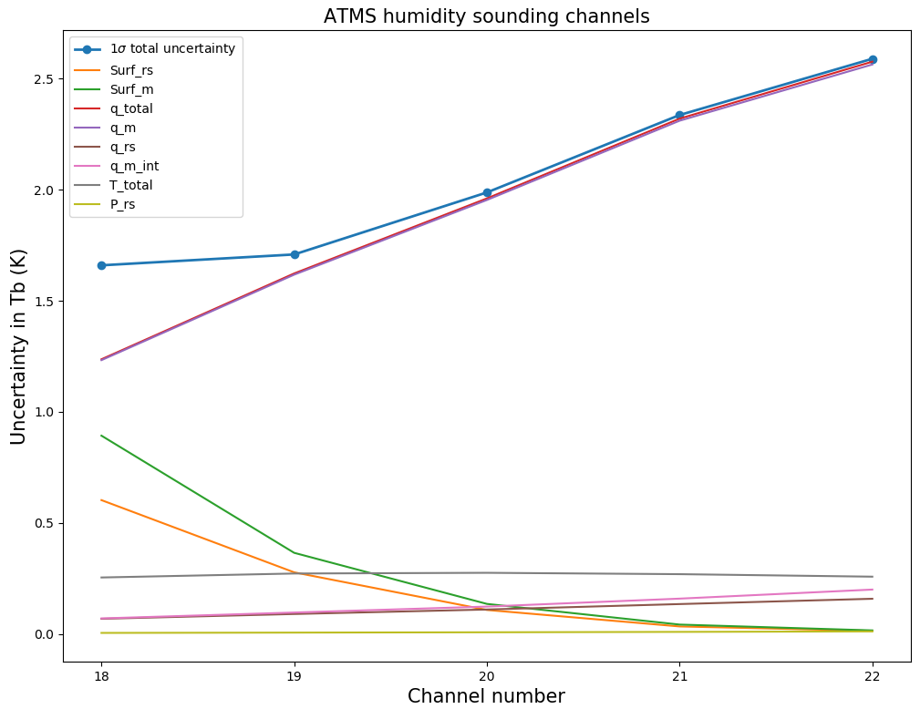
Propagation of uncertainty (2)

Slide 11
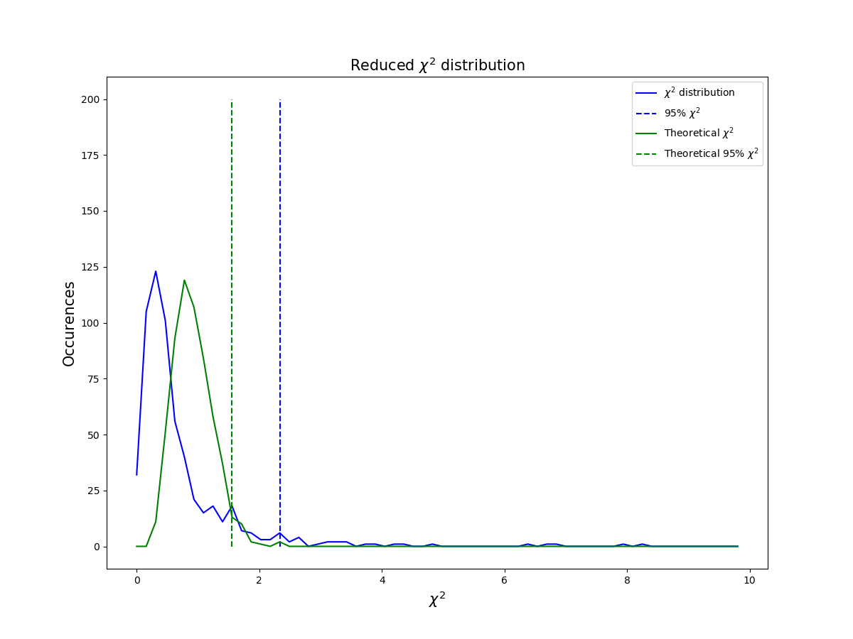
Assessment
We can use a reduced Chi-square test for assessment:
$${\tilde{Χ}}^{2}=\frac{1}{c} {\left(δy_{i}−\overline{δy}\right)}^{T}S_{δy}^{−1} (δy_{i}−\overline{δy})$$
Where c is the number of degrees of freedom
95%
5%
95%
5%
3%
Good … but not perfect
${\tilde{Χ}}_{calc}^{2}\left(95\%\right)>{\tilde{Χ}}_{theo}^{2}\left(95\%\right)$ means:
One (or more) component of $S_{δy}$ have been underestimated, and/or
Missing unforeseen sources of uncertainty

Slide 12
Summary
The GRUAN processor: a collocation and top-of-atmosphere brightness temperature simulation tool for comparison between NWP fields and GRUAN radiosondes in satellite observation space with uncertainty propagation via (a) perturbation of profiles and (b) use of Jacobians.
Total uncertainty ranges from 0.08 to 0.13 K at frequencies sensitive to temperature and from 1.6 to 2.5 K at frequencies sensitive to humidity (preliminary, but in line with previous estimations).
Next step will be to process and analyse collocated profiles spanning several years and multiple GRUAN sites, and provide a refined set of model bias & uncertainty for selected frequencies spanning both microwave and infrared domains.

