Slide 1
Updates of GDWG Recommendations for GSICS Action Tracking Tool
Masaya Takahashi (JMA) and Manik Bali (NOAA)

Slide 2
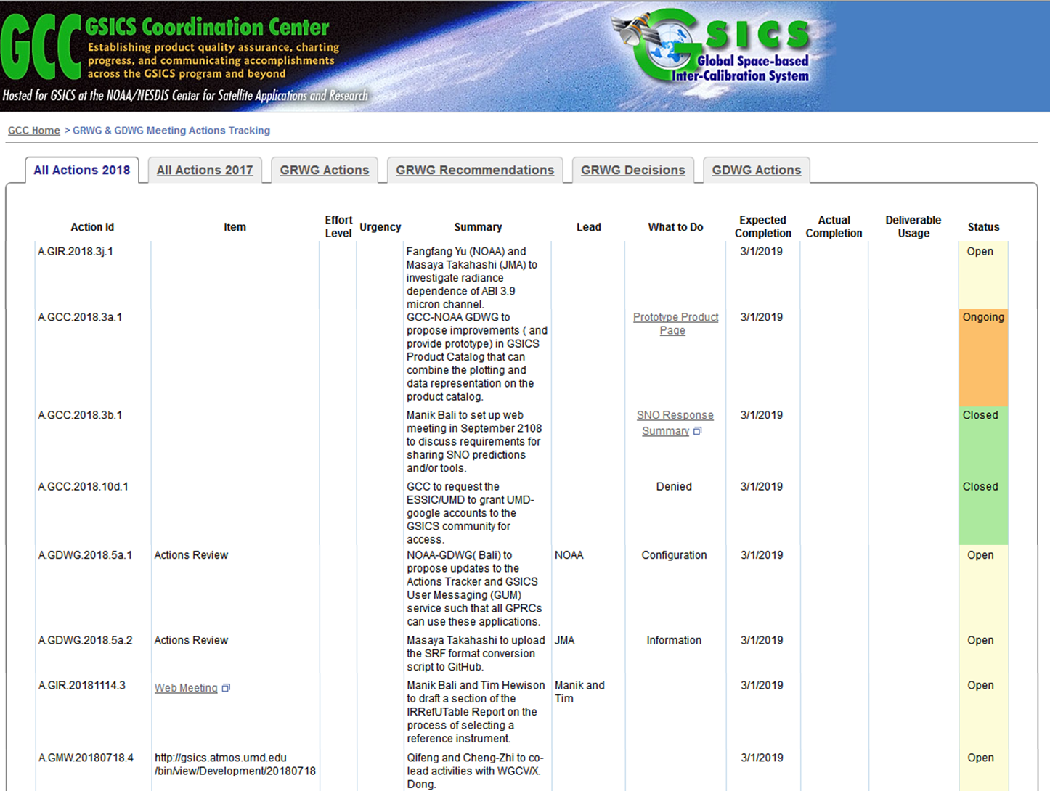
Action Tracking Page on GCC Website
https://www.star.nesdis.noaa.gov/smcd/GCC/MeetingActions.php

Slide 3
Components of Current Action Tracking Page – Lot of columns!
Action ID: Format agreed at 2016 Annual Meeting
Item: action category
Effort Level
Urgency
Summary
Lead
What to Do
Expected/Actual Completion date
Deliverable Usage
Status

Slide 4
Components of Current Action Tracking Page – Lot of columns!
Action ID: Format agreed at 2016 Annual Meeting
Item: action category
Effort Level
Urgency
Summary
Lead
What to Do
Expected/Actual Completion date
Deliverable Usage
Status
Issues to be Reported/Discussed Today
Too wide “Item” column and too narrow “Summary” column
Use of “Outcome” rather than “Deliverable Usage”
Revisiting the usage of “Effort Level”, “What to do” and “Urgency”

Slide 5
1) Issue of too wide “Item” column and too narrow “Summary” column
Wide “Item” column: caused by a long URL of GSICS Wiki (Web Meeting Page).
New function to replace the URL by other words was introduced.
This new function could solve the narrow “Summary” column.

Slide 6
2) Use of “Outcome” rather than “Deliverable Usage”
Suggestion by Tim Hewison:
“Outcome” seems to better reflect what that column is used for.
What do you think?

Slide 7
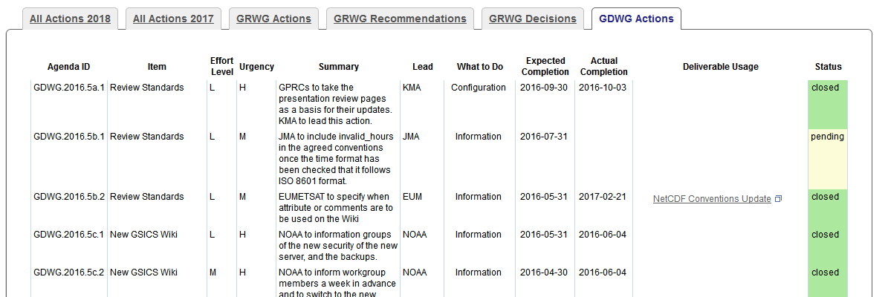
3) Revisiting the usage of “Effort Level”, “What to do” and “Urgency”
Reducing number of columns could be effective for simplicity, but need to recall GDWG consensus at the past Annual Meeting.

Slide 8
Discussion Summary at 2017 GRWG/GDWG Annual Meeting, Madison
Agenda Item: 6b Action tracking – 10:00 (60 minutes)
Presenter | Manik Bali (NOAA) - Lori Brown is the NOAA Web Master
Discussion point, conclusions, Actions, Recommendations, Decisions
Manik presented a new action tracking tool that has been developed at NOAA by the NOAA-GDWG -NOAA combine. *snip* Proposed updates for the next version: Remove “Effort Level” as this is the same as “What to do”. A table should be available to describe the “What to do” categories mean, and what the urgency means. *snip* Use of “What to do” and “Urgency” columns were supported by the group from management point of view. The group confirmed the following definitions of types in “What to do” columns and “Urgency”. What to do: Analysis: examining a subject and reporting if it is suitable/applicable for GSICS Configuration: Updates to websites, documentation and/or data files for GSICS Data Management systems. Implementation: The development of a GSICS Data Management System. Information: Provision of existing known material for use in GSICS. Specification: The development of a GSICS Data Management Concept. Tech Support: Provision of existing known material that requires tailoring for use in GSICS. Urgency: High: to be closed within 1 month Medium: to be closed within 6 month Low: to be closed within 1 year or next joint meeting

Slide 9
“What to do”: useful to see action (e.g. kind of tasks, effort needed) at a glance if we follow the GDWG definition.
But nothing big disadvantage even if it is removed?
"Urgency” could be removed as Expected Completion covers the info
“Urgency” could be removed as Expected Completion covers the info.

Slide 10
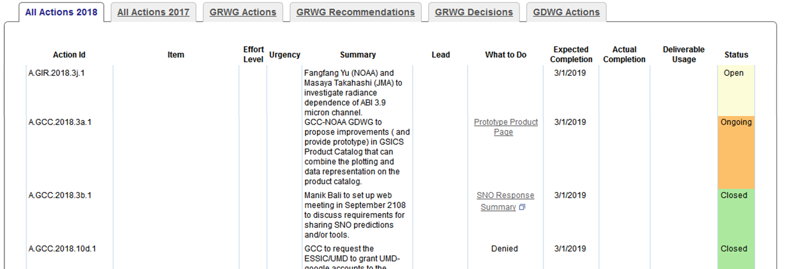
Proposal of New GDWG Recommendations for GSICS Action Tracking Tool
To replace “Deliverable Usage” column by “Outcome”
To remove “Effort Level” and “Urgency” columns
To remove “What to do” column?

