Slide 1
Progress in CMA on GSICS Collaboration Servers Synchronisation
XU Zhe
CMA GDWG

Slide 2
Agenda
EUMETSAT Sync code test in CMA
CMA Sync EUMETSAT RAC product status
Suggestions
Notes:
GSICS Processing and Research Centres (GPRC)

Slide 3
EUM Sync Code Test
Version 1:
2018-05-17, CMA received Sync code and document from Peter. Miu(EUM);
Re-engineered the CMA script for downloading all RAC oper products.
Test result:
8 EUM RAC product can be downloaded: MSG1（2,3,4）+SEVIRI-MetOpA(B)+IASI_C_EUMG
Error exist: http response：500
Notes:
GSICS Processing and Research Centres (GPRC)

Slide 4
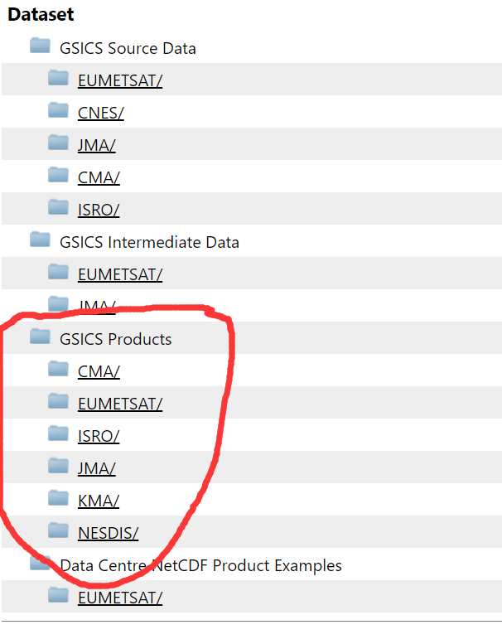
EUM Sync Code Test
Version 2:
2018-06-29, CMA received update Sync code and XML configuration file;
Include:
Code: gsicsSyncDaemon.pl
Configuration file: gsicsServers2Sync.xml
Run: perl gsicsSyncDaemon.pl gsicsServers2Sync.xml
Test result:
Run smoothly on CMA server without error report
Download file from GSICS Products
Notes:
GSICS Processing and Research Centres (GPRC)

Slide 5
CMA Status
CMA replicate EUMETSAT RAC product
Continue using our Shell script
Get and Put
Why?
Replicated remote file has already integrated in CMA GSICS data preparation software in operation mode
Routine job, runs 1 daily
Download catalogue can be configured on demand.

Slide 6
Suggestion
EUMETSAT Sync code +XML configuration file is convenient to users, easy to learn ,deploy, and integrated in local application;
CMA recommend for other GDWG members to use it in GPRC for sync RAC product;
GDWG Chair make a SYNC GSICS RAC product list;
Thanks Peter.Miu (EUMETSAT)’s contribution on Sync code development.

Slide 7
Thank you for your attention
WMO GSICS Portal
http://gsics.wmo.int
GSICS Coordination Centre http://www.star.nesdis.noaa.gov/smcd/GCC/index.php
GSICS Product Catalog https://www.star.nesdis.noaa.gov/smcd/GCC/ProductCatalog.php
GSICS Wiki
http://gsics.atmos.umd.edu/wiki/Home

