Slide 1
WMO new mini site for the GSICS Web

Slide 2
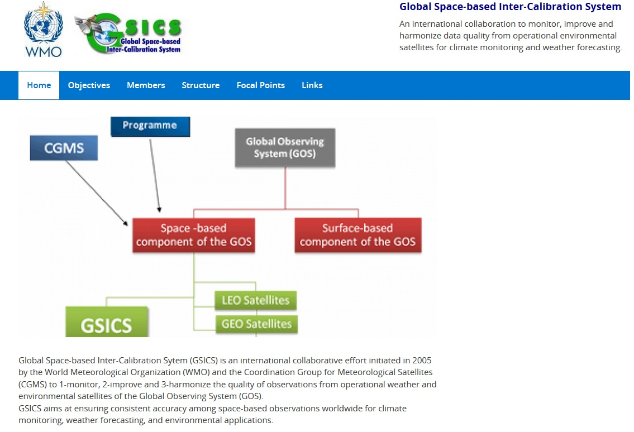
Click

Slide 3
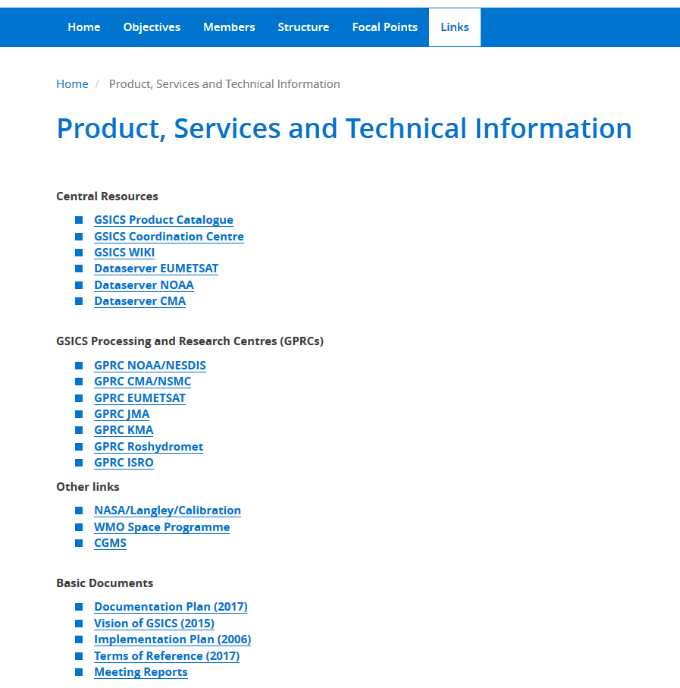

Slide 4
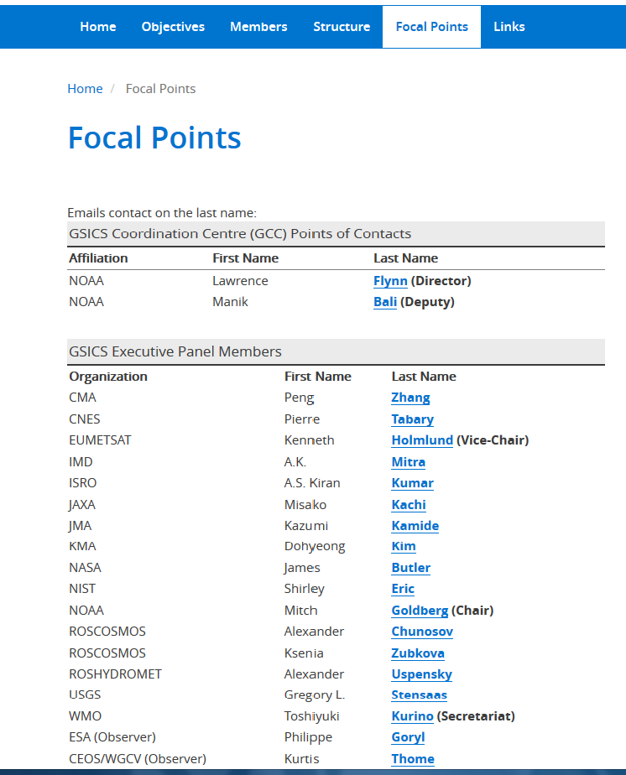
Click: “mail to:”
e-mail address is embedded

Slide 5
Link from OSCAR/Space to
GSICS Inter-calibration Page

Slide 6
Click

Slide 7
Click

