Slide 1
ISRO GSICS THREDDS Server
Current status and future plans
Munn Vinayak Shukla
Pradeep Kumar Thapliyal
Nitant Dube

Slide 2
Overview
ISRO GSICS Products
ISRO THREDDS Server implementation
Development of Visualization Tool

Slide 3
Current Status of ISRO GSICS Products
Satellite | Sensor | Status | Type
INSAT-3D | Imager | Demo | NRTC
INSAT-3D | Sounder | - | Implementation in Progress
INSAT-3DR | Imager | - | Internal Validation completed, will be available soon
INSAT-3DR | Sounder | - | Implementation in Progress
INSAT-3D and INSAT-3DR | Imager -VIS | - | DCC approach developed with support from Dave Doelling, products will be made available
Kalpana-1 | VHRR | As mission is completed and hence only RAC products will be made available
INSAT-3A | VHRR | As mission is completed and hence only RAC products will be made available

Slide 4
ISRO THREDDS Server
Based on Inputs and Configuration files provided by Peter Miu, the existing configuration of ISRO THREDDS Server is modified
New Reconfigured THREDDS is available at
https://mosdac.gov.in/thredds

Slide 5
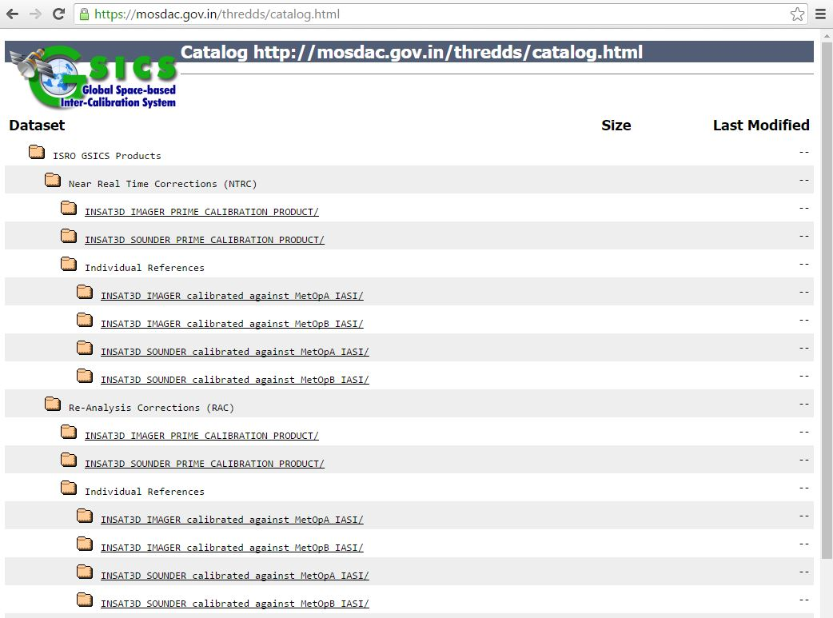

Slide 6
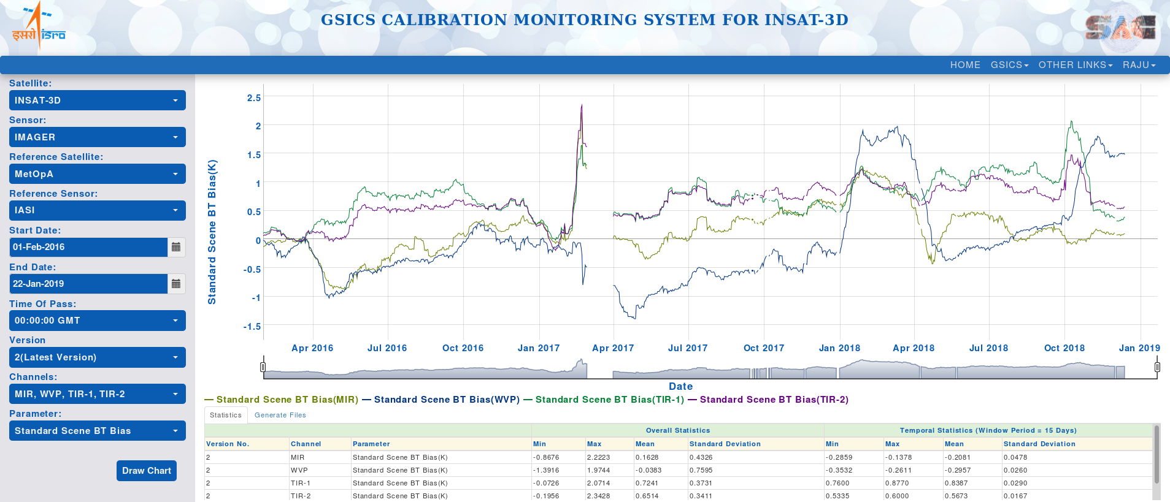
Visualization Tool (Under Development)

Slide 7
Thanks

