Slide 1
GSICS Actions Tracker – New Additions and Way forward Thoughts on the GSICS Wiki GSICS Product Catlog Prototype
Manik Bali, Lori Brown nd Lawrence E. Flynn
GDWG Webmeeting, 1/23/2019

Slide 2
Outline
Introduction
Requirements
Google Cloud Solution
How to Use Action Tracker
New Features Added to the Action Tracker
Google Cloud Account for GSICS members at UMD
Proposal to migrate GSICS Wiki to ESSIC
New GSICS Product Catalog Prototype
Summary and Discussion

Slide 3
Introduction
Each year actions are generated in GSICS community.
These actions were previously monitored on the GSICS Wiki Page
Over the years activity in GSICS has increased as has the number of Actions generated in GSICS Annual, EP, UW and group and subgroup meetings.
GRWG placed a request to GCC-NOAA-GDWG to provide an alternative to the wiki actions page. Features that were requested.
Fast search.
Easy Action writing.
Easy updating.
Easy to understand layout.
New Category of actions ( For example, Lunar, Recommendation, Decision)
Some level of automation.
Big Thank you to Tim Hewison and Masaya Takahashi for posting requirements and testing the existing tool

Slide 4
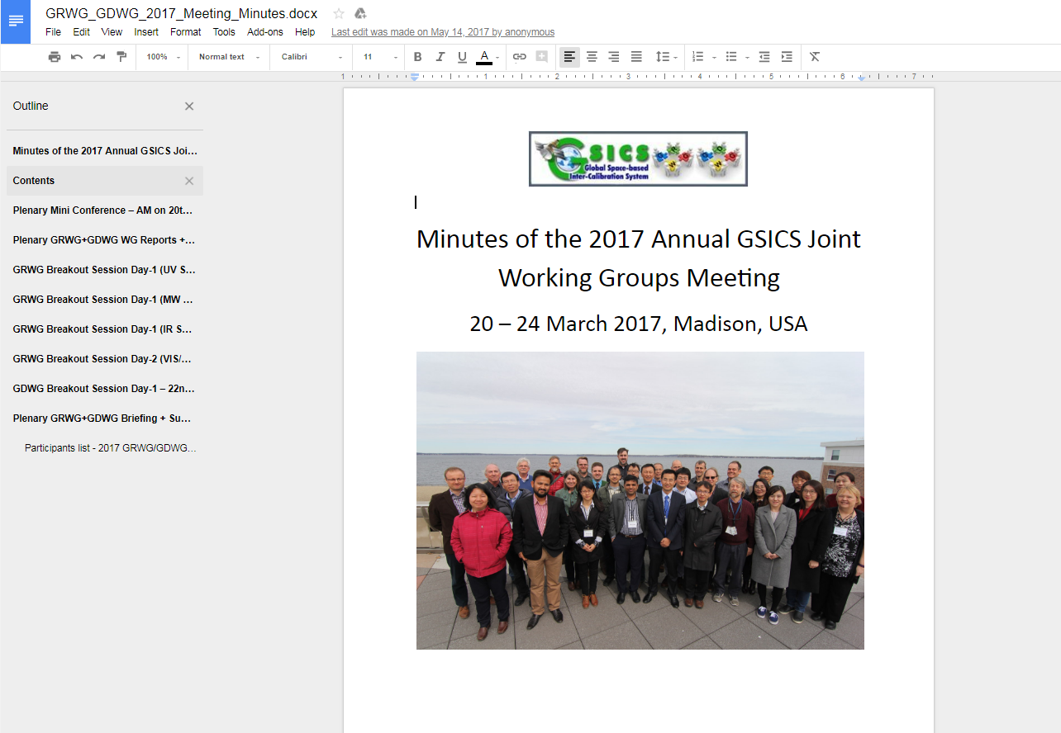
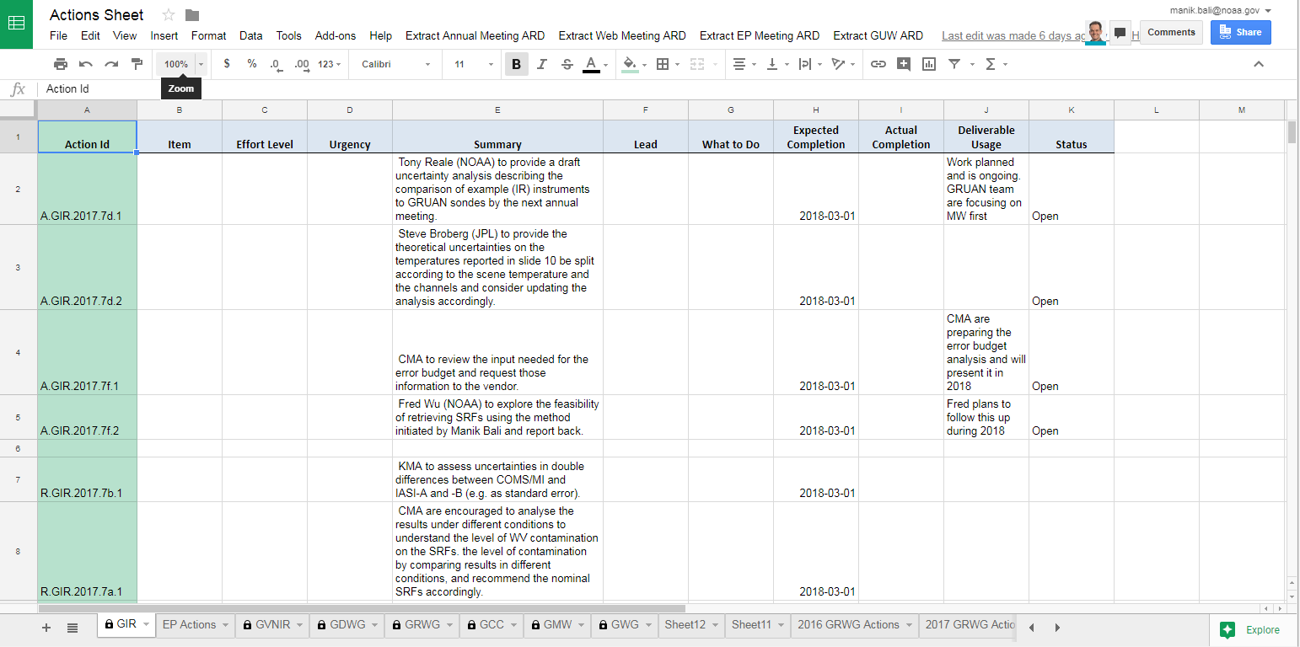
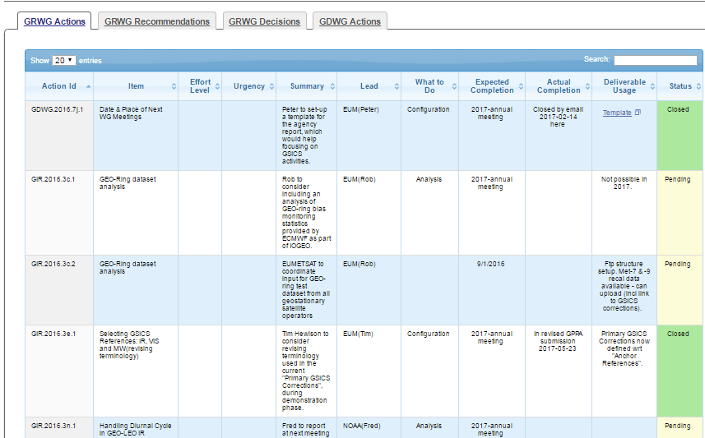
Approach - Google Cloud + Web

Slide 5
Au
How to Use the Action Tracker
Automatically reads the Annual Meeting report Goodle Doc and extracts Actions/Recommendations/Decisions and puts them onto Google Sheet ( Direct Reduction of Overhead by 50% as compared to Wiki)

Slide 6
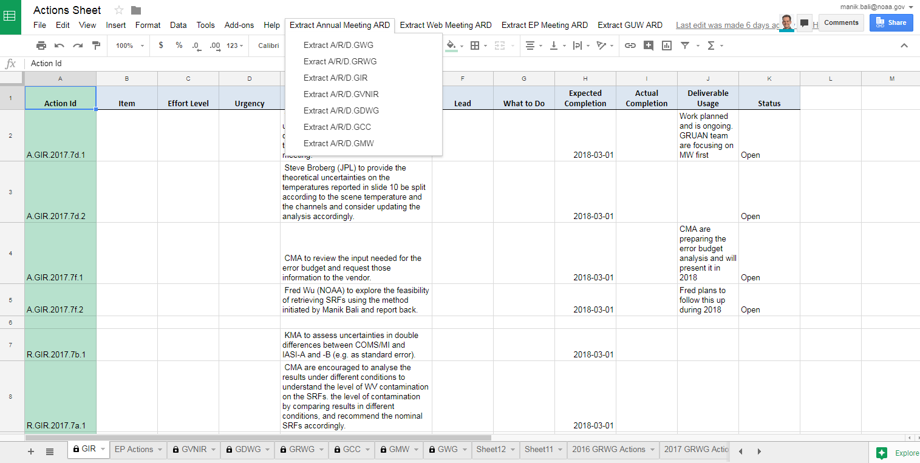
New Features
Dropdown Menu extracts Actions/Recommendations and Decisions from Annual GUW and EP meeting

Slide 7
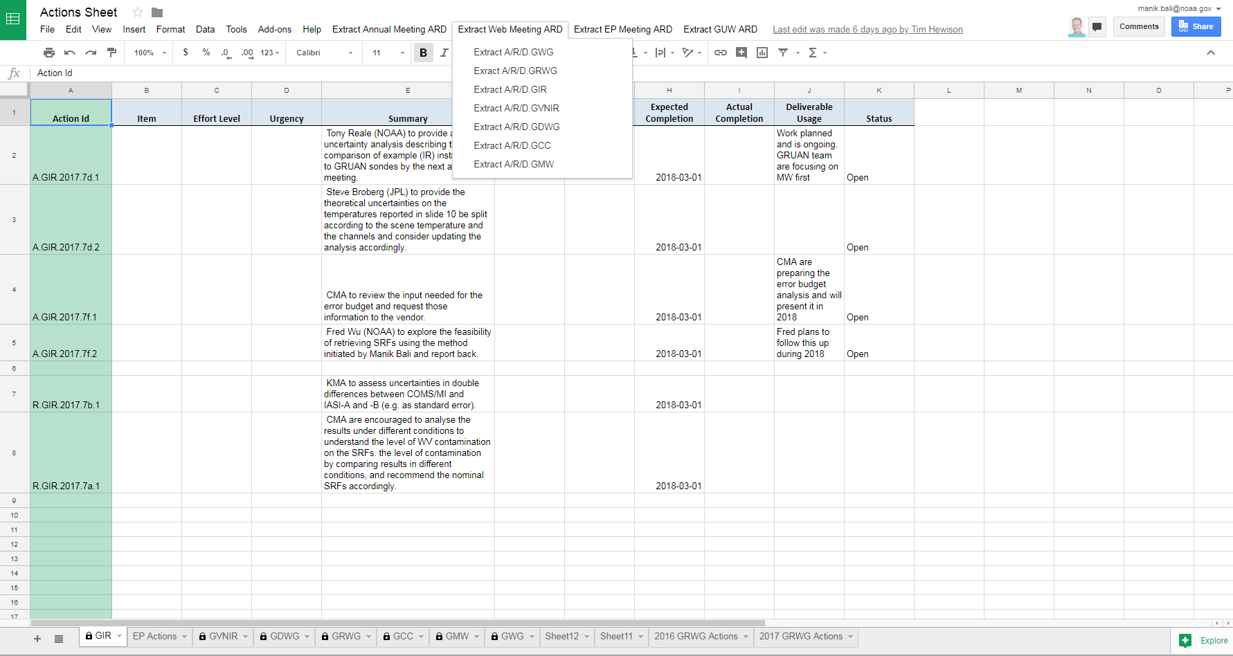
New Features
Dropdown Menu extracts Actions/Recommendations and Decisions from Annual GUW and EP meeting

Slide 8
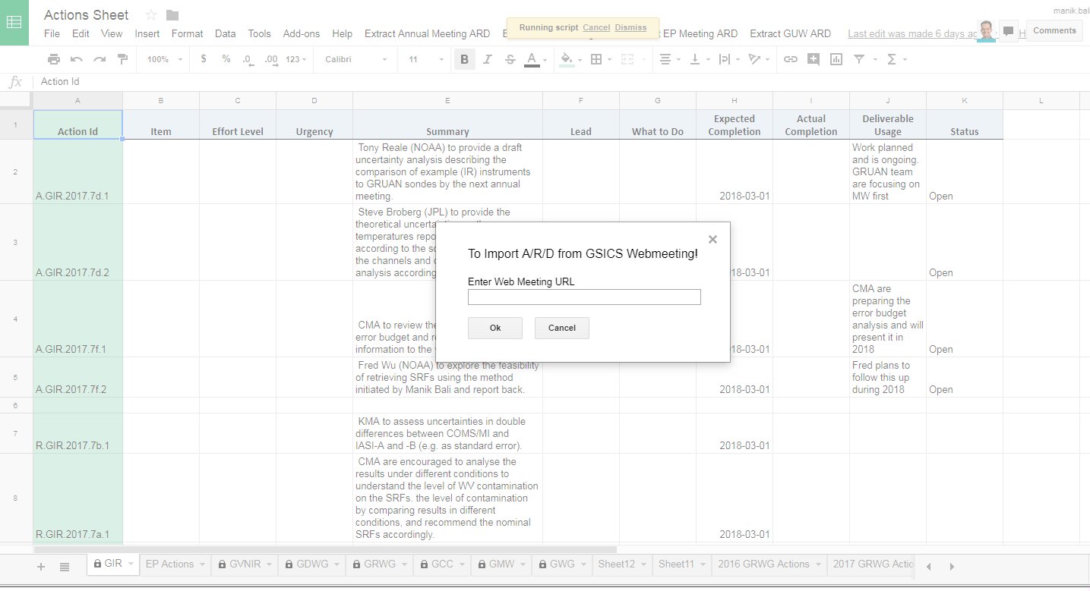
New Features
A new feature to extract Actions from Wiki page has been added and tested successfully.

Slide 9
How to Use the Action Tracker
GCC creates a google Sheet for each type of action being tracked. The Sheet link is shared among GSICS members.
The actions are grouped into pages by year, each different type viewable on a separate tab. The content of the tables on the tabs are sortable and searchable.
If users need to add hyperlinks to any action sheet, users should use the ‘Activate Hyperlink’ button to activate on the google sheet to activate ithe hyperlink on the GCC Action Tracker website.
When users’ changes are saved, they are dynamically updated onto the correct Action Tracker page.
A.GroupID.YYYY.sessionID.Action number (Actions )
D.GroupID.YYYY.sessionID.Decision number (Decisions )
R.GroupID.YYYY. sessionID.Reccomendation number (Recommendations )
Always Use Actions/Recommendations/Decisions ID’s correctly (Eg A.GDWG.2017.5a.8 )

Slide 10
Summary of New Additions
Added new buttons. Each GSICS Meeting has a button
Direct extraction of Actions/Recommendations and Decisions from from google document without any human intervention
Added new Tabs on the Excel Sheet
Added the ability to import actions from Wiki Page and Webpages
New Parser has been developed to extract actions from GSICS EP meeting
Activtehyperlink button has been re-integrated into the new Tracker Sheet to add hyperlink( To n extent this has reduced the column width)
Done tests with reducing columns , should be operational coming yer
Demo: Google is not Available in China however import from Zoho to google sheet has been successfully tested.
https://docs.google.com/spreadsheets/d/11-U2XDE7J5cHYjksRsZ5WGFVXMyw_hgEz5XG1RG4BoY/edit#gid=1779096712

Slide 11
New requirements after first use
a) Behaviors of Action/Recommendation/Decision (ARD) extraction buttons
When I clicked "Extract Annual Meeting ARD" button to read 2017 GDWG actions, a pop-up message which says "script is ongoing" is shown, but nothing seems to be changed on the GDWG sheet. On the other hand, new action information columns were added when I clicked "Extract Web Meeting ARD".
I remember your information at the GDWG Web meeting last November that existing information on the Action Sheet is overwritten when we click the ARD buttons. As I often update the sheet (e.g. addition of action completion dates), I asked you not to delete existing information. Nothing happened this time, so can we assume that the issue was solved? Or does it means that the script does not work properly?
I prefer to the behavior of "Extract Web Meeting ARD" button because existing information remains (even though we have to delete duplicated old information).
Problem has been addressed and feedback is sought on the actions of the 2018. Over writting and duplication has also been addressed. Please provide feedback.
b) Integrating all actions to one sheet
A yearwise ‘All Action is published on the webpage. Backend remains split into various subgroups to allow experts . Feedback is sought can combine all actions into one as well but then action ids of previous year needs to be harmonized with the latest version of Action ID
Feedback
is sought round the year to help improve the system

Slide 12
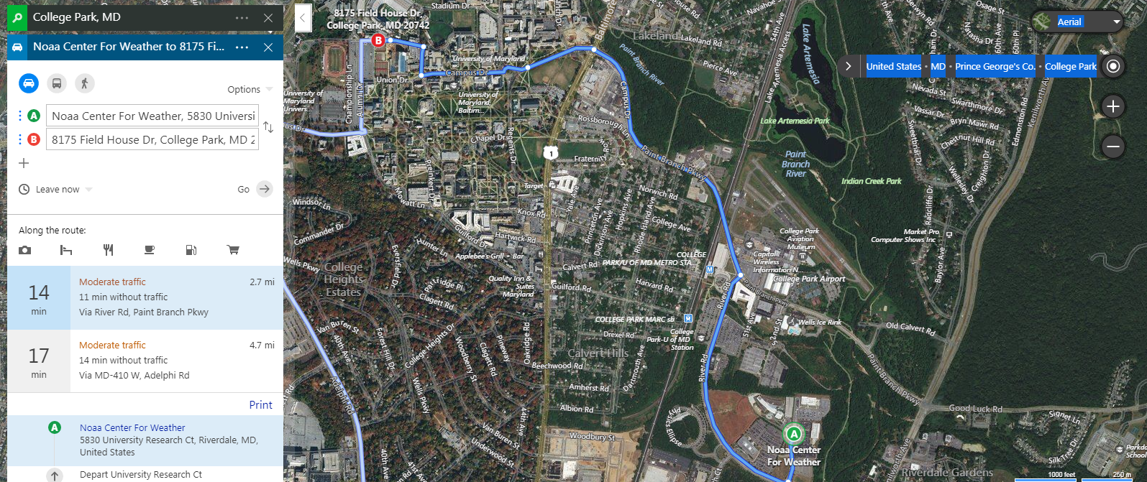
Status of GSICS Wiki
Due to changes in NOAA IT Security policy the GSICS Wiki was re-located to UMD Campus.
ESSIC
Server situated 3 Miles from NOAA inside UMD Campus on a m/c shared with AOMSUC

Slide 13
Conclusion
A new Google based Action Tracker has been setup at NOAA.
The action tracker utilizes key features of the google sheets ( versioning, projects)
Tracker is fast and efficient
New features have been added to the tracker that streamline generated actions.
Utilizes the new Action naming convention.
New categories of actions have been created ( such as lunar, EP, Recommendation, Decisions)
Propose to migrate wiki from UMD to AE

Slide 14
New Ideas
https://www.a2hosting.com/lamp-hosting
A2 hosting is a enterprise that can provides h/w support to host GSICS Wiki
Cost Effective and assured uptime.
We would use the gsics.net domain or can even use the umd domain.
Overheads
Low overheads as the Wiki would be on Virtual Cloud in a few months
However-> Hyperlinks to be updated

Slide 15
New GSICS Product Catalog Prototype
IDL Scripts that plot the
Standard Scene bias and Corrected bias w.r.t standard reference
Uncorrected and Corrected biases charts displayed on the Product Catalog
Bash Script Downloads the products
Charts Copied to server
GSICS THREDDS SERVER
https://www.star.nesdis.noaa.gov/smcd/GCC/ProductCatalogImages.php
Compliments the Plotting Tool
Charts for RAC and NRT available each day

Slide 16
Conclusion

