Slide 1
GSICS MW Subgroup
May 7, 2019
Tony Reale, Bomin Sun, Cheng-zhi Zou, Isaac Moradi, Nick Nalli …
NOAA / NESDIS /STAR
IMSG, CICS…

Slide 2
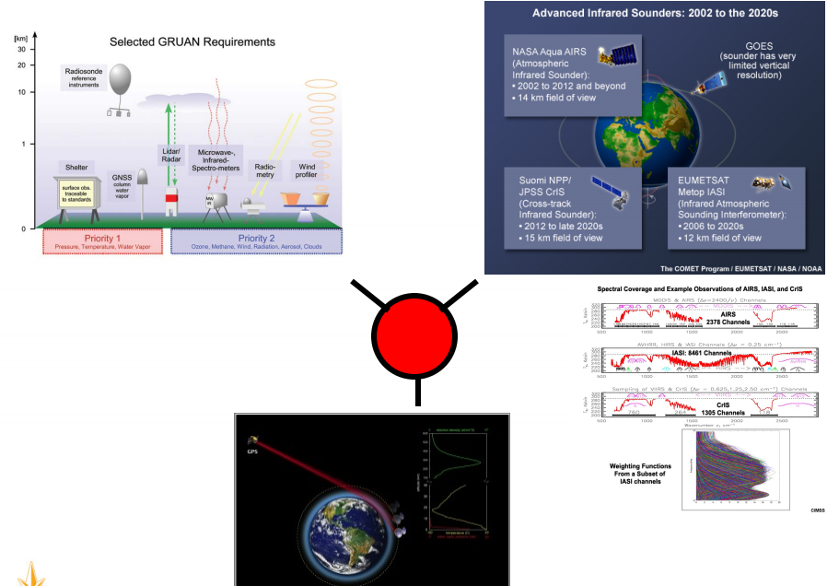
GSICS GNSS GRUAN (3G) Framework
GRUAN-GSICS Interaction
GRUAN-GNSS Interaction
GNSS-GSICS Interaction
entering radiance space … RT model and sensor monitoring courtesy Manik

Slide 4
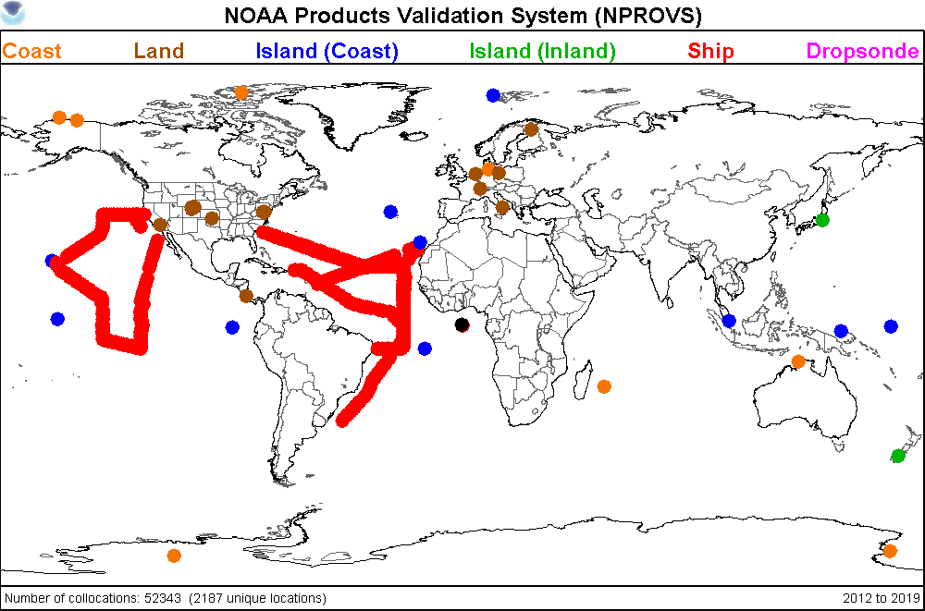
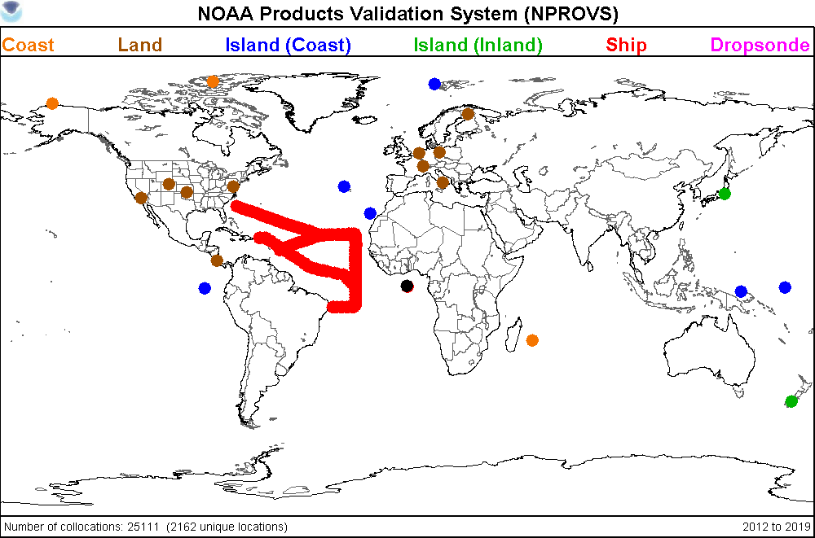
NPROVS Special
ALL
GRUAN Processed
52000 radiosondes (+ collocated satellites) and counting … reprocessing!

Slide 5
Begin Access New GRUAN Data Inventory

Slide 6
Radiosonde Intercalibration and VAL (RIVAL) Campaign (Dual Vaisala RS41/92; 2 years (2018, 19); Weekly ( N20 overpass)
ARM / GRUAN Sites
Southern Great Plains
Eastern North Atlantic
North Slope Alaska
Beltsville / Sterling …
Example of RIVAL radiosonde tracking for ENA. Red text indicates data currently missing

Slide 7
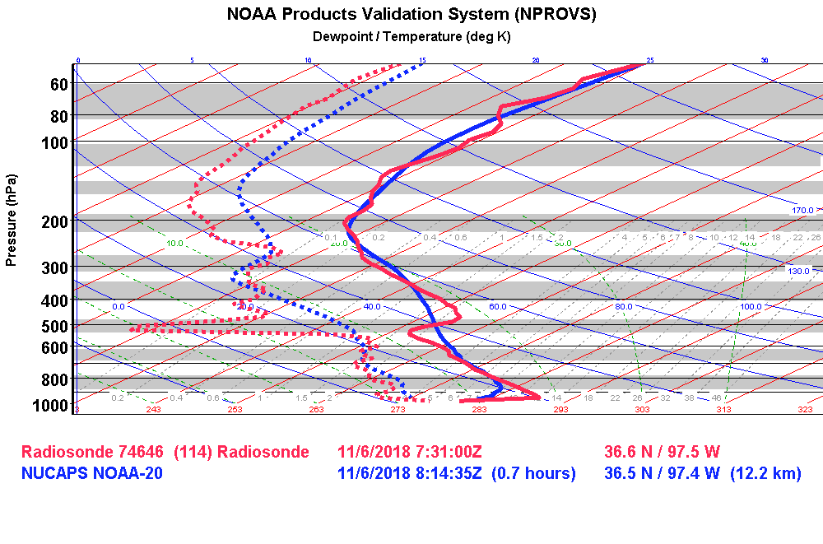

Slide 10
Status
RIVAL dataset forwarded to Isaac Moradi; EDR, SDR, TDR; ATMS N20
Checkout underway
More datasets to follow
Present at GRUAN ICM-11 (Singapore, May 20-24, 2019)

