Slide 1
GSICS VIS/NIR GEO ring considerations
Oct 17, 2019
David Doelling, Rabi Palikonda

Slide 2
VIS/NIR GEO ring considerations
Calibration, must calibrate to the same reference
This is the easy part, GEO/LEO-reference.
Spectral band differences, a reference SRF needed for each band
Each surface type and cloud (scene type), would have its own spectral adjustment to the reference band
Parallax, navigation shifts, Use a geo-rectified grid
Need to map to a common grid and account for cloud height
BRDF/glint, what is a suitable reference view?
IR you could adjust the BT to a nadir view
In the visible you have to worry about 3 angles, glint is a function of the sensor location.

Slide 3
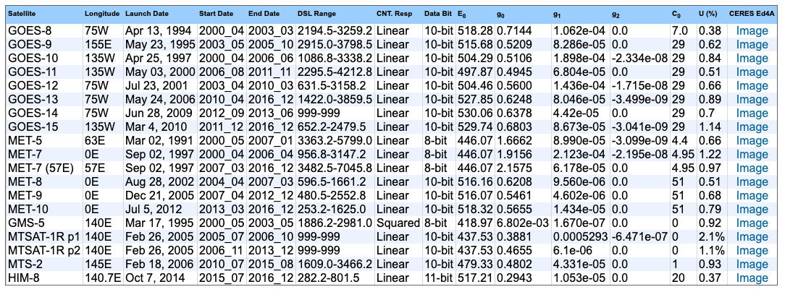
The CERES Ed4 GEO calibration was referenced to Aqua-MODIS C6.1 and the solar constant was based on the MODIS solar spectra
https://cloudsway2.larc.nasa.gov/cgi-bin/site/showdoc?mnemonic=CALIB-ED4
Realtime updated every 2 months: https://cloudsway2.larc.nasa.gov/cgi-bin/site/showdoc?mnemonic=CALIB-UPRT

Slide 4
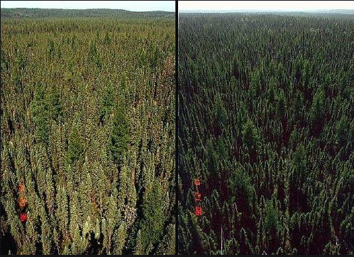
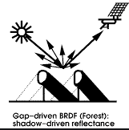
Vegetation BRDF effects
Forward scatter
Back scatter
Back scatter
Forward scatter
No shadows
shadows
Backscatter is brighter than forward scatter

Slide 5
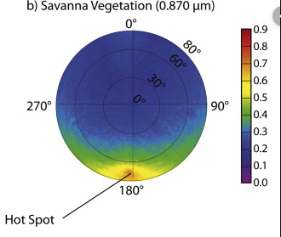
Vegetation BRDF effects
Forward scatter
Back scatter
Forward scatter
No shadows
shadows
Back scatter
Backscatter is brighter than forward scatter

Slide 6
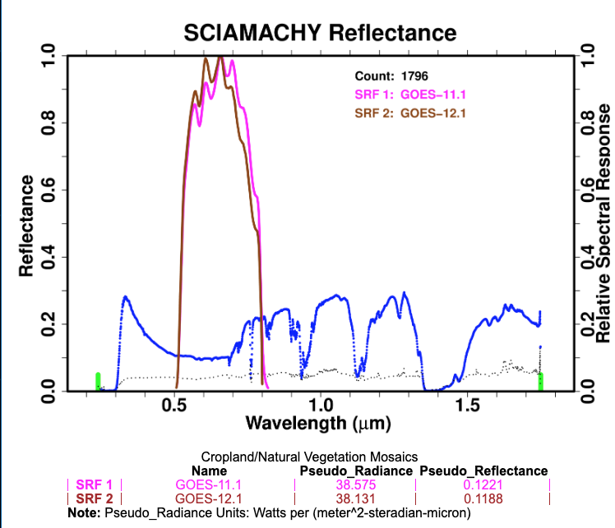
GOES-11/12 mosaic over the US
https://cloudsway2.larc.nasa.gov/cgi-bin/site/showdoc?mnemonic=SCIAMACHY-SPECTRA-ENHANCED
• For this case the SRFs are very similar
• Any change in the reflectance is mostly due to angular differences
• 0.0033 reflectance difference

Slide 7
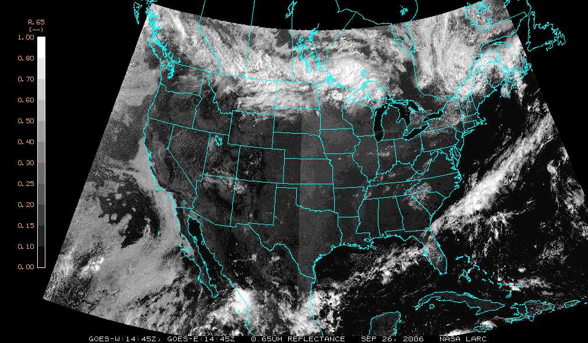
GOES-11/GOES-12 Visible, Sep. 26, 2006, 14:45
GOES-11
GOES-12
Line of matching VZA, where the two satellite images are pasted together
Images taken at the same GMT, at matching VZA the time is the same, therefor the SZA is the same

Slide 8
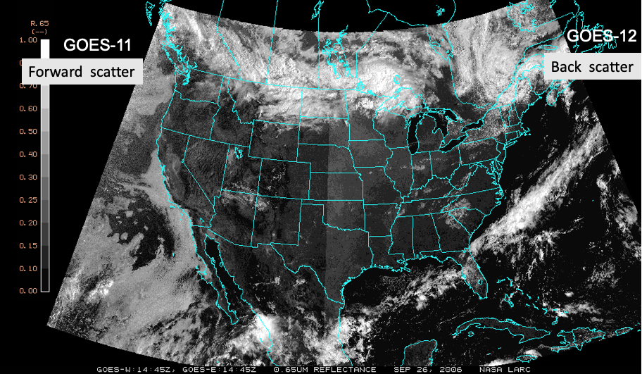
GOES-11/GOES-12 Visible, 20:45Z, Sep. 26, 2006, 20:45
GOES-11
GOES-12

Slide 9
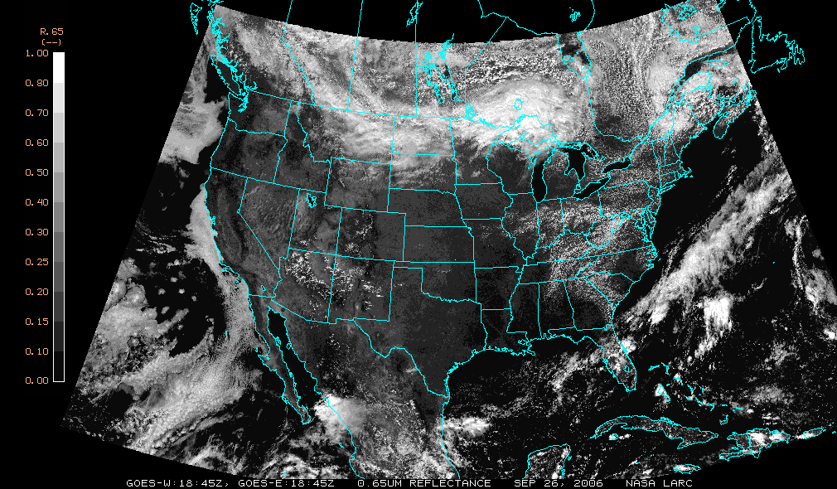
GOES-11/GOES-12 Visible, 18:45Z, Sep. 26, 2006
Both satellite have same SZA, VZA, and RAZ, geometry at local noon
Sat2
135°W
Sun
Local noon
Sat1
75°W

Slide 10
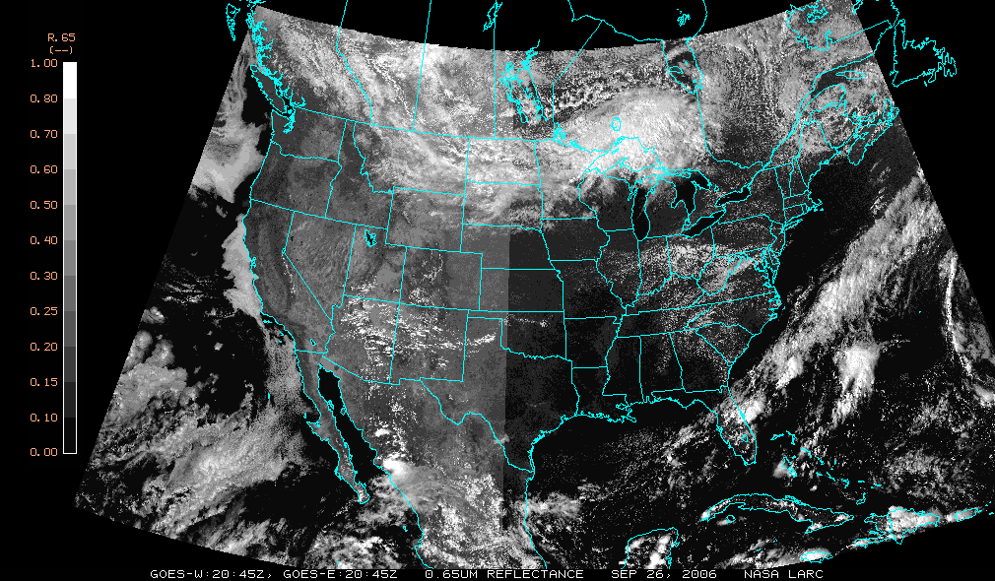
GOES-11/GOES-12 Visible, 20:45Z, Sep. 26, 2006, 20:45
GOES-11
GOES-12
Back scatter
Forward scatter

Slide 11
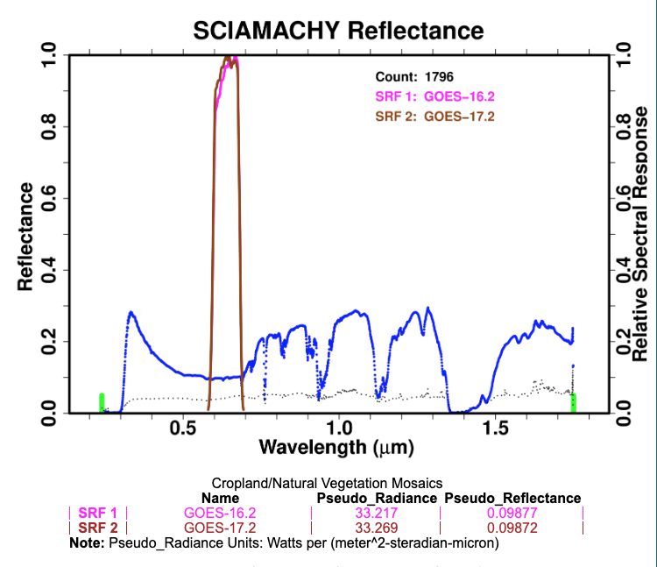
GOES-17/16 mosaic over the US
• For this case the SRFs are very similar
• Any change in the reflectance is mostly due to angular differences
• 0.0001< reflectance difference

Slide 12
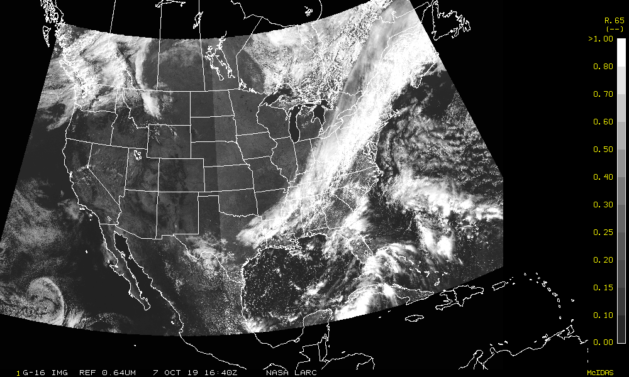
GOES-17/GOES-16 Visible, Oct 7, 2019, 16:45
GOES-17
GOES-16
Forward scatter
Backscatter
GOES-12
GOES-11
Line of matching VZA, where the two satellite images are pasted together
Images taken at the same GMT, at matching VZA the time is the same, therefor the SZA is the same

Slide 13
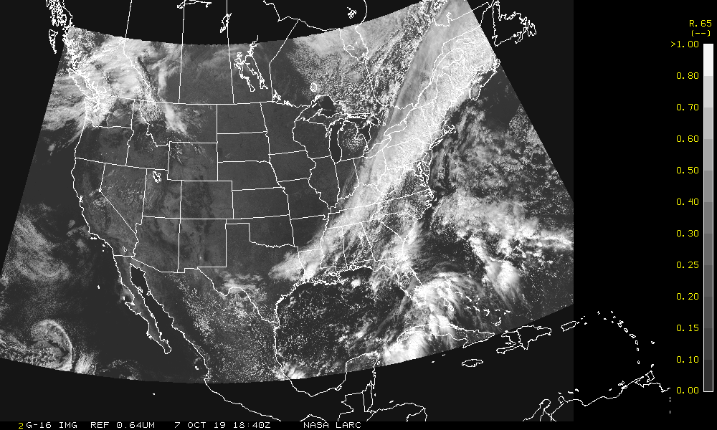
GOES-17/GOES-16 Visible, Oct 7, 2019, 18:45
GOES-17
GOES-16
Both satellite have same SZA, VZA, and RAZ, geometry at local noon
Sat2
135°W
Sun
Local noon
Sat1
75°W

Slide 14
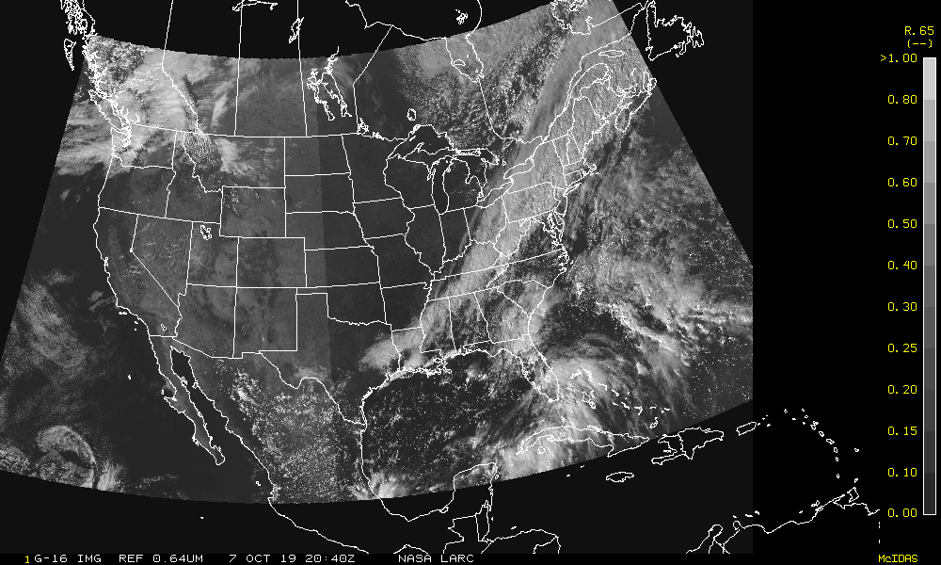
GOES-17/GOES-16 Visible, Oct 7, 2019, 20:45
GOES-17
GOES-16
Backscatter
Forward scatter

Slide 15
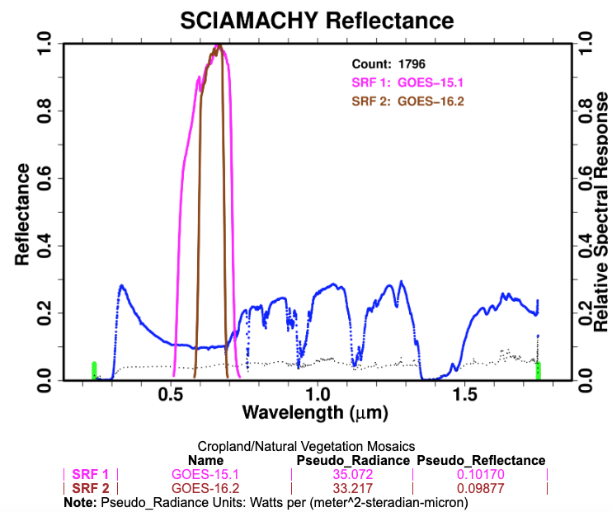
GOES-15/16 mosaic over the US
• For this case the SRFs differ
• 0.0293 reflectance difference
• GOES-15 brighter than GOES-16

Slide 16
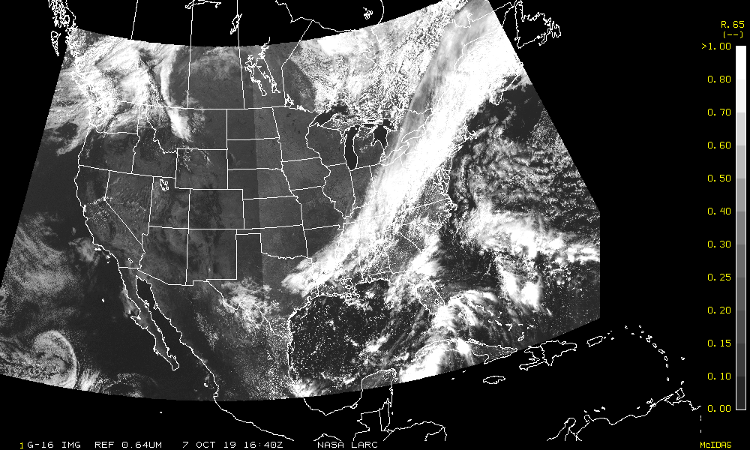
GOES-15/GOES-16 Visible, Oct 7, 2019, 16:45
GOES-15
GOES-16
Forward scatter
Backscatter

Slide 17
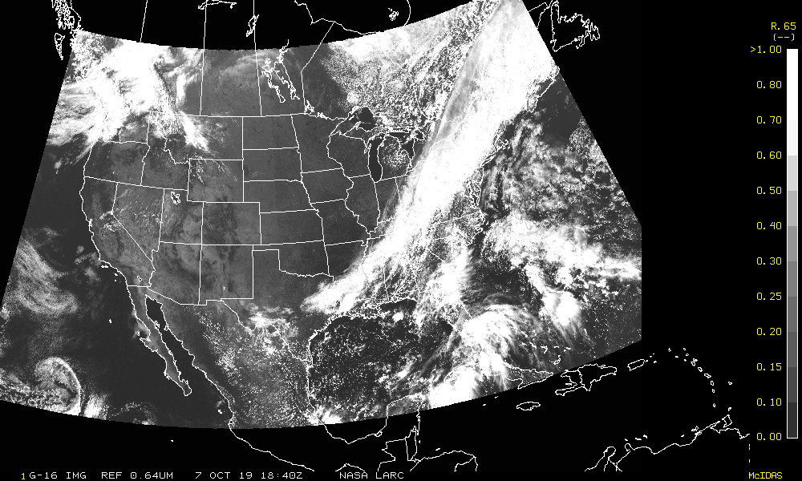
GOES-15/GOES-16 Visible, Oct 7, 2019, 18:45
GOES-15
GOES-16
•Here there is a faint line where the satellites intersect due to the spectral difference between GOES-15 and 16.
• GOES-15 was predicted to be brighter and is
Sat2
135°W
Sun
Local noon
Sat1
75°W

Slide 18
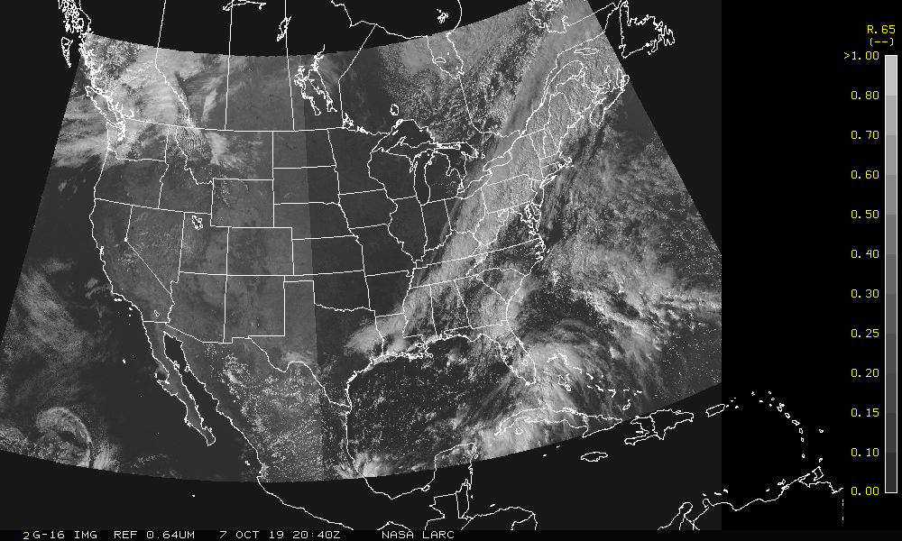
GOES-15/GOES-16 Visible, Oct 7, 2019, 20:45
GOES-15
GOES-16
Backscatter
Forward scatter

Slide 19
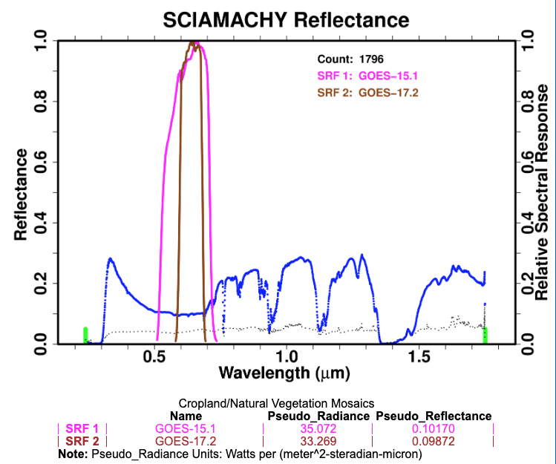
Spectral difference between GOES-15 and GOES-17 over same domain
• For this case the SRFs differ
• 0.0298 reflectance difference
• GOES-15 brighter than GOES-17

Slide 20
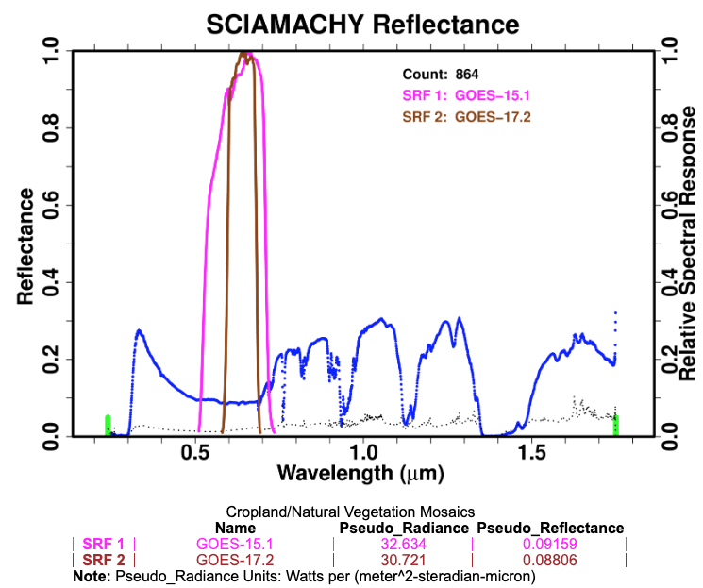
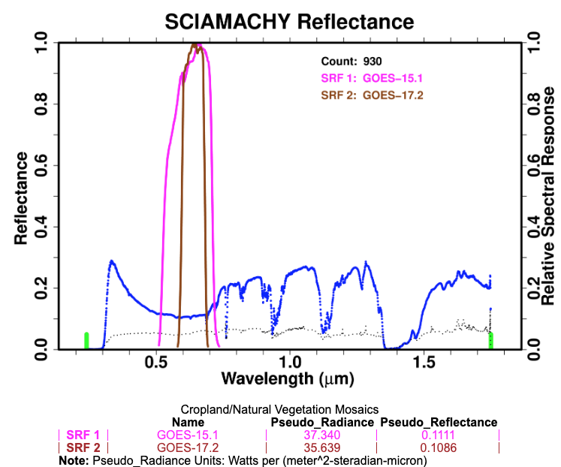
Comparison of SCIA reflectance by azimuth angle
Forward scatter
Backscatter
Backscatter is 0.02 brighter than forward scatter over vegetation

Slide 21
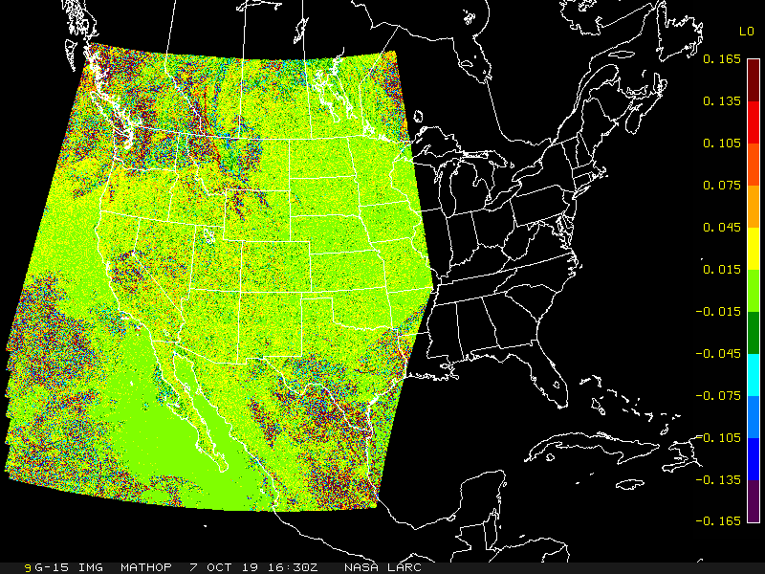
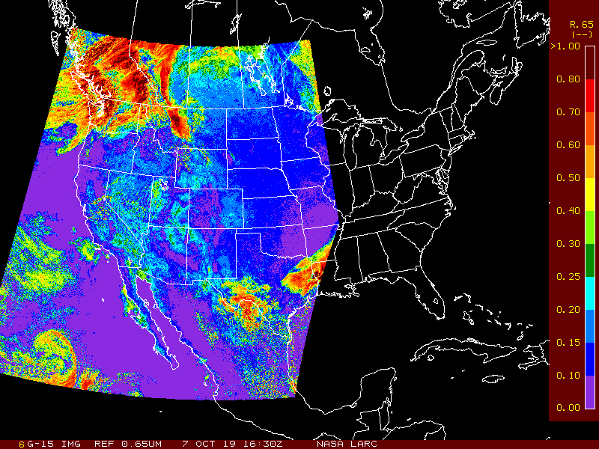
GOES-15/GOES-17 Visible, Oct 7, 2019, 16:45 GMT
GOES-17 135°W
GOES-15 128°W
The GOES-15 minus GOES-17 visible 4-km reflectance difference is mostly spectral

Slide 22
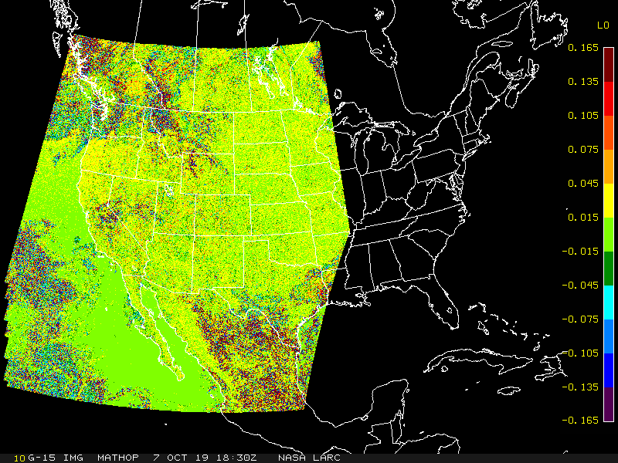
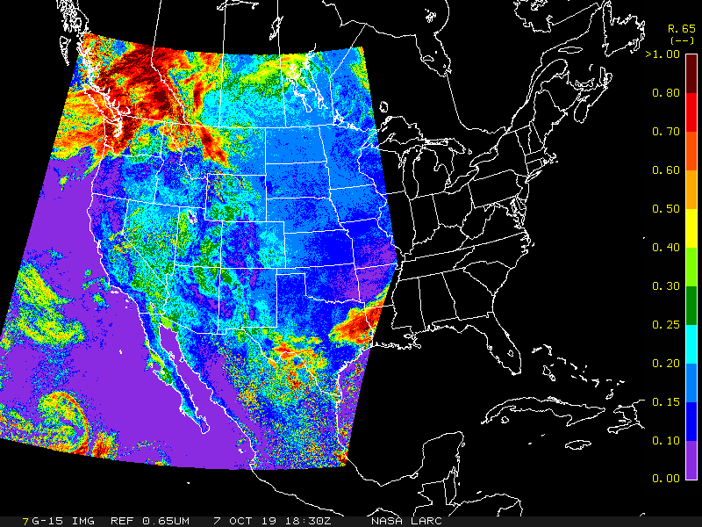
GOES-15/GOES-17 Visible, Oct 7, 2019, 18:30 GMT

Slide 23
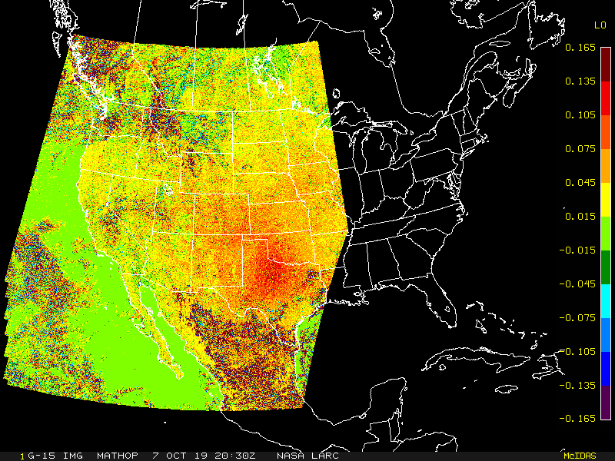
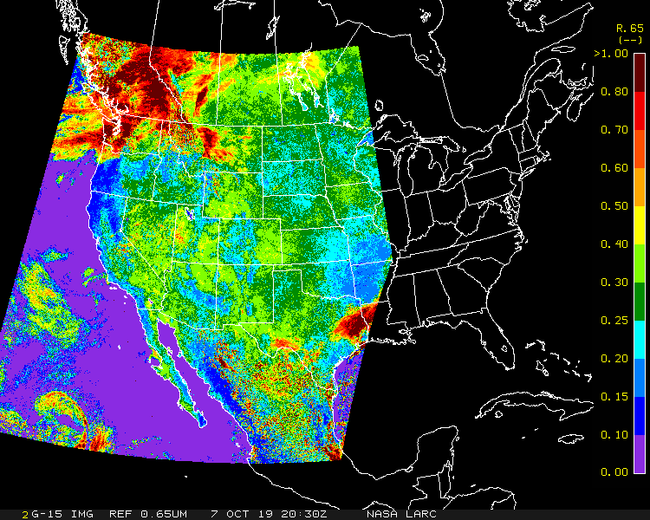
GOES-15/GOES-17 Visible, Oct 7, 2019, 20:30
The land reflectance is increasing (bottom image)
The GOES 15 minus 17 reflectance increases as the image is more in backscatter due to the vegetation hotspot.

Slide 24
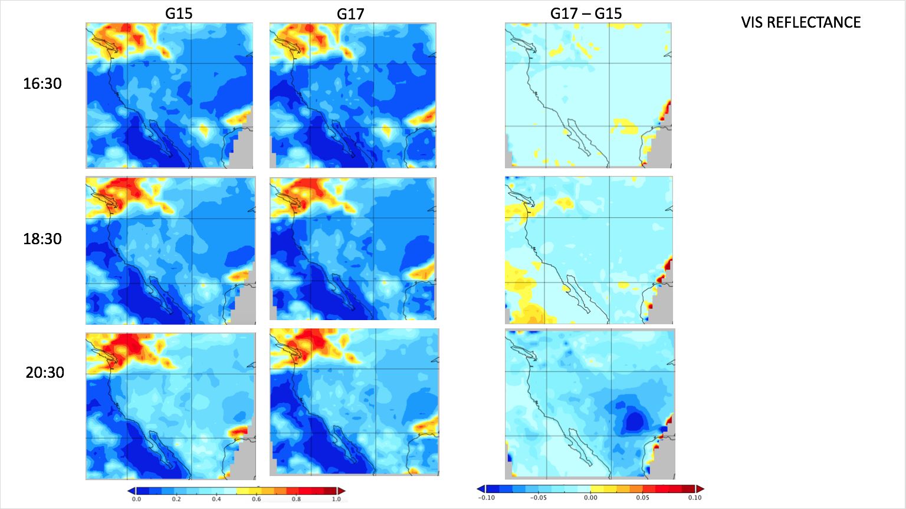
Oct 7, 2019
1° lat/lon averaged grid,
The clouds can be compared at the 100² km scales, at 4-km the cloud differences were noisy
Note that for forward scatter there is very little G17 – G15 difference. The differences become more negative for back scatter.
The maritime stratus is burning off during the day and cloud properties are changing over time

Slide 25
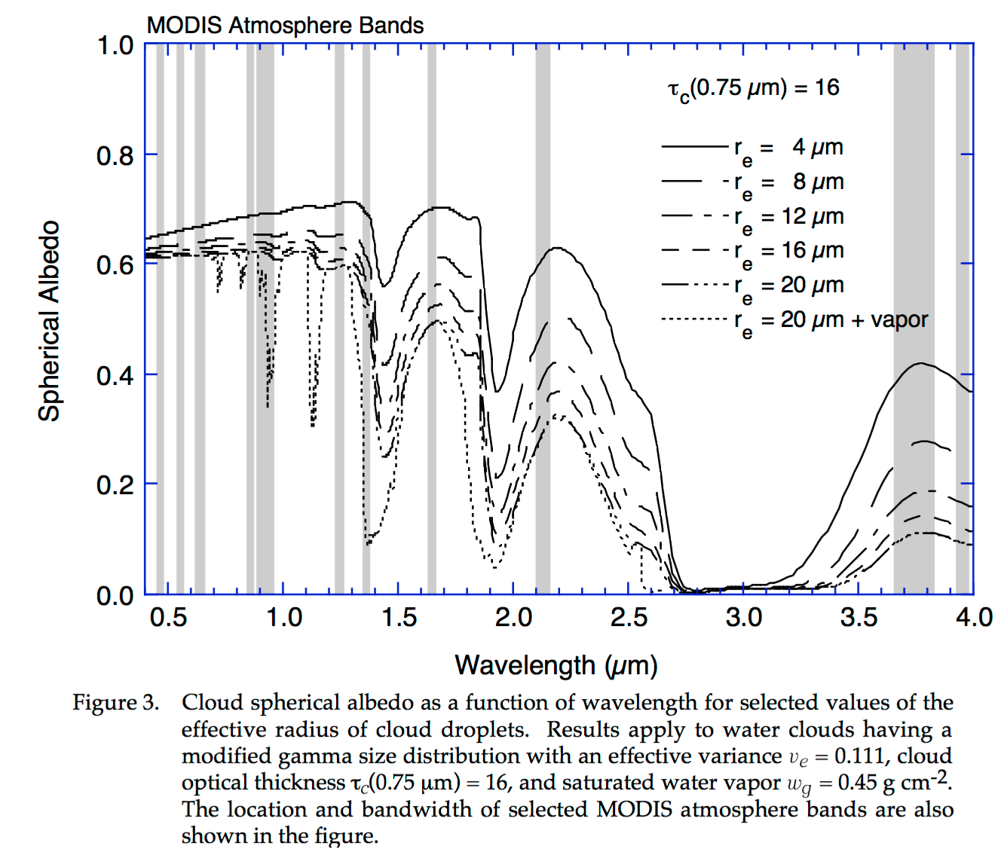
Smaller particles are brighter, water clouds
Bands are located, where there is the greatest stratification of particle size
Cloud spectra a function of particle size

Slide 26
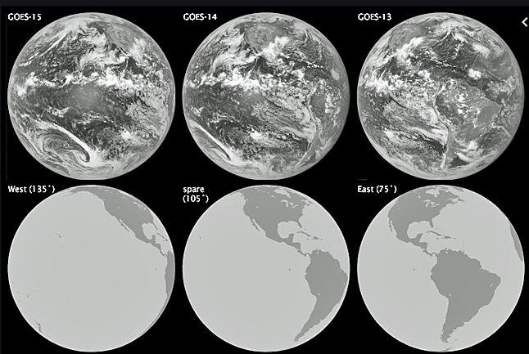
Parallax demonstration
Will be looking for the parallax effect at the location in blue

Slide 27
Parallax Error
SAT
VZA nadir
cloud
In this case the cloud is mapped 10km further North than clear sky underneath cloud
VZA=45°
10 km
45°
EARTH
10 km

Slide 28
Parallax Error
SAT #1
SAT #2
VZA nadir
cloud
Satellite #1 and #2 see the cloud 20km apart
10 km
45°
EARTH
10 km

Slide 29
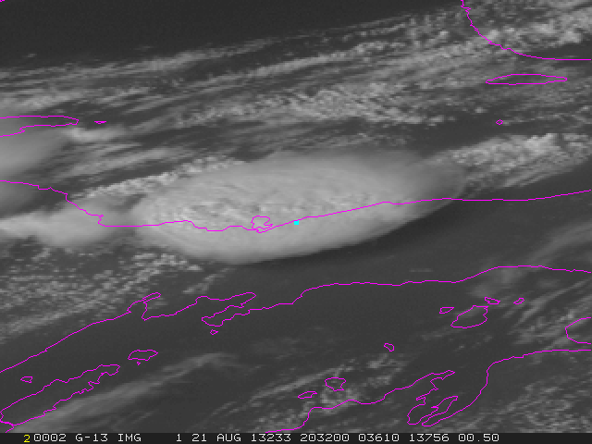
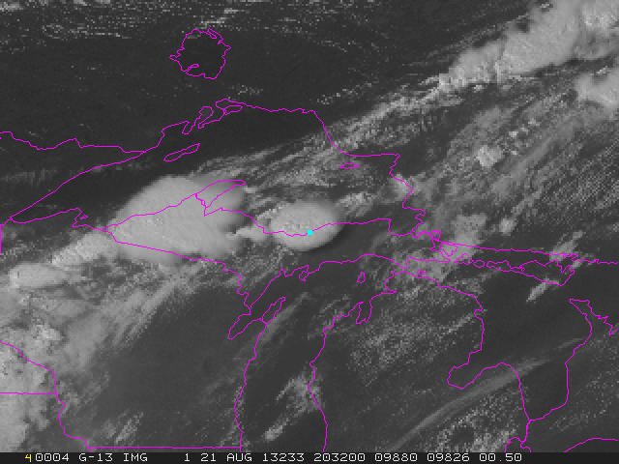
Parallax, GOES-13 (75°W) CONUS, Aug 21, 2013, 20:32 GMT
Satellite projection
Equal angle latitude and longitude grid
46.5°N 86.5°W, VZA=54.66°

Slide 30
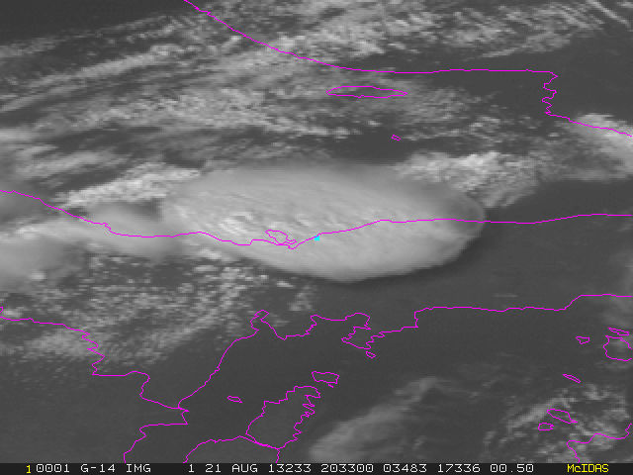
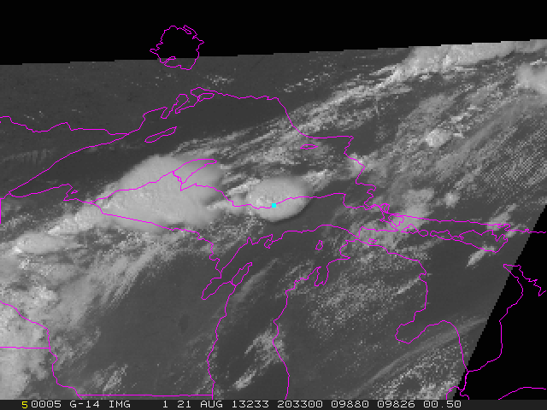
Parallax, GOES-14 (105°W) Rapid Scan, Aug 21, 2013, 20:33 GMT
Satellite projection
Equal angle latitude and longitude grid
46.5°N 86.5°W, VZA=56.49°

Slide 31
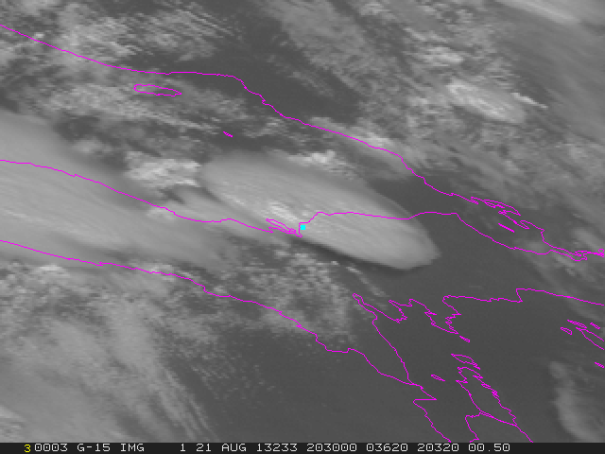
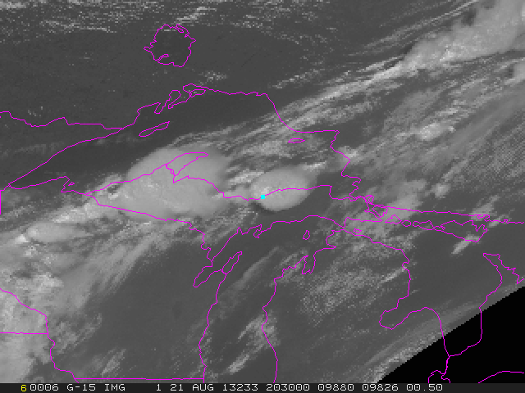
Parallax, GOES-15 (135°W) NH, Aug 21, 2013, 20:30 GMT
Satellite projection
Equal angle latitude and longitude grid
46.5°N 86.5°W, VZA=71.08°

Slide 32
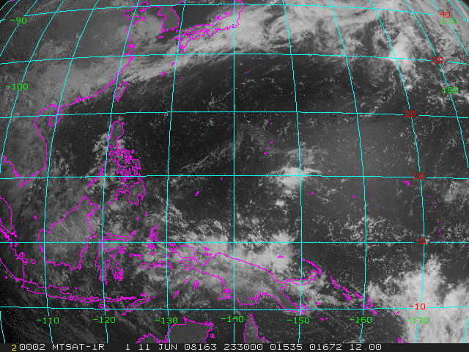
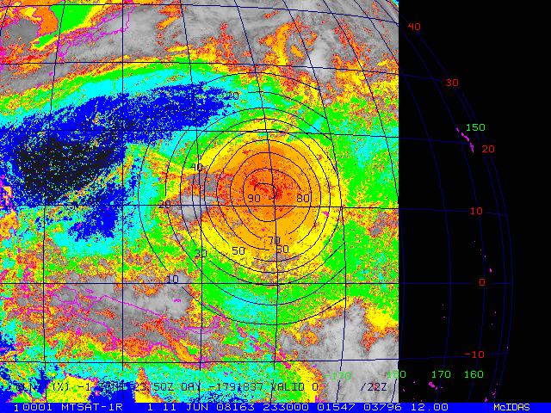
GEO Sunglint probability
MTSAT-1R June 11, 2008, 23:30 GMT
Sunglint probability 0-100%
Colorcoded with VIS count

Slide 33
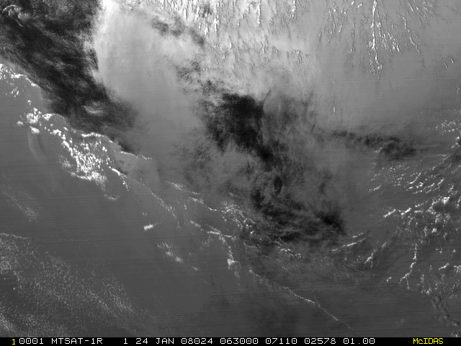
GEO Sunglint, close up
MTSAT-1R Jan. 24, 2008, 6:30 GMT
Smooth water
Waves
clouds
Dependent on wind speed

Slide 34
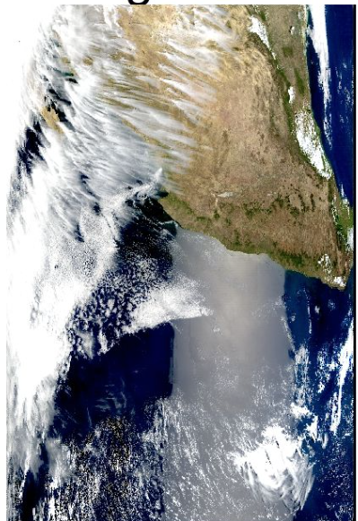
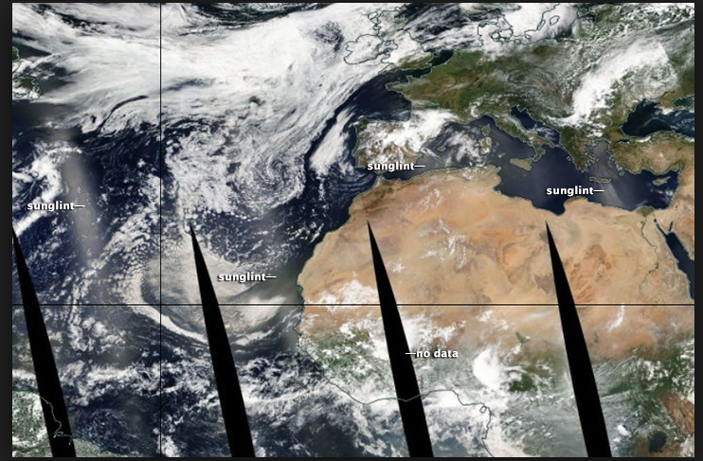
Aqua MODIS orbit mosaic
sunglint

Slide 35
Conclusions
GEO L1B -> calibration -> GEO cloud retrievals
The GEO ring composite is between the calibration and cloud retrievals
To create the GEO ring composite, the calibration, scene dependent spectral difference and BRDF, as well as parallax must be taken into account
GEO calibration is the easy part
The spectral band and BRDF is typically part of the retrieval code and is highly dependent on scene type
For parallax the cloud top height, cloud shadow and navigation errors must be known
Many GEO bands were designed for cloud/land/aerosol/ocean color retrievals
Need to make sure that during harmonization, the band information is not diluted

Slide 36
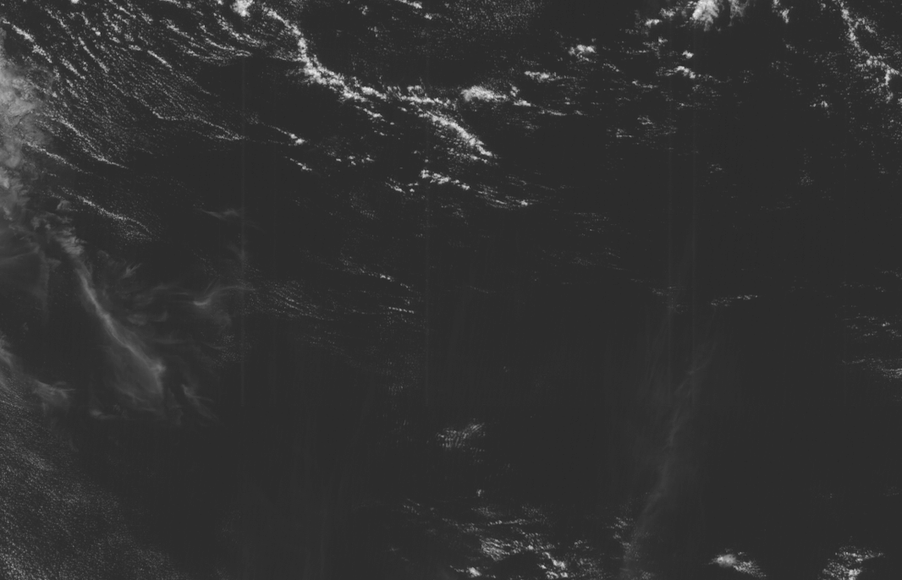
Himawari-8 band 3 (0.65µm) faint vertical lines
usually at 3 GMT

Slide 37
Backup

Slide 38
Sept 26, 14:45, 18:45 (noon), 20:45
GOES-W/E, GOES10/12 May 2003- May 2006, GOES-11/12 June 2006-Mar 2010, GOES-11/13 May 2010-Nov 2011, GOES-15/13 Dec 2012-Dec 2017, GOES-15/16 Jan 2018 – July 2019,
GOES-15/16 and GOES-17/16 for Oct 7, 2019, and GOES-15 and GOES-17 domain difference.
GOES-13/16 Dec 2017-Jan 2018 over same domain
GOES-15/17 July 2019 over same domain

Slide 39
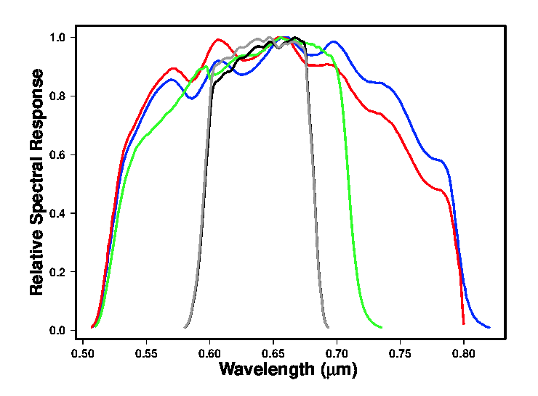
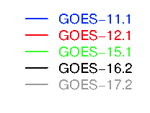

Slide 40
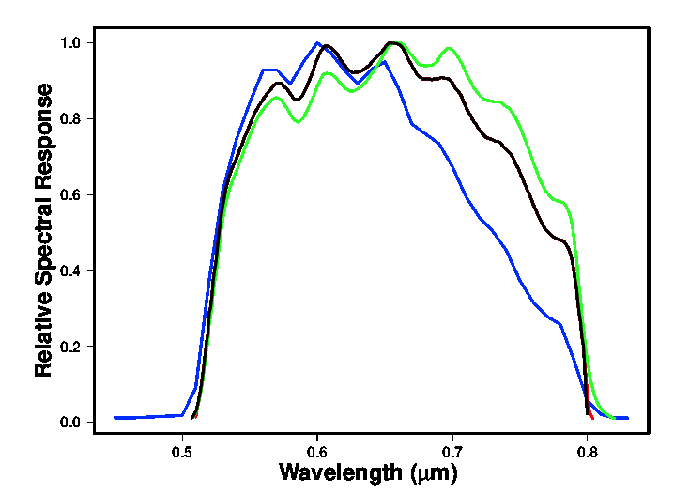
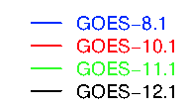

Slide 41
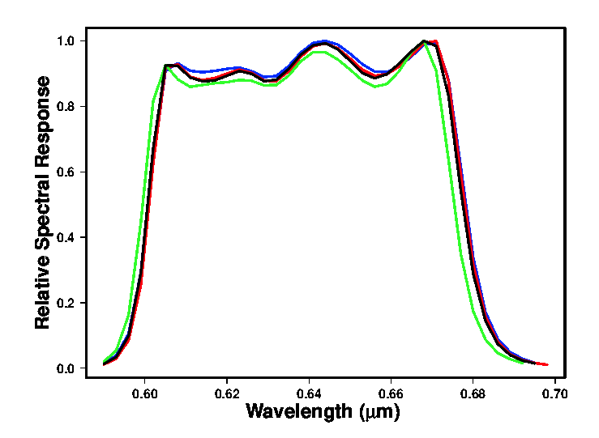
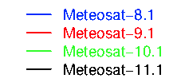

Slide 42
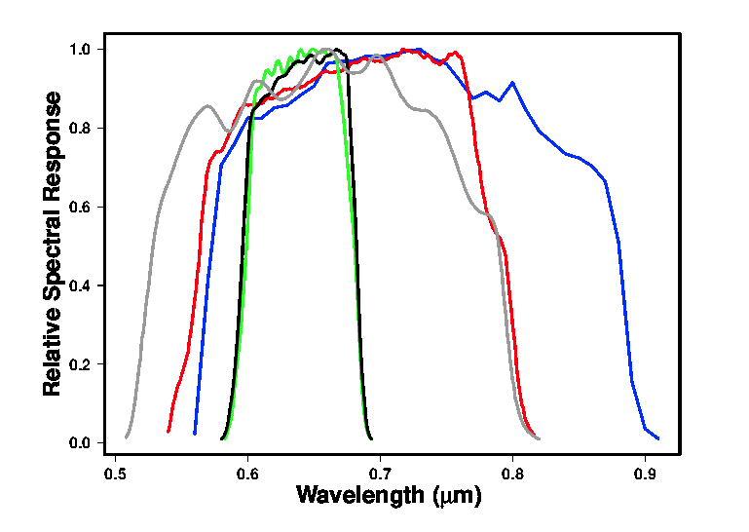
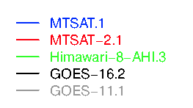

Slide 43
