Slide 1
The early results of inter-comparison between AMI and AHI
2019.10.17.
Hyeji Yang, and Minju Gu

Slide 2
Contents
Introduction
Results
Issue

Slide 3
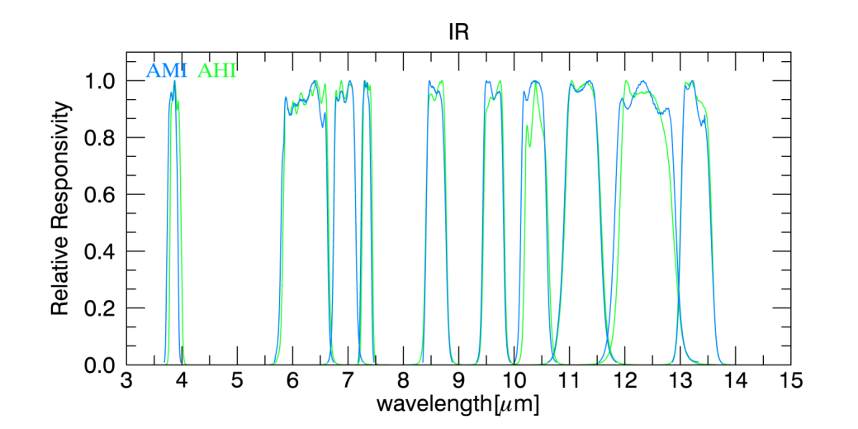
Information
Bands |  | Central wavelength (㎛)
 |  | AMI | AHI | ABI
V N I R | 1 | 0.47 | 0.47 | 0.47
 | 2 | 0.51 | 0.51
 | 3 | 0.64 | 0.63 | 0.64
 | 4 | 0.85 | 0.85 | 0.86
 | 5 | 1.38 |  | 1.37
 | 6 | 1.61 | 1.61 | 1.61
M W I R |  |  | 2.25 | 2.25
 | 7 | 3.83 | 3.88 | 3.90
 | 8 | 6.24 | 6.24 | 6.18
 | 9 | 6.95 | 6.94 | 6.95
 | 10 | 7.34 | 7.34 | 7.34
 | 11 | 8.59 | 8.59 | 8.50
L W I R | 12 | 9.62 | 9.63 | 9.61
 | 13 | 10.40 | 10.40 | 10.35
 | 14 | 11.21 | 11.23 | 11.2
 | 15 | 12.36 | 12.38 | 12.3
 | 16 | 13.31 | 13.28 | 13.3
○ Geo-Kompast-2A AMI is launched on Dec. 5th 2018
started regular operation on July 25th 2019
○ AMI is similar imager with GOES-R ABI, Himawari AHI
○ KMA compare AMI infrared channels to AHI
* GK2A is located at 128.2ºE, H8 is located at 140.7ºE

Slide 4
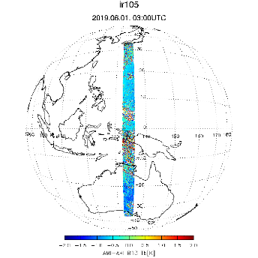
Method and Data
Methods
○ Based on GSICS Algorithms
- Difference of Satellite Zenith Angle (Optical path) < 1%
- Difference of Observation time < 1min.
- STDV(Rad_{9x9}) / MEAN(Rad_{9x9}) < 1%
Data
○ AMI, AHI lv1b data
○ 2019.8.1.~31. (10 minutes bin)
○ Latitude < ±10º, Longitude < 105~163ºE
Mon Lv1b Inter File Data
Ref Lv1b Inter File Data
Geometry Data
collocation
Col. criteria
Collocated Data
Uniformity /
Normality test
Test criteria
Uniform Data
Compare the Brightness Temperature

Slide 5
Contents
Introduction
Results
Issue

Slide 6
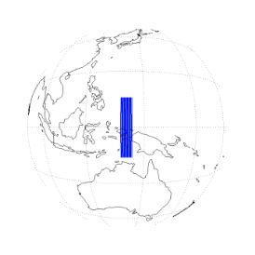
AMI vs. AHI Tb
○ This is the statistics of AMI and AHI IR channels in August 2019
○ Biases (AMI-AHI) are within 0.5K, except for SWIR038
* maybe attributed to AHI’s anomaly in lower temperature
○ Biases contain the SRF difference
* e.g. WV063 is reduced to 0.088K when SRF difference is corrected)
* SRF difference is corrected by applying SBAF(Spectral Band Adjustment Factor) provided by NASA Langley Lab.
 | SWIR038 | WV063 | WV069 | WV073 | IR087
Bias | 0.558 | 0.393 | 0.070 | -0.125 | 0.128
RMSE | 0.810 | 0.353 | 0.428 | 0.613 | 2.495
Slope | 0.951 | 1.001 | 0.993 | 0.981 | 0.990
Intercept | 14.781 | 0.041 | 1.896 | 4.782 | 2.885
 | IR096 | IR105 | IR112 | IR123 | IR133
Bias | 0.062 | 0.186 | 0.128 | 0.242 | -0.243
RMSE | 0.985 | 1.223 | 1.295 | 1.354 | 1.221
Slope | 0.993 | 0.998 | 0.995 | 0.999 | 0.984
Intercept | 1.765 | 0.685 | 1.498 | 0.504 | 3.904

Slide 7
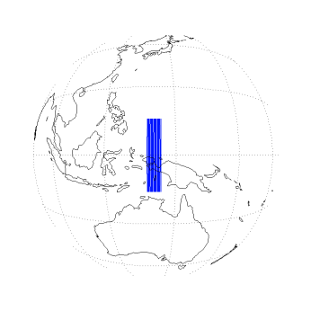
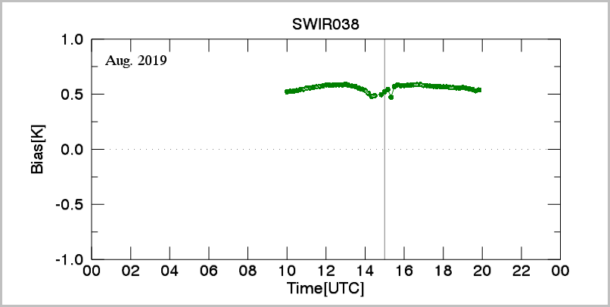
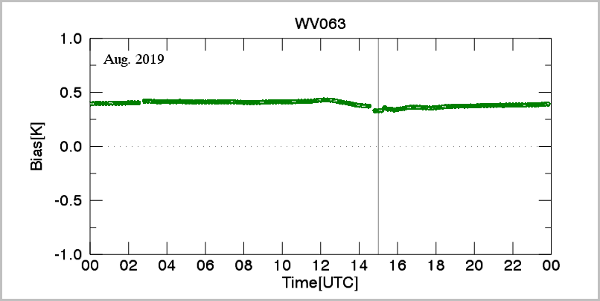
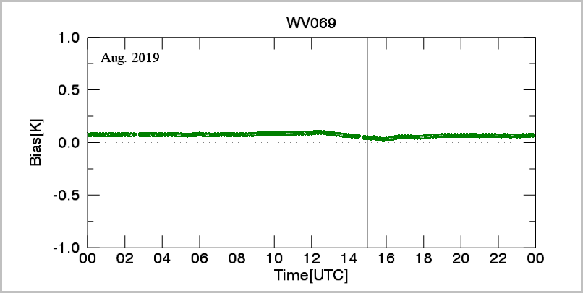
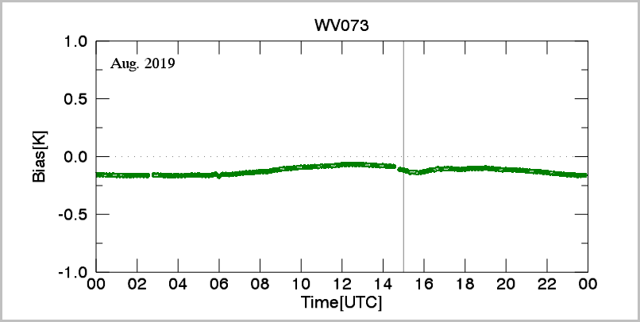
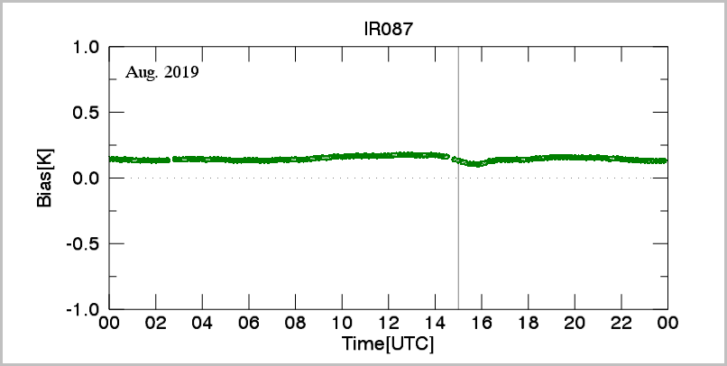
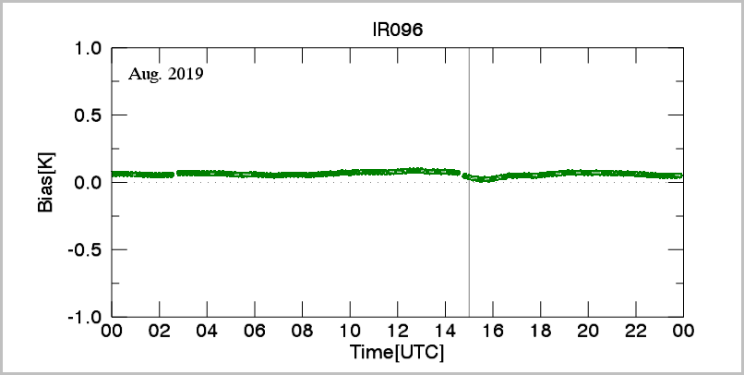
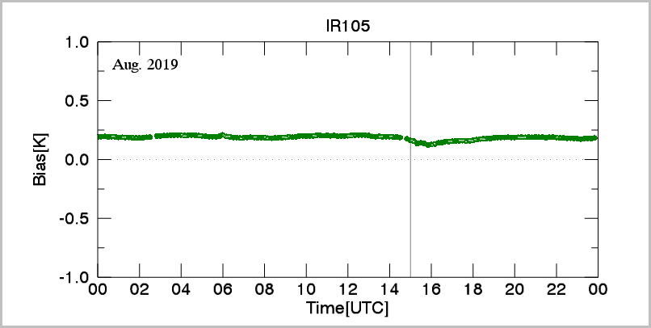
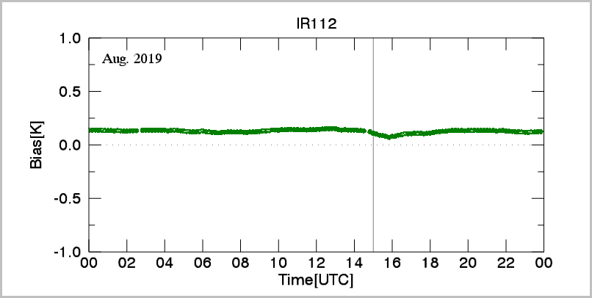
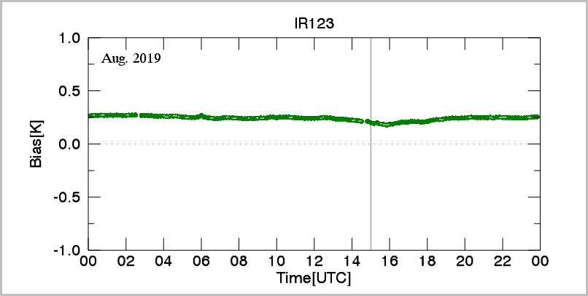
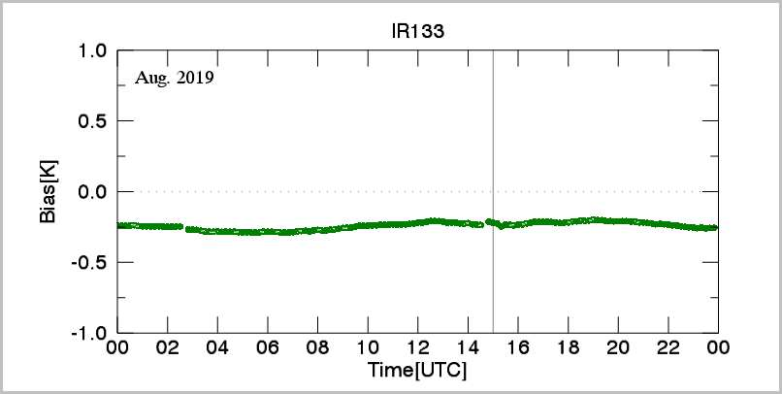
Diurnal variation
○ The range of variation is within 0.1K
○ Very stable than COMS MI
* COMS MI SWIR(3.8um) 0.7K, WV(6.7um) 0.5K,
IR1(10..8um) 0.8K, IR2(11.2um) 0.3K
in summer(Jun.~Aug.)
midnight

Slide 8
Contents
Introduction
Results
Issue

Slide 9
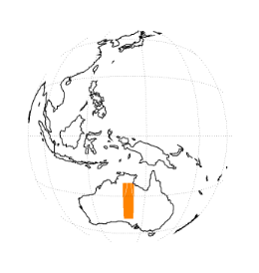
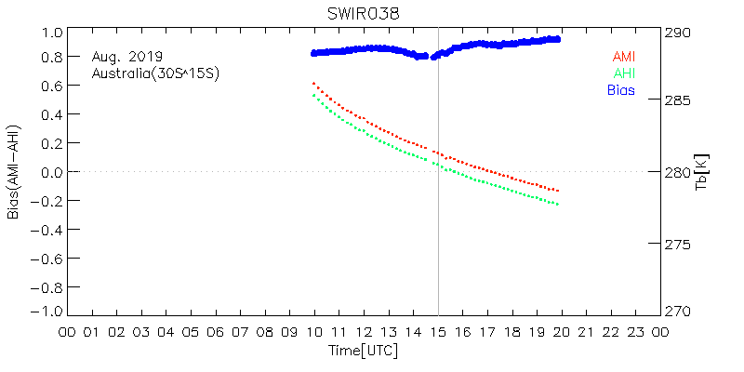
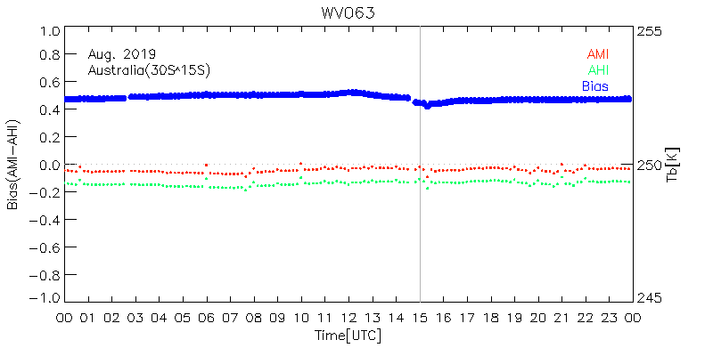
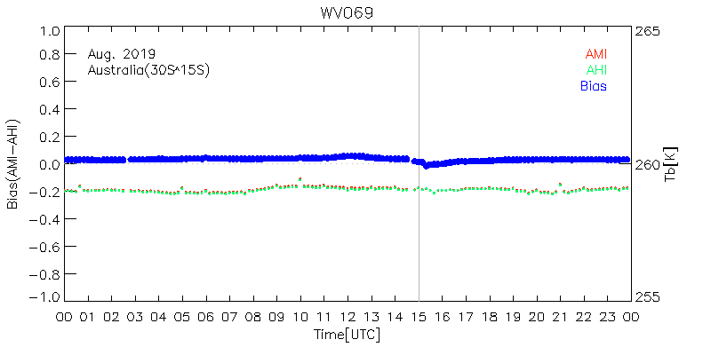
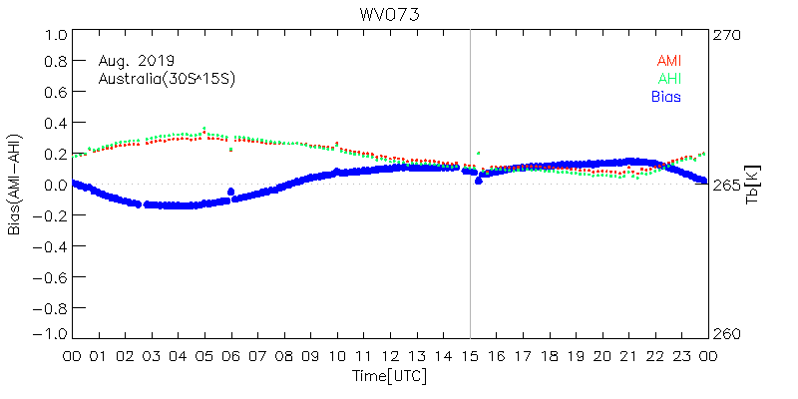
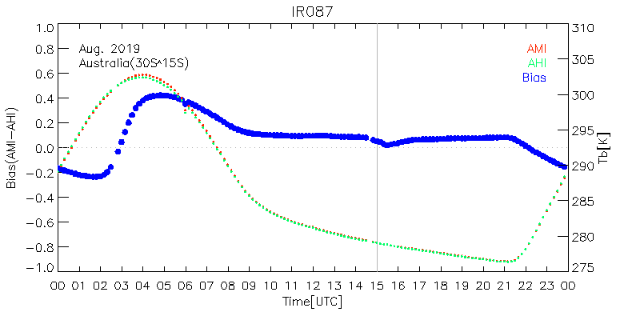
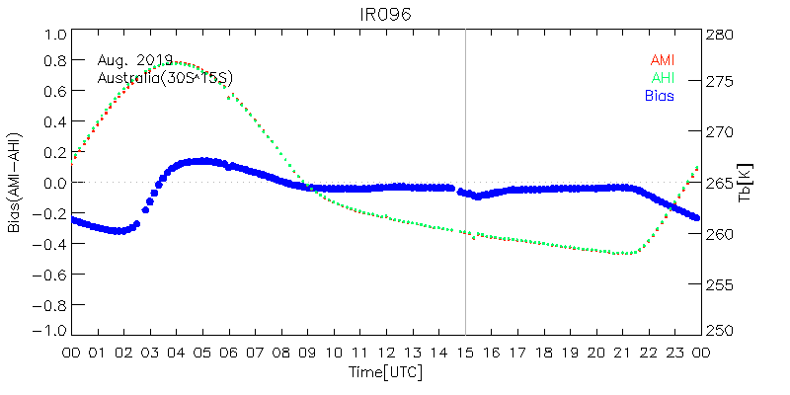
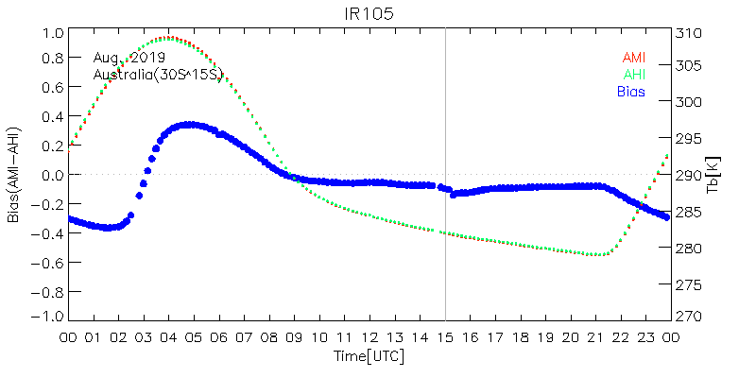
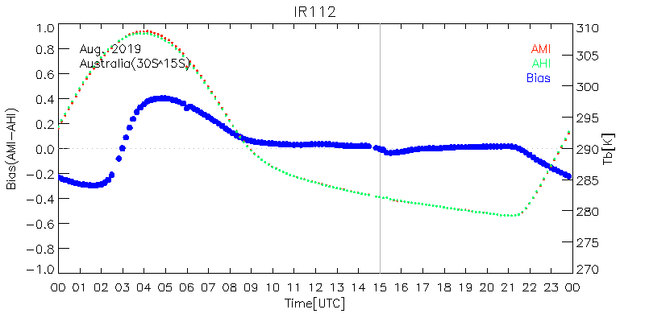
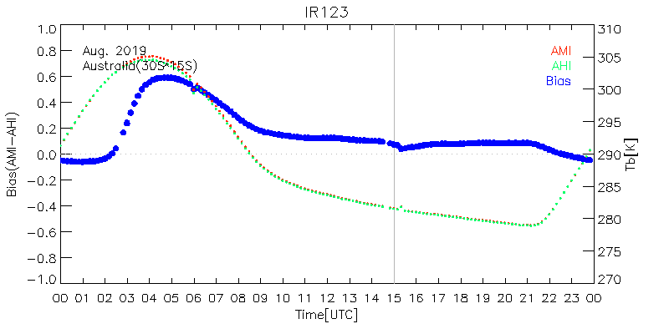
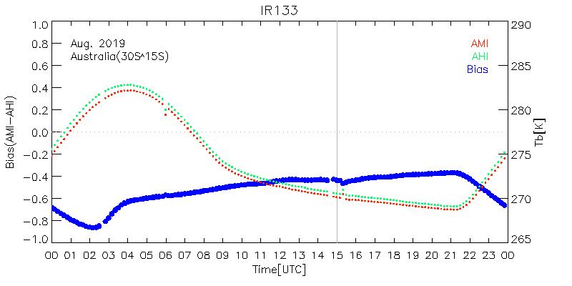
Issue : Diurnal variation in Australian Desert Area
○ Data in 132~136ºE, 15ºS~30ºS were used (orange colored area)
○ The range of variation is greater than 0.5K during daytime
○ This appeared on surface sensitive+IR133

Slide 10
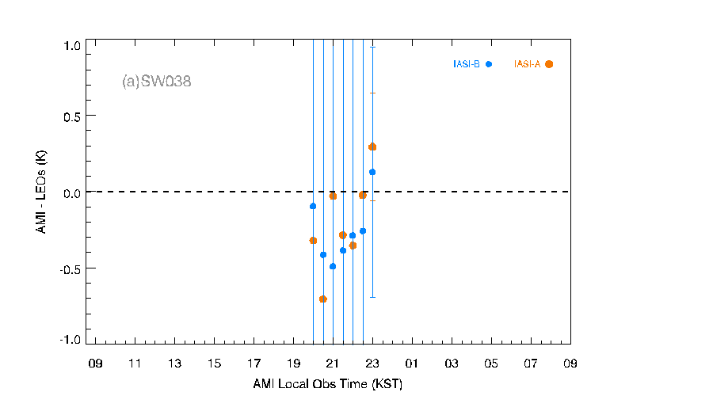
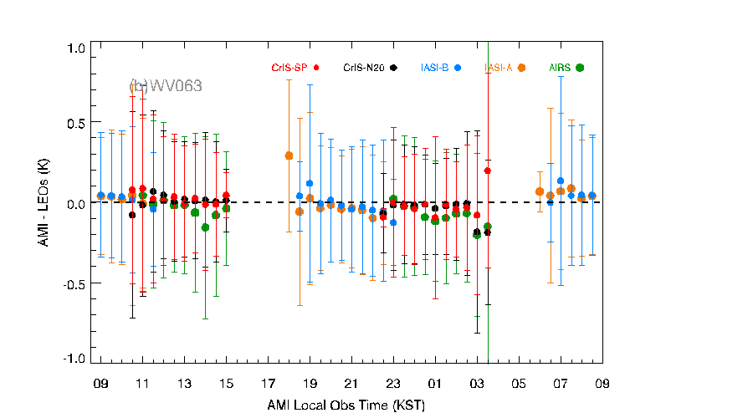
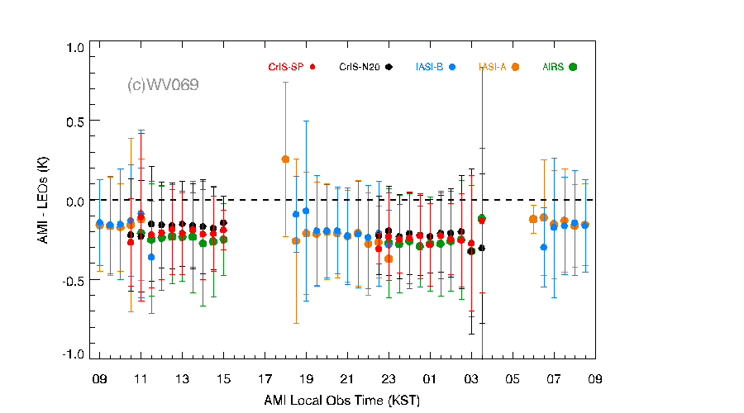
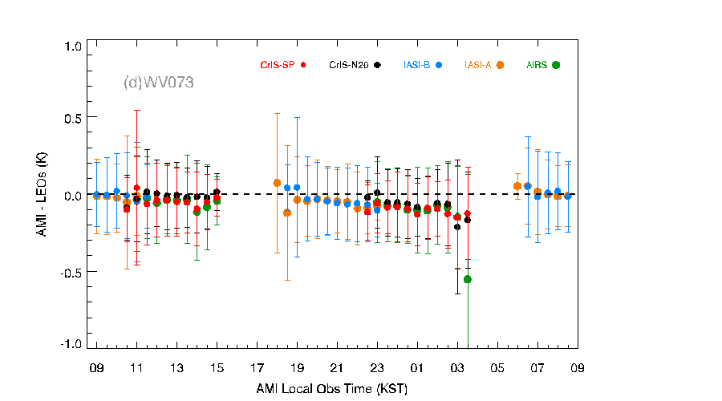
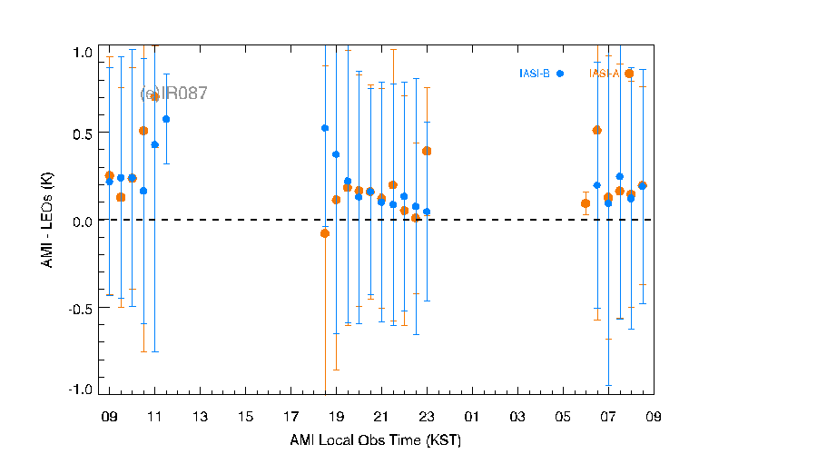
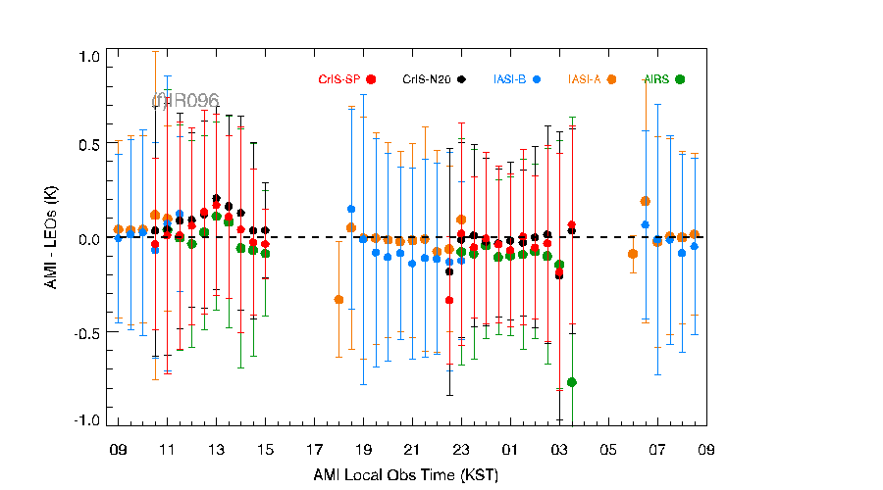
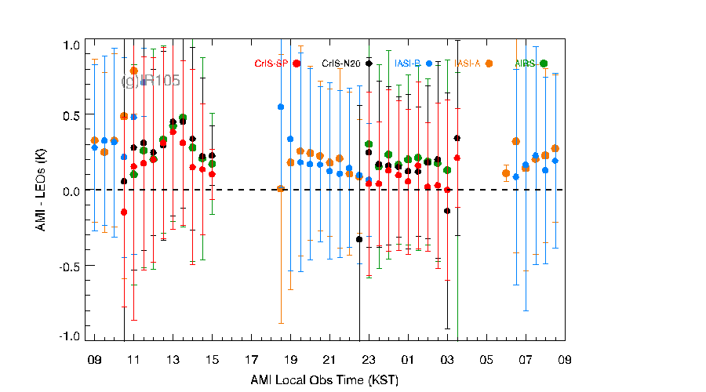
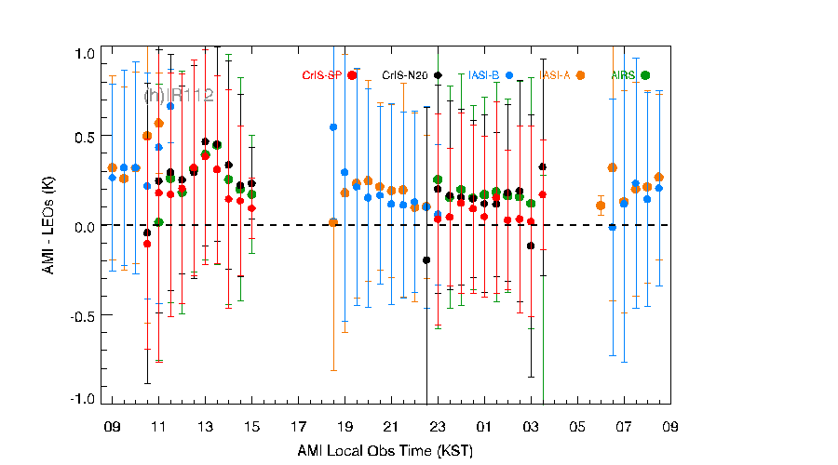
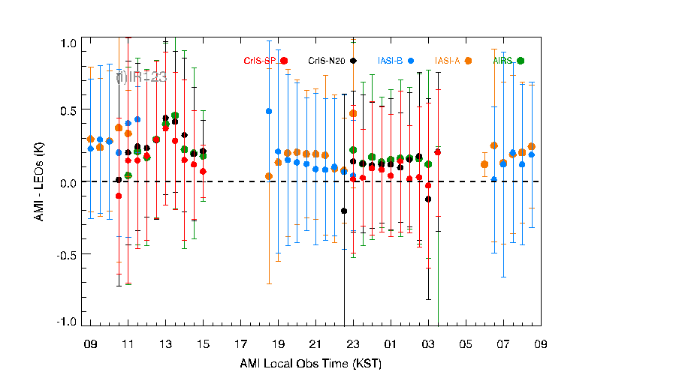
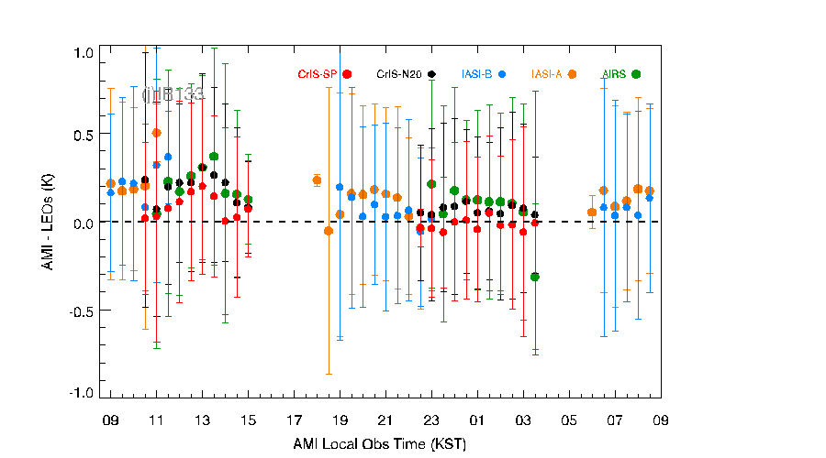
Diurnal variation with LEOs
IASI-A, IASI-B, AIRS, CrIS-SNPP and CrIS-NOAA20
period of data : 1 June.~ 30 September. 2019
110 ≦ lon. ≦ 170 and -35 ≦ lat. ≦ 35
No large variation

Slide 11
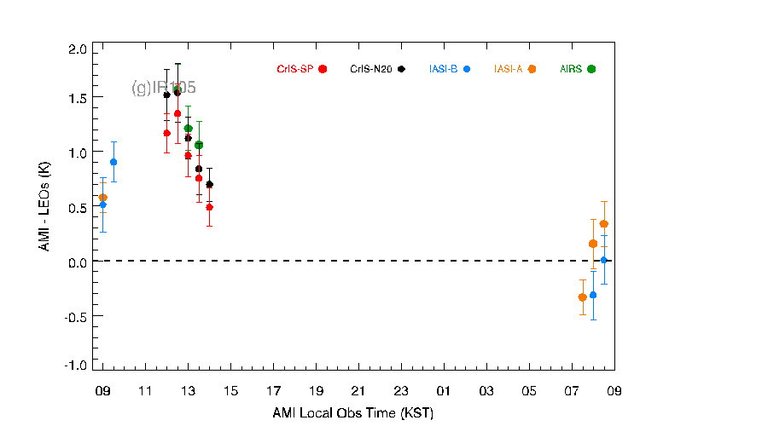
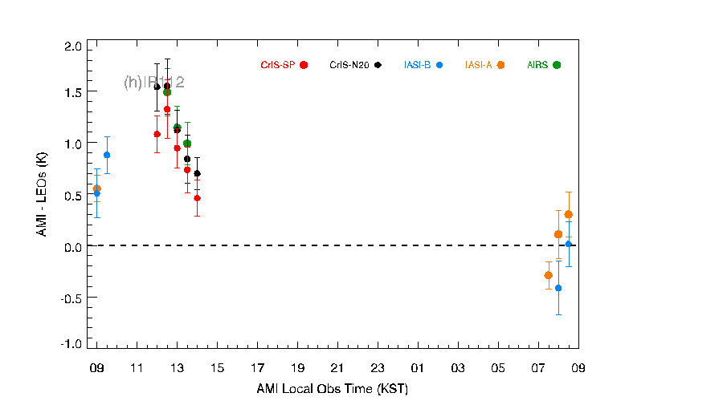
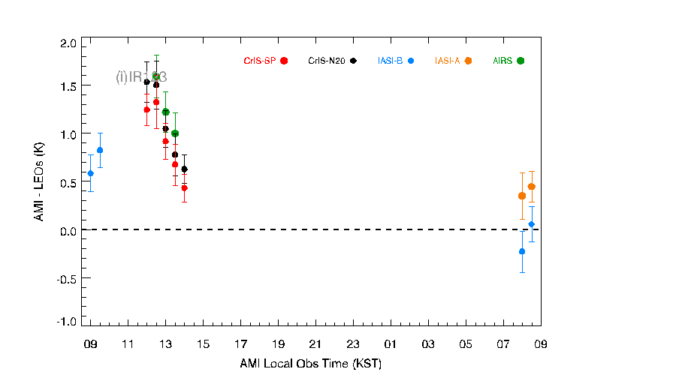
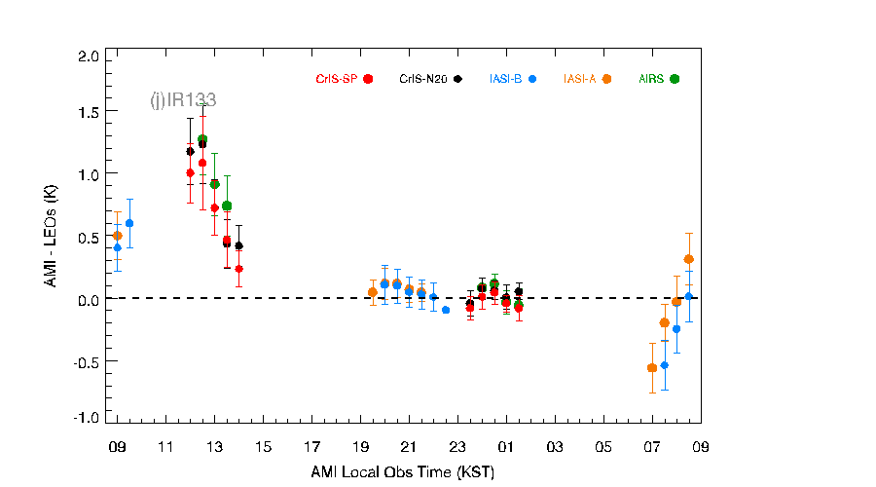
Issue : Diurnal variation with LEOs in Australian Desert Area
IASI-A, IASI-B, AIRS, CrIS-SNPP and CrIS-NOAA20
period of data : 1 June.~ 30 September. 2019
for AMI Tb ≥ 300K (≥ 280K for IR133), 130 ≦ lon. ≦ 150 and -40 ≦ lat. ≦ -20
A large variation from 07 to 14 (LST)

Slide 12
Thank you ☺

