Slide 1
Calibration Considerations for GEO Ring
Xiangqian Wu¹, Fangfang Yu², Hyelim Yoo², Satya Kalluri¹, and Changyong Cao¹
1: NOAA/NESDIS/STAR 2: University of Maryland
Originally Presented to JSC on 2019-10-03
Modified for GSICS Web Meeting on 2019-10-17

Slide 2
What Is GEO Ring?

Slide 3
What Is GEO Ring?

Slide 4
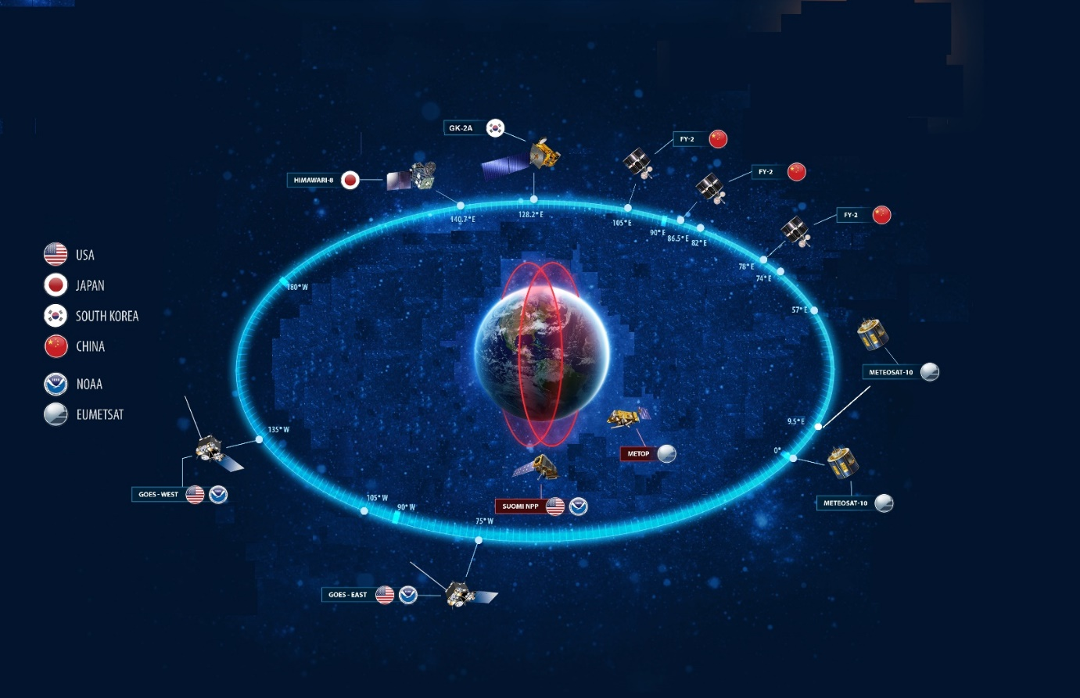
GEO Ring – A constellation of …
https://www.nesdis.noaa.gov/content/why-does-noaa-collaborate-internationally
… geostationary meteorological satellites (operated by various national and international agencies) that provide complete coverage of the non-polar part of the Earth.
COMS 2010
FY-2 1997
Uneven Distribution
LEO
GMS 1977
IODC 1998
GOES-WEST 1977
METEOSAT 1977
GOES-EAST 1977

Slide 5
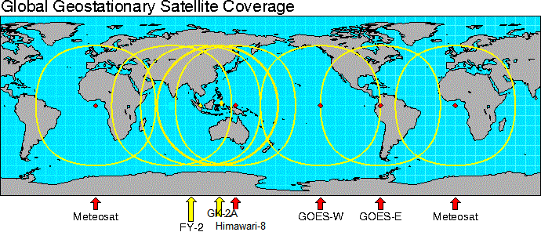
Merge Frequent Coverage Globally
Unlike LEO, a GEO monitors a relatively small part of the Earth much frequently.
https://ral.ucar.edu/~djohnson/satellite/geo_coverage2.html

Slide 6
Opportunity and Challenge
The prospective of such a “GEO Ring” becomes more attractive as a new generation of advanced geostationary meteorological satellites are being deployed with similar capability:
AHI (2014), ABI (2016 & 2018), AGRI (2016), AMI (2018), and FCI (2021)
Channel allocation (16)
Spatial resolution (0.5-2km)
Cadence (10 min)
Performance (noise, accuracy, stability, geolocation, etc.)
Each participating instrument must be well calibrated.
To avoid unpleasant seams after merge.

Slide 7
SI Traceability
https://www.bipm.org/en/bipm-services/calibrations/traceability.html
Useful, but neither necessary nor sufficient.
Unbroken chain of documented uncertainty.
Not necessary: Seamless if wrong by the same but unknown amount.
Not sufficient: Knowledge of uncertainty, not the magnitude.
Non-trivial to maintain SI traceability for satellite instruments upon and long after launch.
metrological traceability is the property of a measurement result whereby the result can be related to a reference through a documented unbroken chain of calibrations, each contributing to the measurement uncertainty
Bureau International des Poids et Masures, adopted by WMO

Slide 8
How about Inter-Calibration?
Unlike LEO, each GEO covers a relatively small part of the Earth, but much frequently.
https://ral.ucar.edu/~djohnson/satellite/geo_coverage2.html

Slide 9
What Is Inter-Calibration
Calibration is the process of determining instrument responses to known signals in order to determine instrument response to unknown signals.
Inter-calibration is the process of assessing calibration of multiple instruments by observing common targets at the same time, over the same region, from the same angle, and with the same spectral (polarization) responses.
None is likely to be true in reality. The best practice is to minimize these effects, and properly account for the residual effects in analysis.
Can include radiative transfer model + NWP model
If one of the measurements is considered known, this may become calibration, for example “GSICS Correction” (with other assumptions)
Valuable even if none of the measurements is perfect or better than the other, as long as their errors are independent.

Slide 10
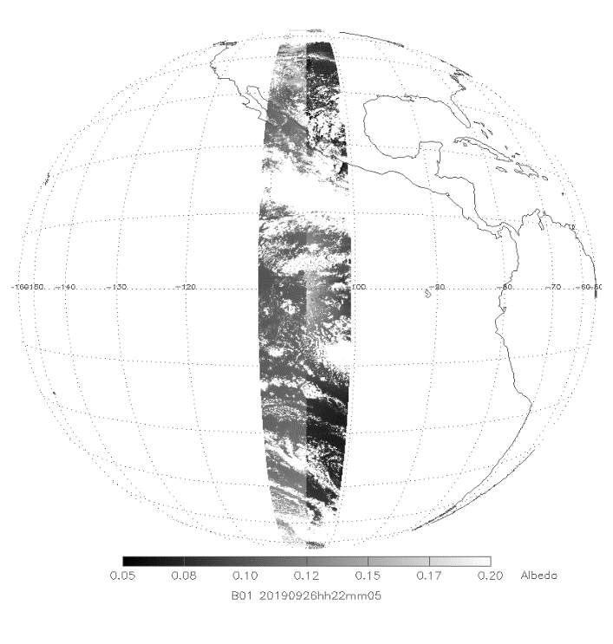
Direct GEO-GEO Inter-Calibration
Requirement Review:
At the same time:
Often <1 min, or ~5 min if one scans S→N.
Over the same region:
Usually, except for parallax.
From the same angle:
Never, therefore
Difficult for VNIR.
Minimize (geometric path) and accounts for optical path
With the same spectral (polarization) responses:
Channel-dependent. Account for the uncertainty.
GOES-17
GOES-16
Sun
26 Sep 2019, 2205 UTC.
GOES-16/17 are viewing forward and backward scattering, respectively.
The apparent difference is due largely to viewing geometry.
It also changes with viewing geometry

Slide 11
Parallax: 106W Viewed by GOES-16 (075W)
~0.7*(Cloud Height) when two GEOs are 60° apart.
~12 km (6 ABI IR pixels) in tropics.
Mitigate parallax error:
Large area – dilute the error.
Uniformity filter – avoid the error.
T. Schmit & M. Gunshor
Proportional to satellite separation and cloud height

Slide 12
Parallax: 106W Viewed by GOES-17 (137W)
~0.7*(Cloud Height) when two GEOs are 60° apart.
~12 km (6 ABI IR pixels) in tropics.
Mitigate parallax error:
Large area – dilute the error.
Uniformity filter – avoid the error.
T. Schmit & M. Gunshor
Proportional to satellite separation and cloud height

Slide 13
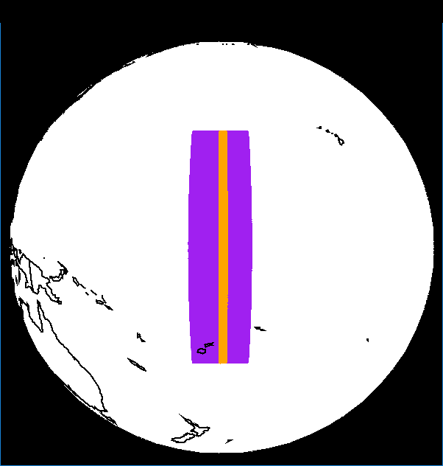
Another Compromise
The common target needs to be small to minimize viewing zenith angle difference, and to be large to increase sample size.
AHI at 140°E.
ABI at 137°W.
Path length difference
(δ sec(VZA)) is
2% and 20%

Slide 14
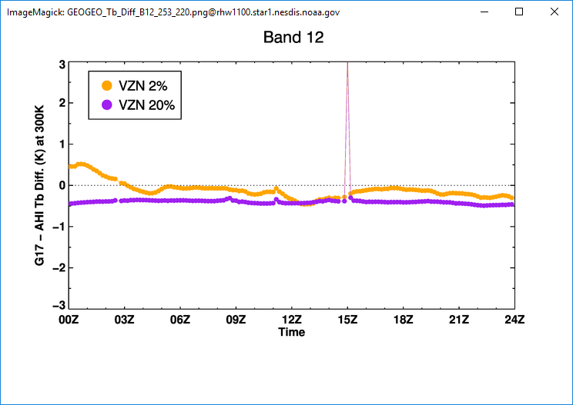
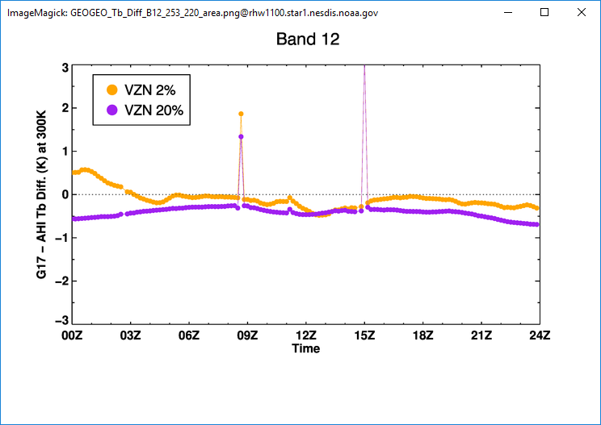
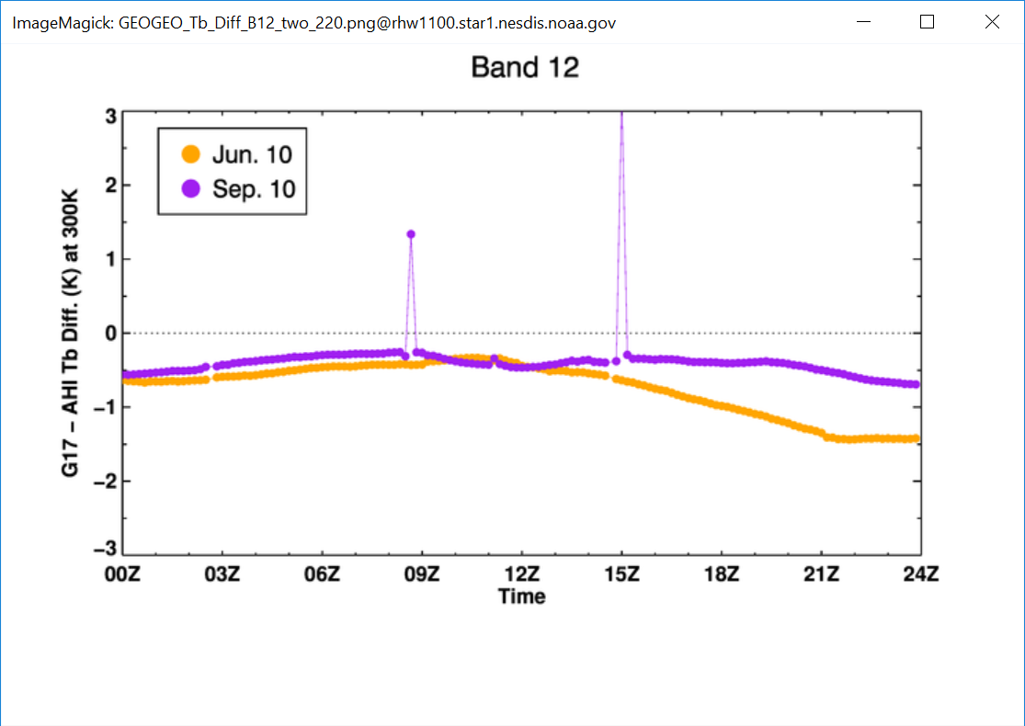
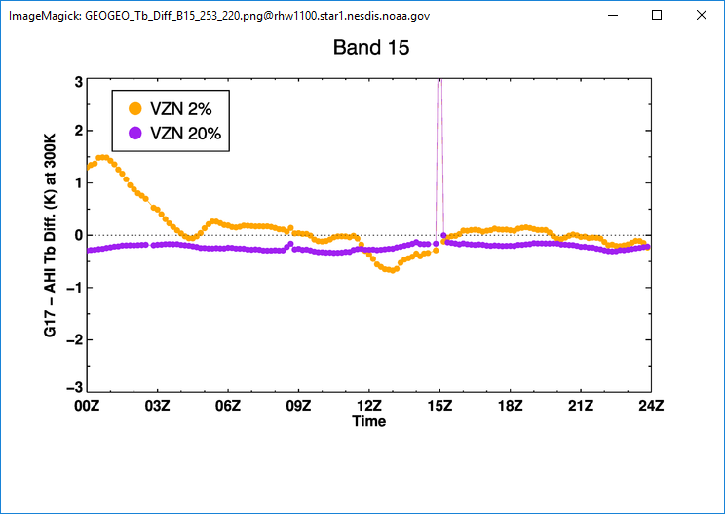
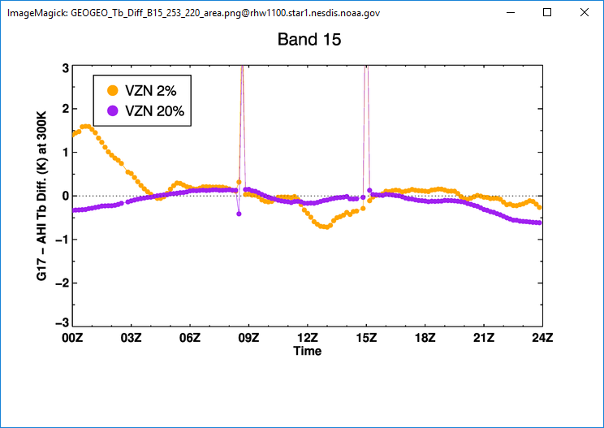
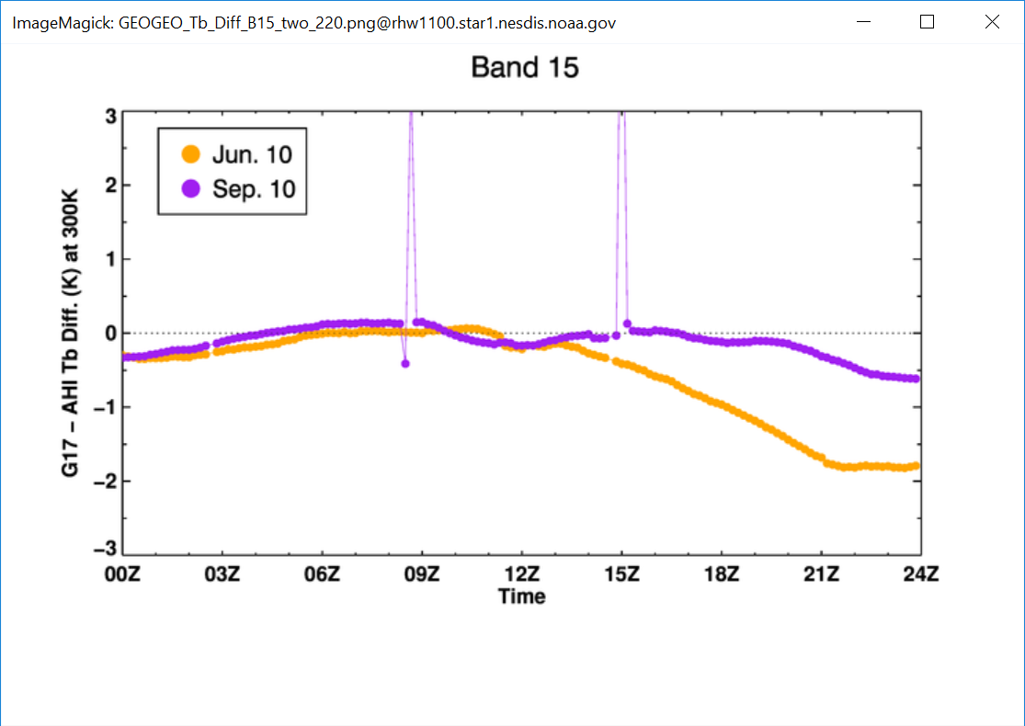
GOES-17 – Himawari-8
Effects of Small Sample Size
Effects of Residual Parallax
Uniform Pixels
All Pixels
Sample size and parallax increase uncertainty, but not necessarily bias.
MJO & ENSO lead to bias for absorptive channels at large VZA, but still relatively temporary.

Slide 15
Direct GEO-GEO Inter-Calibration
Requirement Review:
At the same time:
<1 min, or ~5 min if one scans S→N.
Over the same region:
Usually, except for parallax.
From the same angle:
Never, therefore
Difficult for VNIR.
Minimize (geometric path) and accounts for optical path
With the same spectral (polarization) responses:
Channel-dependent. Account for the uncertainty.

Slide 16
Impacts of SRF Difference
0.3K
0.2K
1.3K
“Constant” difference for window channels.
Variable differences for absorptive channels,
depending on constituents and temperature profiles.
M. Gunshor, PFAAST Tropical
d_lon = 30°, d_lat = 0°, 10°, 20°, and 30°

Slide 17
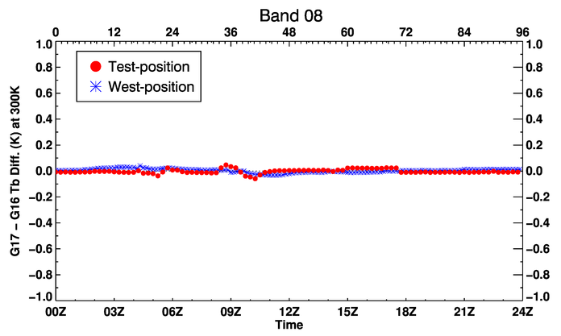
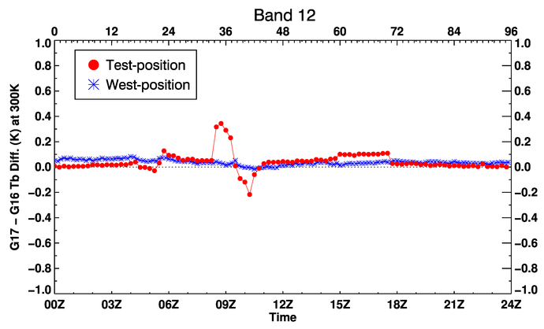
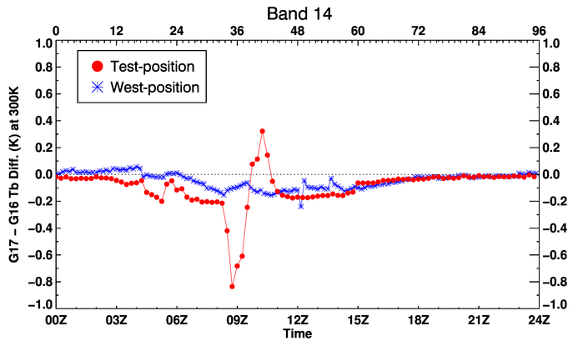
G16 at 75°W; G17 at 89°W and 137°W
H₂O, similar SRF
O₃, similar SRF
On 9/21 of 2018 and 2019
Window, similar SRF
CO₂, different SRF

Slide 18
Indirect GEO-GEO Inter-Calibration
Through a transfer reference:
LEO:
At the same time:
<5 min.
Over the same region:
To the extent of geolocation accuracy of both GEO & LEO.
From the same angle:
Ray matching, or relaxed when unnecessary.
With the same spectral (polarization) responses:
Yes if one is hyperspectral instrument.
Other References:
Minimize the difference and account for the residual, e.g.:
Lunar: ROLO/GIRO to account for difference in time and spectral. Also over-sampling.
Pseudo-Invariant Calibration Site (PICS): RadCalNet to account for difference in time & angle.
Deep Convective Cloud (DCC): SBAF to account for difference in angle.

Slide 19
G16 ABI B12 – LEO’s
Initially, ABI bias was -0.1K & -0.2K as compared to S-NPP CrIS & IASI-B.
IASI-B updated its calibration (nonlinearity). Observed the predicted change of -0.1K. CrIS showed that ABI was stable.
ABI updated its calibration (scan mirror emissivity). The difference between CrIS and IASI-B was reduced as predicted.
ABI updated its calibration (BB temperature). The bias was reduced by ~0.2K as predicted.
It’s important to compare with multiple hyperspectral sounders.
ABI calibration is on a par with hyperspectral sounders in terms of accuracy, precision, and stability.

Slide 20
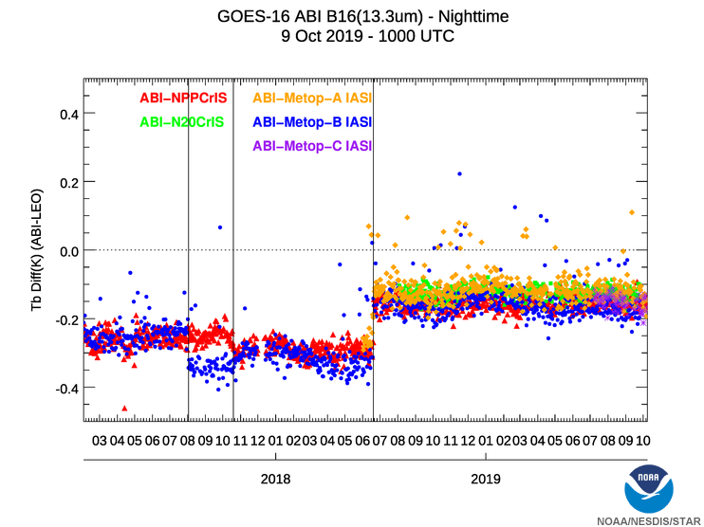
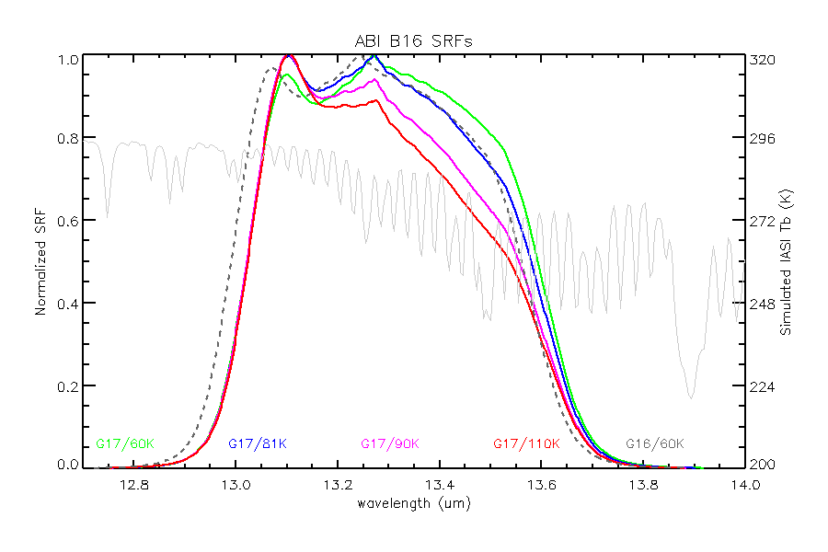
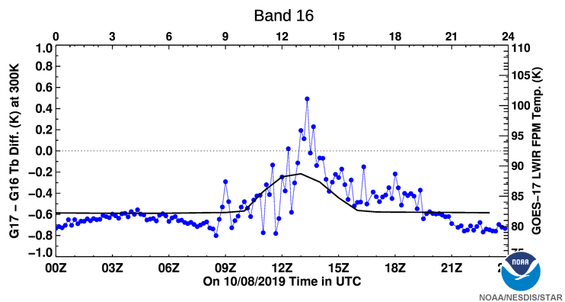
Double Difference Dilemma
(G17-IASI) – (G16-IASI) ≠ G17 - G16
~+0.5K
~-0.1K
Not the same “IASI”
~-0.8K

Slide 21
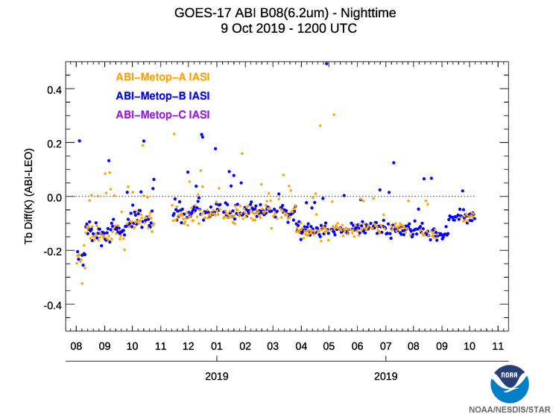
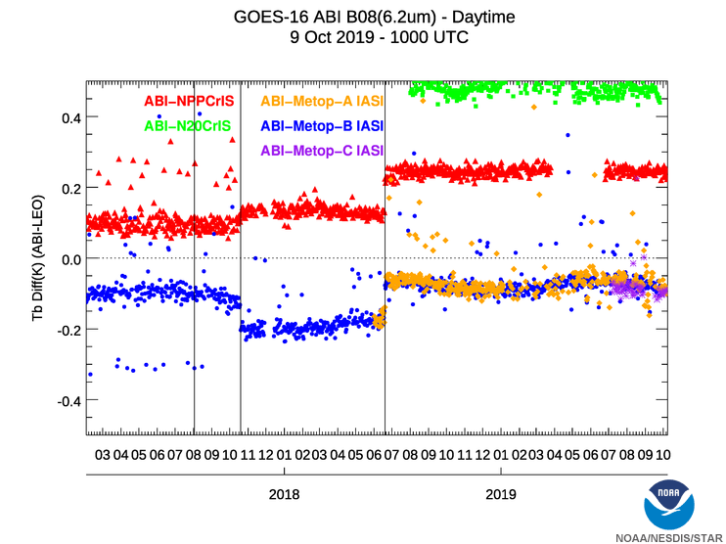
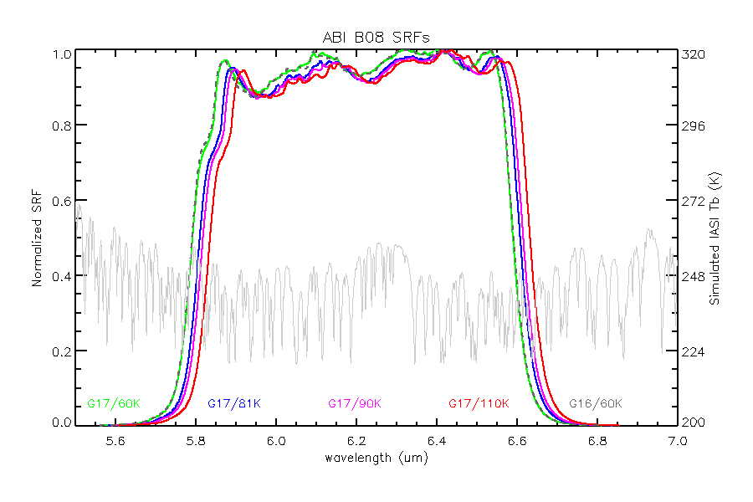
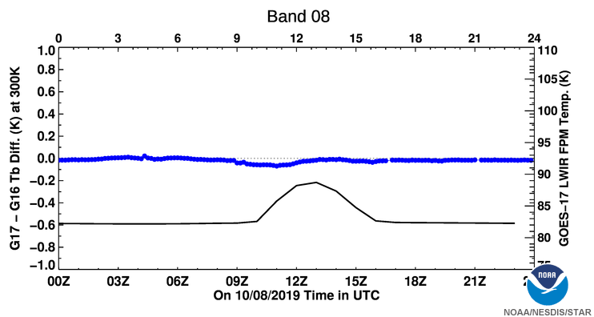
Double Difference Dilemma
(G17-IASI) – (G16-IASI) ≅ G17 - G16
~-0.1K
~-0.1K
Similar “IASI”
~-0.8K
~-0.0K

Slide 22
Summary
GEO ring, or frequent and seamlessly merged images by a ring of geostationary meteorological satellites, becomes more feasible with the new generation of GEOs.
All participating GEOs must be well calibrated.
SI traceability is part of calibration performance.
GEO-GEO, or inter-calibration among wide- or narrow-band instruments:
Valuable tool to detect and diagnose anomaly at diurnal or shorter time scales.
Did not elaborate in this presentation.
Parallax, zenith angle, and climate variations lead to GEO-GEO differences at various time scales.
Random over sufficiently long time, therefore impacts on precision instead of accuracy.
SRF difference results in bias that is neither static nor random, which is the most difficult obstacle.
GEO-LEO, or inter-calibration with hyperspectral instruments:
Best practice for validation of instrument calibration.
Reveal bias among GEOs via double-difference for channels of identical SRF or invariant spectral radiance.
Instrument calibration is necessary but may not be sufficient for GEO ring.
Often need data harmonization and homogenization, in addition to instrument calibration.

