Slide 1
3rd Lunar Calibration Workshop – Model Inter-Comparison
Preparation of LCWS 3 – 10.12.2019
S. Wagner – EUMETSAT
T. Stone - USGS

Slide 2
Model inter-comparison
Advantage: workshop = workshop
Common dataset for testing
Candidate dataset = GIRO benchmark
Provide indication of the variability among the models as a function of:
  Moon position (geometry)
  Instrument typical SRFs

Slide 3
Scope and purpose of the benchmark
  As presented in Xi’an 2017
  Definition of a reference synthetic dataset
  Assessment of the GIRO performances with respect to the current lunar calibration reference model ROLO:
    Verification / Validation of new developments
    Uncertainty assessment
    ➔ Traceability
  Uncertainty assessment / traceability to the GIRO for local implementations
  Possibility to perform a similar assessment for newly developed models with respect to the GIRO

Slide 4
Parameters to vary
Geometry:
  Time: possibly the complete 18-year cycle with “feasible” time step (currently every 6 hours)
    ➔ Libration + phase coverage
  Satellite position:
    Earth centre (x=0., y=0., z=0.) or at the surface of the Earth
    In orbit at 800km or at 36000km from the Earth ground
  ➔ Extract the cases to cover the parameter space
Spectral Response Functions:
  Central wavelengths as for existing Ocean Colour sensors + geostationary imagers + additional bands in between the ROLO bands (in particular for short wavelengths)
  Narrow + large SRFs
  Spectral resolution down to 1nm at first. May require a higher resolution (0.1nm)!
  More shapes of the SRFs

Slide 5
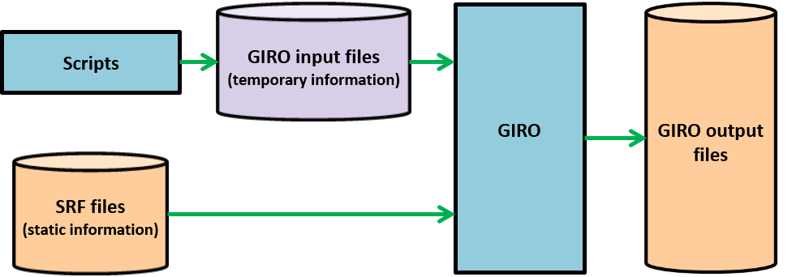
Overview of the benchmark generator
All input / output files: netCDF
➔ Conventions defined by GSICS + first LCWS in 2014)
Scripts: coded in Python + Shell script
Currently input are not saved (generation based on a template)
Only the output are saved
GIRO output = part of the GSICS Lunar Observation Dataset (GLOD)
Availability of the GIRO tool as part of the GLOD = to be discussed

Slide 6
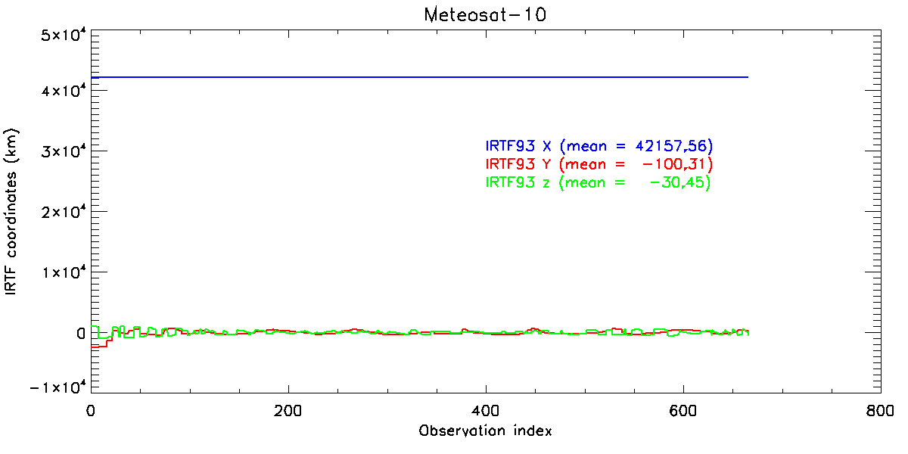
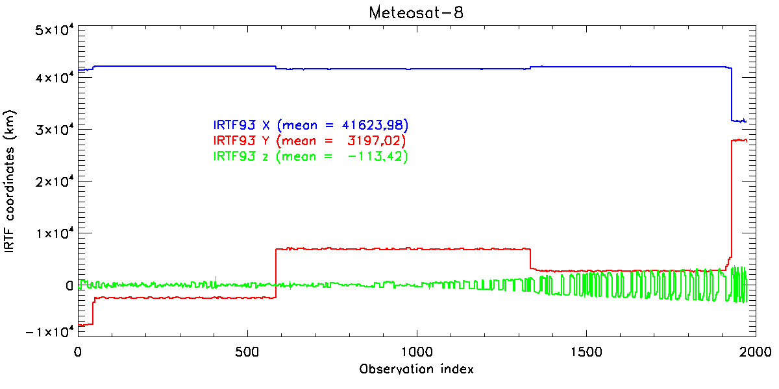
Geometries
  Started date: 1 January 2000 at 0:00 UTC
  End date: 31 December 2017
  Time step: 6 hours
  Location:
    X: 42000.0
    Y: 0.0
    Z: 0.0
    ➔ ~14000 cases in [2°, 92°] range
  To check the coverage of the geometries in the selenographic coordinate space, two other locations were tried:
    X: 0.0
    Y: 0.0
    Z: 0.0
    X: 31600.0
    Y: 28000.0
    Z: 0.0

Slide 7
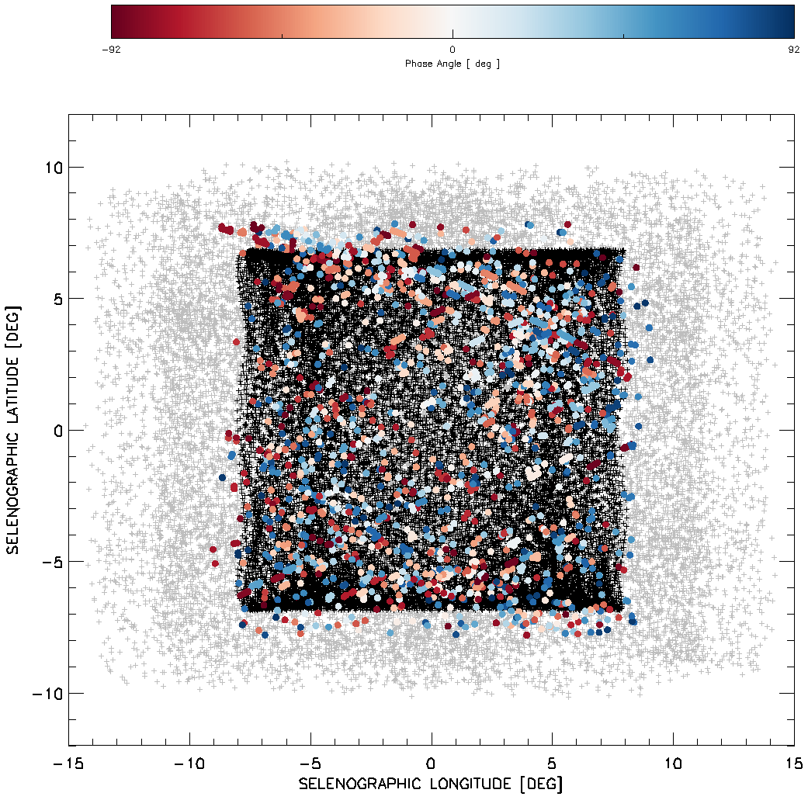
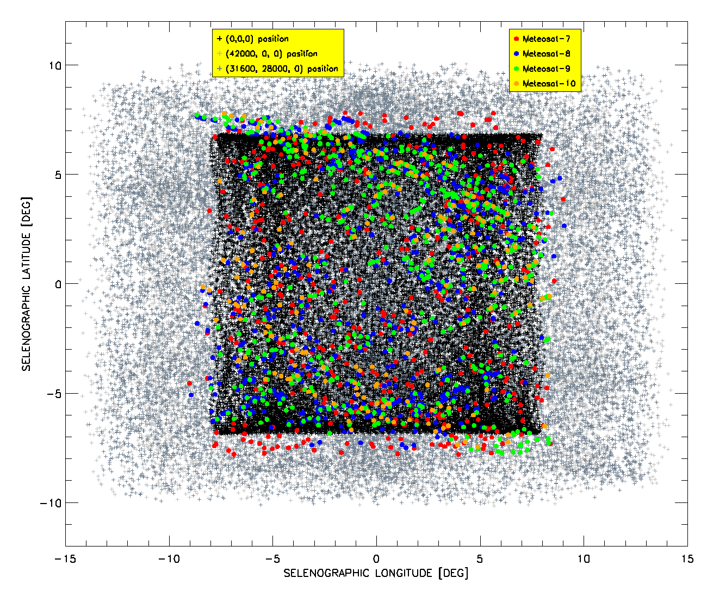
Selenographic coordinates coverage
-92 deg.
0 deg.
Phase angle
92 deg.
(42000,0,0) position
(31600,28000,0) position
(0,0,0) position

Slide 8
Spectral Response Functions
  SRF generator = 4th order Chebyshev filter with a pass band ripple
  SRF widths:
    10nm, e.g. OLCI.
    30nm, e.g. MODIS or VIIRS and new generations of geostationary imagers (even though a bit broader).
    300nm, e.g. high-resolution panchromatic bands (e.g. PLEIADES) and some (older) GEO visible channel imagers.
  SRF spectral resolution = 1nm (as a start) ➔ Planned to reach 0.1 nm
  Range = [350nm, 2350nm]
  Spectral shift:
    2.5 nm in [350nm, 1200nm], i.e about 340 SRFs
    10 nm in [1200nm, 2350nm], i.e about 115 SRFs

Slide 9
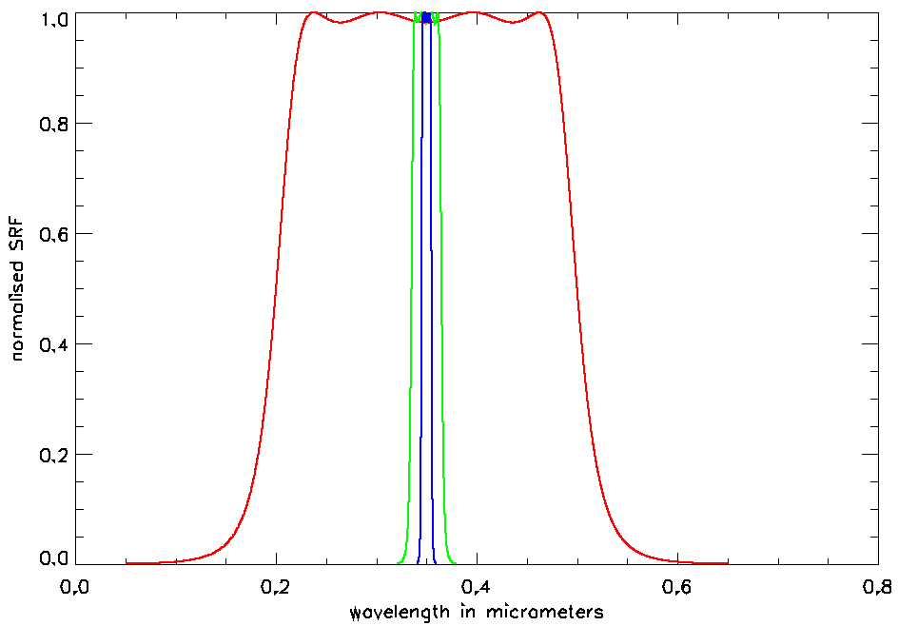
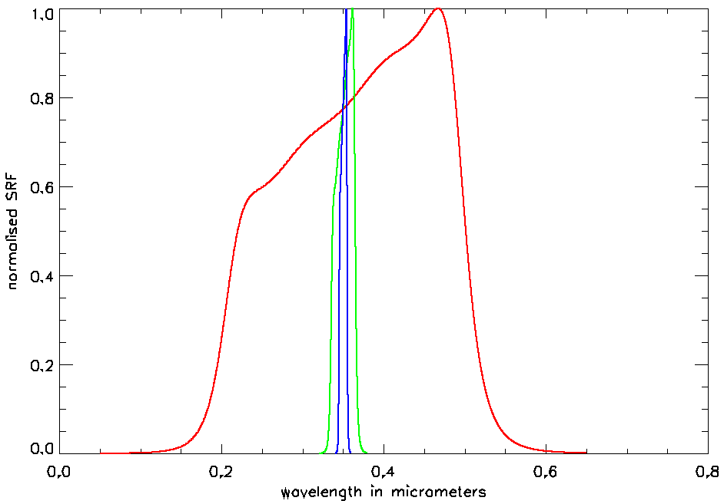
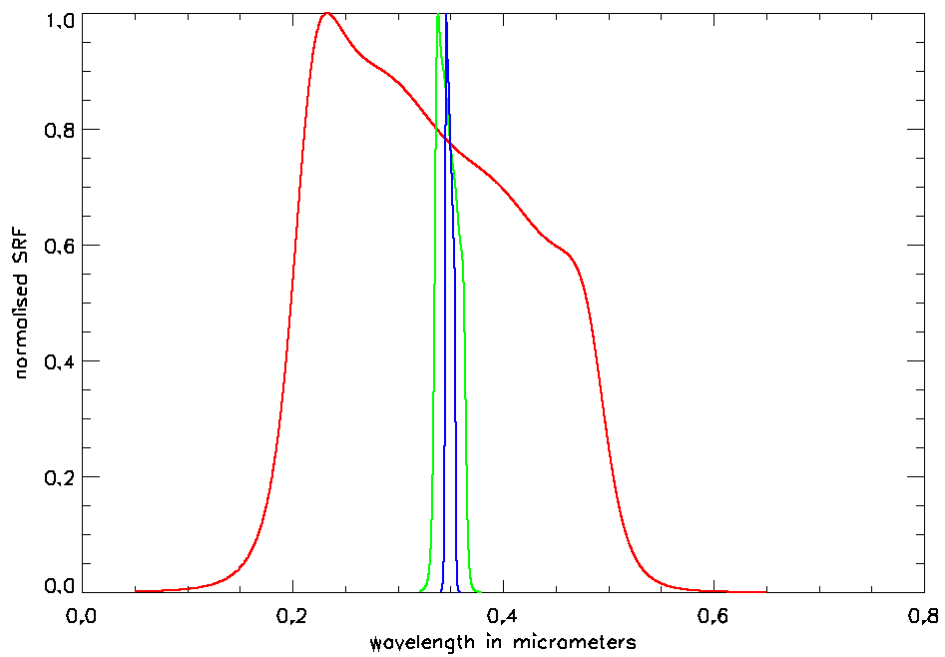
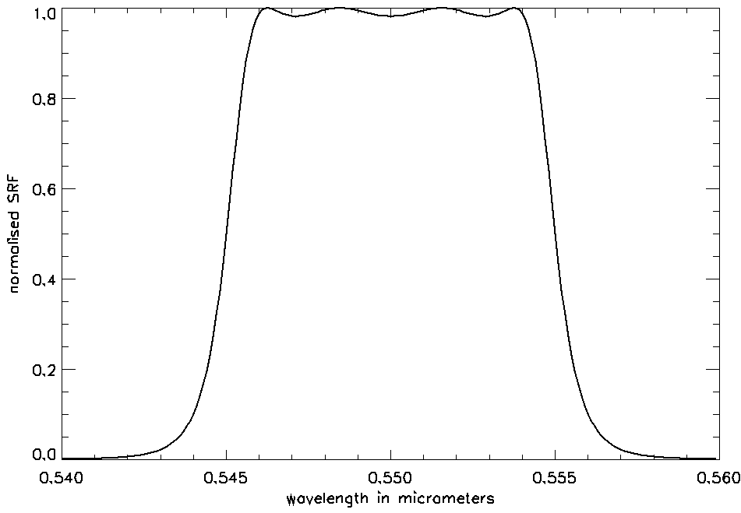
Spectral Response Functions
Solely used at 550nm for the whole Saros cycle

Slide 10
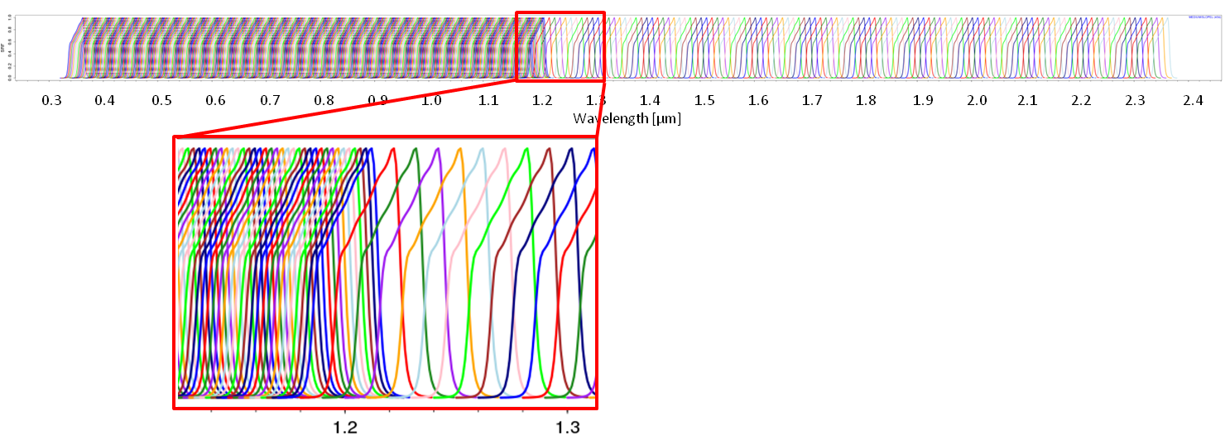
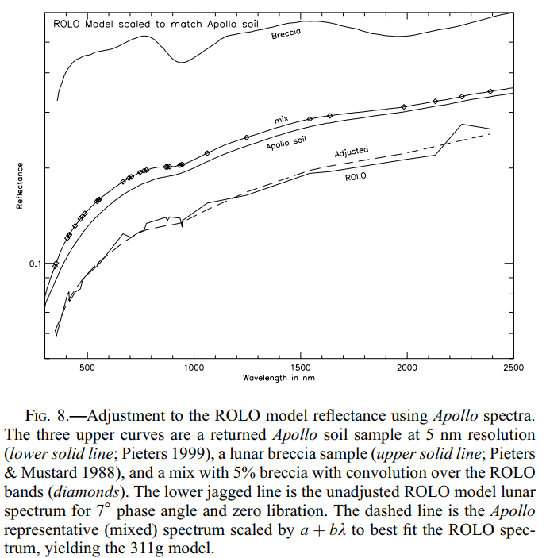
Spectral Response Functions
  Example of spectral shift

Slide 11
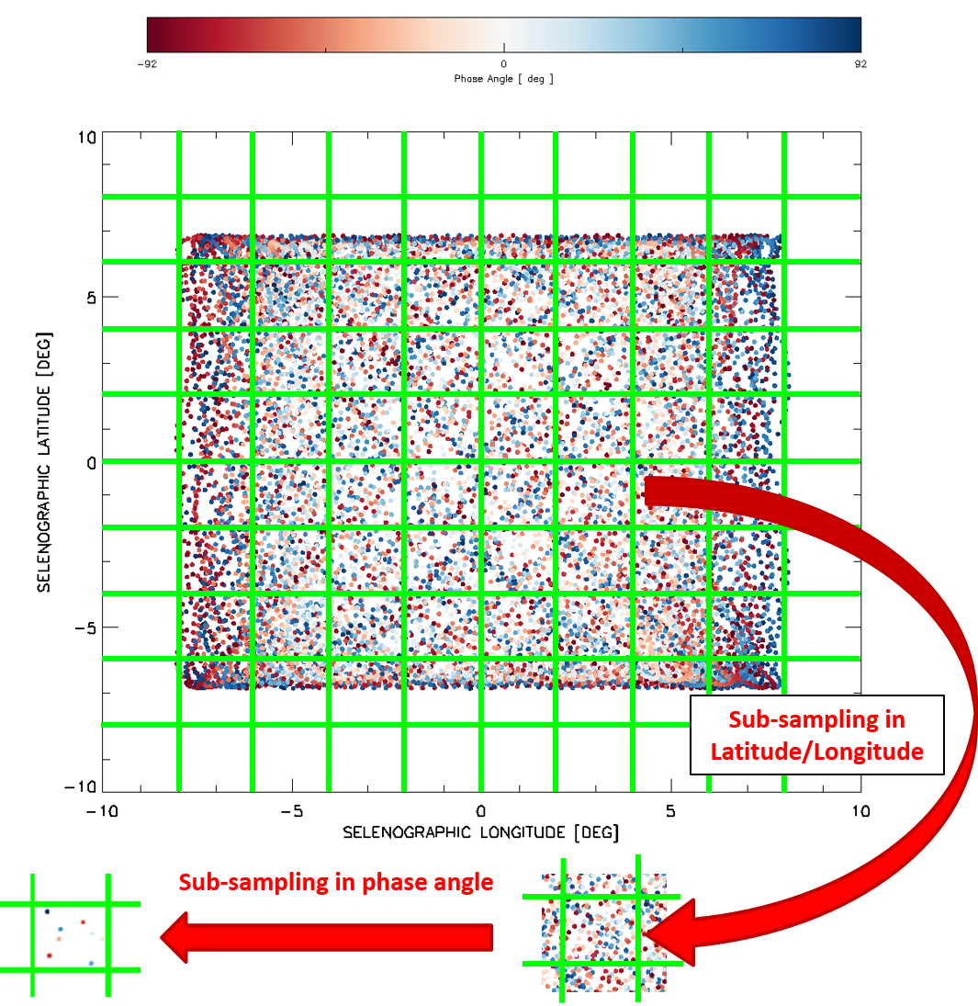
Case reduction for testing all the SRFs + SRF shifts
  Idea = sub-sampling of the selenographic space
  For each sub-domain, a regular sampling of phase angles is taken
  SRFs + SRFs shifts are tested on that subset
  ➔ Currently ~280 dates / geometries (configurable)

Slide 12
Identified potential participants (not exclusive ☺)
  USGS - ROLO
  EUMETSAT – GIRO + New model (in collaboration with Earth Space Solutions)
  ESA – Model based on CIMEL measurements
  CMA
  CSU – MT2009
  H. Kiefer – SLIM
  JAXA – SP model
  Any other potential participants?

Slide 13
Discussion
Is there a general interest in such an activity?
How to integrate it in the workshop? (would require a dedicated session…)
If we go ahead with such an exercise, participants should confirm by end Feb 2020
➔ GSICS annual meeting (early March) = presentation of the overall set-up + refinement of the technical details to clearly define the inter-comparison framework.

