Slide 1
GSICS Annual Meeting 2020 - Second Announcement -

Slide 2
GSICS Annual Meeting 2020
GSICS Annual Meeting will be held at the GLAD HOTEL YEOUIDO, on Seoul, Republic of Korea, from 16 to 20 March, 2020
GSICS Annual Meeting 2020 web-site : nmsc.kma.go.kr/gsics2020.html
At a Glance
VISA application | 31 January 2020 → 15 February 2020 (extended)
Meeting Registration | 29 February 2020
Hotel Reservation | 29 February 2020

Slide 3
GSICS Annual Meeting 2020
Meeting room
Icebreaker : 16 March (Day 1)
Welcoming Dinner : 17 March (Day 2)
Room name | Session | Floor | Remarks
Bloom A | Plenary (Day 1, 2, and 5) | B1 | U shape / 50~60 person
 | GRWG- VIS/NIR & IR sub group
Project BC | GRWG – MW, UV sub group | 2F | U shape / 20~30 person
Project D | GDWG | 2F | U shape / 14~20 person

Slide 4
Venue
Location
17-5, Yeouido-dong, Yeongdeungpo-gu, Seoul, 150-874, Korea
+82.2-6222-5000,
https://gladyeouido-hotels.com/en/web/yeouido-en
Airport Limousine Bus (Incheon or Kimpo airport → Glad Hotel Yeouido)
No. 6030
Terminal 1: Bus stop 6B on the first floor of the Incheon International Airport
Terminal 2: Bus stop 32 on the B1 floor of the Incheon International Airport
Get off at National Assembly Building Bus Stop (GLAD HOTEL YEOUIDO)
Operation hours:
Departing from GLAD HOTEL YEOUIDO 06:00~23:00
Departing from Incheon International Airport 06:30~23:00
Travel time: about 50 minutes,
price: KRW15,000 (one-way)

Slide 5
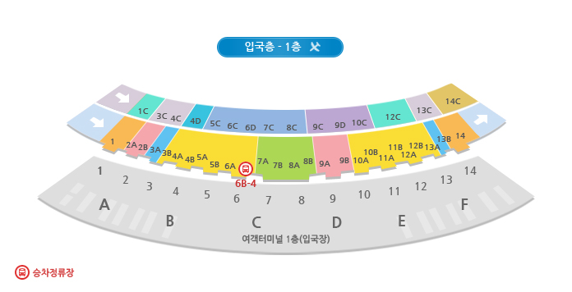
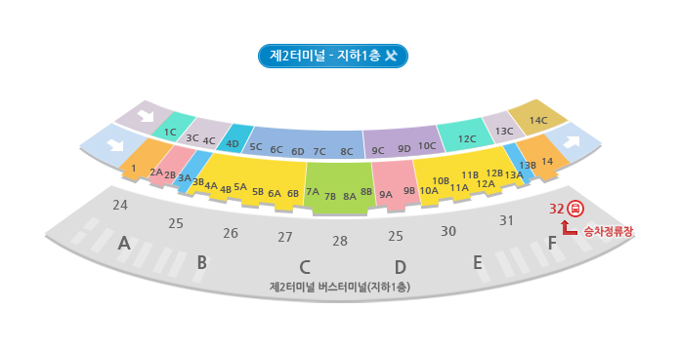
Venue
1st Floor, Incheon International Airport
(Terminal 1)
B1 Floor, Incheon International Airport
(Terminal 2)

Slide 6
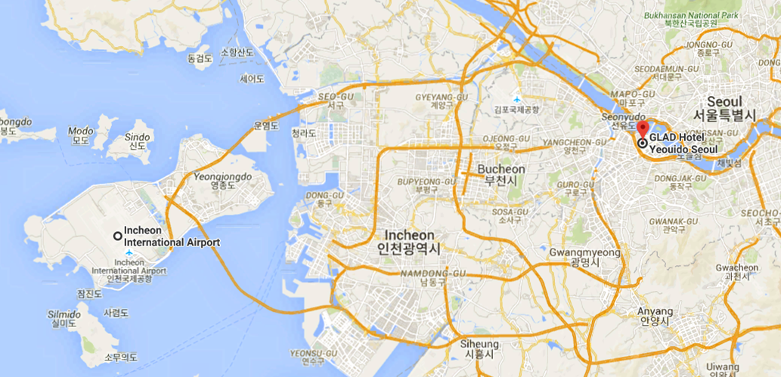
Venue

Slide 7
Venue
National
Assembly
National Assembly Building Bus Stop
GLAD HOTEL YEOUIDO

Slide 8
VISA Application
Those requiring a visa to visit Korea found the visa application form and send the complete version with a copy of their passport photo page to KMA/NMSC
Visa Application : until 15 February 2020 (extended)
Visa application form will be downloaded on GSICS2020 web-site nmsc.kma.go.kr/gsics2020.html
Please fill out and send the Visa application form to KMA/NMSC (hyoung0203@korea.kr, / cc: dkim@kma.go.kr).

Slide 9
Accommodation
Block booking arrangements for accommodation have been made by KMA/NMSC at GLAD HOTEL YEOUIDO (the meeting venue).
Room type : Superior/Standard double room for one or two people
Rate : 126,500 KRW (≈110USD / 100EUR) per night (including wifi, breakfast and taxes)
Number of available rooms : about 50
Hotel Reservation : until 29 February, 2020
Hotel reservation form will be downloaded on GSICS-2020 web site nmsc.kma.go.kr/gsics2020.html
Please fill out and send the reservation form to KMA/NMSC (hyoung0203@korea.kr, / cc: dkim@kma.go.kr)

Slide 10
Meeting Registration
GSICS-2020 web site for Registration : nmsc.kma.go.kr/gsics2020.html
GSICS 2020 Registration : until 29 February, 2020
Now, 17 participants were registered
The in-site registration will take place on the lobby in front of Bloom A (Plenary Session) in GLAD HOTEL YEOUIDO on Monday 16th March 2020 from 08:00 until start of the meetings and during all coffee breaks.

Slide 11
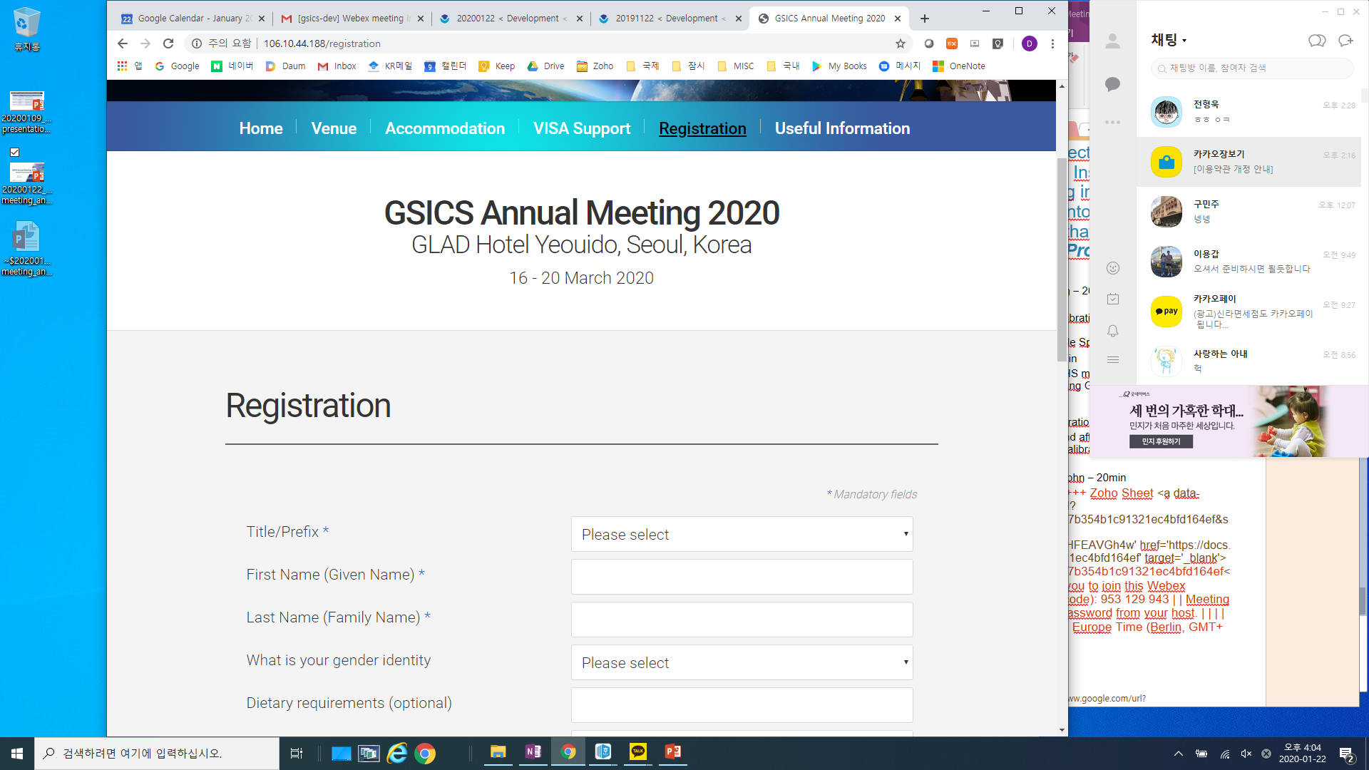
Meeting Registration
GSICS-2020 web site for Registration : nmsc.kma.go.kr/gsics2020.html
GSICS 2020 Registration : until 29 February, 2020
Now, 17 participants were registered
The in-site registration will take place on the lobby in front of Bloom A (Plenary Session) in GLAD HOTEL YEOUIDO on Monday 16th March 2020 from 08:00 until start of the meetings and during all coffee breaks.

