Slide 1
2020 Annual GSICS Calibration Report - GEO

Slide 2
Template for 2020
(Revised based on the 2019 Template – Many thanks to Masaya Takahashi!)
Major satellite/Instrument events relevant to calibration and the impact on the radiance quality: 1 page for summary + 1-2 pages to show the impacts, if applicable
Radiometric calibration performance for GEO imagers using GSICS inter-calibration/inter-comparison approaches (2-3 pages/instrument, )
Table/Figure summarizing bias/unc: average of last one year or typical time period
Time series chart of bias/unc: since operation start or last one year
Scene Dependent Bias: Scatterplot of scene dependent bias
Detailed information: referred to Calibration Landing Page or other monitoring website

Slide 3
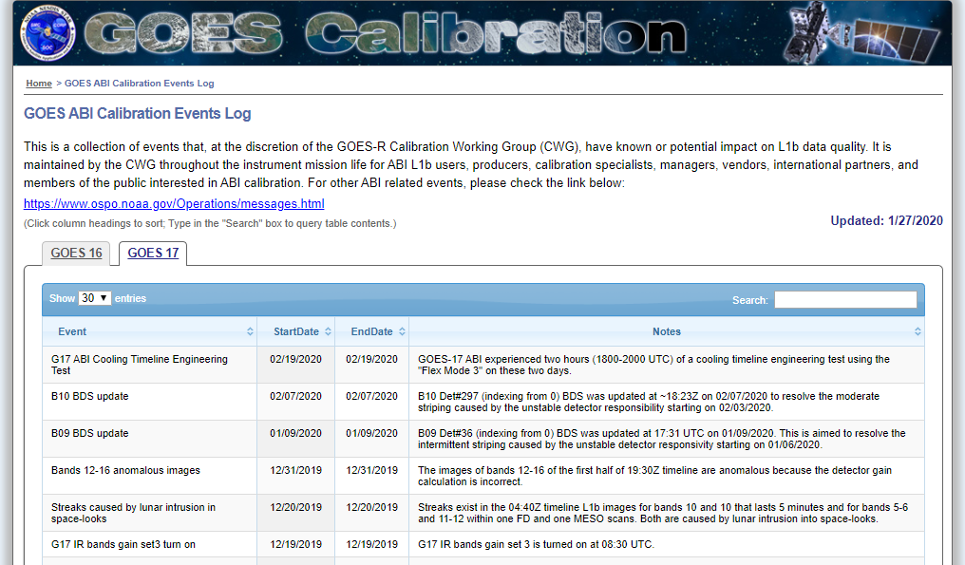
GOES-16/17 Calibration Events in 2019
http://planet.rssi.ru
Satellite (status) |  | Current Location | Launch Date | Operation Date
GOES-16 | (Op) | 75.2W (GOES-East) | 2016-11-19 | 2017-12-18
GOES-17 | (Op) | 137.2W (GOES-West) | 2018-03-01 | 2019-02-12
GOES-16/17 ABI Calibration Event Log:
https://www.star.nesdis.noaa.gov/GOESCal/goes_SatelliteAnomalies.php
This is to provide the major calibration events the agency would like users to be aware.
Major Calibration Related Events | GOES-16 | GOES-17
B02 (0.64um) solar cal. LUT update | 04/23/2019 | 04/27/2019
Predictive Calibration Algorithm Implementation |  | 07/25/2019

Slide 4
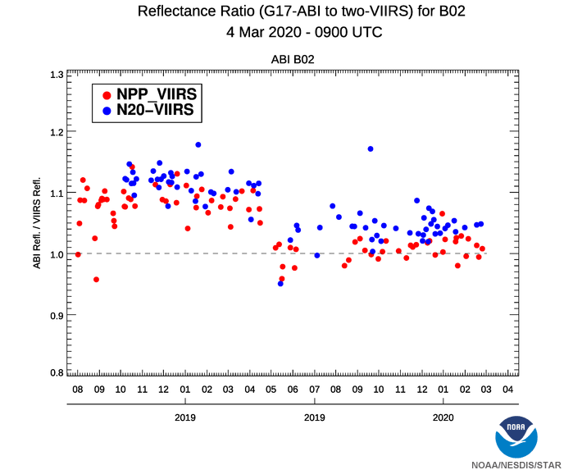
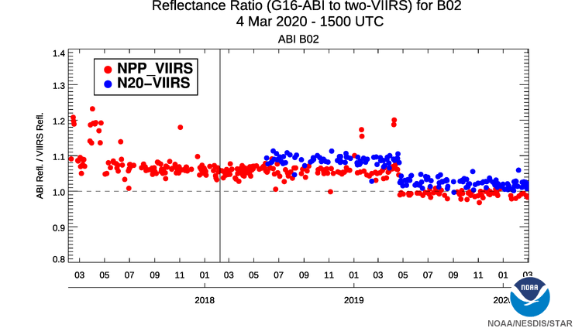
G16/17 B02 Solar Cal. LUT Updates
The update of the B02(0.64um) solar calibration LUT reduces the calibration difference to SNPP and NOAA-20 VIIRS
More information: https://www.star.nesdis.noaa.gov/GOESCal/G16_ABI_VNIR_InterCal_static.php
https://www.star.nesdis.noaa.gov/GOESCal/G17_ABI_VNIR_InterCal_static.php

Slide 5
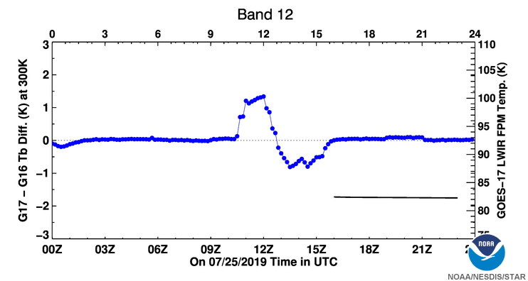
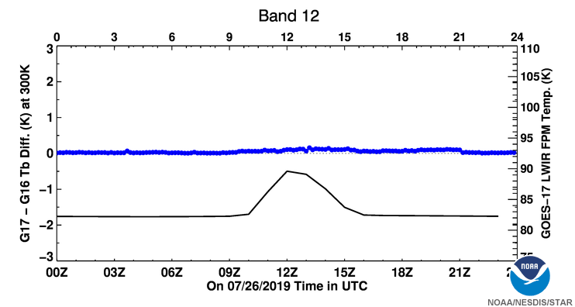
G17 IR pCal Implementation on 07/25/2019
Before implementation
After implementation
The GEO-GEO inter-comparison shows that the GS update on July 25, 2019 significantly improves the G17 IR radiance accuracy at unstable FPM temperature time
More information at: https://www.star.nesdis.noaa.gov/GOESCal/G17_ABI_GEO_GEO_IR_daily.php

Slide 6
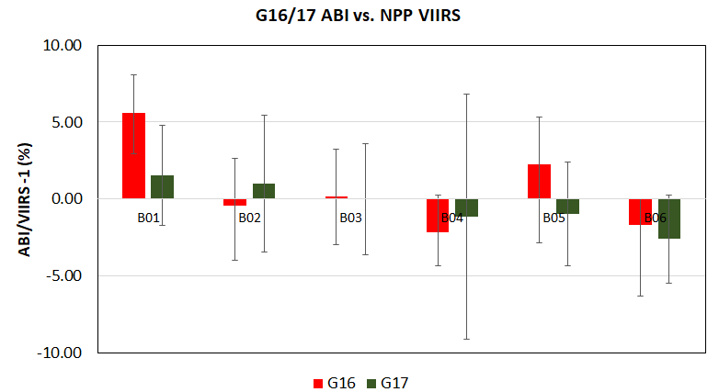
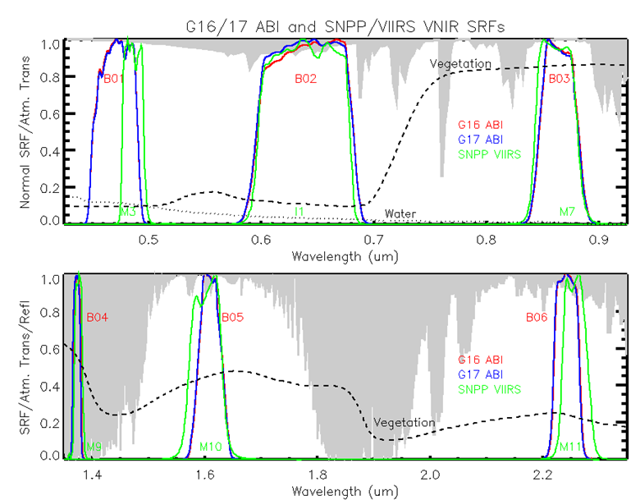
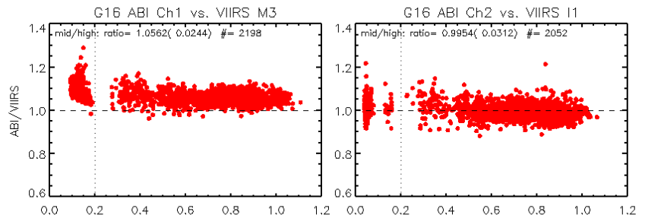
G16/17 ABI VNIR Cal. Performance
The mean calibration difference between G16/17 ABI and SNPP/VIIRS from Oct. 1, 2019 – Nov. 30, 2019 (unit: %, all uncertainties k=1)
GEO | Reference Instr. | B01 (0.47um) | B02 (0.64um) | B03 (0.86um) | B04 (1.37um) | B05 (1.6um) | B06 (2.2um)
G16 | SNPP/VIIRS | 5.62(±2.44) | -0.46(±3.12) | 0.16(±3.10) | -2.16(±2.41) | 2.28(±3.06) | -1.70(±1.71)
G17 | SNPP/VIIRS | 1.52(±3.24) | 0.99(±4.45) | 0.00(±3.60) | -1.17(±7.97) | -0.97(±3.36) | -2.61(±2.86)
All the ABI Visible and Infrared (VNIR) channels, except for G16 B01, are within 5% difference to SNPP/VIIRS from 10/01/2019-11/30/2019
G16 B01 is brighter than SNPP/VIIRS by 5.6%
Slight scene radiance/reflectance dependent bias can be observed at some VNIR bands
Uncertainty in SRF correction may contribute
G16/17 VNIR calibration is in general very stable since their operations, apart from the B02 LUT updates in April 2019. Long-term monitoring is available:
https://www.star.nesdis.noaa.gov/GOESCal/G16_ABI_VNIR_InterCal_static.php
https://www.star.nesdis.noaa.gov/GOESCal/G17_ABI_VNIR_InterCal_static.php

Slide 7
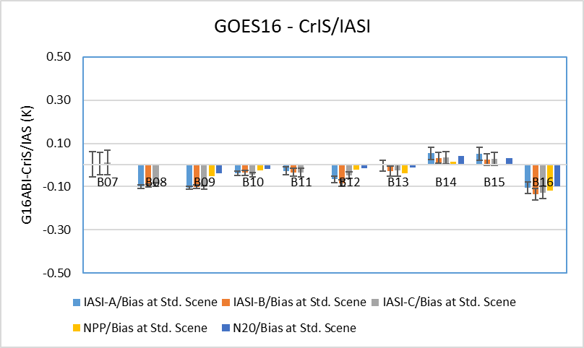
G16 IR Rad. Calibration Performance: Bias
Summary Statistics of GOES-16/ABI IR Calibration Performance in December 2019 (all uncertainties are k=1)
 | Channel Name (Central Wavelength in μm) | BAND07 (3.9) | BAND08 (6.2) | BAND09 (6.9) | BAND10 (7.3) | BAND11 (8.6) | BAND12 (9.6) | BAND13 (10.4) | BAND14 (11.2) | BAND15 (12.4) | BAND16 (13.3)
 | Std. Scene Tb* | 286.0 | 234.5 | 244.0 | 254.5 | 284.0 | 259.5 | 286.0 | 286.0 | 283.5 | 269.5
Metop-A/ IASI | Bias at Std. Scene radiance (K) | -0.00 (±0.06) | -0.10 (±0.01) | -0.11 (±0.01) | -0.04 (0.01) | -0.03 (±0.02) | -0.07 (±0.01) | 0.00 (±0.03) | 0.05 (±0.03) | 0.05 (±0.03) | -0.11 (±0.03)
Metop-B/ IASI | Bias at Std. Scene radiance (K) | 0.01 (±0.05) | -0.09 (±0.01) | -0.10 (±0.01) | -0.04 (±0.01) | -0.03 (±0.02) | -0.08 (±0.01) | -0.03 (±0.02) | 0.03 (±0.03) | 0.02 (±0.03) | -0.14 (±0.03)
Metop-C/ IASI | Bias at Std. Scene radiance (K) | 0.01 (±0.06) | -0.09 (±0.01) | -0.10 (±0.01) | -0.05 (±0.01) | -0.03 (±0.02) | -0.05 (±0.02) | -0.02 (±0.03) | 0.03 (±0.03) | 0.03 (±0.03) | -0.13 (±0.03)
S-NPP/ CrIS | Bias at Std. Scene radiance (K) | - | - | -0.11 (±0.01) | -0.05 (±0.01) | - | -0.02 (±0.01) | -0.04 (±0.02) | 0.00 (±0.02) | -0.01 (±0.02) | -0.13 (±0.02)
NOAA-20/ CrIS | Bias at Std. Scene radiance (K) | - | - | -0.09 (±0.00) | -0.04 (±0.01) | - | -0.02 (±0.01) | -0.01 (±0.01) | 0.06 (±0.02) | 0.04 (±0.02) | -0.10 (±0.02)
Either table/figure can be used.
G16 ABI IR bands are well-calibrated. The mean Tb bias at standard radiance/Tb is within 0.15K for all bands.

Slide 8
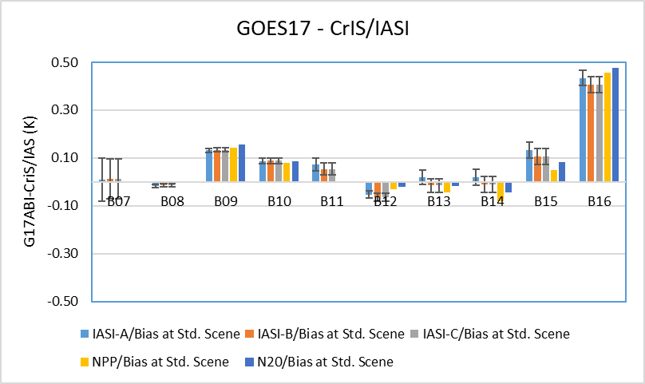
G17 IR Calibration Performance: Bias
Summary Statistics of GOES-17/ABI IR Calibration Performance in Dec. 2019 at Gainset I Period (All uncertainties are k=1)
 | Channel Name (Central Wavelength in μm) | BAND07 (3.9) | BAND08 (6.2) | BAND09 (6.9) | BAND10 (7.3) | BAND11 (8.6) | BAND12 (9.6) | BAND13 (10.4) | BAND14 (11.2) | BAND15 (12.4) | BAND16 (13.3)
 | Std. Scene Tb (K) | 286.0 | 234.5 | 244.0 | 254.5 | 284.0 | 259.5 | 286.0 | 286.0 | 283.5 | 269.5
Metop-A/ IASI | Bias at Std. Scene radiance (K) | 0.01 (±0.09) | -0.02 (±0.01) | 0.13 (±0.01) | 0.09 (±0.01) | 0.07 (±0.03) | -0.05 (±0.02) | 0.02 (±0.03) | 0.02 (±0.03) | 0.13 (±0.03) | 0.43 (±0.03)
Metop-B/ IASI | Bias at Std. Scene radiance (K) | 0.01 (±0.08) | -0.01 (±0.01) | 0.13 (±0.01) | 0.09 (±0.01) | 0.05 (±0.02) | -0.06 (±0.02) | -0.01 (±0.03) | -0.01 (±0.03) | 0.11 (±0.03) | 0.41 (±0.03)
Metop-C/ IASI | Bias at Std. Scene radiance (K) | 0.01 (±0.08) | -0.01 (±0.01) | 0.13 (±0.01) | 0.09 (±0.01) | 0.05 (±0.02) | -0.06 (±0.02) | -0.01 (±0.03) | -0.01 (±0.03) | 0.11 (±0.03) | 0.41 (±0.03)
S-NPP/ CrIS | Bias at Std. Scene radiance (K) | - | - | 0.14 (±0.03) | 0.08 (±0.04) | - | -0.03 (±0.04) | -0.04 (±0.08) | -0.08 (±0.09) | 0.05 (±0.10) | 0.46 (±0.11)
NOAA-20/ CrIS | Bias at Std. Scene radiance (K) | - | - | 0.16 (±0.03) | 0.09 (±0.03) | - | -0.02 (±0.05) | -0.02 (±0.08) | -0.04 (±0.09) | 0.08 (±0.10) | 0.48 (±0.10)
G17 ABI is in general well calibrated at the gain-set I period when the focal plane module (FPM) temperature is stable.
G17 B16 has relatively large bias at 0.4-0.5K
LWIR FPM Temperature
Gainset I

Slide 9
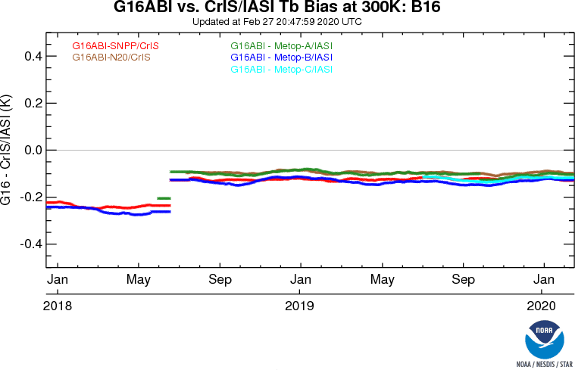
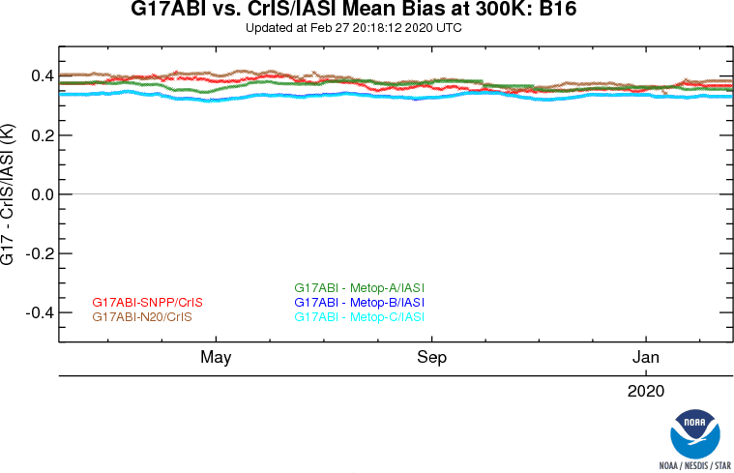
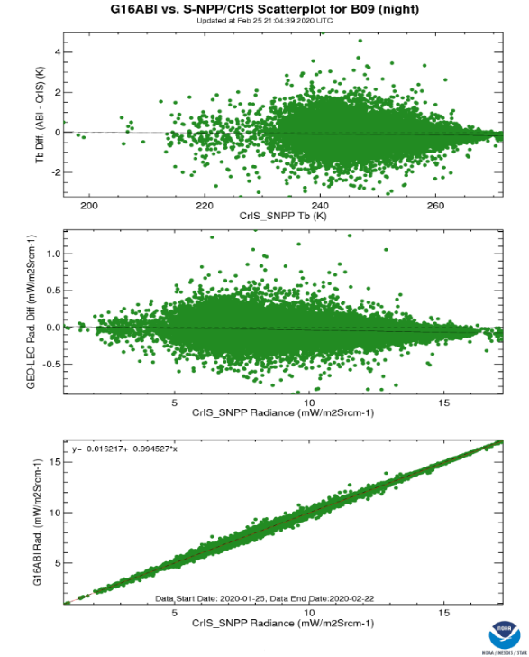
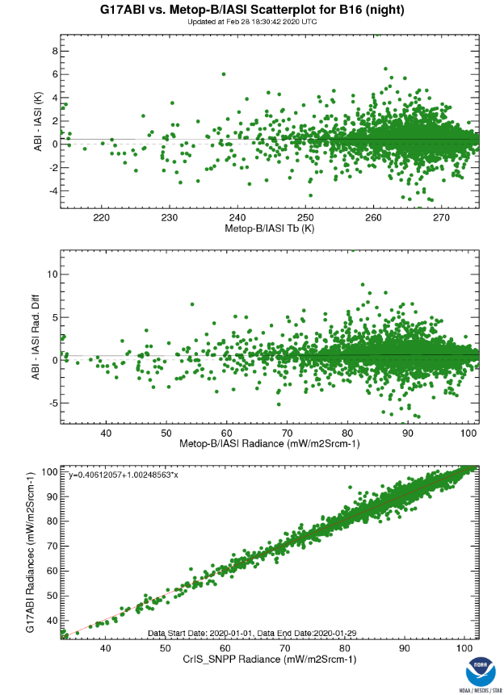
G16/G17 Rad. Calibration Performance: Trending/Scatterplots
GS update on 06/19/2018
Note: Trending can also be characterized with the GSICS correction bias, our traditional GSICS bias monitoring method.
The trending shown in this slide is calculated with the mean radiance difference converted to 300K. This is requirement for ABI.
GOES-16 ABI IR calibration is very stable after the GS update on 06/19/2018.
GOES-17 ABI IR calibration is very stable during the stable FPM temperature period since its operation
No strong scene dependent bias at all IR bands
The different of the Tb bias to CrIS/IASI is within 0.1K
More information and plots are available at: https://www.star.nesdis.noaa.gov/GOESCal/G16_GSICS_ABI_IR_Bias_static.php
https://www.star.nesdis.noaa.gov/GOESCal/G17_GSICS_ABI_IR_Bias_static.php

Slide 10
Discussions
GSICS monitoring vs. GSICS Correction Product Monitoring
Bias vs. Correction bias at reference temperature
Uncertainty of Tb bias at reference temperature
Uncertainty of correction bias at reference temperature
For the GSICS Product Bias Report
Are they typical (k=1) uncertainties on the biases evaluated from the GSICS products? i.e. how well we think we can correct an individual image
Are they standard deviations of these biases evaluated over the period of the repots? i.e. how stable the instruments’ calibration is.
Drift report?
Legacy VNIR bands without on-orbit cal. capacity
How about the on-board cal. instruments?
Degradation of the calibration target(s)?
How often shall we update/maintain the GSICS product monitoring website?
Scripts for auto tables/plots generations from GSICS products

