Slide 1
DCC characterization and improvements to the calibration algorithm for reflective solar bands
Raj Bhatt, David Doelling, Conor Haney, Benjamin Scarino, and Arun Gopalan
CERES Imager and Geostationary Calibration Group
March 18, 2020
GSICS VIS-NIR Meeting

Slide 2
Outline
Background
MODIS and VIIRS as GSICS reference imagers
Baseline DCC method (strengths and limitations)
Improved DCC method
Formulation of Seasonal BRDFs
BRDF normalization
IR BT threshold transformation
Spectral differences and SBAF
Results
Conclusions

Slide 3
Background
High radiometric quality MODIS calibrated radiances have served as benchmark measurements for GSICS inter-calibration studies
GSICS will soon transit to using VIIRS as a reference imager for radiometric harmonization of GEO imagers
A radiometric inter-consistency assessment of multiple reference LEO imagers is essential to ensure a seamless transition.
An improved DCC calibration algorithm is presented here for inter-sensor calibration of multiple reflective solar bands
DCC results can be validated using other independent approaches:
Using a GEO or LEO as a transfer radiometer
Direct ray-matching, where applicable
Pseudo-invariant ground site (Libya-4 PICS)
VIIRS data (C1 for SNPP and C2 for NOAA-20) used in this study are reformatted subsets of the NASA VIIRS Land Science Investigator-led Processing System L1B products

Slide 4
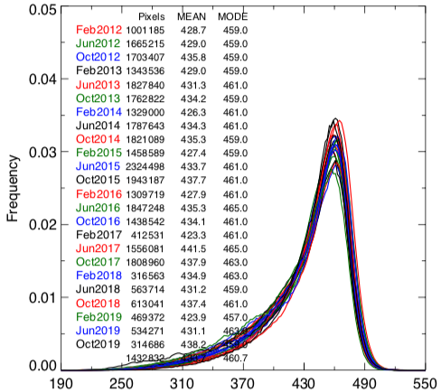
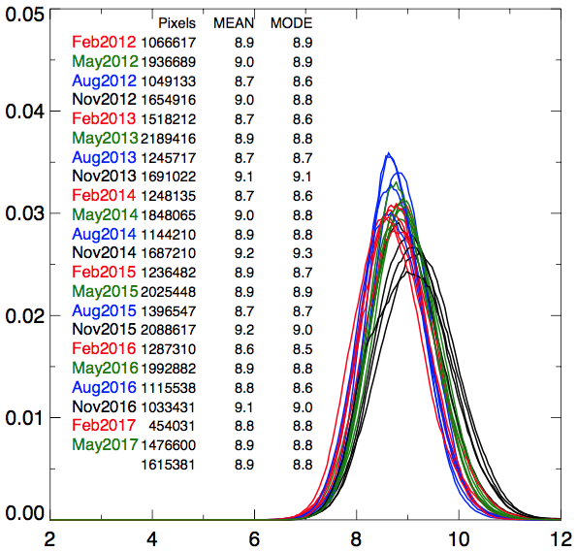
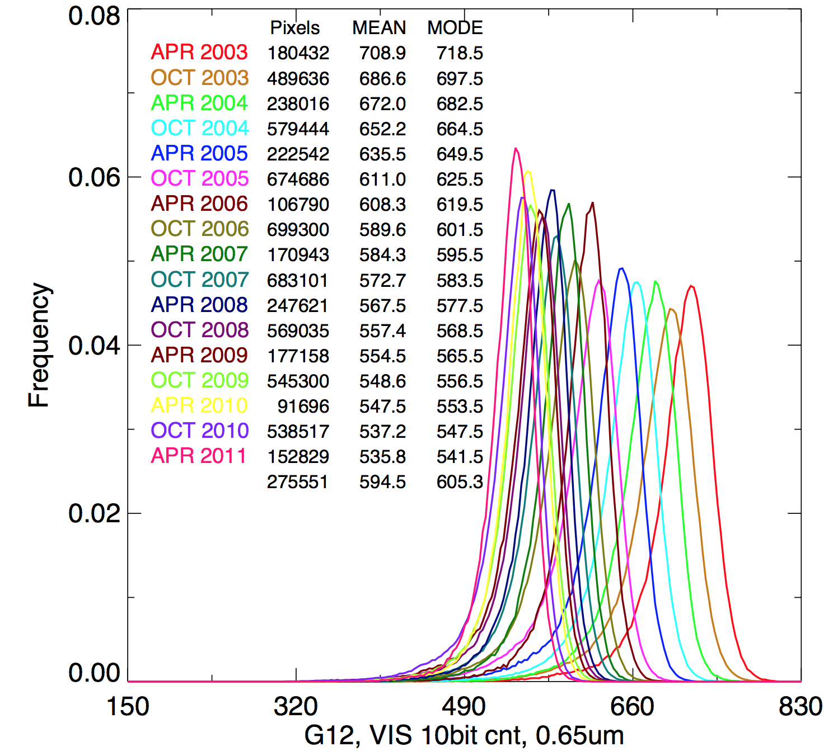
Baseline DCC method
SNPP-VIIRS M5
Stable sensor
DCC are brightest, nearly Lambertian targets viewed by all satellites
DCC pixel selection criteria:
BT_{11μm} < 205.0°K, SZA < 40°, VZA < 40°, 10° < RAA < 170°, σ(BT11μm) < 1.0° K, and σ(VIS) <3%
Anisotropic correction using Hu model.
DCC pixels are compiled into monthly probability distribution functions (PDFs) and their modes are tracked over time.
Suitable for wavelengths <1 μm
At SWIR wavelengths,
DCC reflectivity is affected by ice particle size
larger ice particles are more absorbing
results in large seasonal cycles
DCC response is highly dependent on the IR BT threshold
Frequency
SNPP-VIIRS M11
Stable, but
seasonality
GOES-12 VIS
Degrading sensor
Frequency
Frequency
DCC radiance)
DCC radiance)

Slide 5
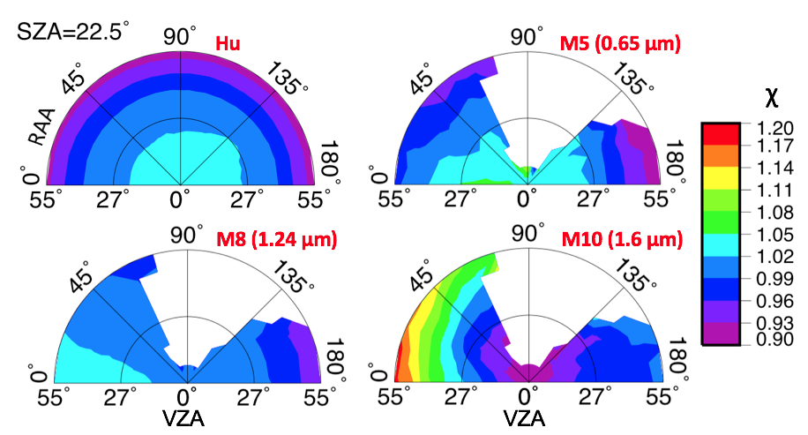
Improved DCC method for SWIR bands
Proper seasonal characterization of DCC allows the extension of DCC method to calibrate SWIR channels
Channel-specific BRDFs are constructed using the SNPP-VIIRS DCC samples from 2012-2016
Pixel-level DCC reflectance values are partitioned into angular bins
Angular discretization:
VZA and SZA range from 0-55° with a 5° step size
RAA varies from 0-180° at 10° intervals
For each SZA bin, albedo is computed by integrating reflectance values by the solid angle defined by VZA and RAA bin
BRDF factor (χ) is the ratio of the bin reflectance to the albedo
VIS-NIR BRDFs are similar to Hu model
SWIR band BRDFs are unique and wavelength-dependent

Slide 6
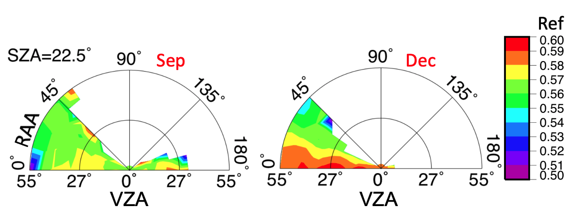
Seasonal BRDF models
1.38μm band
DCC BRDF reflectance also shows seasonal dependencies in both forward and backward scattering
Monthly DCC BRDFs are proposed for SWIR bands
DCC pixels are corrected for anisotropy by normalizing to a single set of angular condition:
ρ_{corrected} = ρ_{observed} * BRF

Slide 7
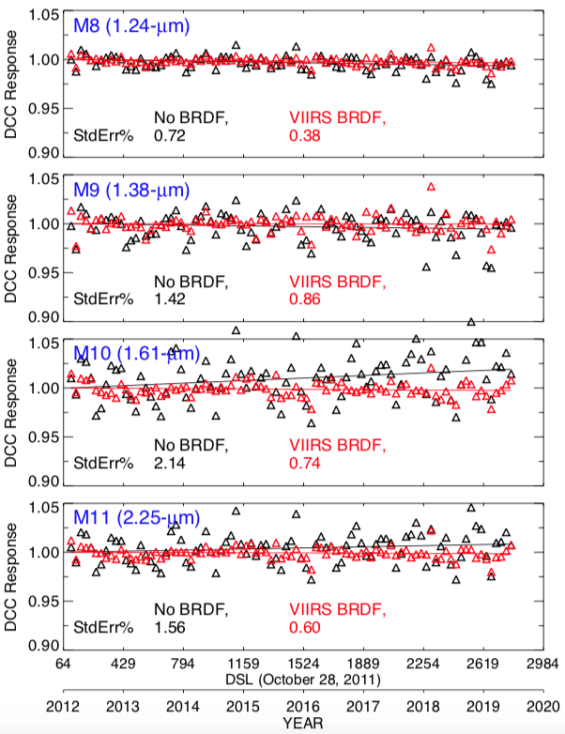
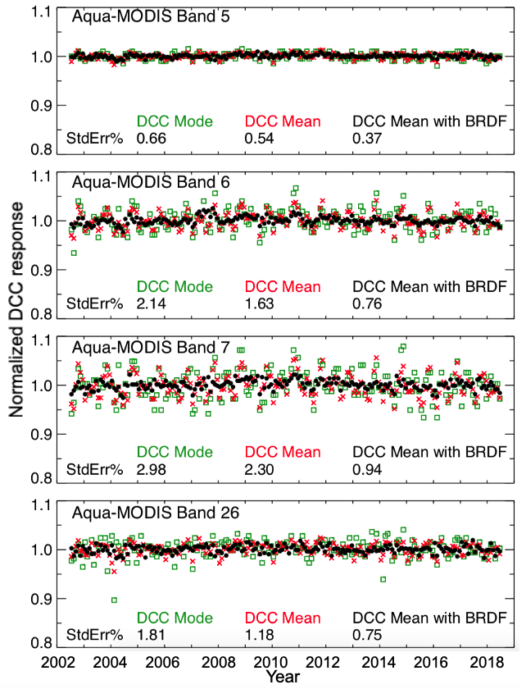
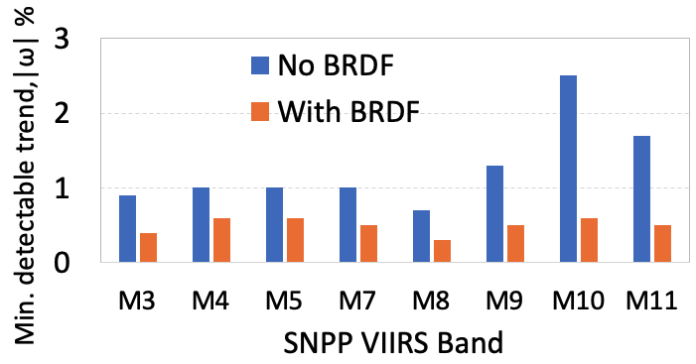
Effectiveness of SWIR bands seasonal BRDFs
SNPP-VIIRS
Aqua-MODIS
VIIRS-based BRDF models are applicable to Aqua-MODIS bands too
For SWIR bands, the monthly mean DCC reflectance is more stable than the PDF mode
Improved BRDF models reduce the SWIR band DCC temporal variability by up to 65%
DCC method can detect a sensor trend of <1%/decade in all reflective solar bands at a significance level of ⍺=0.05
1.24 μm
1.6 μm
2.1 μm
1.38 μm

Slide 8
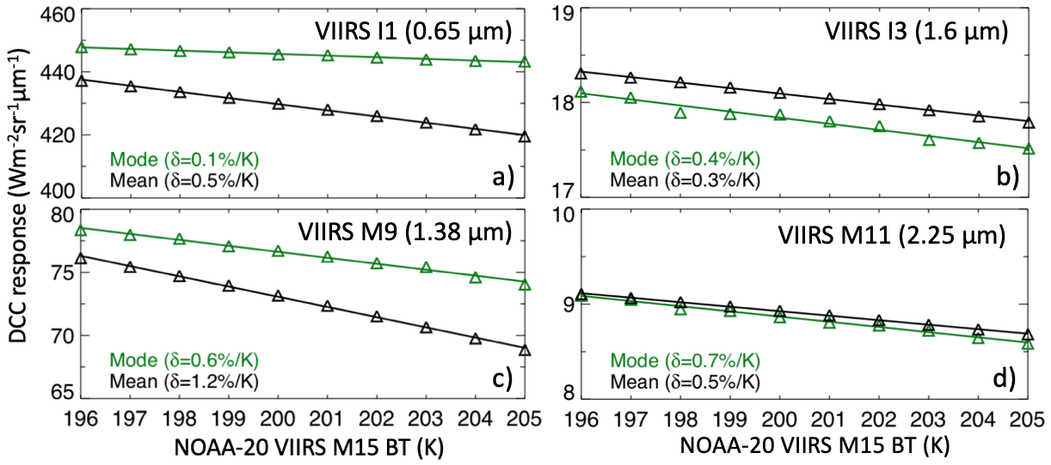
IR BT threshold sensitivity
Monthly mean and mode DCC reflectance increases with decreasing IR BT threshold
For all VIS-NIR bands, the mode statistics shows a greater stability with changing BT
SWIR bands DCC response exhibits a greater variation with BT drift
Cirrus band (1.38 μm) has the highest rate of DCC response change with BT threshold

Slide 9
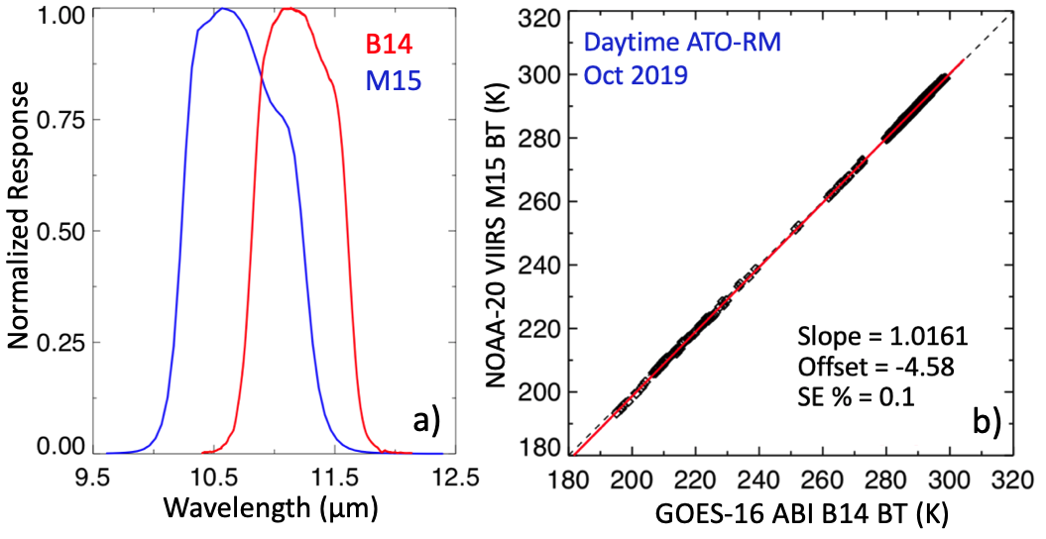
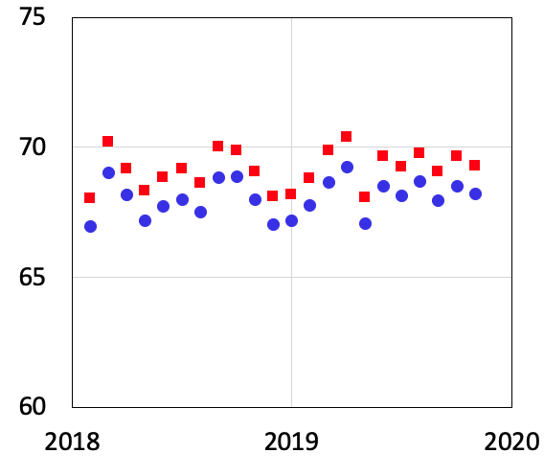
IR BT threshold sensitivity (contd.)
Stability of IR calibration is not an issue in modern LEO and GEO imagers
temporal stability assessments can be performed with high accuracy using DCC
Difference in IR channel spectral response functions can bias DCC inter-calibration results
ABI
VIIRS
NOAA-20 VIIRS M9 (1.38 μm)
DCC mean
BT threshold 205 K (Mean: 68.05)
BT threshold 203.7 (Mean: 69.15)
A DCC pixel with a BT of 205 K measured by GOES-16 ABI is recorded as 203.7 K by NOAA-20 VIIRS IR band.

Slide 10
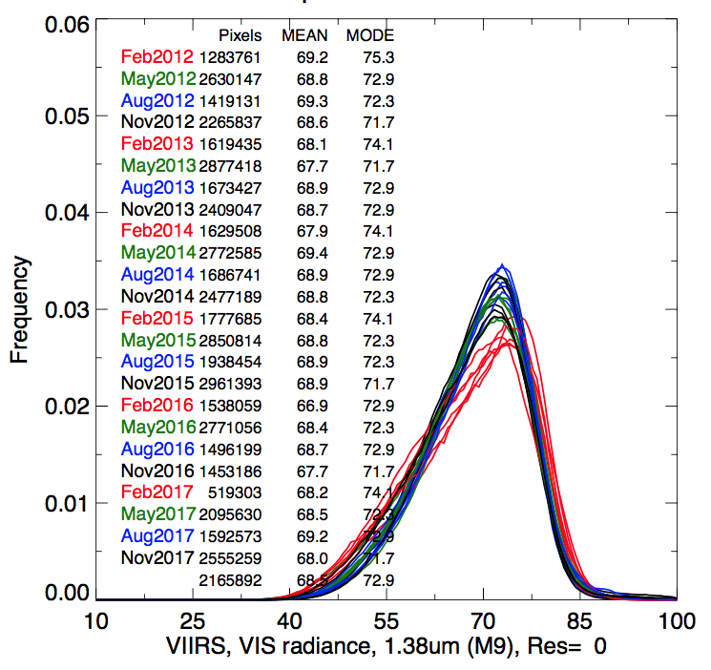
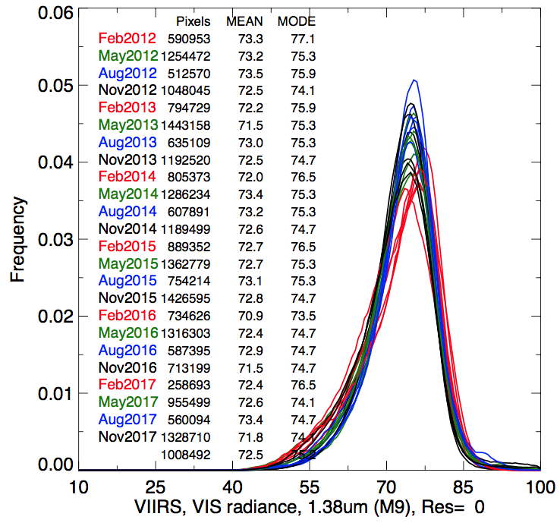
The Cirrus Channel (1.38 μm)
IR BT < 205.0K IR BT < 200.0K
The 1.38-µm channel is in a strong water vapor absorption band
Ground PICS are inapplicable for vicarious calibration
Radiation is mostly absorbed by atmosphere, except in the case of high-altitude ice clouds
Lowering the IR BT threshold improves the monthly PDF and reduces the temporal variability of the DCC response
optimal BT threshold =200 K
NPP-VIIRS M9 (1.38μm) Rad NPP-VIIRS M9 (1.38μm)
Temporal standard error from DCC time series
IR BT threshold

Slide 11
Inter-calibration using DCC method
No coincident measurements are required
Apply consistent DCC thresholds
Normalize DCC pixel reflectance values to a common set of angular conditions (use BRDF corrections)
Inter-sensor comparison is feasible using mean and mode
Inter-sensor SRF differences must be accounted for using SBAF

Slide 12
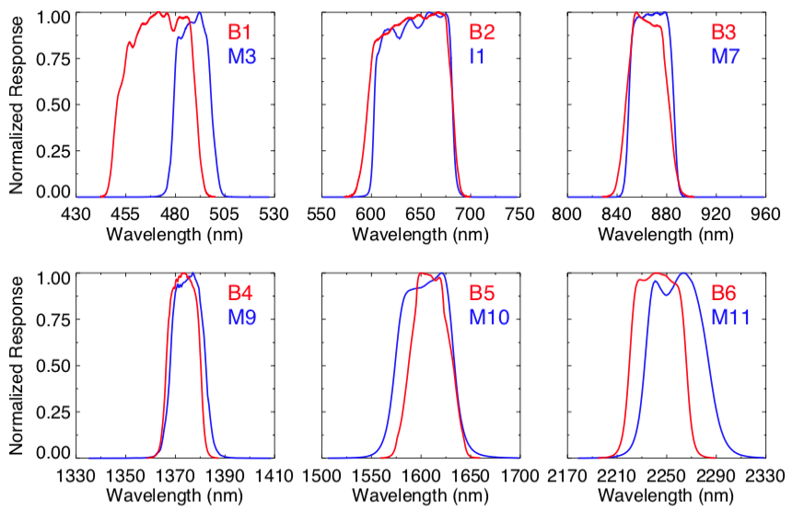
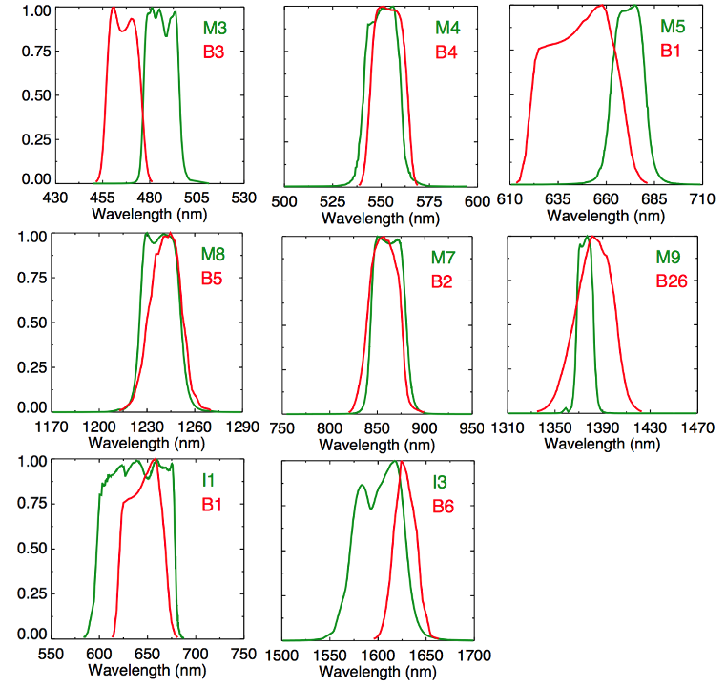
SRF differences and SBAF
NOAA-20 VIIRS and GOES-16 ABI
Aqua-MODIS and SNPP-VIIRS
GOES-16 ABI bands have better spectral matches with VIIRS
SRFs are similar for two VIIRS, but different than MODIS
Spectral corrections (using SCIAMACHY SBAF tool) are essential for inter-calibration

Slide 13
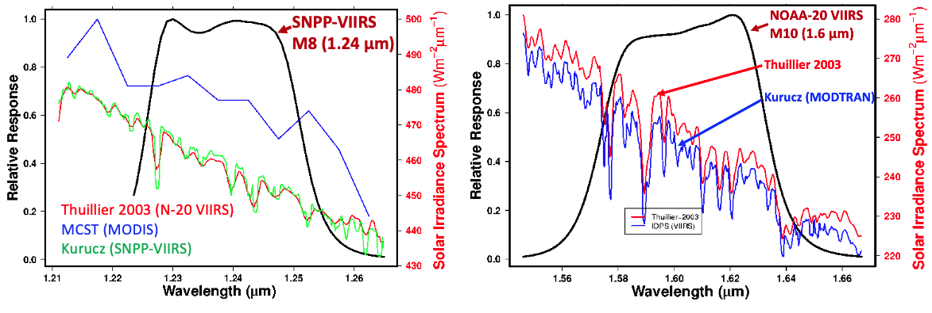
Radiance and Reflectance biases
4% difference in E_{sun} for 1.24-µm band
2.2% difference in E_{sun} for 1.6-µm band
Solar constant tool: https://cloudsway2.larc.nasa.gov/cgi-bin/site/showdoc?mnemonic=SOLAR-CONSTANT-COMPARISONS

Slide 14
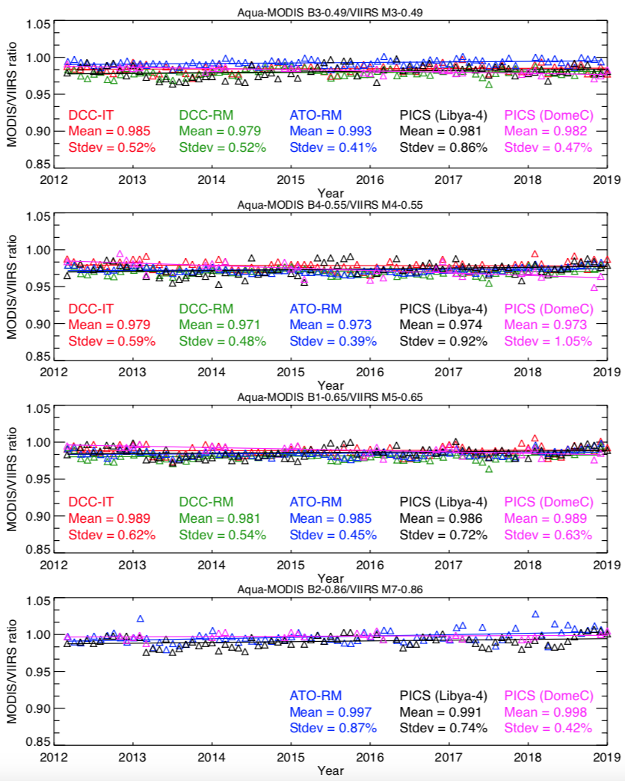
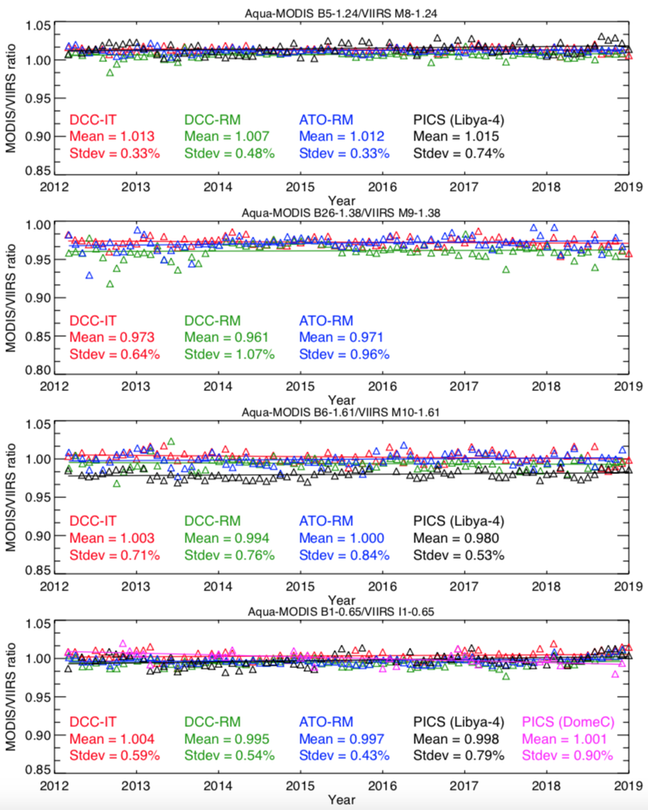
Results (Aqua-MODIS and SNPP-VIIRS)
MODIS B3/VIIRS M3 (0.49 µm)
MODIS B5/VIIRS M8 (1.24 µm)
MODIS B4/VIIRS M4 (0.55 µm)
MODIS B26/VIIRS M9 (1.38 µm)
MODIS B1/VIIRS M5 (0.65 µm)
MODIS B6/VIIRS M10 (1.6 µm)
MODIS B2/VIIRS M7 (0.86 µm)
MODIS B1/VIIRS I1 (0.65 µm)
DCC method is consistent with direct ray-matching approach within 1% for all RSB.

Slide 15
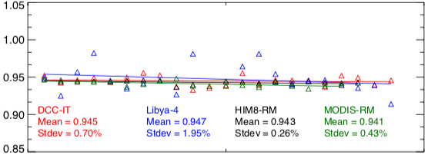
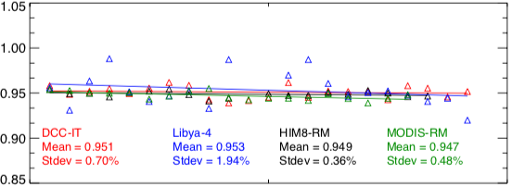
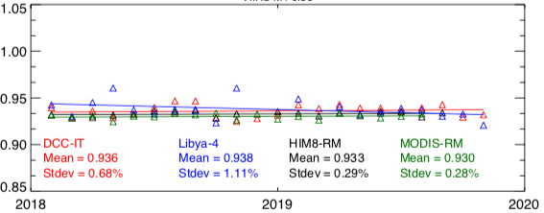
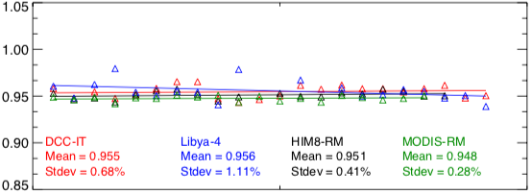
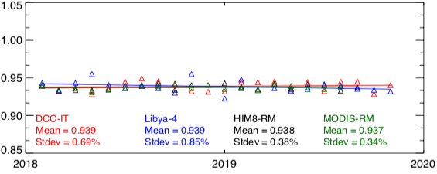
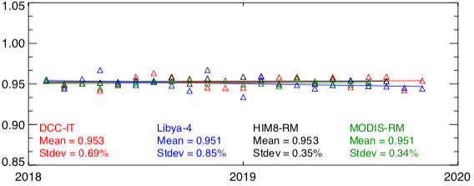
Results (SNPP-VIIRS and NOAA-20 VIIRS)
M3
M4
M5
Radiance
M3
M4
M5
Reflectance
NOAA-20/SNPP VIIRS Radiance
NOAA-20/SNPP VIIRS Reflectance
M4 radiance and reflectance biases differ by 2% (due to solar irradiance model difference)

Slide 16
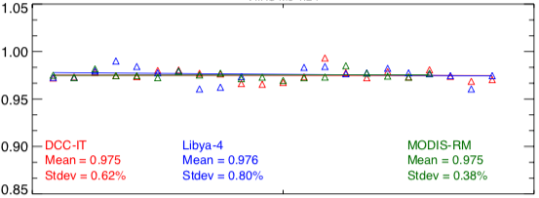
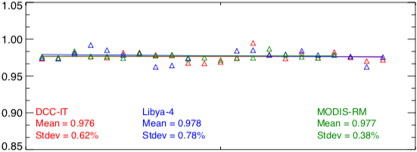
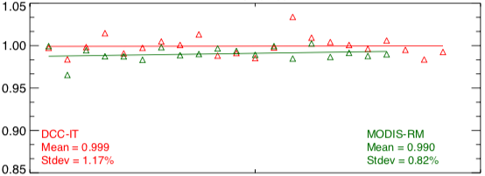
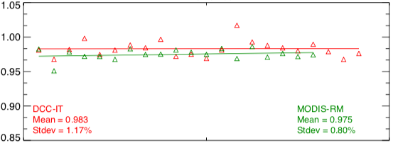
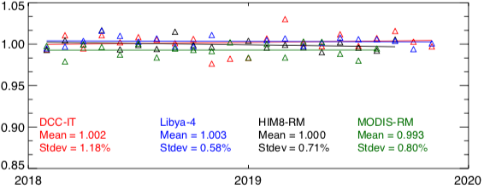
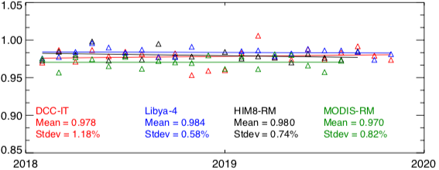
Results (SNPP-VIIRS and NOAA-20 VIIRS)
M8
M9
M10
Radiance
M8
M9
M10
Reflectance
NOAA-20/SNPP VIIRS Radiance
NOAA-20/SNPP VIIRS Reflectance
All methods agree within ~2%

Slide 17
Bias table (SNPP and NOAA-20 VIIRS)
Band | Radiometric bias 100% x (1-NOAA-20/SNPP)
 | HIM8 AHI RM | Aqua-MODIS RM | DCC-IT | Libya-4 PICS
M3 (0.48 µm) | +5.7 (+5.1) | +5.9 (+5.3) | +5.4 (+4.9) | +5.3 (+4.7)
M4 (0.55 µm) | +6.7 (+4.9) | +7.0 (+5.2) | +6.4 (+4.5) | +6.2 (+4.4)
M5 (0.65 µm) | +6.2 (+4.7) | +6.3 (+4.9) | +6.1 (+4.7) | +6.1 (+4.9)
I1 (0.65 µm) | +5.6 (+4.5) | +5.6 (+4.5) | +5.2 (+4.3) | +5.8 (+4.7)
M7 (0.86 µm) | +3.5 (+3.8) | +3.5 (+3.7) | +3.8 (+3.9) | +3.9 (+4.1)
M8 (1.24 µm) | NA | +2.5 (+2.3) | +2.5 (+2.4) | +2.4 (+2.2)
M9 (1.38 µm) | NA | +1.0 (+2.5) | +0.1 (+1.7) | NA
M10 (1.6 µm) | 0 (+2.0) | +0.7(+3.0) | -0.2(+2.2) | -0.3 (+1.6)
I3 (1.6 µm) | +2.1 (+4.5) | +2.6 (+4.8) | 2.0 (+4.6) | +3.3 (+4.6)
M11 (2.25 µm) | -1.7(+1.0) | NA | -1.0 (+1.7) | -1.7 (+1.1)
Reflectance biases are provided in parenthesis
‘+’ indicates SNPP-VIIRS is brighter

Slide 18
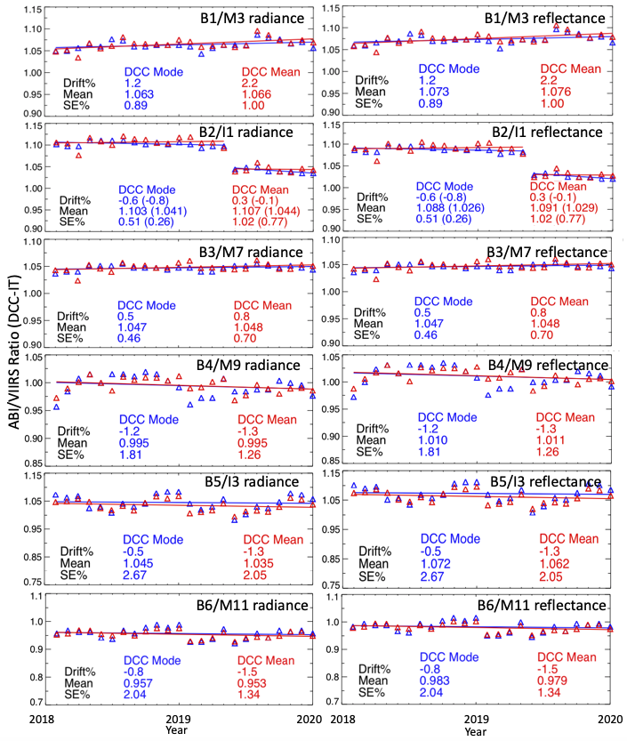
DCC inter-calibration between GOES-16 ABI and NOAA-20 VIIRS
DCC threshold used is 205 K for ABI and 203.7 K for VIIRS
Monthly modes are used for VIS-NIR bands
Mean statistics for SWIR bands
Hu BRDF for VIS-NIR bands
No BRDF applied to SWIR bands
VIIRS based BRDFs are inapplicable to GEO due to different angular samplings
GEO-specific DCC BRDF models are planned for future (collaborate with other GSICS members)
DCC biases were found in good agreement with those derived using ATO-RM
1-sigma uncertainty is within 2% (2.7% for 1.6 µm band)
R. Bhatt et al. “CERES strategy for uniformly calibrating the next generation geostationary visible imagers,” submitted to JARS Special Issue on INSTRUMENT CALIBRATION AND PRODUCT VALIDATION OF GOES-R

Slide 19
Conclusions
DCC are an excellent invariant target for post-launch radiometric calibration of satellite sensors.
Proper seasonal characterization of DCC allows the extension of DCCT to calibrate SWIR channels.
Detectability of temporal trend is significantly improved for SWIR bands using the DCC seasonal BRDFs
DCC can be referenced to a well-calibrated sensor (MODIS or VIIRS) for transferring absolute calibration to other GEO and LEO sensors.
DCC method allows absolute radiometric inter-comparison between multiple GEO and LEO imagers without the use of any coincident measurements.
Refined DCC calibration method can be applied for establishing radiometric uniformity among the new-generation GEO imagers datasets.

