Slide 1
Inter-comparison of NOAA-20 and Suomi-NPP ATMS Data
Ninghai SUNª, Hu “Tiger” YANG^{b}, *Robbie IACOVAZZIª, Quanhua “Mark” LIU^{c}
ªGST, Inc. Greenbelt, MD 20770 USA
^{b}UMD/ESSIC, College Park, MD 20740 USA
^{c}NOAA, NESDIS, STAR, College Park, MD 20740 USA
GSICS Microwave Subgroup “Virtual” Meeting
18 March 2020
*Presenter
Notes:
Acknowledge JPSS Program

Slide 2
Outline
NOAA-20 and S-NPP Advanced Technology Microwave Sounder (ATMS) data monitoring and analysis tools
NOAA-20 and S-NPP Data Comparisons
Instrument Noise
Geolocation Error
ATMS Antenna Temperature (Ta) TDR and/or Brightness Temperature (Tb) SDR Biases
Summary

Slide 3
NOAA-20 and S-NPP ATMS data monitoring and analysis tools
Tracking and trending ATMS measurements is critical to ensuring data quality for use in NOAA numerical weather prediction and climate analysis.
NOAA has established a web-based Integrated Calibration/Validation System in part to fulfill this need (https://www.star.nesdis.noaa.gov/icvs/).
Current short- and long-term tracking an trending methods for ATMS
*Engineering, calibration, and data-quality flag parameters
*Geolocation error determined with the coastline method
Ta (TDR) and/or Tb (SDR) biases determined using various methods
*Generates NOAA-20 and S-NPP ATMS data quality comparison results.

Slide 4
Methods to Monitor TDR and/or SDR Biases
Observed- and Community Radiative Transfer Model (CRTM)-simulated background (O-B) Ta and/or Tb biases computed separately using NWP output and Radio-occultation soundings
Inter-satellite simultaneous nadir overpass (SNO) Ta inter-comparisons with AMSU-A
*Inter-satellite Ta and/or Tb 32-day running-mean difference
*Inter-satellite O-B Ta/Tb bias double difference
*Generates NOAA-20 and S-NPP ATMS data quality comparison results.

Slide 5
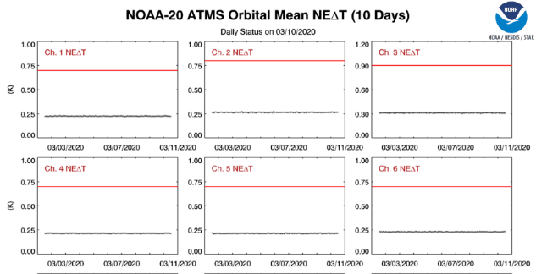
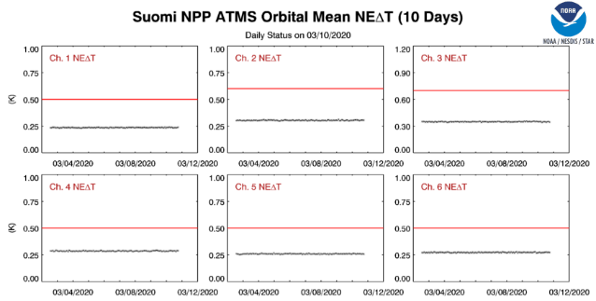
NOAA-20 and S-NPP ATMS data comparisons
Engineering, calibration, and data-quality flag parameters – Instrument Noise (Channel 1-6)
Smaller ΝΕΔΤ

Slide 6
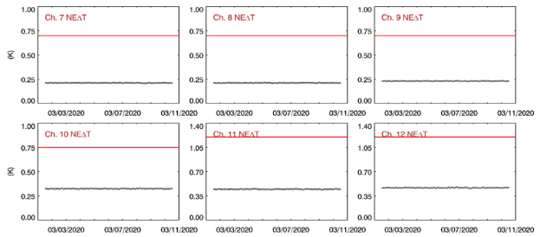
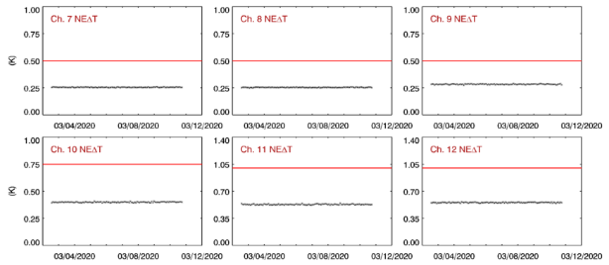
NOAA-20 and S-NPP ATMS data comparisons
Engineering, calibration, and data-quality flag parameters – Instrument Noise (Channel 7-12)
Smaller ΝΕΔΤ

Slide 7
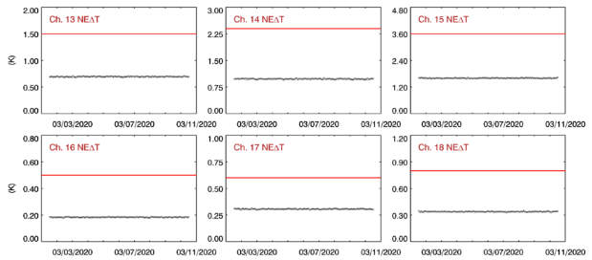
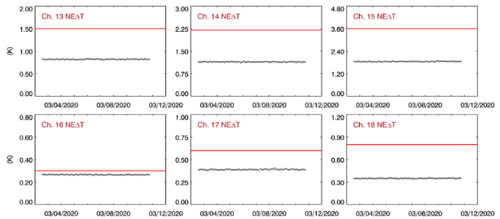
NOAA-20 and S-NPP ATMS data comparisons
Engineering, calibration, and data-quality flag parameters – Instrument Noise (Channel 13-18)
Smaller ΝΕΔΤ

Slide 8
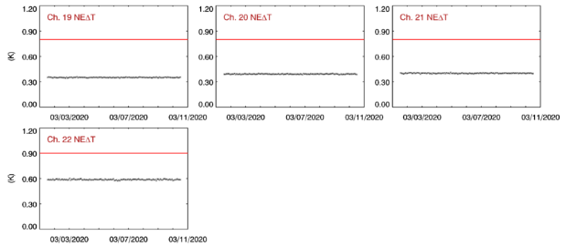
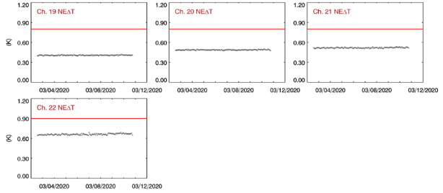
NOAA-20 and S-NPP ATMS data comparisons
Engineering, calibration, and data-quality flag parameters – Instrument Noise (Channel 19-22)
Smaller ΝΕΔΤ
NOAA-20 ATMS has <20% smaller noise than S-NPP
S-NPP and NOAA-20 ATMS have stable noise characteristics

Slide 9
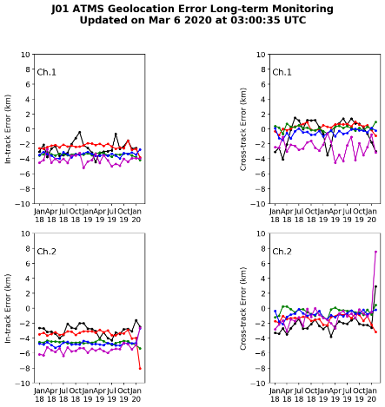
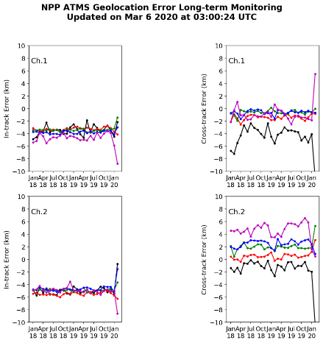
NOAA-20 and S-NPP ATMS data comparisons
Geolocation Error (K and Ka Bands)
Smaller Geo Error Variability
K Band
Smaller Geo Error Variability but Larger Error
Large Geo Error
Ka Band
Large Geo Error Variability

Slide 10
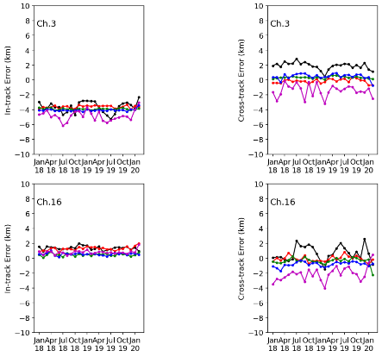
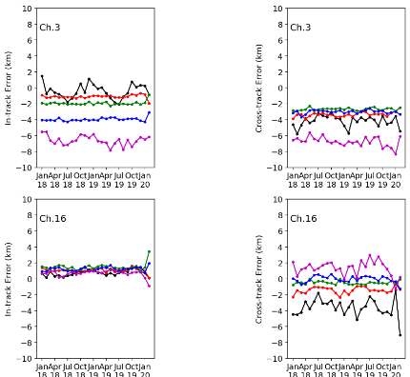
NOAA-20 and S-NPP ATMS data comparisons
Geolocation Error (V and W Bands)
Large Geo Error and Error Variability
V Band
W Band
NOAA-20 ATMS often has less absolute geolocation error and error variability than S-NPP ATMS
Note - G Band is too opaque to apply coastline method

Slide 11
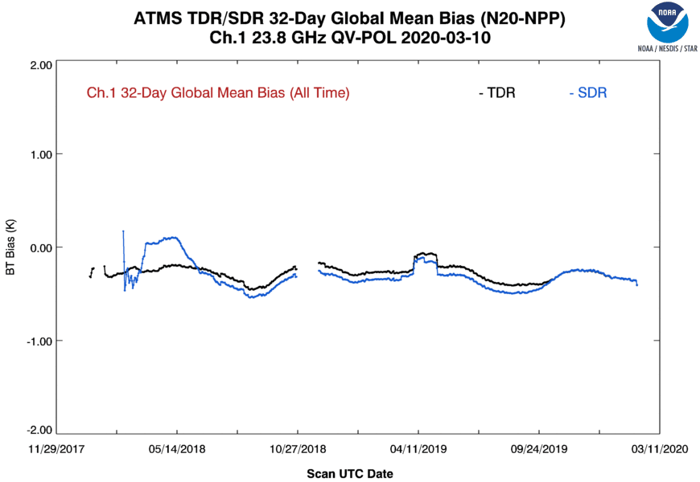
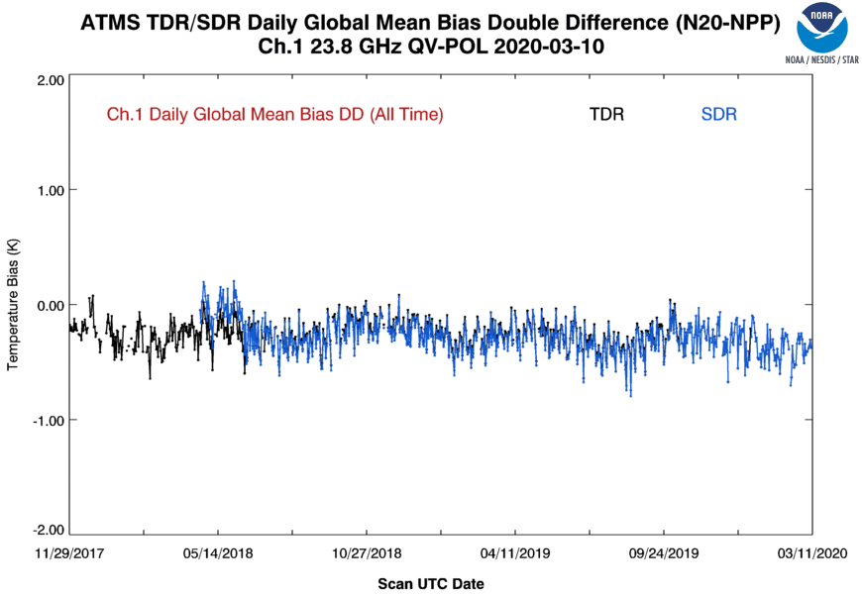
NOAA-20 and S-NPP ATMS data comparisons
ATMS Ta (TDR) and/or Tb (SDR) Biases (Channel 1)
TDR-SDR Bias mismatch.
Possible seasonal cycle.
Negative bias (~-0.25 K) for both TDR and SDR
Possible seasonal cycle in 32-day running-mean global mean bias difference
SDR has a larger magnitude bias until October 15, 2019 software patch to implement reflector emission correction and NPP antenna pattern coefficients update.

Slide 12
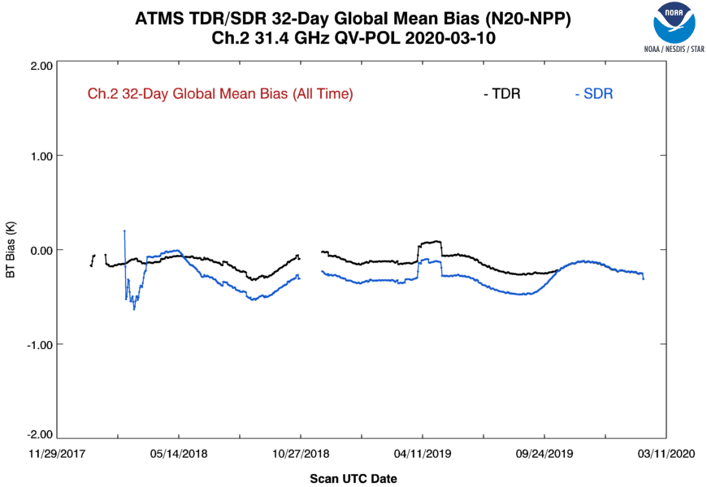
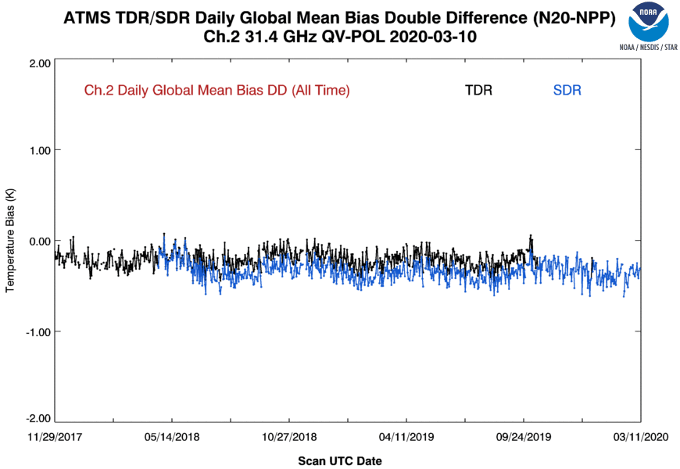
NOAA-20 and S-NPP ATMS data comparisons
ATMS Ta (TDR) and/or Tb (SDR) Biases (Channel 2)
Possible seasonal cycle.
Negative bias (~-0.20 K) for both TDR and SDR
Possible seasonal cycle in 32-day running-mean global mean bias difference
SDR has a larger magnitude bias until October 15, 2019 software patch to implement reflector emission correction and NPP antenna pattern coefficients update.

Slide 13
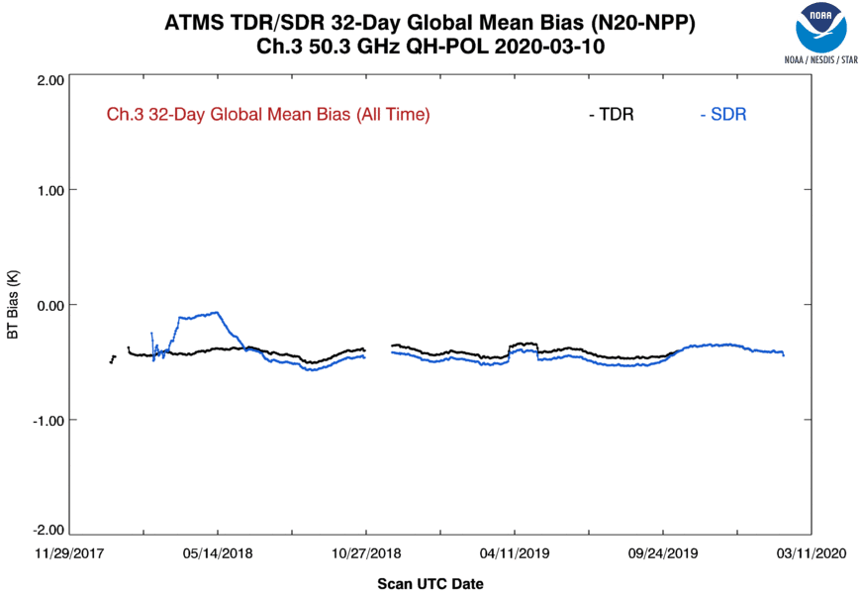
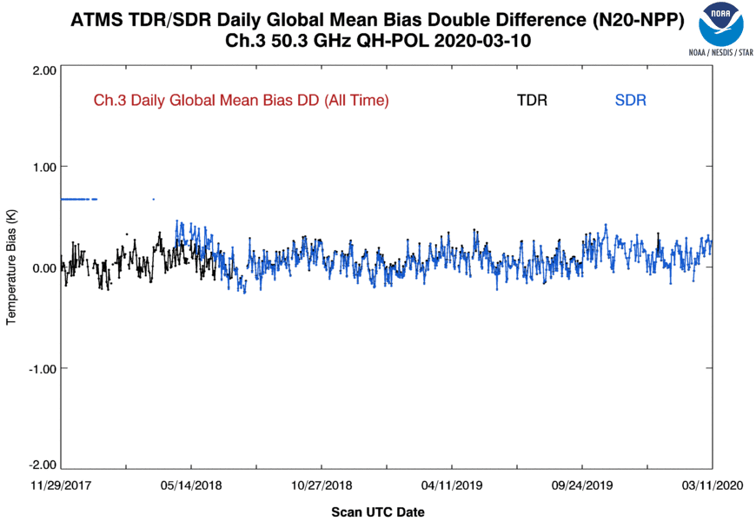
NOAA-20 and S-NPP ATMS data comparisons
ATMS Ta (TDR) and/or Tb (SDR) Biases (Channel 3)
Bias mismatch.
Negative bias (~-0.30 K) for both TDR and SDR for 32-day running mean, but double-difference of ECMWF O-B measurements shows a near zero bias.
SDR has a larger magnitude bias until October 15, 2019 software patch to implement reflector emission correction and NPP antenna pattern coefficients update.

Slide 14
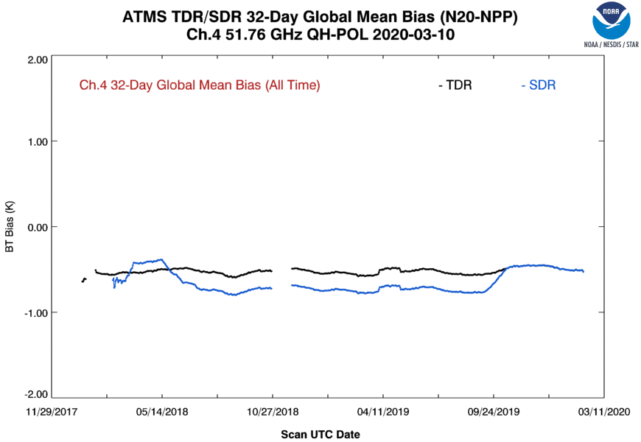
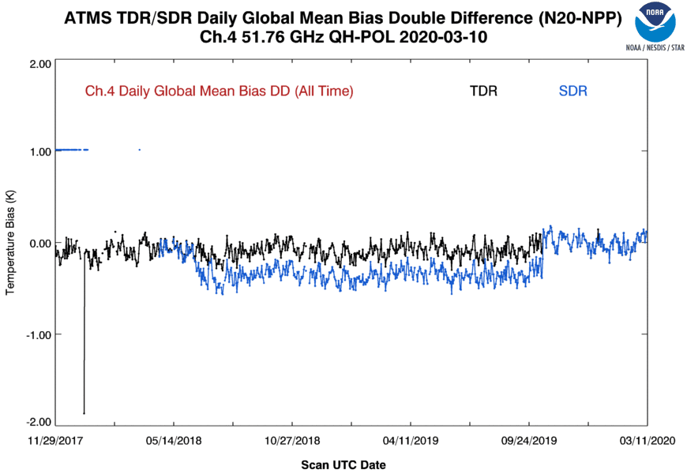
NOAA-20 and S-NPP ATMS data comparisons
ATMS Ta (TDR) and/or Tb (SDR) Biases (Channel 4)
Bias mismatch.
Negative bias (~0.50 K) for both TDR and SDR for 32-day running mean, but double-difference of ECMWF O-B measurements shows a near zero bias.
SDR has a larger magnitude bias until October 15, 2019 software patch to implement reflector emission correction and NPP antenna pattern coefficients update.

Slide 15
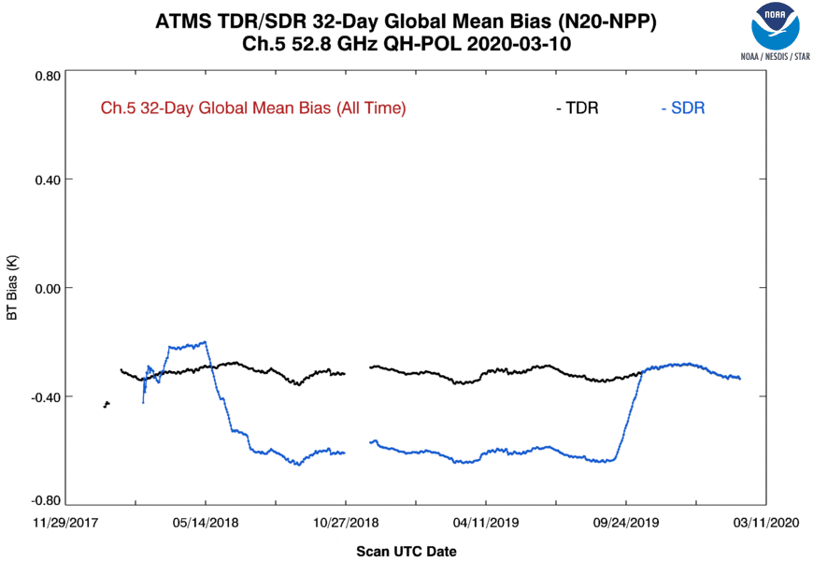
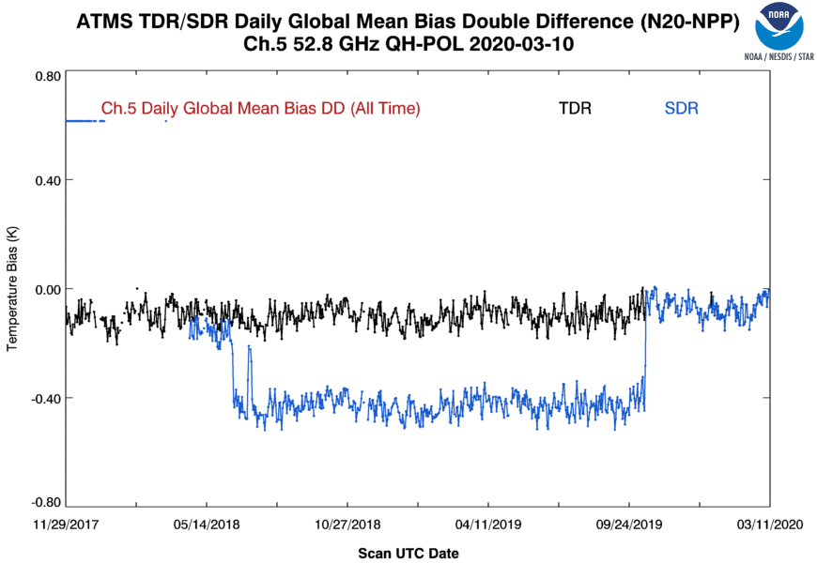
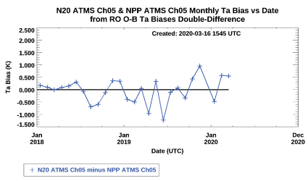
NOAA-20 and S-NPP ATMS data comparisons
ATMS Ta (TDR) and/or Tb (SDR) Biases (Channel 5)
Large variance due to relatively small population and surface contamination.
Bias mismatch.
Negative bias (~0.35 K) for 32-day running mean, but double-difference of ECMWF and RO O-B measurements show a near zero bias. Note that RO results are TDR only.
Double difference from RO has larger variance due to lower sampling and surface contamination.
SDR has a larger magnitude bias until October 15, 2019 software patch to implement reflector emission correction and NPP antenna pattern coefficients update.

Slide 16
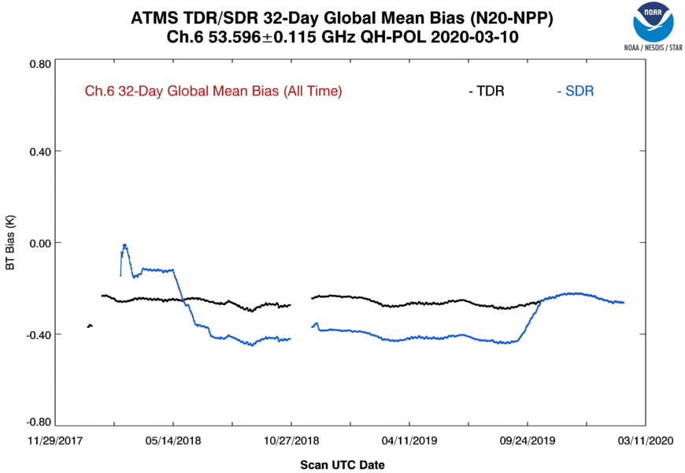
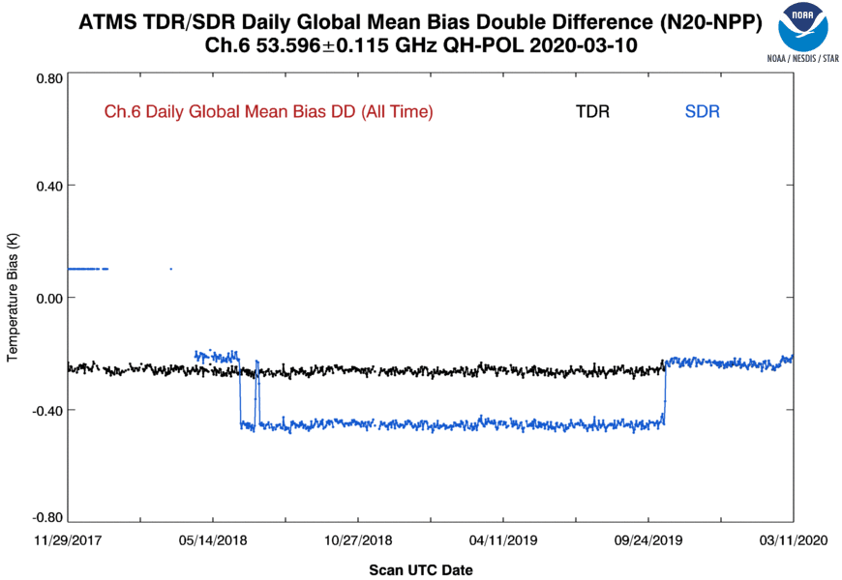
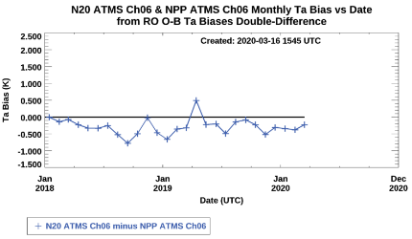
NOAA-20 and S-NPP ATMS data comparisons
ATMS Ta (TDR) and/or Tb (SDR) Biases (Channel 6)
Negative bias (~-0.3 K) for 32-day running mean, and double-difference of ECMWF and RO O-B measurements. Note that RO results are TDR only.
Double difference from RO has larger variance due to lower sampling and surface contamination.
SDR has a larger magnitude bias until October 15, 2019 software patch to implement reflector emission correction and NPP antenna pattern coefficients update.

Slide 17
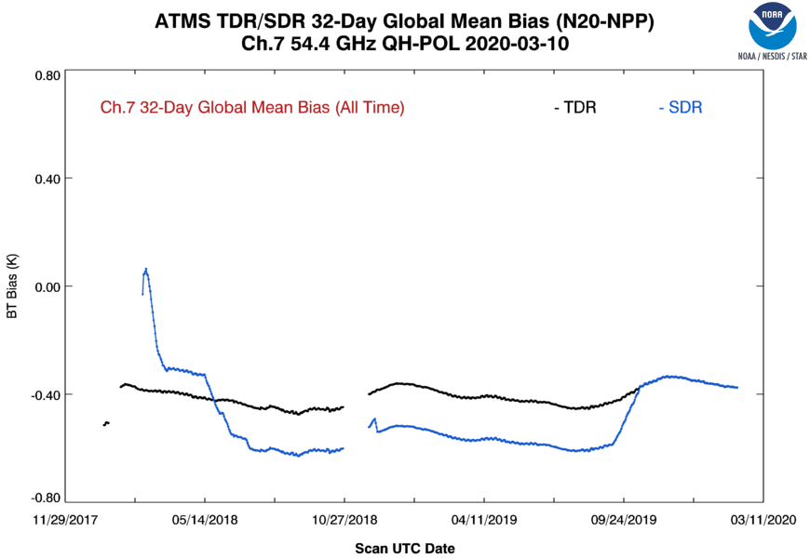
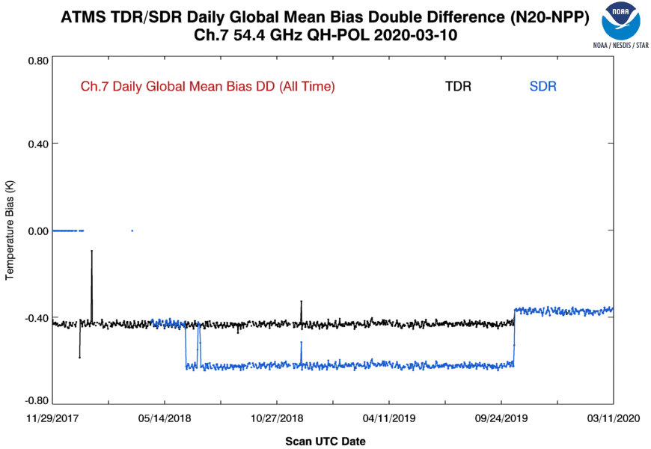
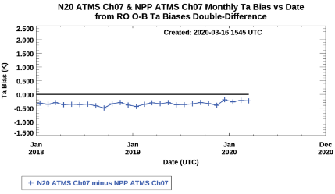
NOAA-20 and S-NPP ATMS data comparisons
ATMS Ta (TDR) and/or Tb (SDR) Biases (Channel 7)
Possible seasonal cycle.
Negative bias (~-0.35 K) for 32-day running mean, and double-difference of ECMWF and RO O-B measurements. Note that RO results are TDR only.
Possible seasonal cycle in 32-day running-mean global mean bias difference
Double difference from RO has larger variance due to lower sampling.
SDR has a larger magnitude bias until October 15, 2019 software patch to implement reflector emission correction and NPP antenna pattern coefficients update.

Slide 18
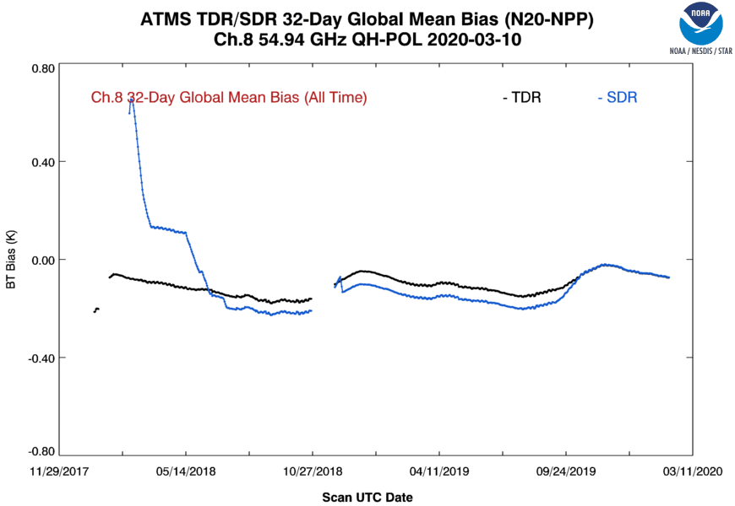
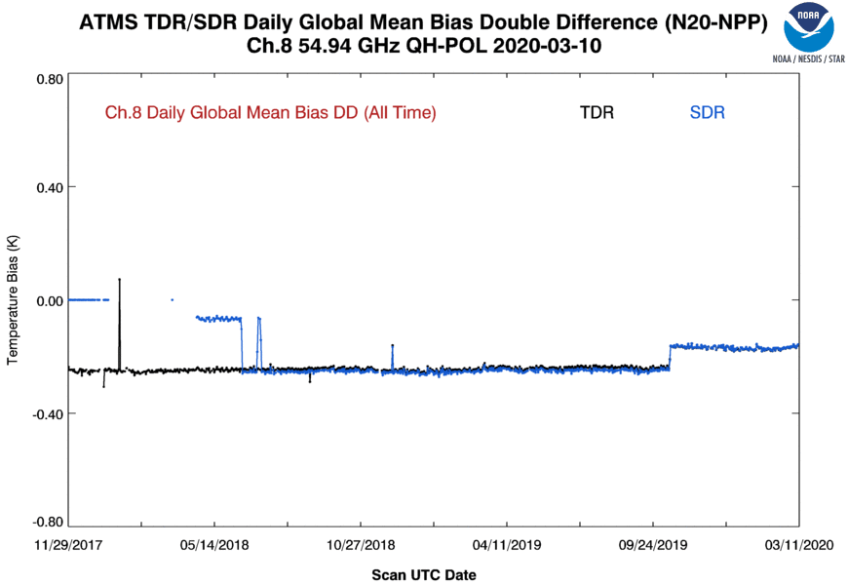
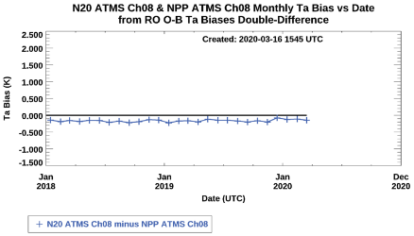
NOAA-20 and S-NPP ATMS data comparisons
ATMS Ta (TDR) and/or Tb (SDR) Biases (Channel 8)
Negative bias (~-0.2 K) for 32-day running mean, and double-difference of ECMWF and RO O-B measurements. Note that RO results are TDR only.
Possible seasonal cycle in 32-day running-mean global mean bias difference
Double difference from RO has larger variance due to lower sampling.
SDR has a larger magnitude bias until October 15, 2019 software patch to implement reflector emission correction and NPP antenna pattern coefficients update.

Slide 19
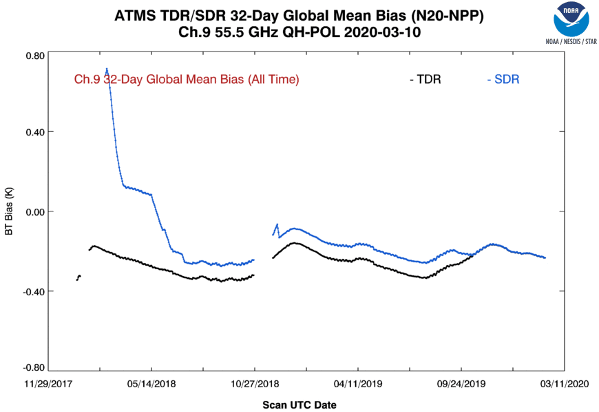
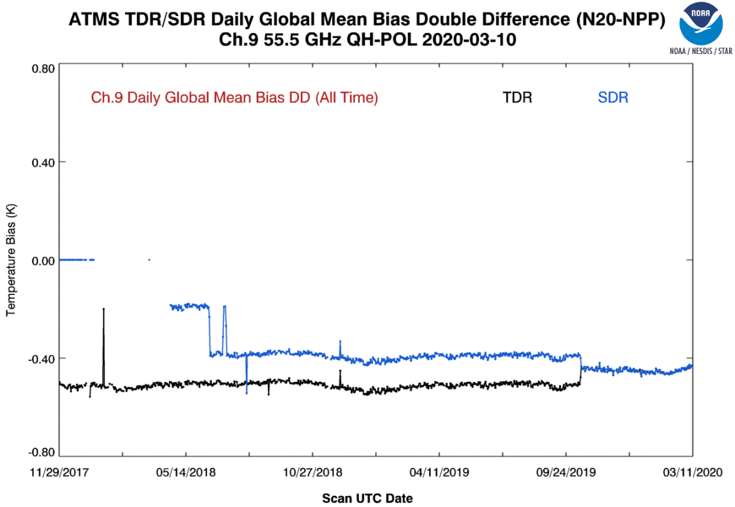
NOAA-20 and S-NPP ATMS data comparisons
ATMS Ta (TDR) and/or Tb (SDR) Biases (Channel 9)
Negative bias (~-0.35 K) for 32-day running mean, and double-difference of ECMWF and RO O-B measurements. Note that RO results are TDR only.
Possible seasonal cycle in 32-day running-mean global mean bias difference
Double difference from RO has larger variance due to lower sampling.
SDR has a larger magnitude bias until October 15, 2019 software patch to implement reflector emission correction and NPP antenna pattern coefficients update.

Slide 20
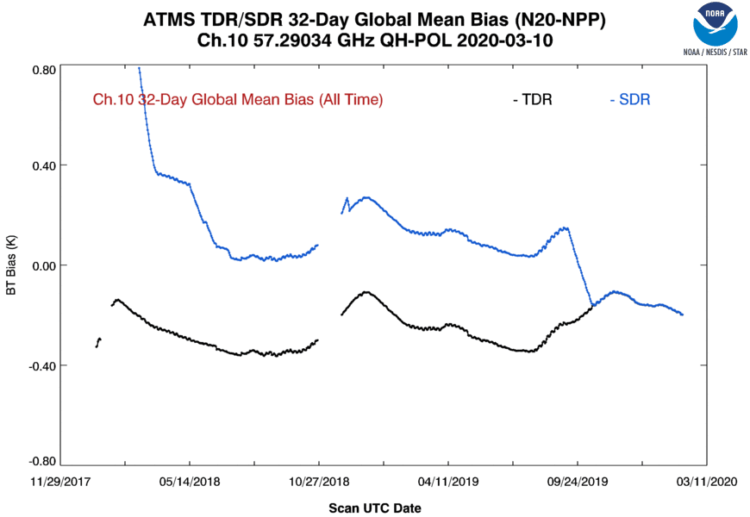
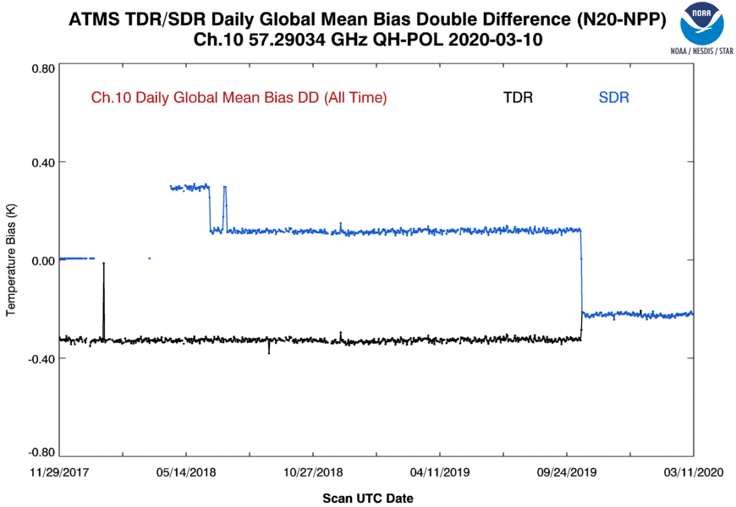
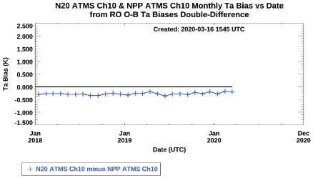
NOAA-20 and S-NPP ATMS data comparisons
ATMS Ta (TDR) and/or Tb (SDR) Biases (Channel 10)
Negative bias (~-0.25 K) for 32-day running mean, and double-difference of ECMWF and RO O-B measurements. Note that RO results are TDR only.
Possible seasonal cycle in 32-day running-mean global mean bias difference
Double difference from RO has larger variance due to lower sampling.
SDR has a larger magnitude bias until October 15, 2019 software patch to implement reflector emission correction and NPP antenna pattern coefficients update.

Slide 21
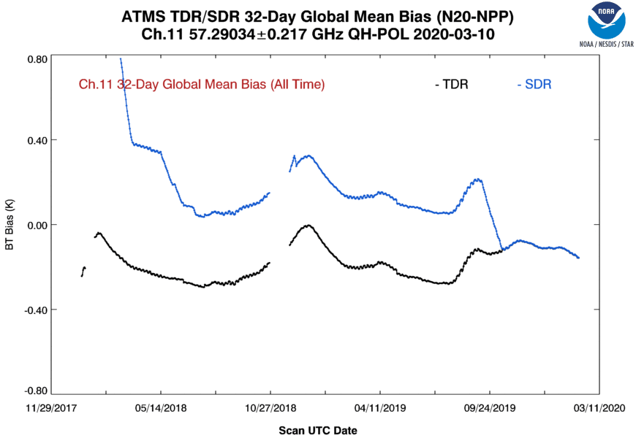
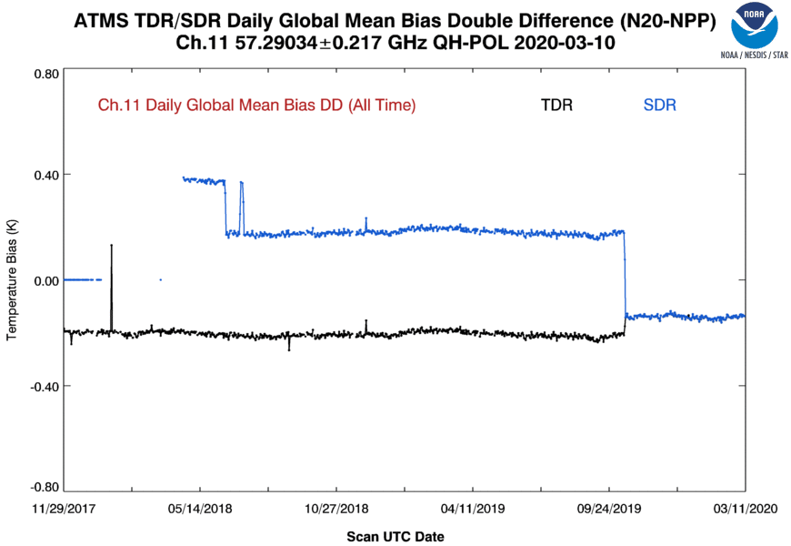
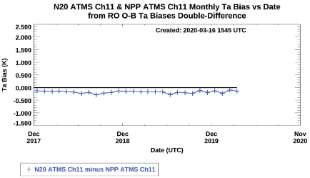
NOAA-20 and S-NPP ATMS data comparisons
ATMS Ta (TDR) and/or Tb (SDR) Biases (Channel 11)
Negative bias (~-0.15 K) for 32-day running mean, and double-difference of ECMWF and RO O-B measurements. Note that RO results are TDR only.
Possible seasonal cycle in 32-day running-mean global mean bias difference
Double difference from RO has larger variance due to lower sampling.
SDR has a larger magnitude bias until October 15, 2019 software patch to implement reflector emission correction and NPP antenna pattern coefficients update.

Slide 22
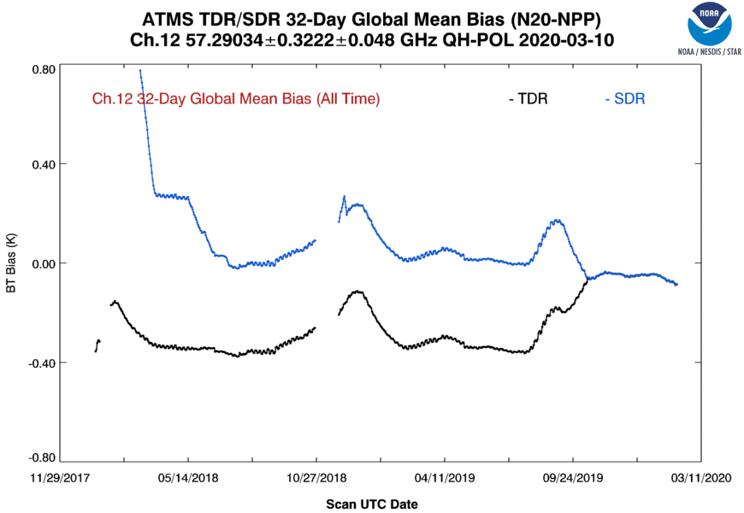
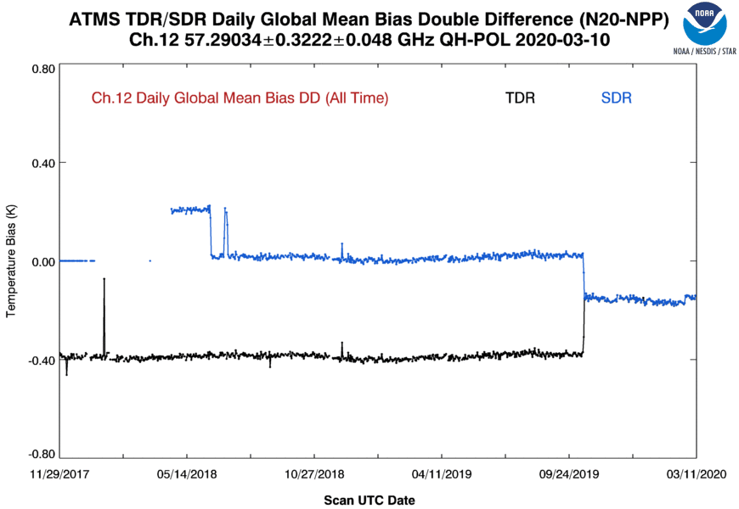
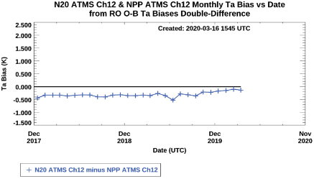
NOAA-20 and S-NPP ATMS data comparisons
ATMS Ta (TDR) and/or Tb (SDR) Biases (Channel 12)
Negative bias (~-0.15 K) for 32-day running mean, and double-difference of ECMWF and RO O-B measurements. Note that RO results are TDR only.
Possible seasonal cycle in 32-day running-mean global mean bias difference
Double difference from RO has larger variance due to lower sampling.
SDR has a larger magnitude bias until October 15, 2019 software patch to implement reflector emission correction and NPP antenna pattern coefficients update.

Slide 23
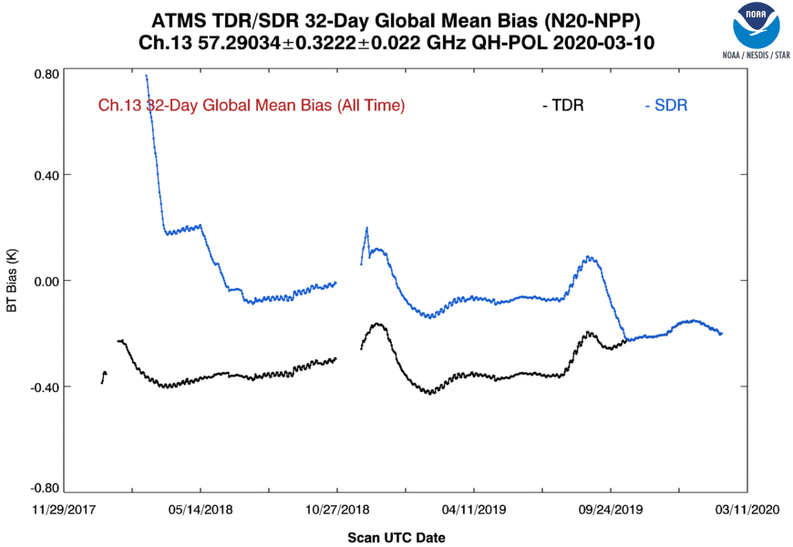
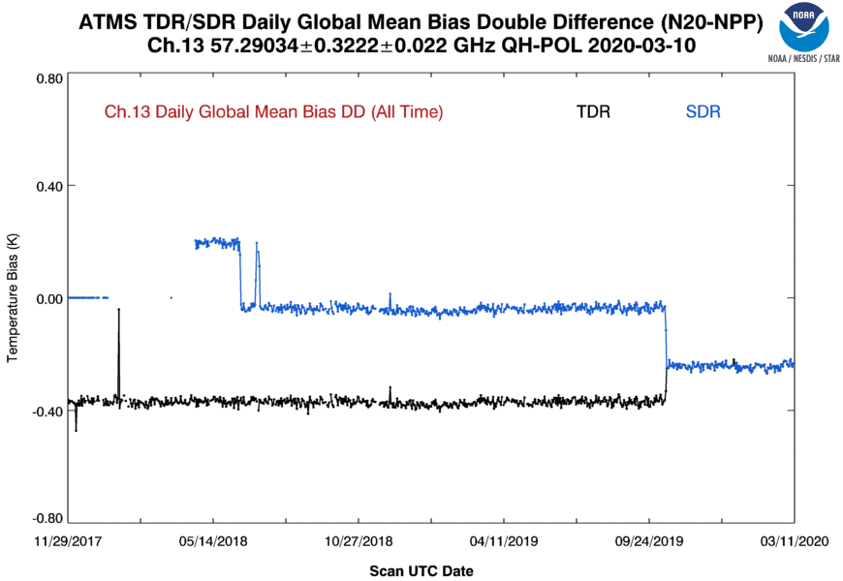
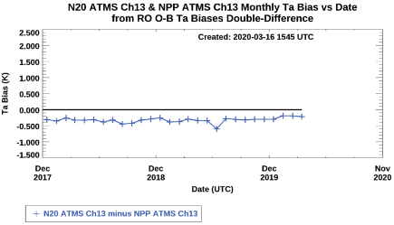
NOAA-20 and S-NPP ATMS data comparisons
ATMS Ta (TDR) and/or Tb (SDR) Biases (Channel 13)
Negative bias (~-0.30 K) for 32-day running mean, and double-difference of ECMWF and RO O-B measurements. Note that RO results are TDR only.
Possible seasonal cycle in 32-day running-mean global mean bias difference
Double difference from RO has larger variance due to lower sampling.
SDR has a larger magnitude bias until October 15, 2019 software patch to implement reflector emission correction and NPP antenna pattern coefficients update.

Slide 24
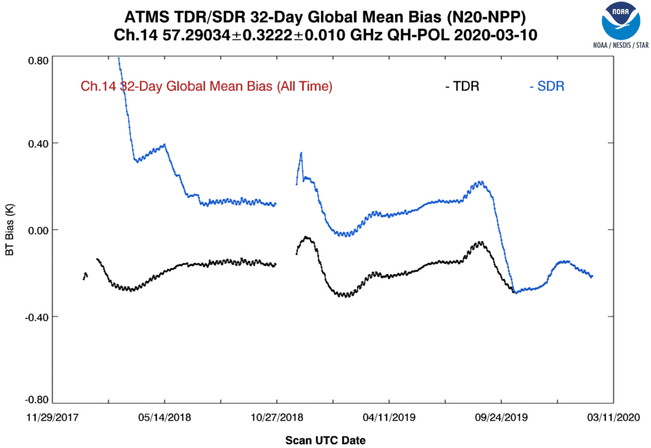
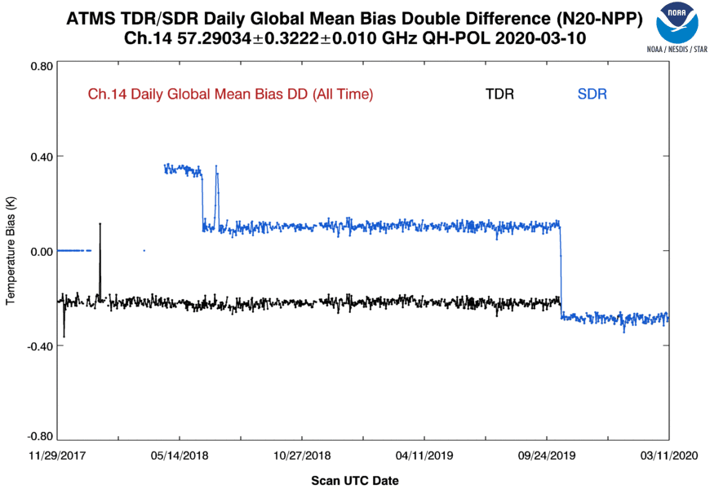
NOAA-20 and S-NPP ATMS data comparisons
ATMS Ta (TDR) and/or Tb (SDR) Biases (Channel 14)
Negative bias (~-0.30 K) for both TDR and SDR
Possible seasonal cycle in 32-day running-mean global mean bias difference
SDR has a larger magnitude bias until October 15, 2019 software patch to implement reflector emission correction and NPP antenna pattern coefficients update.

Slide 25
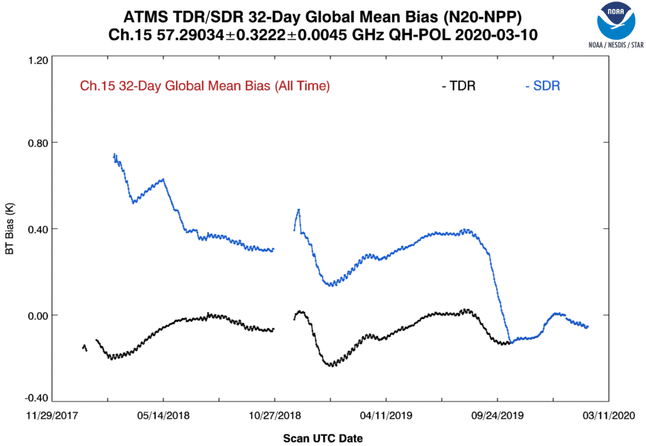
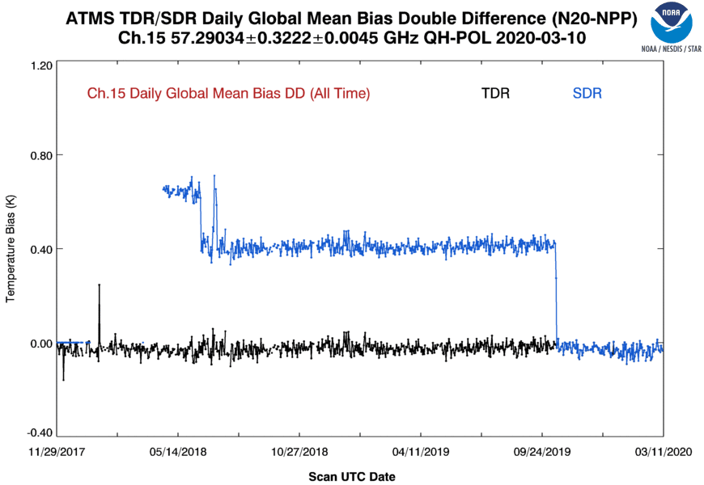
NOAA-20 and S-NPP ATMS data comparisons
ATMS Ta (TDR) and/or Tb (SDR) Biases (Channel 15)
Near zero bias for both TDR and SDR
Possible seasonal cycle in 32-day running-mean global mean bias difference
SDR has a larger magnitude bias until October 15, 2019 software patch to implement reflector emission correction and NPP antenna pattern coefficients update.

Slide 26
NOAA-20 and S-NPP ATMS data comparisons
ATMS Ta (TDR) and/or Tb (SDR) Biases (Channel 16)
Negative bias (~-0.15 K) for 32-day running mean, double-difference of ECMWF O-B measurements shows a 0.15 K positive bias.
Possible seasonal cycle in 32-day running-mean global mean bias difference
SDR has a larger magnitude bias until October 15, 2019 software patch to implement reflector emission correction and NPP antenna pattern coefficients update.

Slide 27
NOAA-20 and S-NPP ATMS data comparisons
ATMS Ta (TDR) and/or Tb (SDR) Biases (Channel 17)
Substantial bias mismatch.
Negative bias (~-0.90 K) for 32-day running mean, double-difference of ECMWF O-B measurements shows a near zero bias.
Possible seasonal cycle in 32-day running-mean global mean bias difference
SDR has a larger magnitude bias until October 15, 2019 software patch to implement reflector emission correction and NPP antenna pattern coefficients update.

Slide 28
NOAA-20 and S-NPP ATMS data comparisons
ATMS Ta (TDR) and/or Tb (SDR) Biases (Channel 18)
Negative bias (~-0.80 K) for 32-day running mean, double-difference of ECMWF O-B measurements shows a bias of about -0.3.
SDR has a larger magnitude bias until October 15, 2019 software patch to implement reflector emission correction and NPP antenna pattern coefficients update.

Slide 29
NOAA-20 and S-NPP ATMS data comparisons
ATMS Ta (TDR) and/or Tb (SDR) Biases (Channel 19)
Negative bias (~-0.70 K) for 32-day running mean, double-difference of ECMWF O-B measurements shows a bias of about -0.3.
SDR has a larger magnitude bias until October 15, 2019 software patch to implement reflector emission correction and NPP antenna pattern coefficients update.

Slide 30
NOAA-20 and S-NPP ATMS data comparisons
ATMS Ta (TDR) and/or Tb (SDR) Biases (Channel 20)
Negative bias (~-0.50 K) for 32-day running mean, double-difference of ECMWF O-B measurements shows a bias of about -0.3.
SDR has a larger magnitude bias until October 15, 2019 software patch to implement reflector emission correction and NPP antenna pattern coefficients update.

Slide 31
NOAA-20 and S-NPP ATMS data comparisons
ATMS Ta (TDR) and/or Tb (SDR) Biases (Channel 21)
Negative bias (~-0.40 K) for 32-day running mean, double-difference of ECMWF O-B measurements shows a bias of about -0.2.
SDR has a larger magnitude bias until October 15, 2019 software patch to implement reflector emission correction and NPP antenna pattern coefficients update.

Slide 32
NOAA-20 and S-NPP ATMS data comparisons
ATMS Ta (TDR) and/or Tb (SDR) Biases (Channel 22)
Negative bias (~-0.30 K) for 32-day running mean, double-difference of ECMWF O-B measurements shows a bias of about -0.2.
SDR has a larger magnitude bias until October 15, 2019 software patch to implement reflector emission correction and NPP antenna pattern coefficients update.

Slide 33
Summary
Tracking and trending ATMS measurements is critical to ensuring data quality for use in NOAA numerical weather prediction and climate analysis.
NOAA-20 and S-NPP ATMS performance are compared using
Engineering, calibration, and data-quality flag parameters
Geolocation error determined with the coastline method
Inter-satellite Ta and/or Tb 32-day running-mean difference, or O-B Ta/Tb bias double difference
NOAA-20 and S-NPP ATMS Noise Comparison
NOAA-20 ATMS has <20% smaller noise than S-NPP
S-NPP and NOAA-20 ATMS have stable noise characteristics
NOAA-20 and S-NPP ATMS Geolocation Error Comparison
NOAA-20 ATMS often has less absolute geolocation error and error variability than S-NPP ATMS
NOAA-20 and S-NPP ATMS TDR and/or SDR Comparison
SDR has a larger magnitude bias until October 15, 2019 software patch to implement reflector emission correction and S-NPP antenna pattern coefficients update.
Biases are usually negative, and vary between about -0.15K and -0.9 K.
There can be large bias differences between the 32-day running mean difference, and those determined from the double-difference of ECMWF O-B measurements. Note that RO results are TDR only.
Possible seasonal cycle in 32-day running-mean global mean bias difference for many channels
Double difference from RO has larger variance due to lower sampling, and for some channels surface contamination.
Acknowledgements: Supported by the JPSS Program
Notes:
33
33

