Slide 1
JMA GSICS IR product status
Reference LEO data switch for AHI/IR: SNPP/CrIS(NSR) → SNPP/CrIS(FSR)
Uncertainty analysis for AHI-8
Meteorological satellite center, JMA
Arata Okuyama
(and Masaya Takahashi as outgoing member)

Slide 2
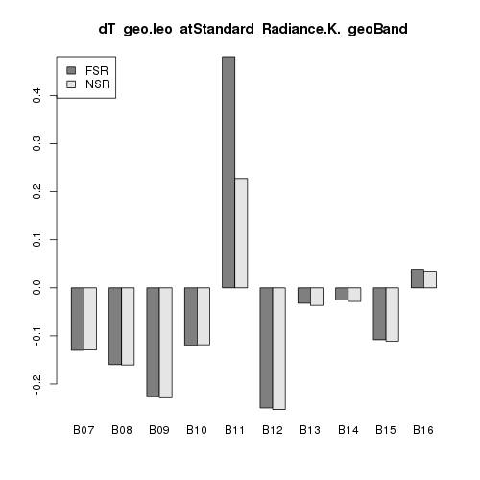
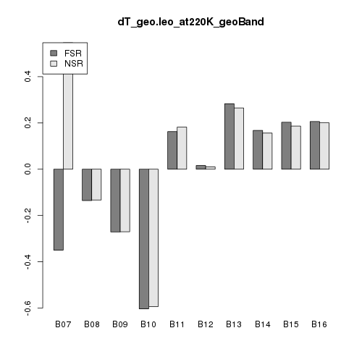
Reference LEO data switch
Reference LEO data for AHI inter-calibration will be switched in the end of April.
SNPP/CrIS(NSR) → SNPP/CrIS(FSR)
Differences of Tb bias computed from NSR and FSR are small except for B11 (8.6um) and for low-Tb of B07 (3.9um), e.g. ΔT@std.rad differences between NSR and FSR < 0.02 K
Uncertainty is large for these bands, due to wide gap channel and low radiance.
The inter-cal result for AHI vs. CrIS is on JMA’s web page only, not delivered to the GSICS data server for now.
[K]
FSR NSR
ΔT@std.rad
[K]
FSR NSR
ΔT@220K
0.4
0.4
0.0
0.0
-0.2
-0.6
3.9
6.2
6.9
7.3
8.6
9.6
10.4
11.2
12.4
13.3
3.9
6.2
6.9
7.3
8.6
9.6
10.4
11.2
12.4
13.3

Slide 3
Uncertainty analysis on AHI/IR inter-cal
Uncertainty analysis for AHI/IR is performed toward promotion to the Pre-Op phase based on (Hewison, 2013).
Systematic component and random component of uncertainty are computed from Δx (typical difference) and dL/dx (sensitivity) for each factors such as temporal mismatch and longitude mismatch.

Slide 4
Typical difference and sensitivity
Systematic component | Δx |  | ∂L/ ∂x [mW/m^2/Sr/cm^-1/deltaX]
 |  |  | B07 (3.9 um) | B08 (6.2 um) | B09 (6.9 um) | B10 (7.3 um) | B11 (8.6 um) | B12 (9.6 um) | B13 (10.4 um) | B14 (11.2 um) | B15 (12.4 um) | B16 (13.3 um)
Temporal Mismatch[hr] | 0.000706 |  | -0.00313 | -0.00290 | -0.00327 | -0.00051 | -0.06475 | -0.05735 | -0.07949 | -0.07893 | -0.05872 | -0.00409
Longitudinal Mismatch[km] | IASI | 1.119 | 0.00001 | -0.00013 | -0.00035 | -0.00048 | -0.00026 | 0.00016 | -0.00056 | -0.00086 | -0.00127 | -0.00096
 | AIRS | 0.628
 | CrIS | 0.383
Latitudinal Mismatch[km] | IASI | 1.106 | 0.00001 | -0.00003 | -0.00009 | -0.00018 | -0.00075 | -0.00049 | -0.00111 | -0.00121 | -0.00121 | -0.00091
 | AIRS | 0.616
 | CrIS | 0.370
Geometric Mismatch[deg] | 0.000506 |  | 0.02540 | 0.02551 | 0.02551 | 0.02551 | 0.02543 | 0.02543 | 0.02544 | 0.02544 | 0.02544 | 0.02545
Spectral Mismatch | IASI | 1 | 0 | 0 | 0 | 0 | 0 | 0 | 0 | 0 | 0 | 0
 | AIRS | 1 | 0.00015 | -0.00292 | -0.01204 | 0.00054 | -0.14843 | 0.00419 | -0.00793 | -0.01402 | -0.00079 | 0.00076
 | CrIS | 1 | 0.00237 | 0.00001 | 0.00000 | 0.00000 | -0.21112 | 0.00000 | 0.00000 | 0.00000 | 0.00000 | 0.00000
Spectral Calibration [ppm] | 2 |  | N/A | N/A | N/A | N/A | N/A | N/A | N/A | N/A | N/A | N/A
Systematic
Random component | Δx |  | ∂L/ ∂x [mW/m^2/Sr/cm^-1/deltaX]
 |  |  | B07 (3.9 um) | B08 (6.2 um) | B09 (6.9 um) | B10 (7.3 um) | B11 (8.6 um) | B12 (9.6 um) | B13 (10.4 um) | B14 (11.2 um) | B15 (12.4 um) | B16 (13.3 um)
Temporal Variability [min] | 5 |  | 0.041 | 0.092 | 0.270 | 0.527 | 2.446 | 1.855 | 3.593 | 3.880 | 3.824 | 2.987
Longitudinal Variability [km] | 2.130 |  | 0.015 | 0.029 | 0.087 | 0.174 | 0.847 | 0.639 | 1.238 | 1.323 | 1.286 | 0.990
Latitudinal Variability [km] | 2.181 |  | 0.016 | 0.029 | 0.086 | 0.170 | 0.861 | 0.649 | 1.249 | 1.326 | 1.284 | 0.975
Geometric Variability [deg] | 1 |  | 0.025 | 0.026 | 0.026 | 0.026 | 0.025 | 0.025 | 0.025 | 0.025 | 0.025 | 0.025
Radiometric Noise (GEO) | 1 |  | 0.001 | 0.002 | 0.005 | 0.005 | 0.008 | 0.011 | 0.018 | 0.015 | 0.022 | 0.056
Radiometric Noise (LEO) | IASI | 1 | 0.001 | 0.001 | 0.001 | 0.002 | 0.019 | 0.014 | 0.022 | 0.020 | 0.019 | 0.024
 | AIRS | 1 | 0.001 | 0.001 | 0.001 | 0.005 | 0.017 | 0.010 | 0.018 | 0.016 | 0.038 | 0.023
 | CrIS | 1 | 0.001 | 0.009 | 0.009 | 0.012 | 0.009 | 0.008 | 0.008 | 0.007 | 0.007 | 0.009
Random

Slide 5
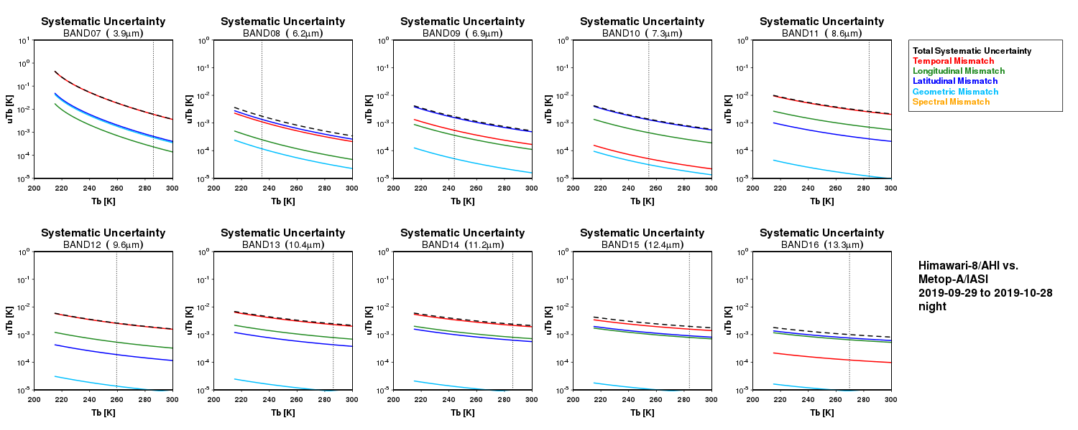
Systematic component (IASI/A, night)
Larger uncertainty in lower temperature
B07(3.9um) < 1K, Other bands ~ 0.01K
10⁺¹
10⁰
3.9
6.2
6.9
7.3
8.6
10⁻⁵
10⁻⁵
9.6
10.4
11.2
12.4
13.3

Slide 6
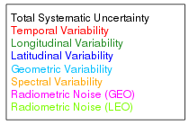
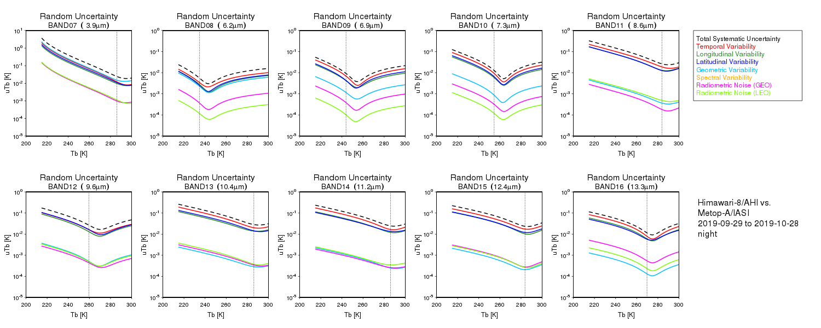
Random component (IASI/A, night)
Uncertainty by spatial/temporal variation is dominant factor
Small uncertainty in a Tb range with much collocation data
10⁺¹
10⁰
3.9
6.2
6.9
7.3
8.6
10⁻⁵
10⁻⁵
9.6
10.4
11.2
12.4
13.3

Slide 7
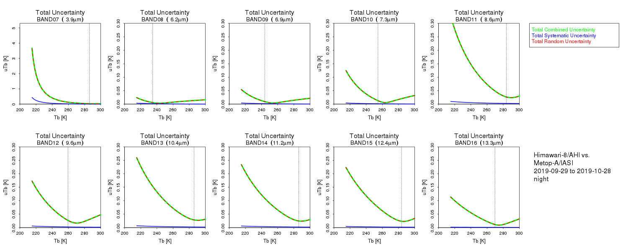
Systematic + Random (IASI/A, night)
Random component is a dominant factor.
5
3.9
0.3
6.2
6.9
7.3
8.6
0
0.0
9.6
10.4
11.2
12.4
13.3

Slide 8
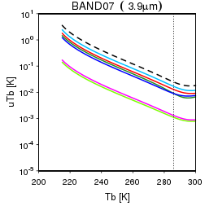
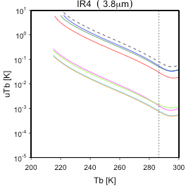
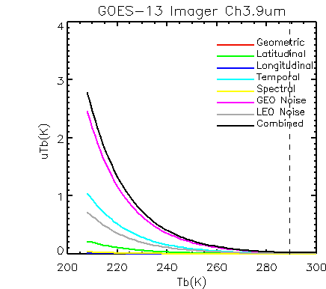
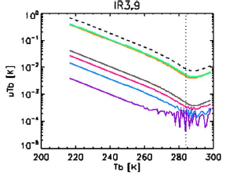
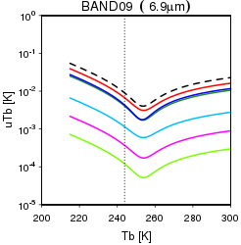
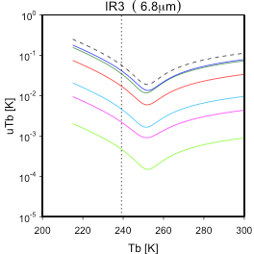
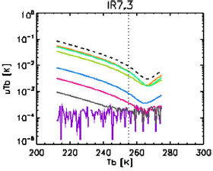
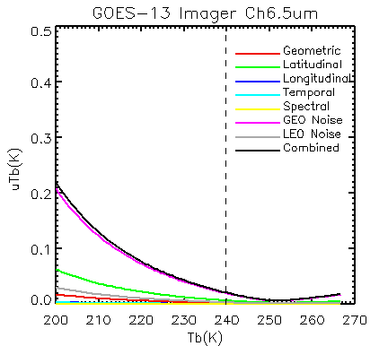
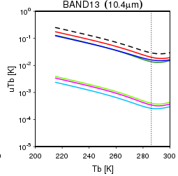
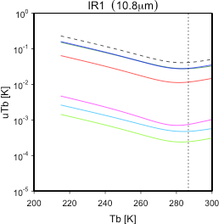
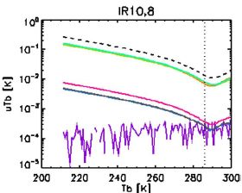
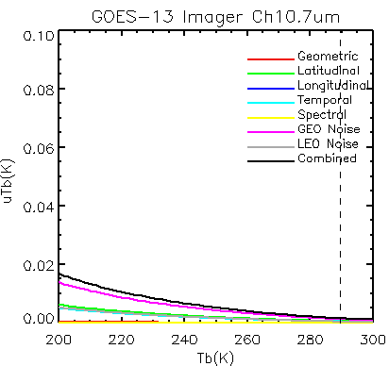
Comparison among sensors (Random component)
SW
HIMAWARI 8
MTSAT 2
MSG
GOES13
WV
Window
Note: Y-axes are linear scale for GOES-13, and log scale for other sensors.

Slide 9
Summary and discussion
Reference LEO data (CrIS) for AHI inter-calibration will be switched to NSR → FSR.
Uncertainty analysis for AHI/IR is performed toward promotion to the Pre-Op phase based on (Hewison, 2013).
Users’ guide also will be documented.
Parallax?
Parallax may effect as a combination of lon-lat variability and uniformity test.
Reference
Tim J. Hewison, 2013, “An Evaluation of the Uncertainty of the GSICS SEVIRI-IASI Intercalibration Products”, IEEE TGRS, VOL. 51, NO. 3, 1171-1181
Yu, F., and X, Wu., 2012, “GSICS GOES-IASI Inter-Calibration Uncertainty Evaluation”, available on: http://gsics.atmos.umd.edu/pub/GPRC/GeoLeo/GSICS.GOES2IASI.IR.uncertainty.DemoV3product.docx

Slide 10
Back up

Slide 11
Variogram for time

Slide 12
Variogram for Lon/Lat

Slide 13
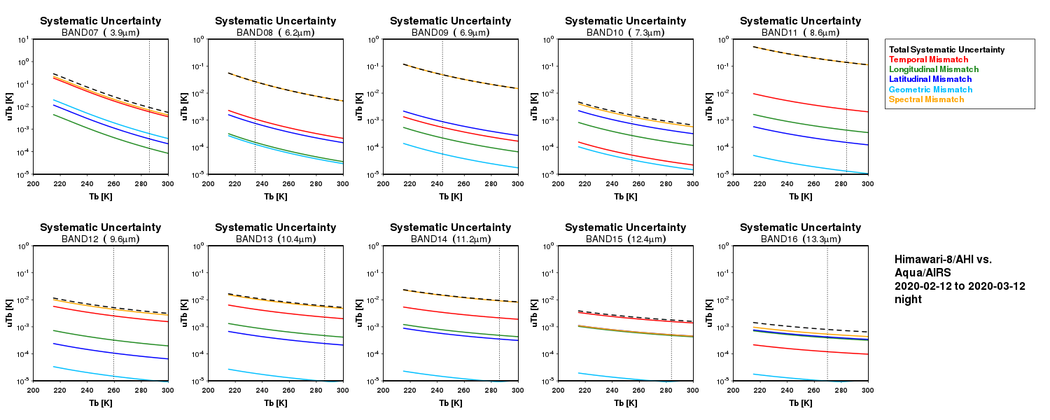
Gap filling? (vs. AIRS)
B13 (10.4um)
Many AHI bands contain the gap-channels and/or the black listed channels.
Green: available channels
Purple: black-listed channels
10⁺¹
10⁰
Orange line: Uncertainty from gap filling
10⁻⁵
10⁻⁵

Slide 14
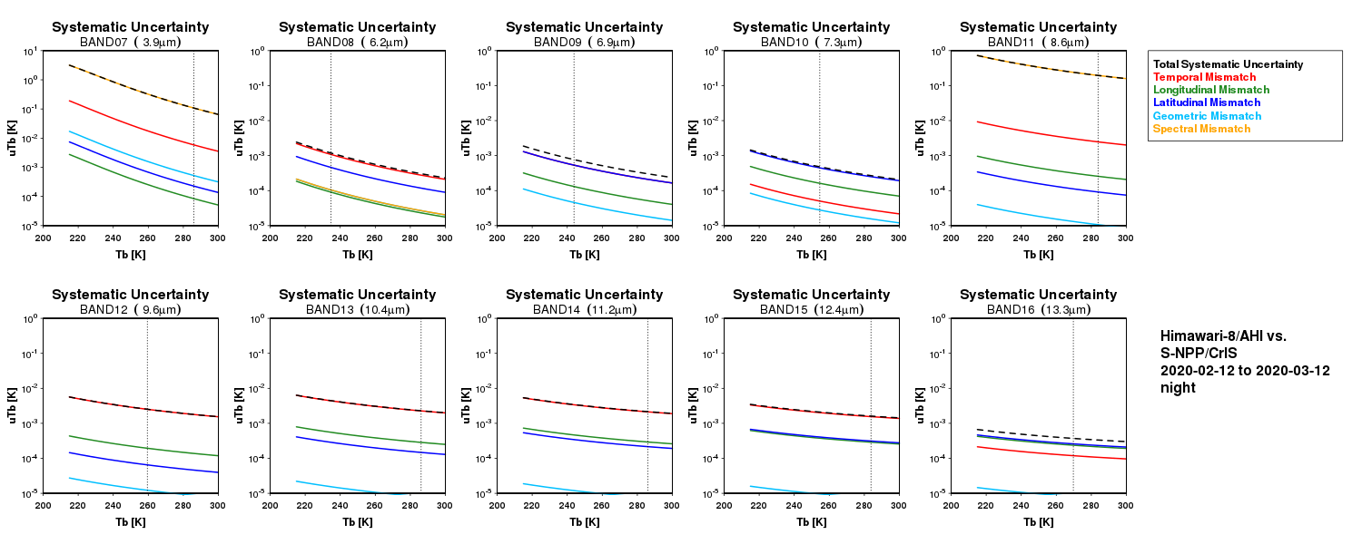
Gap filling? (vs. CrIS)
B11 (8.6um)
B07 and B11 contain wide gap-channels.
Green: available channels
Orange: gap channels
Orange line: Uncertainty from gap filling

