Slide 1
Introduction to STAR ICVS GSICS Portal March 19, 2020
Banghua Yan, Xin Jin, Jingfeng Huang, Warren Porter, Ninghai Sun
STAR ICVS Team
Special Thanks to STAR CrIS, VIIRS, and ABI Cal/Val Team

Slide 2
Outline
Objectives
ICVS GSICS Portal Web Page
System Description
Sample Product Demonstration
Future Plan

Slide 3
Objectives
Provide a centralized platform to integrate STAR GEO-LEO inter-sensor comparison results for broader users
Provide a interface for NOAA GEO and LEO sensor performance and stability trending products
Contribute to the calibration and trending of data products of global weather/environmental satellite constellation
Support NOAA operational weather satellite sensor cal/val activities

Slide 4
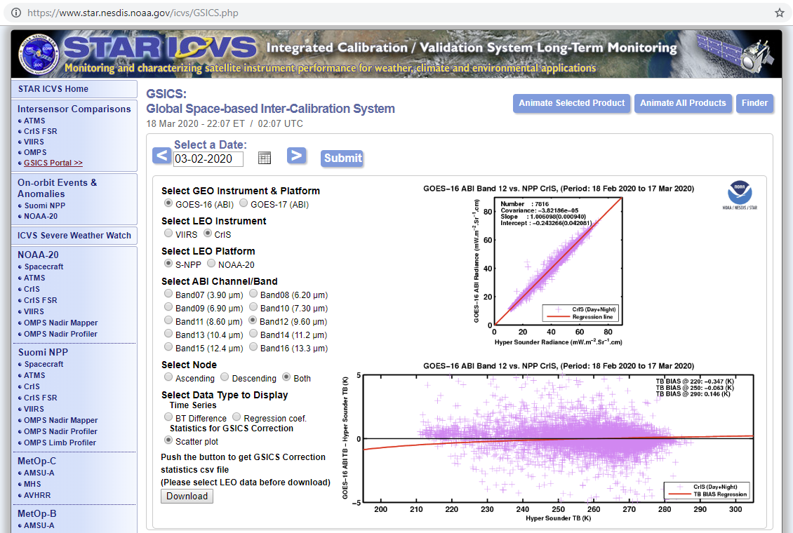
ICVS GSICS Portal

Slide 5
System Description
GEO
GOES-16 ABI
GOES-17 ABI
LEO
NOAA-20 CrIS & VIIRS
S-NPP CrIS & VIIRS
Match-up Method
Simultaneous Nadir Overpass (SNO) provided by National Calibration Center
Products
VIIRS 29-day running mean GEO-LEO inter-sensor bias time series
CrIS daily mean GEO-LEO inter-sensor bias time series
Daily updated 29-day running mean GEO-LEO inter-sensor bias scattering plot and regression coefficients
Daily updated 29-day running mean GEO-LEO inter-sensor bias regression coefficients time series

Slide 6
VIIRS vs. ABI Schematic Flow Chart
29-Day Running Mean (±14 days)
Collective Statistics:
Bias
Regression Coefficients
Scatterplots
Geolocation Stratification
Temporal Stratification
SNO VIIRS vs. ABI:
ABI Time & Geo
ABI Data
VIIRS Data
RSB (B1-6) / TEB (B7, B11, B13)
Solar Zenith Angle (SZA)
Sensor Zenith Angle (SeZA) <36°
Relative Azimuth Angle (RAZ)
No Sun Glint
High Data Quality
All sky tropical ocean
RSB (B1-6) / TEB (B7, B11, B13)
Solar Zenith Angle (SZA)
Sensor Zenith Angle (SeZA) <36°
Relative Azimuth Angle (RAZ)
No Sun Glint
High Data Quality
All sky tropical ocean
VIIRS observations within the ROI but from nearby orbits that satisfy these viewing stratifications are also considered.
Because of the spectral wavelength differences, the SBAF corrections are conducted
Collocation Stratification
∆ RAZ < 15
∆ SZA < 5
∆ SeZA < 15
Any ABI/VIIRS ratios outside of the previous 30-day 1-STD are removed, before the daily bias are calculated
ABI/VIIRS Ratios have large non-linearity when the reflectance/BT is low
Non-linearity Screening
Previous 30-day 1-Std Screening
Spectral Bias Correction (SBAF)
Daily ABI-VIIRS Bias
29-Day ABI-VIIRS Mean Bias
S-NPP vs. NOAA-20 Double Difference (DD)

Slide 7
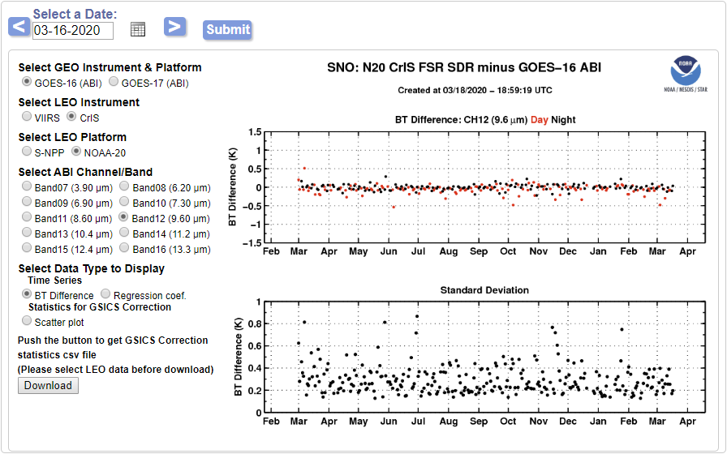
Sample Products
Daily CrIS-ABI inter-sensor bias time series

Slide 8
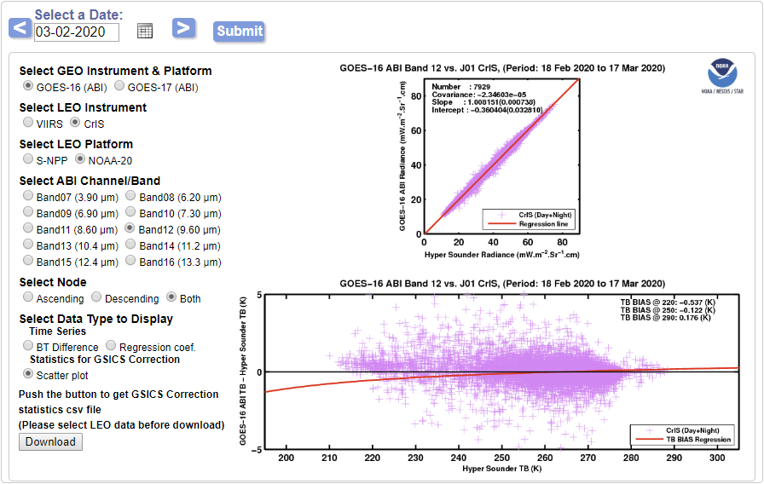
Sample Products
29-day running mean CrIS-ABI inter-sensor bias scattering plots

Slide 9
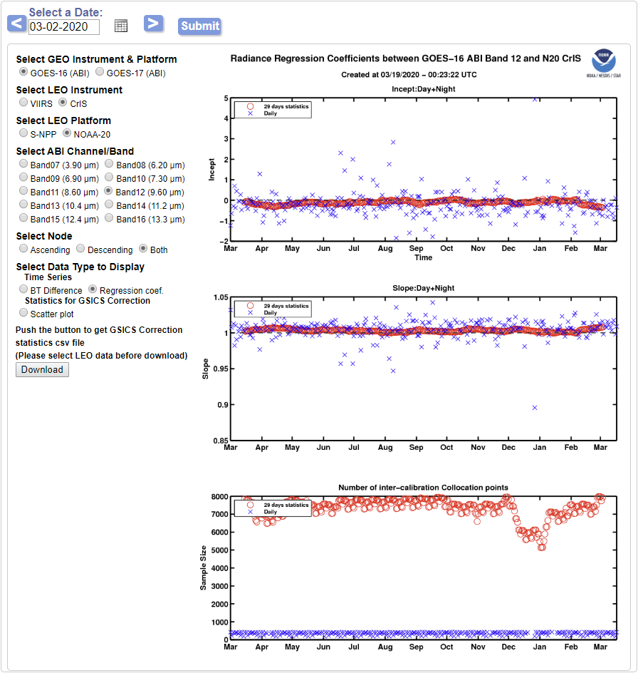
Sample Products
29-day running mean CrIS-ABI inter-sensor bias regression coefficients time series

Slide 10
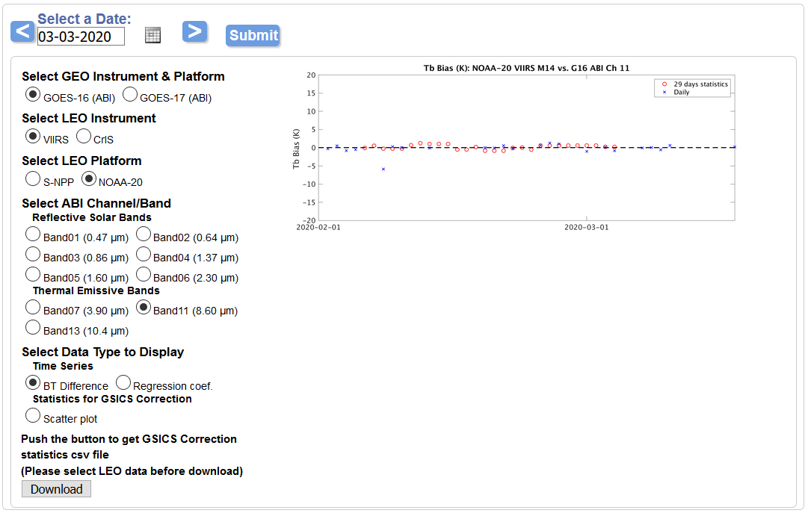
Sample Products
29-day running mean VIIRS-ABI inter-sensor bias time series

Slide 11
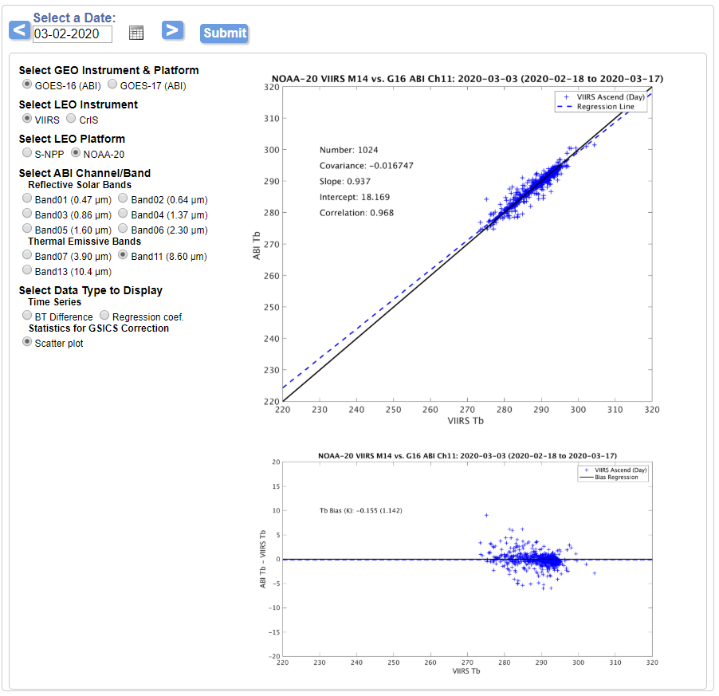
Sample Products
29-day running mean VIIRS-ABI inter-sensor bias scattering plots

Slide 12
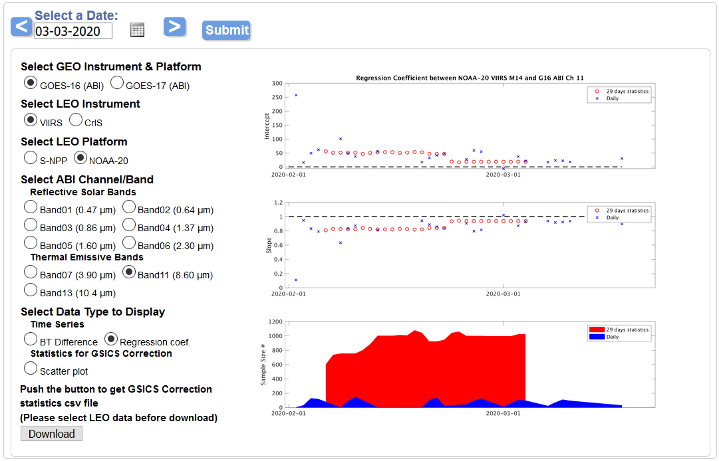
Sample Products
29-day running mean VIIRS-ABI inter-sensor bias regression coefficients time series

Slide 13
Future Plan
Improve inter-sensor comparison products accuracy in ICVS
Add ABI-IASI inter-sensor comparison products in ICVS GSICS portal
Apply standard GEO-LEO inter-sensor comparison algorithm recommended by GSICS
Prepare ICVS GSICS portal user documents following GSICS standard
Prepare GOES-16/GOES-17 ABI vs S-NPP/NOAA-20 CrIS/VIIRS near real time correction datasets for GSICS product catalog
Welcome any suggestion or comment to improve the portal

