Slide 1

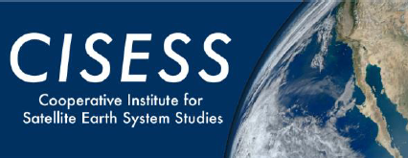
Updates on the IASI short-wave gap filling
Hui Xu and Likun Wang
03/19/2020
(CISESS/ESSIC/Univ. of Maryland, College Park, MD)
GSICS Annual Meeting 2020
Notes:
1

Slide 2

Outline
Background
Methodology
Inter-comparison before and after the gap filling
Conclusions
Notes:
2

Slide 3
Background
Why do we have to extend IASI Shortwave channels?
We don’t have any real measurements in
There are still several important short-wave broadband channels not fully covered by any of the current infrared sounders, such as the AVHRR channel 3B, SEVIRI channel 4, … Therefore, it is essential to find a way to fill up this gap in the GSICS community.
Previous presentations on this topic
H. Xu, L. Wang, Y. Chen, F. Yu, F. Wu and M. Goldberg, 2019, Sensitivity Test and Further Validation of Cross-track Infrared Sounder Spectral Gap Filling in Inter-comparisons.
T. Hewison and A. Burini, 2018, Development of inter-comparison method for 3.7µm channel of SLSTR-IASI.
N. Xu H. Xu X. Hu, 2018, CrIS Spectral filling method test on FY-3D MERSI 8.55μm band.
H. Xu, L. Wang, F. Yu, Y. Chen, and F. Wu, 2018, Cross-track Infrared Sounder Spectral Gap Filling Accuracy Analysis using GOES-16 ABI as Example.
H. Xu, Y. Chen, L. Wang, 2018, Cross-track Infrared Sounder Spectral Gap Filling toward Improving Inter-calibration Accuracy.

Slide 4
Method
Forward Simulation
Coefficients Derivation
Profile
(pressure, …, )
Geometry
(nadir to limb)
Convert monochromatic radiance to IASI specification;
Appling gaussian apodization and adding instrument noise;
Principle component transformation;
Filling up the SW channels (to 3275 cm-1) with the PC gap filling method (Xu et al., 2019).
LBLRTM
+
DISORT
Training Spectra
(500-3300, 0.1 cm-1)
Layer Optical Properties
(SSA, Legendre, …)
Surface Emissivity
Finally, there are nearly 300,000 spectra were simulated and used as the training dataset.
Profile: ECMWF (profile in different seasons) + TIGR (profile in tropical, mid- and hi-latitude regions);
Layer optical properties: Clear sky + Aerosol (Dust) + Cloud (Water + Ice) in different optical depths
Molecular and trace gas: HITRAN 2012 absorption database was used;
Aerosol : mineral dust calculated in coarse and transportation modes from OPAC;
Water cloud: calculated with Mie scattering model from Libradtran;
Ice cloud: general habit mixture, severely roughened solid columns, and severely roughened aggregate of solid columns from Baum et al., (2014) of UW-SSEC;
Surface Emissivity: IGBP typical emissivity;
Geometry: from nadir to limb in three different zenith views.

Slide 5




Method
PC spectral gap filling
If the IASI gap channel radiance $y∈\left\{y_{1},y_{2},⋯,y_{m},m=2260\right\}$ can be predicted by the measured channel radiances $x∈\left\{x_{1},x_{2},⋯,x_{n},n=8461\right\}$ using (1),
(1)
where $β$_{j,i} is the prediction coefficients, $u_{i}$ is the residual, $j$ is the $j$th measured channel and $i$ is the $i$th gap channel. Thus, all the gap channel radiances with a total of $t$ observations can be written in the matrix form
(2)
The prediction coefficient matrix $B$ then can be calculated through (3) with the training dataset,
(3)
By replacing measured radiances x in the design matrix Dx with their principal component scores${pcs}_{X}$, the relationship between the principal component scores of the measured channel radiances and the gap channel radiances now can be properly established through (4) with the training dataset,
(4)
Since most of the earth spectra variances are mainly distributed in the first few principal components, therefor, only the leading k ${pcs}_{X}$ is used in (4). After${ B}_{pcs}$is calculated, the IASI gap channel radiances can be predicted with (5)
(5)
where $C_{pcs}$is the constant row of the $B_{pcs}$ and $P_{pcs}$is the coefficient rows of the $B_{pcs};{E_{X}, N}_{X} \text{and} \overline{X} \text{are} \text{the} \text{eigenvector}\text{s}\text{, }\text{instrument} \text{noises} \text{and} \text{mean} \text{radiances} \text{of} \text{the} \text{measured} \text{channels} \text{of} \text{the} \text{training} \text{dataset}\text{,} \text{respectively}$.
By combining all the above matrices together, Eq.5 finally becomes
(6)
(Xu et al., 2019)
$P_{0}$ is the IASI gap channel prediction coefficients, $C_{0}$ is the gap channel constant.

Slide 6








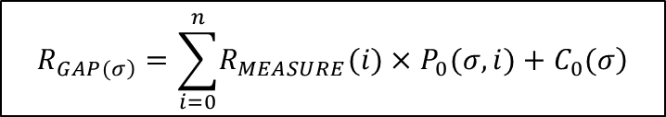
Method
How to use the IASI Gap filling coefficients
All the IASI gap filling coefficients have been put into a H5 file - ‘iasi.GapCoeff.h5’.
There are 3 datasets inside the H5 file
P0：is gap-filling coefficient matrix with a dimension of 2060(col) ×8461(row)
C0：is gap-filling constant vector with a length of 2060
GAP_NUM: number of gap channels (2260 channels from 2760.25~3275 cm-1)
The use of the H5 file
$$R_{\left.GAP(σ\right)}=\sum_{i=0}^{n}{\left.R_{MEASURE}(i)×P_{0}(σ,i)+C_{0}(σ\right)}$$
8461 measured radiances
2060 gap channels
2060 gap radiances
IASI
measured spectra
IASI
gap spectra
2060 gap channels
8461 coefficients
t observations
t observations

Slide 7
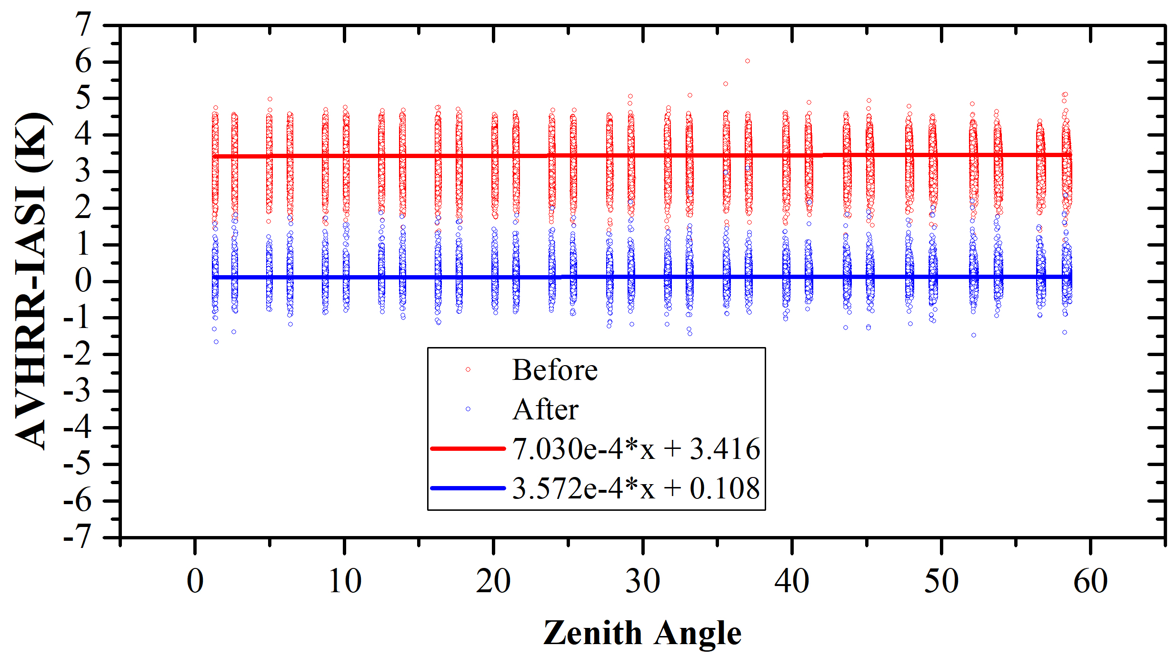
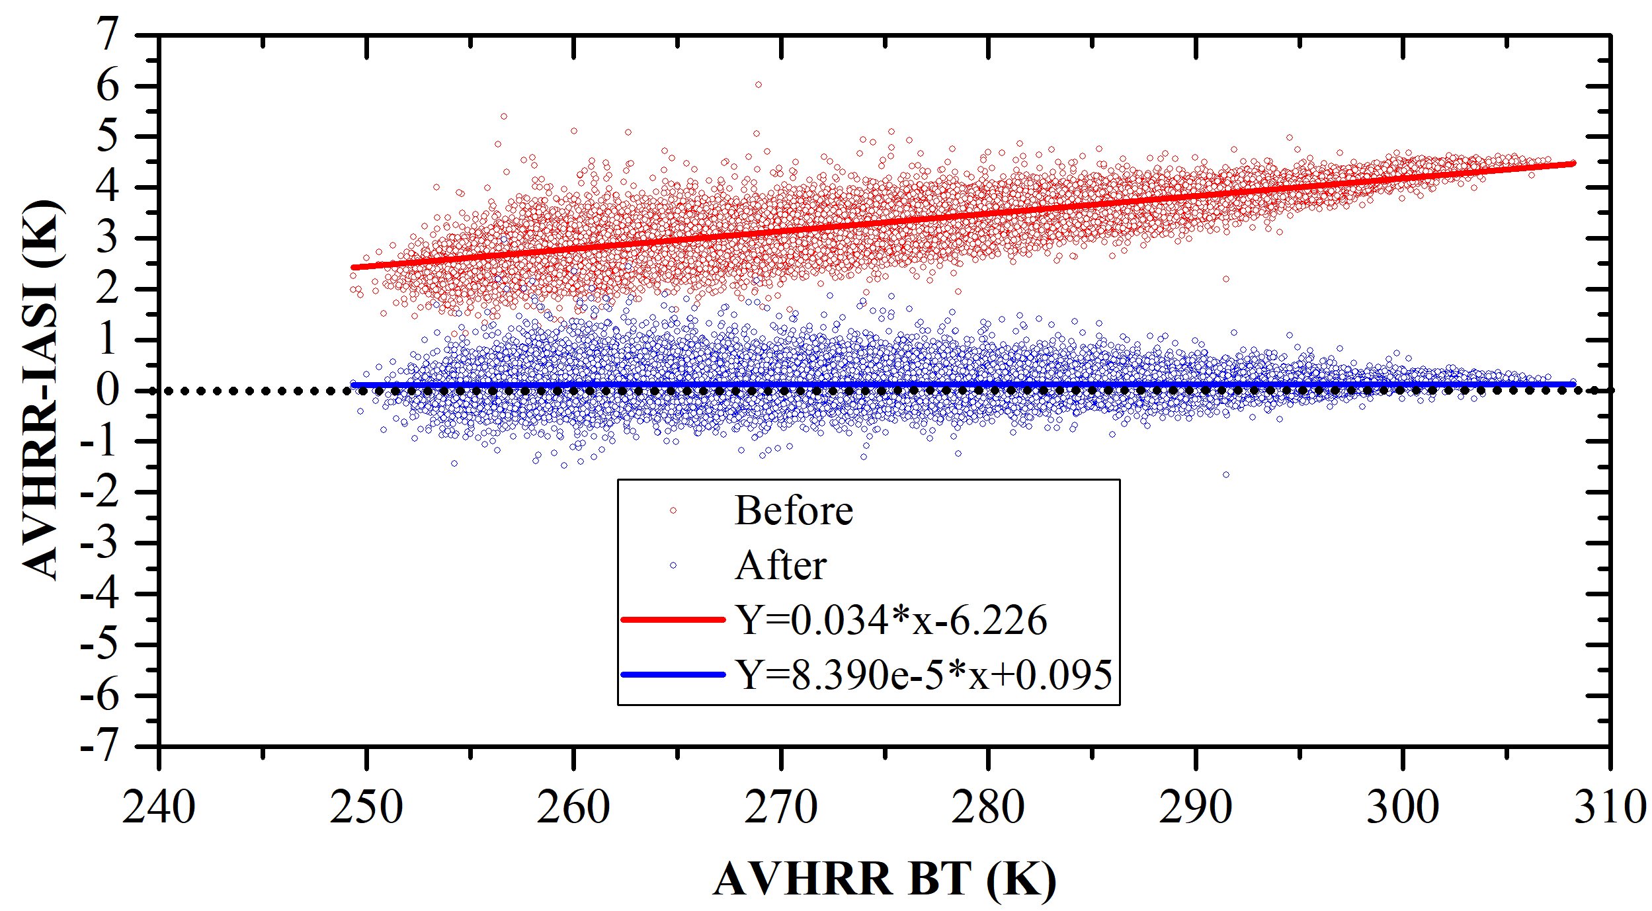
Inter-comparison between Metop-A AVHRR and IASI
IASI-AVHRR collocated Channel 3B BT
Jan 16, 2019
Scenes with negative IASI measurements are filtered.
Both the mean and standard deviation are greatly reduced.
However, we still see a 0.1 K bias between Metop-A AVHRR and IASI even after the gap was filled.
There is no obvious scene or angle dependent after the gap was filled

Slide 8
Inter-comparison between Metop-A AVHRR and IASI
AVHRR-IASI (BEFORE)
Cold Scenes
Jan 16, 2019
Large biases are observed due to the spectral gaps.
Cloud scenes
AVHRR-IASI (AFTER)
It seems that the gap filling method works well for most of the scenes even over the cloudy areas.

Slide 9
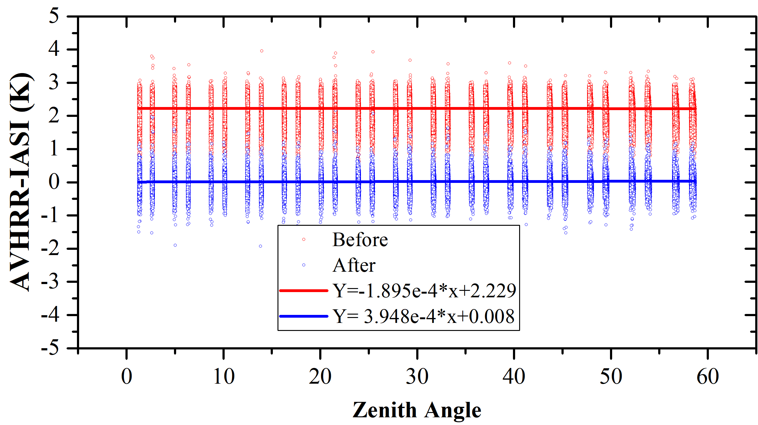
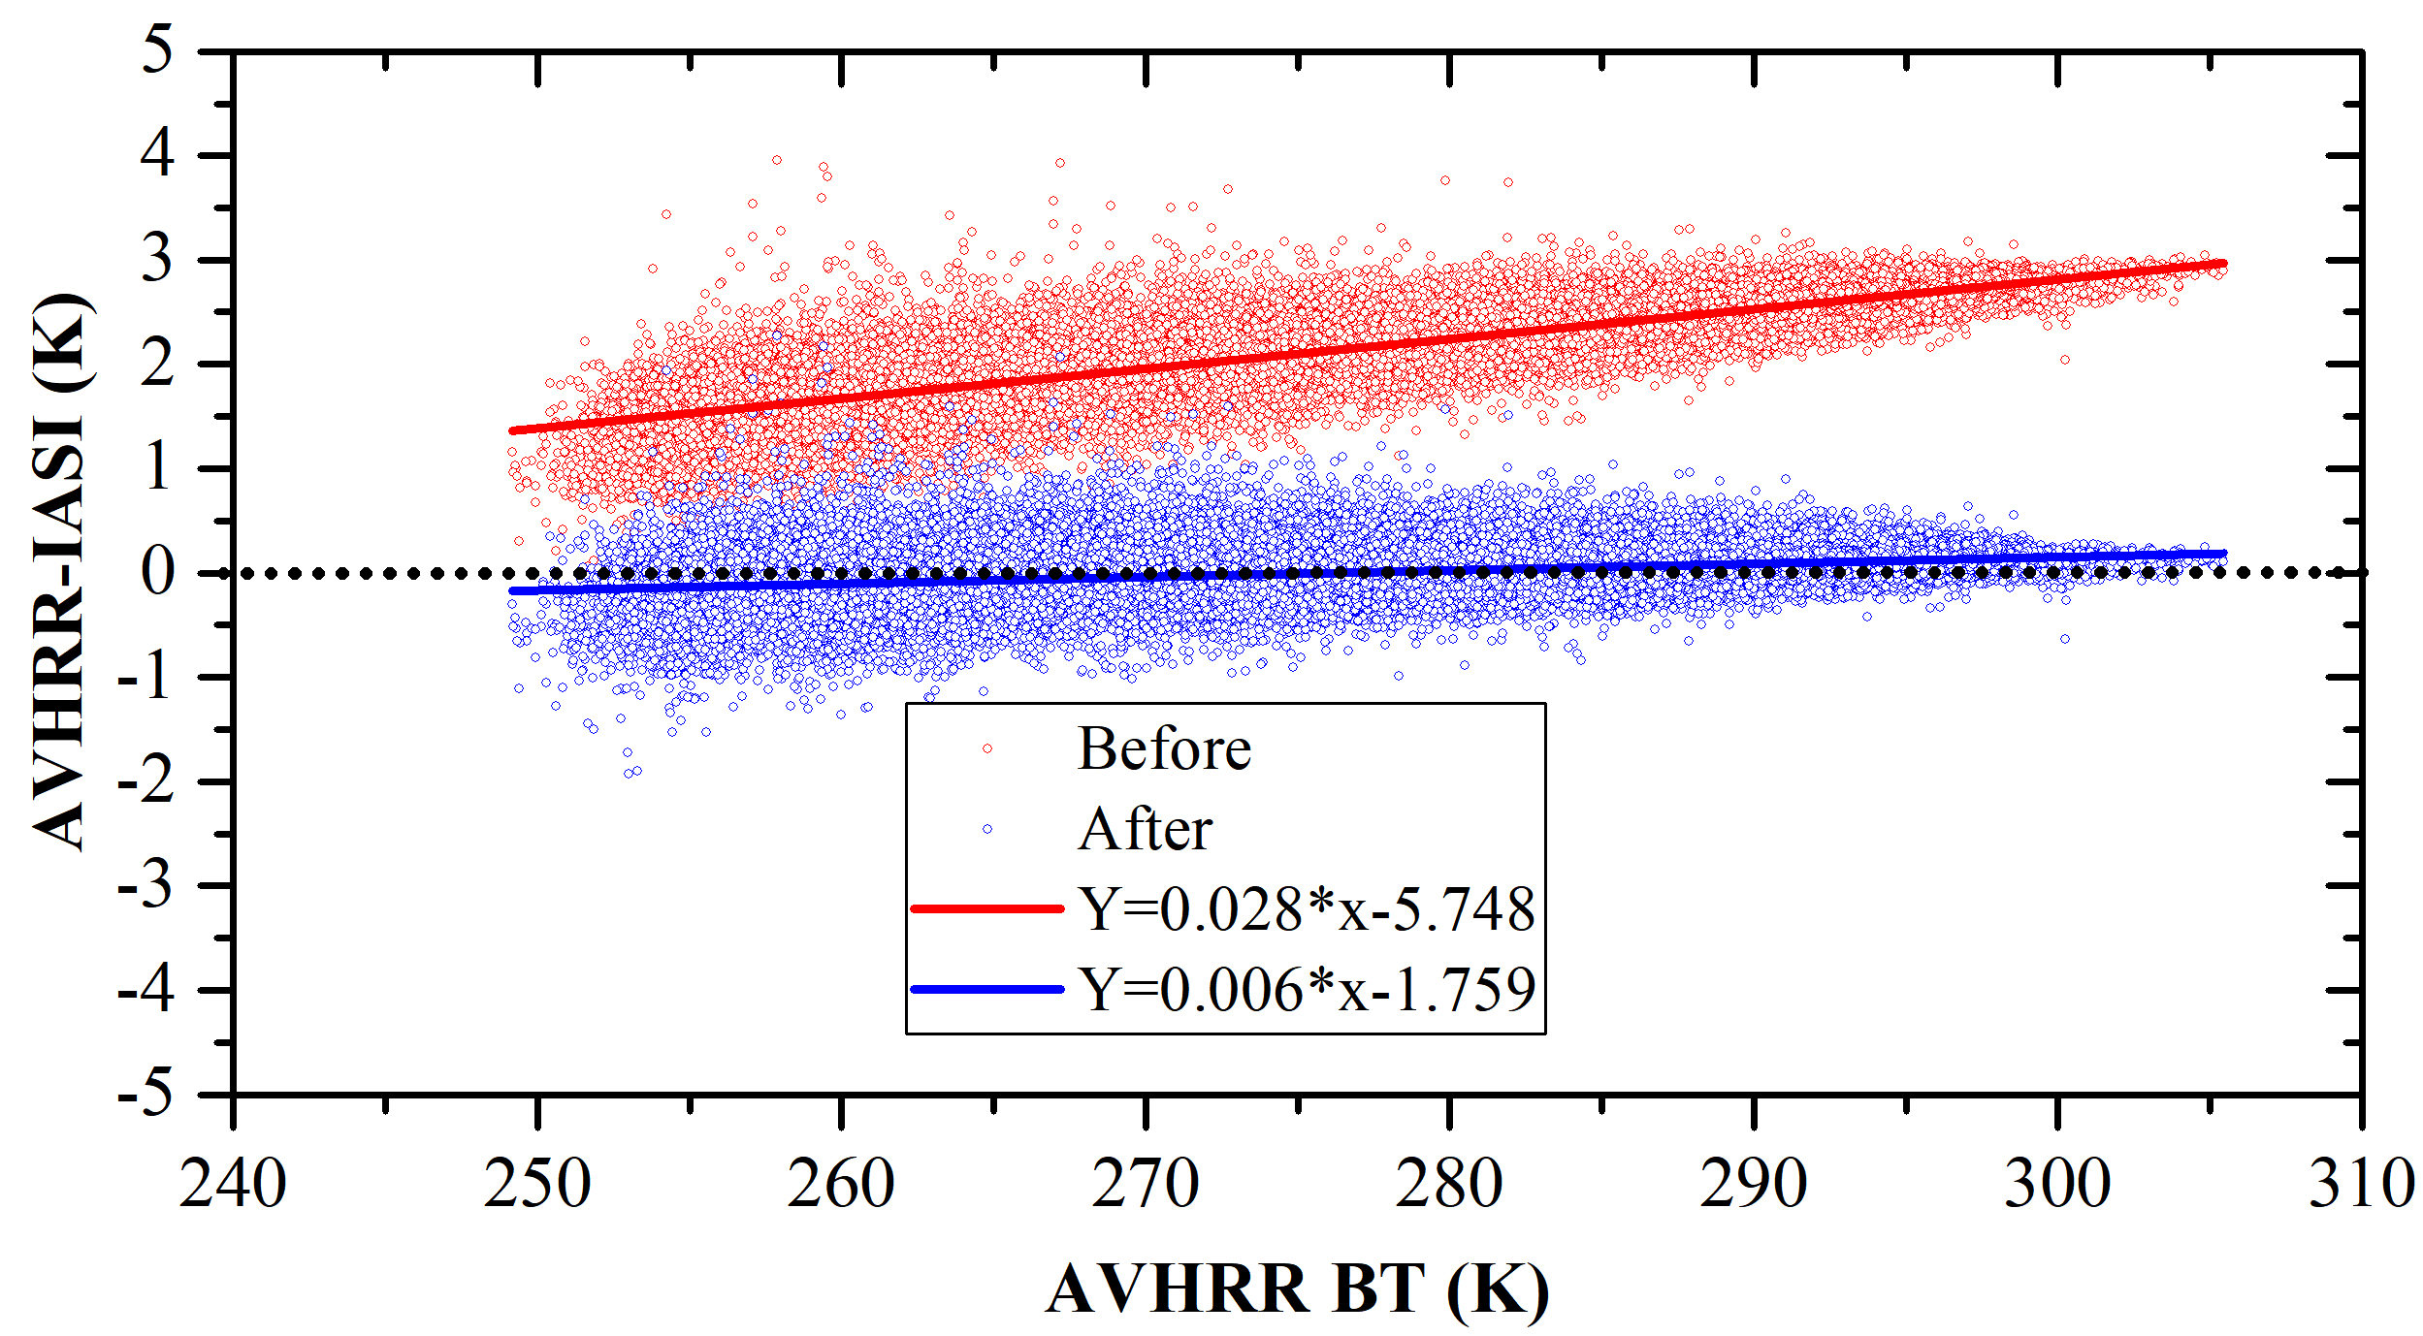
Inter-comparison between Metop-B AVHRR and IASI
Jan 16, 2019 (Same Day)
IASI-AVHRR collocated Channel 3B BT
Similarly, both the mean and standard deviation are greatly reduced.
Slightly scene dependent, 0.006K/K, mostly due to the negative biases over cold scene.

Slide 10
Inter-comparison between Metop-B AVHRR and IASI
AVHRR-IASI (BEFORE)
Cold scenes
Large biases are observed due to the spectral gaps.
Cloudy scenes
AVHRR-IASI (AFTER)
Similarly, their differences have been greatly reduced.
Relatively larger differences are still observed in the cold scenes. (Is this due to the nature of the two instruments?)

Slide 11
Intra-annual variability
Mean(mean)=3.504 K
STD(mean)=0.465 K
Trend(mean)=3.0e-2K/K
Partially covered by IASI
METOP-A AVHRR-IASI
Mean(mean)=0.117 K
STD(mean)=0.193 K
Trend(mean)=2.0e-4K/K
Mean(mean)=0.248 K
STD(mean)=0.161 K
Trend(mean)=4.0e-3K/K
Fully covered by IASI
Mean(mean)=0.206 K
STD(mean)=0.147 K
Trend(mean)=3.0e-3K/K
positive bias
CW(CH3B)=2689.886 cm-1, CW(CH4)=926.103 cm-1, CW(CH5)=837.050 cm-1

Slide 12
Intra-annual variability
Mean(mean)=2.288 K
STD(mean)=0.374 K
Trend(mean)=2.0e-2K/K
Partially covered by IASI
METOP-B AVHRR-IASI
Mean(mean)=0.053 K
STD(mean)=0.189 K
Trend(mean)=5.0e-3K/K
slightly scene dependent
Mean(mean)=0.086 K
STD(mean)=0.189 K
Trend(mean)=7.0e-3K/K
Fully covered by IASI
Mean(mean)=-0.097 K
STD(mean)=0.152 K
Trend(mean)=7.0e-4K/K
CW(CH3B)=2661.541 cm-1, CW(CH4)=931.313 cm-1, CW(CH5)=837.867 cm-1

Slide 13
Summary and future works
Summary
The PC gap filling method was applied to IASI (extending its short-wave channels to 3275 cm-1).
The gap filling method shows good performance in the inter-comparison between IASI and AVHRR.
The intra-annual analysis shows that the spectral gap filling method in general is stable.
Several thing we have to pay attention to
Currently, the gap filling coefficients can only be applied to IASI spectra without negative values in the measured channels.
Relatively larger uncertainty would be expected in the very cold scene even though it has been greatly reduced.
Future works?
Training dataset representative analysis
Can the training dataset have a general representative of the earth scene?
If not, how can we add more spectra to the training dataset?
Uncertainty analysis
Validations? Other inter-comparisons?

Slide 14
Inter-comparison between Metop-A AVHRR and IASI
Old Coefficients derived from clear sky only – (used in GSICS 2019 Annual meeting)
Large biases still exist over cloud areas
Standard deviation=0.224
New updated coefficients with cloud + aerosol spectra were added to the training dataset
The gap filling result has been greatly improved with this new coefficient matrix, especially over the cloudy regions.
Standard deviation=0.176

