Slide 1
The preliminary results of GK2A AMI VIS/NIR calibration
Special Issue of the IEEE TGRS on “Inter-Calibration of Satellite Instruments”:
Special Issue of the IEEE TGRS on “Inter-Calibration of Satellite Instruments”:
Eunkyu Kim, Tea-Hyeong Oh
KMA/NMSC

Slide 2
Introduction
일평균
KMA/NMSC has been monitoring GK2A VNIR channels performance
Ray Matching(Terra MODIS, SNPP VIIRS, respectively)
GSICS DCC(Aqua MODIS, Histogram and monthly time series of Mean and Mode)
Lunar calibration using GIRO (May 2019 ~ Mar. 2020)
Applied SBAF from NASA SCIAMACHY.
Ray Matching MODIS: Aug. 2019. ~ Mar. 2020.
Ray Matching VIIRS: Oct. 2019. ~ Mar. 2020.
From NOAA CLASS
From NASA LADSWEB
Method | Thresholds | Reference Values
Ray Matching (All Sky) | Time Difference $≤$ 5min. 0.1°ⅹ0.1° Grid (Lat/Lon) SZA $<$ 40°, VZA $<$ 40° SZA Difference $≤$ 5° Reflectance STDV in each grid < 0.05 Viewing Angle Difference $≤$ 10° Bin Spatial homogeneity < 80% Remove Sun-glint pixels | Terra MODIS, SNPP VIIRS
GSICS DCC | IR_TB ≤ 205°K VZA $<$ 40° TB_IR $<$ 1K STDV Rad._VIS / Mean Rad._VIS $<$ 0.03 | Aqua MODIS (MYD02SSH)
 | Central Wavelength(μm)
 | AMI | MODIS | VIIRS
1 | 0.47 | B3 (0.459~0.479) | M3 (0.49)
2 | 0.51 | B4 (0.545~0.565) | M3 (0.49)
3 | 0.64 | B1 (0.620~0.670) | I1 (0.64)
4 | 0.86 | B2 (0.841~0.876) | M7 (0.865)
5 | 1.37 | B26 (1.360~1.390) | M9 (1.378)
6 | 1.61 | B6 (1.628~1.652) | M10 (1.61)

Slide 3
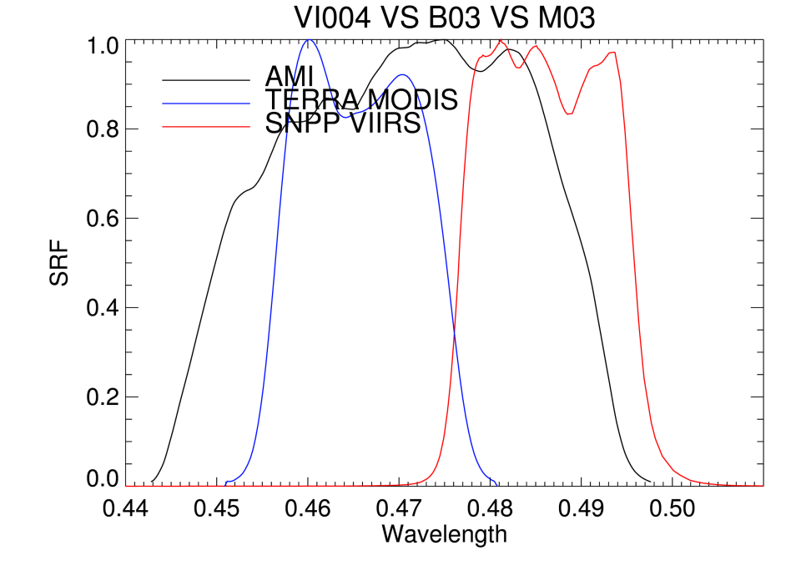
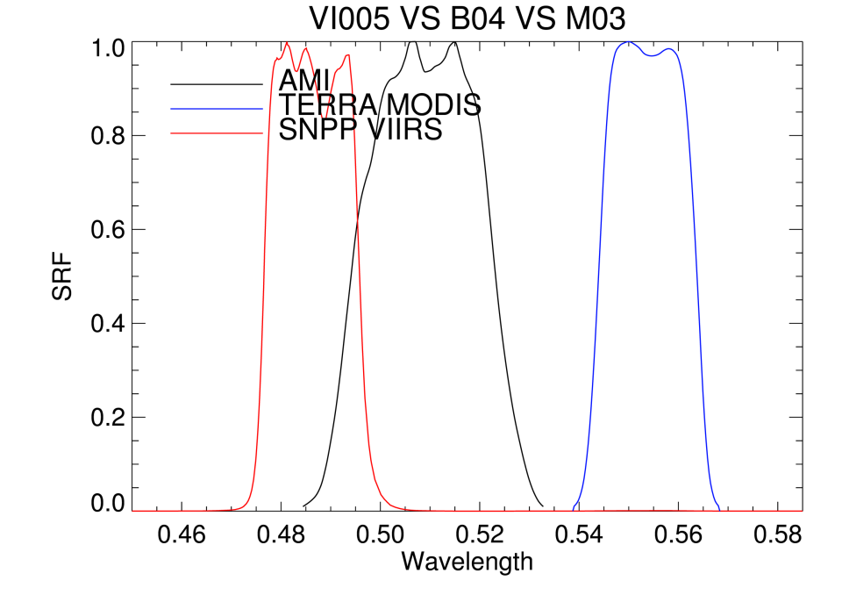
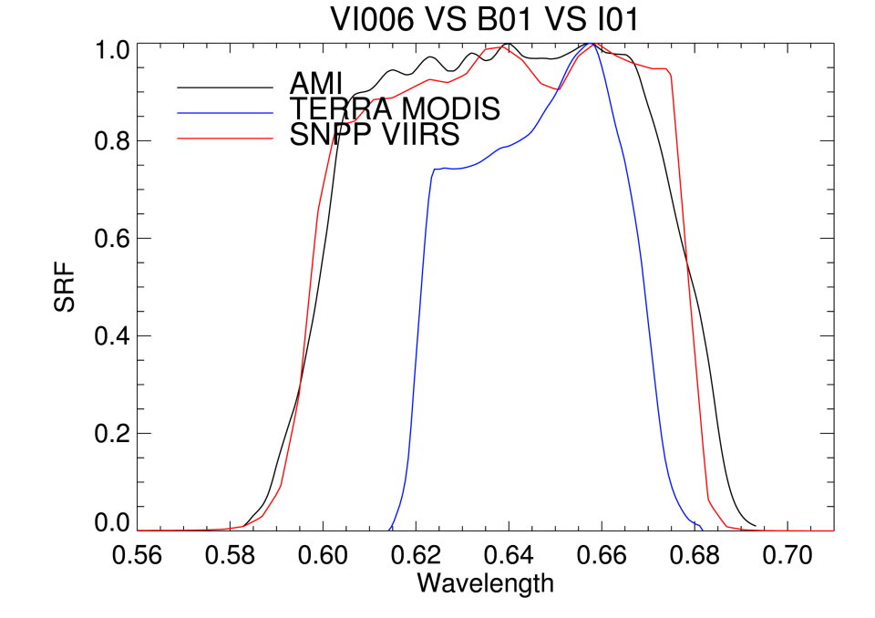
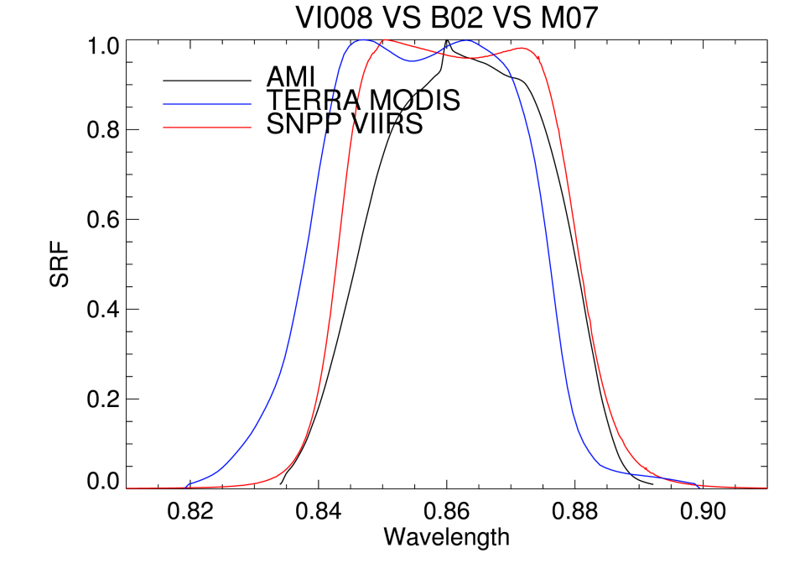
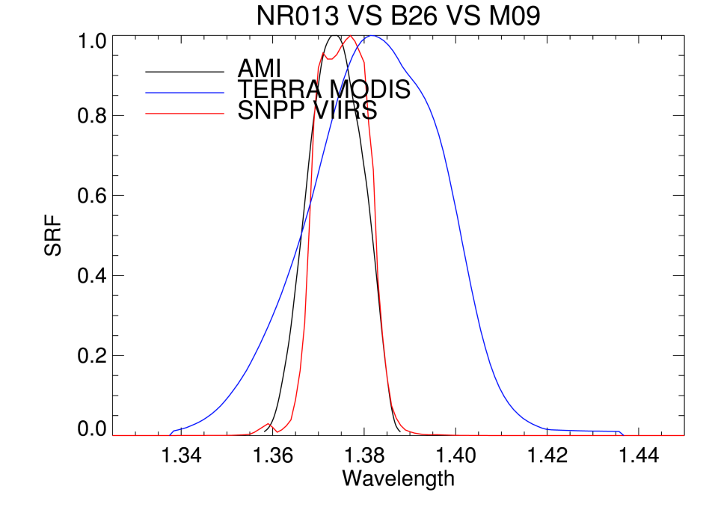
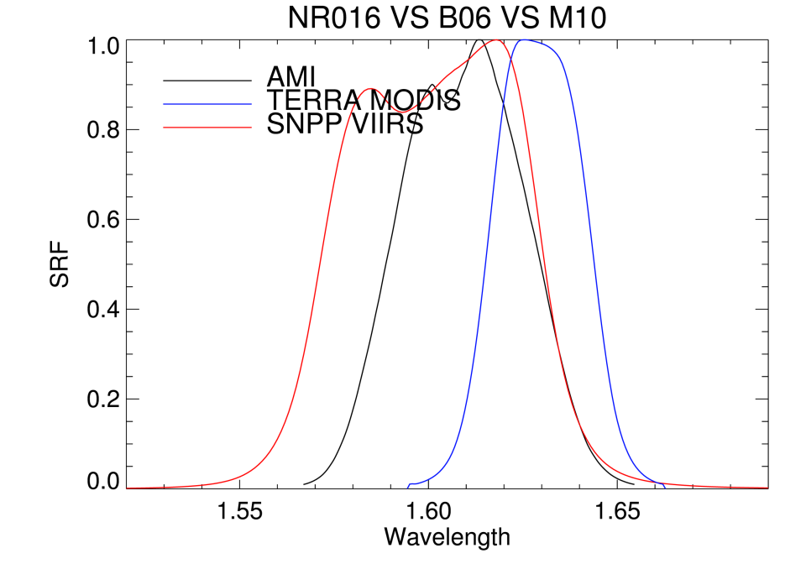
AMI & Terra MODIS & SNPP VIIRS SRF
일평균

Slide 4
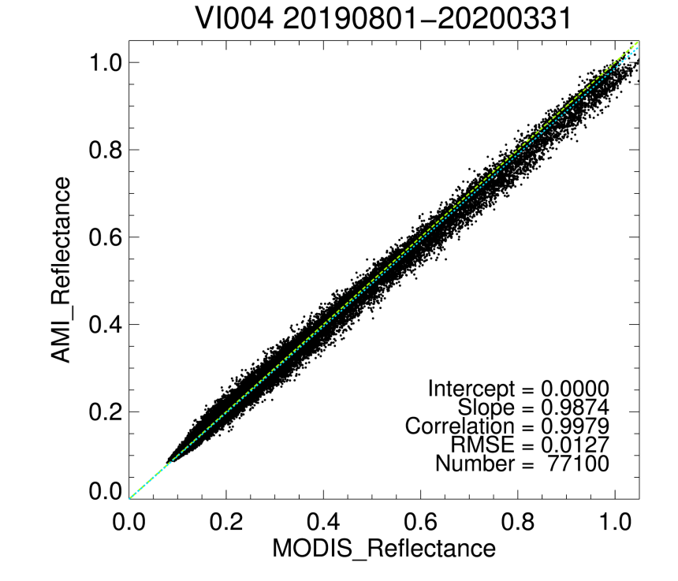
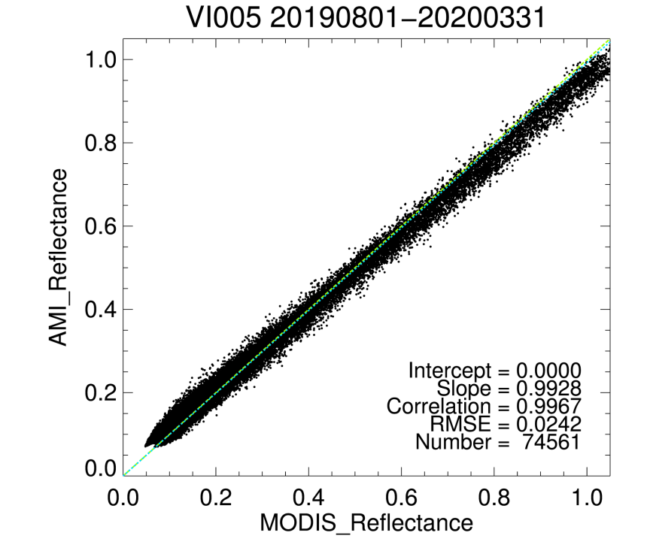
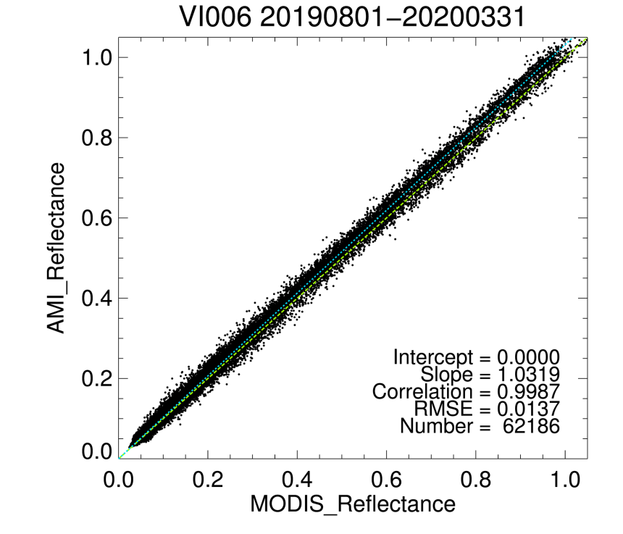
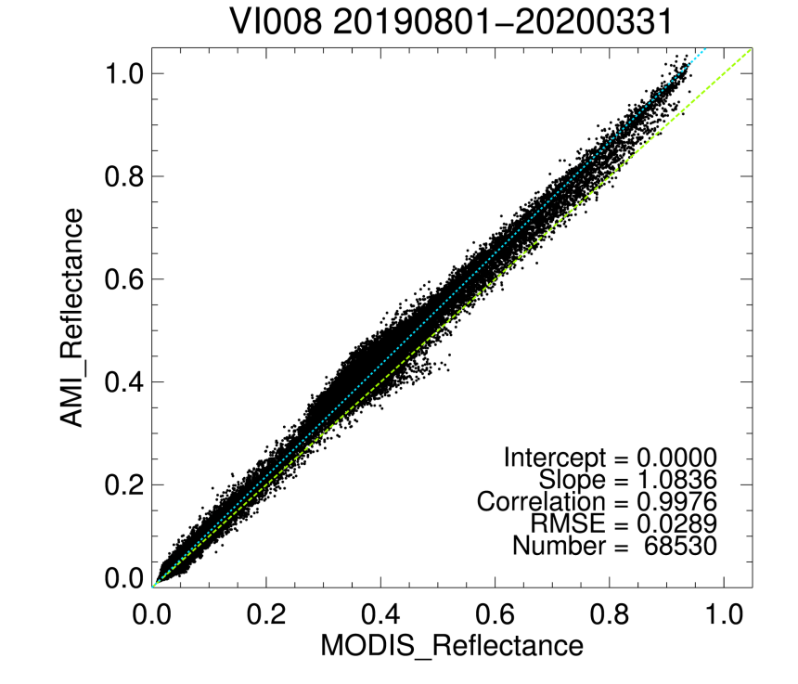
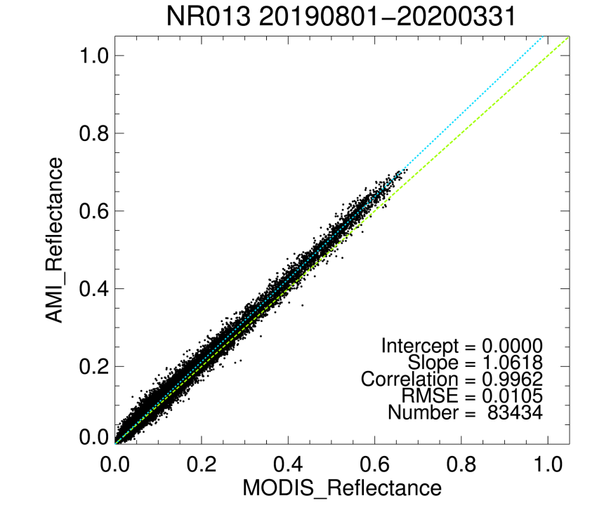
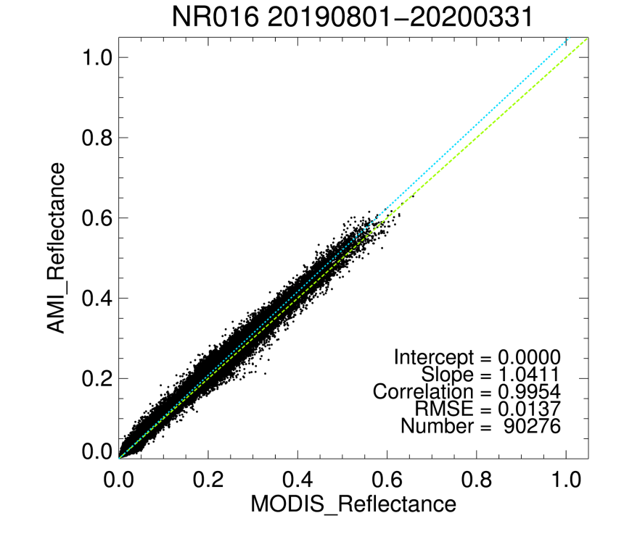
Ray Matching MODIS results(Aug. 2019.~Mar. 2020.)
일평균

Slide 5
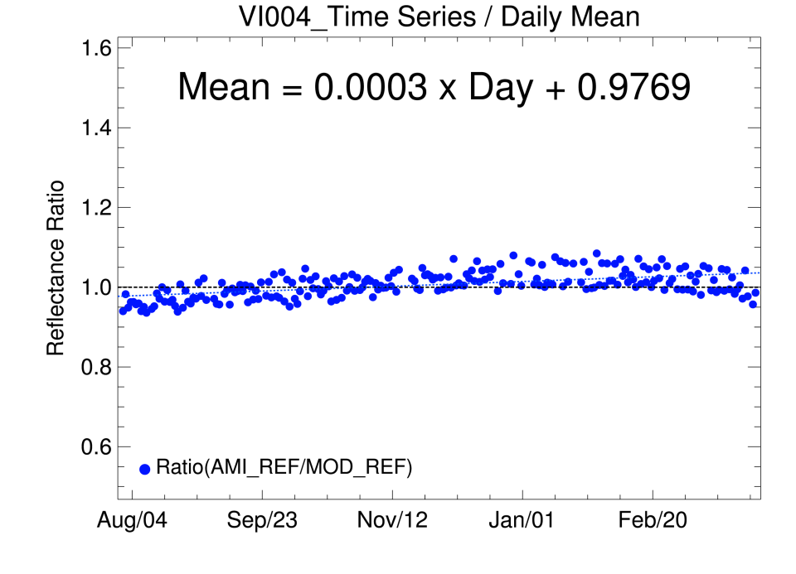
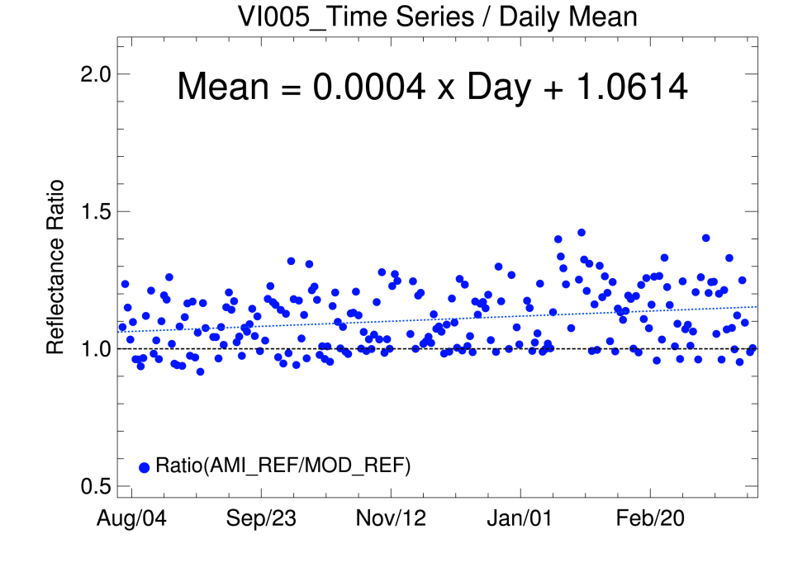
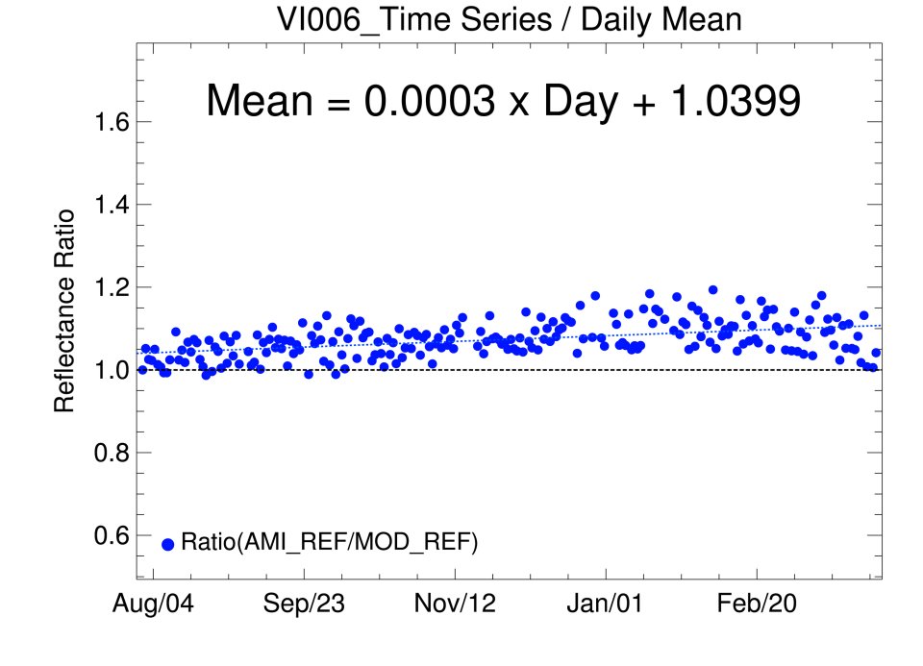
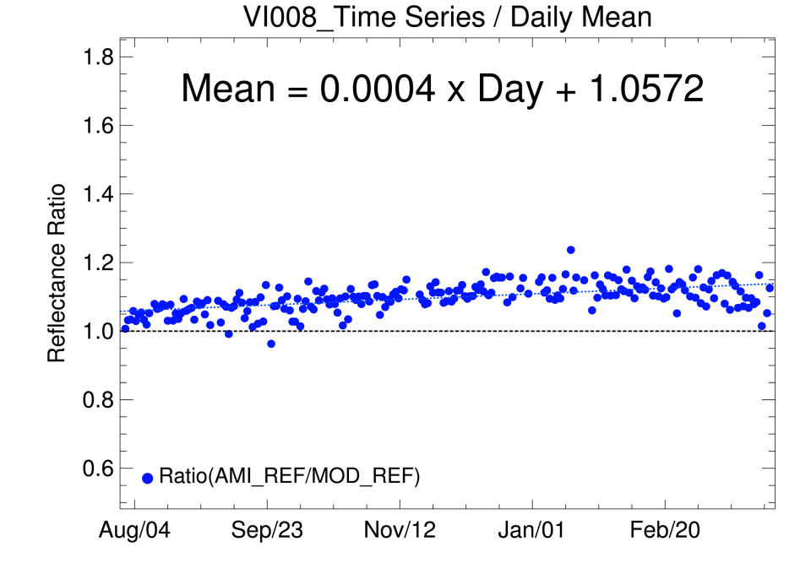
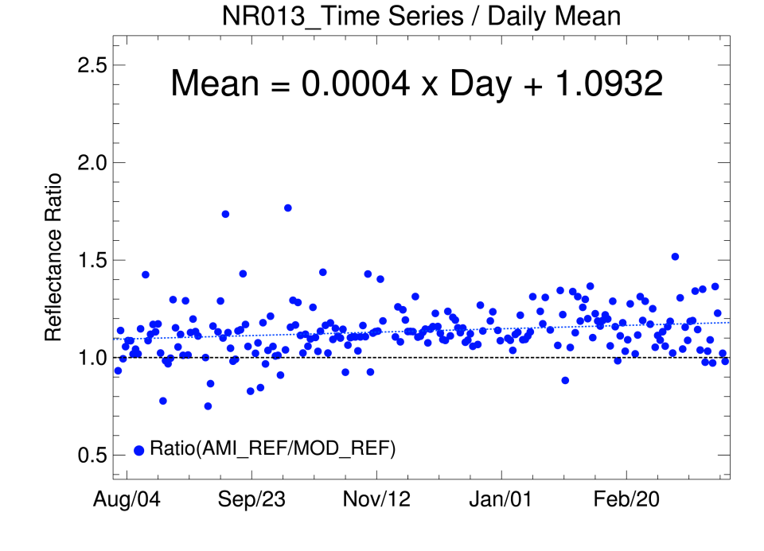
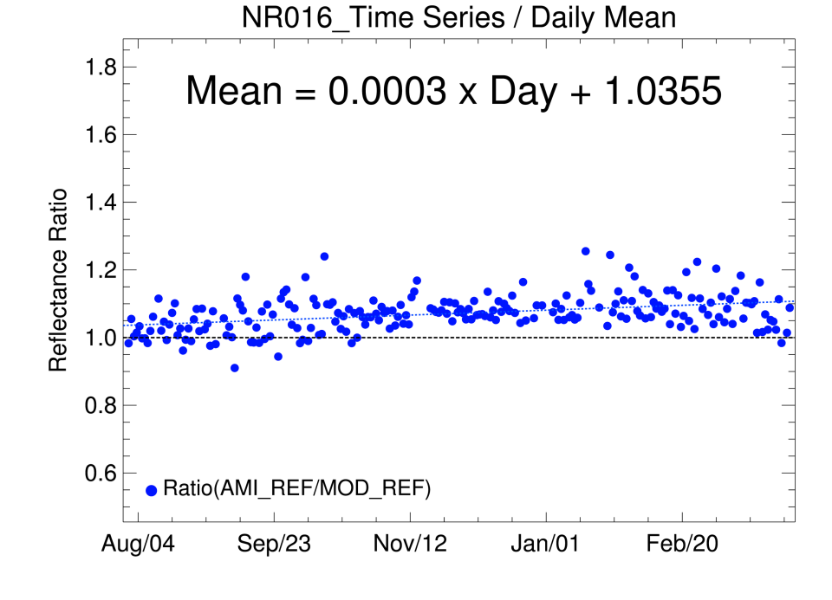
Ray Matching MODIS results(Aug. 2019.~Mar. 2020.)
일평균
Y Axis =$AMI Ref. / MOD Ref.$

Slide 6
Ray Matching MODIS results(Aug. 2019.~Mar. 2020.)
일평균
Monthly Variation…
We have to keep watching…

Slide 7
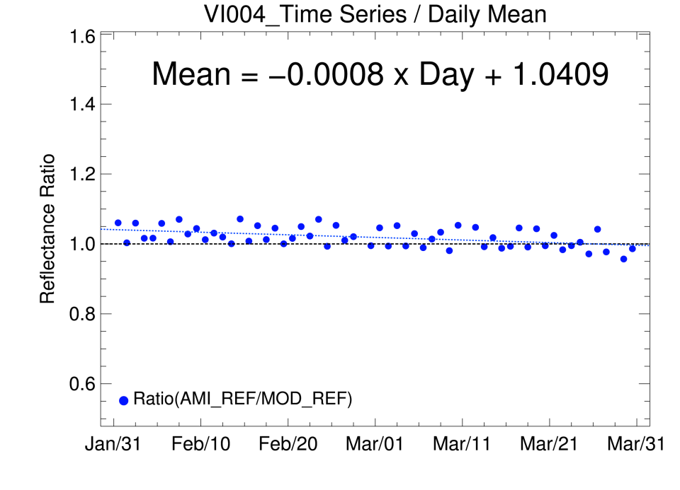
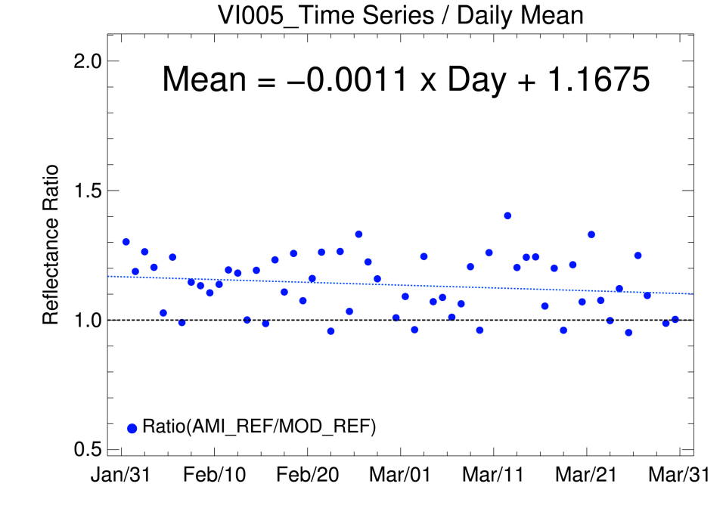
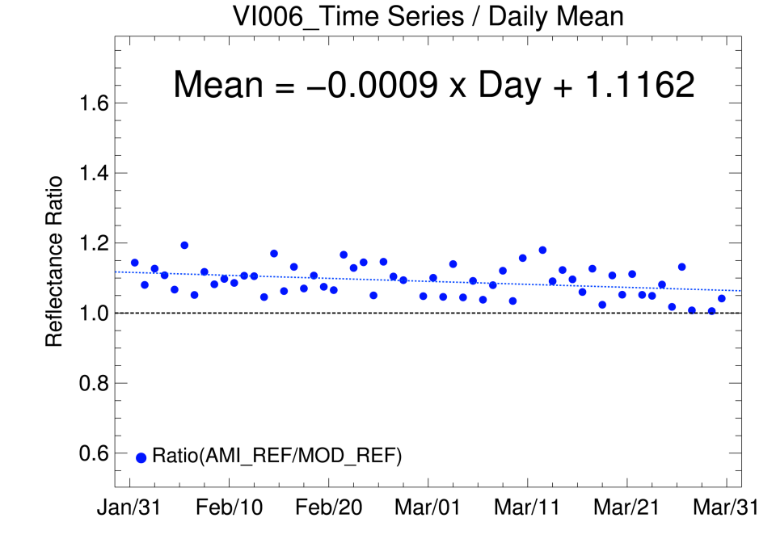
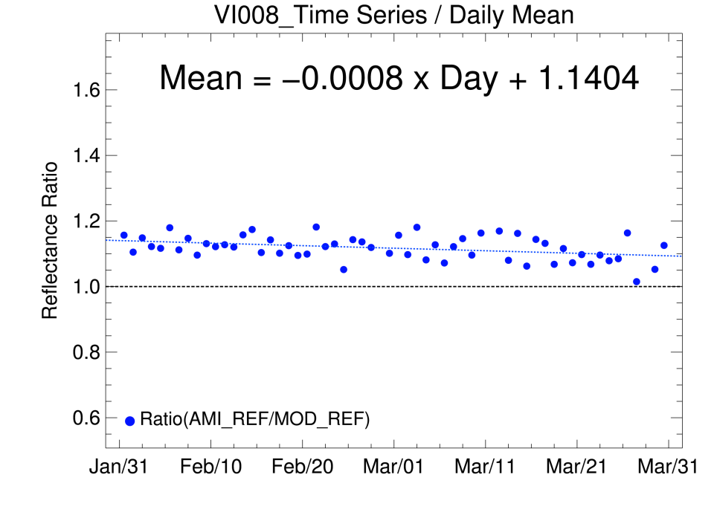
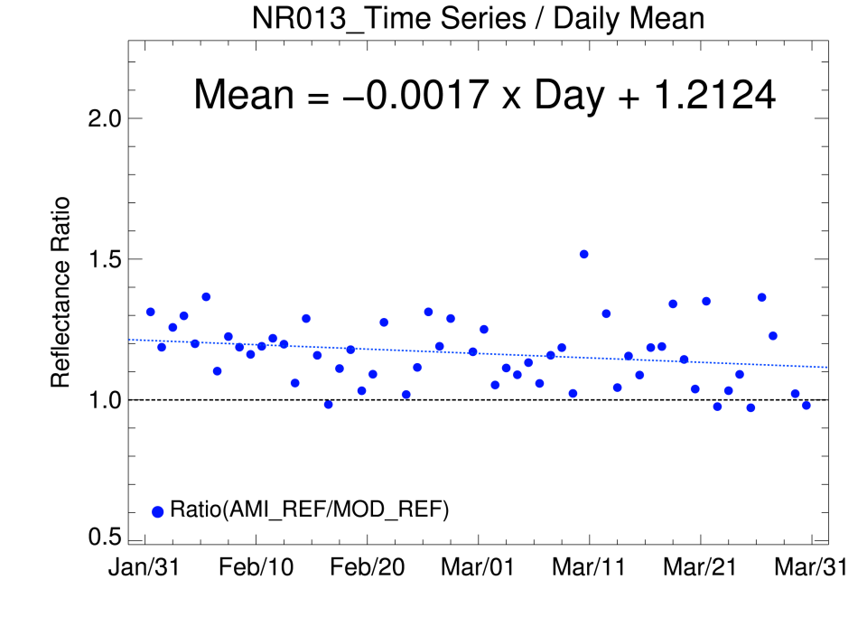
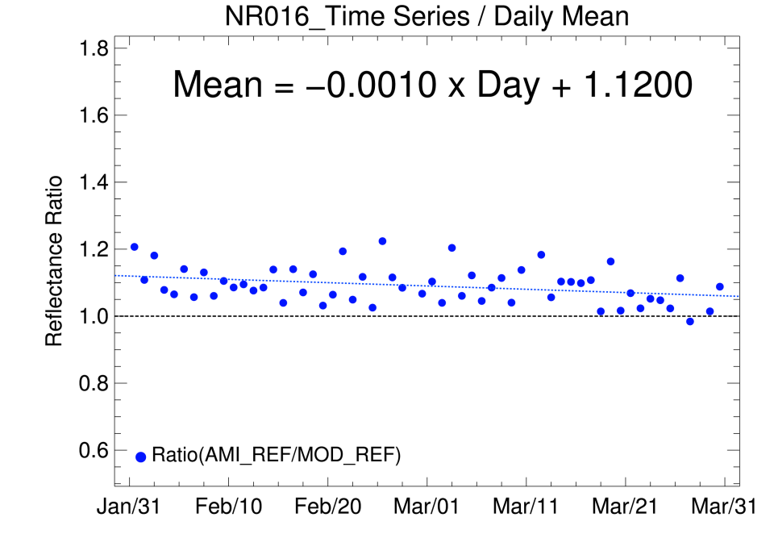
Ray Matching MODIS results(Feb. ~Mar. 2020.)
일평균
Slopes show negative value in February to March 2020.

Slide 8
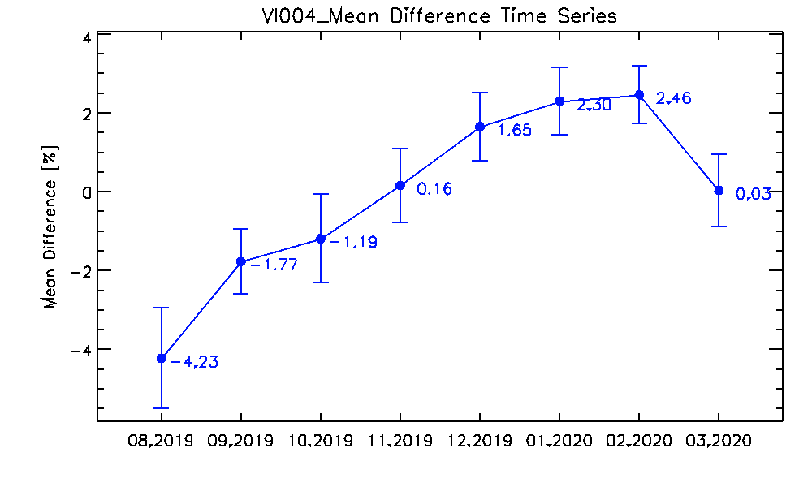
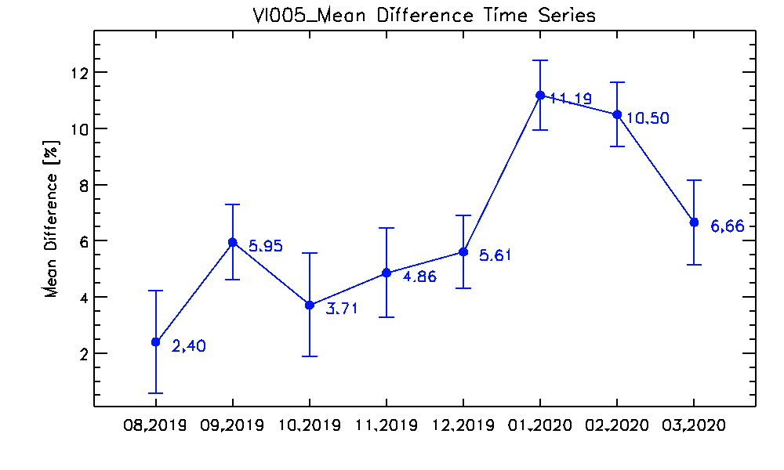
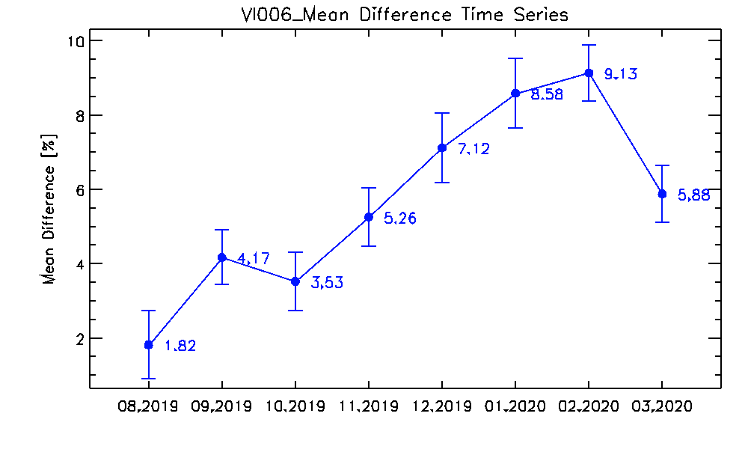
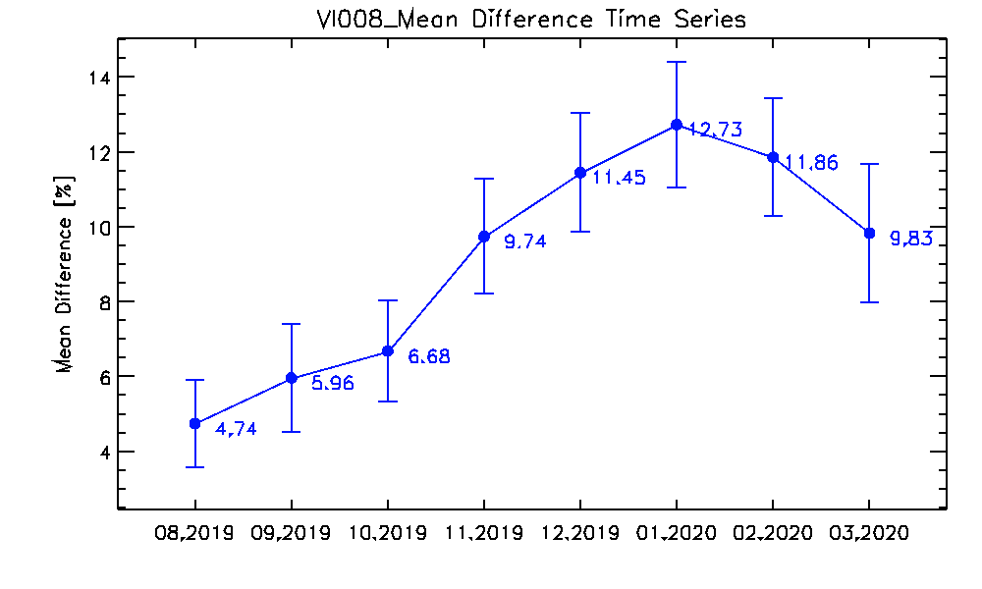
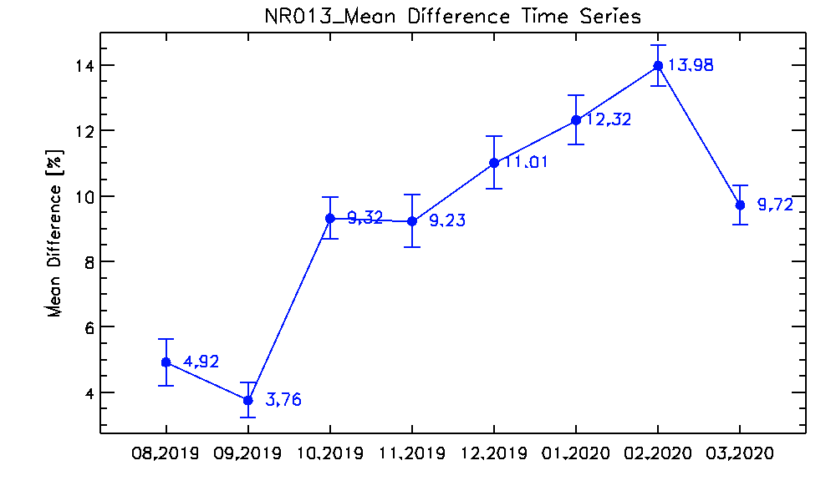
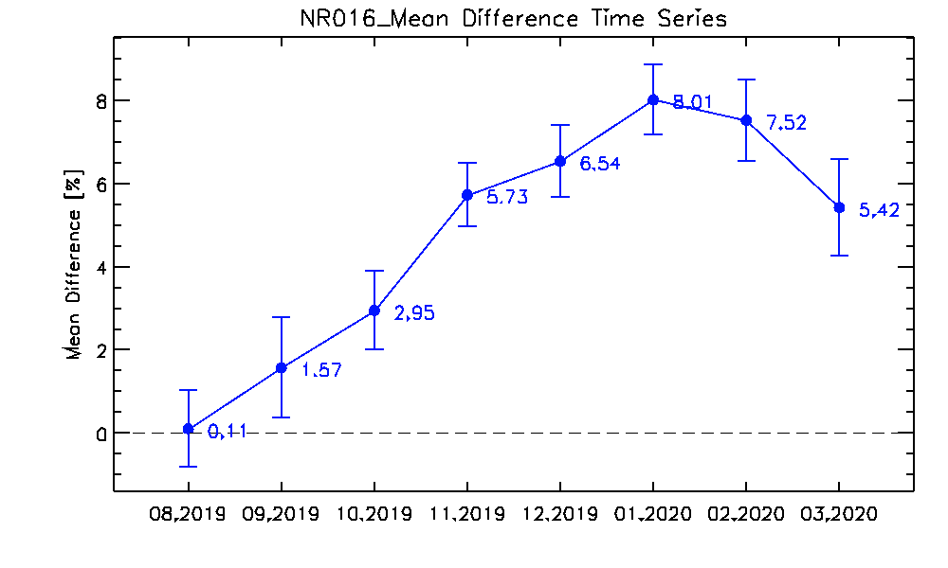
Ray Matching MODIS Mean Diff.(Aug. 2019.~Mar. 2020.)
일평균
Mean Difference & Uncertainty(k=1)

Slide 9
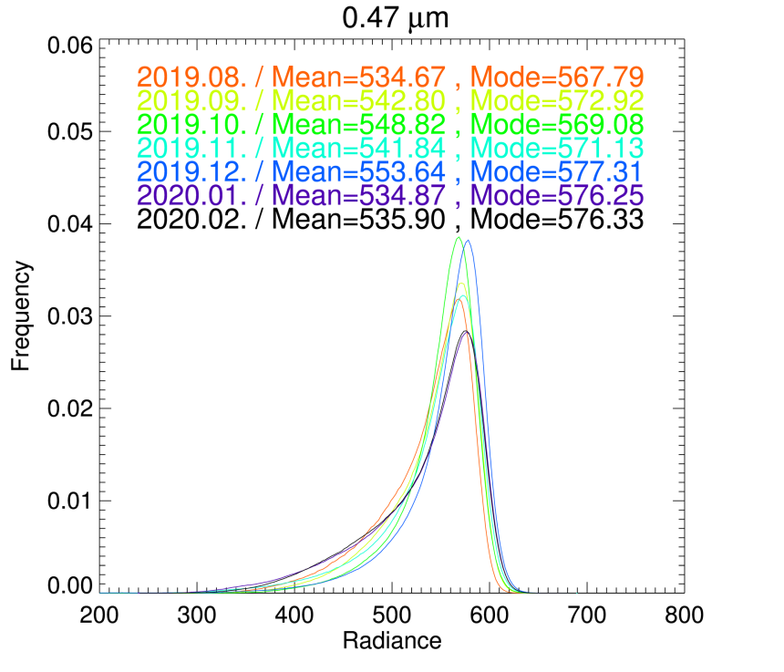
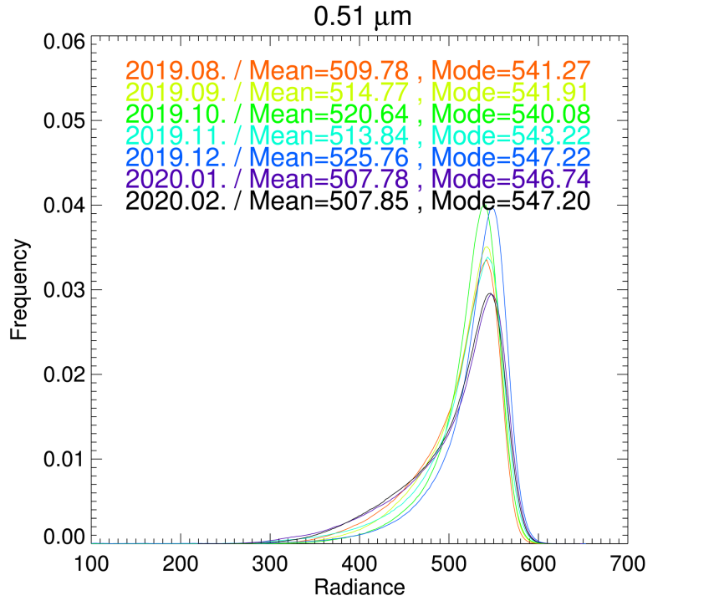
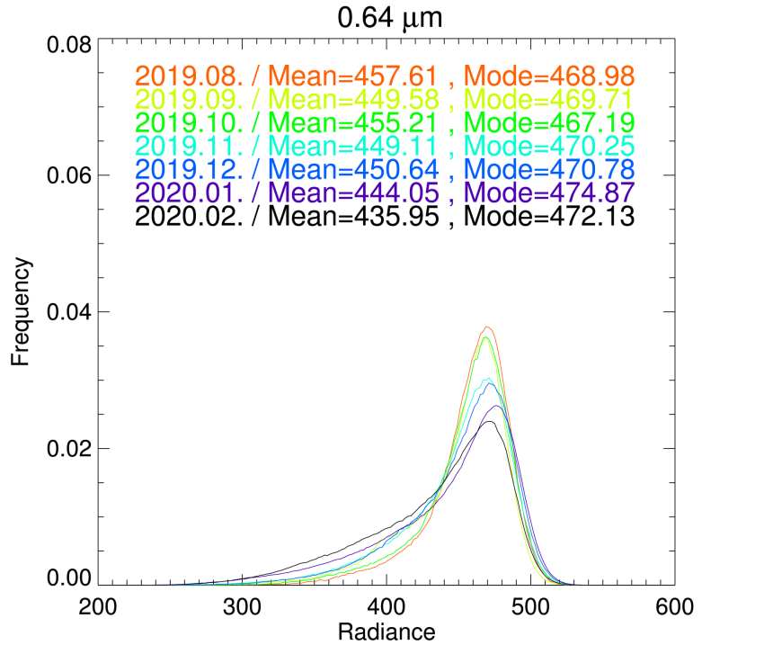
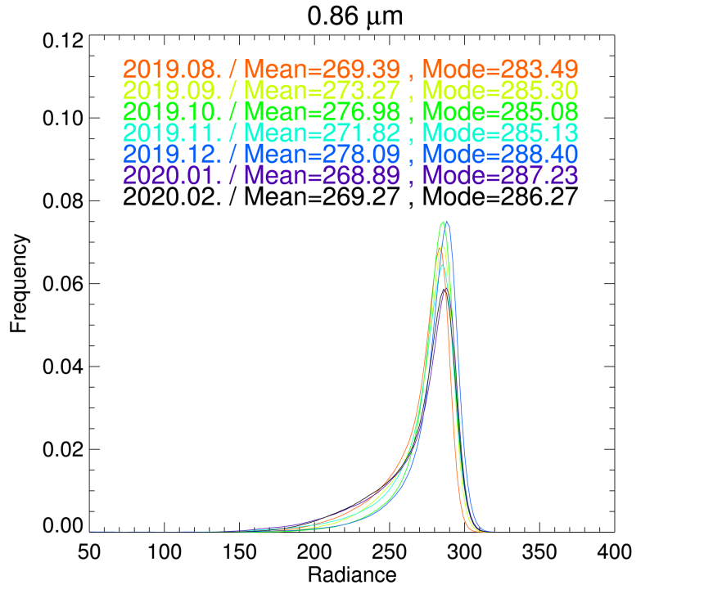
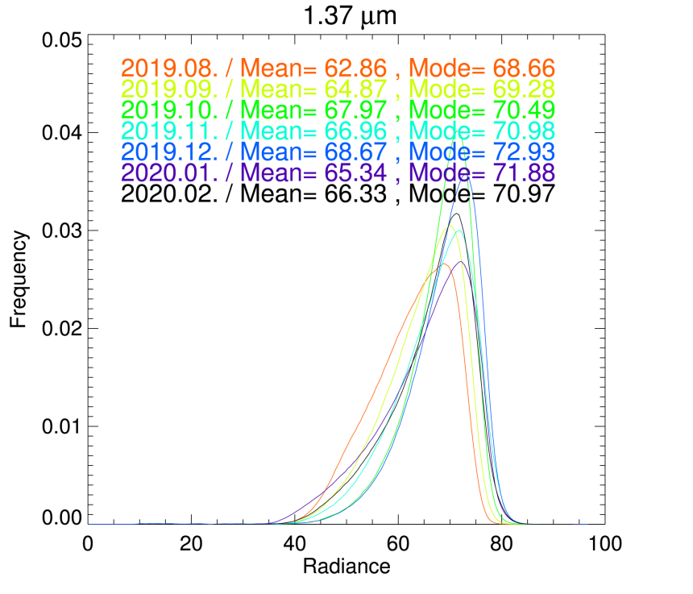
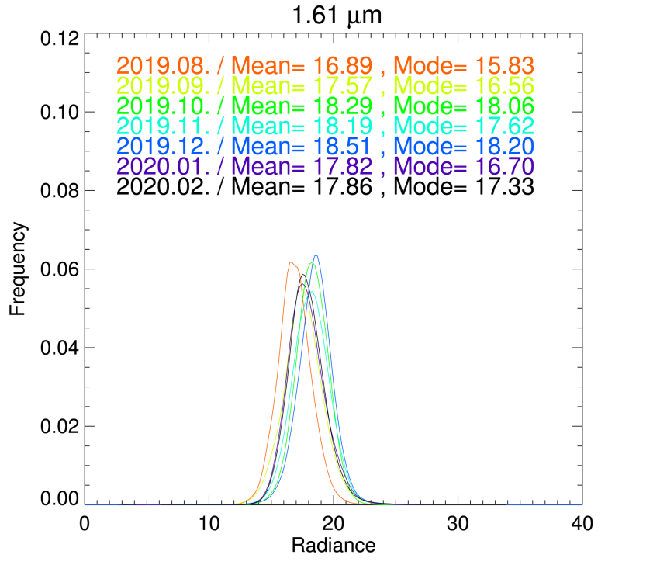
Monthly Histogram(Radiance, Over DCC)
일평균
Aug. 2019. ~ Feb.2020.

Slide 10
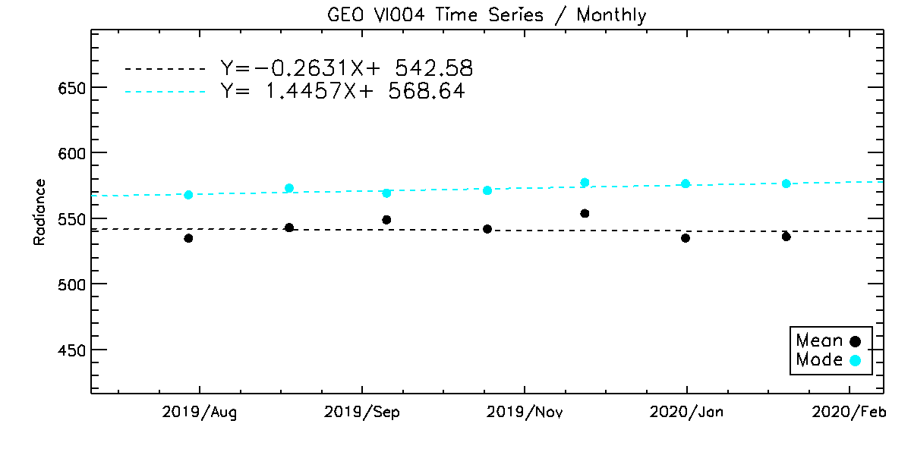
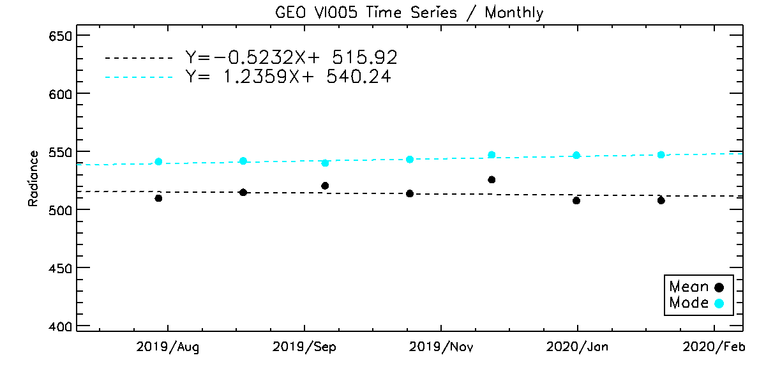
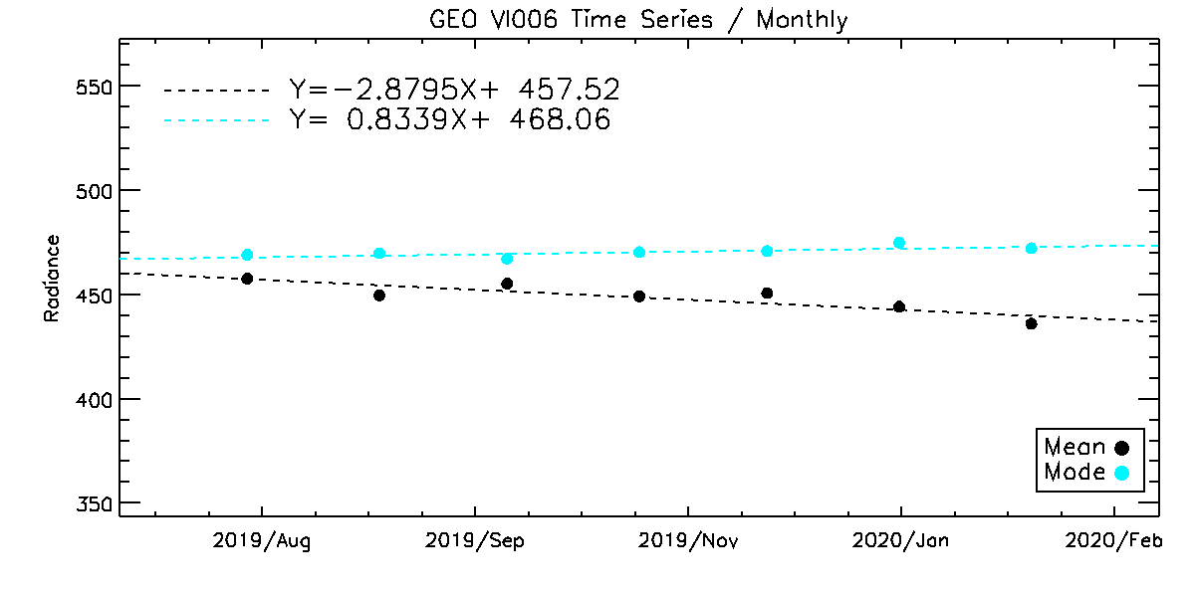
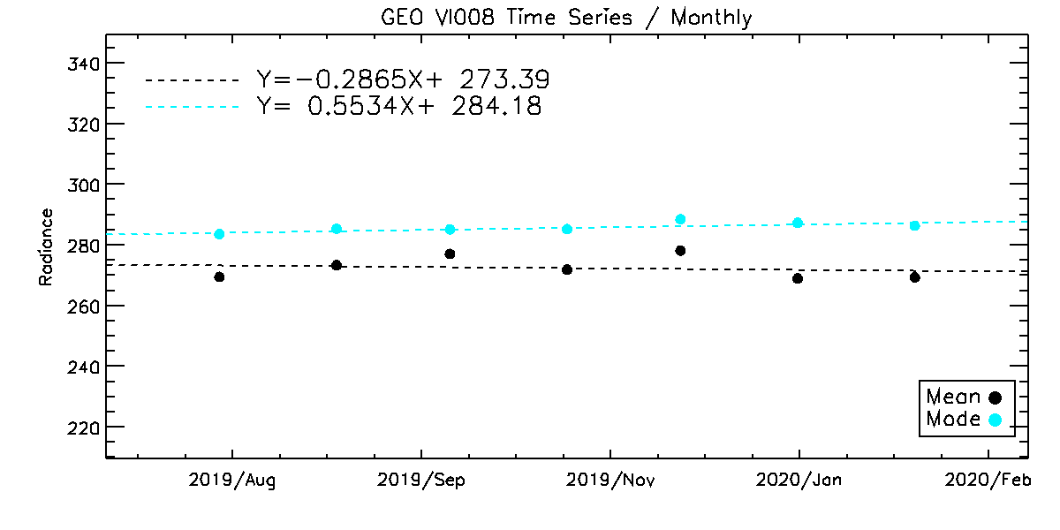
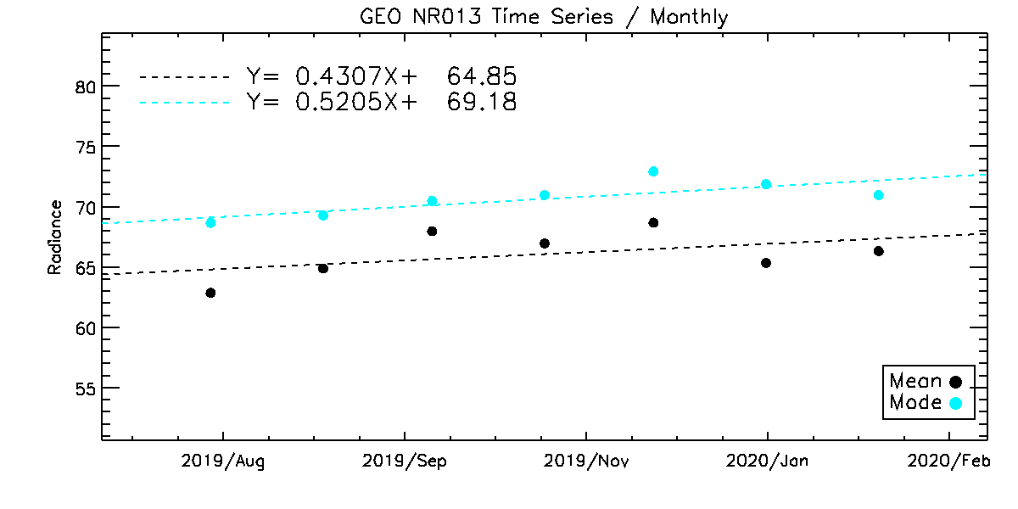
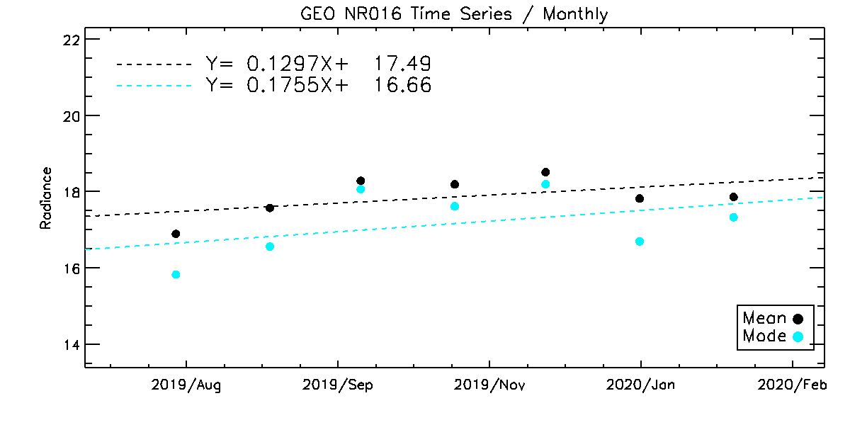
Time Series(Mean, Mode)
일평균
Aug. 2019. ~ Feb.2020.

Slide 11
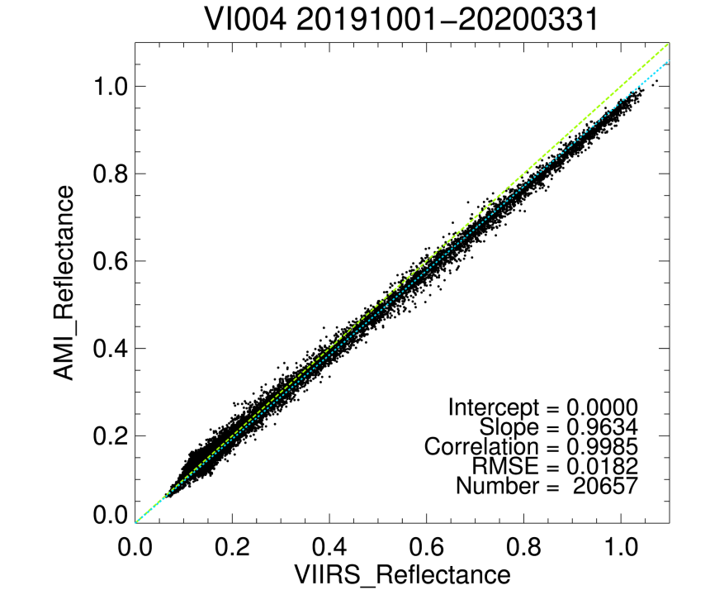
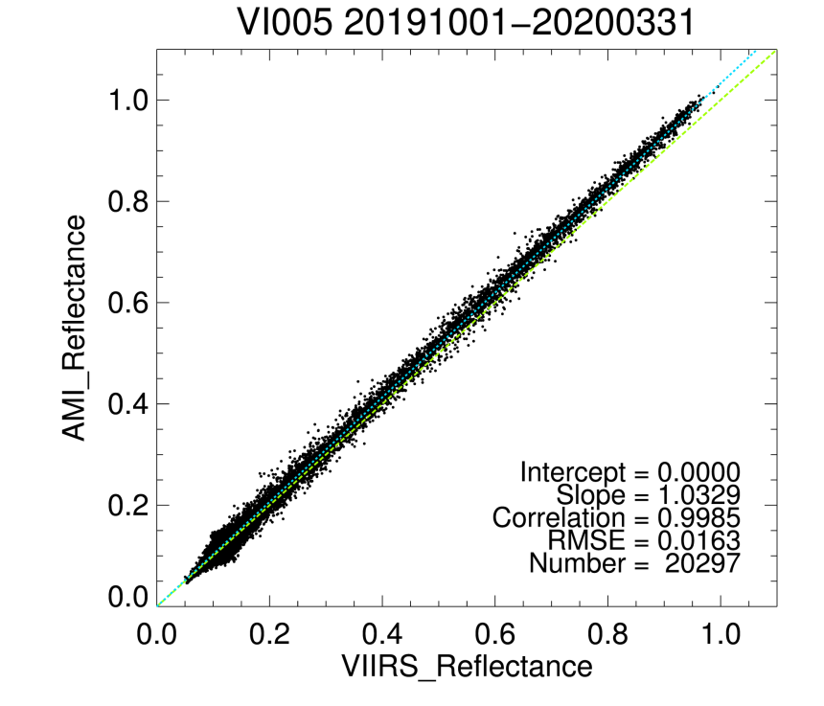
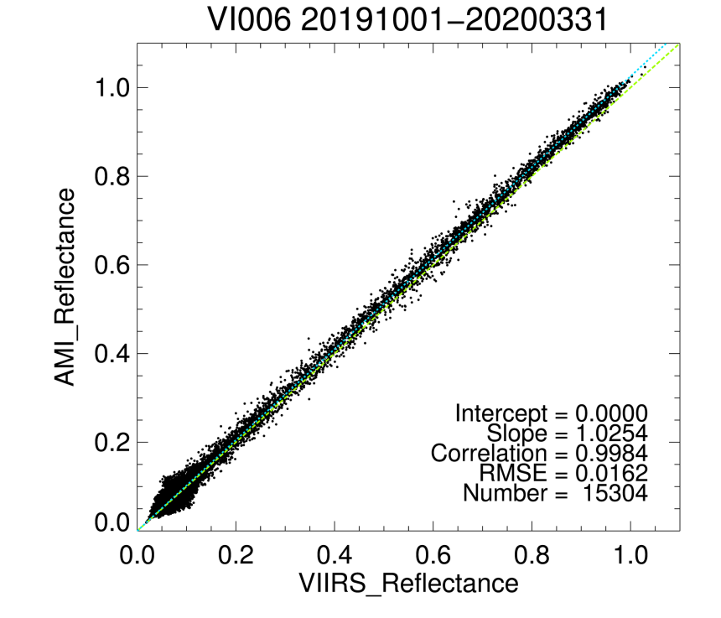
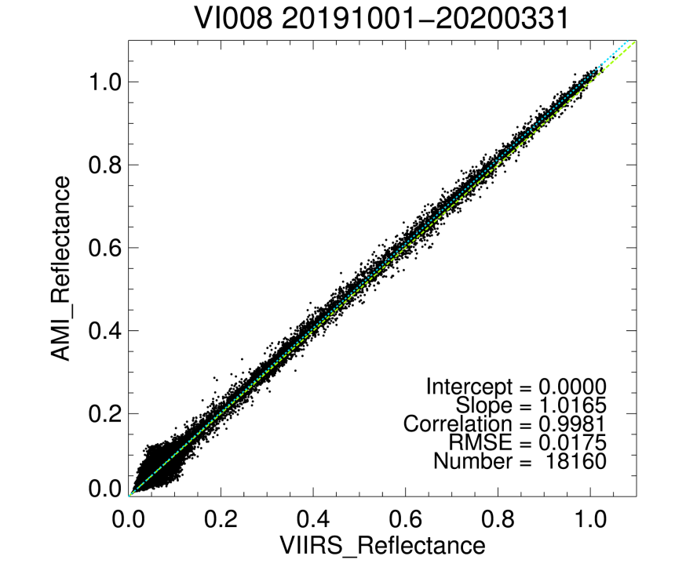
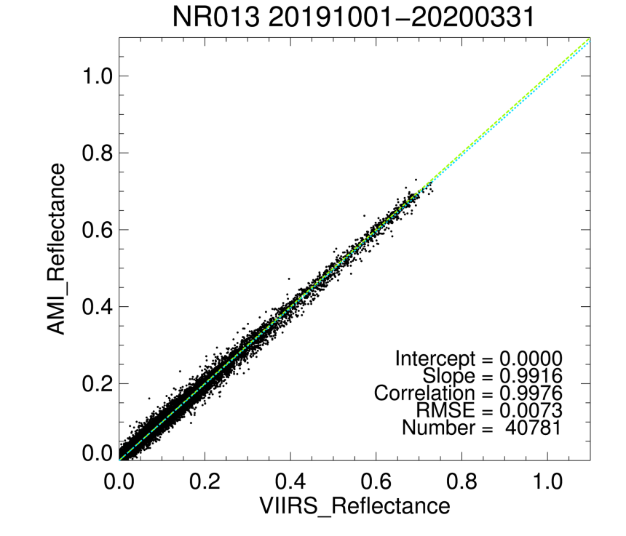
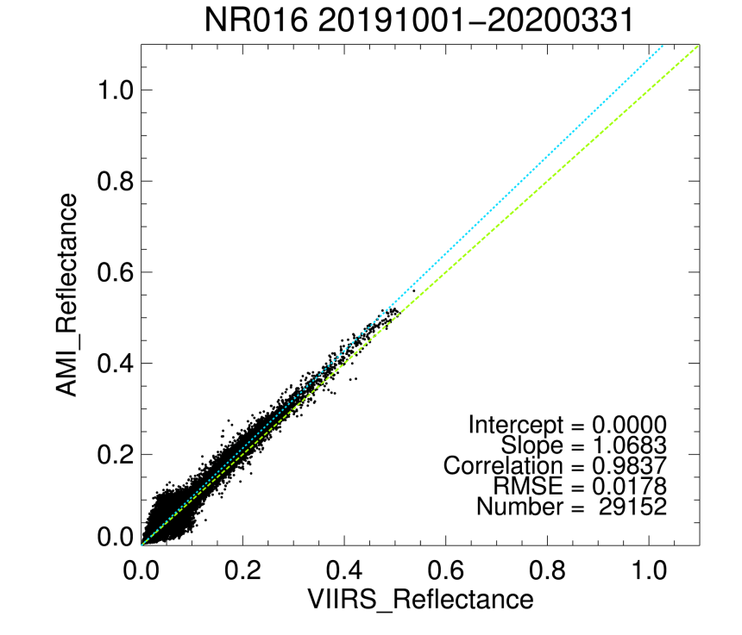
Ray Matching VIIRS results(Oct. 2019.~Mar. 2020.)
일평균

Slide 12
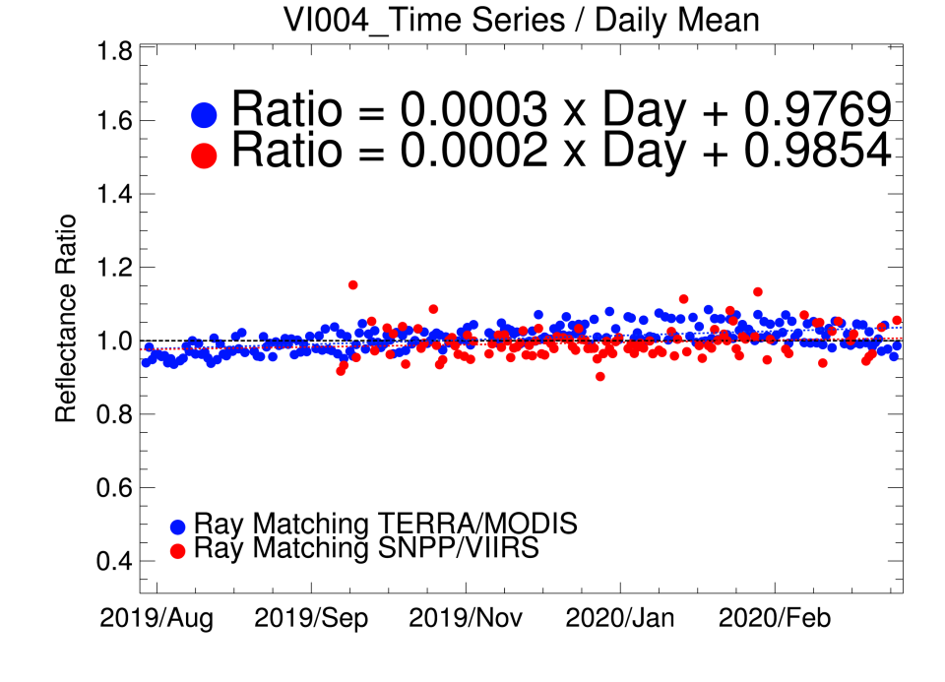
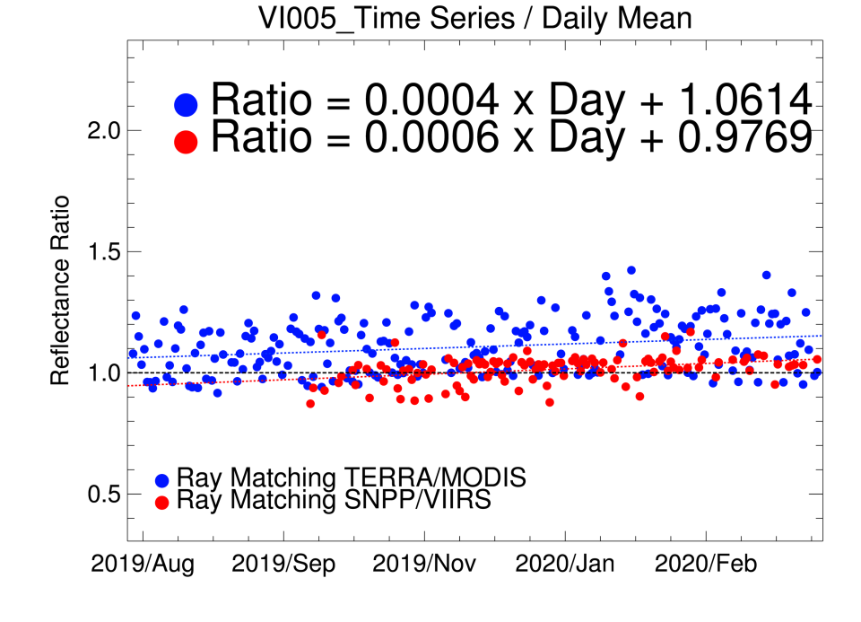
Ray Matching VIIRS results(Oct. 2019.~Mar. 2020.)
일평균
Y Axis =$AMI Ref. / MOD Ref.$

Slide 13
Ray Matching VIIRS Mean Diff.(Oct. 2019.~Mar. 2020.)
일평균
Mean Difference & Uncertainty(k=1)

Slide 14
Lunar Calibration
GK2A observed the moon about 40~50 times per month
GIRO model is used for lunar calibration
GK2A observes the moon where is located between red circle(FOV) and green circle(earth rim)
month | No. of moon observation | No. of used data for calibration
5 | 21 | 18
6 | 36 | 27
7 | 45 | 36
8 | 42 | 39
9 | 51 | 42
10 | 42 | 30
11 | 42 | 39
12 | 75 | 60
1 | 42 | 30
2 | 69 | 33
3 | 39 | 24

Slide 15
Lunar Calibration results
Normalized Ratio
$R_{nor}= \frac{{Ratio}_{t}}{{Ratio}_{t0}} −1$
* : monthly mean of
VNIR channels Gain(m)
Lunar calibration results (degradation trend) are similar with Ray matching results on page 6 and 12

Slide 16
Summary
AMI shows the positive degradation ratios (All channels!)
But, the slope values become negative on February 2020.
It seems there are monthly variation in VISNIR calibration?
For lunar calibration, it look like a seasonal variation, so it needs more long term monitoring
More detailed lunar calibration results will be presented in the 3rd lunar calibration workshop
SNPP VIIRS seems more stable than Terra MODIS. But, showing relatively large uncertainty
Method | Data period | Values | B01 (0.47um) | B02 (0.51um) | B03 (0.64um) | B04 (0.86um) | B05 (1.37um) | B06 (1.61um)
Ray Matching (AMI VS MODIS) | August 2019 ~ March 2020 | Mean difference [%] | -0.17(±0.95) | 6.22(±1.49) | 5.57(±0.82) | 8.97(±1.51) | 9.19(±0.68) | 4.59(±0.96)
Ray Matching (AMI VS VIIRS) | October 2019 ~ March 2020 | Mean difference [%] | -1.82(±1.34) | 1.00(±1.08) | 1.66(±1.20) | 0.65(±1.33) | -1.29(±0.60) | 3.90(±1.22)
Lunar Calibration (using GIRO) | May 2019 ~ March 2020 | Degradation ratio [%] | 0.059±0.010 | 0.039±0.007 | 0.027±0.008 | 0.023±0.005 | 0.051±0.009 | 0.042±0.012
*All Uncertainties k=1

Slide 17
Thank you
Name : E.K. (EunKyu Kim)
E-mail : ngnku456@korea.kr
Any Comments or Questions.
Special thanks to Fangfang ! ☺

Slide 18
Ray Matching method
일평균
Level1B Data
Level1B Data
Subset threshold : 98.2~158.2°E, 30°N~30°S, 0.1°ⅹ0.1° Grid
GEO(AMI)
LEO
Temporal Collocation
Time Difference of GEO-LEO : ± 5 Min.
Make Grid Data
Solar zenith angle & Viewing zenith angle < 40°
Difference of solar zenith & azimuth angle < 5°
Difference of viewing zenith angle < 10°
Difference of viewing azimuth angle < 10°
Reflectance STDV in each grid < 0.05
Bin spatial homogeneity < 80% (Ex. 96#/121#)
Remove Sun Glint Data
Filtering data
Analysis

Slide 19
GSICS DCC method
일평균
Level1B Data
Level1B Data
Subset threshold : 108.2~148.2°E, 20°N~20°S
GEO(AMI)
LEO
DCC detection
BT 11μm < 205°K
Standard deviation of 3x3 pixels BT 11μm < 1°K
Standard error of 3x3 pixels radiance < 3%
SZA < 40° , VZA < 40°
Select
GEO DCC Pixels
Select
GEO DCC Pixels
Hu BRDF Model Apply
GEO
$${CNT}_{nadir}$$
LEO
$${Radiance}_{nadir}$$
DCC counts are normalized using Hu BRDF model.
PDF Analysis
GEO Monthly
Mode/Mean
LEO Monthly
Mode/Mean
Monthly PDF(Possibility distribution function).
Monthly Mode, Mean, Gain(LEO Radiance/GEO DC)
Long Term
Relative trending Analysis

Slide 20
Ray Matching MODIS results(Aug.2019.~Mar. 2020.)
일평균

Slide 21
Ray Matching VIIRS results(Oct.2019.~Mar. 2020.)
일평균

Slide 22
Ray Matching VIIRS results(Oct. 2019.~Mar. 2020.)
일평균
Y Axis =$AMI Ref. / MOD Ref.$

Slide 23
Ray Matching VIIRS results(Feb.~Mar. 2020.)
일평균
Slopes show negative value in February 2020.

Slide 24
SCT Averaged Gain M

Slide 25
SCT Averaged Gain M

Slide 26
GSICS DCC(Deep Convective Cloud)
Implementation of GSICS DCC method
To select DCC pixels using TB(IR) and homogeneity checks
TB(IR) < 205K; STDV(RB) < 1K; STDV/Mean(rad) < 0.03%
Use Hu BRDF model to consider the DCC reflectance
To investigate degradation rate using MODE and MEAN of monthly DCC pixels
*Shading area: 3 sigma values
Red = 2011
Blue = 2017
Degradation Rate(Mode) [%/year]
Degradation Rate(Mean) [%/year]
= -1.34 ±0.08
= -1.25 ±0.17
Notes:
GSICS DCC is a method of monitoring the degradation rate of the visible channel using the monthly mode and average value of the digital count. This method is applying the BRDF model by selecting the DCC pixel corresponding to the above condition.
From the figure on the right side, you may see the similarity among the monthly distribution of digital count
and there is moving trend from the right to the left red to blue over time starting from 2011 to 2017.
This is same results at the left figure.
The degradation ratio of MODE is -1.34% per year and MEAN is -1.25% per year.
The MODE’s uncertainty is lower than earth targets uncertainty.
So, GSICS DCC method can get a stable results.

Slide 27
Lunar Calibration results
Lunar Irradiance Ratio (%)
$${Ratio}_{t}= \frac{{Obs}_{irr, t}}{{Rolo}_{irr,t}}$$
* : monthly mean of
VNIR channels Gain(m)

Slide 28
VI004
(20190517_013119_L0)
IR133
(20190517_013119_L0)

Slide 29
20190820_061058
VI005
IR133

