Slide 1

Input from CEOS/GSICS Workshop of SI-traceable Space-based Climate Observing System
Greg Kopp¹ and Tim Hewison²
¹ Univ. of Colorado / LASP
² EUMETSAT

Slide 2
SI-traceable Space-based Climate Observing System (SITSCOS)
Goal
  Quantify benefits and requirements of a space-based climate observing system
Logistics
  Hosted by the National Physical Laboratory in London, UK
    9-11 September 2019
  100 attendees (international)
  SOC: Nigel Fox, Tim Hewison, Greg Kopp, Bruce Wielicki, Xiuqing Hu
  Organized by the Global Space-based Inter-Calibration System (GSICS) and the Committee on Earth Observation Satellites - Working Group on Calibration and Validation (CEOS-WGCV)

Slide 3
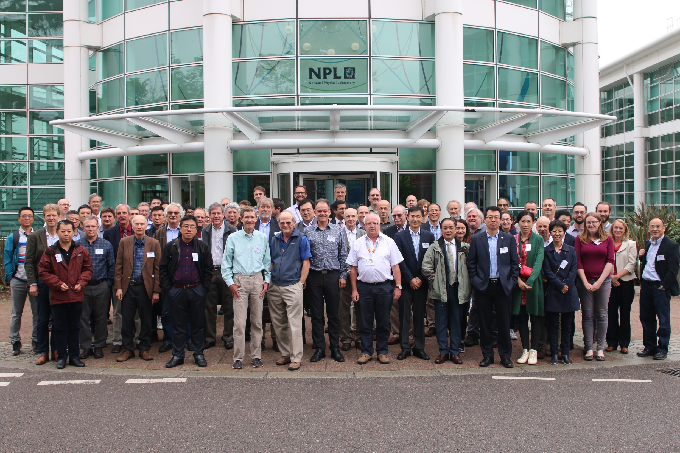
SI-traceable Space-based Climate Observing System (SITSCOS)

Slide 4
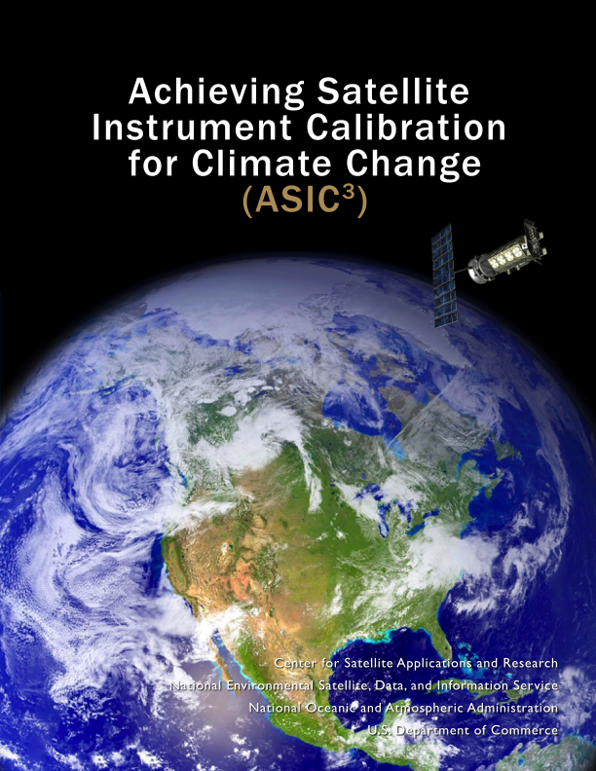
SITSCOS Workshop Report
Key Questions
  What is the interplay between stability, overlap, and absolute calibration?
  What are the measurement requirements?
Will become the final overview and report of workshop with input solicited from all attendees and other international researchers
Intent: Solicit endorsements from agencies (GSICS, CEOS, GCOS, GEO, space agencies, etc.)
  To be incorporated as input to their vision documents
Organizing committee writing high-level front-end overview

Slide 5
SITSCOS Workshop Report
Consolidates climate-driven measurement requirements

Slide 7
Calibration Methods
Ground calibrations for accuracy
In-instrument calibration source
Reliance on on-orbit stability and continuity
Inter-calibration
  Under-flights, vicarious targets, SNOs, solar/lunar observations
SI Traceability
Weather vs. Climate Measurements

Slide 8
Stability and Continuity vs. Absolute Accuracy
Stability and Continuity
Absolute Accuracy
Uncertainties increase monotonically with time
  Relies on instrument stability with time
  and every transition from one instrument to another increases uncertainties
Risk of a data gap is loss of the entire record
  This risk increases with time
Relative uncertainties are good over short time periods
Uncertainties are independent of time and temporal separation
Can span a data gap
Absolute accuracy helps over long time periods
Has benefits even with continuous measurements
Accuracy
Uncertainty
Inst. 3
Inst. 5
Inst. 2
Data Gap
Inst. 4
Inst. 1
Stability & Cont
Stability & Cont
Inst. 6
Instrument (& Time)

Slide 9
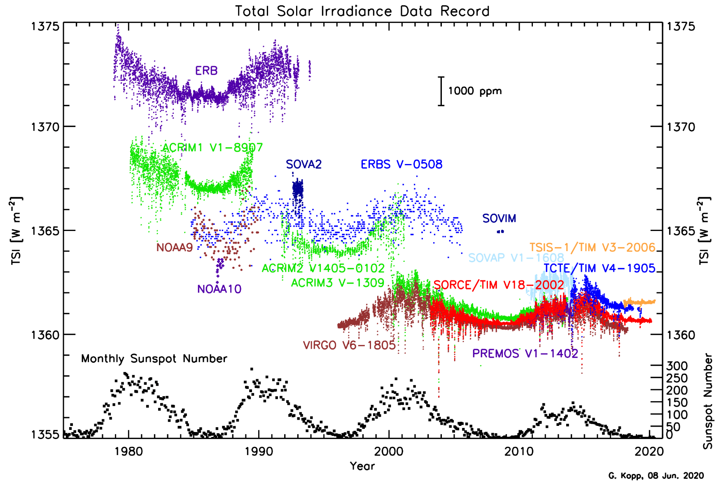
Importance of SI Traceability
SI traceability and absolute accuracy help bridge data gaps in long-term records

Slide 10
SI Traceability Relies on Thorough Uncertainty Budgets:
Example – TSI Instrument Uncertainties

Slide 11

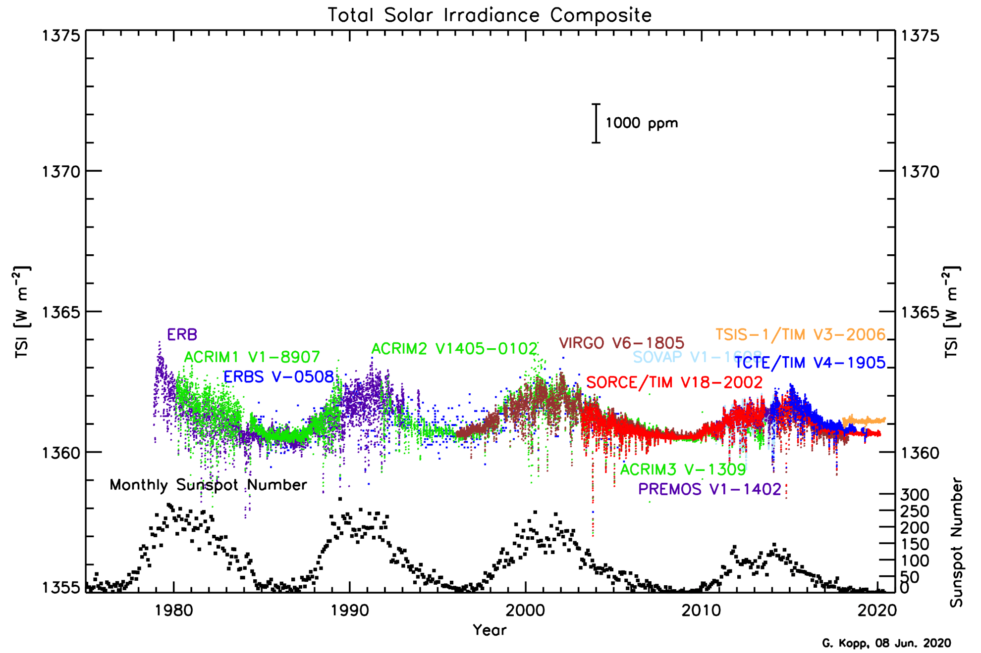
Issues With Continuity and Stability Approach:
Example – Total Solar Irradiance Composite

Slide 12
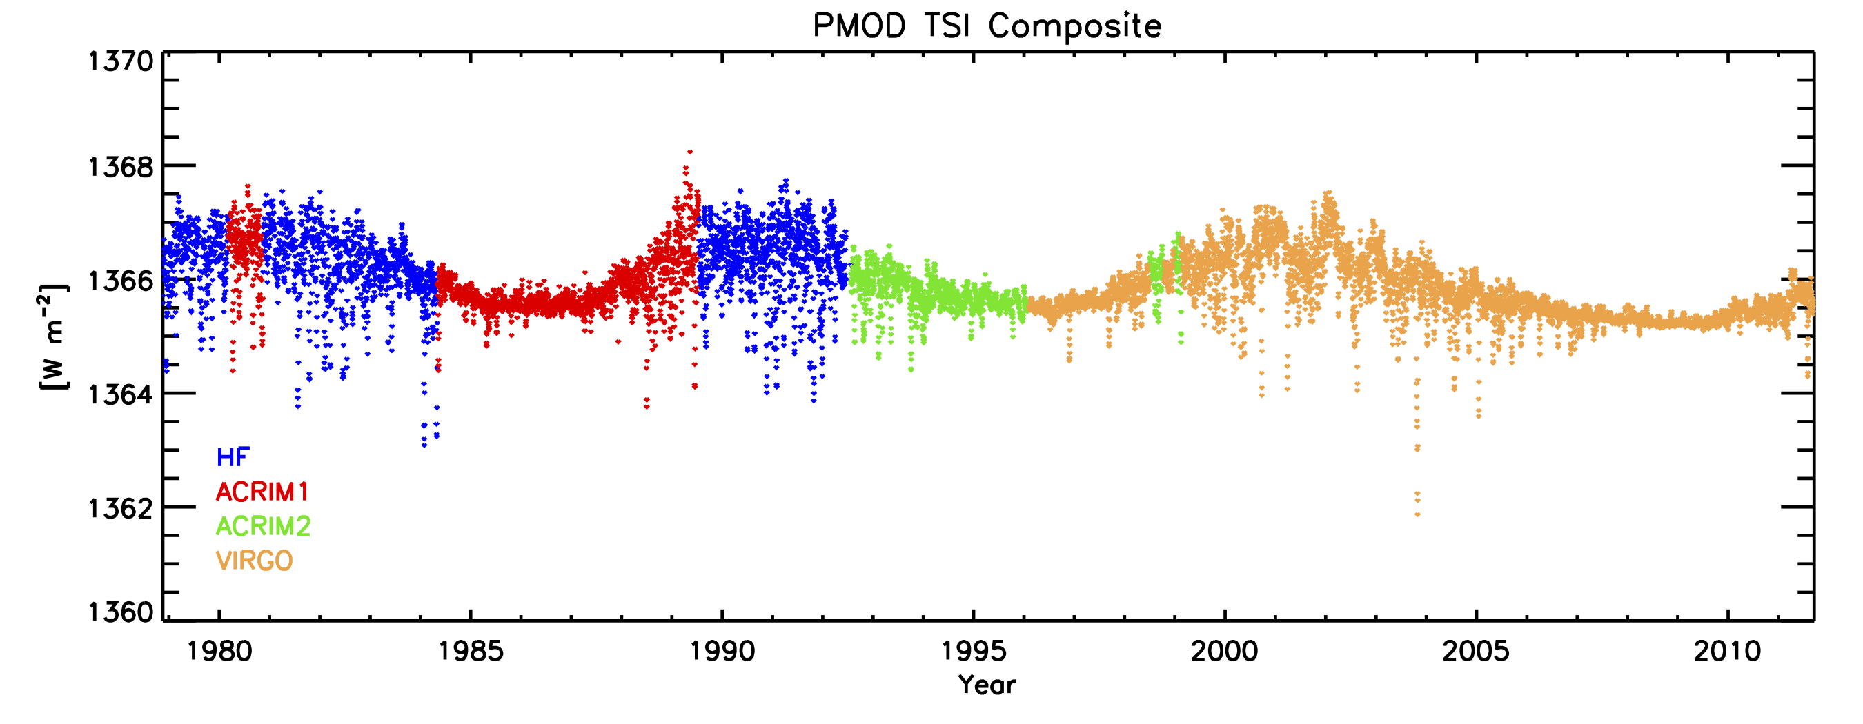
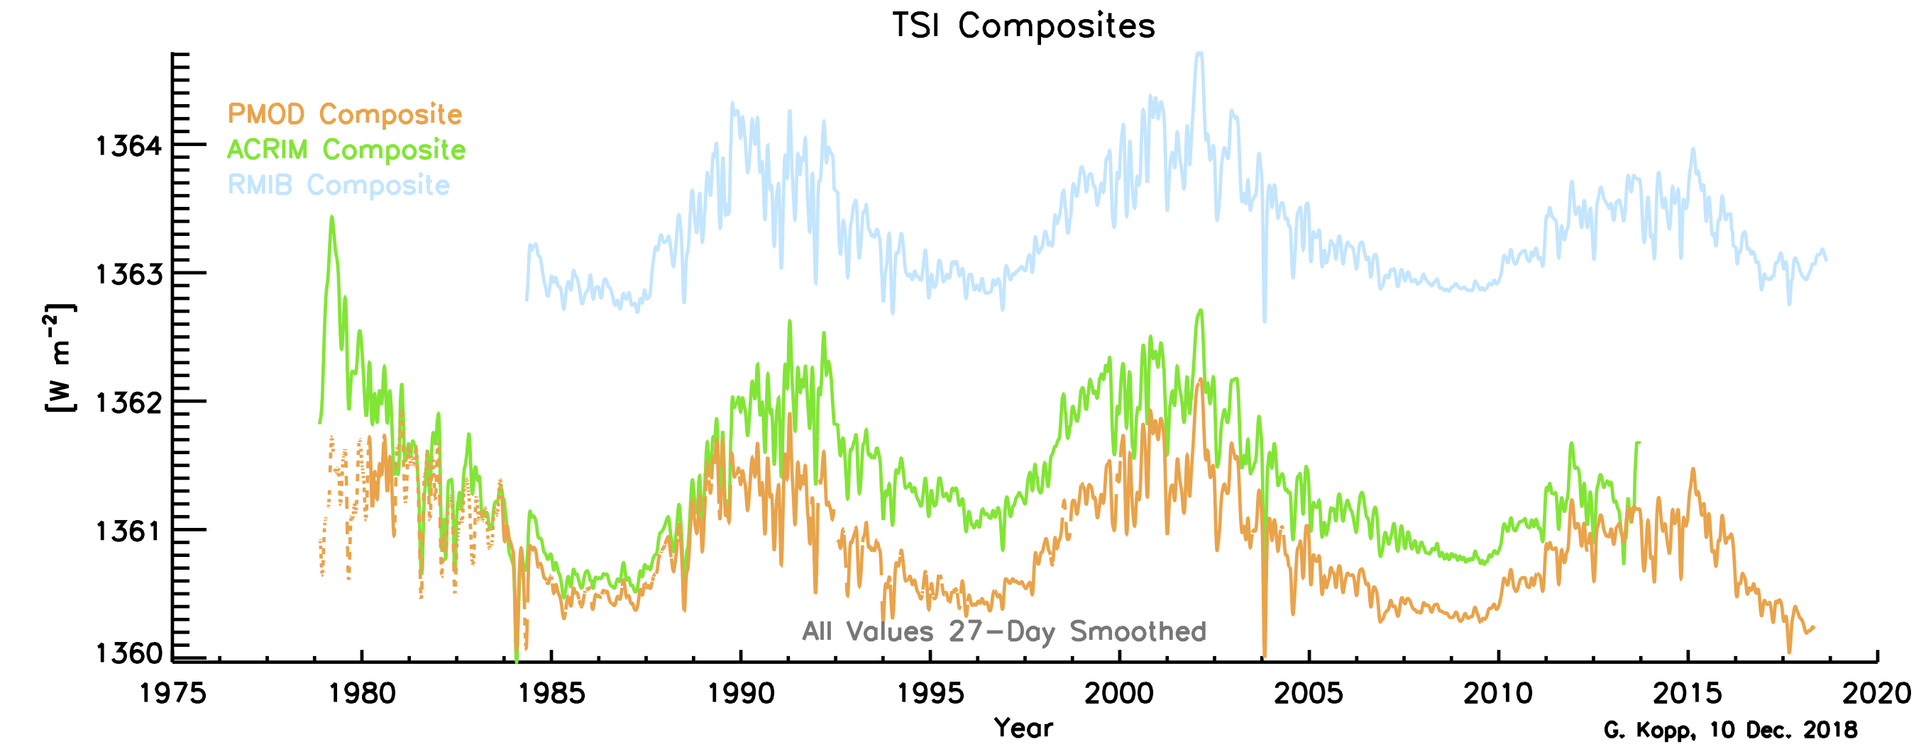
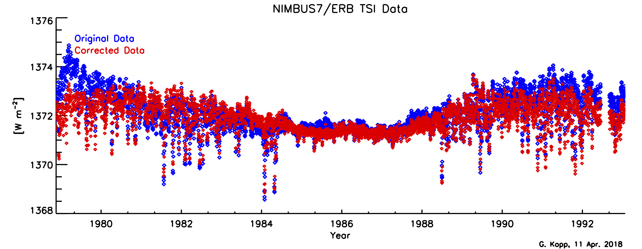
Issues With Continuity and Stability Approach:
Problems with Traditional TSI Composites
Created by individuals (PIs)
Binary (and biased) selection of instrument data used
  Discontinuities at boundaries
Controversial corrections applied to data records
Normalizations incorrect
Lack uncertainties

Slide 13
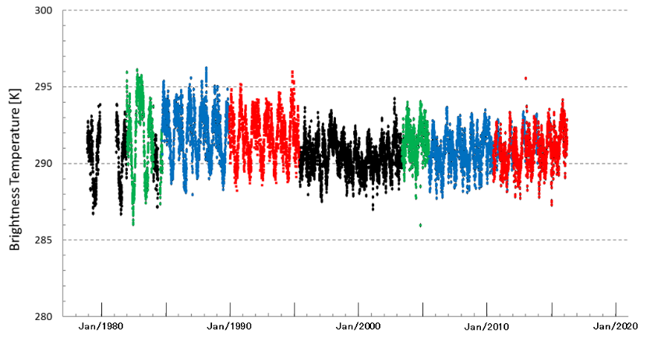
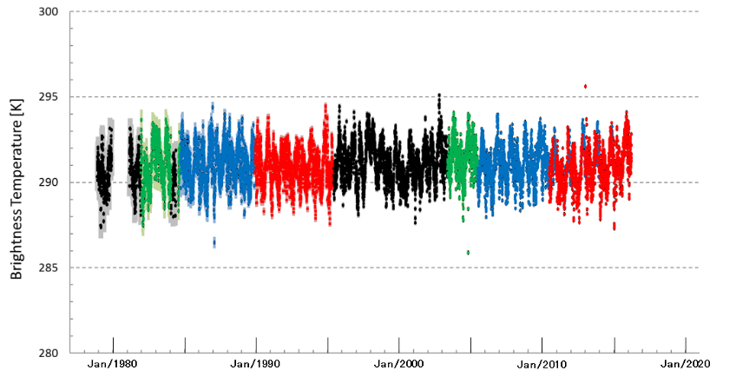
Example – Prime Corrections
- Applying Prime Corrections to create a Fundamental Climate Data Record -
Harmonization
Sensor 1
Sensor X
Radiances
Harmonized calibration
Original calibration
Time
Note, radiances from harmonized calibrations differ due to differences in spectral characteristics of the sensor
● GMS/VISSR
● GMS-3/VISSR
● GMS-5/VISSR
● MTSAT-1R/JAMI
● GMS-2/VISSR
● GMS-4/VISSR
● GOES-9/Imager
● MTSAT-2/IMAGER
Figure : Harmonized time-series of GMS, GMS-2, GMS-3, GMS-4, GMS-5, GOES-9, MTSAT-1R and MTSAT-2 of infrared clear sky radiances
using Metop-A/IASI as Prime Reference (Tabata et al. 2019, Remote Sensing)
Figure : Operational calibrated time-series of GMS, GMS-2, GMS-3, GMS-4, GMS-5, GOES-9, MTSAT-1R and MTSAT-2 of infrared clear sky radiances
using IASI as Prime Reference (Tasuku et al. 2019, Remote Sensing)
Notes:
Shows Prime GSICS Correction approach applied to re-calibration of Japanese geostationary imagers to generate for Fundamental Climate Data Records
using historical references based on a series of double-differences to tie whole time series to the anchor reference at one point in time
Top figure shows timeline of different reference instruments’ relative calibration (HIRS/2, AIRS and IASI-A) – before and after adjustment
Bottom figure shows timeline of mean BT from series of geostartionary imagers’ IR window channels – before and after applying the prime correction – including uncertainties
13

Slide 14
Concept – Prime GSICS Corrections
Prime corrections aim to correct for biases between different reference instruments and combine them
Define one Anchor GSICS Reference
  For each spectral band/application
  By consensus agreement within GSICS
Use other references as Transfer References
Construct delta corrections from double-differences
Apply to GSICS corrections from each reference
So they are consistent with the anchor reference
Blend modified corrections, accounting for uncertainties
Ensures long-term continuity without calibration jumps
Traceability back to single Anchor GSICS Reference
Propagate uncertainties from all constituent parts
But how to account for possible drifts outside overlaps?

Slide 15
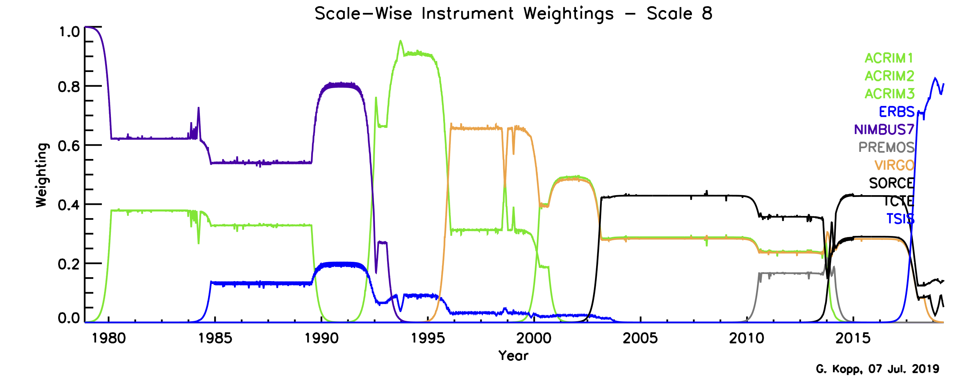
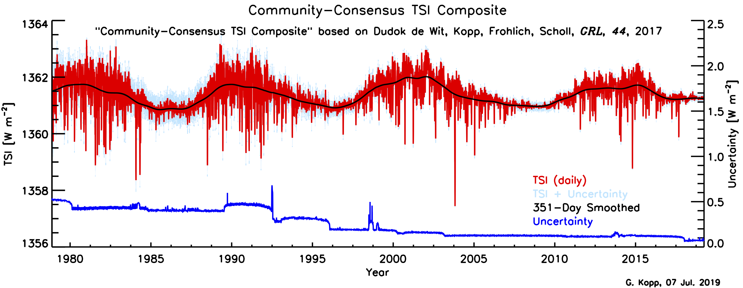
Example – Blending of Data for
“Community-Consensus TSI Composite”
Use scale-wise weightings to blend data from all instruments

Slide 16
Overview of Inter-Calibration Methods
 | Direct Inter-Calibration (IR) | Indirect Inter-Calibration (VIS/NIR)
 | Direct Inter-Calibration | Indirect Inter-Calibration
Inter-Calibration Approach | “SNO” using contemporary references | Pseudo Invariant Calibration Targets (PICTs) e.g. Moon, Deserts, DCC, … Transfer calibration from Reference Instrument
Issues | Cover target mission lifetime Different sensors/orbits combinations Ensure full range of conditions covered: Spectral bands Viewing Angles Scene Radiances Latitude Equator Crossing Time Spectral matching | Target characterization Static reference period (<10y) Spectral matching Over full range of conditions: Moon: Full range of lunar phase & libration Deep Convective Cloud (DCC): Seasonal/geographic variations Deserts: All viewing/solar geometries, seasons But reference + target subject to degradation

Slide 17

















Global Space-based Inter-Calibration System
What is GSICS?
  Global Space-based Inter-Calibration System
  Initiative of CGMS and WMO
  Effort to produce consistent, well-calibrated data from the international constellation
  of Earth Observing satellites
What are the basic strategies of GSICS?
  Improve on-orbit calibration by developing an integrated inter-comparison system
        Initially for GEO-LEO Inter-satellite calibration
        Being extended to LEO-LEO
  Best practices for calibration & characterisation
This will allow us to:
  Improve consistency between instruments
        Towards Interoperability
  Reduce bias in Level 1 and 2 products
  Support Cal/Val of new instruments
  Provide traceability of measurements
  Retrospectively re-calibrate archive data
  Better specify future instruments
NASA
USGS
JAXA
NOAA JMA
NIST KMA
WMO ROSCOSMOS
CMA
ROSHYDROMET
EUMETSAT
ESA IMD
CNES ISRO
Notes:
17
Well, what is GSICS?
The Global Space-based Inter-Calibration System (GSICS) is an initiative of CGMS and WMO, which aims to ensure consistent calibration and inter-calibration of operational meteorological satellite instruments.
One of the basic strategies of GSICS is to develop an integrated on-orbit cal/val system - initially by LEO-GEO Inter-satellite/inter-sensor calibration.
This will then allow us to provide corrections to improve the consistency between instruments, produce less biased level 1, and therefore, level 2 data, and ultimately, retrospectively re-calibrate archive data, which is of great interest in the climate monitoring community
CGMS= Coordination Group for Meteorological Satellites

Slide 18
Tying GSICS Products to Absolute Scale
Pre-launch instrument tests against SI standards
  CEOS+GSICS Workshop 2020 on pre-flight characterisation/calibration
Traceability chain may be compromised during launch
  Due to unexpected changes to the instrument and its operating environment
GSICS endorses establishing of a Space-based Climate Observing System
  Calibration directly traceable to SI-standards on-orbit
    e.g. CLARREO, its Pathfinder, or TRUTHS
  Provide an inter-calibration reference, which could be used to anchor inter-calibration products to an absolute scale
  Ideally hyperspectral with non-synchronous orbit
    To cover all reference instruments, characterise diurnal variations, viewing/solar geometry
Generically referred to as SI-Traceable Satellite instruments (SITSATs)

Slide 19

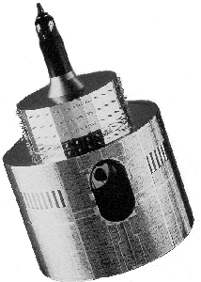


Inter-Calibrations Using SITSATs
REF
REF
MON
PICT
MON
SITSAT
SITSAT
Direct Inter-Calibration
Indirect Inter-Calibration
Figure: Different approaches to provide traceability of inter-calibration products for a Monitored instrument (MON) to an SI-Traceable Satellite instrument (SITSAT); Left: Direct Inter-Calibration: Using SNO-like approach to transfer calibration of Reference Instrument (REF) and direct inter-calibration of MON using SITSAT by SNO/Ray-matching (green arrow); Right: Indirect Inter-Calibration: Using a Pseudo Invariant Calibration Target (PICT) to transfer calibration of REF or SITSAT to MON (red arrow).

Slide 20
Guiding GSICS Data Principles
Generation of high-quality products
  Compare, monitor, and correct calibrations against community references
  Update calibration corrections routinely
  Specify uncertainties
  Thorough, well-documented, peer-reviewed procedures
  Based on varied techniques to ensure consistent and robust results
Delivery to users
  Free and open access
  Compare to community standards and other’s measurements
Best practices and uses
  Promote greater understanding of instruments’ calibration, by analysing the root causes of biases and open, community-inclusive inter-comparisons
  Near real-time availability (needed for more accurate weather forecasting products)
  Re-analysis (for improved understanding of long-term climate processes)
  Re-calibration of archive data (to generate Fundamental Climate Data Records)
SI Traceability =
unbroken chain of comparisons with associated uncertainties tied to accepted references

Slide 21
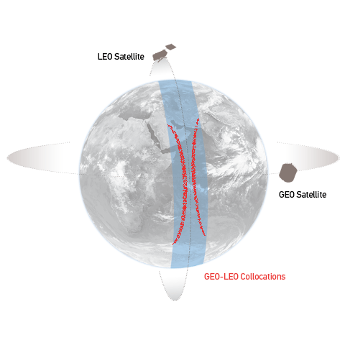
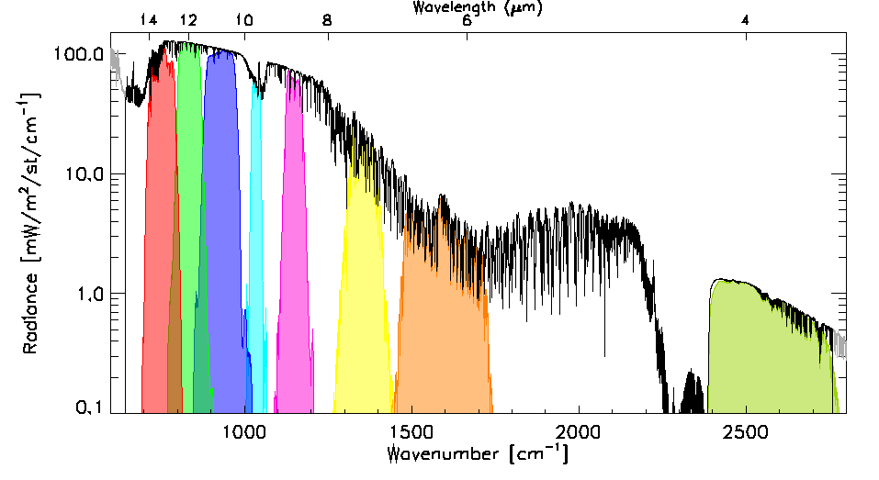
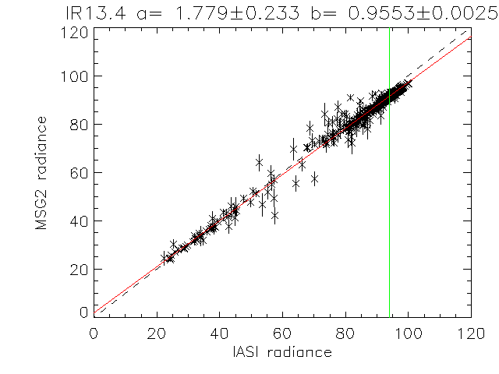
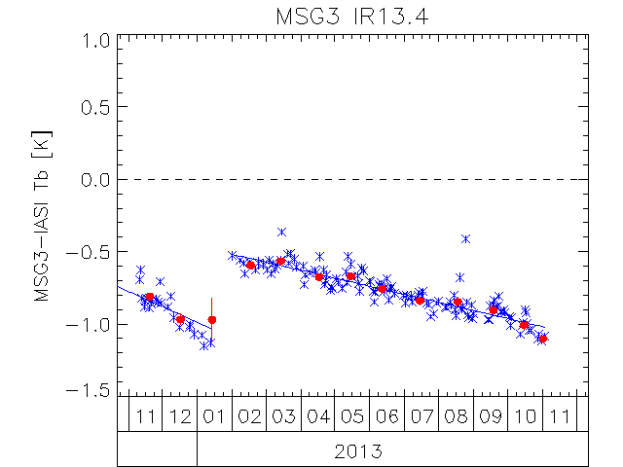
Direct Inter-Calibration
Example: GEO Imagers’ IR Channels
Tie to contemporary reference instrument with very small uncertainty
  Example – Hyperspectral Reference (IASI)
    Convolve IASI spectrum with Spectral Response Function (SRF) of monitored instrument
    Can diagnose SRF errors
Collocate in Space, Time, Angle
  Simultaneous Nadir Overpasses (SNOs)
Compare
  Apply weighted regression to collocated radiances
  Evaluate uncertainties
Generate Corrections
  Update daily
  Distribute data
Evaluate & Monitor Bias
[mW/m2/sr/cm-1]
[mW/m2/sr/cm-1]

Slide 22
GEO-LEO IR GSICS Corrections
GEO-LEO IR GSICS Corrections
  Empirical functions of scene radiance fitted
    in radiance-space of monitored instrument
  Each tied to single reference sensor
  Provided with image-to-image uncertainties
  Validated against error budget analyses
  Updated regularly
  Enable near-real-time analysis & re-analysis
Schematic illustration of typical GSICS Correction
applied to 13.4 µm channel of Meteosat-9
based on inter-calibration with IASI
Correction is radiance-dependent
Uncertainties increase for extreme radiances

Slide 23
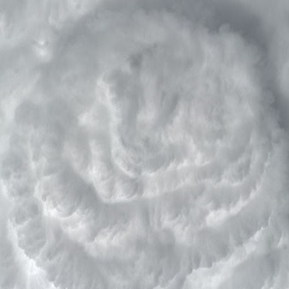
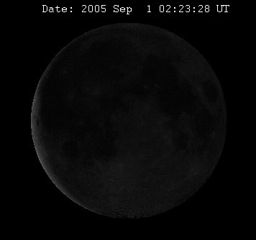
Indirect Inter-Calibration
Example: GEO Imagers’ Vis/NIR Channels
  To transfer calibration from single reference instrument
    Over a static period (when reference calibration is stable)
    Currently using NOAA-20/VIIRS
  But no suitable hyperspectral reference covering full VIS/NIR band
    Need Spectral Band Adjustment Factors (SBAFs)
    CLARREO & TRUTHS will help fill this need
  Uncertainties derived from statistics of invariant targets’ time series
    Difficult to propagate uncertainties through RTMs
  Pseudo Invariant Calibration Targets (PICTs) = Sites (PICS) + Moon + DCC + …
    Deep Convective Cloud (DCC)
      Globally available in equatorial band
      Selected based on IR, SZA, VZA thresholds - Invariant Reflectance – up to ~1 µm
      Long-term stability unknown – needs monitoring
    Moon
      Based on GSICS Implementation of ROLO lunar irradiance model (GIRO)
      Applicable between 350 and 2500nm, Phase angles ~±(2-90)°
      ARCSTONE and CLARREO to improve accuracy
    Deserts – potentially, in the future

Slide 25
GSICS IR Reference Traceability & Uncertainty Report
Aims
  To support choice of reference instruments for GSICS
  To provide traceability between IR reference instruments (IASI, AIRS, CrIS)
  To seek consensus on uncertainties in absolute calibration of reference sensors
  By consolidating pre-launch test results and various in-flight comparisons
Error Budget & Traceability
  Focus on radiometric and spectral calibration – for AIRS, IASI, CrIS
  Analysed following common approach
  To generate directly comparable error budgets for all reference sensors
Inter-comparisons
  Direct Comparisons: Polar SNOs, Tandem SNOs (AIRS+CrIS), Quasi-SNOs,
  Double-Differencing: GEO-LEO, NWP+RTM, Aircraft campaigns
  Bin all results in common spectral/radiance intervals to allow direct comparisons
Notes:
So within GSICS we have started to develop a report to …

Slide 26
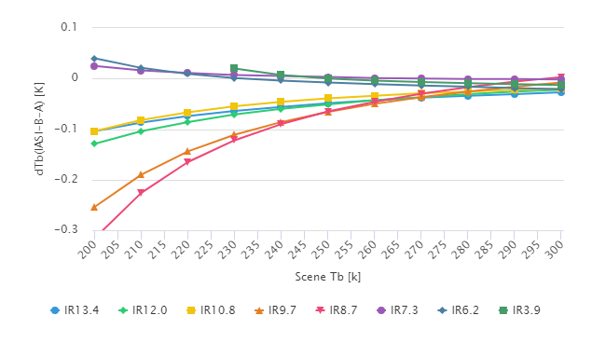
IR Reference Sensor Inter-Comparisons
Form consensus on relative calibration
  Re-binning results of existing comparisons
Biases with respect to Metop-A/IASI
  With standard uncertainties (k=1)
At common spectral resolution
  In 10 cm⁻¹ bins within AIRS bands
  Or average results over broad-band channels
Converted into Brightness Temperatures
  For specific radiance scenes 200-300K
For all viewing angles
  and/or for specific ranges - e.g. nadir ±10°
Over specific period
  Common 4-year period from IASI-B start
Easy to inter-compare and Calculate Double-Differences
Mean Double Difference IASI B-A – wrt Meteosat/SEVIRI
  Plotted where uncertainty < 0.1K
  Difference increase for colder scenes in all channels
SWIR: V. small positive differences (<<0.1K)
MWIR: V. small positive differences (<<0.1K)
LWIR window: Small negative differences (<~0.1K)
LWIR absorption: Larger negative differences (<~0.3K)
Notes:
For example results are shown here for the double-differences for all the IR channels of Met-10
as a function of the scene TB with different channels in different colours
Bullets summarise results

Slide 27
Measurement Requirements Must Be Science Driven

Slide 28
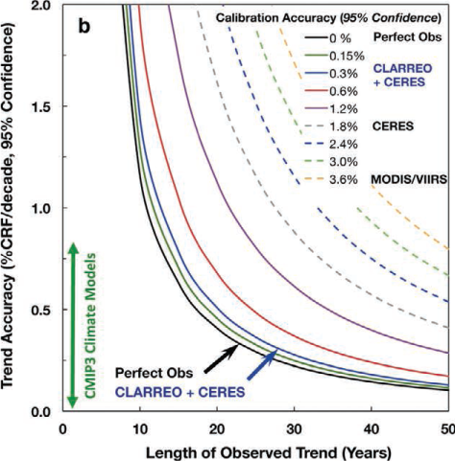
CLARREO Uncertainties and Trend Detection
The relationship between absolute calibration accuracy and the accuracy of global average decadal climate change trends. Trend accuracy shown for a perfect observing system (black), varying levels of instrument absolute accuracy (solid color lines) for possible CLARREO requirements, and current instruments in orbit (dashed lines). Shown are the relationship between reflected solar spectra and changes in broadband CRF and cloud feedback. The figure shows the dramatic effect of instrument accuracy on both climate trend accuracy (vertical axis) as well as the time to detect trends (horizontal axis).
Bull. Amer. Meteor. Soc., “Achieving Climate Change Absolute Accuracy in Orbit,” 2013; 94(10):1519-1539. doi:10.1175/BAMS-D-12-00149.1

Slide 29
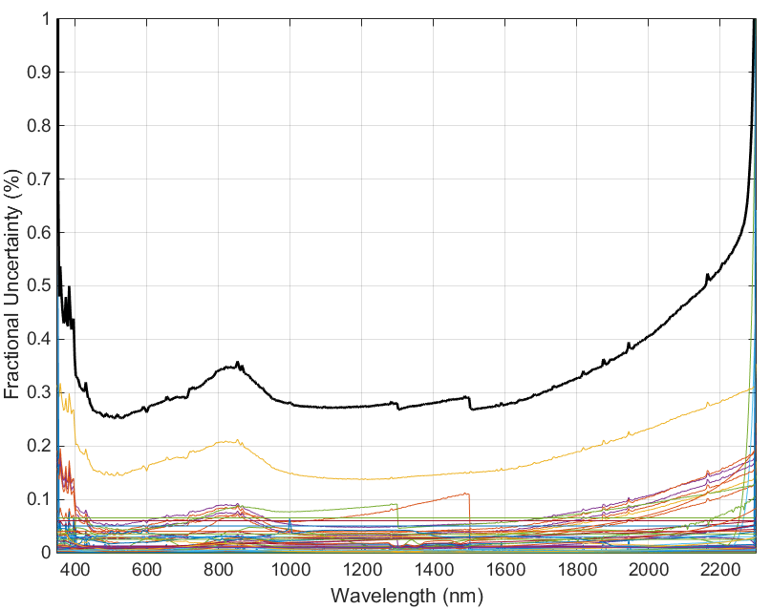
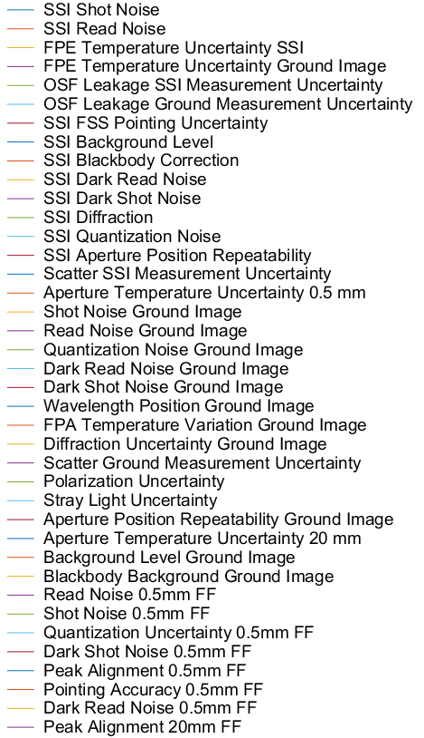
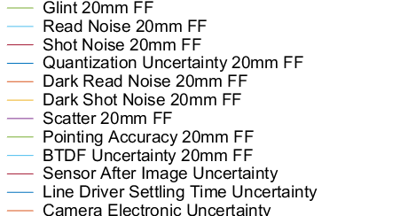
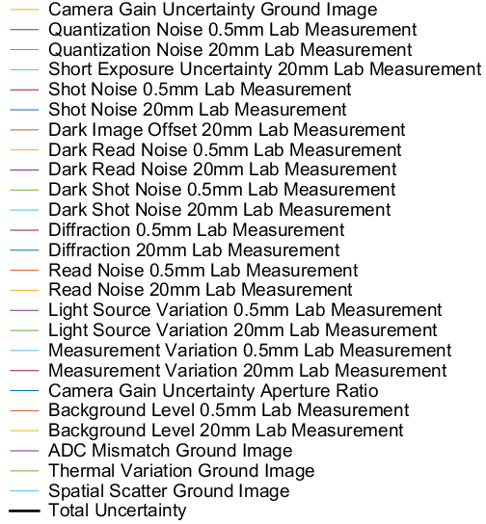
CLARREO Uncertainty Budget: Single Pixel
Consider all factors

Slide 30
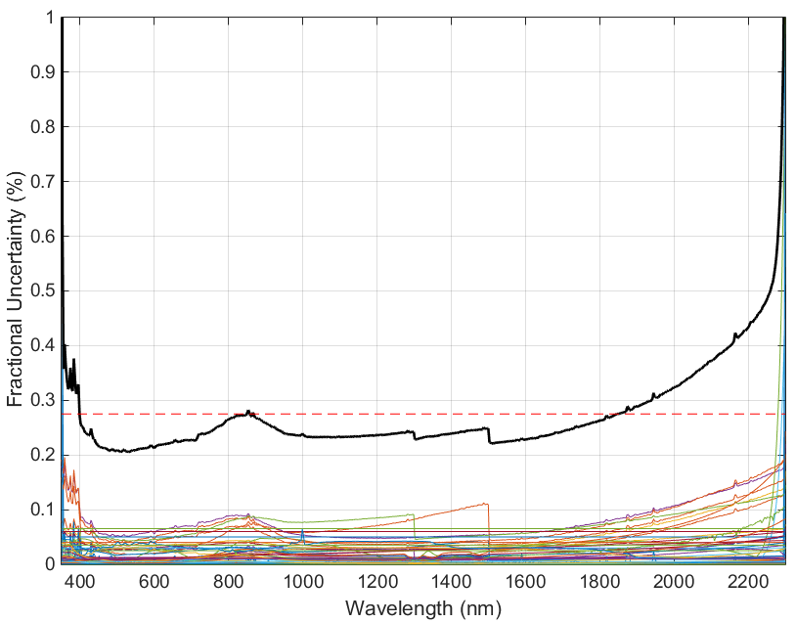
The Full CLARREO Uncertainty Budget (10-km average)
Estimate for “as used” case
Mean = 0.27%

Slide 31
Recommendations and Issues:
IR
Important to have control of all aspects of instrument design and build for achieving good accuracy and traceability chain
Calibration & characterization often get cut at end of program
  But less so if instrument end-users are also the instrument builders
Spectral calibration often significant contribution to uncertainty
  Benefit of hyperspectral inter-calibration reference instruments
Blackbody sources are primary means of SI traceability
  Calibration uncertainties currently limited by BB thermometry/gradients
  Uncertainties minimised by operating BB at ambient temperature
  Good blackbodies and phase-change cells are now suitable for integration into flight instruments (breakthrough calibration improvement)

Slide 32
Recommendations and Issues:
Solar-Incoming and Solar-Reflected
Outgoing measurements (CERES) still rely on continuity and SNOs
SSI measurements have moved toward end-to-end accuracy / calibrations and detector-based instrumentation
  Accuracies improved from ~3-8% (esp. in NIR) to 0.2-0.3%

Slide 33
Recommendations and Issues:
Microwave
Current calibration accuracies
  Sufficient for NWP – main users – need to push for SI-traceablity
  NIST prototype of black-body standard (18-220 GHz)
  There is no requirement on national labs to support these measurements with standards
  Need means for calibration transfer
Reference Model of Lunar Microwave Radiance:
  Emissivity & temperature profile
  Reference Observations - Frequency Range, – range of phase angles + libration?
  How to account for Antenna Pattern?
Towards Climate Reference Microwave Satellite Instruments
  Technology Developments needed?
  Suitable platforms/orbits/overlaps?
  Possibility of on-orbit SI-traceability?

Slide 34
Recommendations for ECMWF Error Workshop
SITSATs offer key advantages for NWP and climate applications
  Provision of an irrefutable reference
  Can provide traceability of on-orbit calibration to SI
  Can be assimilated without bias correction
  Can help diagnose model errors, independent of instrument errors
  Resilience against gaps/drifts outside of overlap between reference instruments
  ➔ Robust and harmonised Fundamental Climate Data Records
  Additional benefits (depending on SITSAT design)
    Ability to resolve residual dependencies in calibration of other sensors, such as scan angle, non-linearity, diurnal variations, and spectral coverage or response (gap-filling, SRF)
Challenge
  Knowledge of spectral response functions can limit inter-calibration accuracy
  Priority is to establish usable and accurate SI-traceable references for LEO and GEO sensors

