Slide 1
AHI/B07(3.9μm) Tb bias for cold scene
Meteorological Satellite Center of JMA
Arata Okuyama
GSICS GRWG web meeting on 13 January 2021

Slide 2
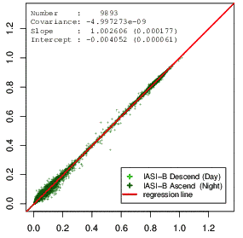
Tb bias on AHI/B07 (3.9μm)
The IR cal/val based on IASI shows there is a negative Tb bias around a cold scene for AHI/B07 (3.9μm).
The bias appears in both of results using IASI-A and -B. (IASI-C is not implemented yet.)
There is no apparent negative bias for the results using AIRS and SNPP/CrIS.
H8/AHI radiance
IASI-B based radiance
H8/AHI – IASI-B Tb [K]
220
240
260
280
300
IASI-B based Tb [K]

Slide 3
Tb bias on AHI/B07 vs HSSs
vs Metop-A/IASI
vs Metop-B/IASI
H8/AHI – LEO Tb [K]
H8/AHI – LEO Tb [K]
LEO based Tb [K]
LEO based Tb [K]
vs Aqua/AIRS
vs SNPP/CrIS
H8/AHI – LEO Tb [K]
H8/AHI – LEO Tb [K]
LEO based Tb [K]
LEO based Tb [K]

Slide 4
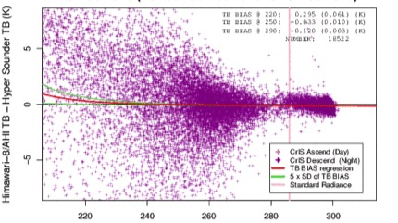
Tb bias on AHI/B07 at 220K Trend
vs Metop-A/IASI
Negative bias
vs Metop-B/IASI
Negative bias
vs Aqua/AIRS
vs SNPP/CrIS
220K
2015
2016
2017
2018
2019
2020

Slide 5
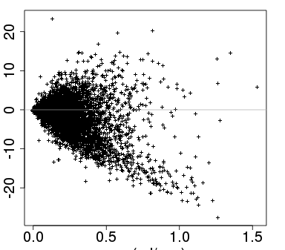
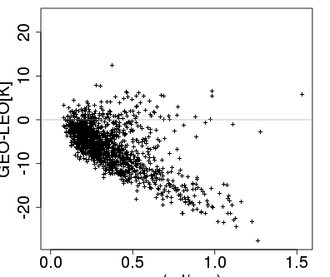
Uniformity check by CoV (coef. of variation)
As Fangfang pointed, the Tb bias for IASI for cold scene does not appear under adequate filtering by CoV (sd/ave) of radiance same as ABI.
No filtering by cov
Cov < 0.25
Cov < 0.05
IASI-B
Only the filtering by std. dev. of rad. is applied.
All Tb
Tb < 230K
For cold scene, the GEO-LEO Tb on the collocation data shows dependency on the cov of radiance.
H8/AHI – IASI-B Tb [K]
Cov
Cov

Slide 6
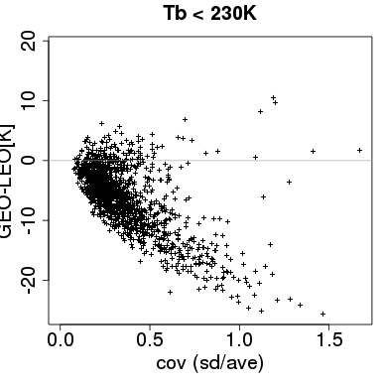
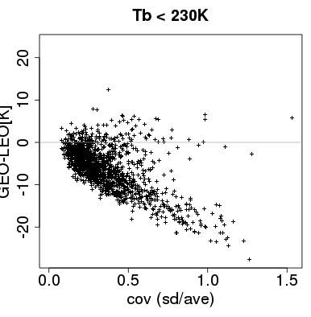
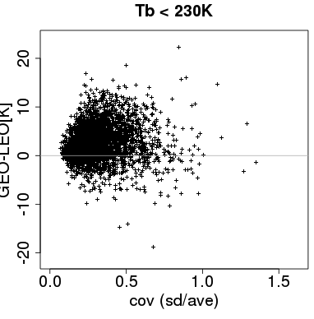
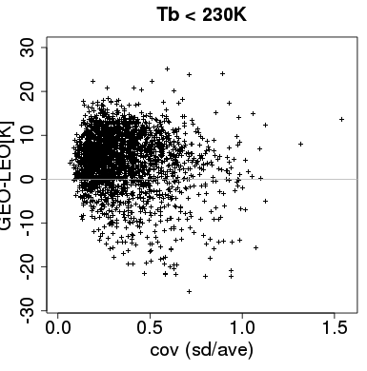
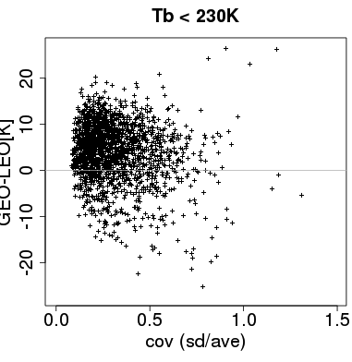
Dependency of the Tb bias on cov
But, why do only the results using IASI show the Tb bias for cold scene?
IASI-A
IASI-B
Dec. 2020
Dec. 2020
AIRS
SNPP/CrIS
N20/CrIS
Dec. 2020
Dec. 2020
May 2020

Slide 7
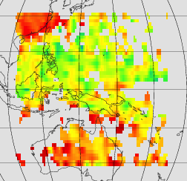
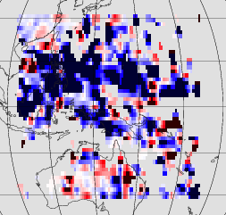
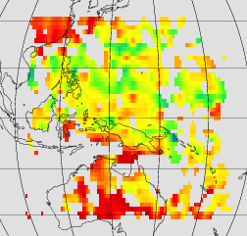
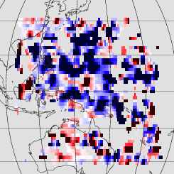
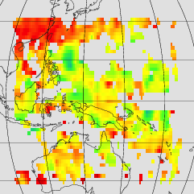
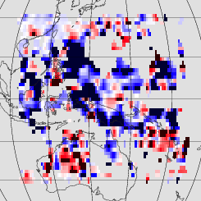
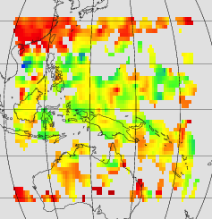
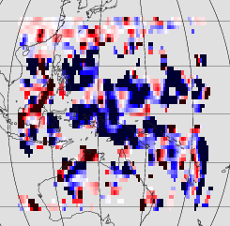
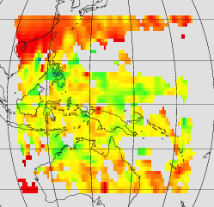
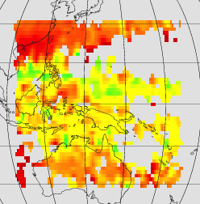
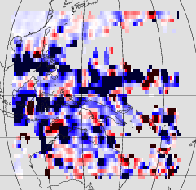
Where is the negative bias area?
持ち時間２０分ですので、本スライドは軽く見せるだけに留めます。
Metop-A/IASI (cloudy sky)
Metop-B/IASI (cloudy sky)
Oct. 2020
Nov. 2020
Dec. 2020
mean Tb
mean ΔTb
mean Tb
mean ΔTb
The negative bias (dark blue) area:
corresponds to low Tb areas.
isn’t localized.

Slide 8
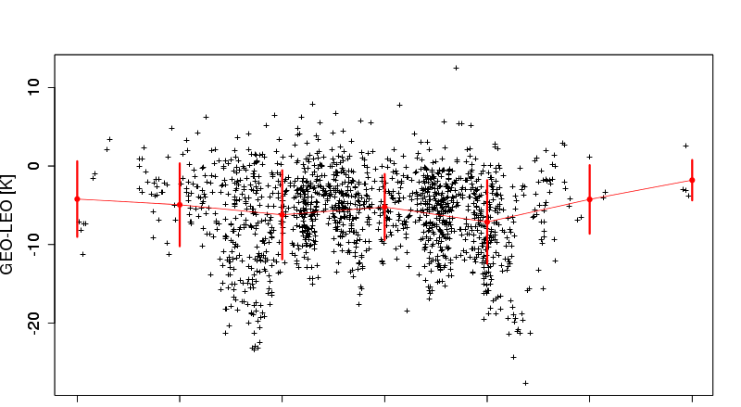
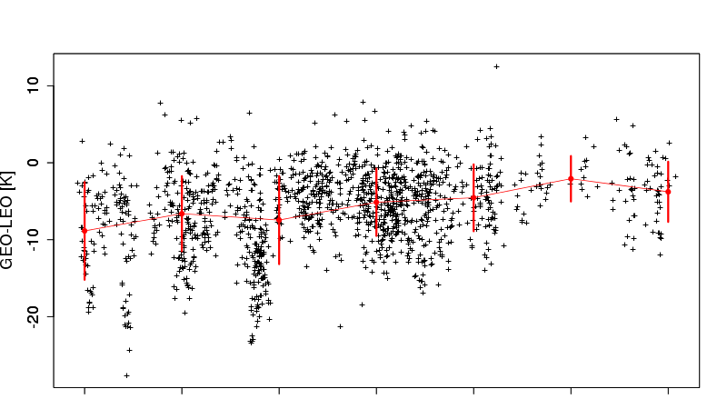
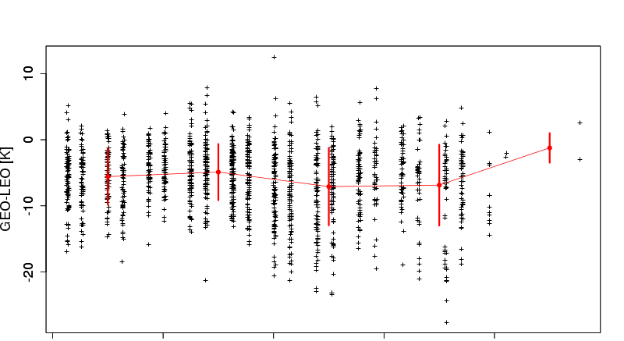
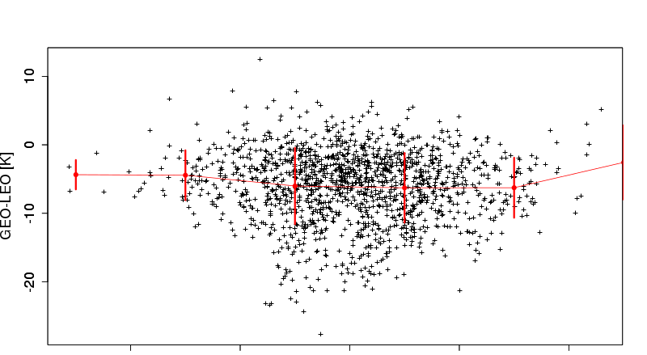
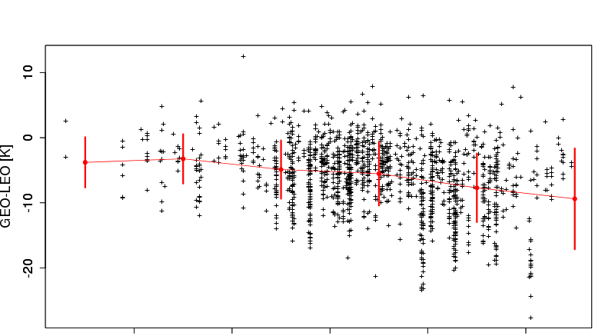
Where does the negative bias appear?
持ち時間２０分ですので、本スライドは軽く見せるだけに留めます。
H8/AHI – IASIB Tb [K] vs…
Latitude [deg]
Longitude [deg]
-30 -20 -10 0 10 20 30
110 120 130 140 150 160 170
Zenith angle (LEO) [deg]
Zenith angle (GEO-LEO) [deg]
0 10 20 30 40
-10 -5 0 +5 +10
Observation time [HH]
Dec. 2020
The negative bias seems to be less dependent on the parameters such as zenith angles.
(Minor dependency on longitude and observation time?)
10 11 12 13 14
1-29 Dec. 2020, the collocation data with GEO/LEO_Tb < 230K

Slide 9
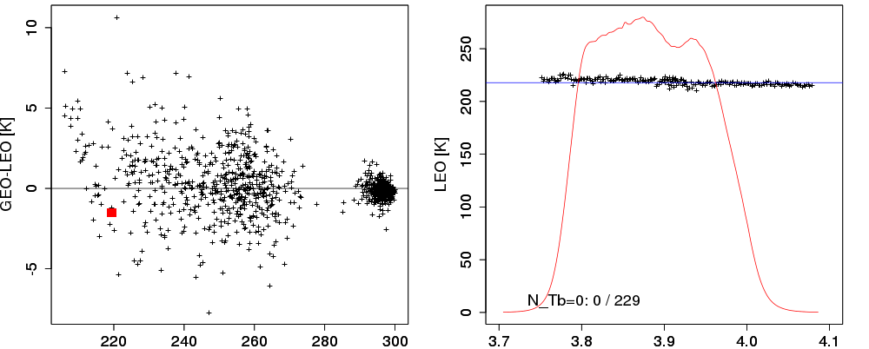
Each channel of the hyper-sounder data
Before, I only had seen the plots (left) by the super-channel and AHI Tb bias.
This time, I focused on each channel data of the hyper-sounder at a collocation point (right).
This AIRS case shows good agreement between the AIRS each channel measurement and AHI observation.
AIRS and AHI Tb bias
AIRS Tb
23-25 Dec. 2020
pick up AIRS measurement at this collocation data →
AHI obs. Tb
AIRS each channel data
H8/AHI – AIRS_based_Tb[K]
AHI/B07
AIRS based Tb [K]
Wavelength [um]

Slide 10
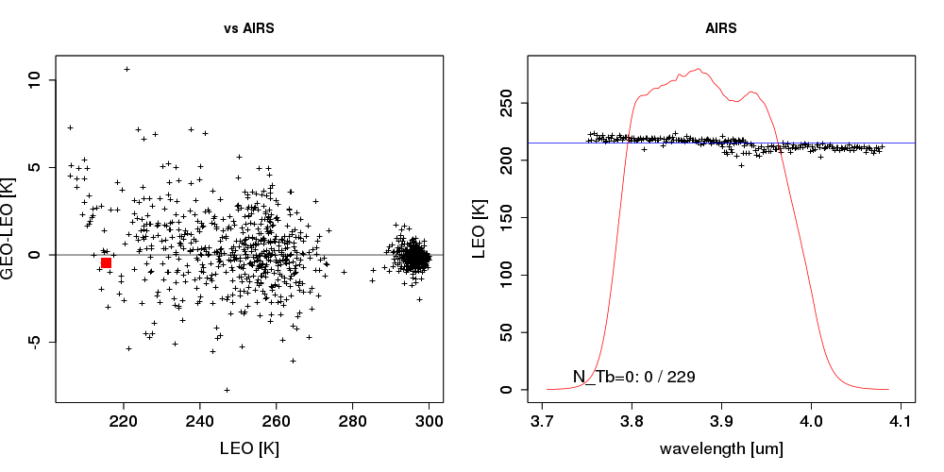
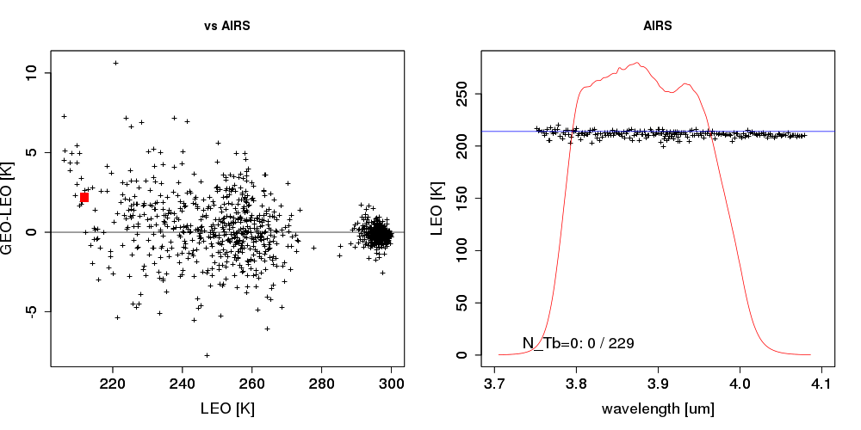
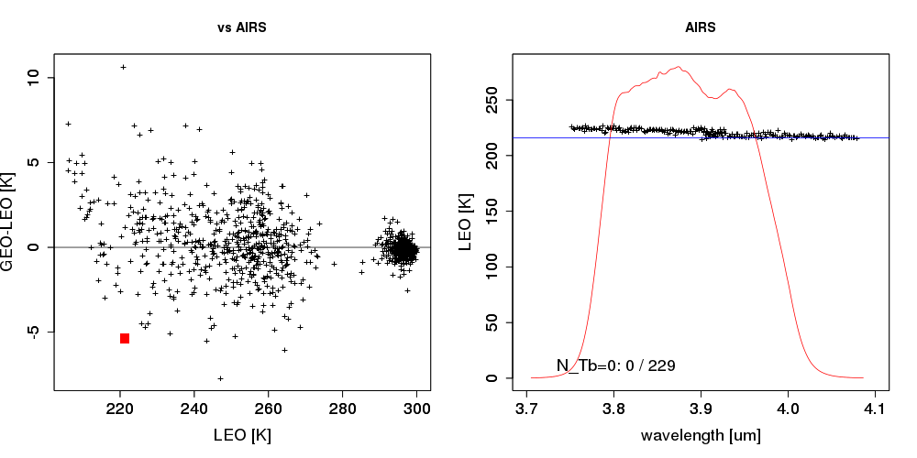
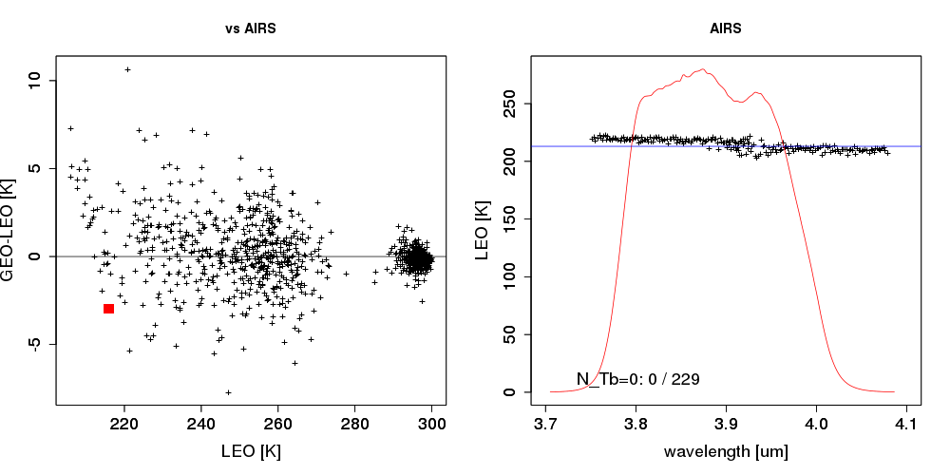
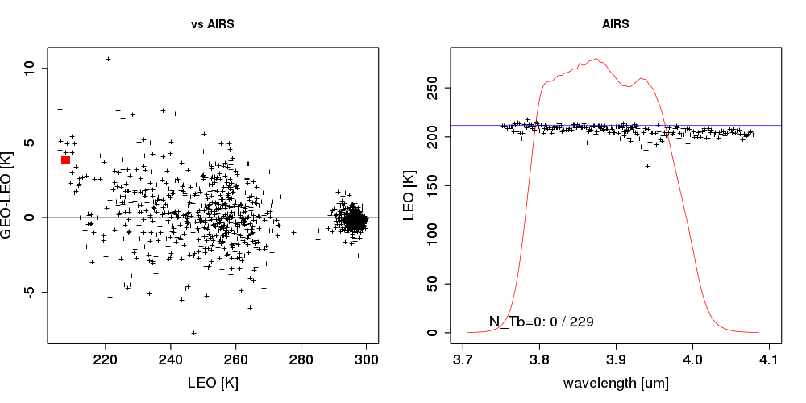
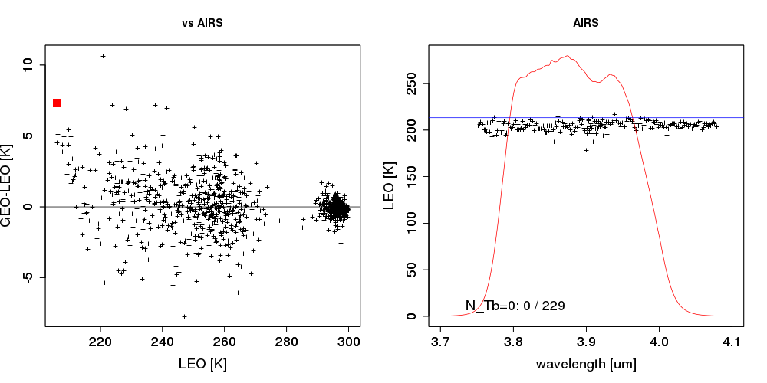
more examples by AIRS with ~220K
consistent with AHI observation.

Slide 11
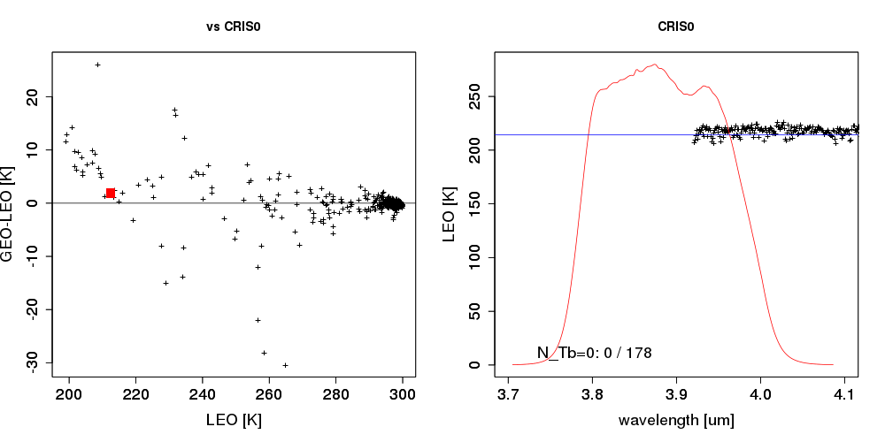
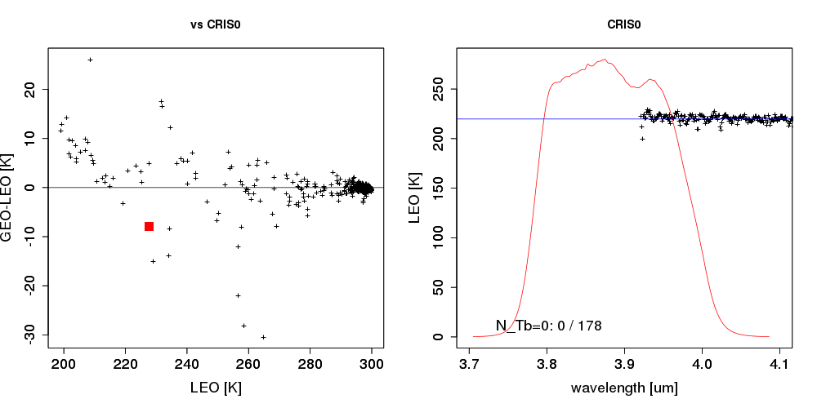
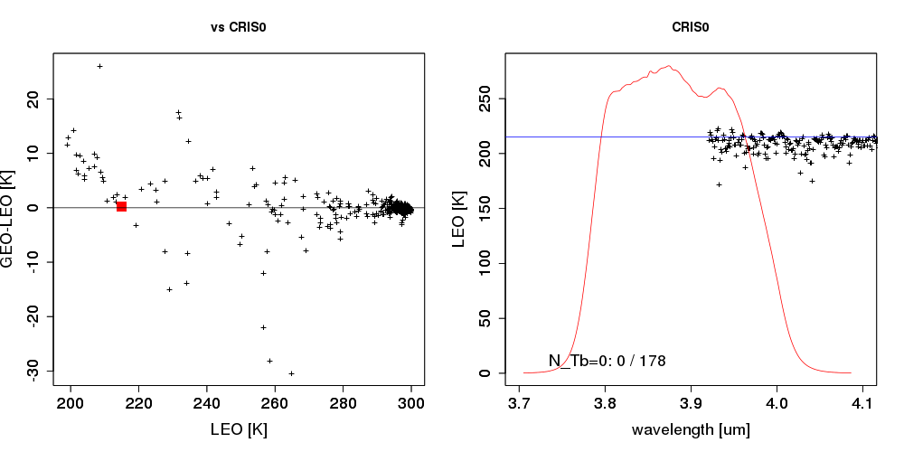
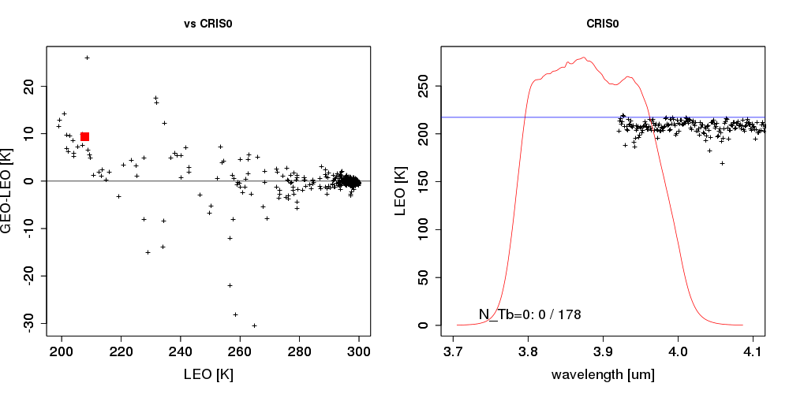
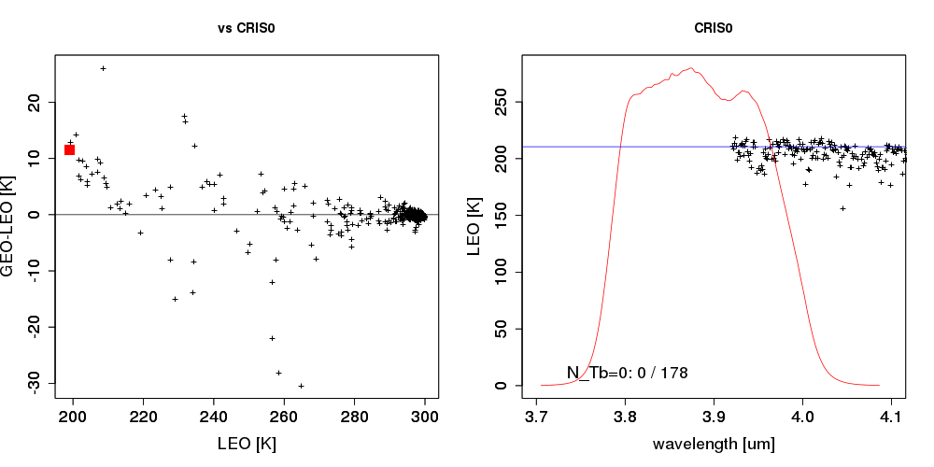
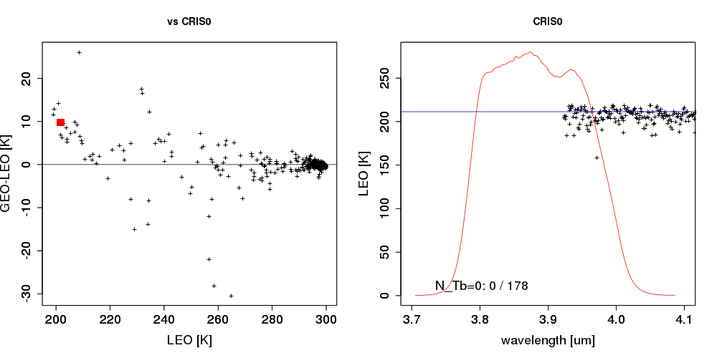
SNPP/CrIS cases with ~220K
CrIS covers
λ > 3.9um
Similar to AIRS, consistent with AHI observation.

Slide 12
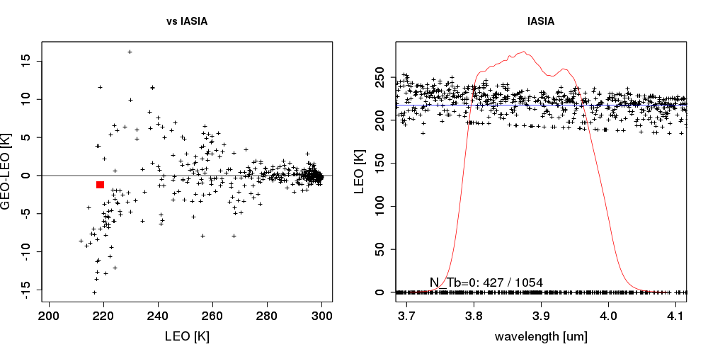
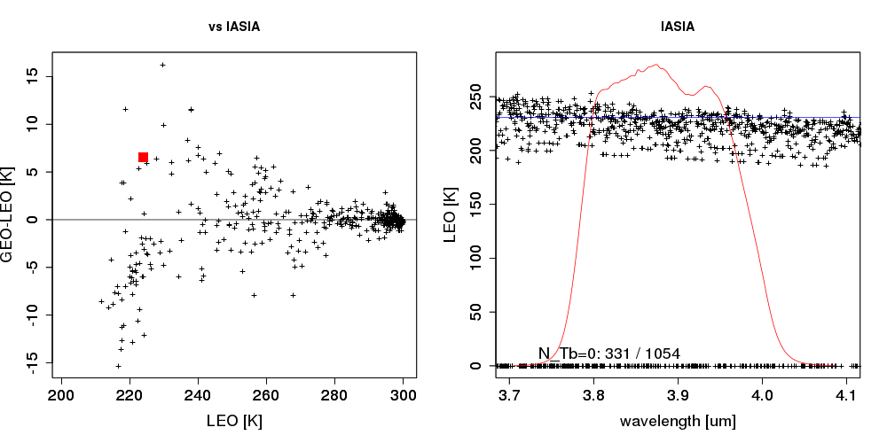
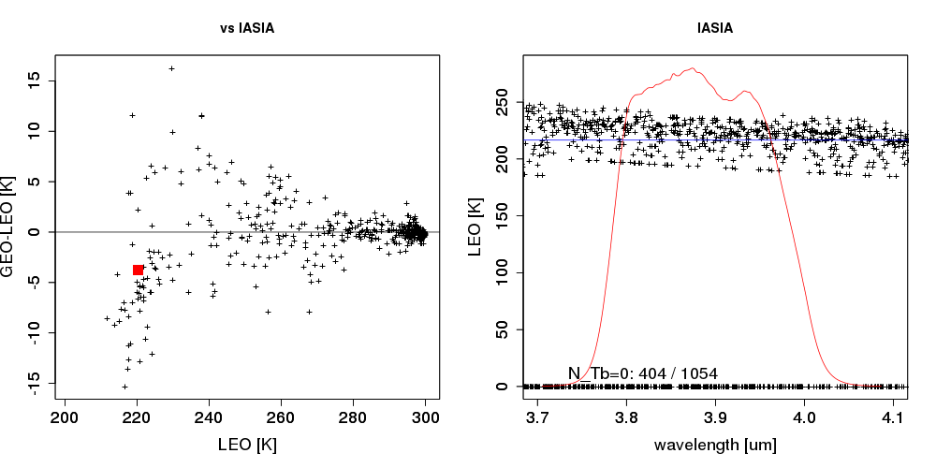
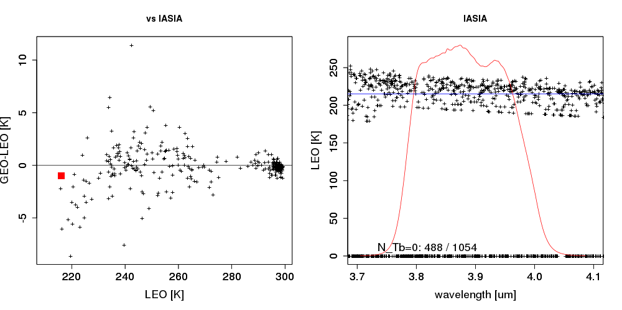
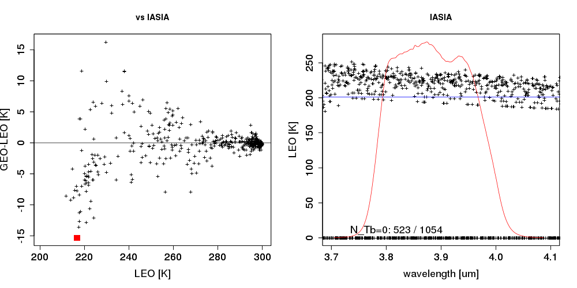
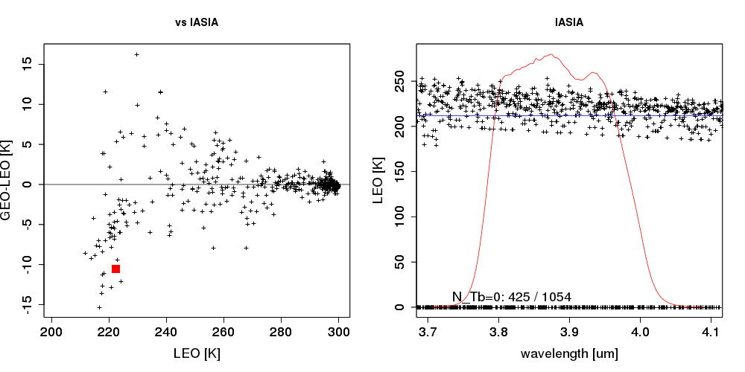
Metop-A/IASI cases with ~220K
Negative radiances
IASI data has more fluctuation than AIRS and CrIS,
and it has negative radiance values in some channels.

Slide 13
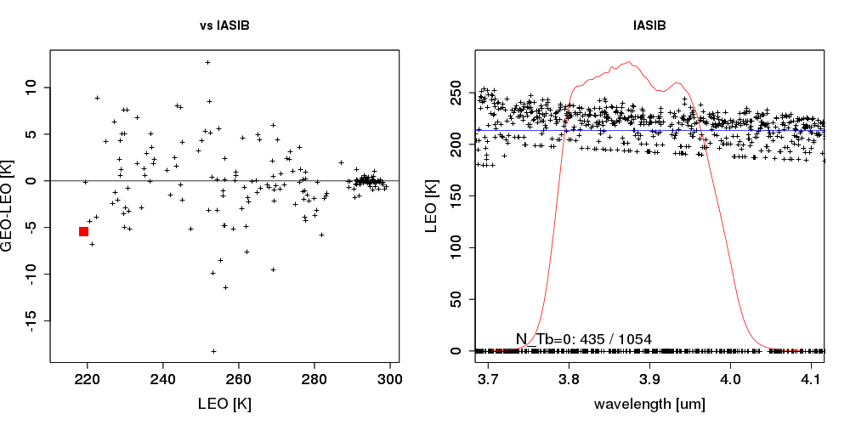
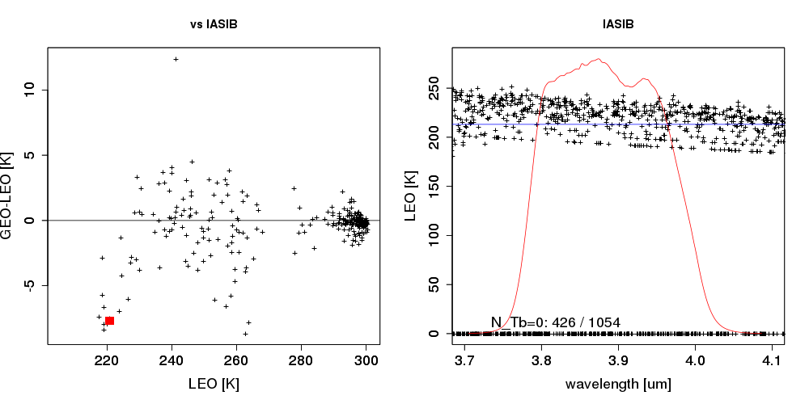
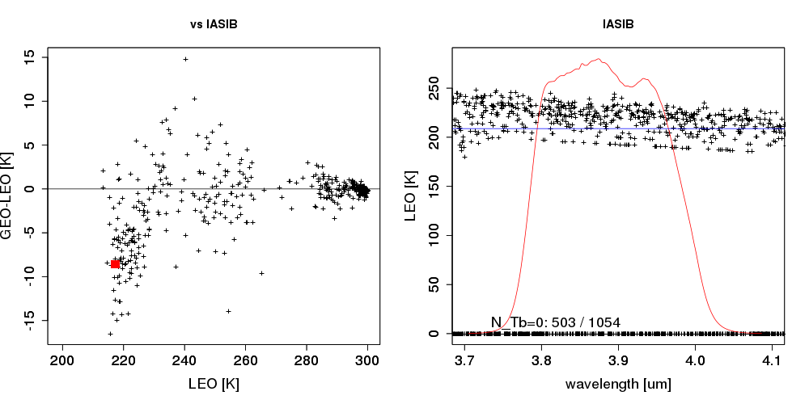
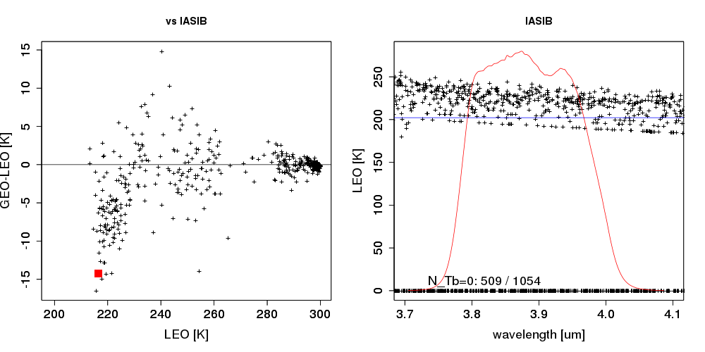
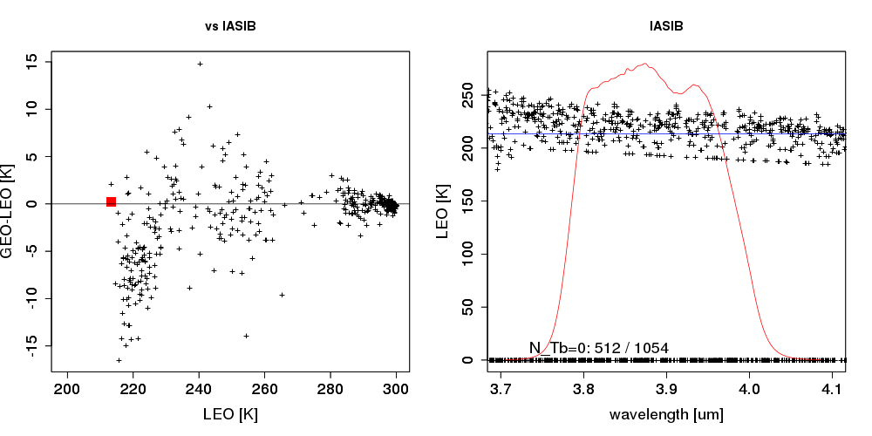
Metop-B/IASI cases with ~220K
also fluctuated,
and negative radiance values in some channels.

Slide 14
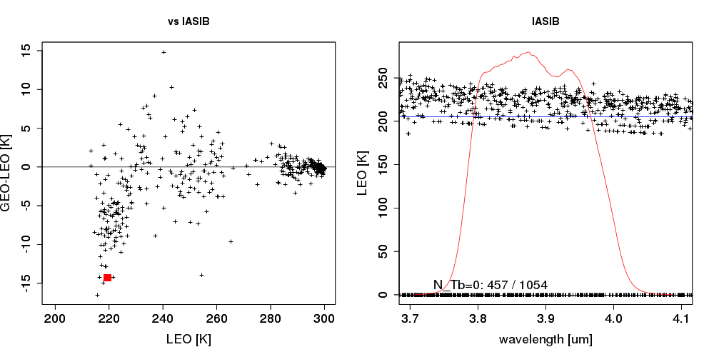
The fluctuation on IASI measurement
IASI-B
~220K
457 / 1054 negative
No negative radiances for longer wavelength
~230K
1) The negative radiances:
are observed for some channels in the cold scene.
are not limited by specific channels.
less for longer wavelength.
79 / 1054 negative
~250K
2) The radiance with fluctuation:
can be seen in colder scenes.
No negative-radiance
Both of IASI-A and –B show these aspects.

Slide 15
1) How do we process the negative values?
時間次第で省略するかも
In JMA’s implementation, the observation by the channels with the negative radiance is replaced by the “gap channel” radiance.
Does the gap channel bring error? → wouldn’t be expected.
For the cold scene, the estimated Tb bias of w/o compensated by the gap channel method is larger than that of w/ compensation .
Thus, the bias could not be caused by the negative radiance but by the fluctuation of the radiance.
w/ the gap channel compensation
w/o the gap channel compensation
AHI –IASI-B Tb [K]
IASI-B based Tb [K]
IASI-B based Tb [K]
* Gap channel: A virtual channel to complement an absence of HSS channel data. It’s composed by RTM computation based for several atmospheric profiles.

Slide 16
2) How much does the radiance fluctuate in the band?
時間次第で省略するかも
LBLRTM computation for atmospheric profiles with thick cloud around upper air shows almost constant radiance for the 3.9um band.
Simulated Tb by LBLRTM
Thick cloud at 194.36 hPa of Tropic
Thick cloud at 194.36 hPa of US Std
Thick cloud at 478.54 hPa of Tropic
Thick cloud at 478.54 hPa of US Std
4
6
8
10
Wavelength [um]
AHI/B07
3.7 3.8 3.9 4.0 4.1

Slide 17
Summary
AHI/B07 shows negative Tb bias in cold scenes under the validation using IASI-A/-B. (IASI-C is not checked yet.)
The negative Tb bias does not seen under the application of the uniformity check by cov.
→ Is the strict uniformity check necessary also for AHI? Even though no collocation data remains under the condition?
There are negative radiance values and fluctuations on some of IASI channels at collocation data in cold scenes.
Is there any existing research which reports calibration characteristics of IASI for cold scenes for shorter wavelength?

Slide 18
Backup

Slide 19
Radiance plot of each channel

