Slide 1
G16 ABI B07 Cold Scene Bias to IASI
Fangfang Yu, Xiangqian Wu and Hyelim Yoo
01/13/2021

Slide 2
Revised from the presentation given in the 2019 GSICS annual meeting in Frascati, Italy (7u_ABIB07ColdSceneBias.pptx)
Title: G16 ABI B07 Cold Scene Bias to IASI – Action: GIR.2018.3j by Yu et al. (2019)

Slide 3
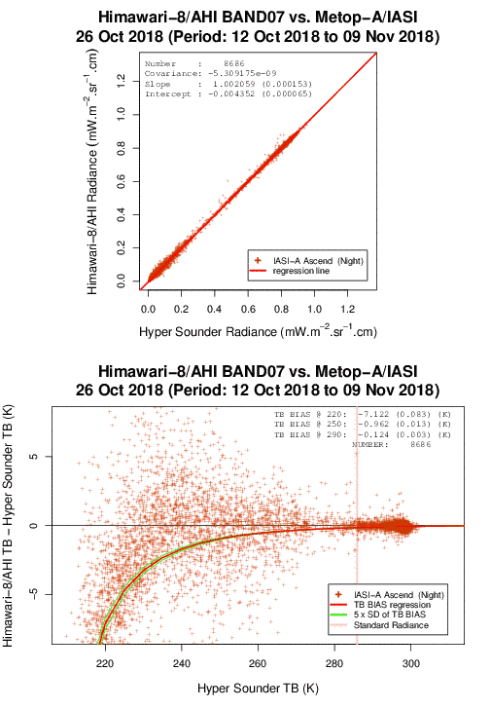
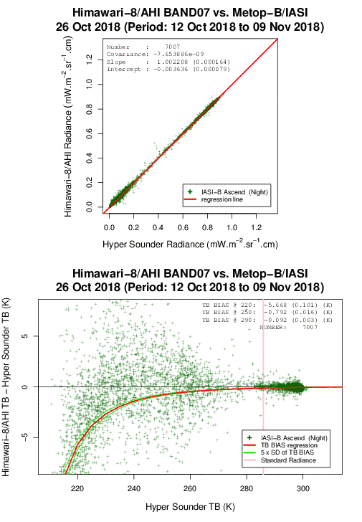
H8 AHI vs. IASI
Courtesy of JMA
AHI-8 B07 Cold non-linear bias to IASI-A/IASI-B at cold scenes

Slide 4
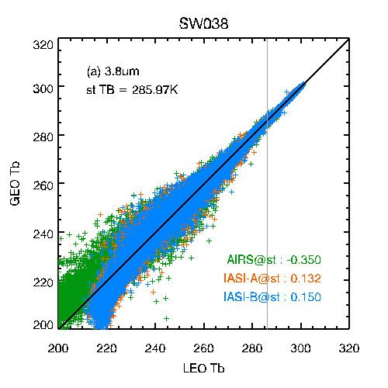
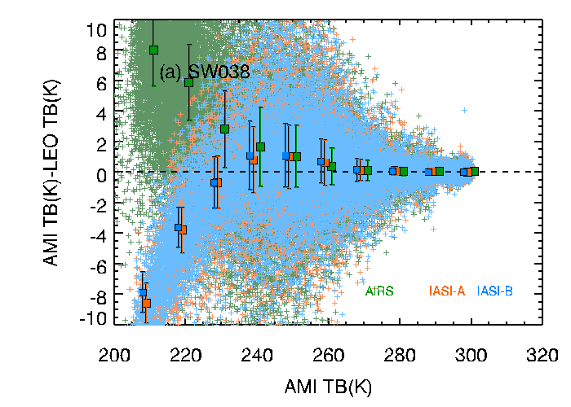
GK-2A AMI vs. IASI
Non-linear bias only observed at B07
Courtesy of KMA

Slide 5
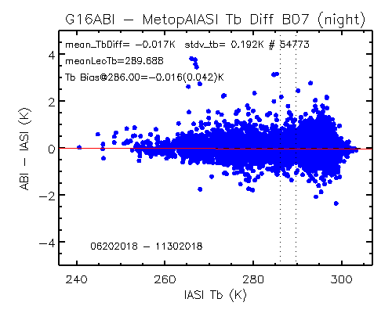
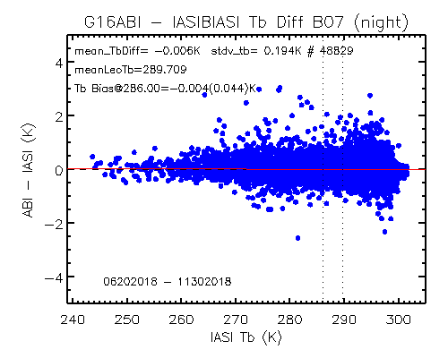
GOES-16 ABI vs. Metop-A/B IASI
NO extreme cold scenes if standard GSICS homogenous collocation criteria applied:
CoV of radiance < 5%

Slide 6
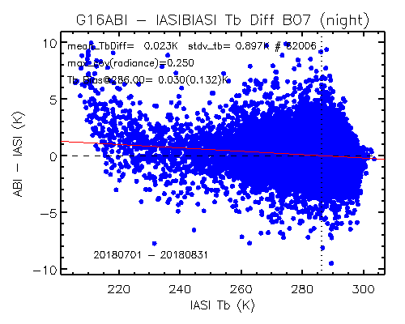
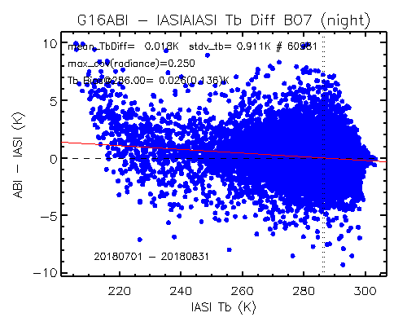
GOES-16: CoV of Radiance < 25%
At relaxed uniformity threshold (from 5% to 25%), positive radiance dependent Tb bias can be observed at extreme cold scenes (<230K). This radiance dependent Tb bias only observed at B07.

Slide 7
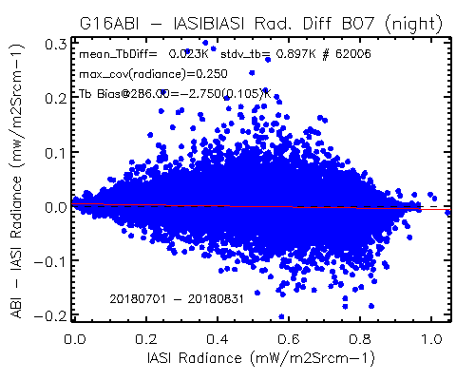
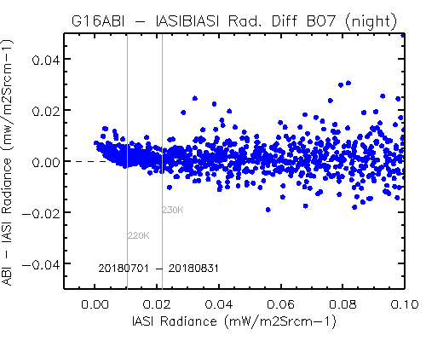
Radiance Bias (Zoom-in)
Same data in the TB bias pots in the previous slide, but for the scene radiance Bias.
Scene dependent bias occurs at low radiance scenes

Slide 8
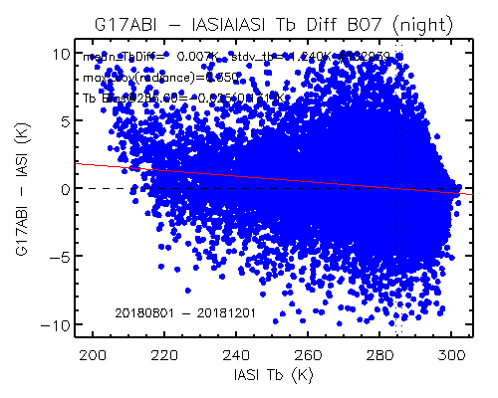
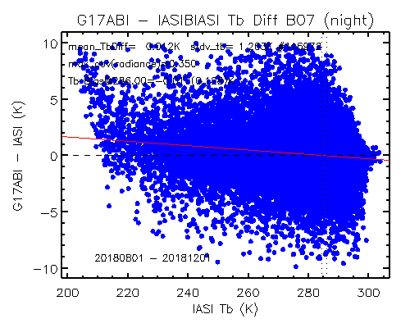
GOES-17 ABI B07 vs. IASI-A/B
CoV of radiance < 35%
Positive Tb bias can also be seen at G17 B07 cold scenes (<220K). Further relaxed the uniformity threshold to 35%

Slide 9
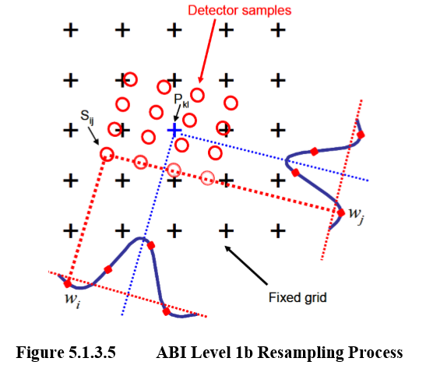
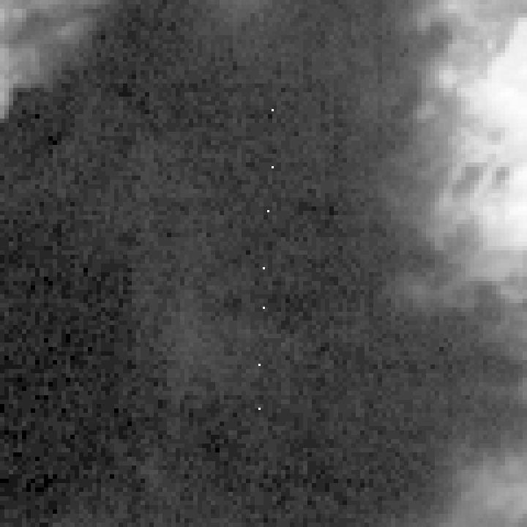
Most likely introduced during the resampling process
Locations of the extreme cold pixels with warm bias at B07 L1b image
Need to relax the uniformity scene threshold to detect the bias
At a heterogeneous area, resampling may slightly increase the radiance for the cold scenes
B07 Tb is sensitive to radiance variation at cold scenes, due to the nature of the Planck function.

Slide 10
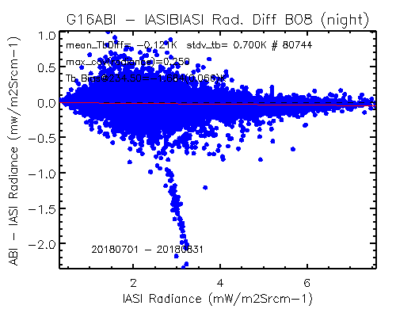
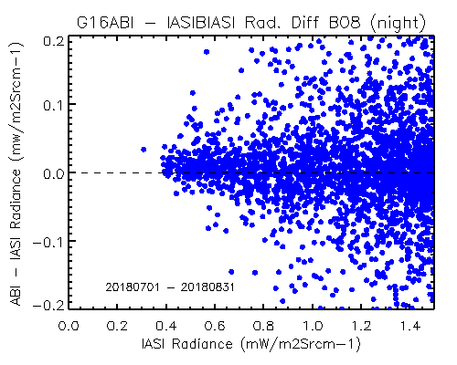
G16 B08 vs. IASI-B
No apparent non-linear scene dependent bias at cold scenes for G16 B08
CoV threshold is set to 25%

Slide 11
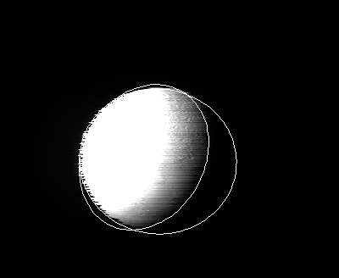
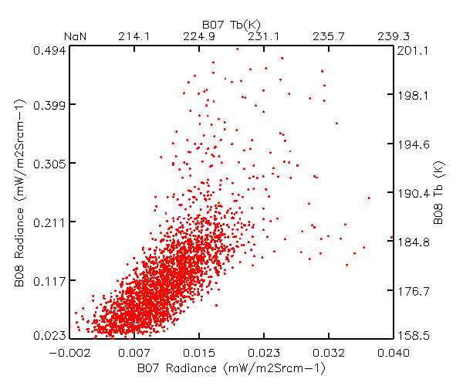
Comparison with B08 over the Moon
Linear!
Imply no nonlinear bias to IASI at extreme cold scenes

Slide 12
Summary
No extreme cold pixels in uniform ENV/FOV areas can be detected within the G16/17 ABI spatial domains yet.
Relaxing the uniform collocation criteria resulted in a warm GEO-LEO bias “non-uniform” area
The ABI L1B resampling process is most likely the culprit.
No evidence of non-linear difference to B08 data over the non-illuminated lunar surface
May imply ABI B07 might not have non-linear bias to IASI at extreme cold samples

