Slide 1

Paul Poli, Timo Hanschmann, Viju John, Joerg Schulz (EUMETSAT)
Acknowledgements
ECMWF & C3S for ERA-Interim & ERA5 data
NWP-SAF for RTTOV & RADSIM

Slide 2
Outline
SSM/T-2 instrument & data record
Methodology
  Collocation with HOAPS
  Radiative transfer simulations
Results
Conclusions

Slide 3
SSM/T-2 instrument
Mounted on 3 block 5D-2 satellites (F11, F12, F14) and the first block 5D-3 satellite (F15)
First instrument to routinely observe the 183 GHz band
(3 channels: 183.31 GHz ± 1, ± 3, ± 7 GHz)
“Reference article” for this instrument: I. Galin, D.H. Brest, and G.R. Martner, 1993: DMSP SSM/T-2 microwave water vapor profiler, Proc. SPIE 1935, Microwave Instrumentation for Remote Sensing of the Earth. doi: 10.1117/12.152603.

Slide 4
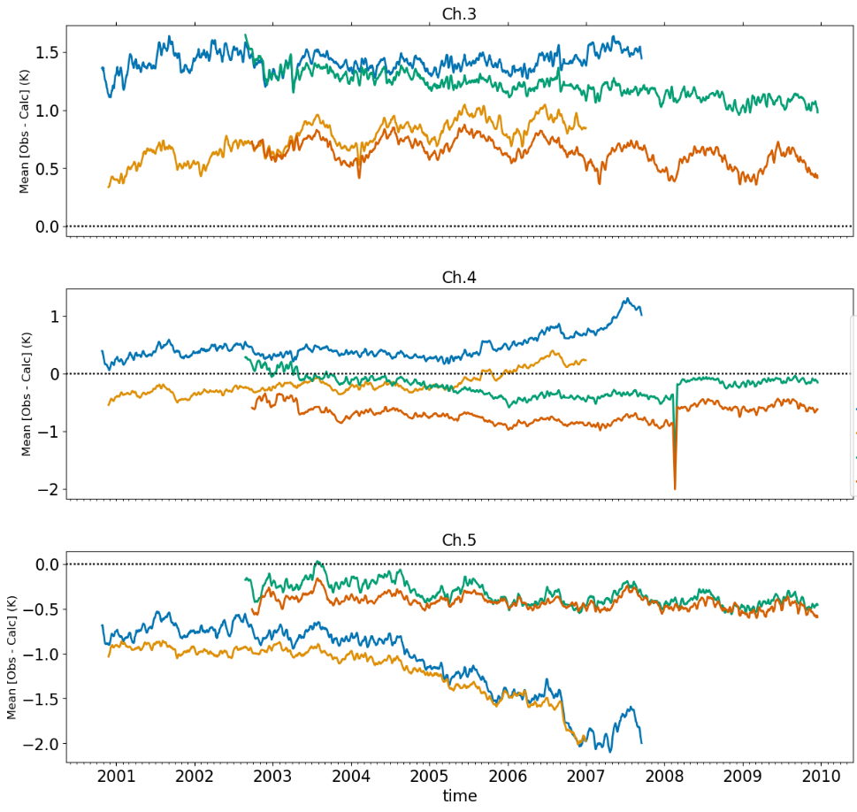
183 GHz (AMSU-B) mean diff. with ERA
NOAA-16 AMSU-B minus ERA-Interim
NOAA-17 AMSU-B minus ERA-Interim
AMSU-B channel 3
183.31±1.00 GHz
~Upper-Tropos. Hum.
NOAA-16 AMSU-B minus ERA5
NOAA-17 AMSU-B minus ERA5
ERA-Interim
AMSU-B channel 4
183.31±3.00 GHz
~Mid-Tropos. Hum.
~ 0
ERA5
AMSU-B channel 5
183.31±7.00 GHz
~Lower-Tropos. Hum.
ERA-Interim & ERA5 AMSU-B assimilation:
clear-sky only
excludes sea-ice, mountains
NOAA-16, -17 AMSU-B brightness temperature observations assimilated in ERA-Interim, ERA5 (feedback 2000-2010); Diagnostics on a daily basis, subjected then to 10-day moving average

Slide 5
SSM/T-2 Data Record
SSM/T-2 level-1b data at NOAA CLASS:
(APC are all missing)
MW FCDR produced within EU H2020 FIDUCEO,
by the University of Hamburg
  183 GHz channels on SSM/T-2, AMSU-B, and MHS
  For SSM/T-2, the FCDR contains antenna temperatures with uncertainty est.
  PUG: http://cedadocs.ceda.ac.uk/1415/1/MW_PUG_v4.1.pdf
  DOI:10.15770/EUM_SEC_CLM_0046
Need for a SSM/T-2 FCDR release 2, e.g.:
  To improve the detection of scenes contaminated by scattering rain/clouds
  (as pointed out by the study by Kobayashi et al., 2017, doi:10.1016/j.asr.2016.11.017)
  To flag contamination by the glare obstruction bracket
SENSOR | START | END
DMSP F11 | 1994-07-05 | 1995-04-02
DMSP F12 | 1994-10-13 | 2001-01-08
DMSP F14 | 1997-04-28 | 2005-01-10
DMSP F15 | 2000-01-24 | 2005-01-02

Slide 6
Outline
SSM/T-2 instrument & data record
Methodology
  FCDR release 2
  Radiative transfer simulations
Results
Conclusions

Slide 7
SSM/T-2 FCDR Release 2
Input
SSM/T-2 FIDUCEO FCDR
SSM/I HOAPS 4.0 retrievals over ice-free oceans
HOAPS Collocation
Distance < 1/3 of the SSM/T-2 pixel size
If SSM/T-2 and SSM/I on different platforms: ± 1 h
For F12: use SSM/I on F10 until 1997/05, on F14 after
Aggregate matching HOAPS retrievals
Mark with SSM/T-2 rain/cloud contamination flag
scenes where rain rate or TWP exceed thresholds:
Output ➔ FCDR Release 2, includes:
  Sensor zenith/azimuth angle (from computations)
  Quality flag, considering GLOB issue (from data analysis)
  Total water path, water vapour path, rain rate, and surface over ice-free ocean (from HOAPS)
  SSM/T-2 rain/cloud contamination flag (from data analysis)
  Release expected (very soon) under DOI:10.15770/EUM_SEC_CLM_0050
doi:10.15770/EUM_SEC_CLM_0046
Characteristic | SSM/T-2 | SSM/I
Scanning type | Across-track | Conical
Scanning pattern, at the Earth’s surface | Linear | Circular
Number of pixels within the same scanning pattern | 28 | 128 at 85 GHz 64 for other channels
Distance between pixels in the same scan | 44 km at nadir, increasing up to 84 km at the edges | 12.5 km at 85 GHz 25 km for other channels
Separation between consecutive scans | 54 km | 12.5 km
Instantaneous Field-Of-View (IFOV) size | At nadir: 88 km at 91.655 GHz 54 km at 150 GHz 48 km at 183.31 GHz | Along-track x across-track: 69 km x 43 km at 19 GHz 50 km x 40 km at 22 GHz 37 km x 28 km at 37 GHz 15 km x 13 km at 85 GHz
doi:10.5676/EUM_SAF_CM/HOAPS/V002
Channel frequency [GHz] | Rain rate threshold [mm/h] | TWP threshold [kg/m2]
183.31 ± 1.00 | 1.5 | 1.2
183.31 ± 3.00 | 0.5 | 0.3
183.31 ± 7.00 | 0 | 0.2

Slide 8

SSM/T-2 radiative transfer simulations
Observations to Reanalyses matchup:
ERA-Interim (6-hourly, consider ±1 hour)
ERA5 (hourly, consider ±30 min.)
Consider the observations locations, using nearest-in-time reanalysis (if available)
Radiative Transfer calculations:
RADSIM v2.12 calling RTTOV v12.3,
Clear-sky, TELSEM2 emissivity atlas, 54-level v7 predictors
Quality controls:
FCDR release 2 Quality Controls (including SSM/T-2 rain/cloud contamination flag)
RTTOV Quality Control

Slide 9
Outline
SSM/T-2 instrument & data record
Methodology
  FCDR release 2
  Radiative transfer simulations
Results
Conclusions

Slide 10
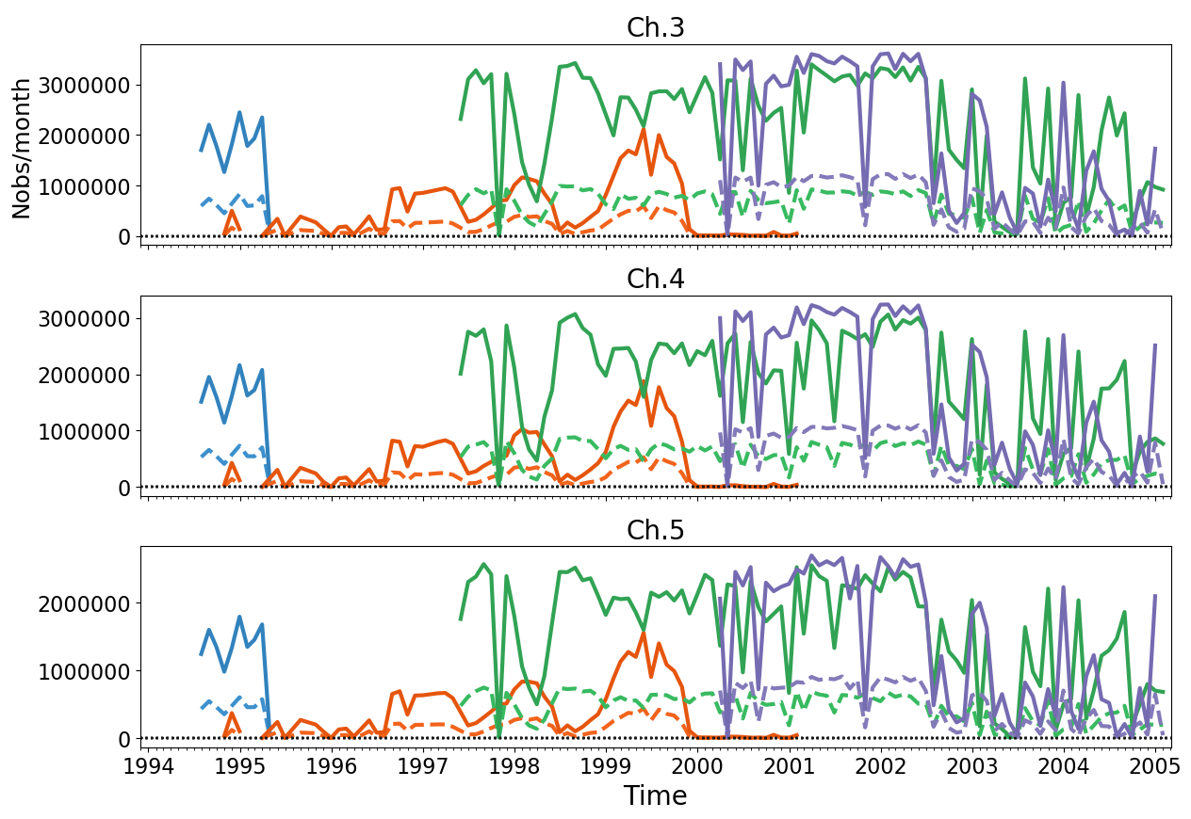
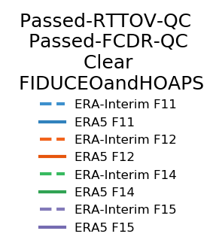
Number of comparisons
SSM/T-2 183.31±1.00 GHz ~Upper-Tropos. Hum.
SSM/T-2 183.31±3.00 GHz ~Mid-Tropos. Hum.
Fewer clear scenes
SSM/T-2 183.31±7.00 GHz ~Lower-Tropos. Hum.

Slide 11
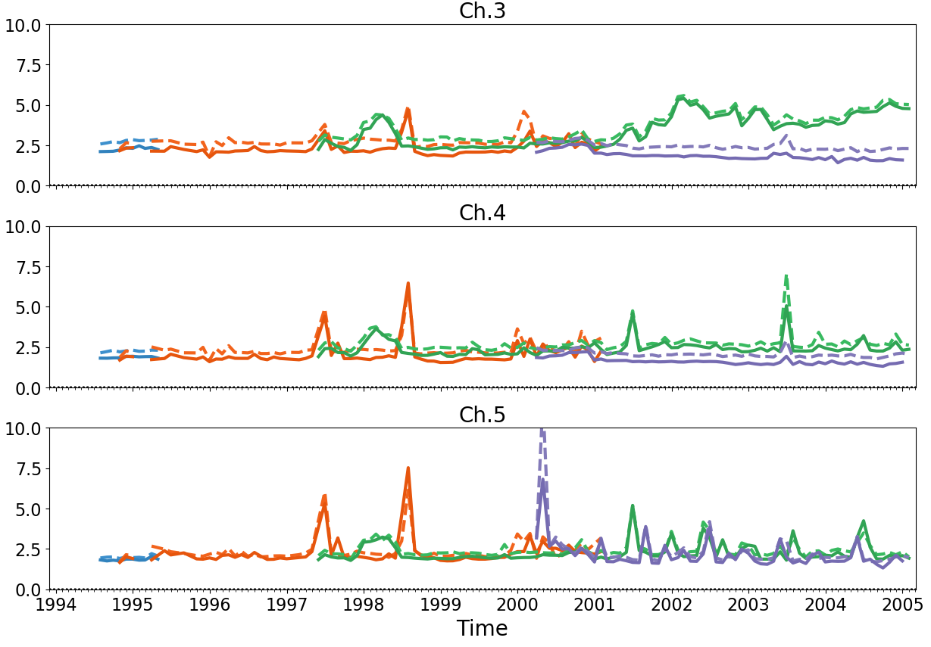
Standard deviation of departures
SSM/T-2 183.31±1.00 GHz ~Upper-Tropos. Hum.
F14
SSM/T-2 183.31±3.00 GHz ~Mid-Tropos. Hum.
(K)
SSM/T-2 183.31±7.00 GHz ~Lower-Tropos. Hum.

Slide 12
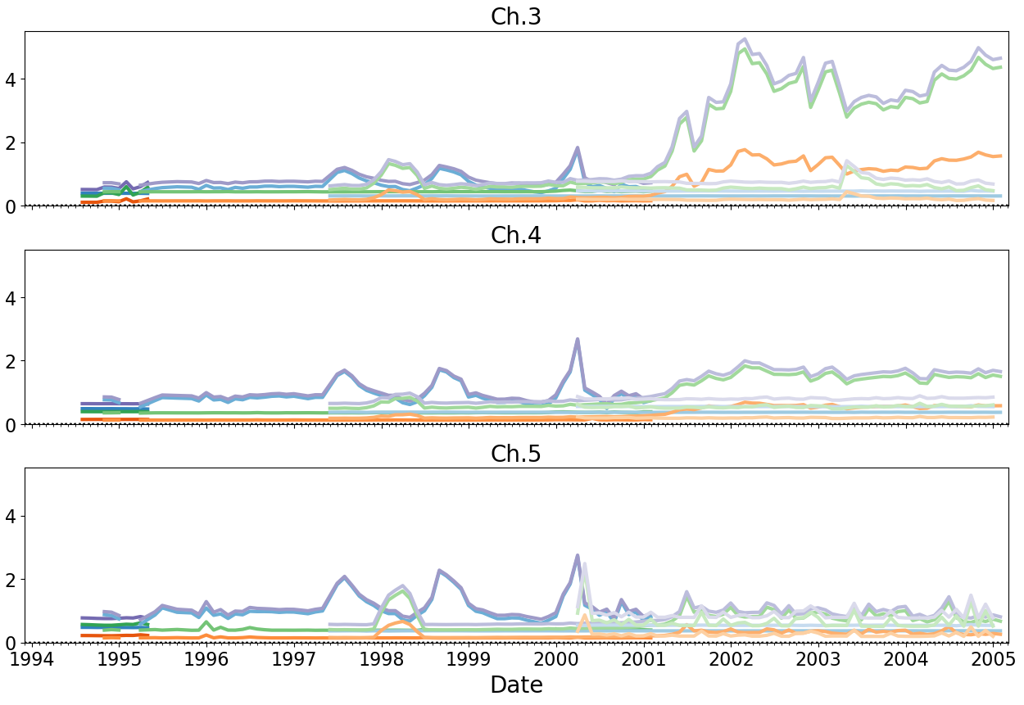
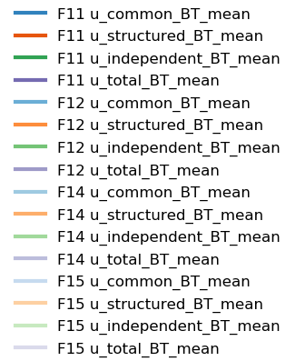
FIDUCEO uncertainties in SSM/T-2 FCDR
(K)
SSM/T-2 183.31±1.00 GHz ~Upper-Tropos. Hum.
Total
Independent
F14 noisy
Structured
Common
SSM/T-2 183.31±3.00 GHz ~Mid-Tropos. Hum.
SSM/T-2 183.31±7.00 GHz ~Lower-Tropos. Hum.
How relevant are the uncertainties surges?

Slide 13
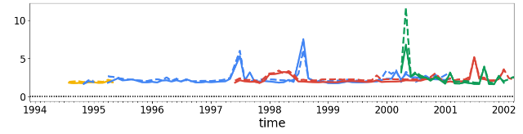
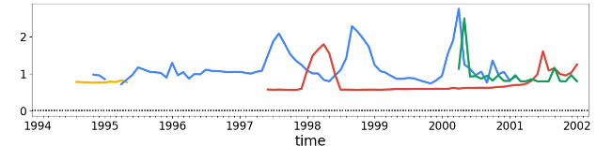
SSM/T-2 Total_u compared to dep. stdev.
SSM/T-2 channel 183 ± 7 GHz (lower tropospheric humidity)
DMSP F11
DMSP F12
DMSP F14
DMSP F15
Std. dev. of differences between FCDR and radiative transfer simulations (K)
ERA-Interim
ERA5
FIDUCEO total
uncertainty (K)
Quite a good correspondence, but does not explain everything!

Slide 14
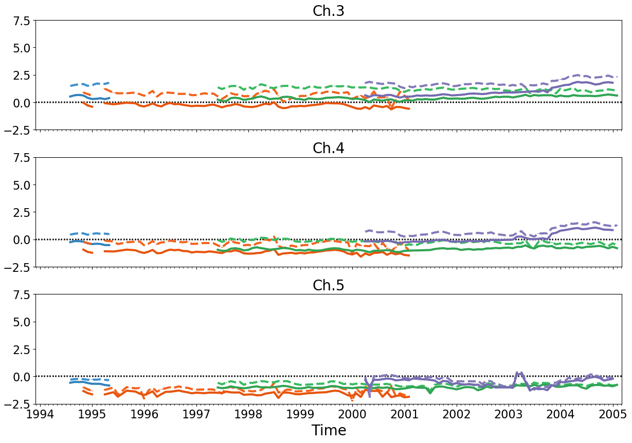
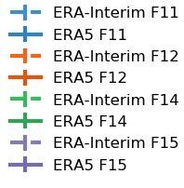
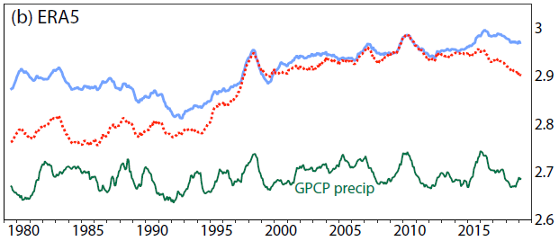
Mean departures (FCDR minus R.T. sim.)
SSM/T-2 183.31±1.00 GHz ~Upper-Tropos. Hum.
F15
SSM/T-2 183.31±3.00 GHz ~Mid-Tropos. Hum.
ERA-Interim
(K)
~ 0
ERA5
SSM/T-2 183.31±7.00 GHz ~Lower-Tropos. Hum.
P
E
mm/day
Fig. 23 excerpt from Hersbach et al. (2020, doi:10.1002/qj.3803)

Slide 15
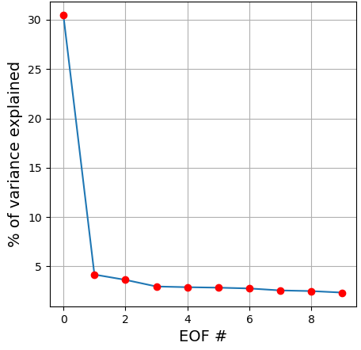
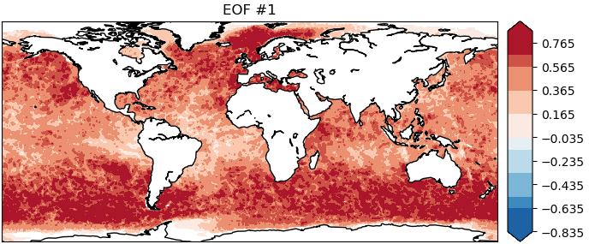
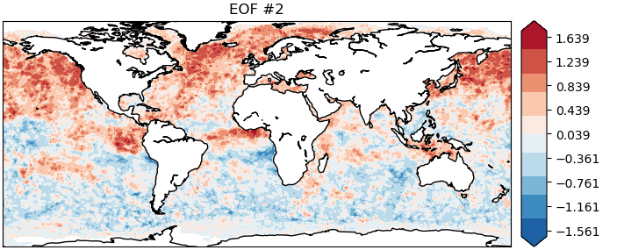
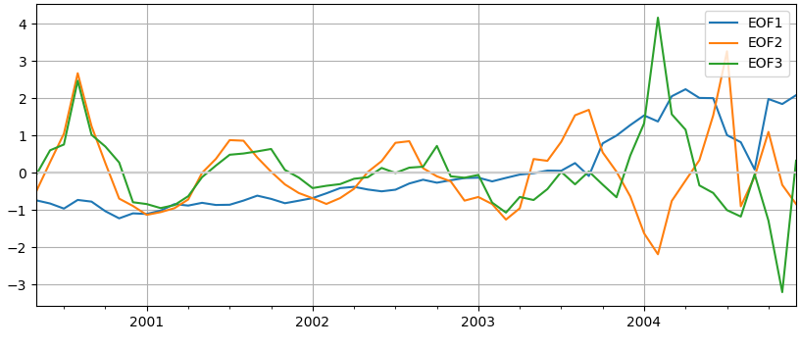
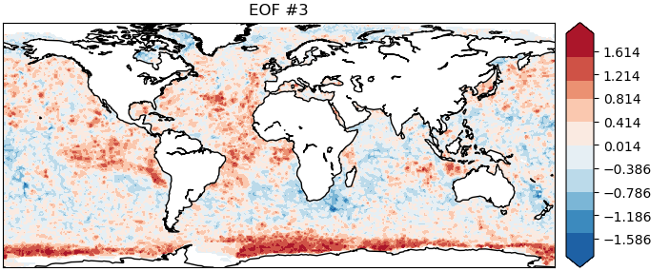
PCA of monthly departures for F15, 183±1
EOF#1: increases over time, really culminates in the last year
EOF#2, EOF#3: annual cycles, possibly reflecting seasonally-varying humidity biases in reanalysis
(+possibly undetected sea-ice contamination in departures around Antarctica)
Amplitude of first 3 EOFs

Slide 16
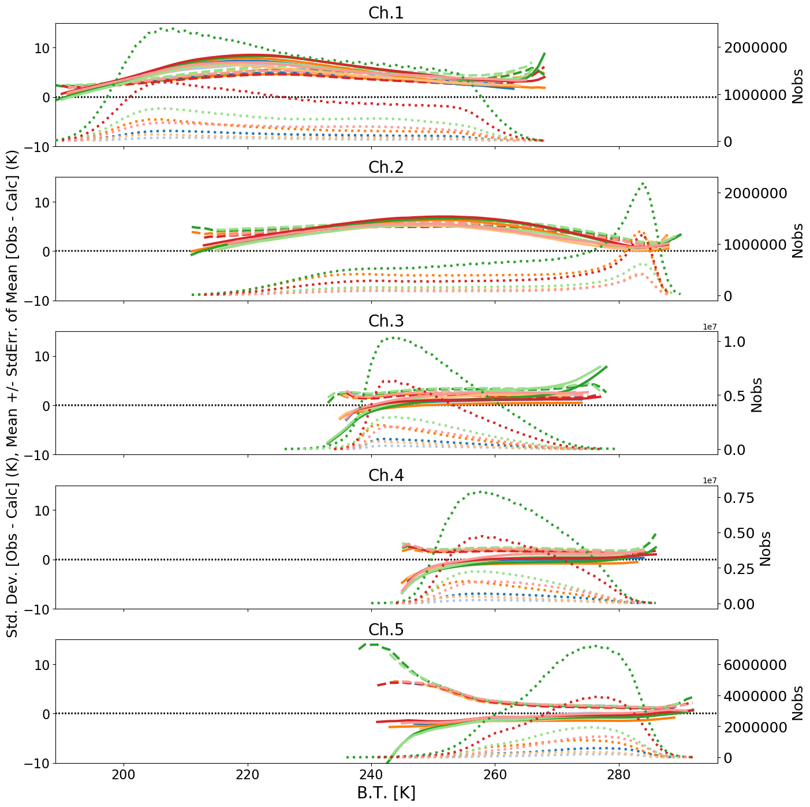
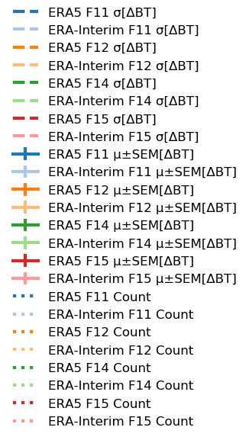
Departure dependence on antenna temp.
SSM/T-2 183.31±1.00 GHz ~Upper-Tropos. Hum.
… Count
- - - Std. dev.
Mean
SSM/T-2 183.31±3.00 GHz ~Mid-Tropos. Hum.
(K)
SSM/T-2 183.31±7.00 GHz ~Lower-Tropos. Hum.
Non-linearity effects, or undetected rain/clouds?
Mean departures decrease (increase),
when observed antenna T decrease (increase, resp.)

Slide 17
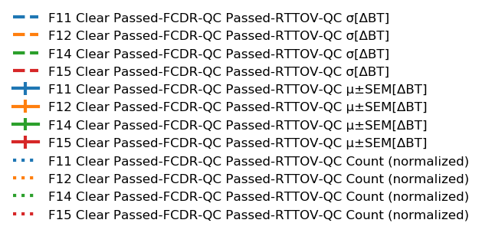
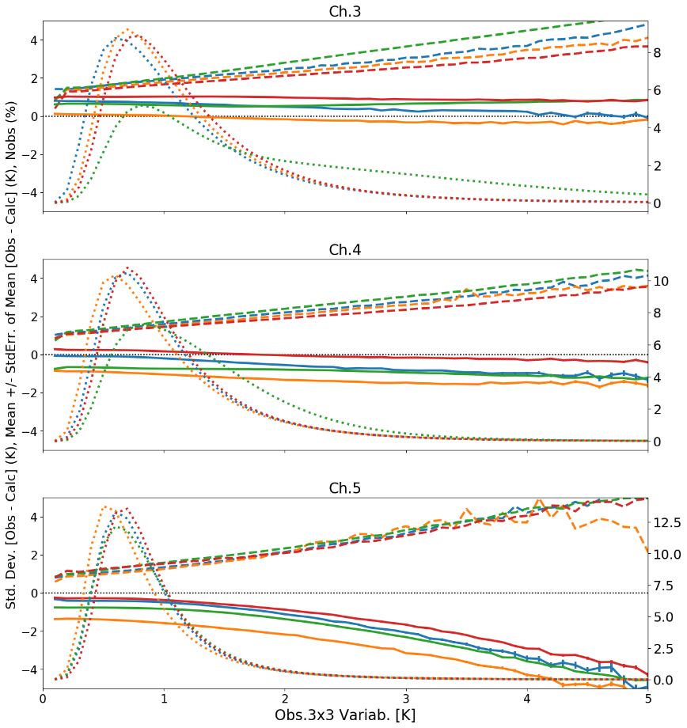
Horizontal (in)homogeneity
SSM/T-2 183.31±1.00 GHz ~Upper-Tropos. Hum.
F14 is more noisy
- - - Std. dev.
Mean
…. Count
SPEC
SSM/T-2 183.31±3.00 GHz ~Mid-Tropos. Hum.
Mean departures become significantly more negative for lowest-peaking channel when the inhomogeneity increases – consistent with earlier results: Bobryshev et al. &
Calbet et al. (2018:, doi:10.1109/TGRS.2017.2786548,
doi:10.5194/amt-11-6409-2018.)
(K)
SPEC
SSM/T-2 183.31±7.00 GHz ~Lower-Tropos. Hum.
SPEC
0.6
0.8
Local standard deviation in 3x3 pixels
(no rain/cloud, for latitudes between 40ºS and 40ºN)

Slide 18
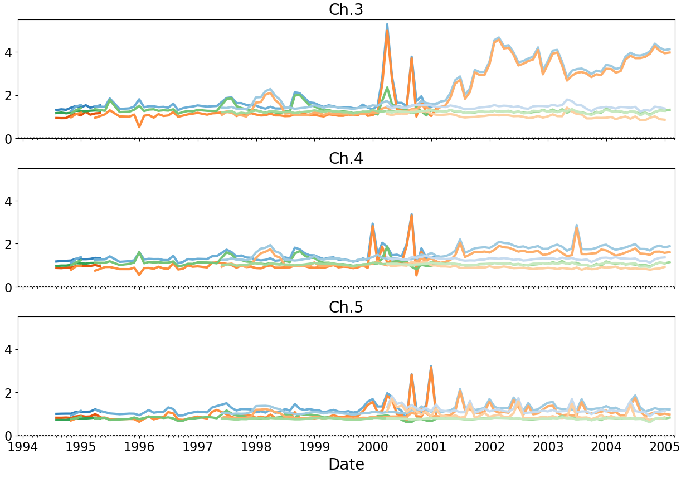
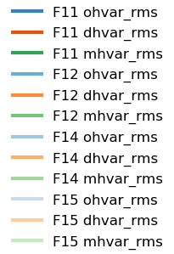
3x3 horizontal variability
SSM/T-2 183.31±1.00 GHz ~Upper-Tropos. Hum.
Obs (FCDR)
Departures
R.T. simulations
SSM/T-2 183.31±3.00 GHz ~Mid-Tropos. Hum.
(K)
SSM/T-2 183.31±7.00 GHz ~Lower-Tropos. Hum.
No rain/clouds within 3x3 pixels, for latitudes between 40ºS and 40ºN

Slide 19
Outline
SSM/T-2 instrument & data record
Methodology
  FCDR release 2
  Radiative transfer simulations
Results
Conclusions

Slide 20
SSM/T-2 FCDR Bias Assessment
SSM/T-2 FCDR release 2, including additional QC, HOAPS retrievals, and SSM/T-2 rain/cloud contamination flag, to be released very soon under DOI:10.15770/EUM_SEC_CLM_0050
Biases assessed by comparison to clear-sky radiative transfer simulations:
Lower-quality SSM/T-2 data for some short time periods:
these time-periods can be identified using the FIDUCEO uncertainty available in the data.
Robust features in biases:
upper-channel > mid-channel > lower-channel (similar to results found in AMSU-B assimilation)
Some seasonal dependence effects as shown by PCA
Scan-position-dependence of the biases (not shown today):
A polynomial may be sufficient to model this dependence.
Effects of non-linearity: cannot be ruled out as shown by antenna-T-dependent biases
Horizontal inhomogeneity: can be estimated by the 3x3 local variability; its increase is associated with negative biases for the lower-peaking channel, important to consider for a good match with RT simulations
Next: Application to assimilation experiments and CDR retrievals, Intercomparisons…
Also, more documentation about SSM/T-2 would certainly help (e.g. for APC)

