Slide 1
GSICS Microwave Subgroup Meeting
Metrology of Antenna
Radiation Pattern
Donglin Meng
mengdl@nim.ac.cn
National Institute of Metrology (NIM), P. R. China
16 February 2021

Slide 2
Outlines
1
Background & Problem
2
Methods for Calibrating antenna radiation pattern
3
NIM Spherical near field facility
4
Uncertainty evaluations

Slide 3
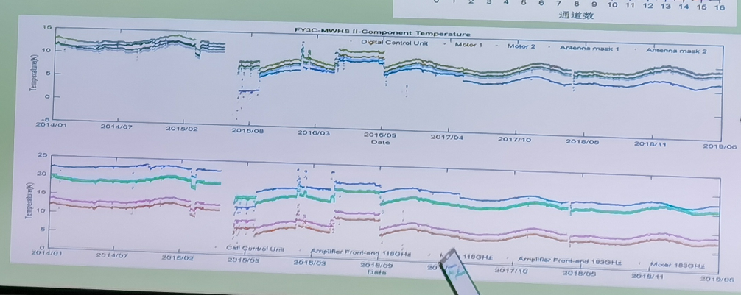
Comparability of remote-sensing measurements ~reproducibility , repeatability
Comparability: different remote-sensing measurements by different instruments at different times can be compared;
Traceability： accurate & adequate calibrations.
Provided by Jieying He from National Space Science Center, CAS

Slide 4
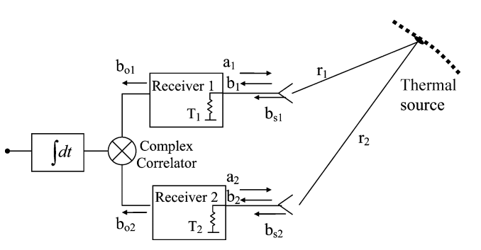
Antenna radiation pattern ~ Visibility function
Visibility function equation -Interferometric Aperture Synthesis Radiometry
How to calibrate radiation pattern
How to evaluatte the uncertainty?
Maximium directivity
Normalized antenna radiation pattern
[1] Corbella, N. Duffo, M. Vall-llossera, A. Camps, and F. Torres, “The visibility function in interferometric aperture synthesis radiometry,”IEEE Trans. Geosci. Remote Sens., vol. 42, no. 8, pp. 1677–1682, Aug. 2004.
Notes:
Polarimetric formulation of the visibility function equation including cross-polar antenna patterns
Published in: IEEE Geoscience and Remote Sensing Letters ( Volume: 2, Issue: 3, July 2005)
Page(s): 292 - 295
Date of Publication: 18 July 2005
ISSN Information:
INSPEC Accession Number: 8592729
DOI: 10.1109/LGRS.2005.846885

Slide 5

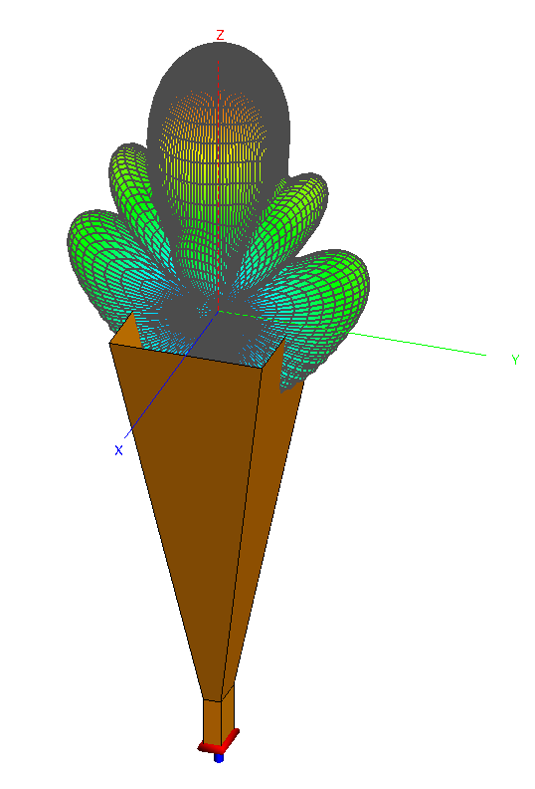
Antenna radiation pattern——Comprehensive parameter
Source /Receiver
E.M. fields in free-space
Guideded Wave
Antenna
A transceiver between guided wave and free-space E.M. fields.
Antenna radiation pattern:
The spatial distribution of a quantity that characterizes the electromagnetic field generated by an antenna.
Phase center
3D pattern
Half-power bandwidth
Sidelobe level

Slide 6
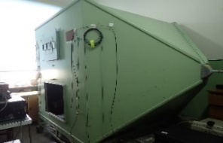
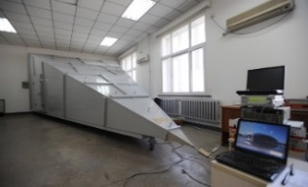
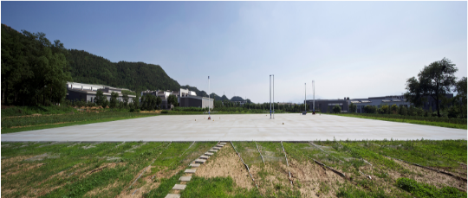
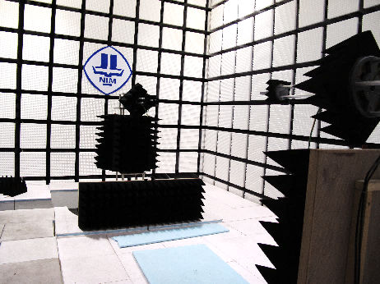
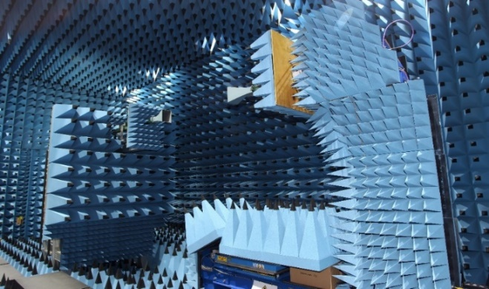
Antenna calibrating capability in NIM
TEM/GTEM/µTEM/ECSM
（环天线, 鞭天线）
开阔试验场 OATS (60m×40m)
远场（EMC天线）
平面近场 PNF
外推法（Extrapolation range）
球面近场 SNF

Slide 7
Comparison of antenna calibration capability
Organization | Country | Facility | Frequency（GHz） | Uncertainty of Sidelobe level dB | Notes
NIST | USA | Roll / Azimuth Robot arms | 2 ~ 60 50 ~ 110 100 ~ 500 | Down up to -50 dB or - 60 dB； Axial ratio measurement uncertainty: 0.1 dB/dB | （23±1）℃
NPL | UK | Integrated with three antenna extrapolation rage, Roll / Azimith | 0.4 – 110 ? | Similar to NIM | （23±1）℃
KRISS | Korean | Planar/Cylind/Spherical | 2 ～ 110 ? | U=3.44 dB @ - 40dB (k=1) | （23±1）℃
TUD | Denmark | Roll / Azimuth Robot arms | 400MHz ~ 50 GHz* | @5.405GHz U (D)= 0.03dB @ HPBW | The most famous one in the world
NIM | China | Integrated with three antenna extrapolation rage, Roll / Azimith | 0.4 - 110 | 400MHz~490MHz : -40dB: U =12.9dB (k=2) 2.6 GHz~110GHz -40dB U =(1.3 ~1.8) dB (k=2) | （23±1）℃

Slide 8
Outlines
1
Background & Problem
2
Methods for Calibrating antenna radiation pattern
3
NIM Spherical near-field facility
4
Uncertainty evaluation

Slide 9
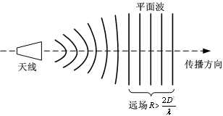
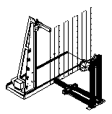
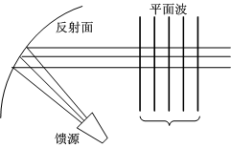
Basic Calibration methods
Methods
Far-field method
Near-field
Near far field
Planer near field
Cylindal
near field
Spherical near field
Compact range
Plane wave generator
G >15 dBi
Large antennas, economical

Slide 10
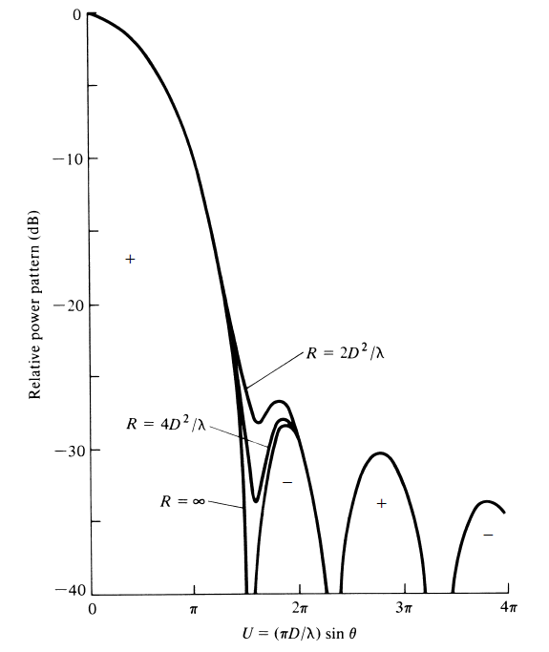
Challenges for calibrating accurately radiation pattern
Far field distance
Low sidelobe level
Phase center
Far field
Spherical near field
Far-field:
R= 4.5 D²/λ
Calculated radiation patterns of a paraboloid antenna for different distances from the antenna， 1970.
Notes:
Calculated radiation patterns of a paraboloid antenna for different distances from the antenna. (SOURCE: J. S. Hollis, T. J. Lyon, and L. Clayton, Jr. (eds.), Microwave Antenna Measurements, Scientific-Atlanta, Inc., July 1970).

Slide 11
Far field distance

Slide 12
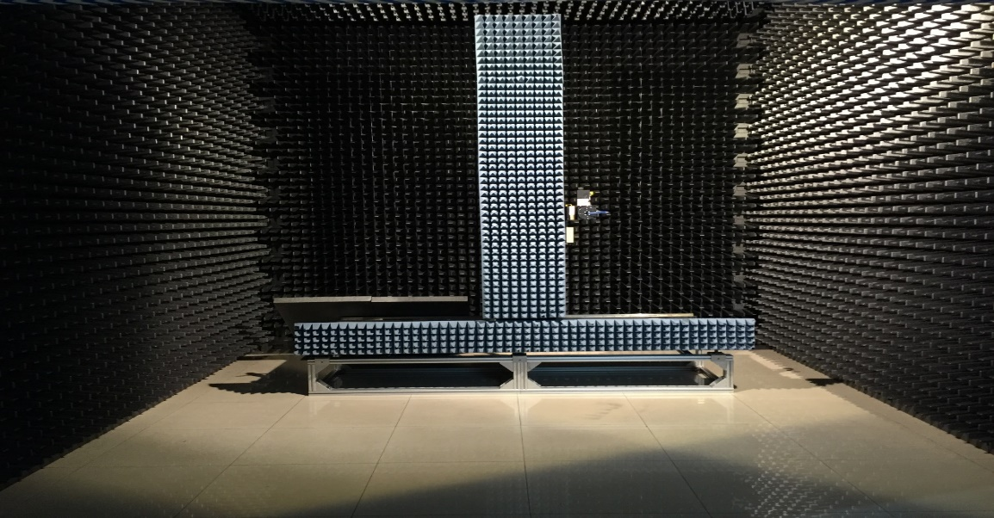
Planar near-field (PNF) requirements
Measurement distance:
Measurement area:
D is the aperture of the antenna under test.

Slide 13
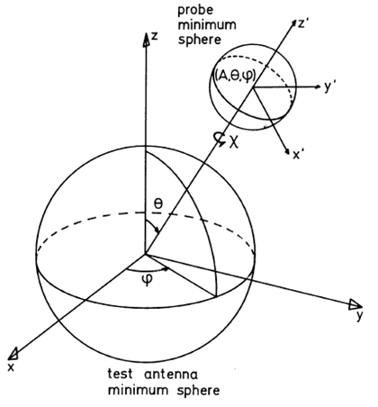
Spherical near-field (SNF) theory ：scattering matrix
IEEE Std 1720-2012 IEEE Recommended Practice for Near-Field Antenna Measurements
Spherical Near-Field Antenna Measurements Edited by J.E. Hansen
Measurand
Probe response coefficient
Measurement distance
SNF data
rotation ceofficent
D.L. Meng, etc., Uncertainty Evaluation of NIM Spherical Near-field Antenna Calibration Facility, ACTA Metrologica SINICA, 38(6), 2017.

Slide 14
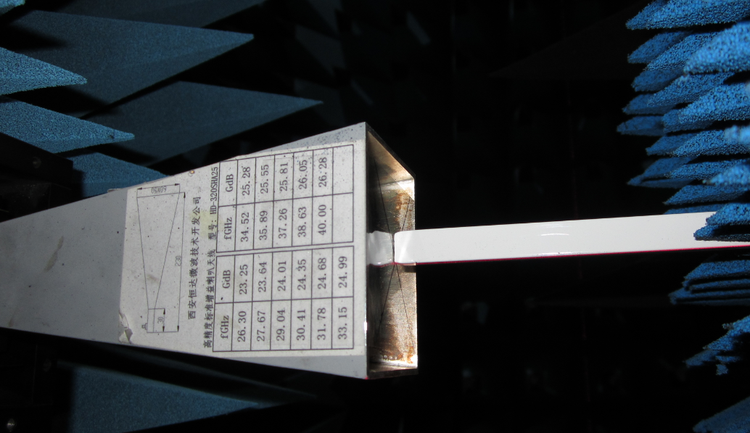
Comparison among Far field, Planar near field and Spherical near field
26GHz E面
40GHz H面
FF: far field method
SNF: Spherical near-field method
PNF: Planar near-field method
XP: cross polarization
NIM: national institute of metrology, China.
CAST: China Academy of Space Technology

Slide 15
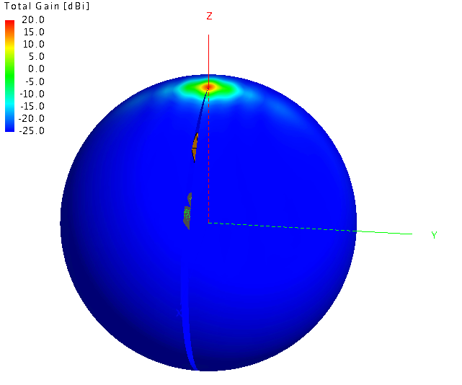
Compared between SNF ~ MoM (Method of Moment)
2.6 GHz E面
2.6 GHz H面
3.95 GHz E面
3.95 GHz H面

Slide 16
Outlines
1
Background & Problem
2
Methods for Calibrating antenna radiation pattern
3
NIM Spherical near field facility
4
Uncertainty evaluation

Slide 17
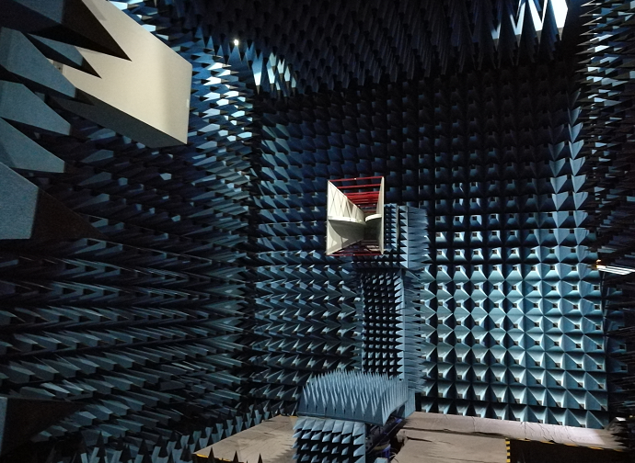
NIM SNF

Slide 18
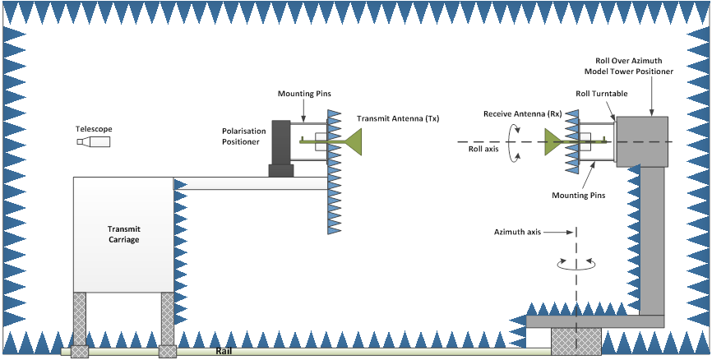
NIM SNF 400 MHz ~ 110 GHz
Sharing with extrapolation range
Enclosure：15m（L） × 7.6m（W） × 7.75m（H）
Rail length：15m
RF system
Anechoic chamber
Temperature ±1℃
Rail system, automatic cover system
Roll / Azimuth positioning
Laser interferometer
Alignment system for antennas and positioner
Software and documents
Notes:
频段范围-Dimension-rail(长度，直线度，定位精度)-激光测距仪-吸波材料自动覆盖系统-发射天线塔(双塔结构)-接收天线塔-测量系统（PNAx-）

Slide 19
Precise Mounting & alignment
Mirror
Rotary joint
Telescope
Mirror
Text mixer
Transit tower
Positioner
Anechoic chamber
Control Room

Slide 20
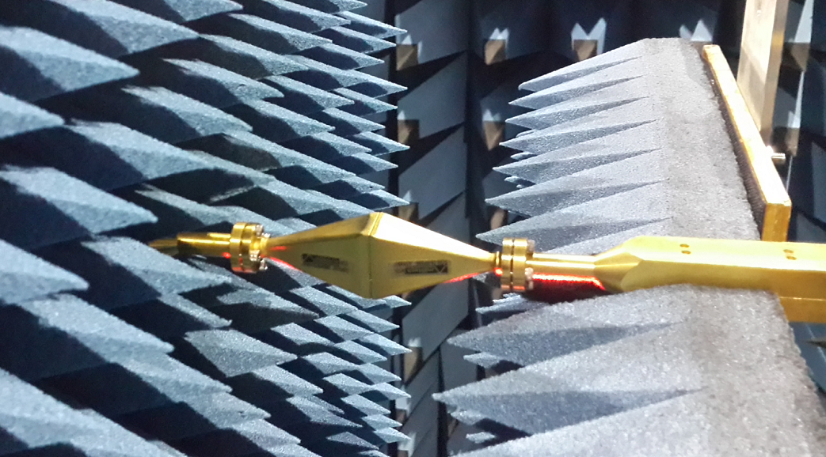
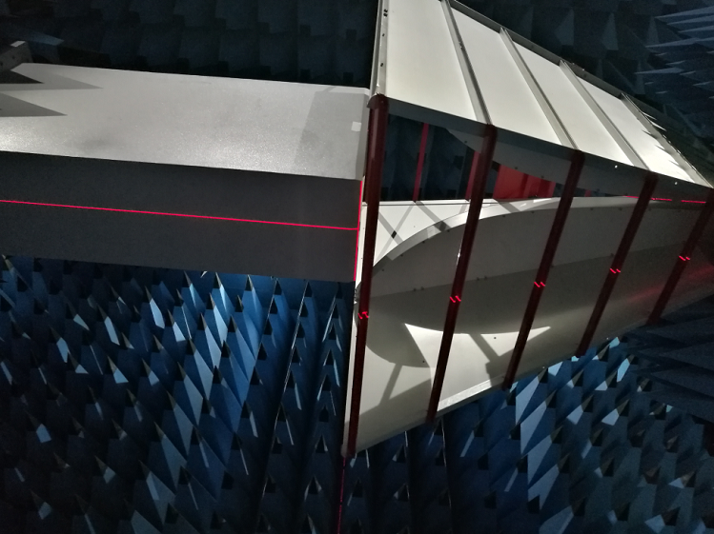
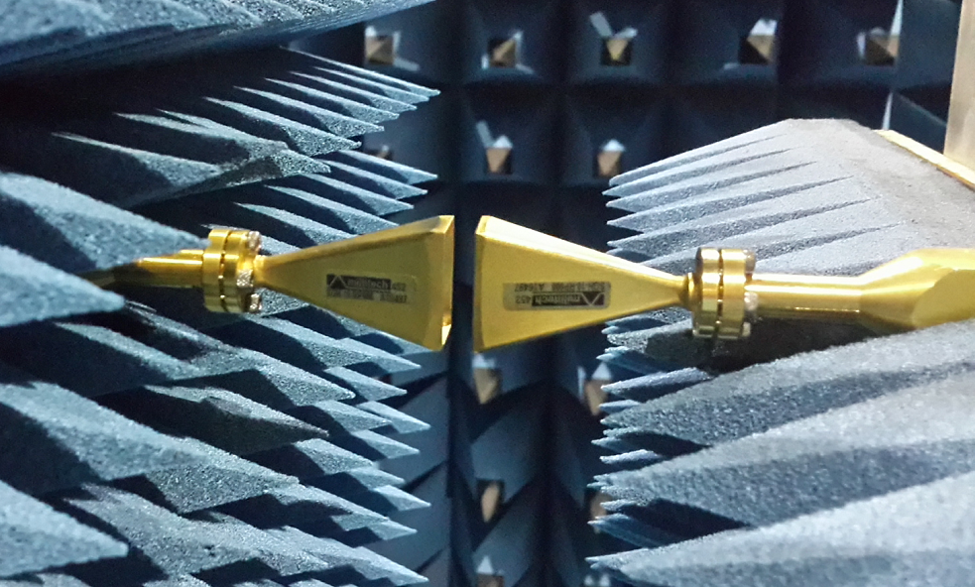
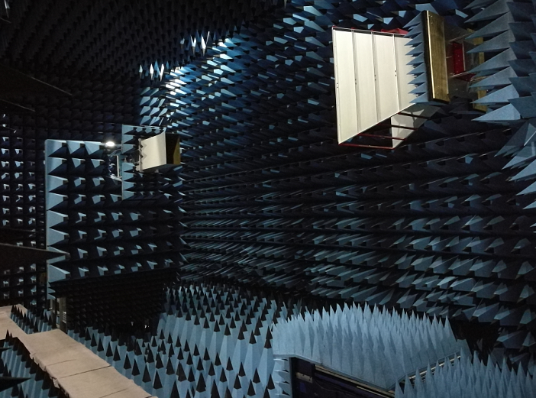
Example for mounting and alignment
75GHz～110GHz
400 MHz～490 MHz

Slide 21
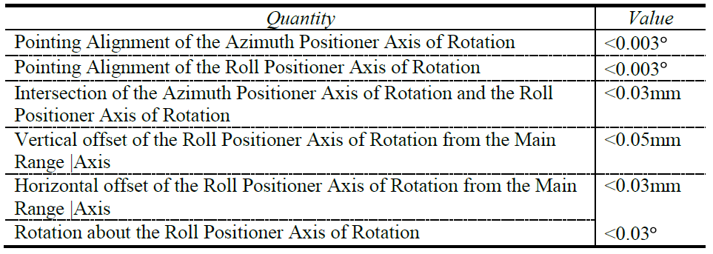
Positioner from Orbit/FR
Orbit/FR AL-360-1P，option：
EN002(incremental encoder)
MM002 (metric threads in mounting hole interface)
TH002 (thru-hole for indoor operation)
CF001 (rear panel connector location)
AUC：
Max weight：250 kg
Max aperture：Ф2.5m

Slide 22
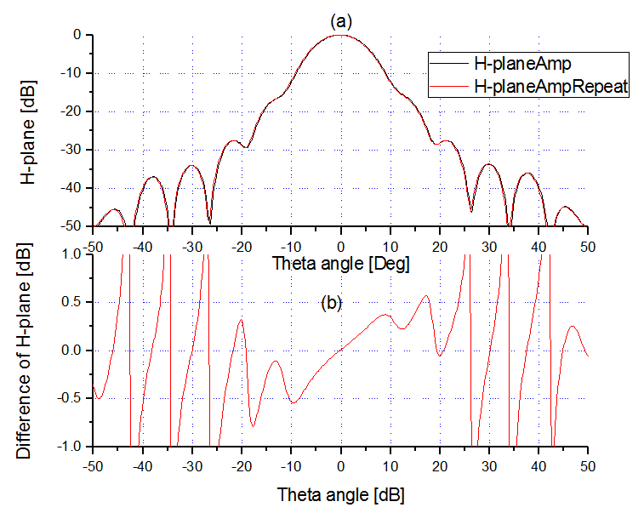
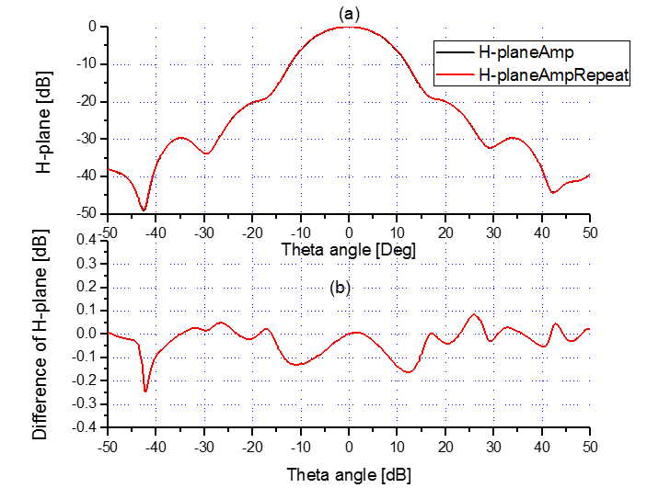
Reproducibility
26 GHz
40 GHz

Slide 23
Outlines
1
Background & Problem
2
Method for Calibrating antenna radiation pattern
3
NIM Spherical near field facility
4
Uncertainty evaluation

Slide 24
Fish-bone model for Radiation pattern with SNF

Slide 25
IEEE Std 1720-2012: Principle of “self-comparison”
IEEE Std 1720-2012 IEEE Recommended Practice for Near-Field Antenna Measurements
Meng Donglin, etc., Uncertainty Evaluation of NIM’s Spherical Near-field Antenna Measurement Facility，ACTA METROLOGICA SINICA , 38(6), 2017
Error
changes
reference
Self-comparison：
disturbances
changes

Slide 26
Measurement repeatability
26GHz
33GHz
40GHz

Slide 27
Uncertainty evaluated with “self-comparison”
E-plane， 2.6 GHz
Changes from the tilting alignment of the AUC
E-plane， 3.95 GHz
Changes from the tilting alignment of the AUC

Slide 28
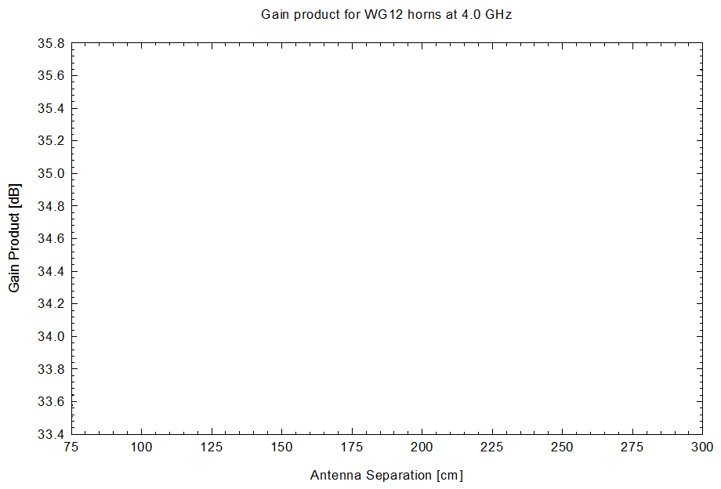
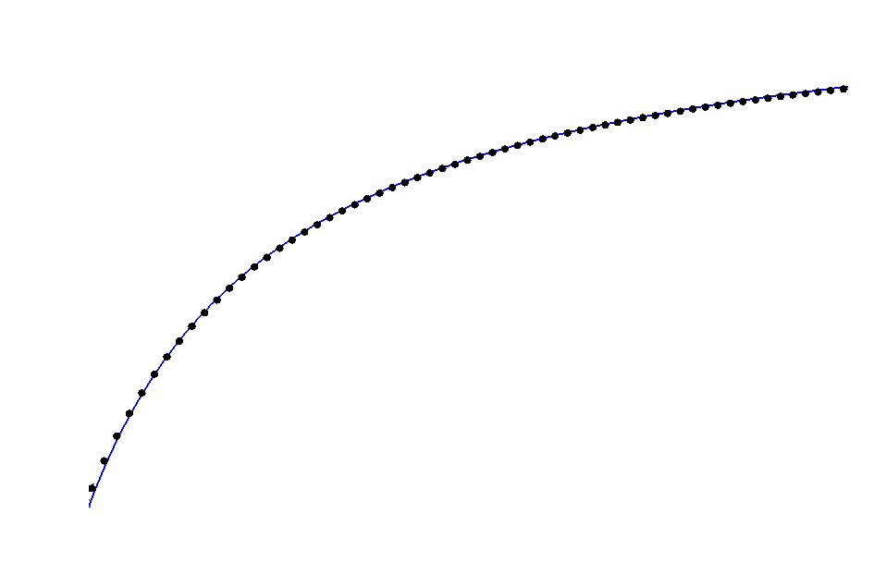
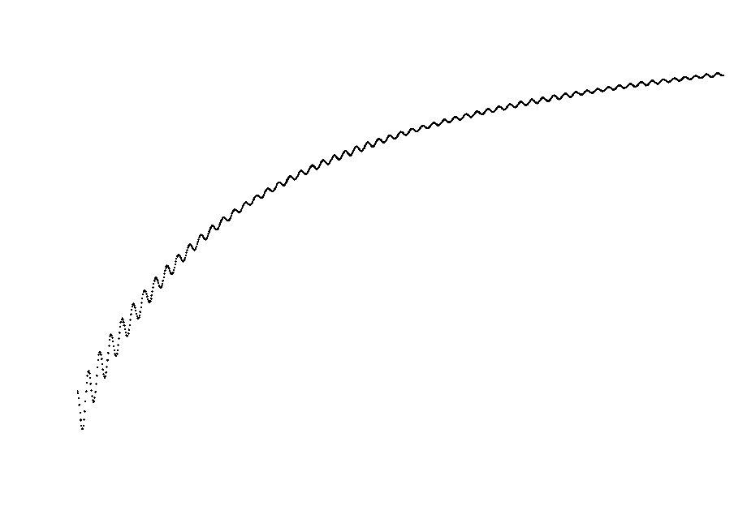
Uncertainty from Multi-reflections

Slide 29
Multi-reflections
E-plane， 400 MHz, Multi-reflections
E-plane， 3.3 GHz Multi-reflections

Slide 30
Uncertainty from the cross-polarization
The SNF performance is depended on the probe’s x-performance
2.6 GHz
Large difference between -20 dB amd -30dB!

Slide 31
The uncertainty budget of radiation pattern for AUT ETS 3106B (-30 dB to -20 dB below the boresight)
No. | Uncertainty source type | Source of uncertainty | Value |  |  | Probability distribution | Divisor
 |  |  | 400 MHz | 450 MHz | 490 MHz
1 | Probe | Radiation pattern (including polarization ratio) | 0.13 | 0.13 | 0.05 | Rectangular
2 |  | Multiple reflections between probe and AUT | 0.60 | 0.40 | 0.45 | Normal | 2
3 | Positioning | Probe misalignment | 0.18 | 0.20 | 0.10 | Rectangular
4 |  | AUT misalignment |  |  |  | Rectangular
5 |  | Scanning radius | 0.02 | 0.02 | 0.01 | Rectangular
6 |  | Blockage From positioner | 1.00 | 1.00 | 1.00 | Rectangular
7 | Data sampling | Measurement area truncation |  |  |  | Rectangular
8 |  | Data point spacing (aliasing) | 0.22 | 0.25 | 0.21 | Rectangular
9 | Room scattering | Room scattering | 2.50 | 2.00 | 1.25 | Normal | 2
10 |  | Scattering from the positioner
11 | Mismatch | Probe to source | - | - | - | - | -
12 |  | AUT to receiver | - | - | - | - | -
13 | RF system and accessories | Flexing cables/rotary joints | 0.60 | 0.50 | 0.25 | Rectangular
14 |  | Temperature effects |  |  |  | U shape
15 |  | Receiver errors |  |  |  | Rectangular
17 |  | Leakage and crosstalk | 0.05 | 0.35 | 0.13 | Rectangular
18 | Random | Random | - | - | - | - | 1
Combined standard uncertainty |  |  | 1.86 | 1.50 | 1.03 | Normal | 2
Expanded Uncertainty (k =2) |  |  | 3.8 | 3.0 | 2.1 |  | 2

Slide 32
The uncertainty budget of radiation pattern for millitech SGH-10-RP1000 (-40 dB level below the boresight)
No. | Uncertainty source type | Source of uncertainty | Value |  |  | Probability distribution | Divisor
 |  |  | 75 GHz | 92 GHz | 110 GHz
1 | Probe | Radiation pattern (including polarization ratio) | 0.05 | 0.05 | 0.05 | Rectangular
2 |  | Multiple reflections between probe and AUT | 0.40 | 0.30 | 0.40 | Normal | 2
3 | Positioning | Probe misalignment | 0.80 | 0.70 | 0.80 | Rectangular
4 |  | AUT misalignment | 0.80 | 0.70 | 0.80 | Rectangular
5 |  | Scanning radius | 0.05 | 0.06 | 0.07 | Rectangular
6 |  | Blockage From positioner | 0.02 | 0.05 | 0.03 | Rectangular
7 | Data sampling | Measurement area truncation |  |  |  | Rectangular
8 |  | Data point spacing (aliasing) | 0.65 | 0.75 | 0.47 | Rectangular
9 | Room scattering | Room scattering | 0.02 | 0.02 | 0.02 | Normal | 2
10 |  | Scattering from the positioner
11 | Mismatch | Probe to source | - | - | - | - | -
12 |  | AUT to receiver | - | - | - | - | -
13 | RF system and accessories | Flexing cables/rotary joints | 0.20 | 0.30 | 0.20 | Rectangular
14 |  | Temperature effects |  |  |  | U shape
15 |  | Receiver errors |  |  |  | Rectangular
17 |  | Leakage and crosstalk | 0.10 | 0.35 | 0.20 | Rectangular
18 | Random | Random | - | - | - | - | 1
Combined standard uncertainty |  |  | 0.87 | 0.86 | 0.83 | Normal | 2
Expanded Uncertainty (k =2) |  |  | 1.8 | 1.8 | 1.8 |  | 2

Slide 33
Conclusions
Introducing the role of metrology of antenna radiation pattern in remote sensing measurements
Demonstrate the accurate calibration of radiation pattern by PNF and SNF.
Detailed SNF facility in NIM is introduced; precise alignment system is key for good reproducibility.
The uncertainty of radiation pattern （amplitude) is introduced. Phase pattern will be researched in future.

Slide 34
Thank you for your attention!
Discussion?

