Slide 1
Global Reanalysis at ECMWF:
ERA5, ERA6 and MW FCDRs
Bill Bell, Hans Hersbach, Adrian Simmons, Julien Nicolas, Dinand Schepers, Paul Berrisford, Andras Horanyi, Joaquin Munoz-Sabater, Cornel Soci and Raluca Radu
Copernicus Climate Change Service Reanalysis Team, ECMWF
Joerg Schulz, Viju John, Paul Poli and Timo Hanschmann
EUMETSAT

Slide 2
Overview
ERA5 & the extension back to 1950
  Comparison with ERA Interim
  Surface and upper air performance
  Observations and impact on EDA spread
Bias correction of MSU and AMSU-A in ERA5
MW data rescue and reprocessing efforts for ERA6 (2024)
Summary

Slide 3
ERA5 and ERA-Interim
 | ERA-Interim | ERA5
Period | 1979 – present | 1950 – present, produced in 2 phases
Availability behind real time | 2-3 months | 2-3 months (final product) 5 days (ERA5T)
Assimilation system | 2006 (31r2), 4D-Var soil moisture: 1D-OI | 2016 (41r2), 4D-Var, hybrid EDA soil moisture: SEKF
Model input (radiation and surface) | As in operations, (inconsistent SST and sea ice) | Appropriate for climate, e.g., evolution of greenhouse gases, volcanic eruptions, sea surface temperature and sea ice
Land-surface model | TESSEL | HTESSEL
Spatial resolution | 79 km globally 60 levels to 10 Pa | 31 km globally 137 levels to 1 Pa
Uncertainty estimate |  | from 10-member EDA at 63 km
Output frequency | 6-hourly Analysis fields | Hourly (three-hourly for the ensemble), Extended list of parameters ~ 9 Peta Byte (1950 - timely updates)
Extra Observations | Mostly ERA-40, GTS | Various reprocessed CDRs, latest instruments
Variational Bias control Radiosondes | Satellite radiances, RAOBCORE | Also ozone, aircraft, surface pressure, RISE
Land downscaling product | ERA-Interim land, 79km | ERA5L, 9km (forced by ERA5)

Slide 4
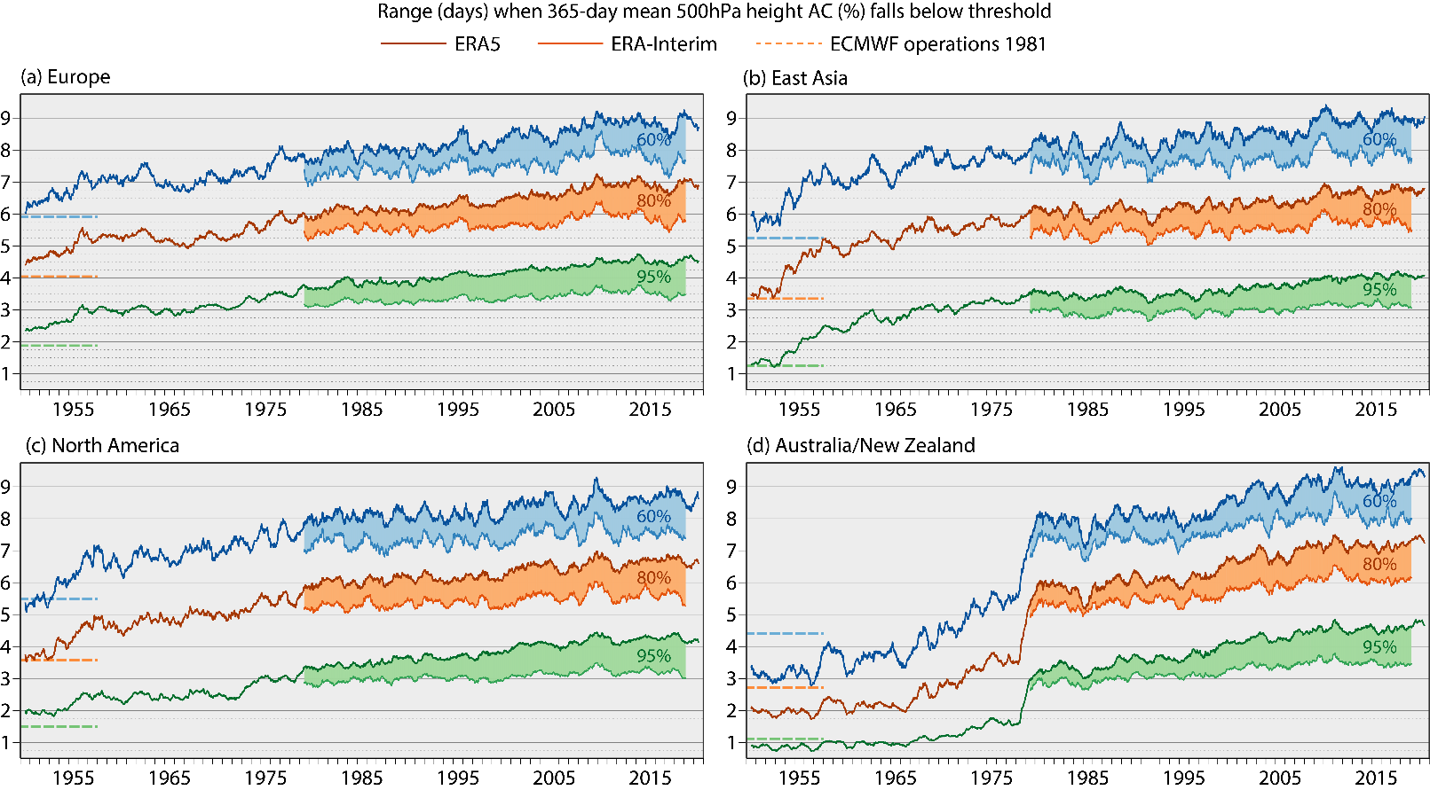
ERA5 extends back to 1950

Slide 5
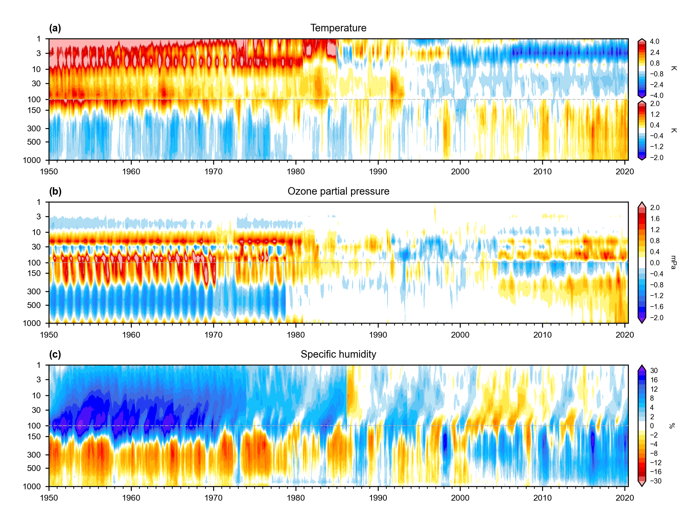
Upper Air Anomalies (relative to ERA5 climate 1981-2010)
Warming troposphere
esp. post-1980
Cooling stratosphere,
punctuated by volcanic eruptions
More discontinuous above 10 hPa
Impact of BUV evident 1970-1972
Anomalies generally smaller when
the observing system constraints the
analysis
Moistening troposphere & drying
stratosphere
Discontinuities evident in stratospheric
humidity at 1974 and 1986 at ‘seams’ -
due to long spin-up.
mitigated more effectively pre-1979

Slide 6
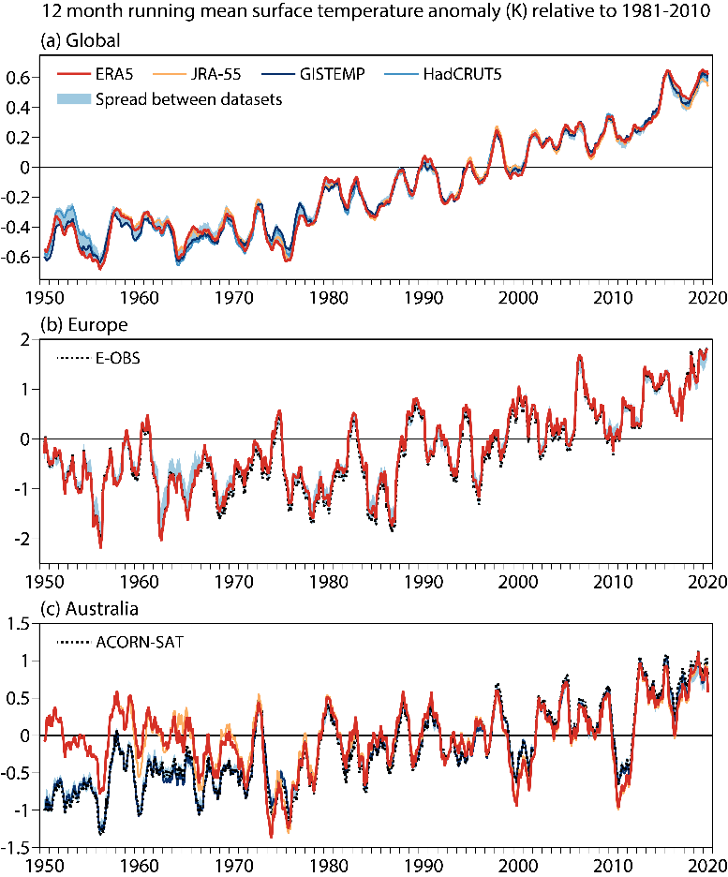
Evolution of 2m temperature anomalies and comparison with other datasets
Temperature trends:
The global mean temperature shows little trend from 1950 to the mid 1970s.
After that global warming becomes clearly visible with a global trend of around
  0.18 K/decade for 1981-2010
  0.24 K/decade for 1991-2020
Consistency between datasets:
reanalyses and more direct observation-based datasets.
In general, quite good and reassuring,
  especially over Europe,
However, there are some discrepancies,
  especially over Australia
Notes:
Twelve-month running-mean surface temperature anomaly (K) relative to 1981-2010, from 1950
to 2020: (a) Global average, for ERA5, JRA-55, HadCRUT5 and GISTEMP, and the spread (pale blue shading) among
these datasets plus Berkeley Earth and NOAAGlobalTemp; (b) European average from ERA5 and E-OBSv21, and the
spread (blue shading) between these datasets and the others used in (a); (c) Australian average from ERA5, JRA-55,
GISTEMP and ACORN-SAT, and the spread (blue shading) between all datasets other than ERA5 and JRA-55. In (b),
the averages for ERA5 and E-OBS are calculated using only grid points for which E-OBS has complete coverage in
time. The ERA5 climate for 1981-2010 is used to calculate both the E-OBS and the ERA5 anomalies

Slide 7
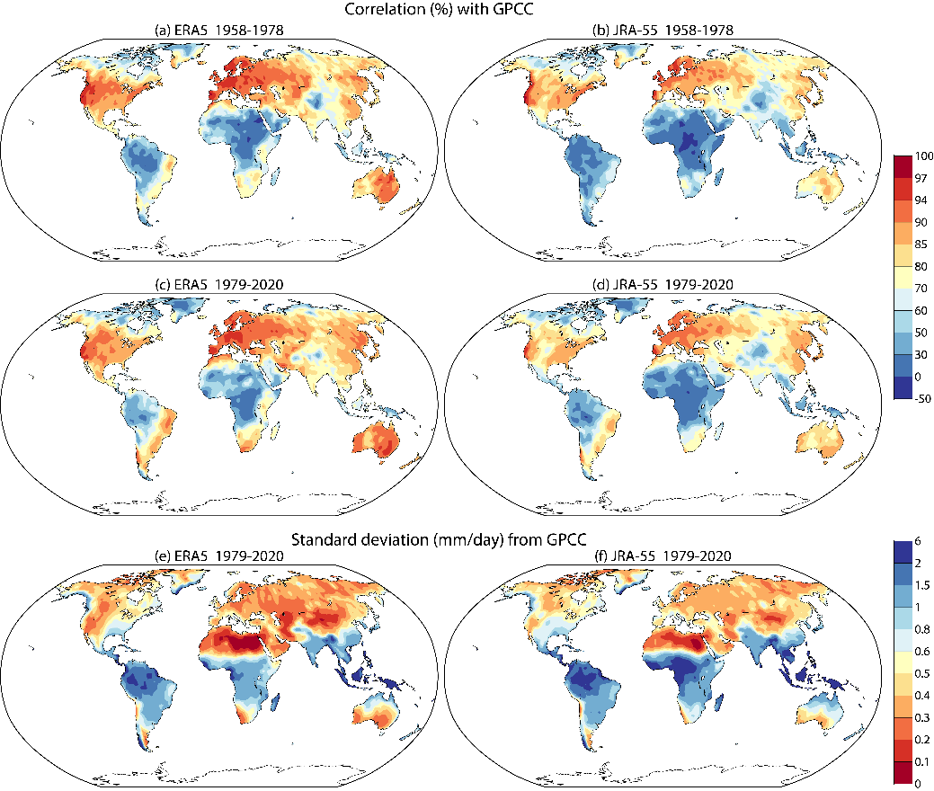
Precipitation: Correlation with GPCC & comparison with JRA-55

Slide 8
Observations assimilated in ERA5 (1979-2020)
Reprocessed
data, or change
in processing
since ERA Interim
Same as ERA Interim (pre-2015)
or operations post-2015
Not used in
ERA5, but used
in ERA Interim (pre-2015) or
ECMWF operations
(post-2015)
Not used in
ERA Interim,
but used in ERA5
MW imagers
and sounders

Slide 9
Observations assimilated in ERA5 (1979-2020) - MW only

Slide 10
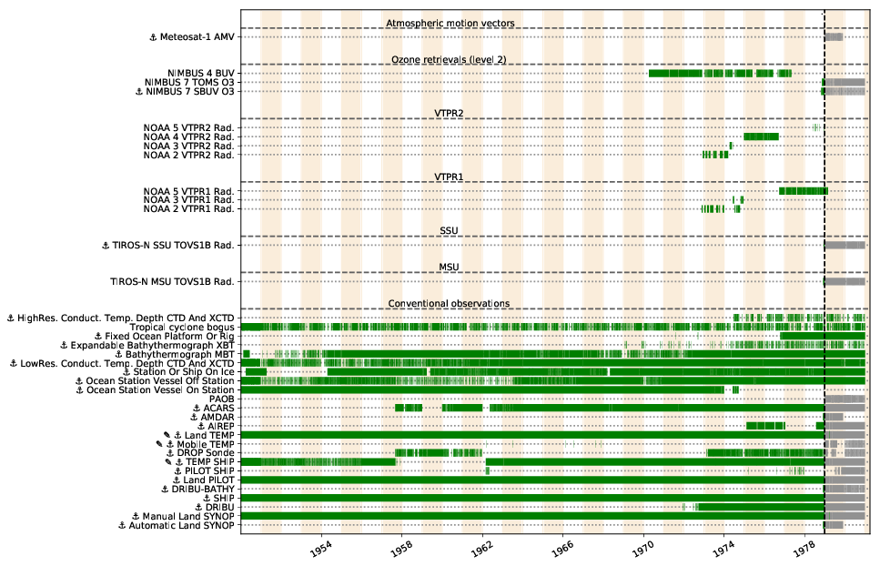
Observations used in the ERA5 back extension (1950-1979)
1950: around 53,000 per day
1978: around 570,000 per day
2020: around 25 million per day
Some satellite observations:
BUV: partial column ozone
VTPR: sensitive to upper-air T and Q
Lots of conventional observations:
Including from extra sources
Upper air:
weather balloons, aircraft,
T, U/V, Q
Surface:
Land, ship, buoy, IBTrACS tropical cyclone bogus:
Ps, 10m wind, Rh2m,
T2m, snow depth
No wave-height observations
Notes:
VTPR, a predecessor of the High Resolution Infrared Sounder (HIRS) instrument, is a passive infrared sounder carried
on four satellites (NOAA-2 through -5) and provided data from November 1972 until February 1979.

Slide 11
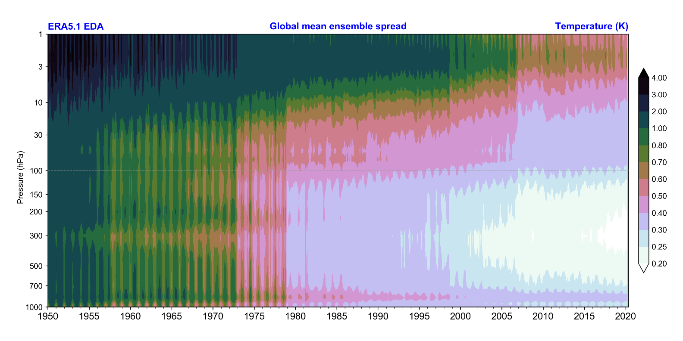

Ensemble spread as a measure for the synoptic ERA5 uncertainty
Spread decreases over time when more and more observations become available
Major changes in the observing system are clearly visible
IGY
VTPR
TOVS
(HIRS, MSU, SSU)
ATOVS
(AMSU-A)
GNSS-RO
(COSMIC,..)

Slide 12
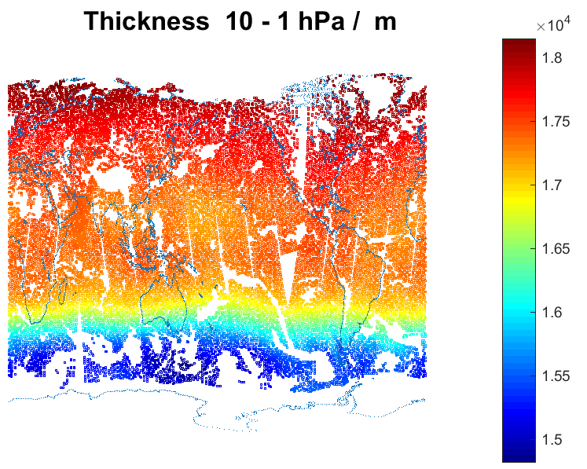
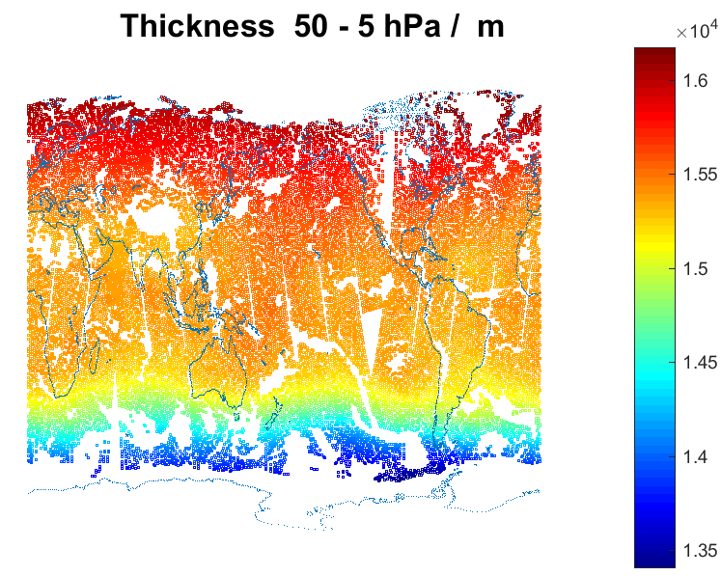
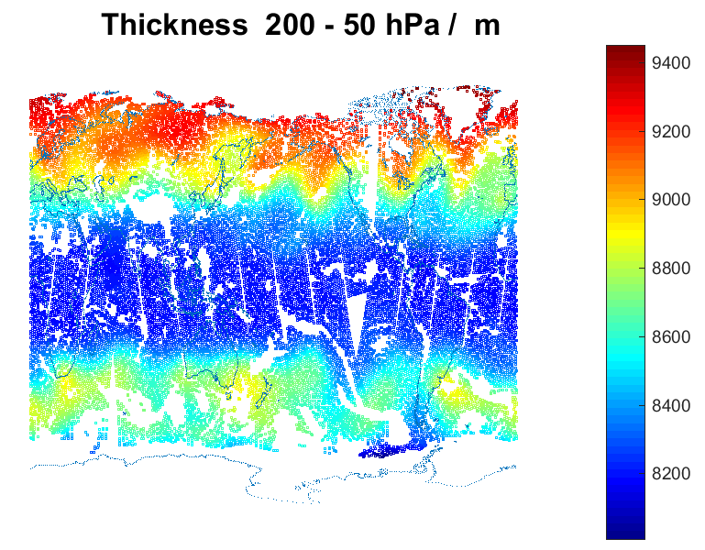
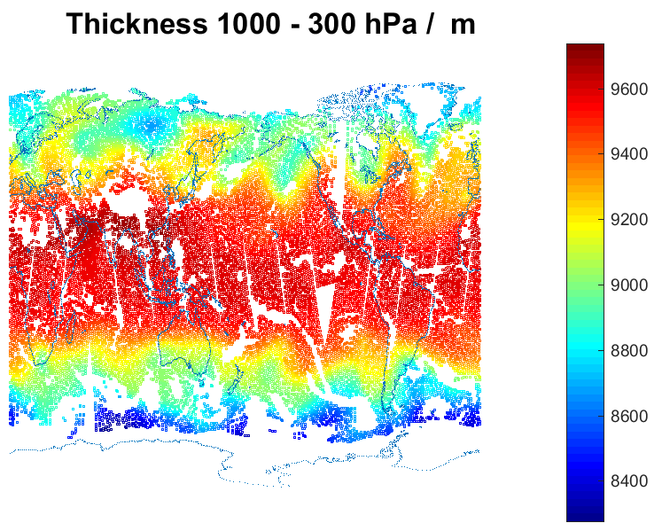
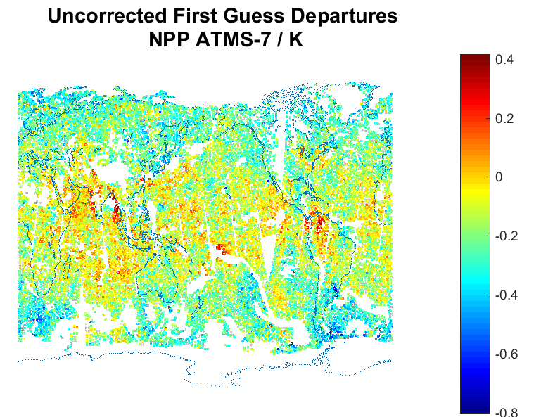
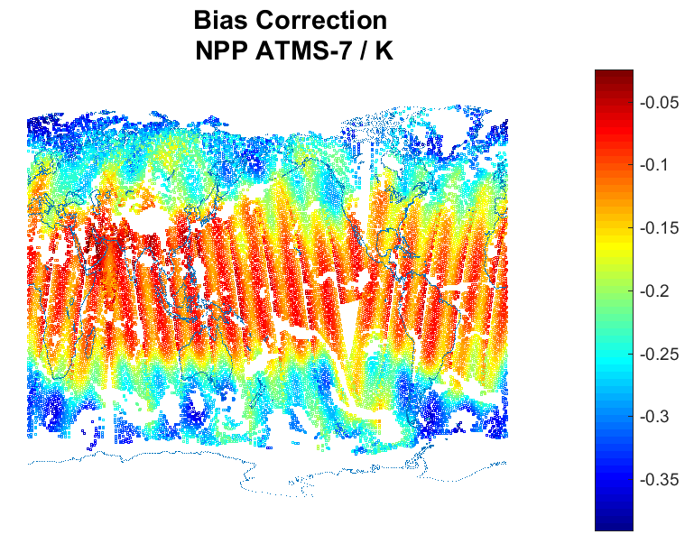
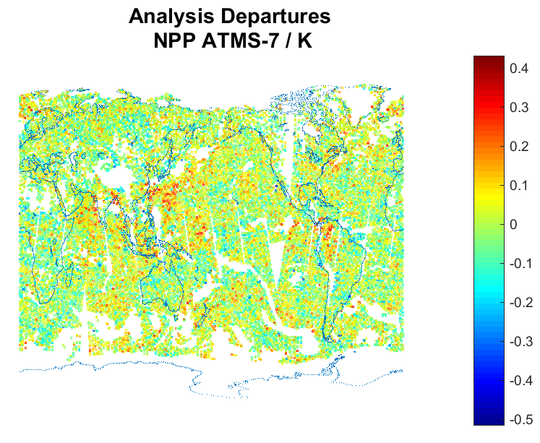
Variational Bias Correction in ERA5 – bias model & typical corrections (example : ATMS-7)
+ offset
+ scan biases
(to 3rd order)
Accounts for:
Instrument errors (spectral, radiometric, …)
Forecast model errors
RT model errors
Expect (hope!) that in time, as instruments & models improve:
The (mean) amplitude of bias corrections reduce; and
The variance of the bias corrections reduce
Eventually – the corrections are (i) small & (ii) bounded by the uncertainties

Slide 13
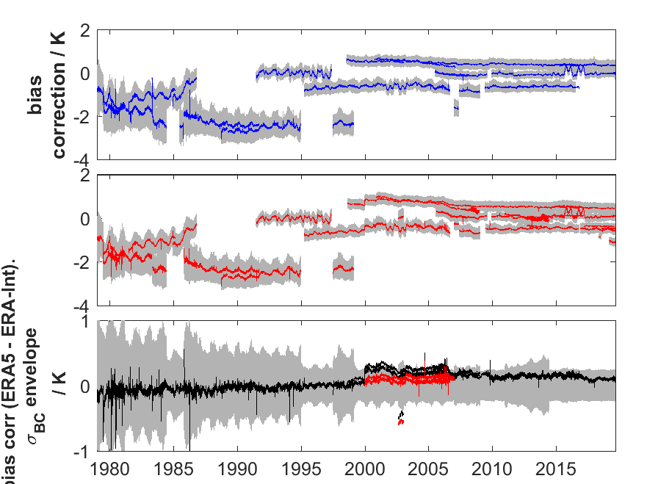
MSU-3 / AMSU-A7 / ATMS-8 Bias Corrections
MSU-3 / AMSU-A7 / ATMS-8
(54.96 / 54.94 / 54.94 GHz)
T –sounding, w.fn. peak at 270 hPa
Improvements MSU - > AMSU-A - > ATMS
(FY-3 MWTS / MWTS-2, Metop-SG MWS ?)
Little change from ERA-Interim to ERA5
Suggests model bias and RT related biases
are less significant than instrument biases
MSU & AMSU-A possible mechanisms identified:
- Radiometer non-linearities. Zou et al
(JTECH, 2010)
- Spectral shifts. Zou et al (JGR, 2011),
Lu and Bell (JTECH, 2013)
But disappointing results in NWP testing so far
(for AMSU-A, Lupu et al, ECMWF TM 770, 2016)
ERA Interim
Bias corrections (bold) ± STDEV
of bias corrections (grey)
ERA5
Difference in bias corrections
STDEV of ERA5 bias corrections
ERA5 – ERA Interim
ERA5.1 – ERA Interim

Slide 14
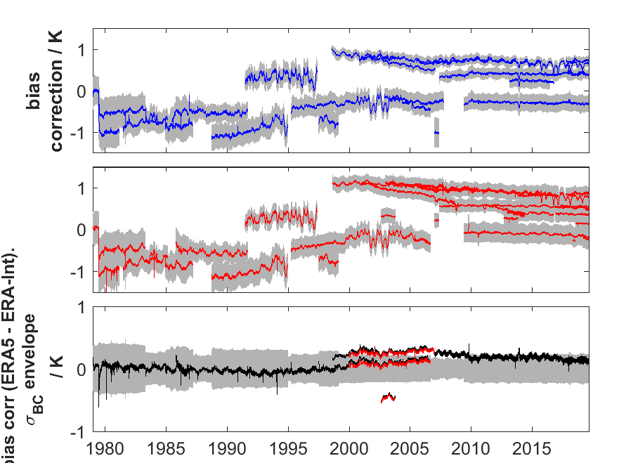
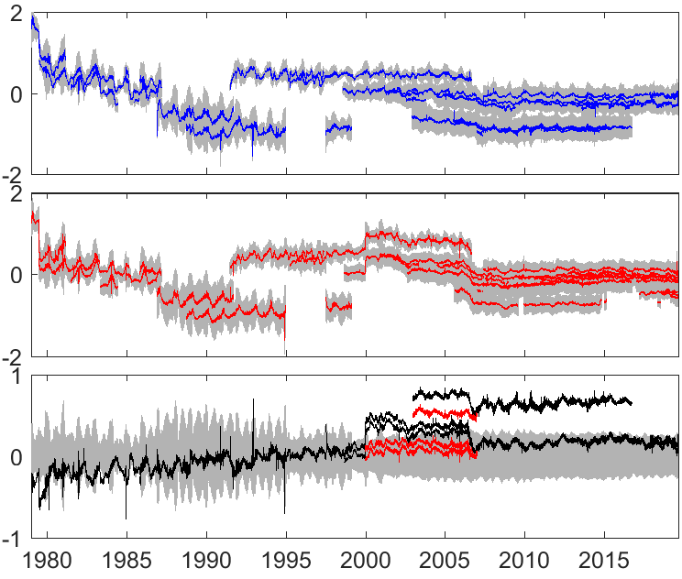
MSU-2 / -3 / -4 Bias Corrections
MSU-2 / AMSU-A5 / ATMS-6
Peak 700 hPa
MSU-3 / AMSU-A7 / ATMS-8
Peak 270 hPa
MSU-4 / AMSU-A9 / ATMS-10
Peak 90 hPa
Difference in bias corrections
STDEV of ERA5 bias corrections
Similar picture (to MSU-3) for MSU-2 and MSU-4.
Changes in bias correction wrt ERA-Interim are generally small, with the exception of:
  Aqua AMSU-A 2003-2016
  The period from 2000 - 2006 ( fixed in ERA5.1 )
Largest discrepancies AMSU-9 (0.5K), but still detectable in AMSU-7 and AMSU-5

Slide 15
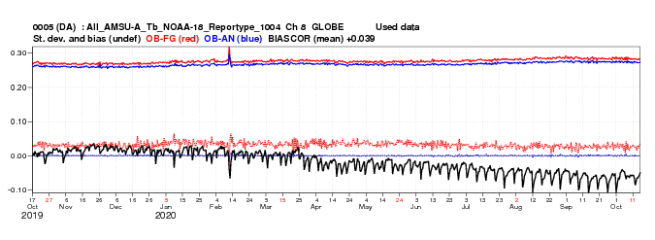
Model error manifested in biased fg_departures
NOAA-18 AMSU-A8
fg departures biased by ~25 mK
x
(T)
OBS
AN
FG
time

Slide 16
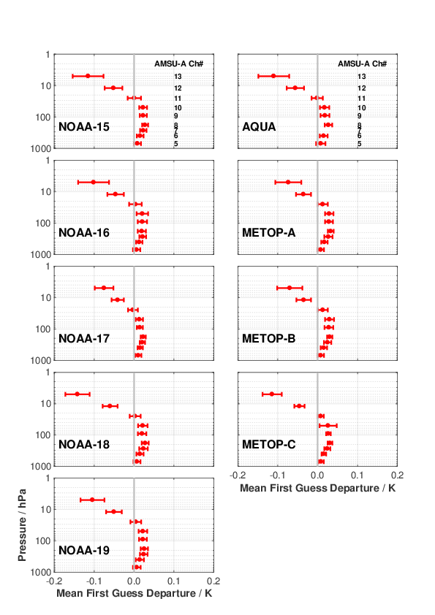
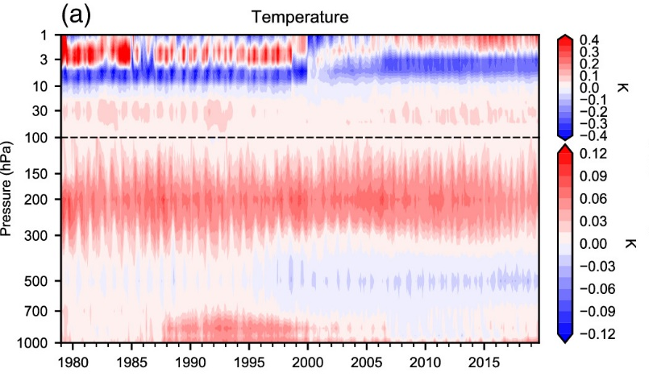
Disentangling Model Error & Instrument Error / AMSU-A Mean FG_DEPS in ERA5
ERA5 mean first guess departures shown for AMSU-A
Error bars represent (±1σ) spread over the lifetime of each sensor
Consistent picture of :
a cold model bias mid-trop to mid-strat
a (larger) warm model bias above 10 hPa
Broadly consistent with analysis increments in ERA5 (below, from Fig 16, Hersbach et al, 2020)

Slide 17
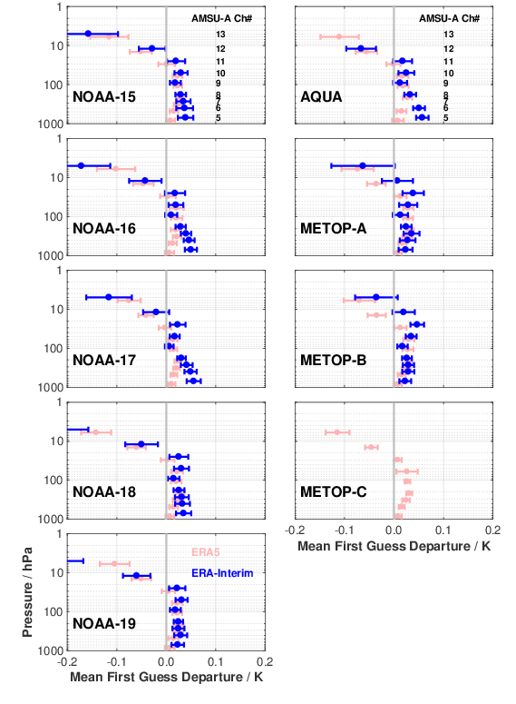

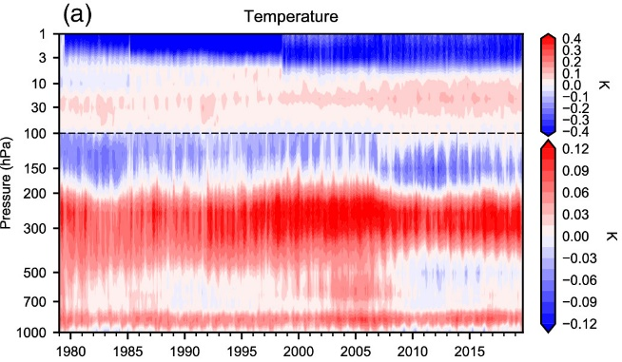
Model Error / AMSU-A Mean FG_DEPS in ERA-Interim
Indications that ERA-Interim:
Exhibits similar biases (to ERA5) above 10 hPa
Exhibits larger biases below 200 hPa
Exhibits smaller biases around 100 hPa.
ERA5
analysis increments
ERA-Interim
analysis increments

Slide 18
EUMETSAT’s contribution to C3S Phase 2 (highlighting MW)
ERA6 preparations (delivery <2025)
  HIRS: infrared, soundings (1978-2021)
  SSMT: microwave, soundings (1991-2005)
  SSMIS: microwave, soundings (2003-2021): addressing upper-atmospheric sounding
  Japanese GEO radiances (1978-2015): assimilation readiness report
F
R
130
F
R
25
F
R
47
R
FCDR/TCDR for European high-resolution reanalyses
  METEOSAT: radiances and atmospheric motion vectors from First and Second Gen. Rapid-Scan
F
T
11
15
Early satellite era FCDR/TCDR
Benchmark FCDR
  SMMR: microwave, images (1978-1987)
  SSH: infrared, soundings (1977-1980)
  SI-1: infrared, spectra (1977, 1979)
  THIR: polar atmos. motion vectors (70-85)
  MSU & AMSUA: microwave, soundings (1978-2020): FIDUCEO-type analysis
  ATMS: microwave, soundings (2011-2021):
  FIDUCEO-type analysis, all channels
F
R
9
F
R
F
R
5
152
F
<1
F
T
R
12
14
Some uncertainty, related to availability and
quality of the sensor data
F
FCDR
T
TCDR
R
Report
xx
Satellite-years expected in deliverable CDR
Builds on existing programme (2016-2021)
which will/has deliver(ed) FCDRs for HIRS, ATMS, MHS and MWHS-1/-2

Slide 19
Satellite Data Rescue to Support ERA6 (and beyond)
Recovery and assessment of
early IR imager and sounder data
was the main focus of a C3S
activity during 2019-2021
(Spascia Ltd, U of Reading,
Met Office, Meteo-France, ICARE)
Next phase (2021-2024)
involves more work on the early
MW sensors

Slide 20
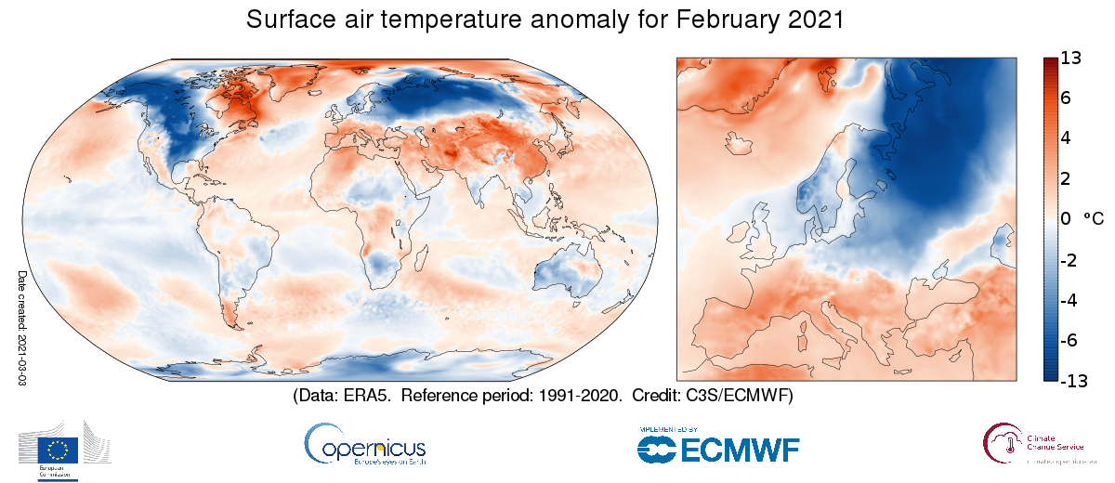
Summary
Over 45,000 C3S Climate Data Store users; typically over 400 Tbyte of downloads per week
ERA5: A full-observing-system global reanalysis for the atmosphere, land and ocean waves
Daily updates 5 days behind real time from 1979 onwards
Hourly snapshots at 31km resolution up to about 80km height
February 2021
Further reading:
The ERA5 journal paper (Hersbach et. al, 2020)
Simmons et. al, 2021: on ERA5 surface temperature and humidity
Bell et. al, submitted: the ERA5 back extension paper.
The ERA5 online documentation
New (autumn 2020) ERA5 Back extension: 1950 - 1978
Has in general good characteristics
However sub-optimal for tropical cyclones
Suitable for many users; be careful with extremes
We are about to start the production of an improved version

