Slide 1
Introducing the “Hot Land Bias”
Tim Hewison (EUMETSAT)
Ali Mousivand
Alessandro Burini
Dorothée Coppens

Slide 2
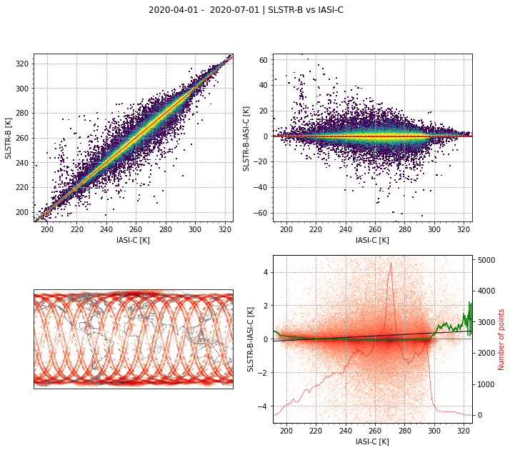
LEO-LEO IR
LEO-LEO Collocation Thresholds:
|dt|<300s (GSICS GEO-LEO)
|dx|<6km (IASI iFOV/2)
|dzen|<0.02 (more relaxed than GSICS GEO-LEO)
All times (day + night) = all SZA
All dates (at least in test of ~1 month)
All geographic coverage (land+sea, all latitudes, all longitudes)
All scan angles (VZA)
All Relative Azimuth Angles (RAA) (not relevant for IR - re-check with 3.8µm)
These thresholds ensure a maximum bias <0.1K
Except for hot scenes (>300K), typically only found over land surfaces in low latitudes during daytime
where the resulting biases have significant sensitivity to dt, dzen, SZA, VZA and RAA

Slide 3
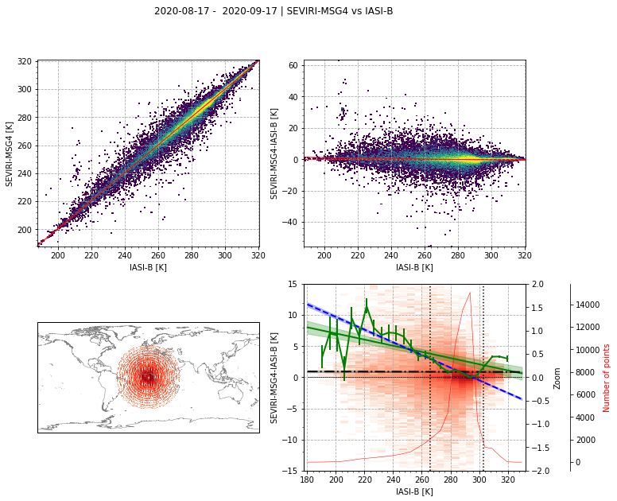
GEO-LEO IR Hot End Issue
GEO-LEO Collocation Thresholds:
|dt|<300s (GSICS GEO-LEO)
|dx|<6km (IASI iFOV/2)
|dzen|<0.01
All times (day + night) = all SZA
All dates (at least in test of ~1 month)
All geographic coverage (land+sea, all latitudes, all longitudes)
All scan angles (VZA)
All Relative Azimuth Angles (RAA)
Unresolved bias for cold scenes
Under investigation
Similar bias to LEO-LEO IR
Bias over hot scenes (>300K), typically only found over land surfaces in low latitudes during daytime
where the resulting biases have significant sensitivity to dt, dzen, SZA, VZA and RAA

Slide 4
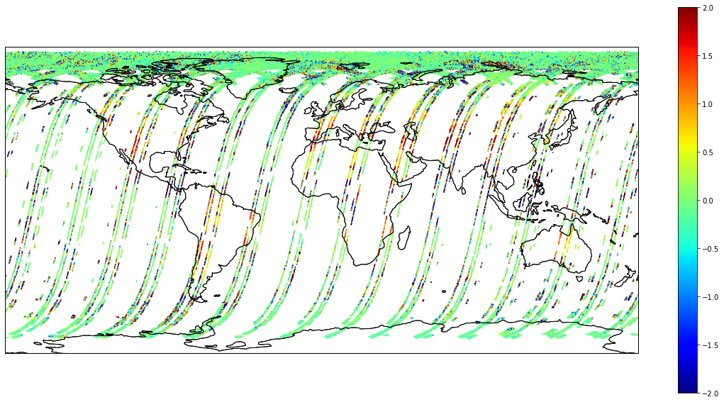
Distribution of SLSTR-IASI daytime biases
Excess biases are visible not only over desert areas, but other land - e.g. Brazil
But some desert areas (e.g. Algeria) are not biased at all, despite being really hot!

Slide 5
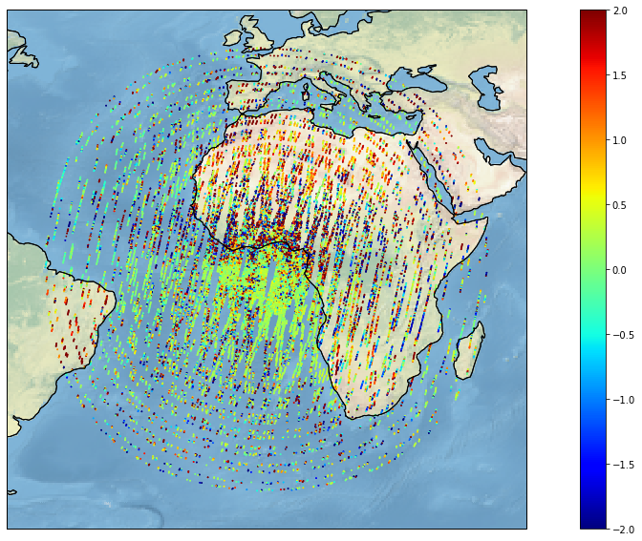
GEO-LEO IR Hot End Issue
Aim to extend dynamic range of GEO-LEO IR inter-calibration
Include collocations over land
in the daytime
Analysis of Radiance Difference (SEVIRI-IASI) IR10.8 :
Many positive biases over desert areas,
Many negative biases over DCCs
Plot of Radiance Difference (SEVIRI-IASI) IR10.8 (mW/m2/sr/cm-1)
for daytime overpasses

Slide 6
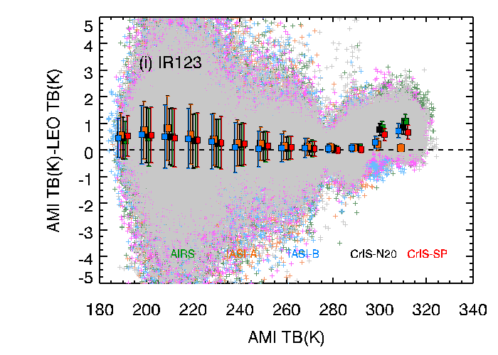
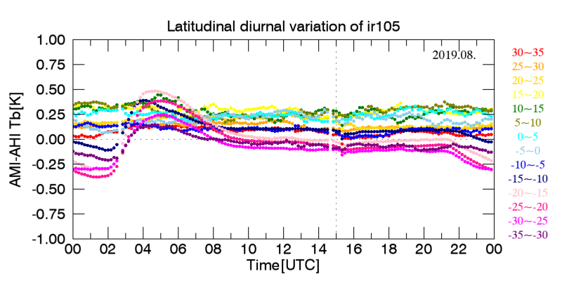
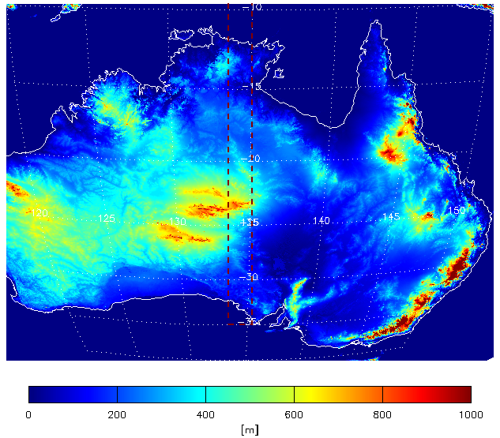
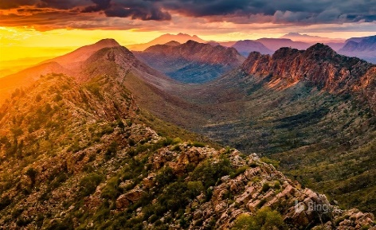
KMA found similar bias in AMI over Australia
Period: August 2019 (10min. bin)
Latitude: 35N~35S (including Australian Desert)
Bias is increased around local noon in window channels
SRTM DEM 90m data (USGS)
West macdonnell (Bing)
Shown abnormal large biases at high temperature (>300K, Australian desert) scene in window channels during the daytime.
Material from Minju Gu (KMA) - KMA GEO-LEO IR product status 2020 GRWG Meeting
The mountain region is included in collocation data
Anomaly is presumed to be the anisotropic effect

Slide 7
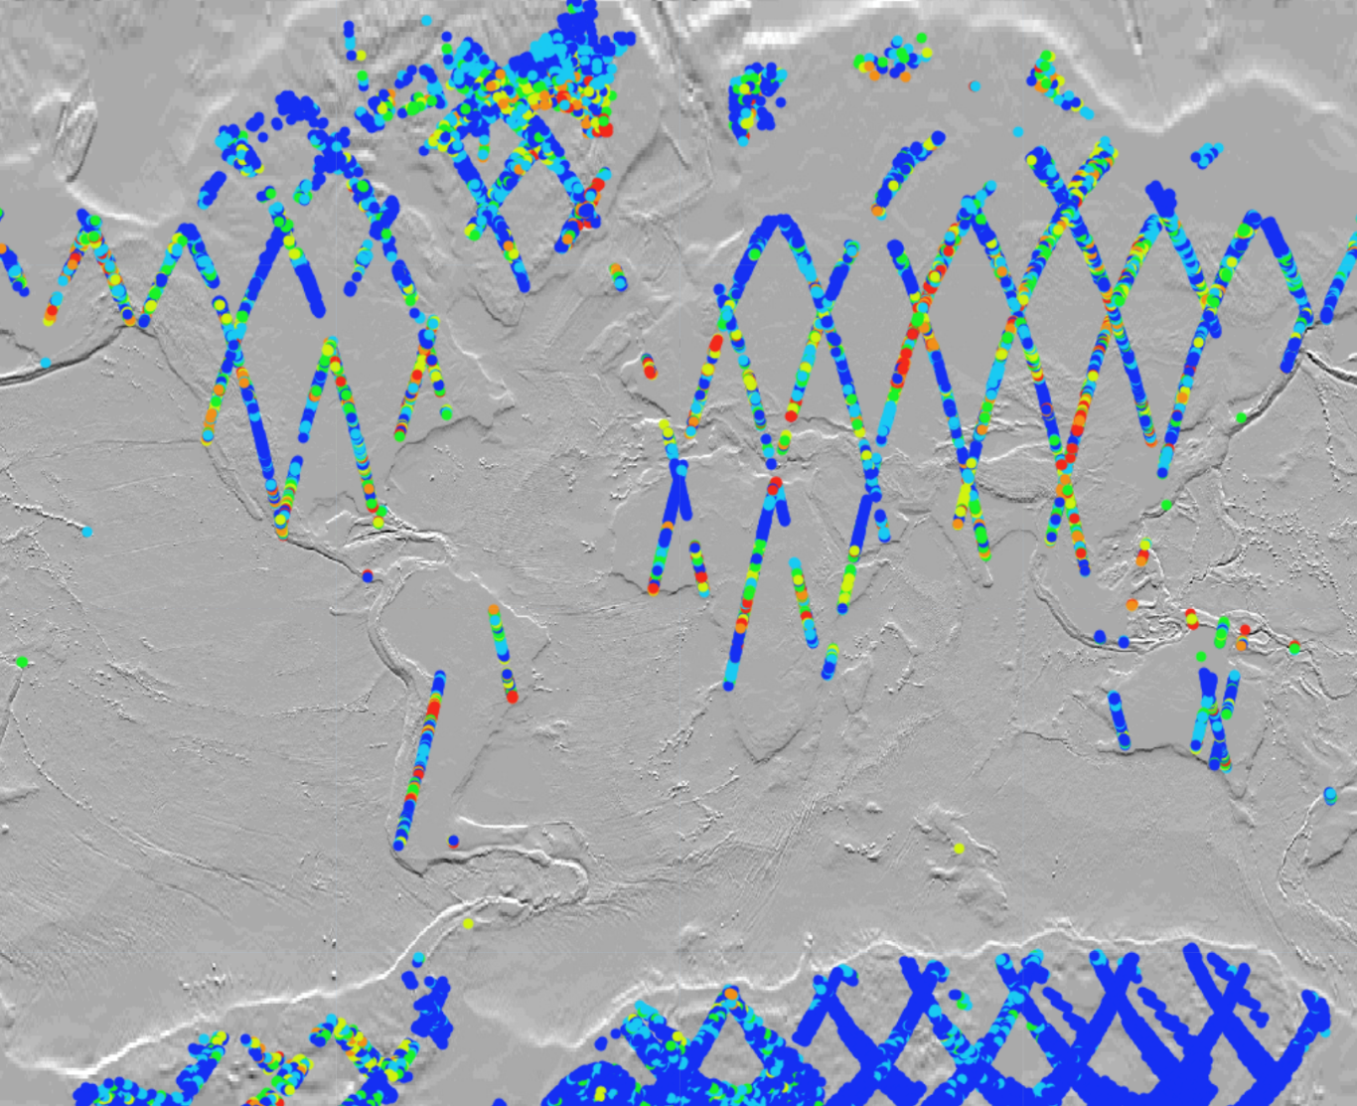
Hot land bias problem
Aim to extend dynamic range
of GEO-LEO and LEO-LEO IR inter-calibration
Include collocations over land
in the daytime
Significant bias (>8K) is seen in some IASI and SLSTR collocations over land
Primary visual inspection suggested biases are larger over high land
Based on this assumption, different per point surface characteristics (e.g. elevation, slope, aspect, NDVI) were extracted and examined to see whether a meaningful correlation exist between such characteristics and bias variation.
Bias (K)
0-1
1-2
2-3
3-5
5-8
>8
Notes:
optically homogeneous areas: areas that show no significant change in their reflectance over time

Slide 8
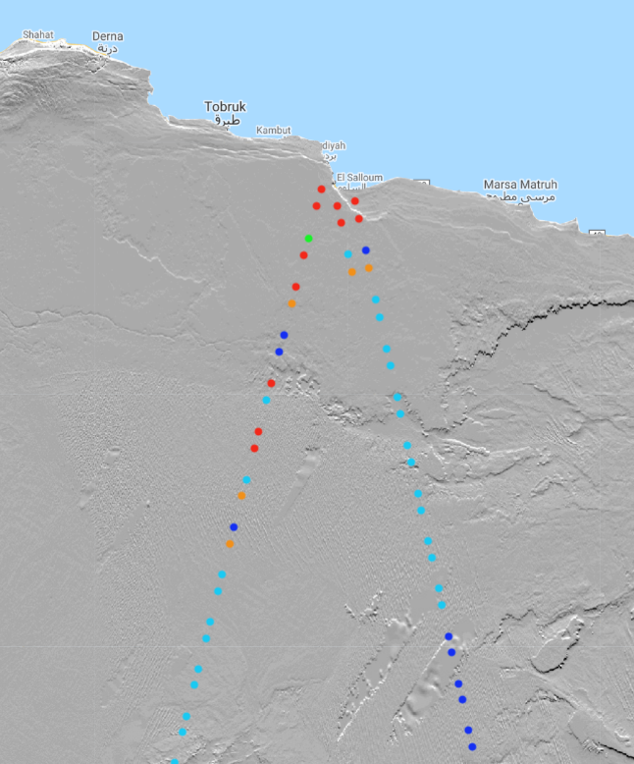
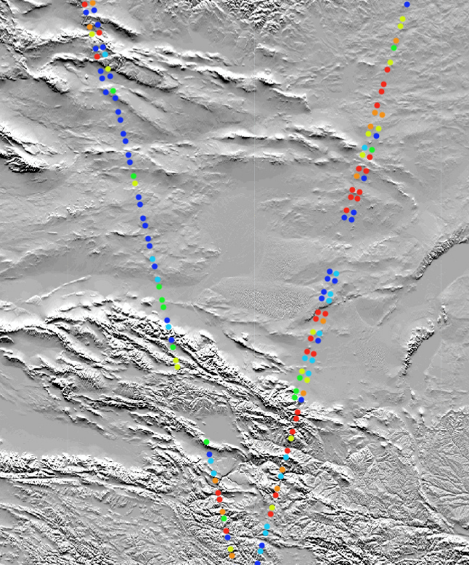
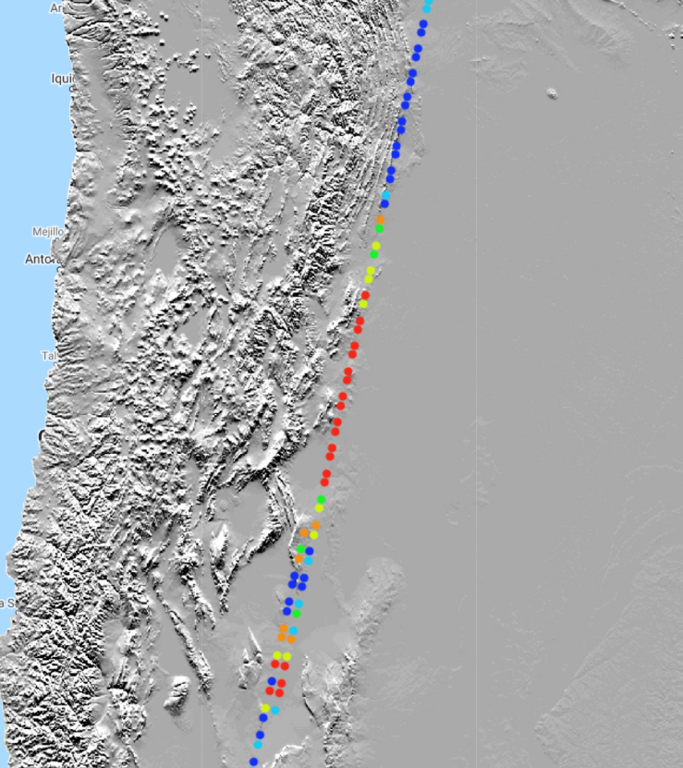
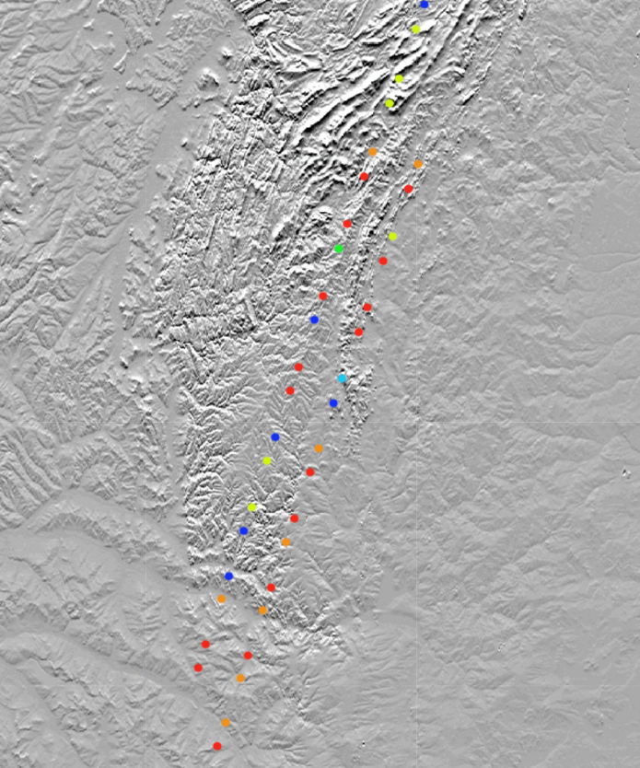
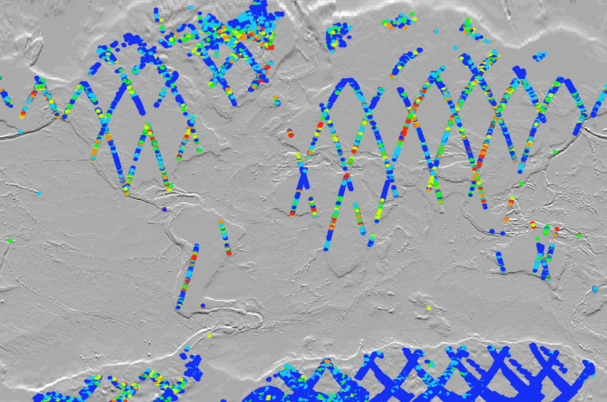
Close-up of some areas with large bias
Bias (K)
0-1
1-2
2-3
3-5
5-8
>8

Slide 9
Hot land bias problem
IASI-SLSTR collocation points from 2020-06-11
Total of 16,860 points over land selected, given that:
Time difference between IASI and SLSTR < 300
Secant of zenith angle difference between IASI and SLSTR < 0.010
Sensitivity of observed bias is checked against:
NDVI, Elevation, Slope and Aspect…
ModisNDVI (median value from ‘2020-06-01‘ to ‘2020-06-15’)
ETOPO1 global DEM (1 arc-minute global relief model of Earth's surface that integrates land topography and ocean bathymetry)
Slope and aspect extracted from the DEM
NDVI, Elevation, Slope and aspect are examined
All converted to 12 km pixel size (downgraded from 1km)

Slide 10
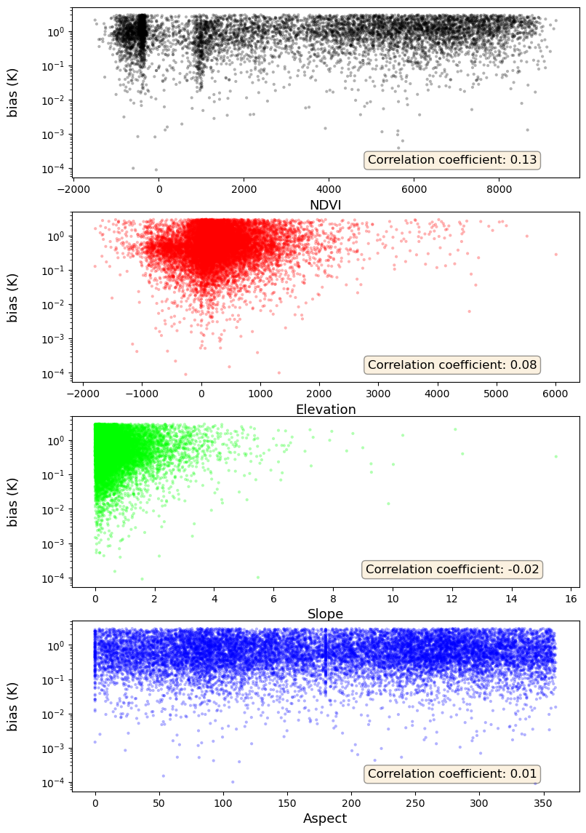
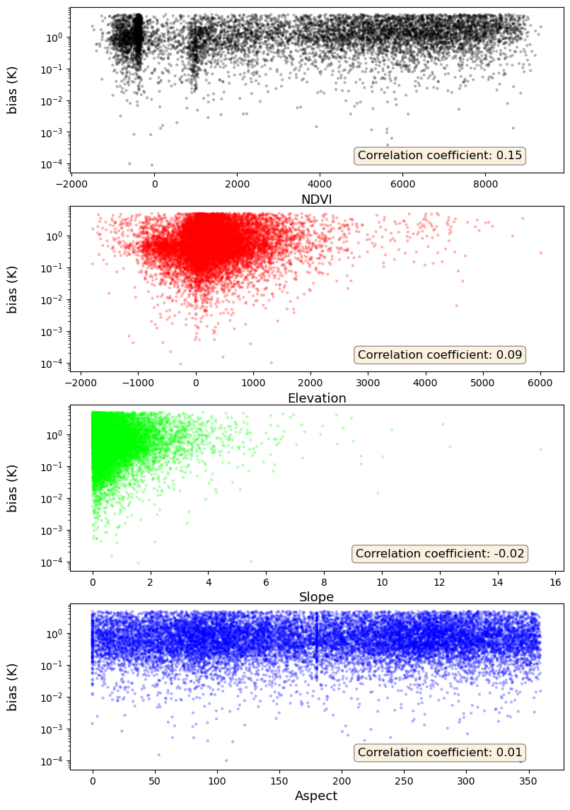
Results
NDVI CorrCoeff = 0.13
NDVI CorrCoeff = 0.15
Elevation CorrCoeff = 0.08
Elevation CorrCoeff = 0.09
Slope CorrCoeff = 0.02
Slope CorrCoeff = - 0.02
Aspect CorrCoeff = 0.01
Aspect CorrCoeff = 0.01
Limited to Biases < 3k
Limited to Biases < 5k

Slide 11
Conclusions on Hot Land Bias and way forward
Initial EUMETSAT analysis indicates that the biases could not be explained by the variations in NDVI/slope/aspect and elevation!
Further Investigation – to extend dynamic range of GSICS Products
Develop filters to reject:
Brightness Temperatures
Geographic areas
Solar Zenith Angles
Applying SolZen > 50° filter to LEO-LEO IR collocations removes hot land bias
Applying SolZen > 40° filter to GEO-LEO IR collocations removes hot land bias
Repeat similar analysis using
at least two sets of same points to check whether biases are location-dependent
different instruments
different geographic areas
Any hypothesis for underlying mechanism introducing bias?
Possible specular solar contributions? Sun-glint? !
Input from Dave Tobin:
spatial mismatch for warm, heterogeneous scenes (fires?)
The symptoms seem to fit that from what I saw. We have seen this with AIRS and CrIS …. The AIRS footprint is smeared more because it does not have a motion image compensation mirror, and so it blurs the hot spots and does not see as warm as scenes as CrIS does, or any sensor with a smaller footprint. Re-dong some of the comparisons assuming a larger (or smaller?) IASI footprint would help diagnose it.
(Your ideas here)?

Slide 12
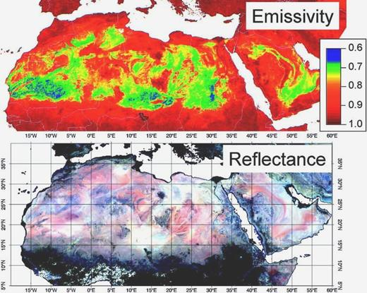
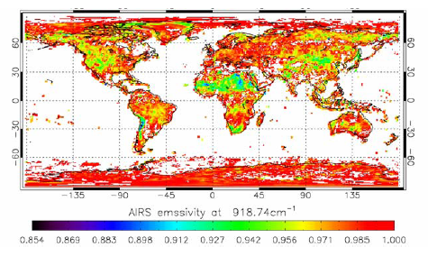
Emissivity Effect?
Emissivity can be as low as 0.7 at 8.7µm [Ogawa & Schmugge, 2004]
But is generally ~0.9 at 11µm: https://www.star.nesdis.noaa.gov/smcd/spb/LANDEM/impact_GDAS_emAIRS.php

Slide 13
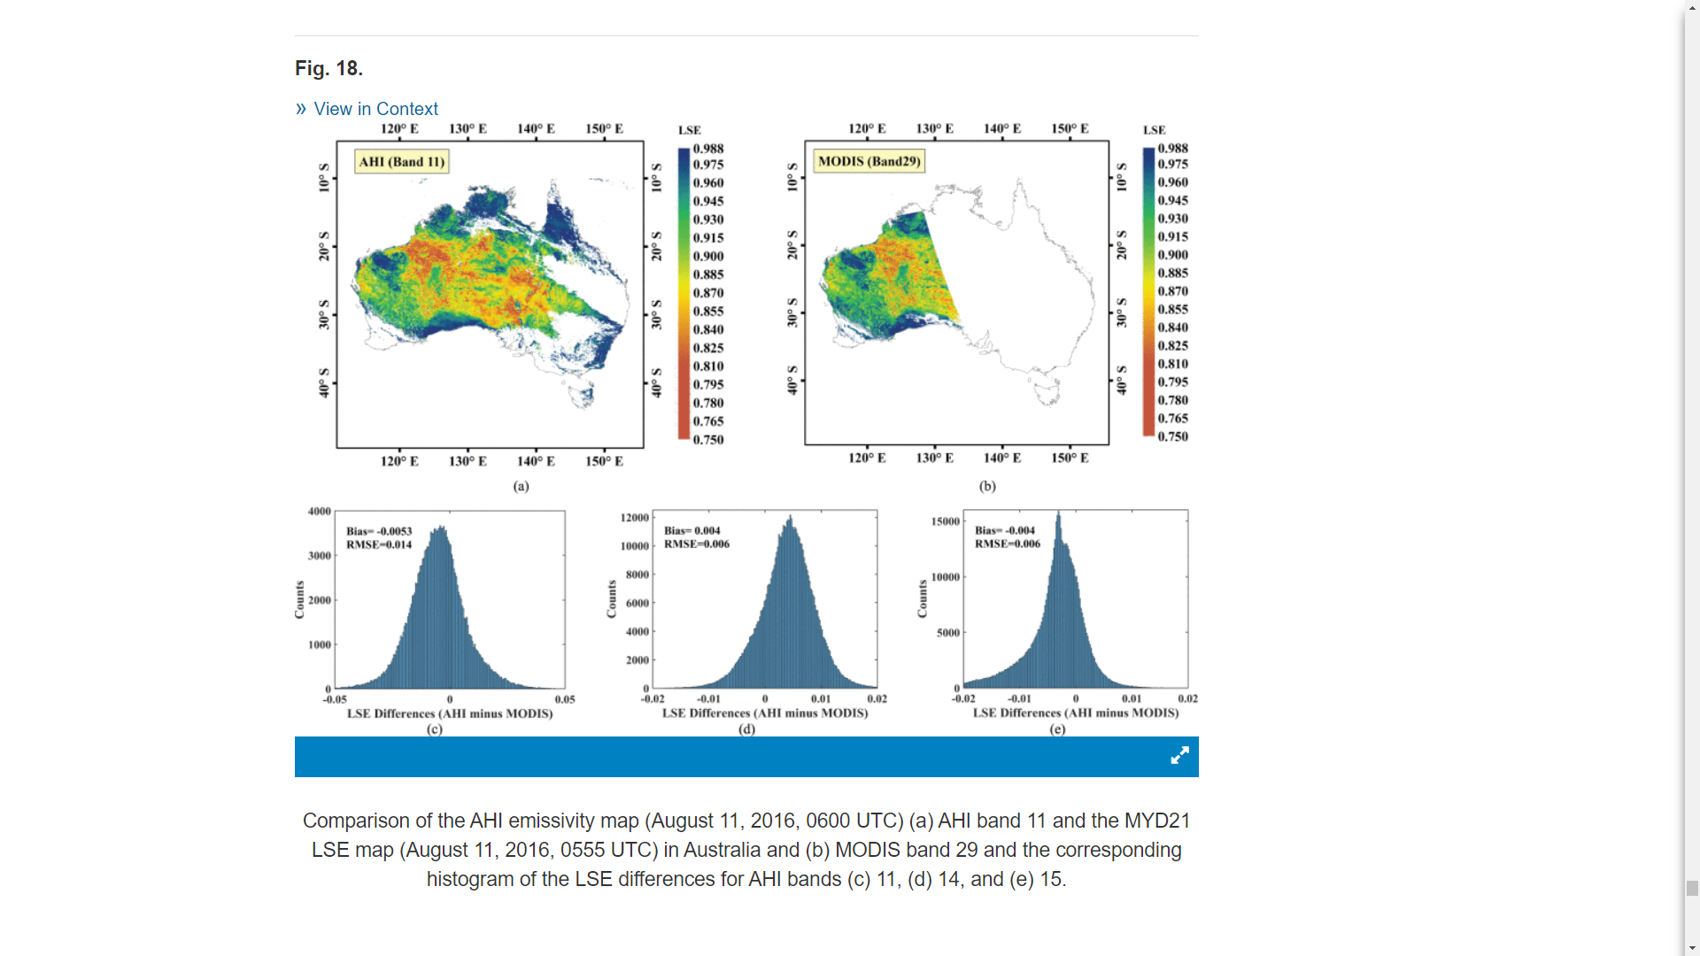
S. Zhou and J. Cheng, "An Improved Temperature and Emissivity Separation Algorithm for the Advanced Himawari Imager,"
in IEEE Transactions on Geoscience and Remote Sensing, vol. 58, no. 10, pp. 7105-7124, Oct. 2020, doi: 10.1109/TGRS.2020.2979846.

