Slide 1
Discussion on GSICS Correction
Likun Wang
ESSIC/Univ. of Maryland; Likun.Wang@noaa.gov
2021 GSICS Web Meeting on May 6 2021

Slide 2
Inter-Calibration Procedure
The same procedures are followed for general inter-calibration for IR sensors
However, there are debates on whether we need to apply for quality control after zenith angle match for paired collocation data
Question 1: Azimuth Angle Constraints
Question 2: Scene uniformity check
Question 3: Outlier Filter
Level 1B file lists
Orbit Predication
Matched file lists
Collocation
Matched observations
Filtered data (angle, scene uniformity)
Convolution
QC
Matched data points with spectral integration and spectral gap filling
Compare
Scatter plot (regression), BT Difference plot
Combination
Double Difference (CrIS, IASI)

Slide 3
Why Need Quality Control ?
The purpose of inter-calibration is to find the instrument-related bias through inter-comparison of different pairs of observations.
We should try our best to void any uncertainties caused by inter-calibration itself. Otherwise, we may contribute the bias or uncertainties to instrument calibration and provide wrong GSICS correction.
We need to understand why we need quality control. If we set a threshold, we need to understand why we choose this value.
Overall, the bottom line is, we need to be careful to provide the GSICS corrections to users.
Using IASI and CrIS and GOES-16 ABI inter-calibration results as an example
04/01-04/20/2021
ABI band 13 (10.8 µm) and band 7 (3.9 µm)

Slide 4
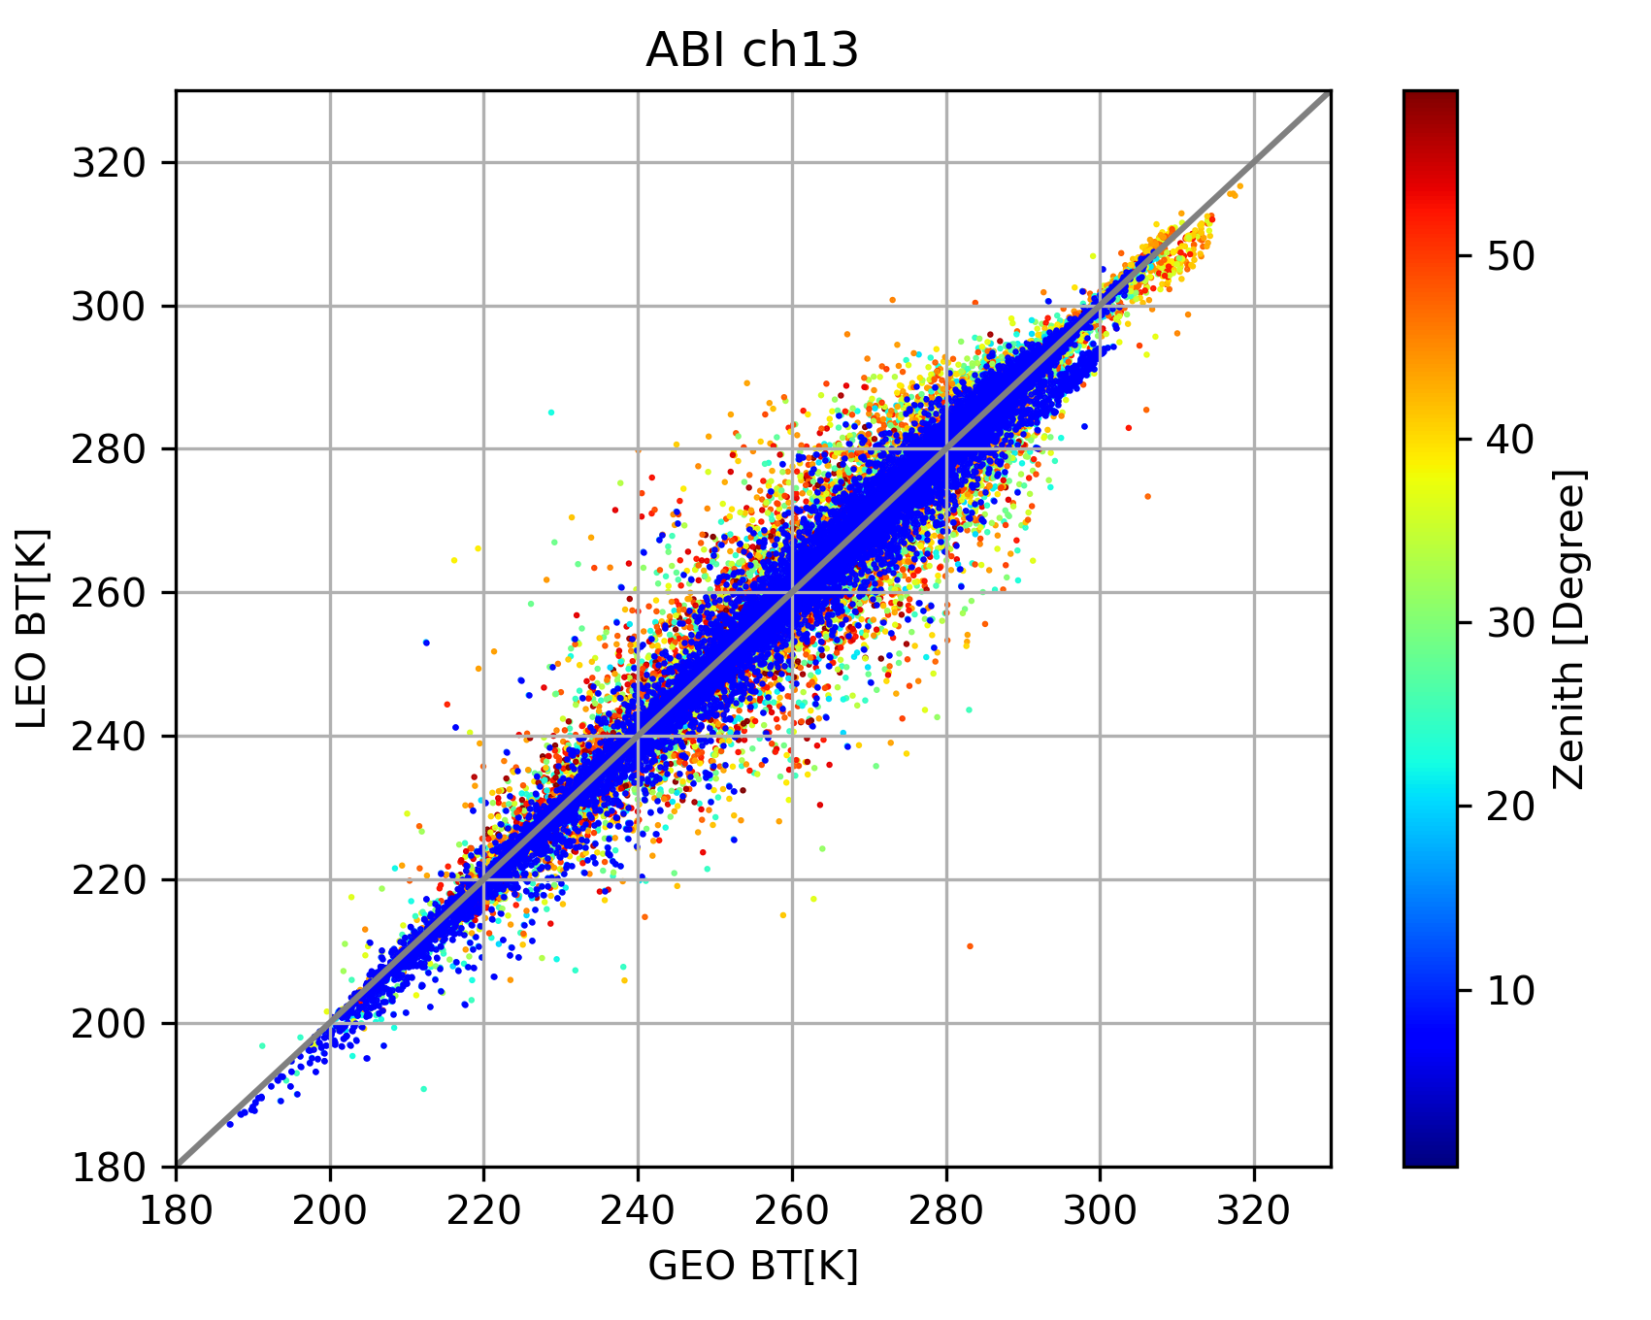
Zenith Angle Threshold
Collocation was performed along the all the zenith angles
After zenith angle match (0.01), we still can see large spread at large zenith angle.
No azimuth angle check: two sensor view angle view the target from different perspective
Cloud or terrain can cause parallel effects for large zenith angle
We use zenith angle 20 degree as threshold to cut off the data without losing too much dynamic range
IASI vs ABI

Slide 5
Uniformity Check
The same rule also applies for uniformity check
Checking the ratio of STD/Mean
Large STD/Mean, large spread
We use the 0.05 as a threshold to reduce uncertainties

Slide 6
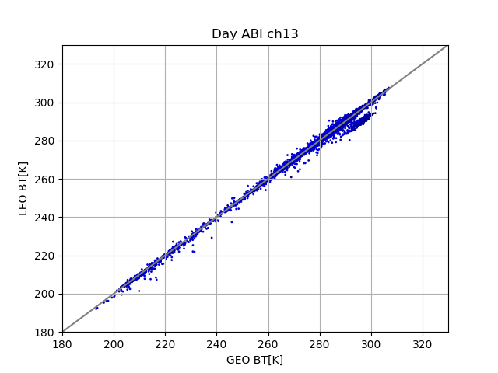
Separated by Day and Night Time
We separate the data into day and night time
The scatter plot show different dynamic range for day and night time
The scatter plot show different error structures
There are fork structures only during daytime
We are not sure whether it is from GOES ABI
Night time
Day time

Slide 7
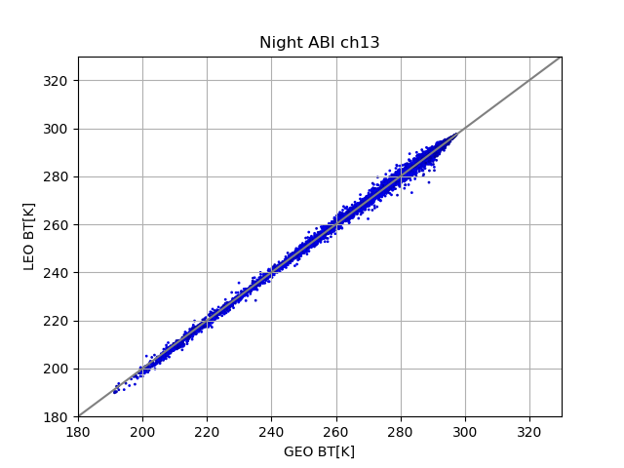
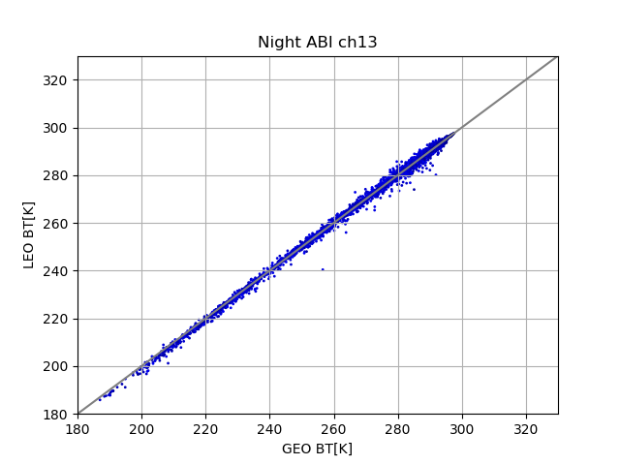
Bring IASI and CrIS Together
The fork structures shown in IASI day time data are not repeated in CrIS day time data
If we make regression without quality control, we probably simple introduce larger bias for GSICS correction.
IASI Day
CrIS Day
IASI Night
CrIS Night

Slide 8
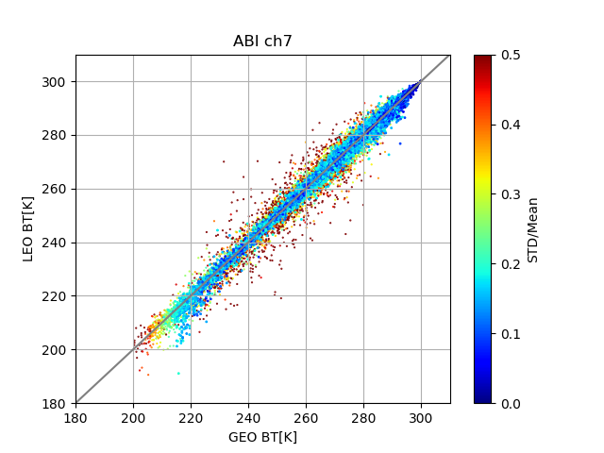
Channel 7
IASI
CrIS
We can’t believe it because the red dots shows large spread along all dynamic range

Slide 9
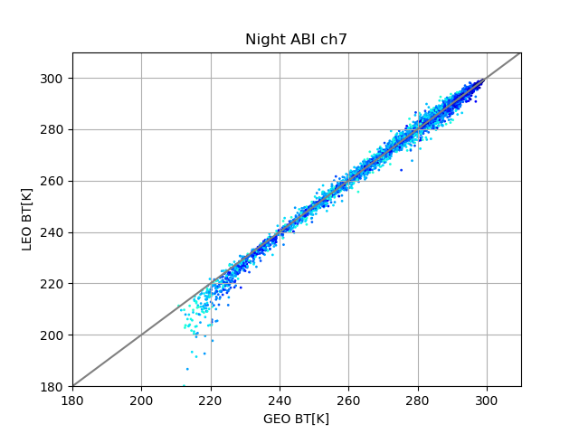
Channel 7
IASI
CrIS
We can’t believe it because IASI and CrIS do not show the same pattern.

Slide 10
Conclusion Remarks
Given advanced new generation GEO imager with improved calibration, we need to be careful to provide the GSICS corrections to users.
With enough samples, quality control with sensitivity test is good to diagnosis the bias pattern
With two CrIS and three IASI, we should cross-validation inter-calibration results.

