Slide 1
Tools to Visualize and Use GSICS Products to Prepare State of the Observing System Reports On Special Issue on the State of Observing System GSICS IR Webmeeting 2021 6 May 2021
Manik Bali , Larry Flynn (GCC)

Slide 2
TABLE OF CONTENTS
Introduction
Demo Google Colab: A tool to visualize and process GSICS Products
Demo Google Colab: A tool to produce State of Observing System Charts
Conclusion
Reference
Action Id | Summary | Expected Completion | Deliverable Usage | Status
A.GDWG.20200416.1 | Manik Bali (NOAA) to coordinate GDWG to investigate developing scripts to generate contents of Annual Calibration Reports from GSICS Corrections. | 3/1/2021 |  | Open

Slide 3
Introduction
The Coordination Group on Meteorological Satellites (CGMS) and the World Meteorological Organization (WMO) recently mandated GSICS (A45.05) to provide an overarching annual assessment of (Satellite) observing system performance with respect to GSICS reference instruments.
The state of Observing system report is a report that
depicts this assessment and is created from
contributions from member agencies.
The SOB report is one of the most crucial documents
provided to CGMS/WMO demonstrating GSICS goal of
Monitoring instruments using selected references
An example of a past report
State of Observing System

Slide 4
Overview of the State of Observing System Report
The report attempts to summarize the departure summaries/in orbit performance of satellites instruments operated by GSICS members
Challenges
The reports attempts to put together complex information for instruments in GEO as well as LEO orbits measuring in the VIS/NIR, IR and UV channels.
Agencies have to deploy resources to generate updated satellite performance charts each year to contribute the to the state of Observing System report.
There is a need to simplify creation of the State of Observing report / Calibration reports provided by agencies and to harmonize the tables and figures.

Slide 5
Contents of State of Observing System (SOB) report
Types of charts in the SOB report
Tables depicting
Mean Standard Bias of past year
Mean Standard Deviation of bias in past year
Mean Standard Bias Drift
Time Series of Standard Biases
Scatter Plots Monitored versus Reference

Slide 6
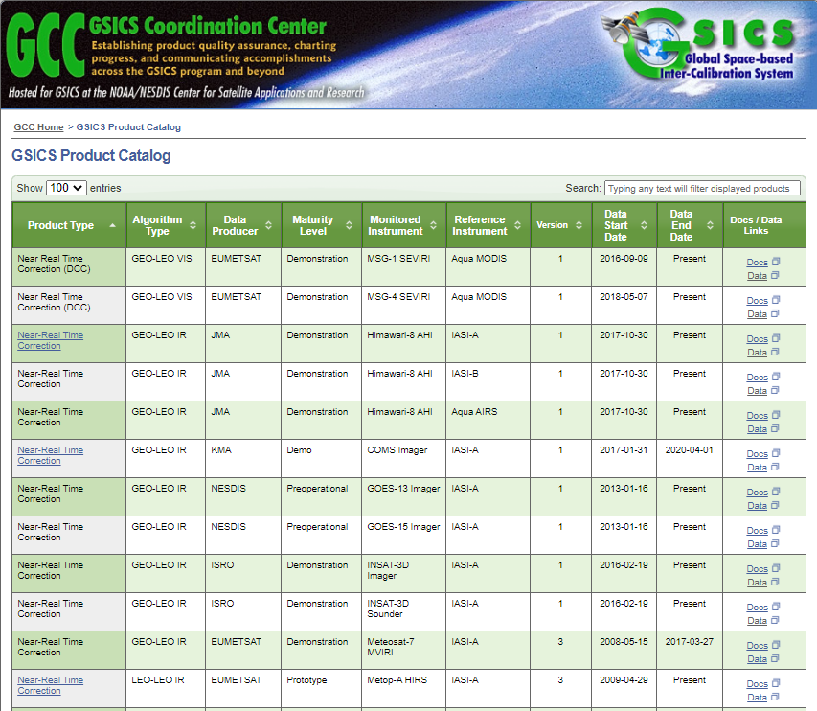
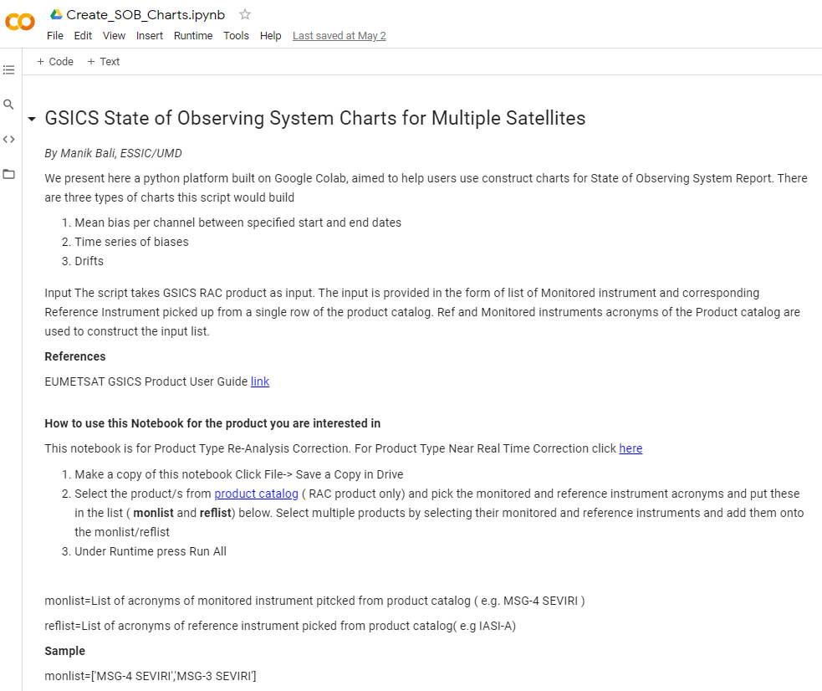
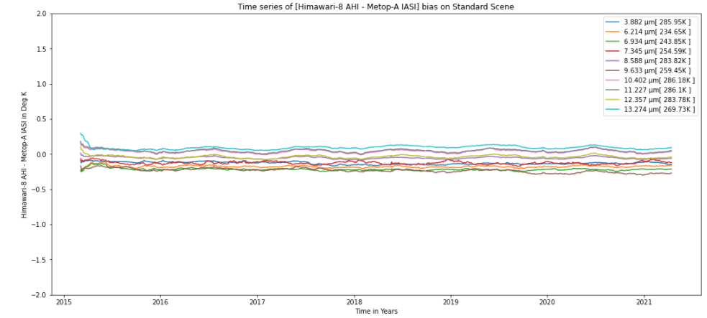
Demo of Google Colab: Tool to generate SOB Charts
Input
GSICS Products on the thredds server can be selected as input
Google Colab
Python scripts that read inputs and produce SOB charts
Output
Tables and Time Series
Scatter plots can be taken from GPRCs
Assumptions:
Coalb scripts currently support
Input data follows GSICS meta data conventions and is on a THREDDS server.
2. GSICS product has been created continuously over the period for which charts are sought.
*Charts for *FY2E , ( a non GPPA product) has been implemented and tested
Script is scalable to non GSICS data conventions
Features
Python Script can be run from browser
A instance available on github
Script is scalable and contributors are invited to coauthor the script and develop new modules in an open-source style development environment.

Slide 7
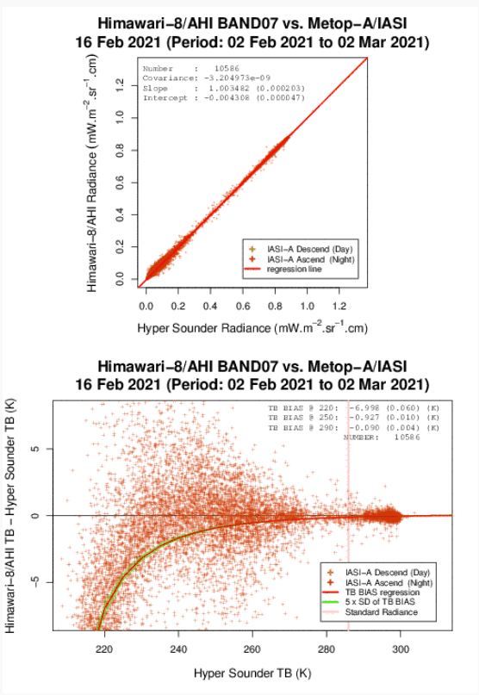
Demo SOB Report: Contd…
Sample Charts that the Colab can generate
Charts that can be picked up from GPRC
Template ( Conclusion)
Low bias/drift and std indicate that Himawari-8 continues to provide L1 measurements in-orbit according to design specifications
https://www.data.jma.go.jp/mscweb/data/monitoring/gsics/ir/monit_geoleoir.html

Slide 8
Demo of Google Colab : Tool to visualize/process GSICS products
Notebooks:
Run from the browser access
Python Environment
Processors
Reader Code
Correction Code
DCC Product notebook
This notebook reads DCC products and plots and lists them.
GIRO SRF notebook
GSICS Product RAC notebook and NRT notebook

Slide 9
Conclusions
Python scripts have been developed that can generate the main charts for the State of Observing System reports.
These scripts can be run directly from the browser or can also be downloaded from github and run in Jupyter notebooks locally.
Members are encouraged to use and contribute to these scripts in an open-source development environment and be co-authors.
Colab and Github( supported by KMA) Provide Collaborative ecosystem
Future ideas such as developing a conda/pip module are welcome
A special issue on State of Observing System is being prepared
And would be published next month.
Many thanks to members who have contributed.
More contributions are encouraged.

Slide 10
THANK YOU

