Slide 1
SNPP and N20 CrIS Radiometric Difference from Direct and Indirect Comparison
Likun Wang
ESSIC/Univ. of Maryland; wlikun@umd.edu
Acknowledgement to Yong Chen (NOAA/NESDIS/STAR)
2021 GSICS Web Meeting on April 8 2021

Slide 2
Outline
Improvements from SNPP to NOAA-20 CrIS
Comparison at fine spectral resolution
Direct comparison
Following the same method from CNES
Off-nadir comparison
Double difference
RTM simulations
IASI as a transfer target at SNOs
L. Wang and Y. Chen, "Inter-Comparing SNPP and NOAA-20 CrIS Toward Measurement Consistency and Climate Data Records," in IEEE Journal of Selected Topics in Applied Earth Observations and Remote Sensing, vol. 12, no. 7, pp. 2024-2031, July 2019, doi: 10.1109/JSTARS.2019.2891701.
Comparison at relatively large band pass
Double Difference using GOES-16 ABI as a transfer Target
GSICS Products

Slide 3
SNPP vs. NOAA-20 CrIS - Internal Calibration Target
SNPP and NOAA-20 CrIS have almost identical instrument design.
All the SDR data are processed at full spectral resolution data using the same software.
Improvements of NOAA-20 CrIS compared to SNPP CrIS
ICT emissivity + 3 PRTs (2 for SNPP)
Noise Performance
Nonlinearity
ICT emissivity
The onboard calibration blackbody has been greatly improved with a new design for NOAA-20 CrIS. The cavity wedge design of NOAA-20 ICT significantly increases the blackbody emissivity

Slide 4
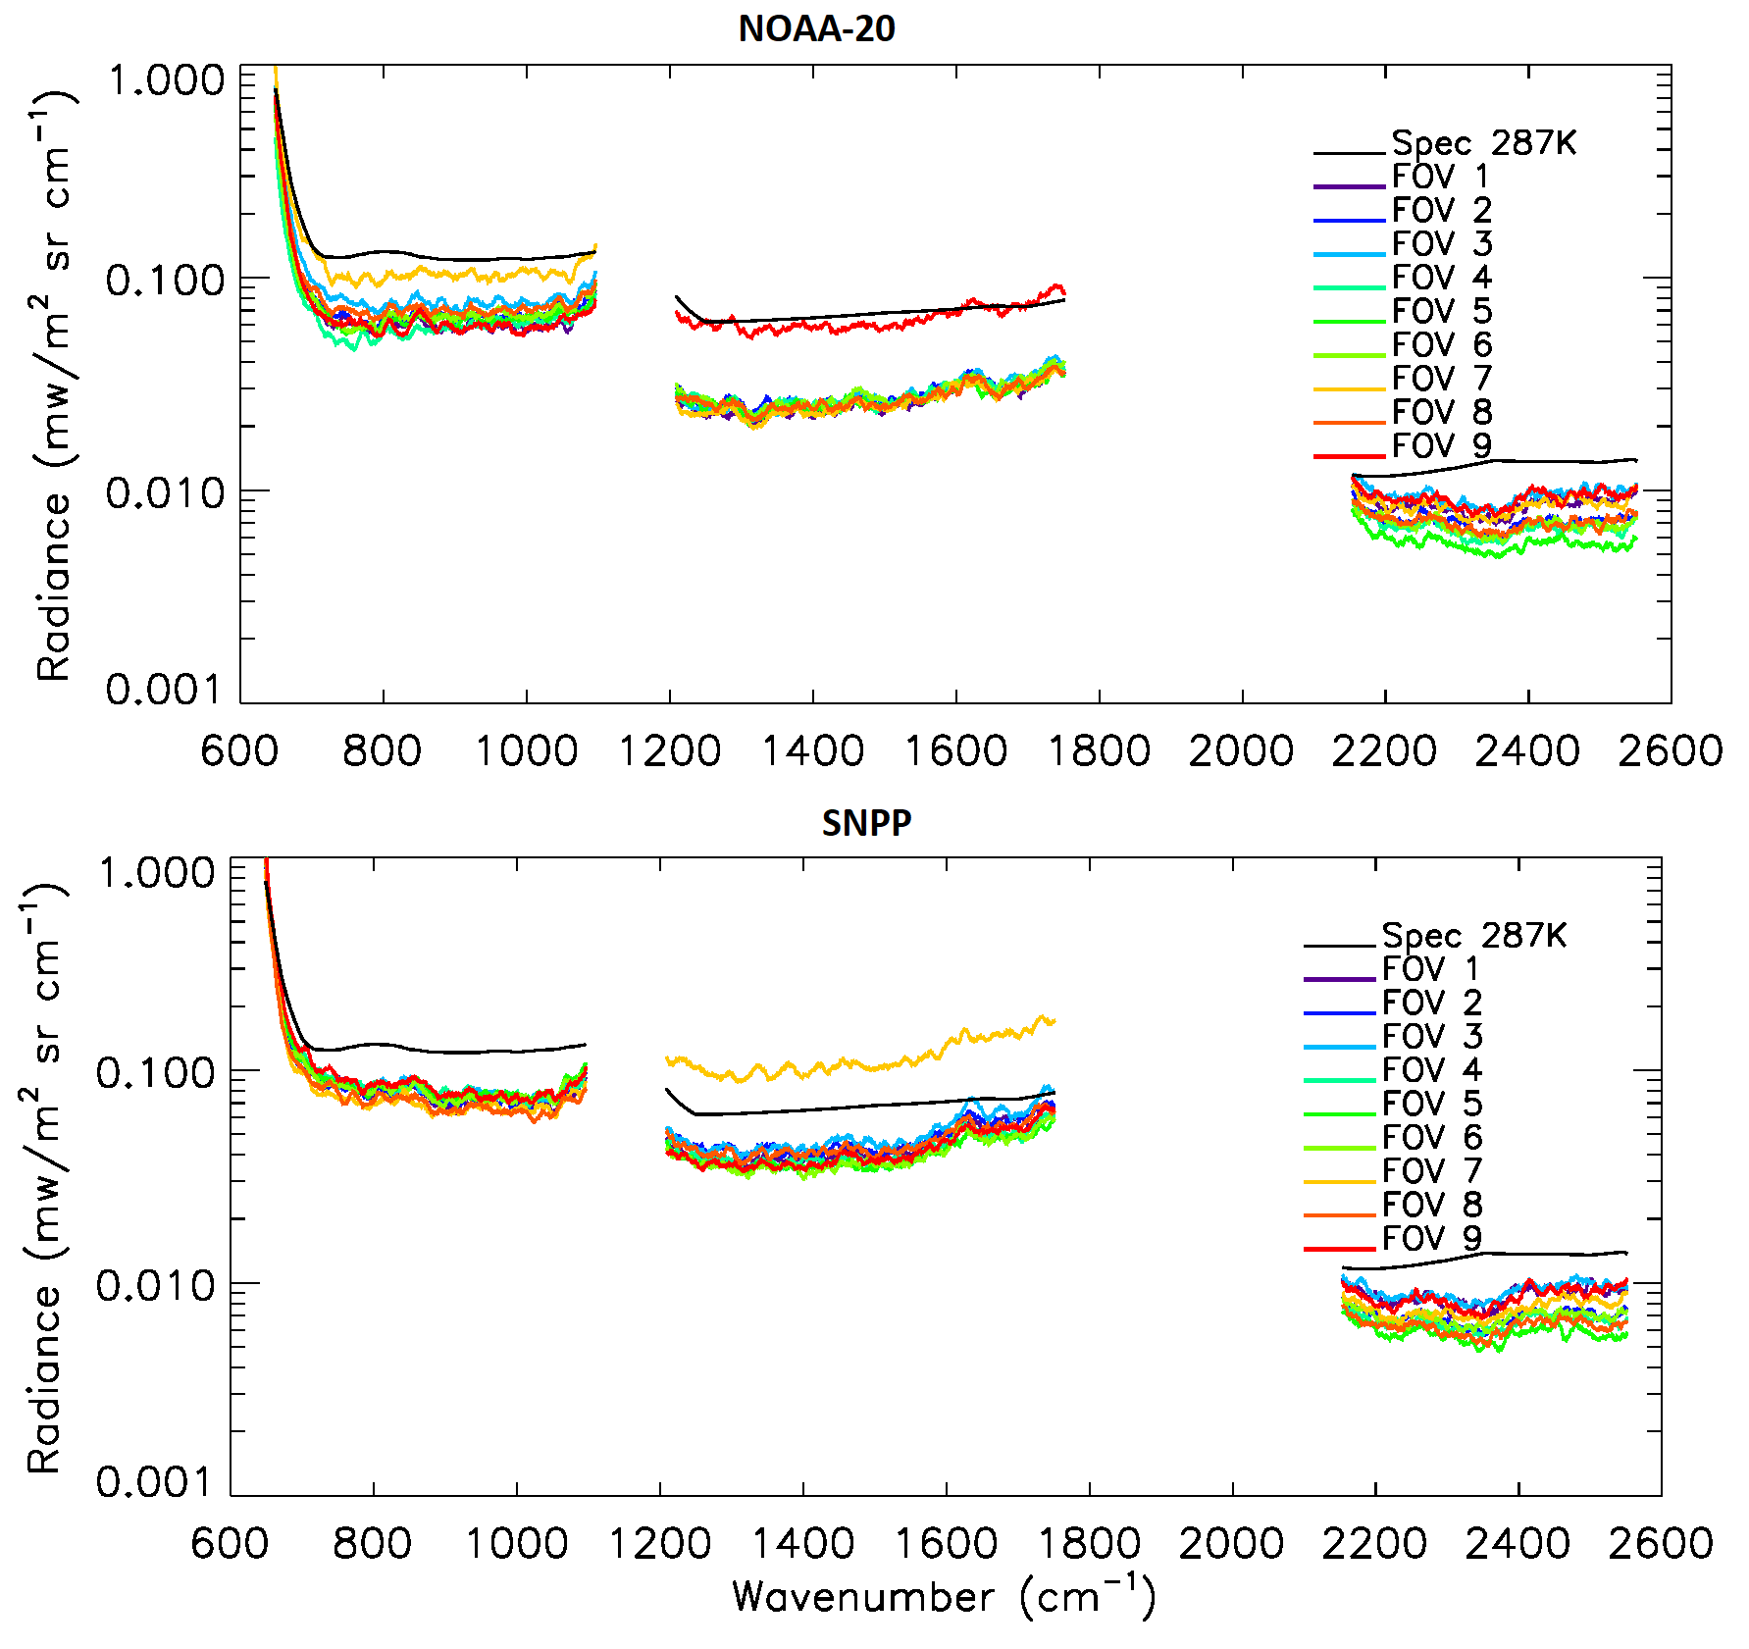
SNPP vs. NOAA-20 CrIS - Noise Performance
SNPP and NOAA-20 CrIS have almost identical instrument design.
All the SDR data are processed at full spectral resolution data using the same software.
Improvements of NOAA-20 CrIS compared to SNPP CrIS
ICT emissivity + 3 PRTs (2 for SNPP)
Noise Performance
Nonlinearity
From Y. Chen
NOAA-20 CrIS noise performance is similar to SNPP in the LWIR and SWIR bands and all FOVs are greatly better than the specifications. However, in the MWIR band, both SNPP and NOAA-20 CrIS have one detector that is out of family among nine detectors.

Slide 5
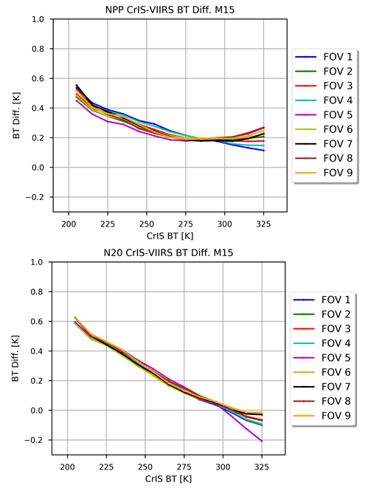
SNPP vs. NOAA-20 CrIS - Nonlinearity correction
SNPP and NOAA-20 CrIS have almost identical instrument design.
All the SDR data are processed at full spectral resolution data using the same software.
Improvements of NOAA-20 CrIS compared to SNPP CrIS
ICT emissivity + 3 PRTs (2 for SNPP)
Noise Performance
Nonlinearity
VIIRS vs CrIS on SNPP
VIIRS vs CrIS on NOAA-20
The scatter pattern among different FOVs points toward a non-perfect nonlinearity correction. NOAA-20 CrIS-VIIRS BT differences are much closer to each other at the temperature range from 200 to 280K.

Slide 6
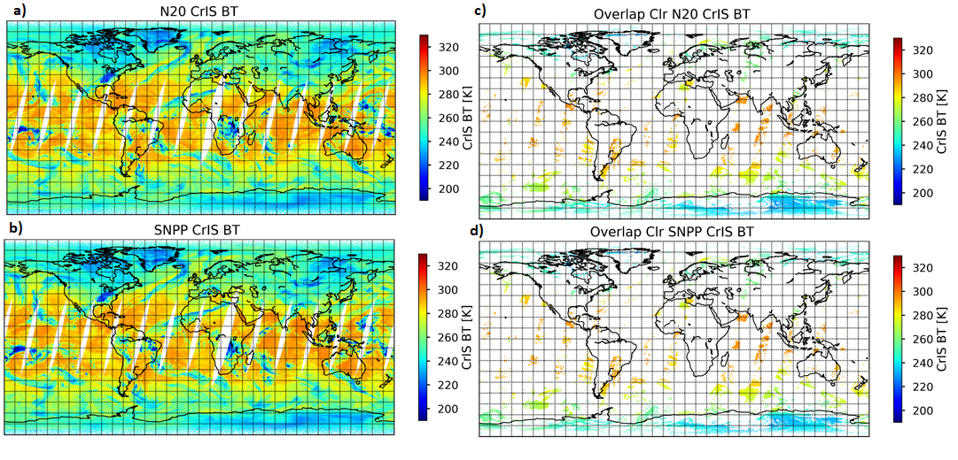
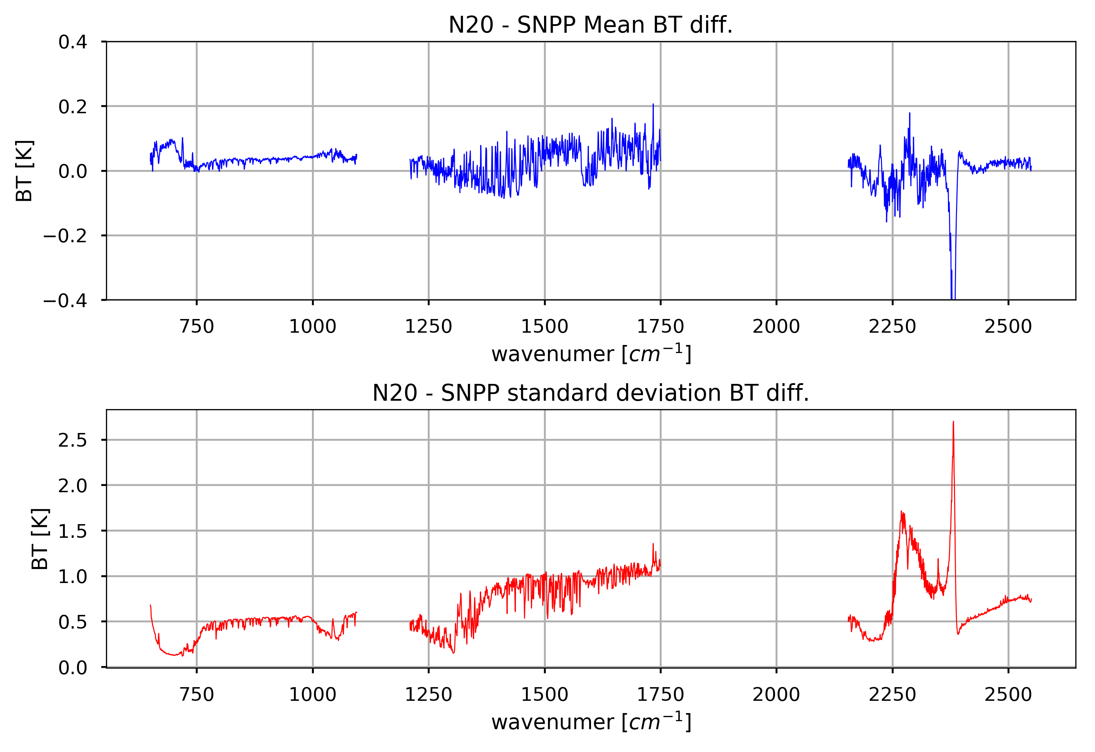
SNPP vs NOAA-20 CrIS - Direct Comparison
Two consecutive orbits of SNPP (red) and NOAA-20 (blue) CrIS. SNPP and NOAA-20 satellites follow each other with ~50.7 minutes’ difference and their overlapped regions exist either at the beginning of the scan or the end of scan dependent on time difference.
Difference of two CrISs: Mean
Difference of two CrISs: STD

Slide 7
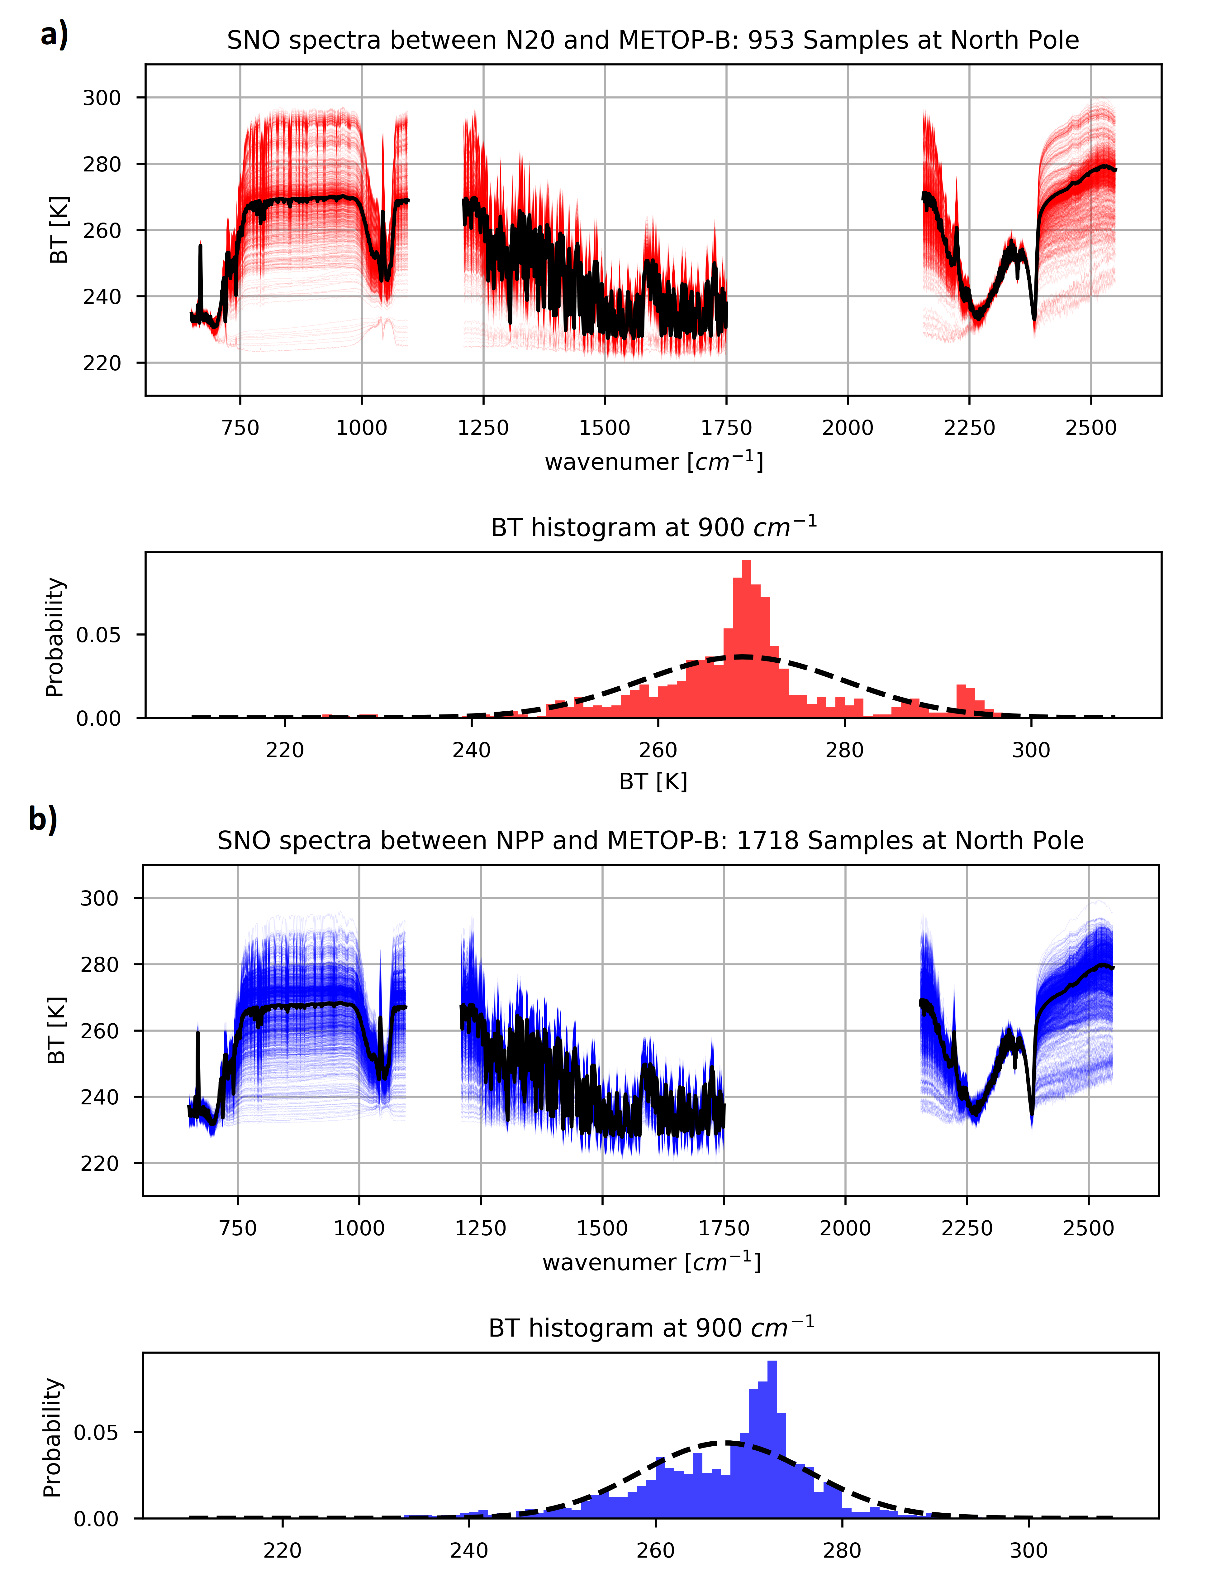
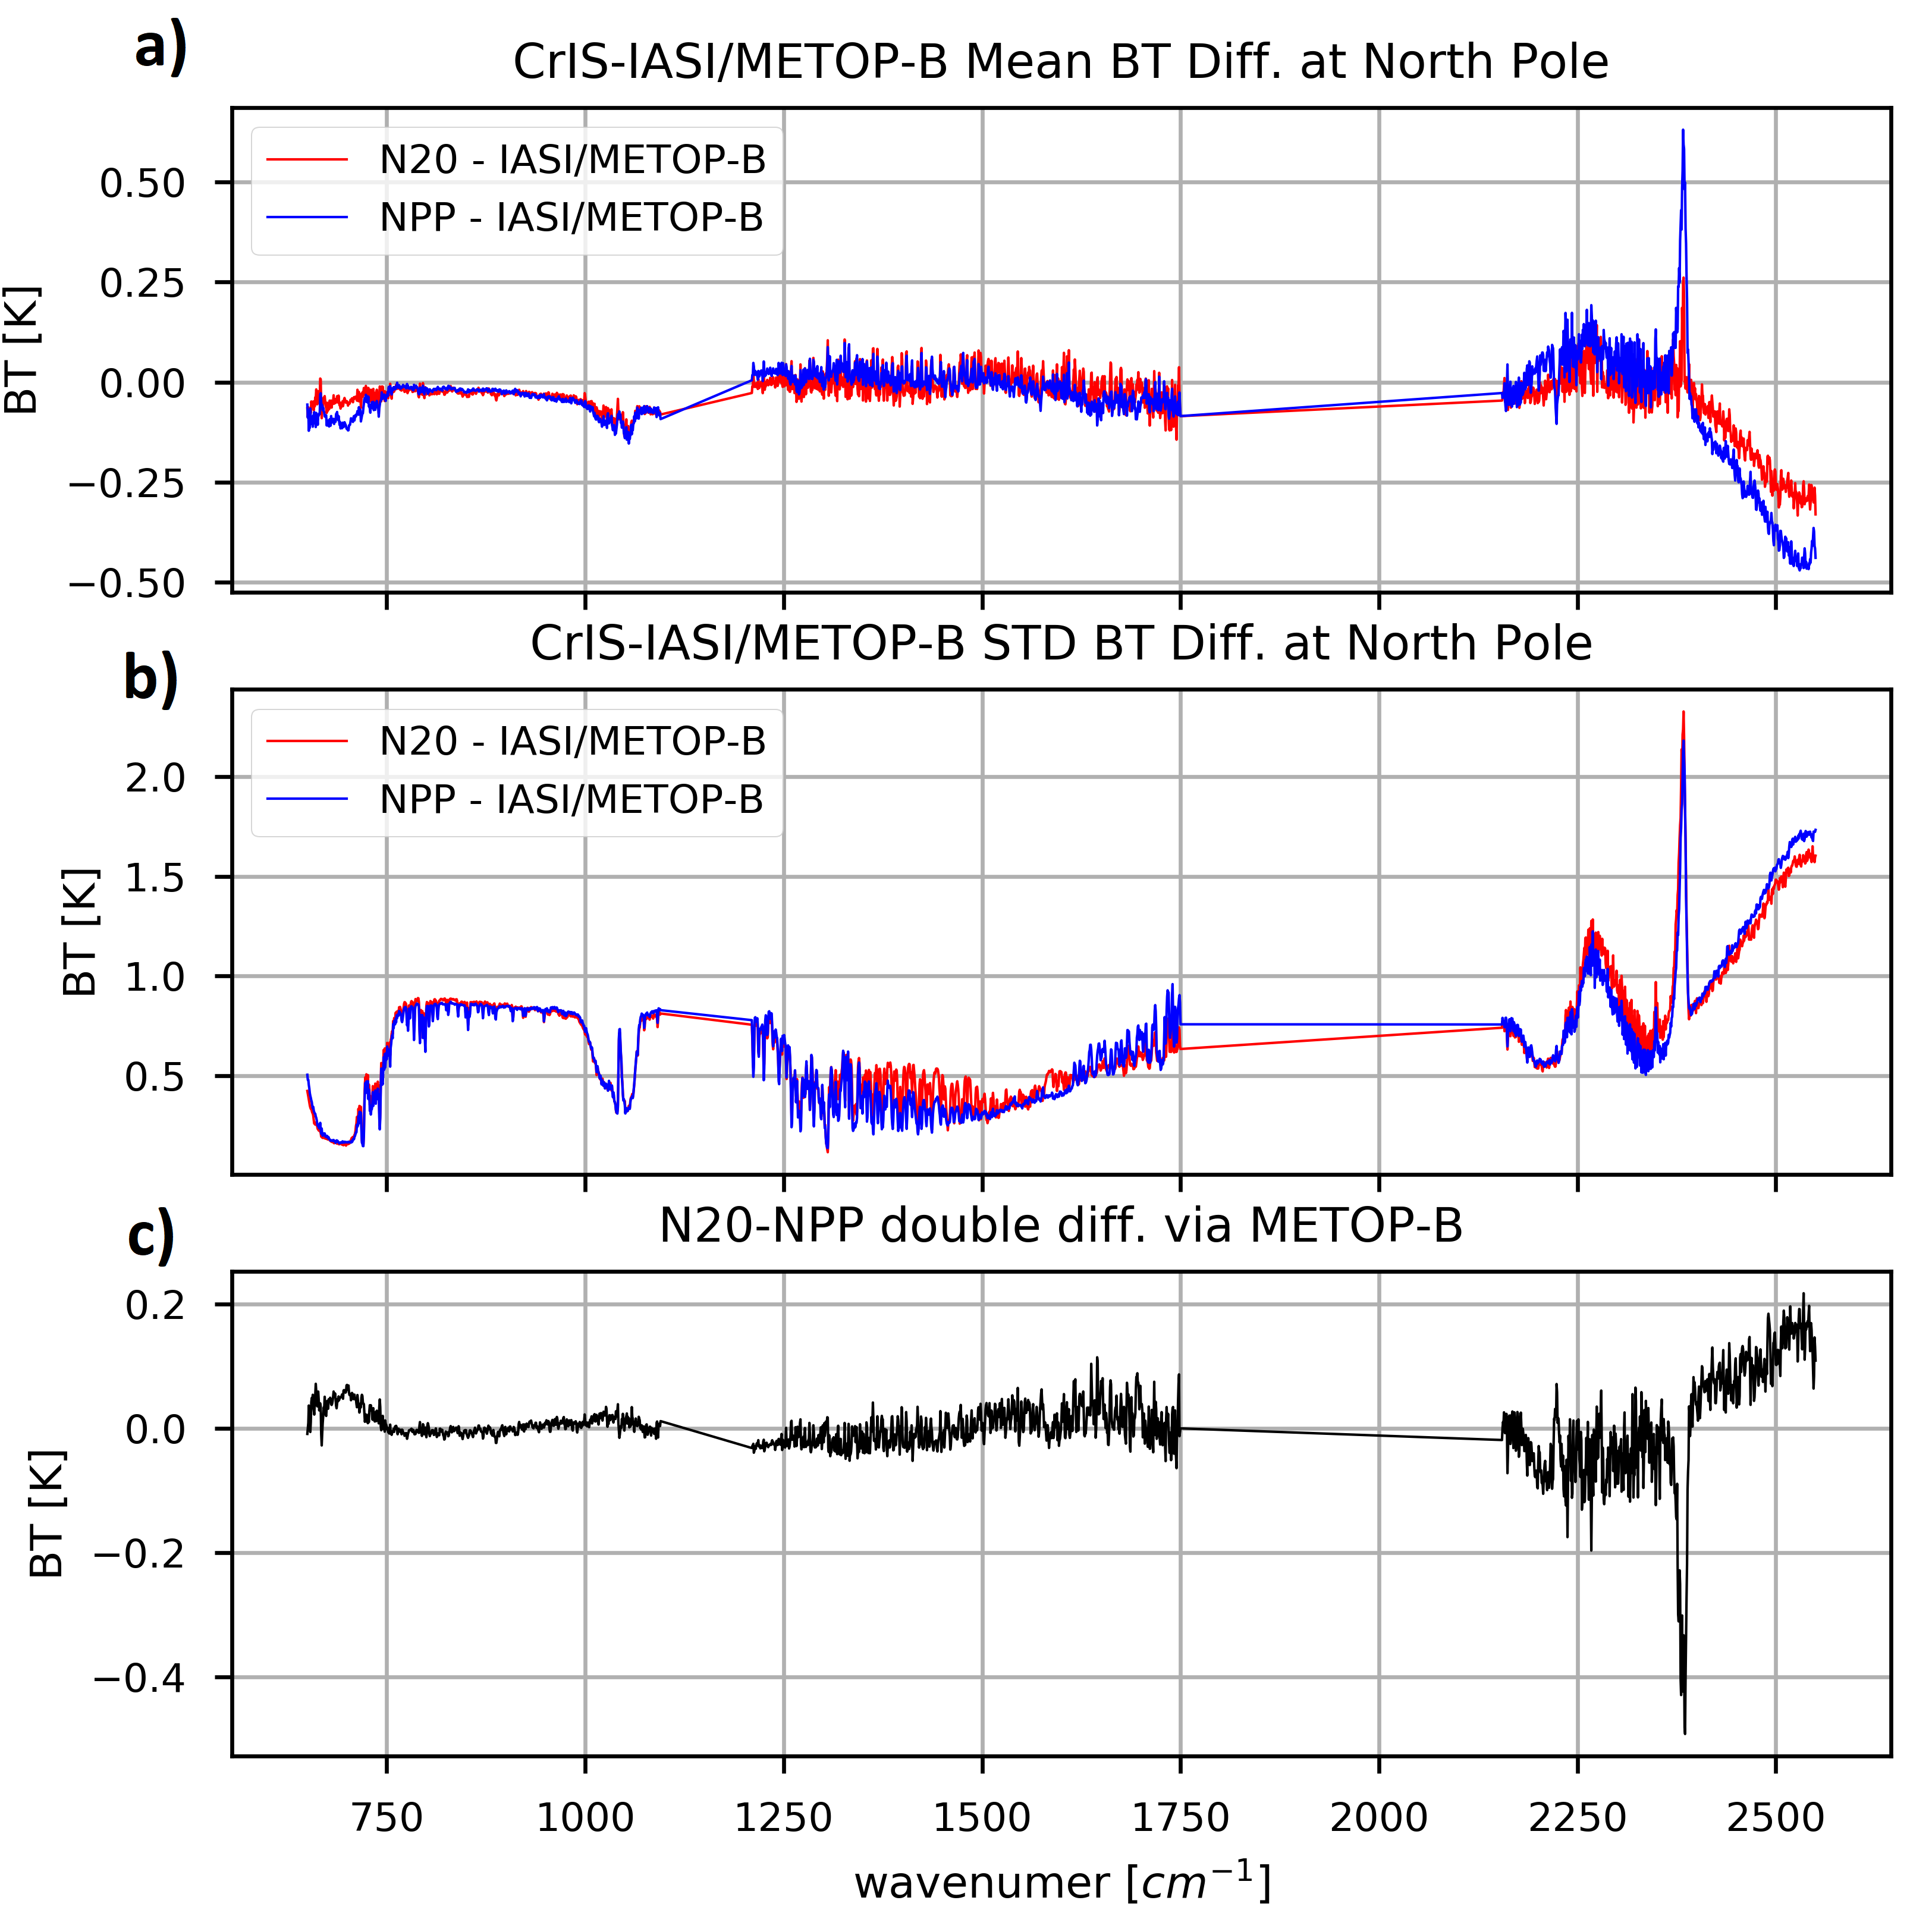
SNPP vs N20 CrIS - Double Difference relative to IASI-B at SNOs
CrIS-IASI: Mean
CrIS-IASI: STD
Double Difference
of two CrISs
SNPP and NOAA-20 CrIS measurements are respectively collocated with IASI-B at SNO scenes.

Slide 8
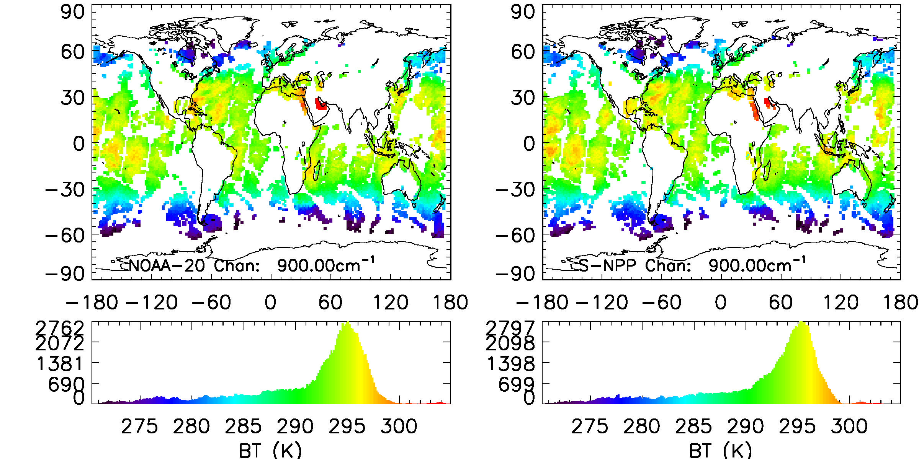
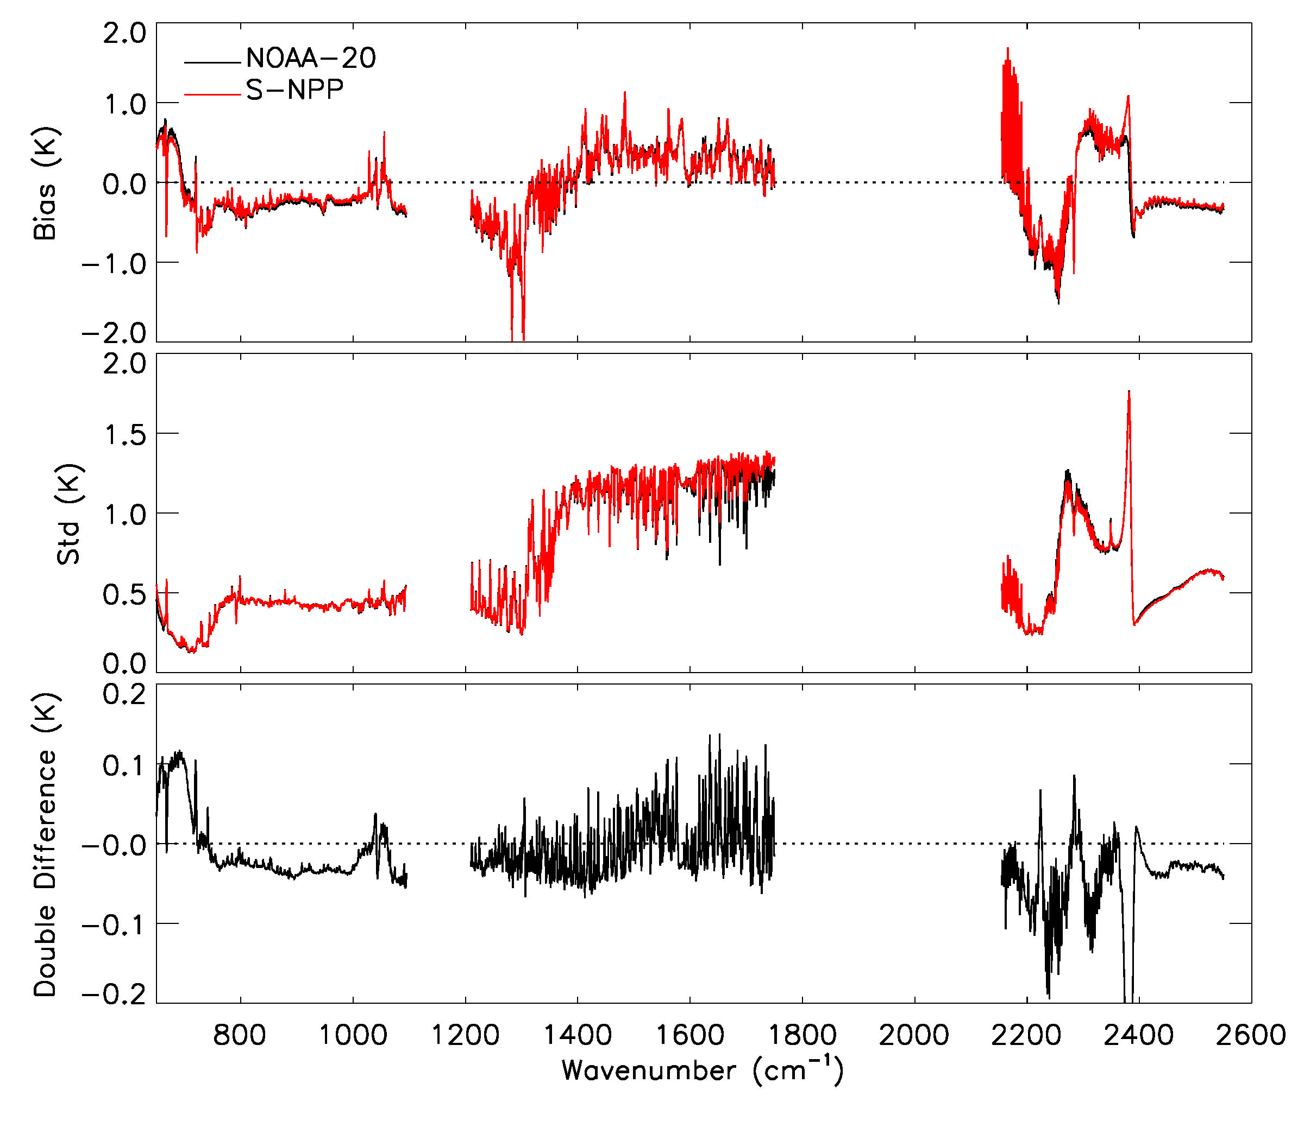
SNPP vs NOAA-20 CrIS - Double Difference relative to RTM simulations
NOAA-20 and SNPP CrIS full spectral resolution radiances were simulated by using the CRTM and ECMWF 3-hour analysis/forecast model data.
To effectively remove the possible contamination by clouds and spatially varying humidity in the CrIS observations, a hyper-spectral infrared cloud detection algorithm coupled with CRTM simulation is used.
The biases are primarily contributed from four possible resources, i.e. the numerical weather prediction error, instrument noise, radiative transfer model error, and undetected cloud contamination.
O-B: Mean
O-B: STD
Double Difference
of two CrISs
From Y. Chen

Slide 9
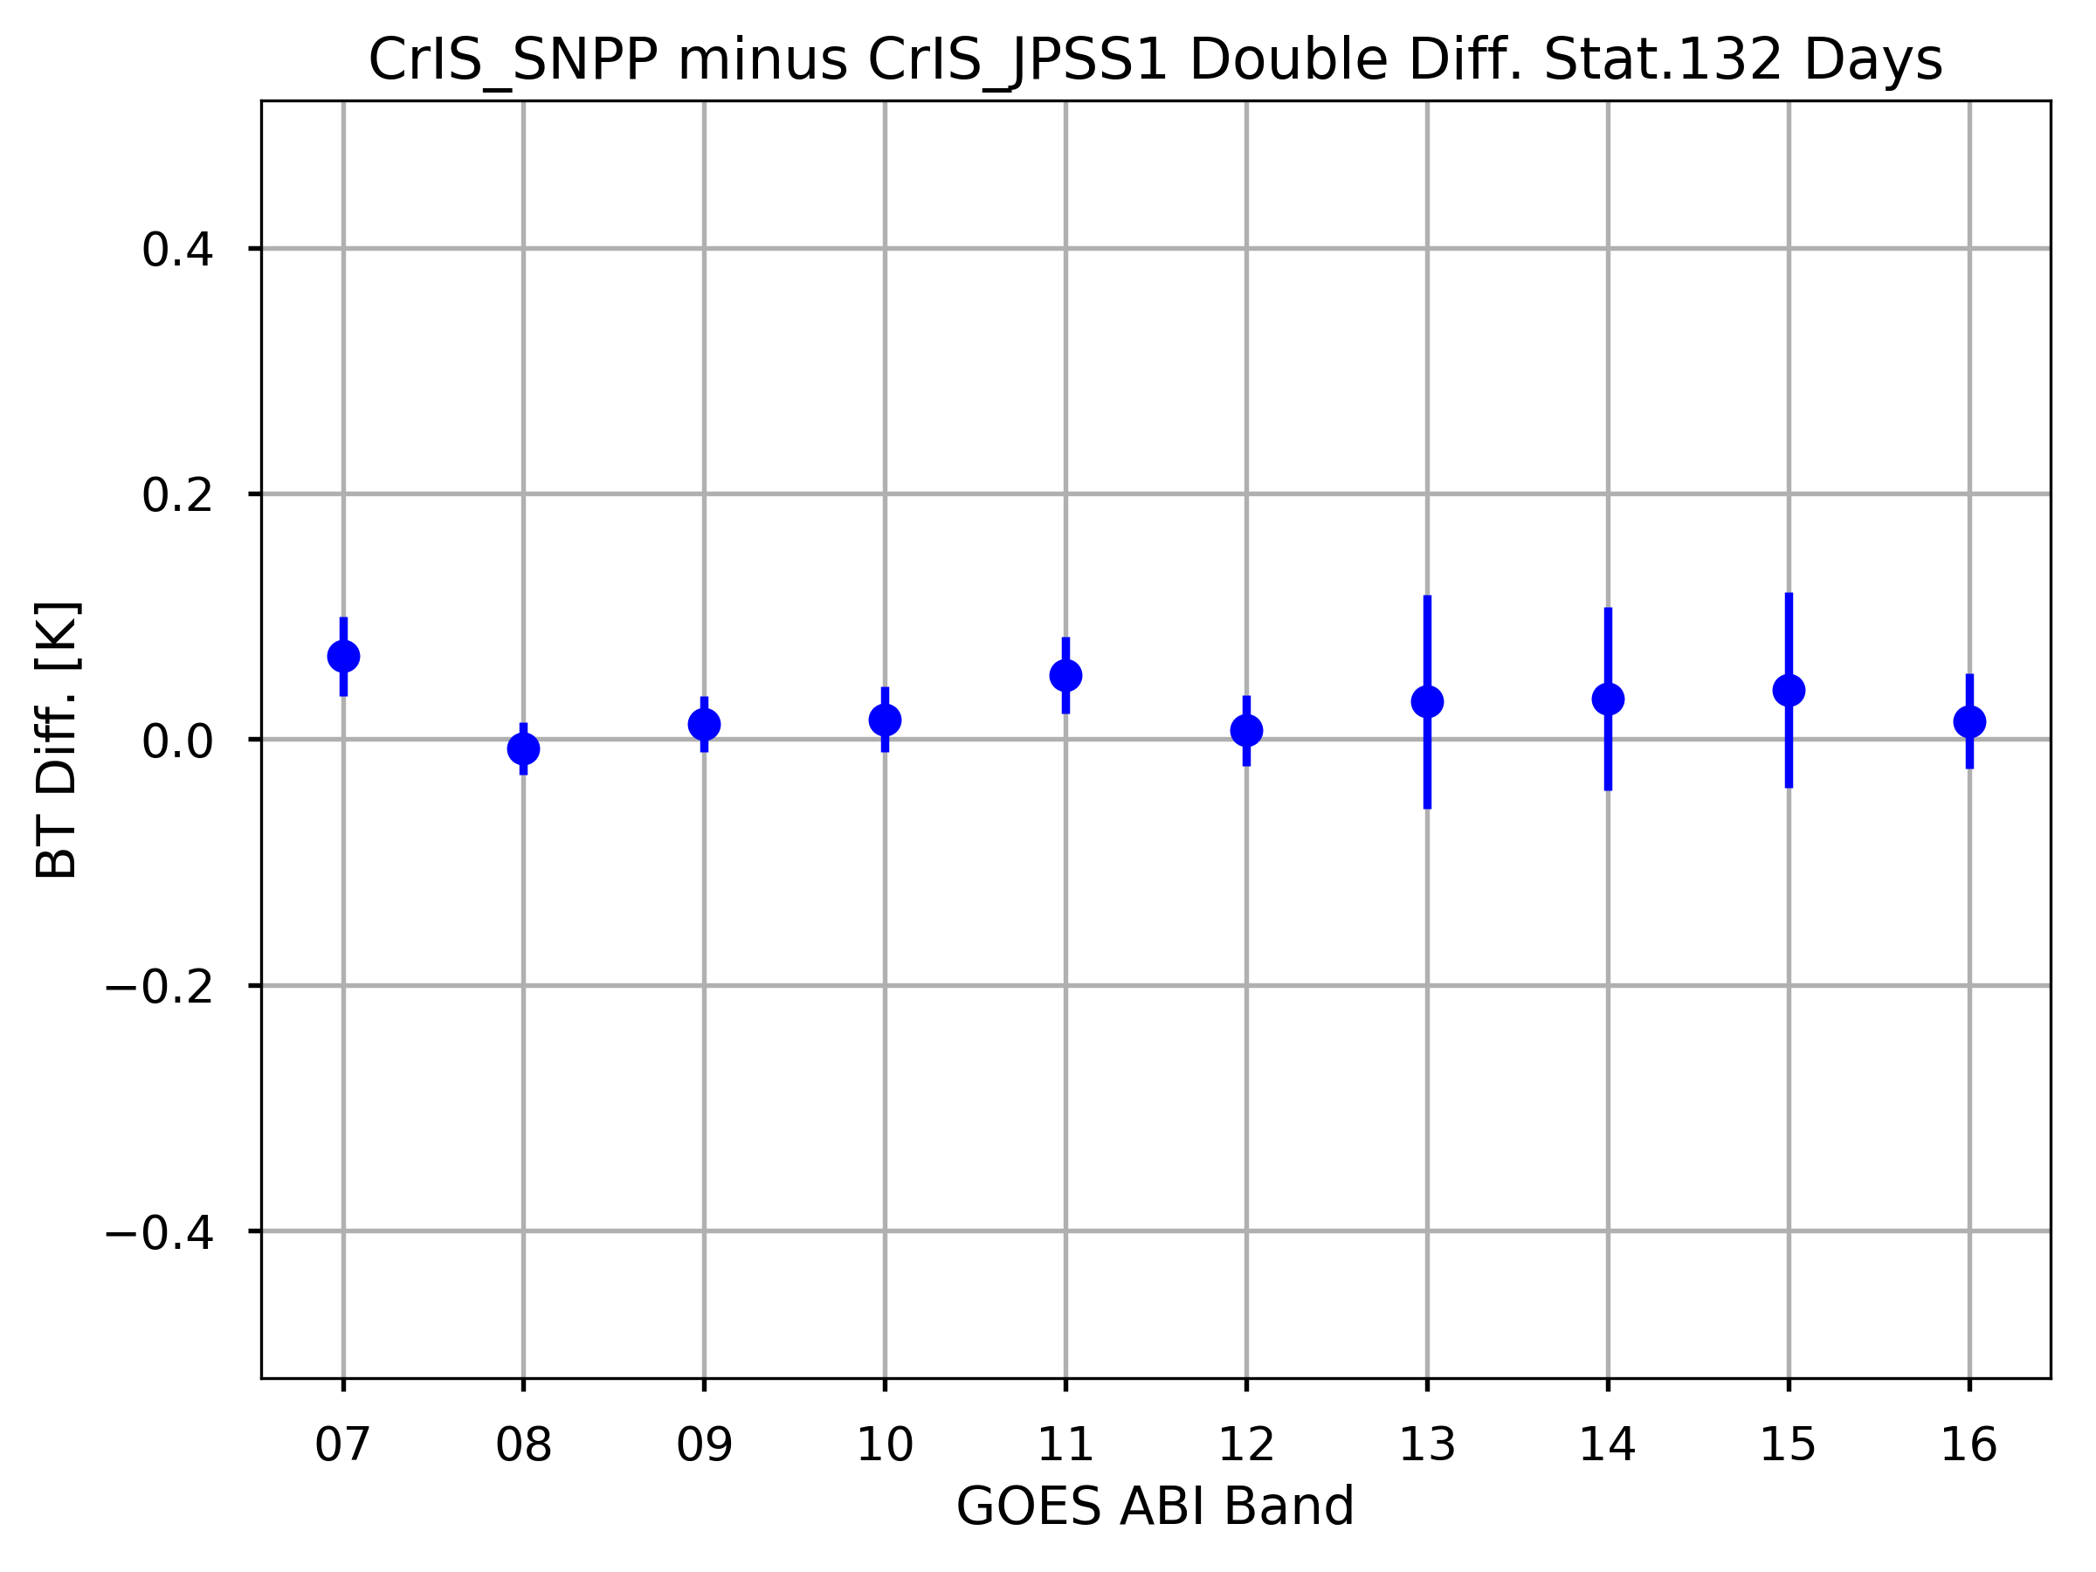
Double Difference of SNPP and N20 CrIS Relative to GOES-16 ABI
GOES-CrIS at 13.3µm Band
Double Difference Statistics for 132 Days
Double Difference
The good agreement between SNPP and N20 CrIS based on the double difference time series.
The difference is on the level of 0.1K.
SNPP is a little warmer than N20.

Slide 10
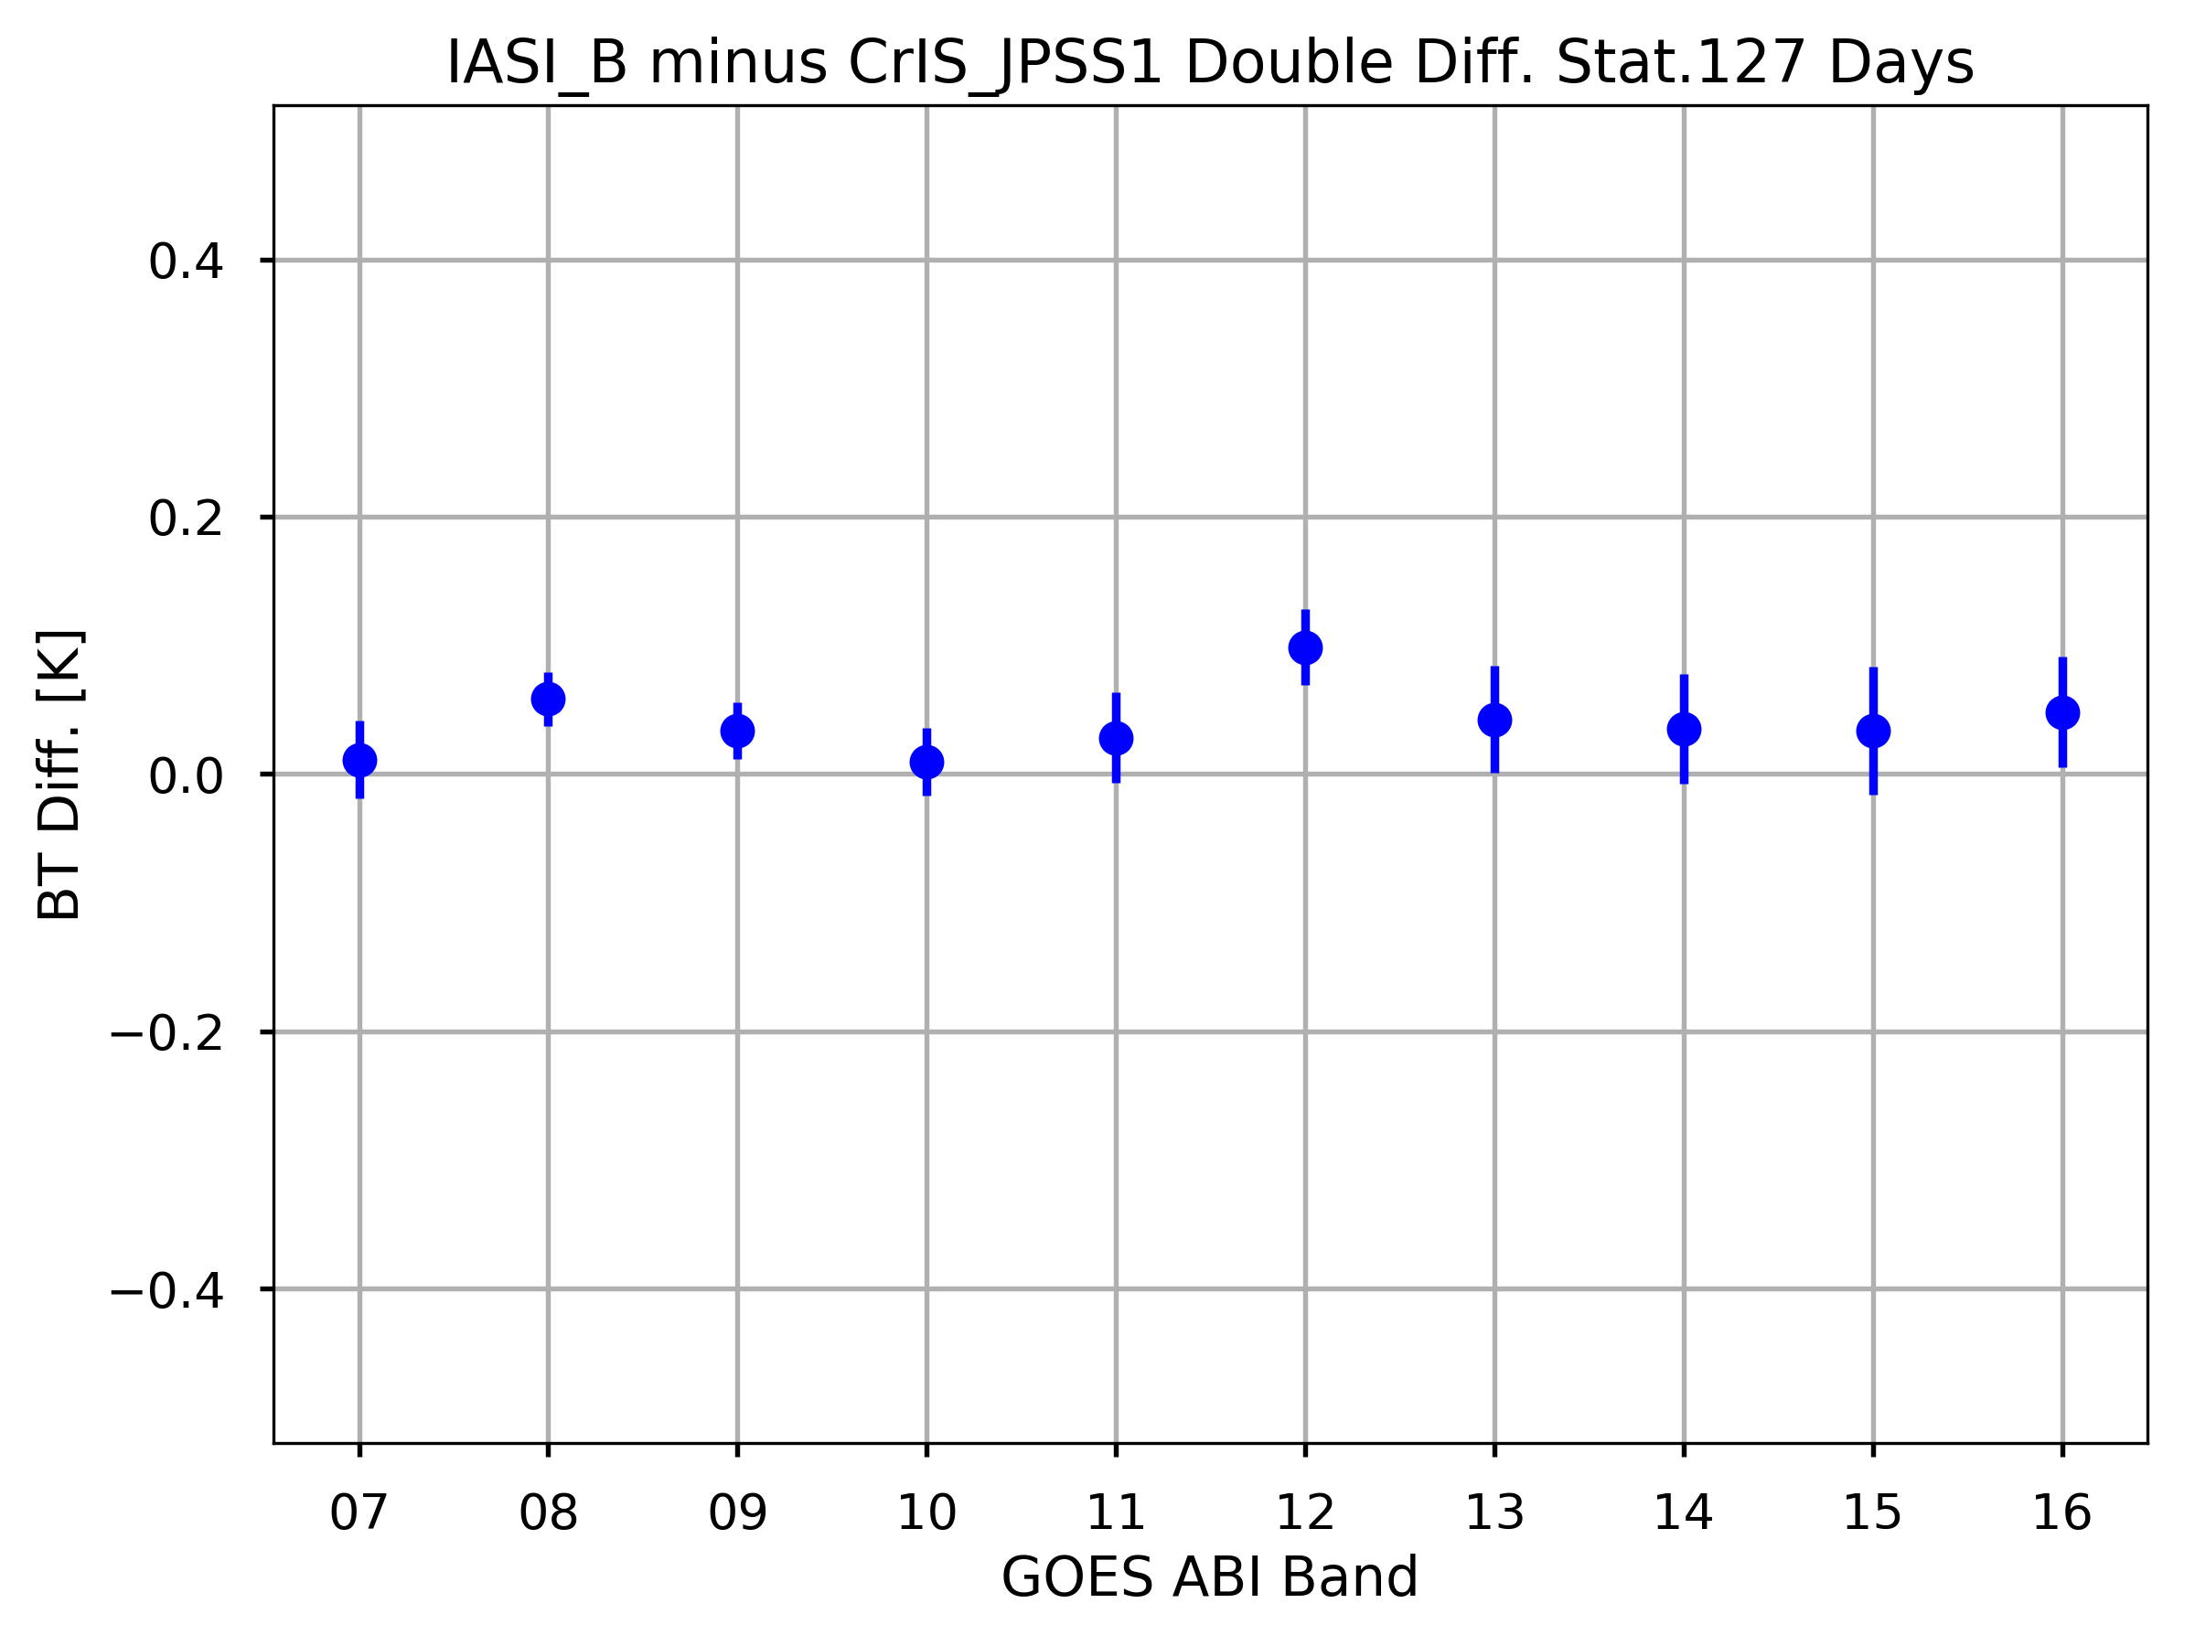
Double Difference of IASI-B and CrIS/N20 Relative to GOES-16 ABI
GOES-IASI(CrIS) at 13.3µm Band
Double Difference Statistics for 132 Days
Double Difference
The good agreement between IASI-B and N20 CrIS based on the double difference time series.
The difference is on the level of 0.1K.

Slide 11
Final Remarks
Different methods have been used to identify the radiometric differences between SNPP and NOAA-20 CrIS.
At a fine spectral domain,
At the CO2 absorption band at 650-750 cm-1 range, a consistent warm bias is found on the level of 0.1K;
At the water vapor absorption band, the two CrIS instruments are well consistent to each other and their BT differences are close to zero lines albeit with variation;
The largest BT difference of more than -0.6 K can be found at the spectral line transition region (around 2380 cm−1) in the SWIR band.
Based on inter-calibration products of CrIS-ABI:
The difference is on the level of 0.1K.
SNPP is a little warmer than N20.
The transition to NOAA-20 CrIS should be recommended.

