Slide 1
Calibration and Validation of EWS-G*
Xiangqian Wu¹, Hyelim Yoo², Fangfang Yu², and Haifeng Qian²
¹ NOAA/NESDIS/STAR
² CISESS, University of Maryland
* Paper 8B.1, Session 8B – Algorithm Development, Verification, and Cal/Val Part II
18th Annual Symposium on Operational Environmental Satellite Systems
102nd American Meteorological Society Annual Meeting
4:45 p.m. 25 January 2022
Disclaimer: The scientific results and conclusions, as well as any views or opinions expressed herein, are those of the authors and do not necessarily reflect those of NOAA or the Department of Commerce.

Slide 2
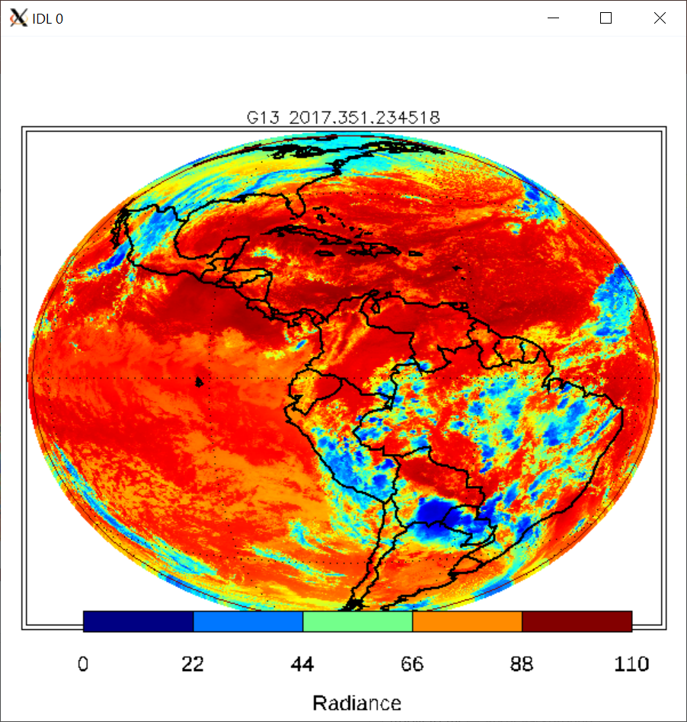
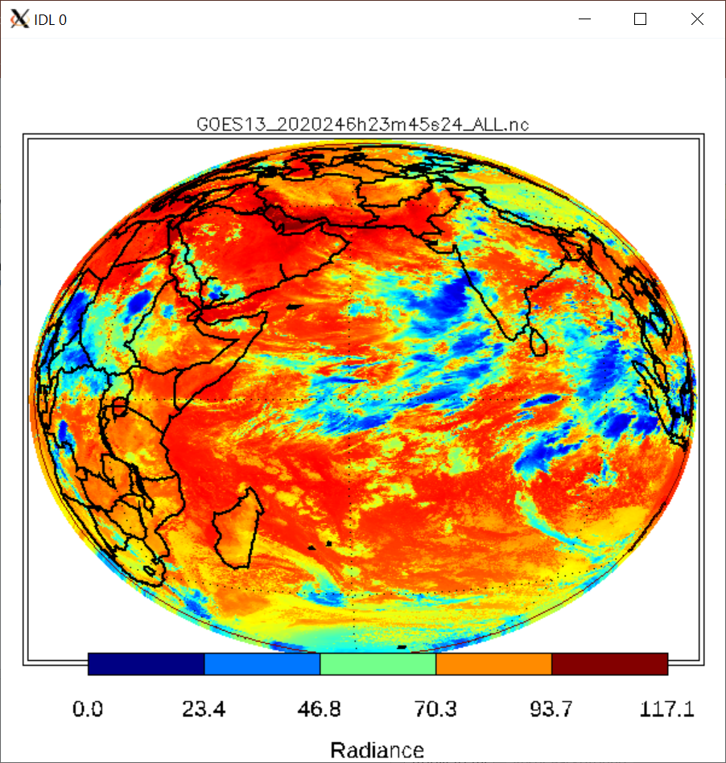
Introduction
In 2019, NOAA’s GOES-13 was transferred to USSF as EWS-G1 over the Indian Ocean.
  NOAA: National Oceanic and Atmospheric Administration
  GOES-13: The 13th Geostationary Operational Environmental Satellite
  USSF: United States Space Force
  EWS-G: Electro-Optical Infrared (EO/IR) Weather System – Geostationary
NOAA assisted the transition and operation of EWS-G1, including its operational calibration.
For the Initial Operational Capability (IOC, achieved in September 2020), the focus was on Imager.
  Calibration priority was its visible channel, which does not have onboard calibration.
GOES-13 Ch 4 at 2345 UTC on 2017-12-17 (above) and EWS-G at 2345 UTC on 2020-09-02 (below)

Slide 3
Outline
Vicarious calibration of GOES Imager visible channel using MODIS.
Application to EWS-G1
  Correct for spectral response functions
  Update for reference radiometer
  Account for degradation when the instrument is stowed.
Calibration issues for IR channels
  Verification of stray light correction
  Near real time monitoring of instrument calibration and product validation
Summary

Slide 4
goes Visible Channel calibration

Slide 5
Vicarious Calibration of Imager Visible Channel
Explored several options:
  Pseudo Invariant Targets/Features/Cal Sites/…: Desert (Sonora), DCC.
  Celestial bodies: Star, Moon (later).
Selected inter-calibration with MODIS.
Requirement | Purpose
MODIS Channel 1 @ 1KM | Matching Spectral Response and Spatial Resolution
Within ~10 minutes | Concurrent in Time
Navigate MODIS to GOES | Co-located in Space
Within ~8° from Both Nadirs Cos(VZA) > 0.99 | Similar Viewing Geometry & Minimal Rayleigh Scattering

Slide 6
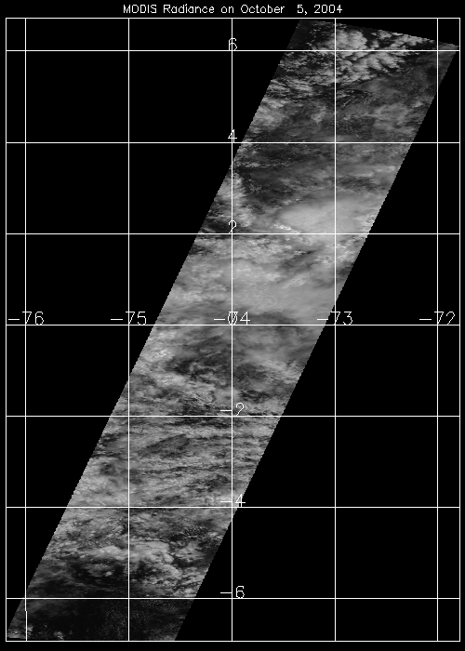
MODIS image in GOES projection …

Slide 7
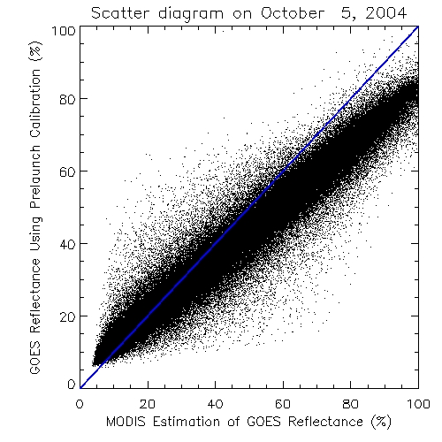
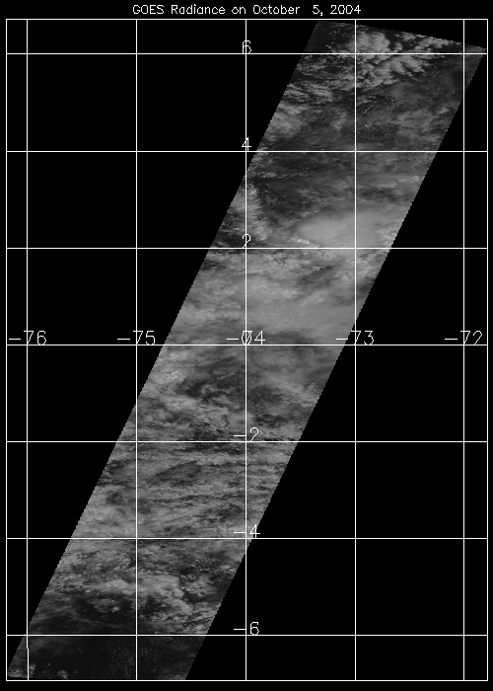
… and the corresponding GOES image
The slope of the regression line (white) would be a good indication of degradation.

Slide 8
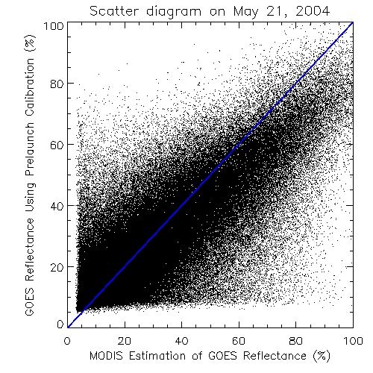
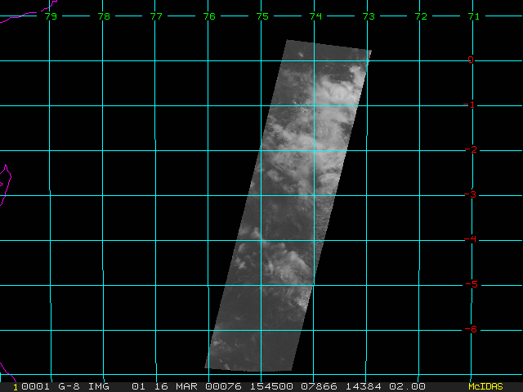
Often, the plot is more scattered …

Slide 9
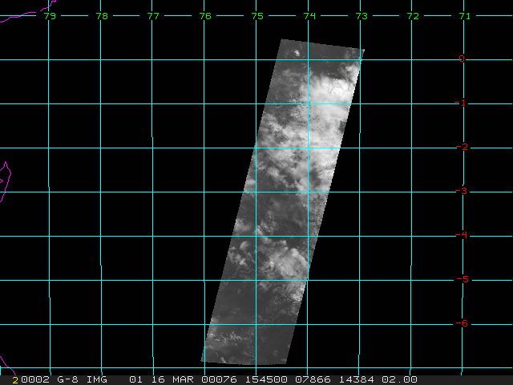
… because of time gap between images

Slide 10
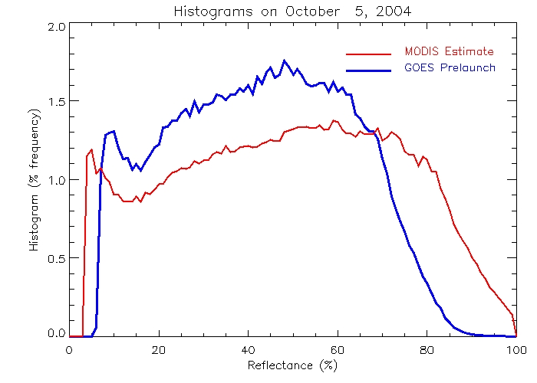
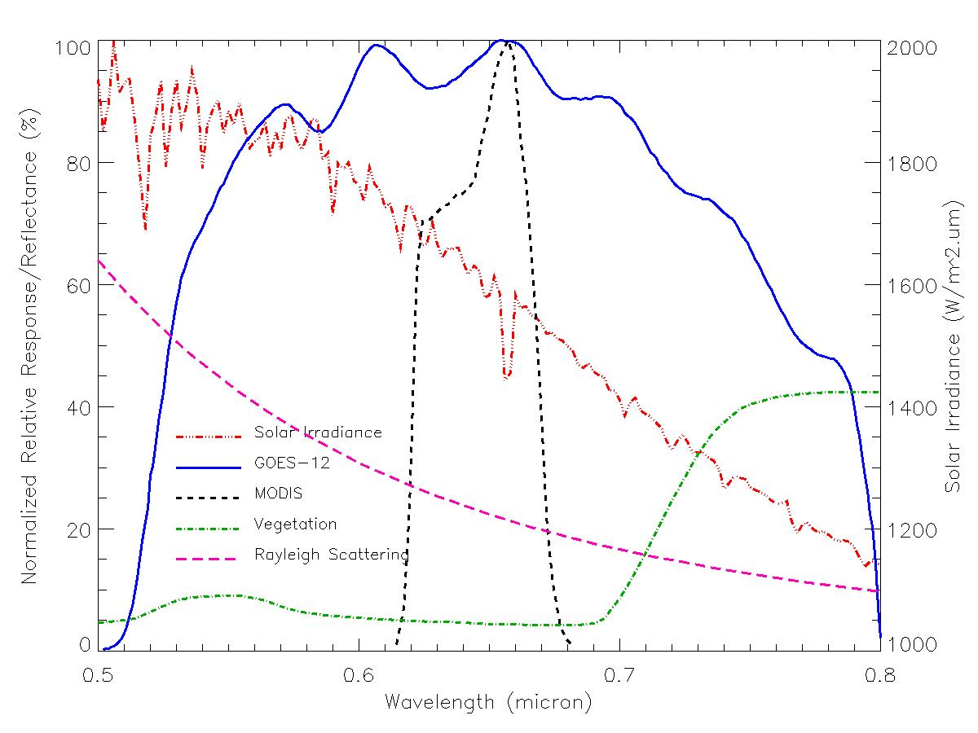
Histogram is More Robust
MODIS is darker than GOES:
Vege Reflection and Rayleigh scattering
MODIS is Brighter than GOES:
Degradation

Slide 11
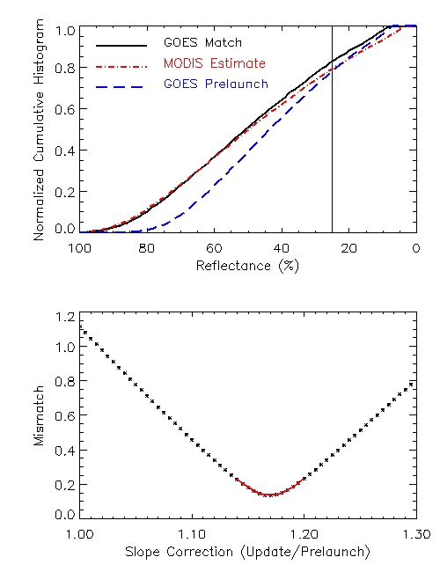
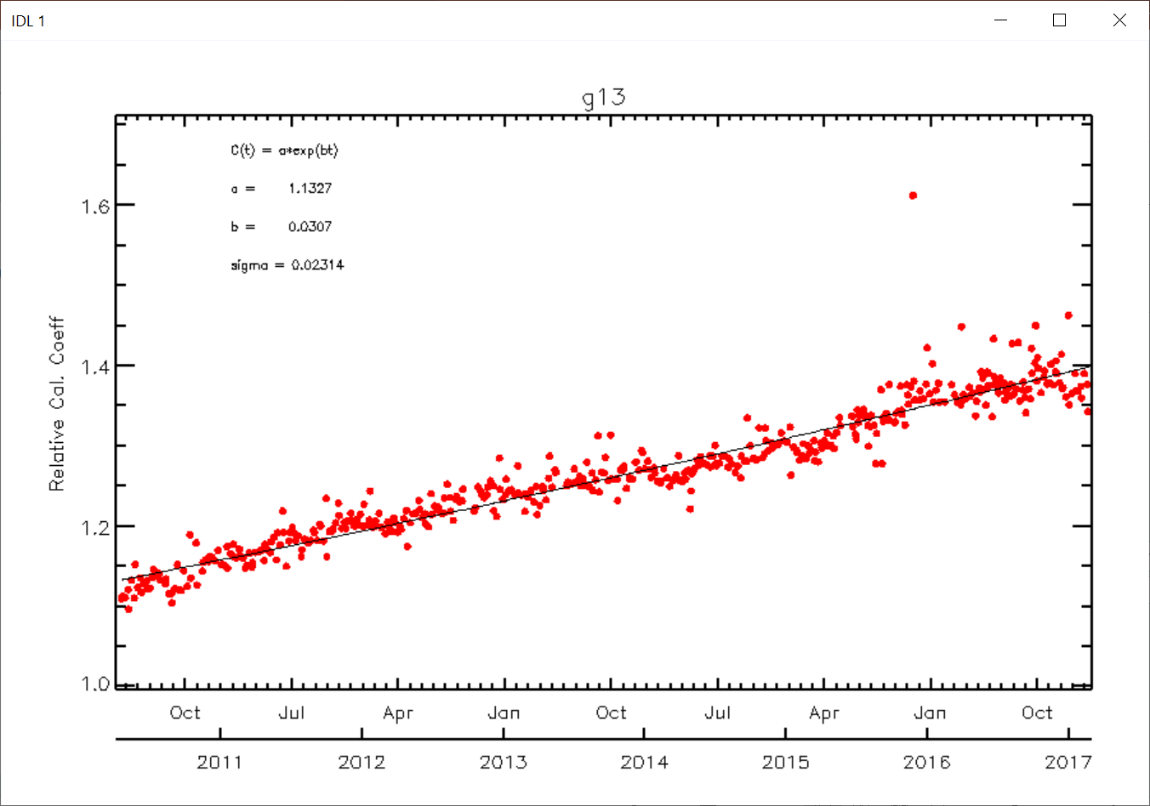
Histogram Matching Algorithm
Accumulate MODIS histogram (red) from 100% reflectance.
Repeat for GOES (blue).
Compute the total difference up to 25% reflectance (avoid clear).
Multiply GOES reflectance by a “correction”, and go to Step 2.
After sufficient number of corrections have been tested, find the one that minimizes the difference in Step 3.
Repeat on all days with collocations. Log regression over time.

Slide 12
Application to EWS-G

Slide 13
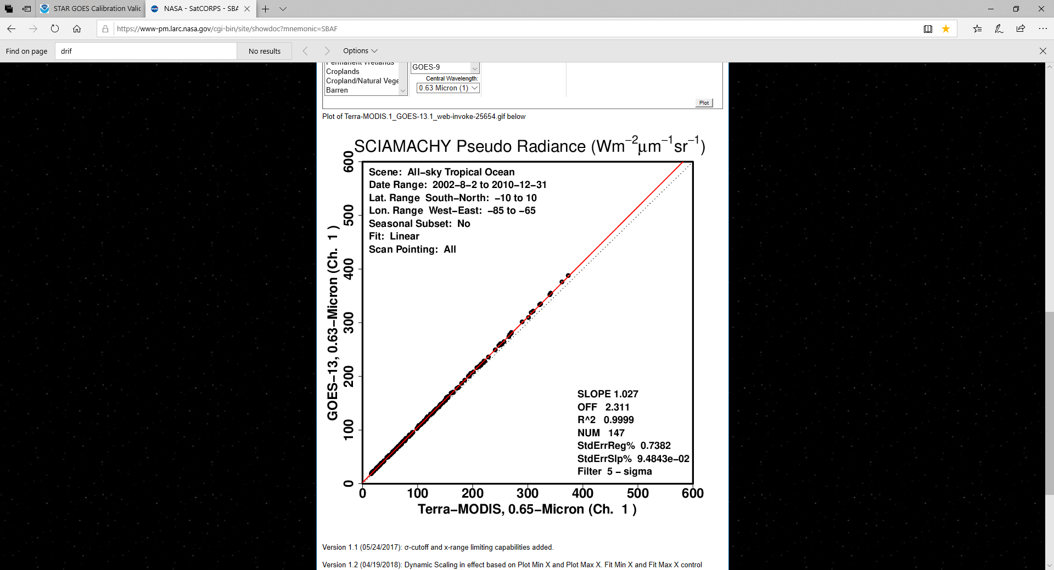
1. Adjust for Spectral Response
The matching channels have similar but not identical Spectral Response Functions (SRF).
MODIS radiance was adjusted for GOES SRF using a radiative transfer model “MODTRAN” (Wu 2003).
The impact of SRF difference has since been characterized comprehensively as Spectral Band Adjustment Factor (SBAF, Doelling et al. 2011, Scarino et al. 2018).
It is found that the difference between SBAF and the MODTRAN-based adjustment is negligible.
  Switched to SBAF for Terra MODIS now.
  And for NOAA-20 VIIRS in future.

Slide 14
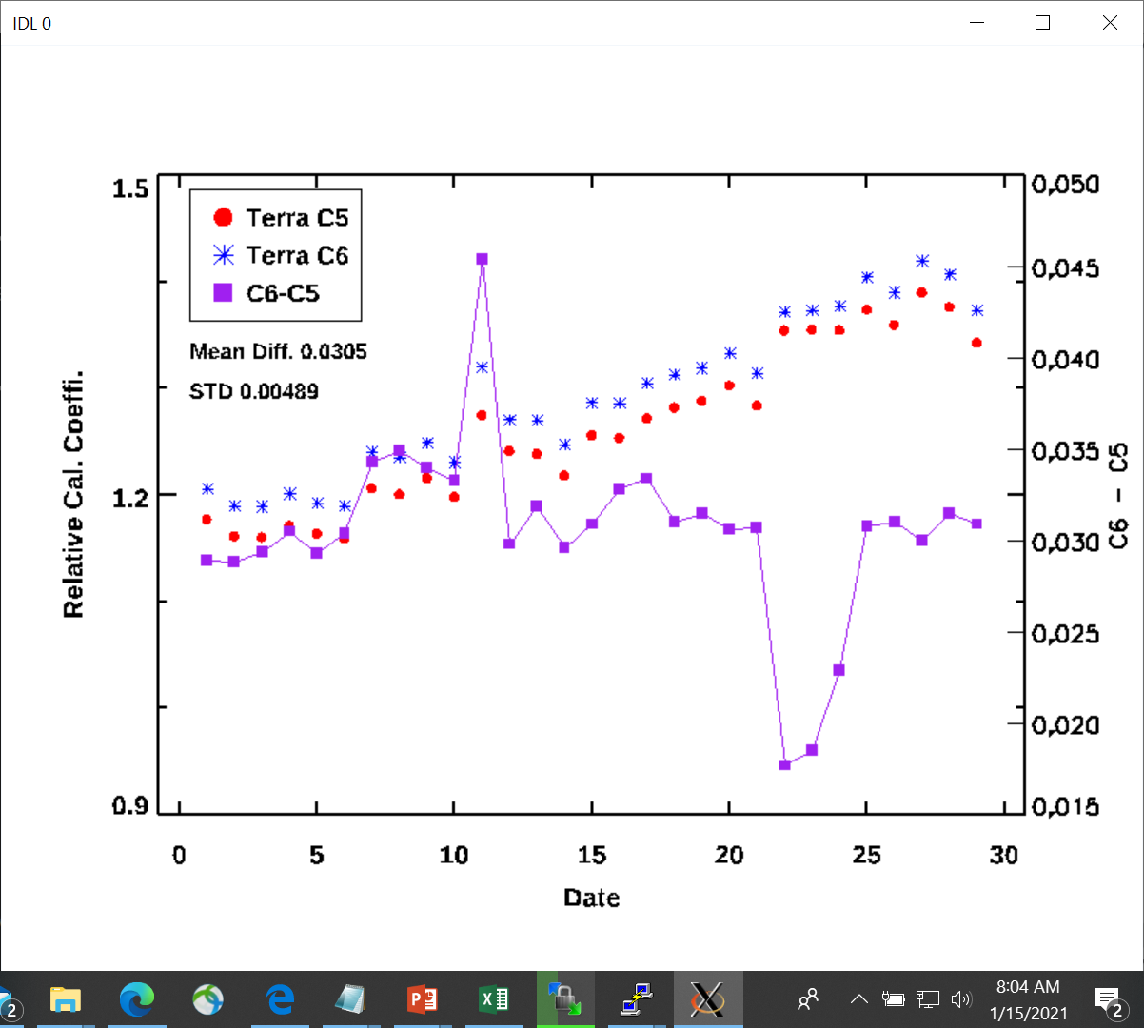
2. Adapt to New Reference
Chose Terra MODIS since 2003.
Operational calibration for GOES-13 started on 14 April 2010.
  Terra MODIS “Collection 5”.
C5 was terminated in Feb 2017, replaced by C6.
Used C6 to reprocessed February data 2011-2017. The C6 – C5 difference is 0.0305.
Adjusted the data prior to Feb 2017.
  Used Terra MODIS C6 thereafter.
  Will shift to NOAA-20 VIIRS in future.

Slide 15
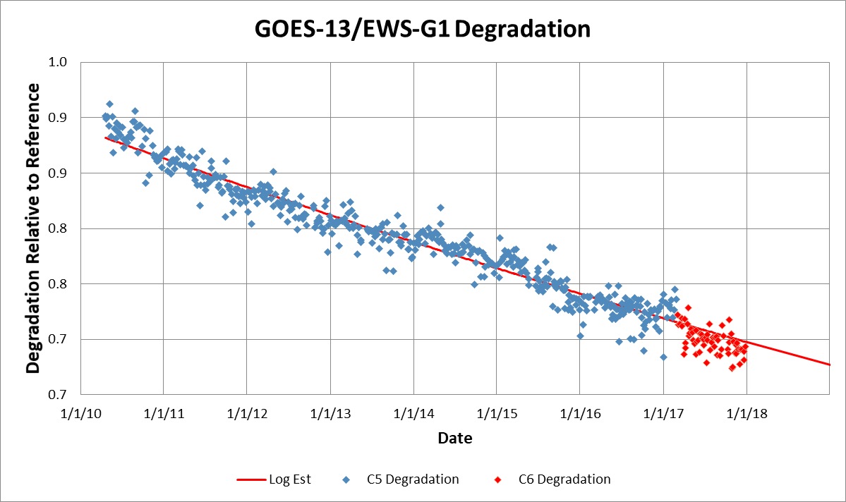
Reference Adjustment

Slide 16
Reference Adjustment

Slide 17
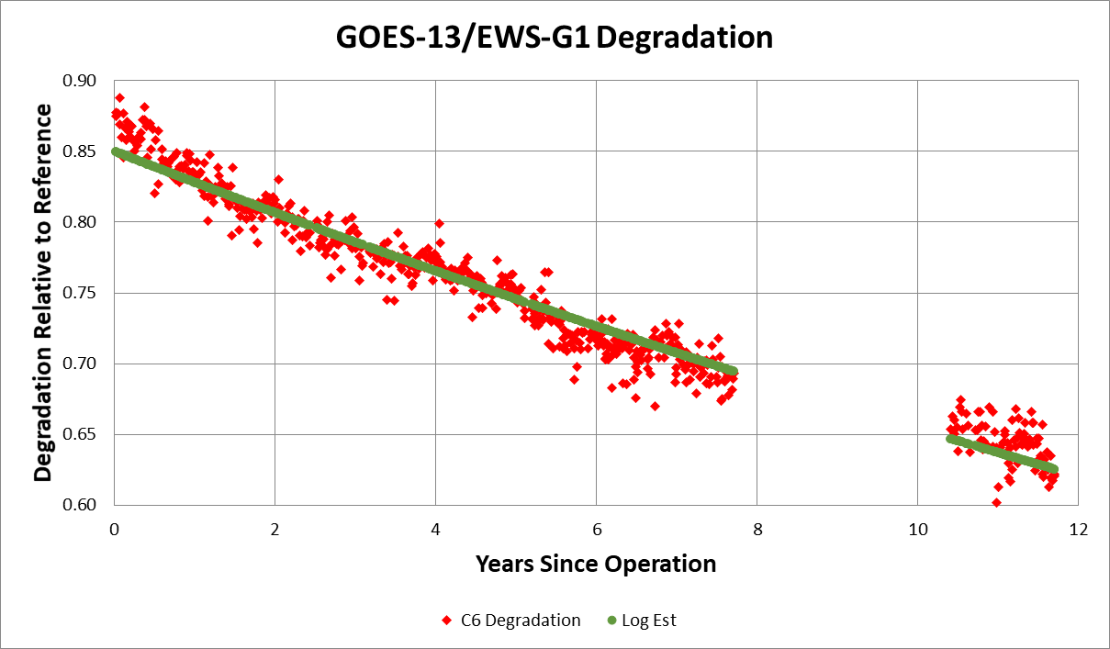
3. Account for Interrupted Operation
Imager was not operated continuously during the 32 months between GOES-13 and EWS-G1.
Overestimate if assuming degradation was as usual.

Slide 18
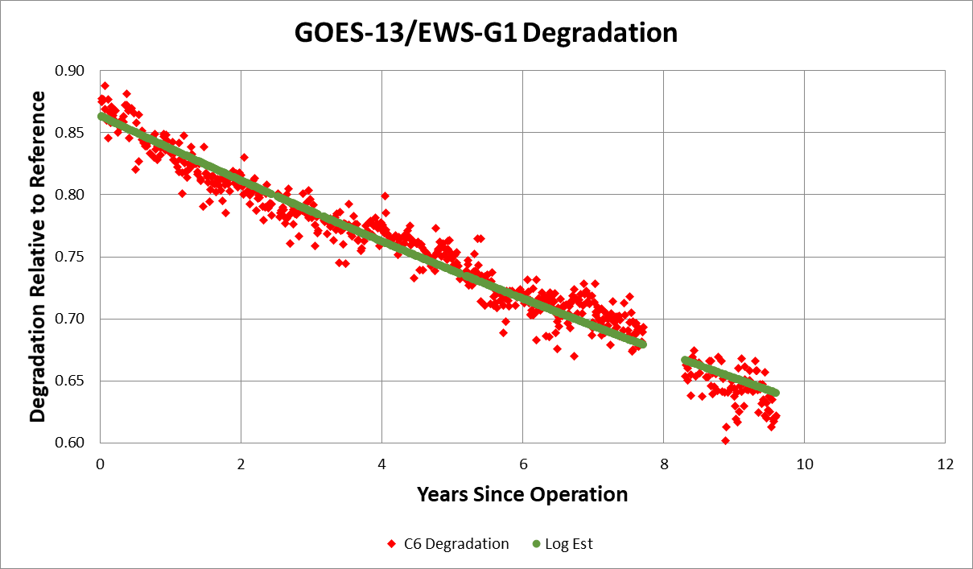
3. Account for Interrupted Operation
Imager was not operated continuously during the 32 months between GOES-13 and EWS-G1.
Underestimate if assuming degradation was stopped.

Slide 19
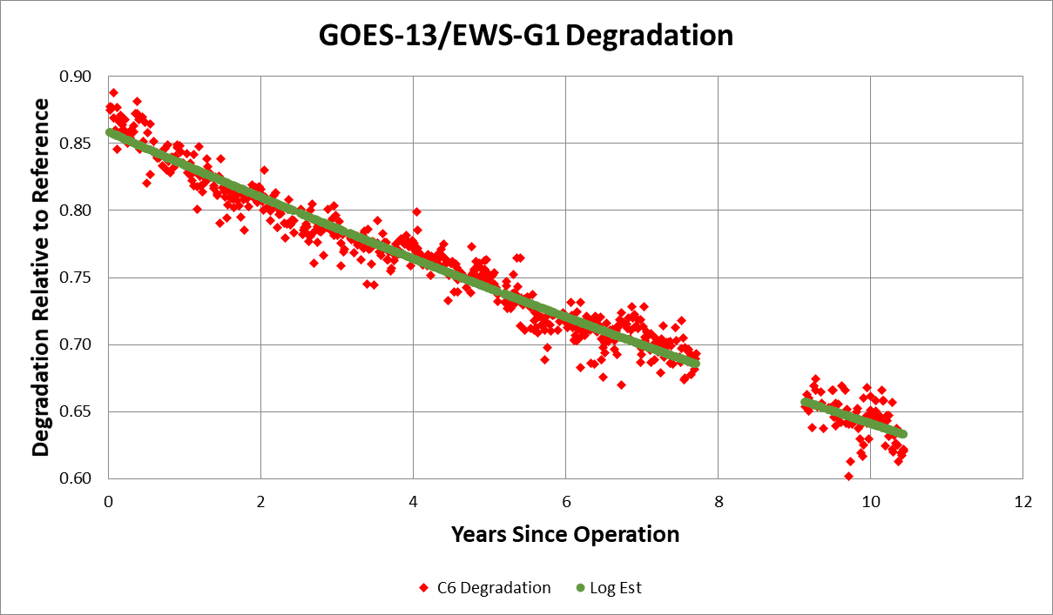
3. Account for Interrupted Operation
Imager was not operated continuously during the 32 months between GOES-13 and EWS-G1.
Designed an algorithm to properly account for degradation during stow.

Slide 20
Calibration for ir channels

Slide 21
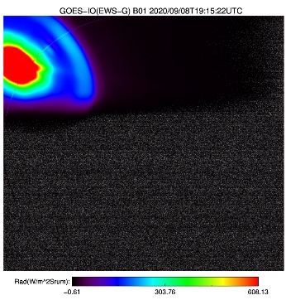
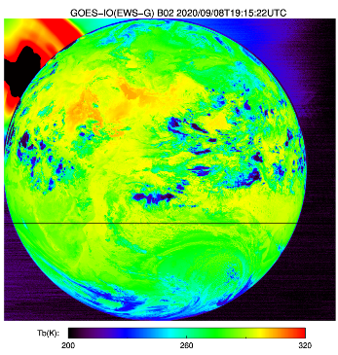
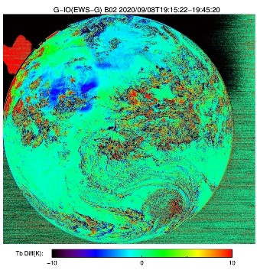
Stray Light Correction During Eclipse
Ch 1 (VIS)
Ch 2 (3.9 µm)
GOES-13 was the first GOES that enabled operation through eclipse.
Because it was unprecedented, elaborate scan schedule to avoid the Sun was not implemented until ten year later with ABI on GOES-16.
Stray light was a serious issue when launched in 2006. It was mitigated before GOES-13 became operational in 2010.
Satisfactory performance for EWS-G1 was verified.
Ch 3 (6.5 µm)
Ch 4 (11 µm)

Slide 22
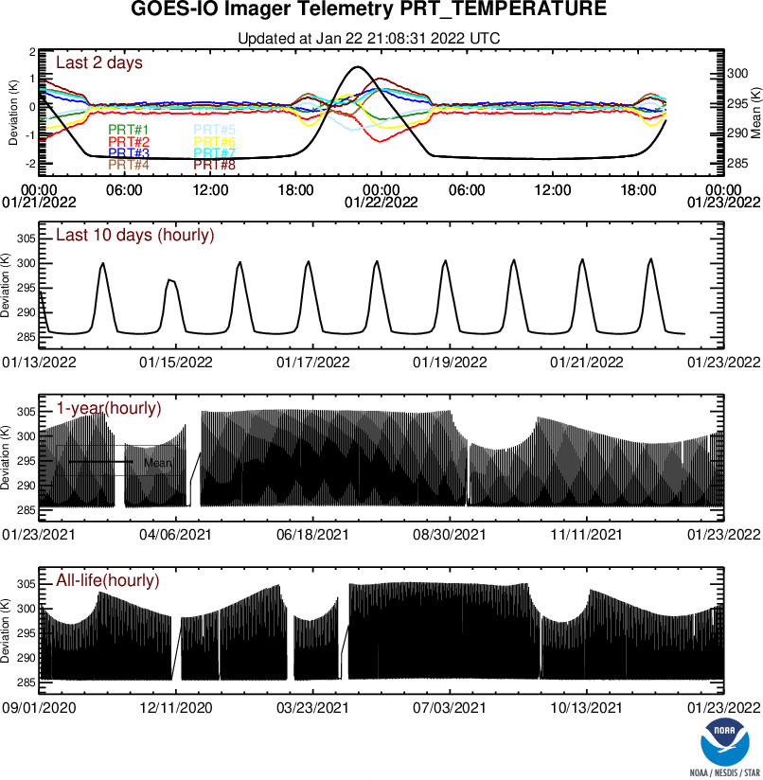
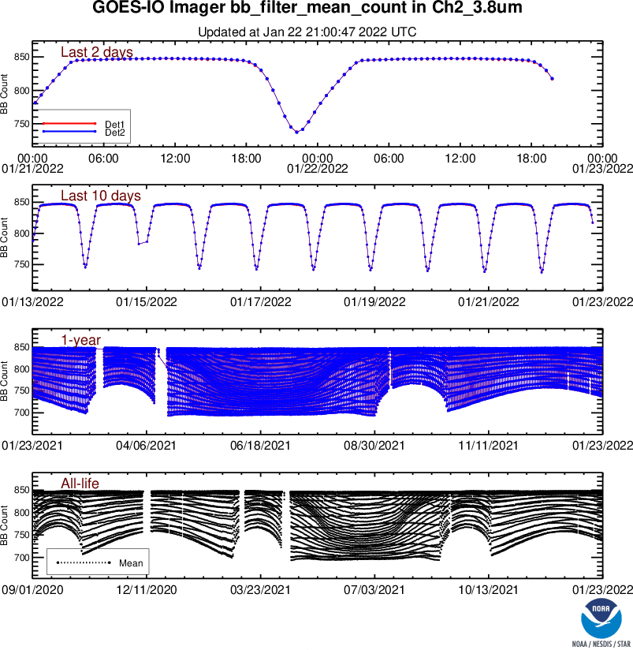
Near-Real-Time Monitoring

Slide 23
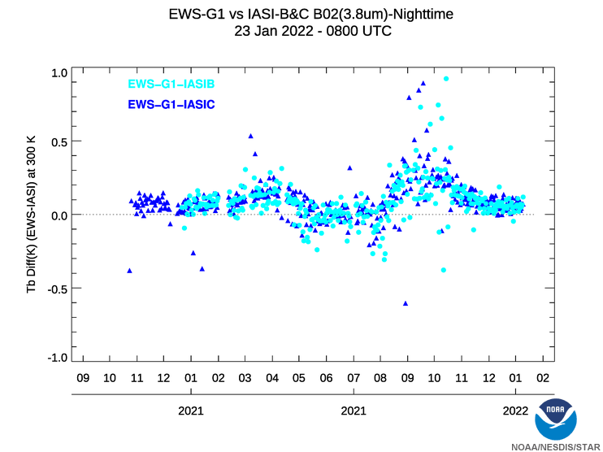
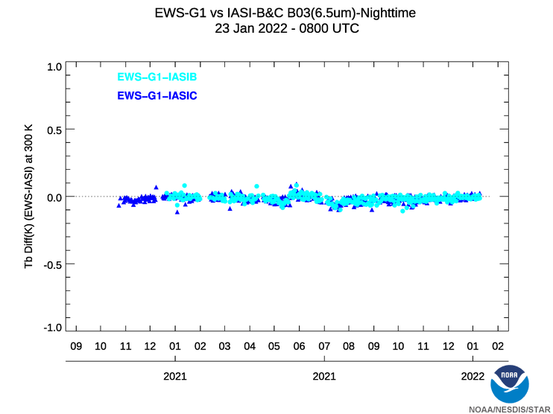
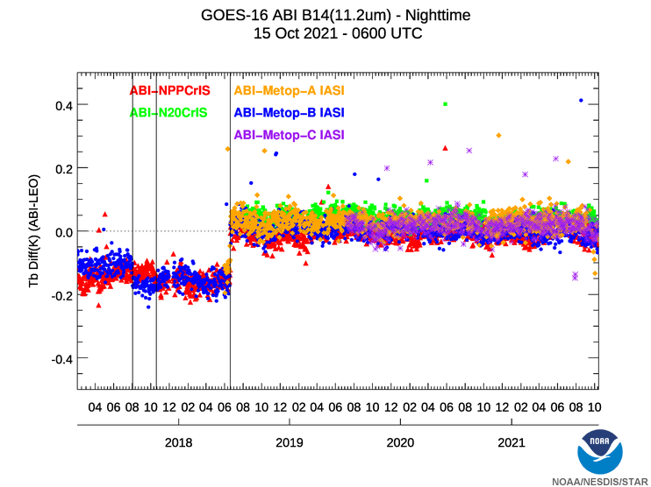
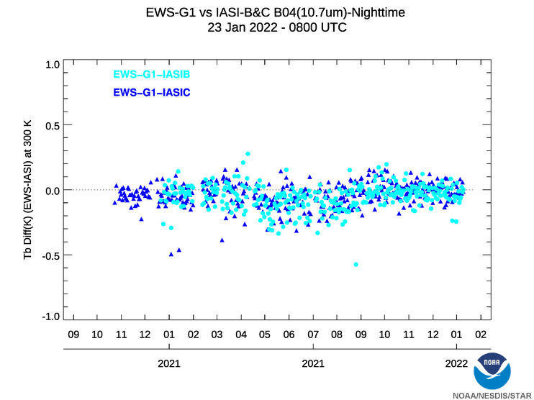
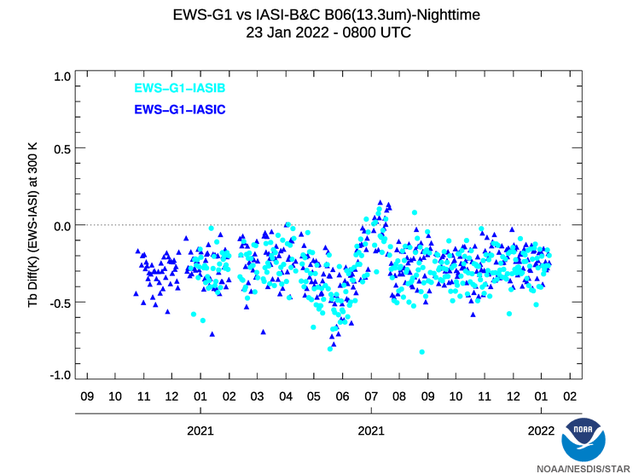
Validation

Slide 24
Summary
EWS-G1 has been transferred from NOAA to USSF and reached IOC in September 2020.
NOAA assisted the transition and operation of EWS-G1, including its operational calibration.
Calibration coefficients for its visible channel have been updated monthly since October 2020.
Near-real-time monitoring of calibration of all channels and validation of their radiance products has started recently.
NOAA is communicating with users to deliver customized calibration products and services.

