Slide 1
SLIMED model status. Hugh Kieffer
Goal: System that can incorporate all useful data, progressively approach the real Moon
SLIMED model of lunar spectral irradiance. Continuous in all 6 dimensions
Based on many [12] instruments, 90,000 measurements. Includes TSI and SSI variation.
Optional: libration model derived from 10 maps by Lunar orbiters. ⇖ ⇧0.1% effect
Since 2021 March: Have added AeroNet Mauna Loa (released 2021 July)
Paper submitted to JARS (2021 Dec.) in review. Since:
Redid libration model from Lunar Orbiters (MapLib) including latitude of the Sun
Resulting SLIMED model slightly different (0.3%) from model in manuscript.
Heft: Adjust overall weight for each instrument. Base model: weight in %:
ROLOG=20 OLI=10 HypM=1 MODT=10 MODA=8 VIIRS=5 VIIRN=10 SeaW=10 PleA=8 PleB=8 NIST=5 AerN=5
SLIMED Base model, 3 ≤g≤ 95, has 34 coefficients. MapLib has 22 fixed coefficients
Mean absolute residual 0.63%, with or without MapLib
Calibrate all instruments in inventory [24]. Get mean gain bias of each band, Fig. 1
Absolute scale still uncertain, maybe 2%, but differences between instruments are solid.
GSICS-VIS/NIR 2022Feb10 zoom

Slide 2
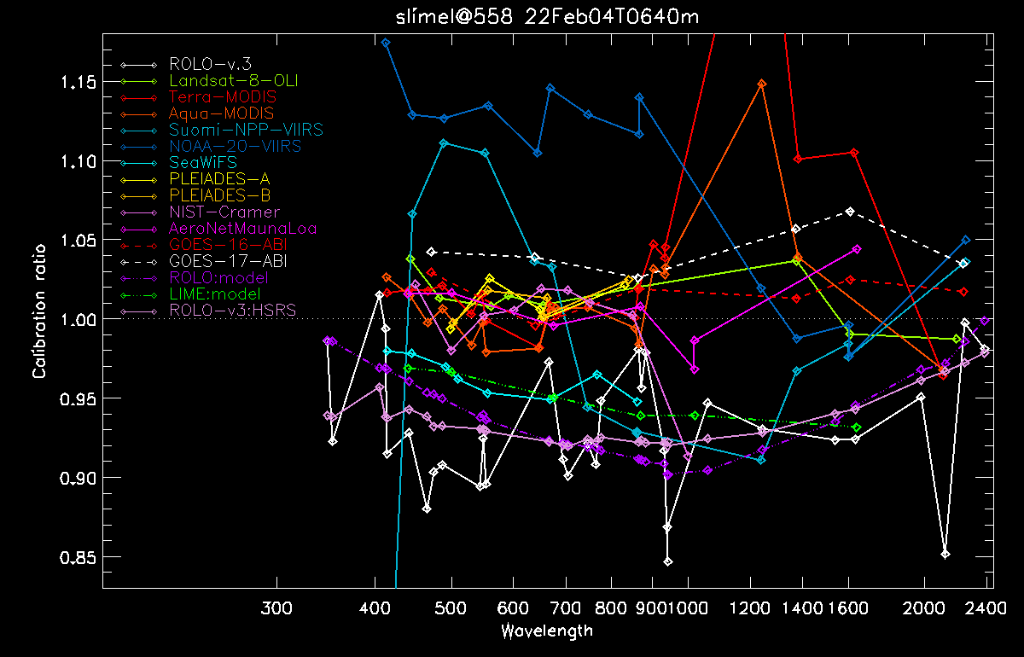
Gain bias for bands in several Instruments and other models
LEO and surface solid, GEO dashed, models dash-dots. Includes trends, mostly tiny.
ROLO: white is 2005 data, purple is model (GIRO), pink is data using HSRS

Slide 3
Discussion
Model generation assumes instruments are consistent (except for first VIIRS trends),
And each band may have a scale error.
Current best estimate of the Moon; but polarization not included.
We are still lacking accurate absolute measurements of spectral irradiance at any geometry.
The relation between instruments (data in hand) will not change substantially.
Instruments cannot really be this different; must result from image-to-irradiance processing
or nadir-view to Moon-view hardware differences.
Choosing NOAA-20 VIIRS as a reference does not look like a good idea based on lunar calibration.
GSICS-VIS/NIR 2022Feb10 zoom

