Slide 1
IASI-A: End of life tests
Laura Le Barbier
Yannick Kangah
Jérémie Ansart
Olivier Vandermarcq

Slide 2
IASI-A End Of Life tests
7 tests achieved from 07/09/2021 to 28/11/2021: analysis of the ouput in progress
IASI-EOL-13
Test of redundancies
IASI-EOL-16
Test of various CSQ thresholds
B-Side & A-Side
IASI-EOL-15
Supersample mode by swath reduction
IASI-EOL-18
NedT improvement by switching off 3 pixels out of 4
IASI-EOL-01&02
Locking Filtering Device (LFD) & Compensation Device (CD) Stop
IASI-EOL-03
Inter-calibration
IASI-EOL-17
Limb acquisition during backflip maneuver
Check remaining redundancies never exercised before Laser 2 & DPC5
Characterize more finely the Cube corder Speed Quality error anomalies
Increase the spatial density of the soundings and improve the spatial resolution
Check the decrease of detector temp. and Nedt improvement in B1 band
Test the release of the 3 LFDs and check the effect of the CD stop
Use the opportunity of the deorbiting of Metop-A to acquire real SNO data by IASI-A and B or C
Test of the spectroscopy and radiance modelling in new conditions
Succes
Partial succes of
operations
Succes of operations
Succes
Succes of operations
SNO acquired
Succes of operations
Laser 2 performances still compliant with reqrts after 15 years in space
Analysis of L2
is on going
Mechanism worked after 15 years in Space ; but no time enough to observe the full deployment.
Data analysis
is on going
Data analysis
is on going
Characterization
achieved on
B-Side only
More in following slides
More in following slides
More in following slides

Slide 3
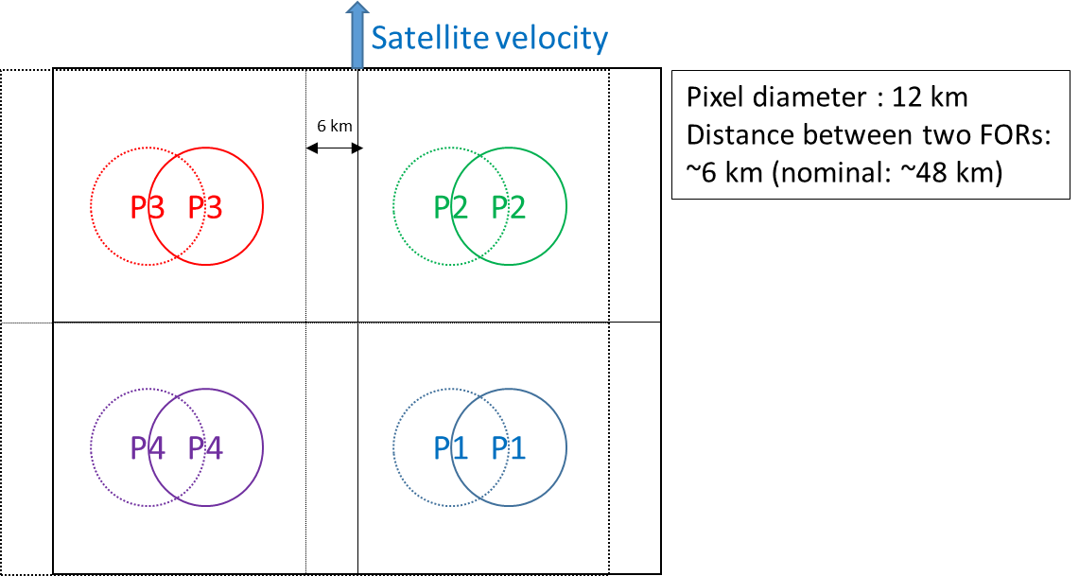
IASI-A End Of Life tests
IASI-EOL-15: Local improvement of spatial sampling and possibly spatial resolution
Purpose:
Increase the spatial sampling
Process:
Modification of the scanning law parameters: dividing by ~8 the spacing between two views (from 58.178 mrad to 7.3 mrad)

Slide 4
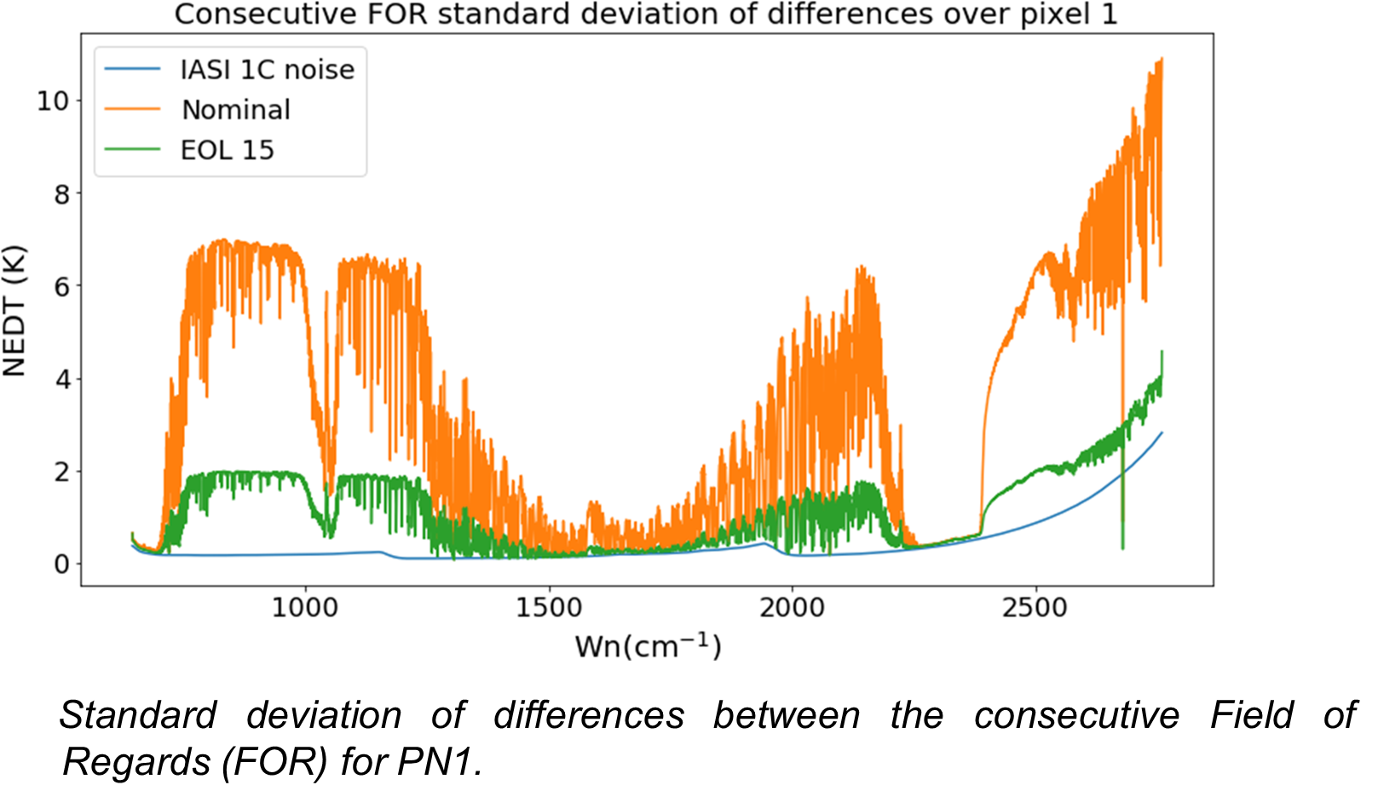
IASI-A End Of Life tests
IASI-EOL-15: Local improvement of spatial sampling and possibly spatial resolution
Results and expected outcomes:
Significant increase of the spatial variability of L1 spectra.
Oversampling area of interest : atmospheric chemistry, pollution
Impact of overlapping pixel on the retrievals: preparation of MTG-IRS
Noise reduction (e.g. by averaging L1 data) : preparation of IASI-NG
Data availability:
22 Sept 2021 - 21 Oct 2021 ~29 days
Consecutive FOR variability exhibit atmospheric structures and exceed noise level

Slide 5
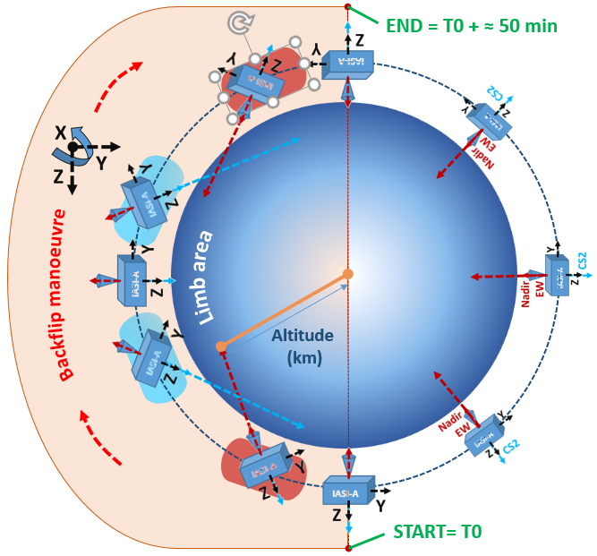
IASI-A End Of Life tests
IASI-EOL-17: Deep space manœuvre acquisition
Purpose:
Performing limb measurements with IASI between ~25km and ~85km during Metop-A backflip manœuvre
Process:
Alternatively using Earth View (EW) nadir and Cold Space 2 (CS2) Scan Positions to perform limb viewing measurements as long as possible
CS2 SP
Nadir EW SP
Limb acquisitions timeline

Slide 6
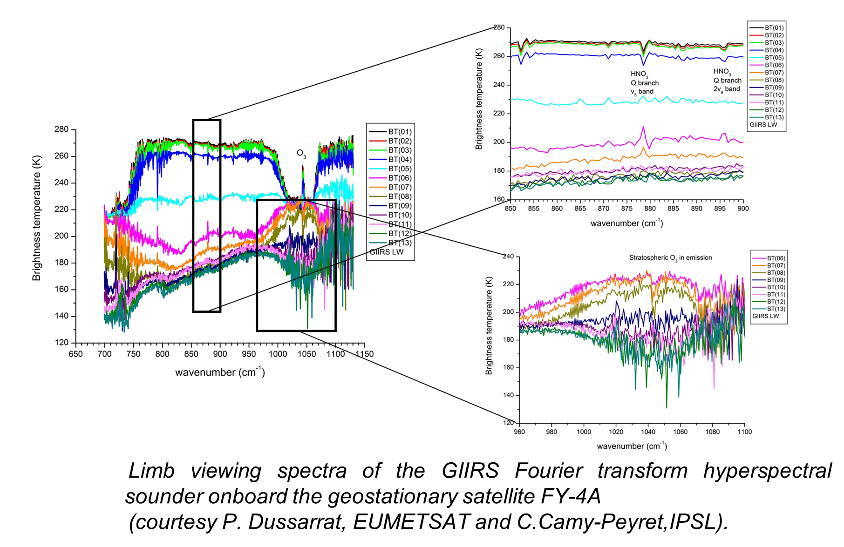
IASI-A End Of Life tests
IASI-EOL-17: Deep space manœuvre acquisition
Results and expected outcomes:
Detection and analysis of stratospheric chemistry
Analysis of the Non local thermodynamical equilibrium of stratospheric CO ?
Data availability:
½ orbit 27/11/2021
We observed a substantial increase of the detectors temperatures after the first 10 mns ➔ Worst performances after that.

Slide 7
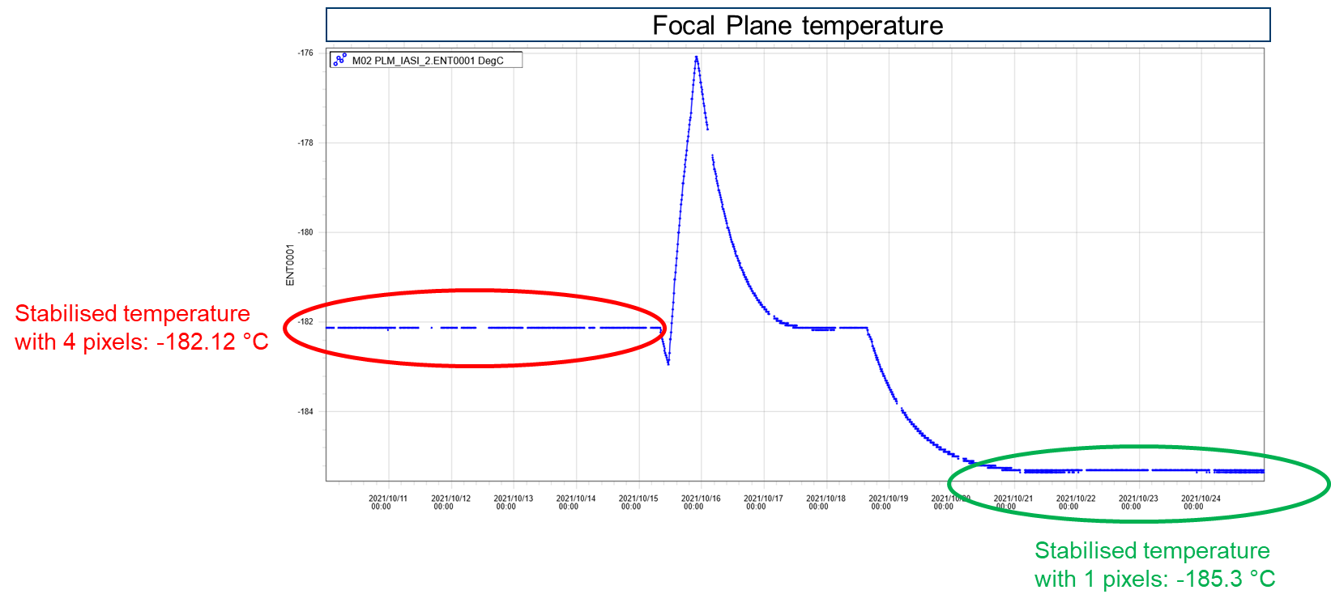
IASI-A End Of Life tests
IASI-EOL-18: NEDT improvment in B1 on 1 sounder pixel
Purpose:
Improve the radiometric noise performance in spectral band B1
Process:
powering only one pixel out of four ➔reduction of detector temperature and improvement of nedt performance in B1
>3°C of temperature decrease

Slide 8
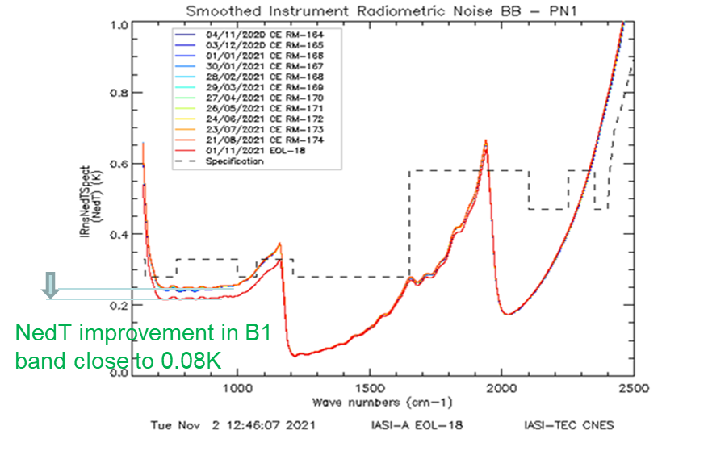
IASI-A End Of Life tests
IASI-EOL-18: NEDT improvment in B1 on 1 sounder pixel
Results:
Significant improvement of the radiometric noise performance in spectral band B1
Data availability:
15-24 October and 27-31 October
L0 (radiometrically calibrated) data. The « routine » processing does not allow interferometric axis calculation with only one pixel.
Spectral calibration can be performed on user request.

