Slide 1
Long-term Monitoring (LTM) of CrIS and ABI Inter-sensor Radiance Differences via ICVS: An Improved SNO Method and Case Studies
Xin Jin¹, Banghua Yan², and Ninghai Sun³
NOAA STAR Integrated Calibration and Validation system (ICVS) Team
1: Science Systems and Applications, Inc.
2: NOAA/NESDIS/STAR
3: Global Science and Technology, Inc.

Slide 2
Outline
Background
ICVS-LTM: GSICS-Portal for Inter-sensor Monitoring
Limitations in the existing CrIS-ABI SNO method
Development of an Improved SNO Method
Temporal Interpolation for SNO Observations
Improved quality controls (QCs)
Application to LTM of CrIS –ABI Inter-Sensor Radiance Differences
LTM of CrIS-ABI radiance differences
Scene temperature dependency analysis of the inter-sensor biases
Detections of sensor calibration anomaly and calibration update
Summary and Conclusions
2

Slide 3
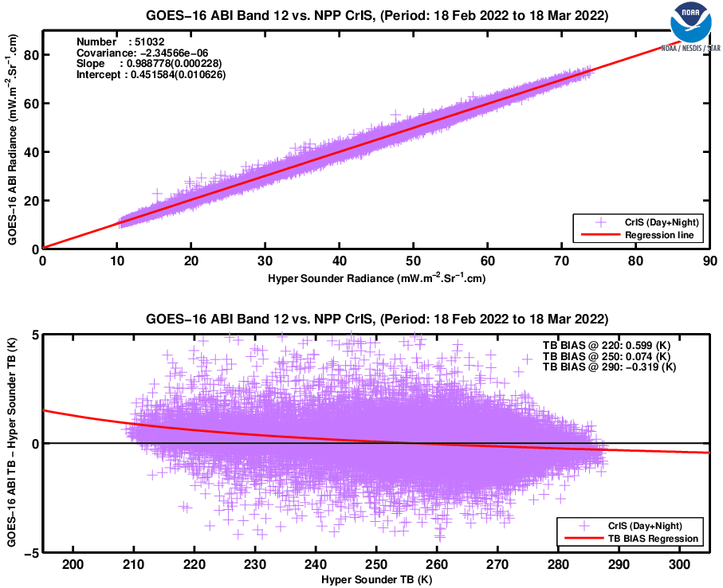
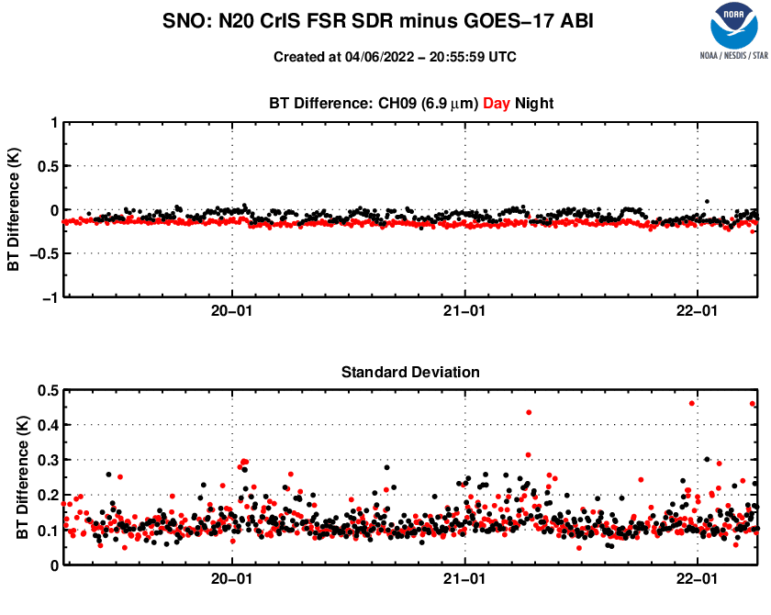
ICVS-LTM System: GSICS-Portal
What does ICVS-LTM do?
An integrated calibration and validation system (ICVS) Monitoring System/Tool for Near-Real Time (NRT) and Long-Term (LT) Performance of Satellite Instrument and Data Monitoring to support all NOAA satellite missions
ICVS is an important tool for instrument, level 1b or Sensor Data Records (SDR), and is used by OSPO, NWS, ECMWF, EUMETSAT, NASA, Air Force, NAVO, as well as STAR scientists (especially the radiance or SDR teams)
Key Features
Currently monitoring 30+ POES satellite instruments with more than 7000 parameters online
(https://www.star.nesdis.noaa.gov/icvs/index.php)
Used to evaluate instrument performance and Level 1b radiance/SDR product quality for SNPP and NOAA-20 ATMS, VIIRS, OMPS and CrIS, AMSU, AVHRR and other satellite instruments
GSICS-Portal and SNPP&NOAA-20 inter-satellite radiances difference monitoring (https://www.star.nesdis.noaa.gov/icvs/GSICS.php and https://www.star.nesdis.noaa.gov/icvs-beta/ )
Serves as a web-based dashboard for satellite instrument status and SDR (TDR) data quality
(Reference: Yan et . al., 2021, AMS virtual annual conference)
3

Slide 4
Current Quality Controls in Leo-Geo SNO Studies
Methods
Reducing time difference between Leo & Geo measurements (Gunshor et al, 2009)
Removing chaotic high-resolution pixels in side of low-resolution pixel footprints (GSICS ATBD, 2015)
Spatial averaging of more high-resolution pixels in extended areas surrounding the SNO view (Gunshor et al, 2009; Okuyama et al. 2018)
Limitations
Loss of valuable cases in chaotic scenes
Reducing sensitivity to outliers caused by instrument anomalies or algorithm flaws
M. Gunshor, T. Schmit, W. Menzel, and D. Tobin, “Intercalibration of broadband geostationary imagers using AIRS,” J. Atmos. Ocean. Technol., vol. 26, no. 4, pp. 746–758, Apr 01, 2009.
A. Okuyama, M. Takahashi, K. Date, K. Hosaka, H. Murata, T. Tabata, R. Yoshino, “Validation of Himawari-8/AHI Radiometric Calibration Based on Two Years of In-Orbit Data”, J. Meteor. Soc. Japan, vol. 96B, pp. 91−109, Sept 20, 2018.
"ATBD for EUMETSAT Operational GSICS Inter-Calibration of Meteosat-IASI”, EUM/TSS/TEN/15/803179, 14 October 2015.

Slide 5
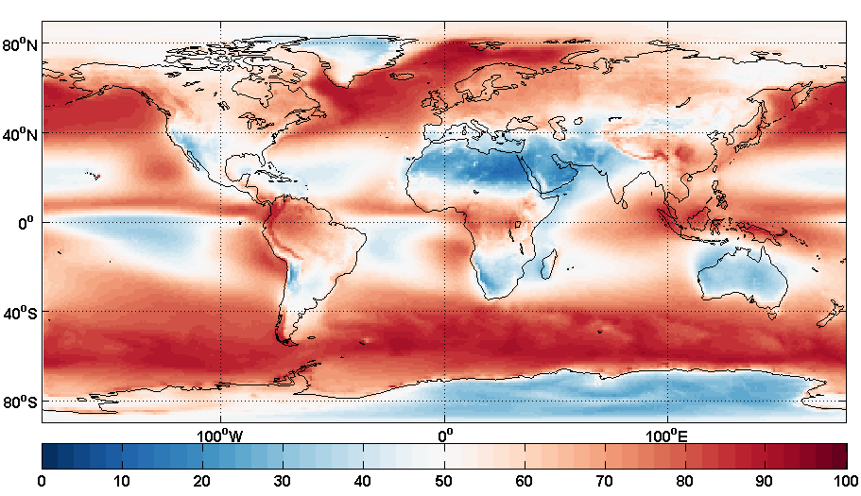
CrIS-ABI Inter-Sensor Bias LTM: Remaining Issues In Existing SNO Method
Original SNO sample population is limited.
The SNO event is selected based on the ABI measurements matching the CrIS measurements around the nadir area.
QC criteria are arbitrary when dealing with chaotic samples that might be relevant to sensor calibration anomalies or related to complicate surface conditions.
Potential impacts:
Loss of valuable cases in chaotic scenes
Reducing sensitivity to outliers caused by instrument anomalies or algorithm flaws
J01/CrIS vs G16/ABI
J01/CrIS vs G17/ABI
G17
G16
https://gcos.wmo.int/en/essential-climate-variables/clouds

Slide 6
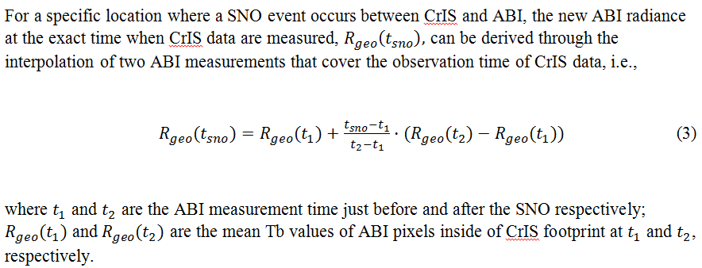
An Improved “SNO” Method: Temporal Interpolation
Quality controls:
CrIS data must be ±5-min around the SNO moment, considering the 10-min refreshing rate of ABI full-disk radiance data
Satellite zenith angle (sza) factor f(=abs(1-cos(sza_leo)/cos(sza_geo))) <0.02
CrIS FOR 12~19 are selected

Slide 7
Application to SNPP/NOAA-20 CrIS and GOES-16/17 ABI
Data Sources
J01 CrIS vs G16 ABI: 2018-06-01 ~ 2021-12-31
J01 CrIS vs G17 ABI: 2019-04-11 ~ 2021-12-31
NPP CrIS vs G16 ABI: 2018-06-01 ~ 2021-12-31
NPP CrIS vs G17 ABI: 2019-04-11 ~ 2021-12-31
Analyzing LT Uncertainty Features of CrIS and ABI biases:
LT stability analysis of CrIS-ABI biases and standard deviations
Existing SNO method
Improved SNO method
Scene temperature dependency analysis
Capturing calibration anomalies

Slide 8
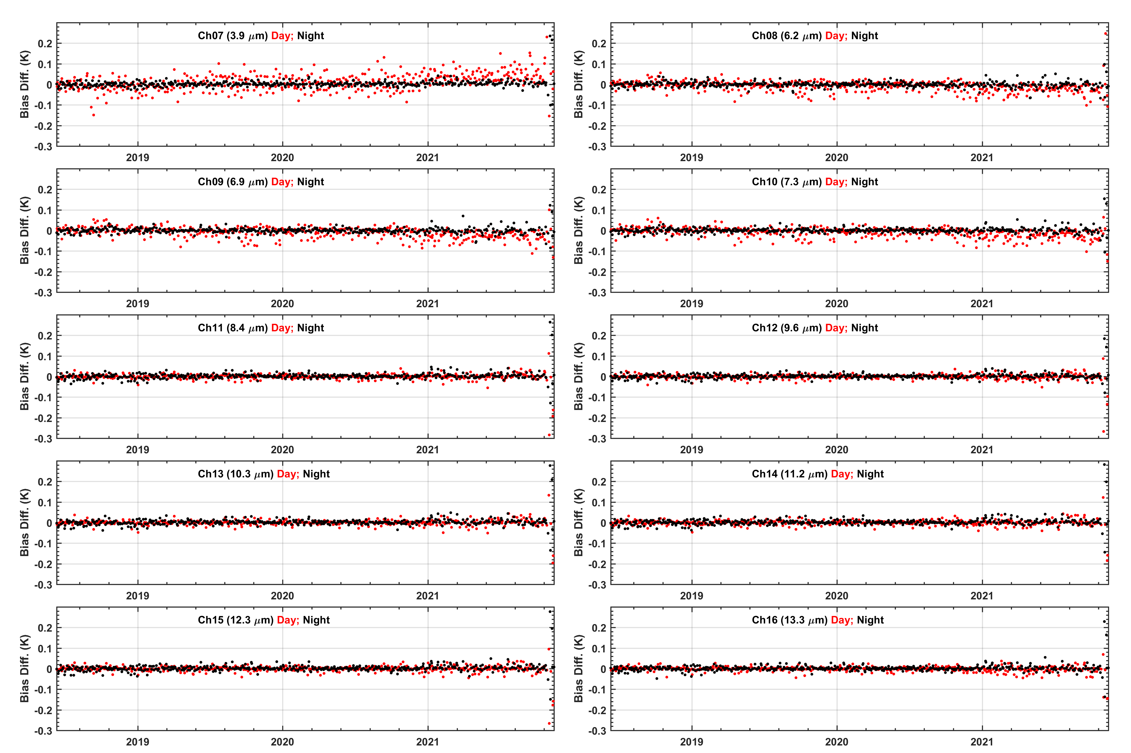
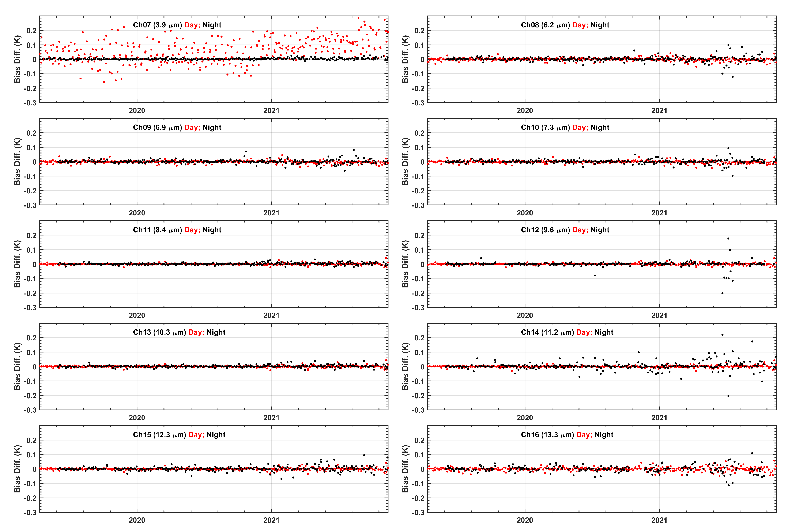
LT Trend of CrIS-ABI Radiance Biases:
Daily Mean between Current - Improved SNO Methods
BT Bias Diff.: nearest time - temporal interpolation
(left) J01/CrIS vs G16/ABI (right) J01/CrIS vs G17/ABI
The new method has excellent consistency with the old method in term of BT bias monitoring

Slide 9
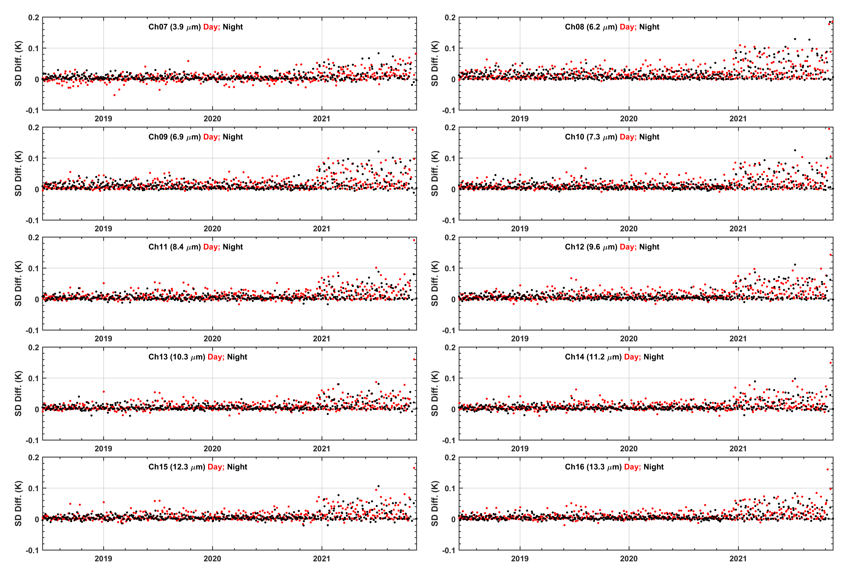
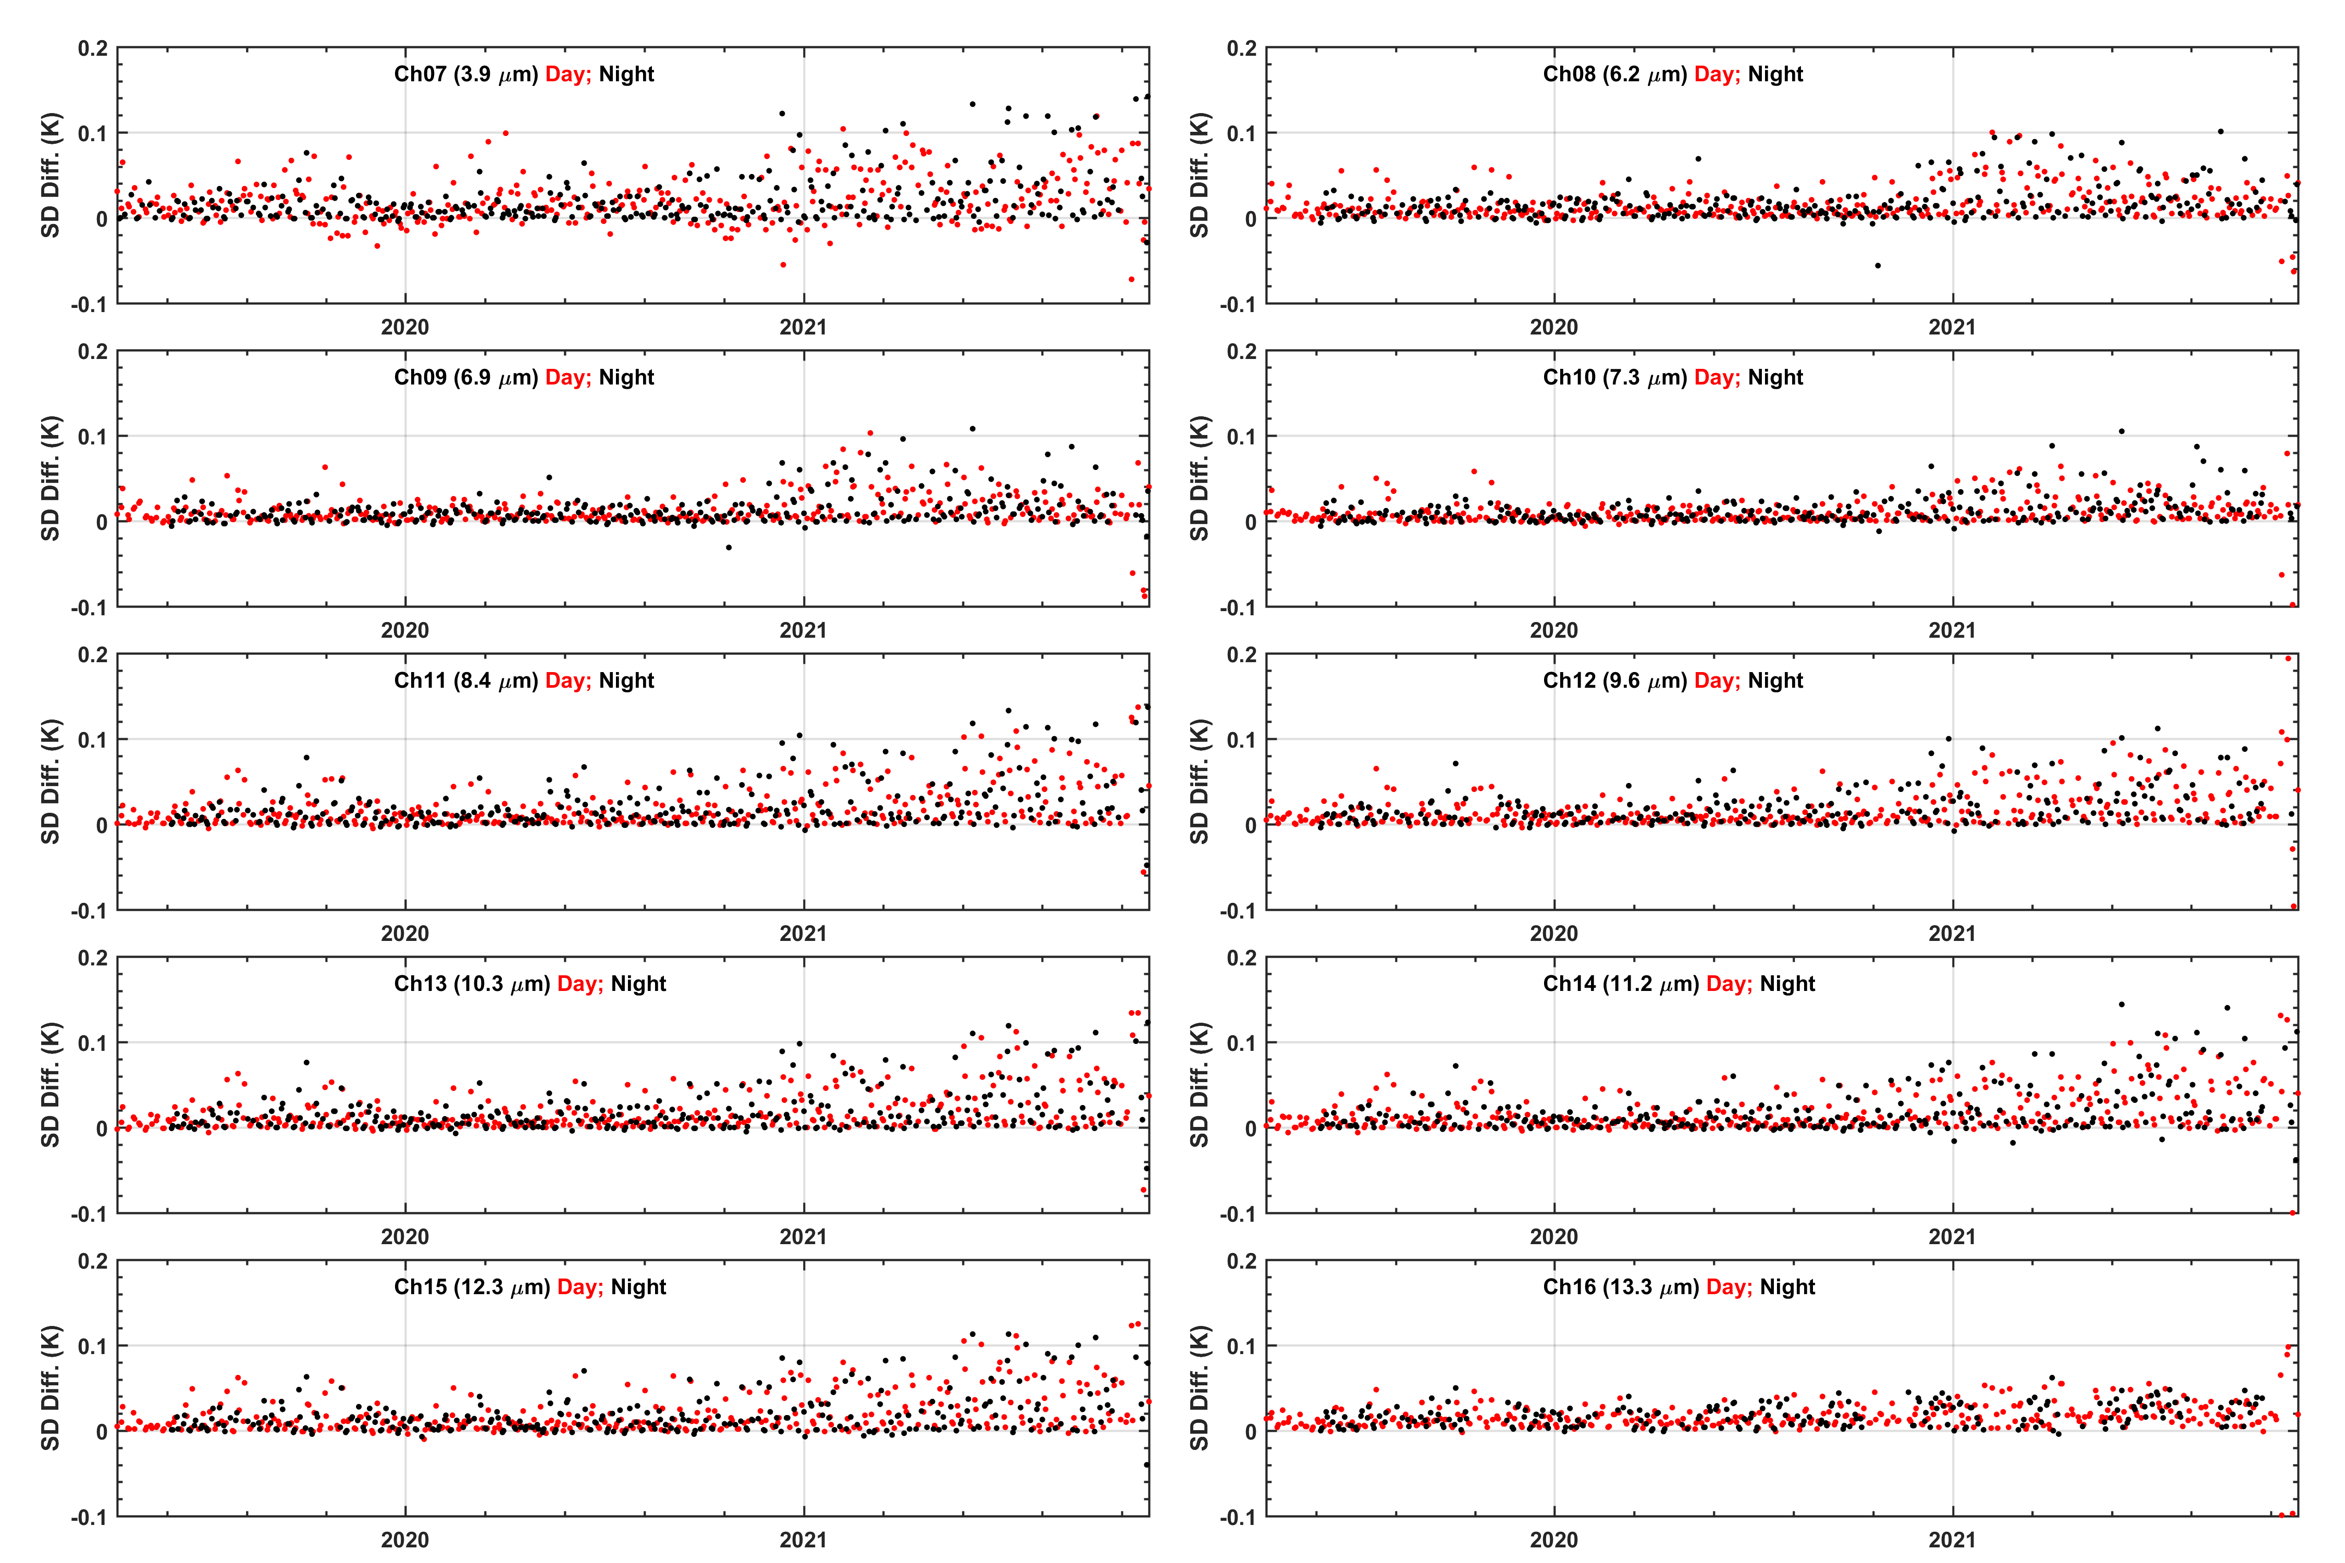
LT Trend of Standard Deviations for CrIS-ABI Radiance Biases:
Daily Mean between Current - Improved SNO Methods
StdDev. Diff.: nearest time - temporal interpolation
(left) J01/CrIS vs G16/ABI (right) J01/CrIS vs G17/ABI
Interesting feature: a gradually increased std. difference for all channels using nearest time method

Slide 10
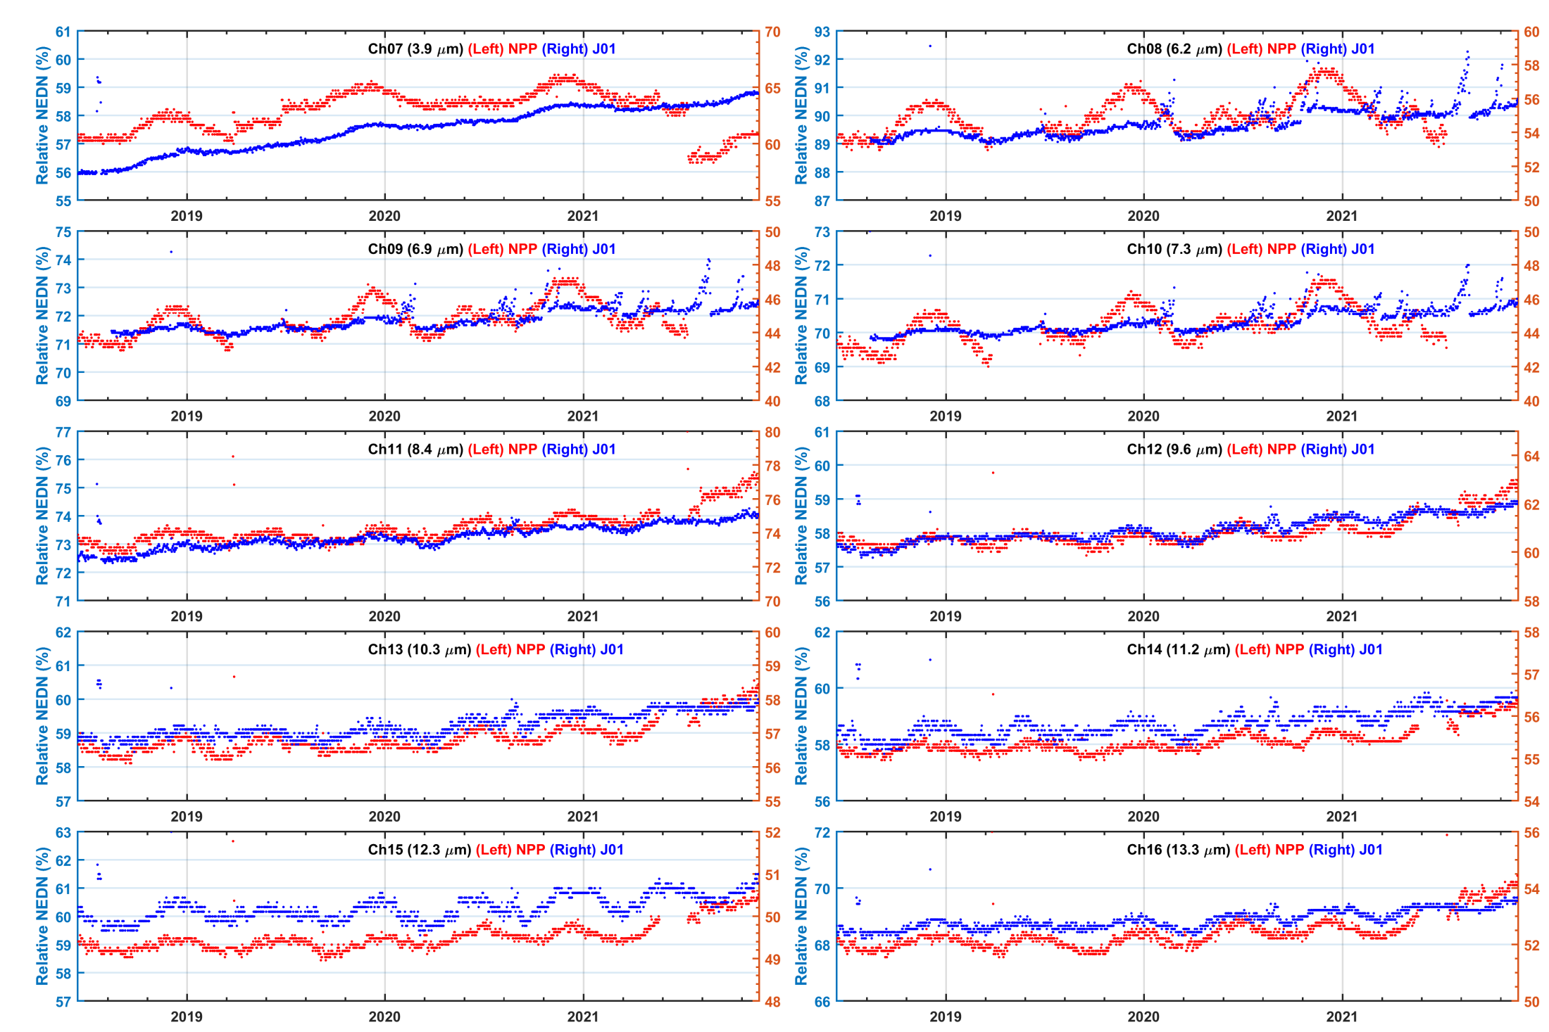
Root Cause of Increased Standard Deviation Differences:
NOAA-20 CrIS Sensor Noise Degradation?
Orbital-averaged NEDN, relative to the specification
Possible root cause: the CrIS noise has an increasing trend. Applying the temporal interpolation method reduced the ABI sensor noise, therefore amplifying the impact of CrIS noise trend in SNO BT StdDev time series

Slide 11
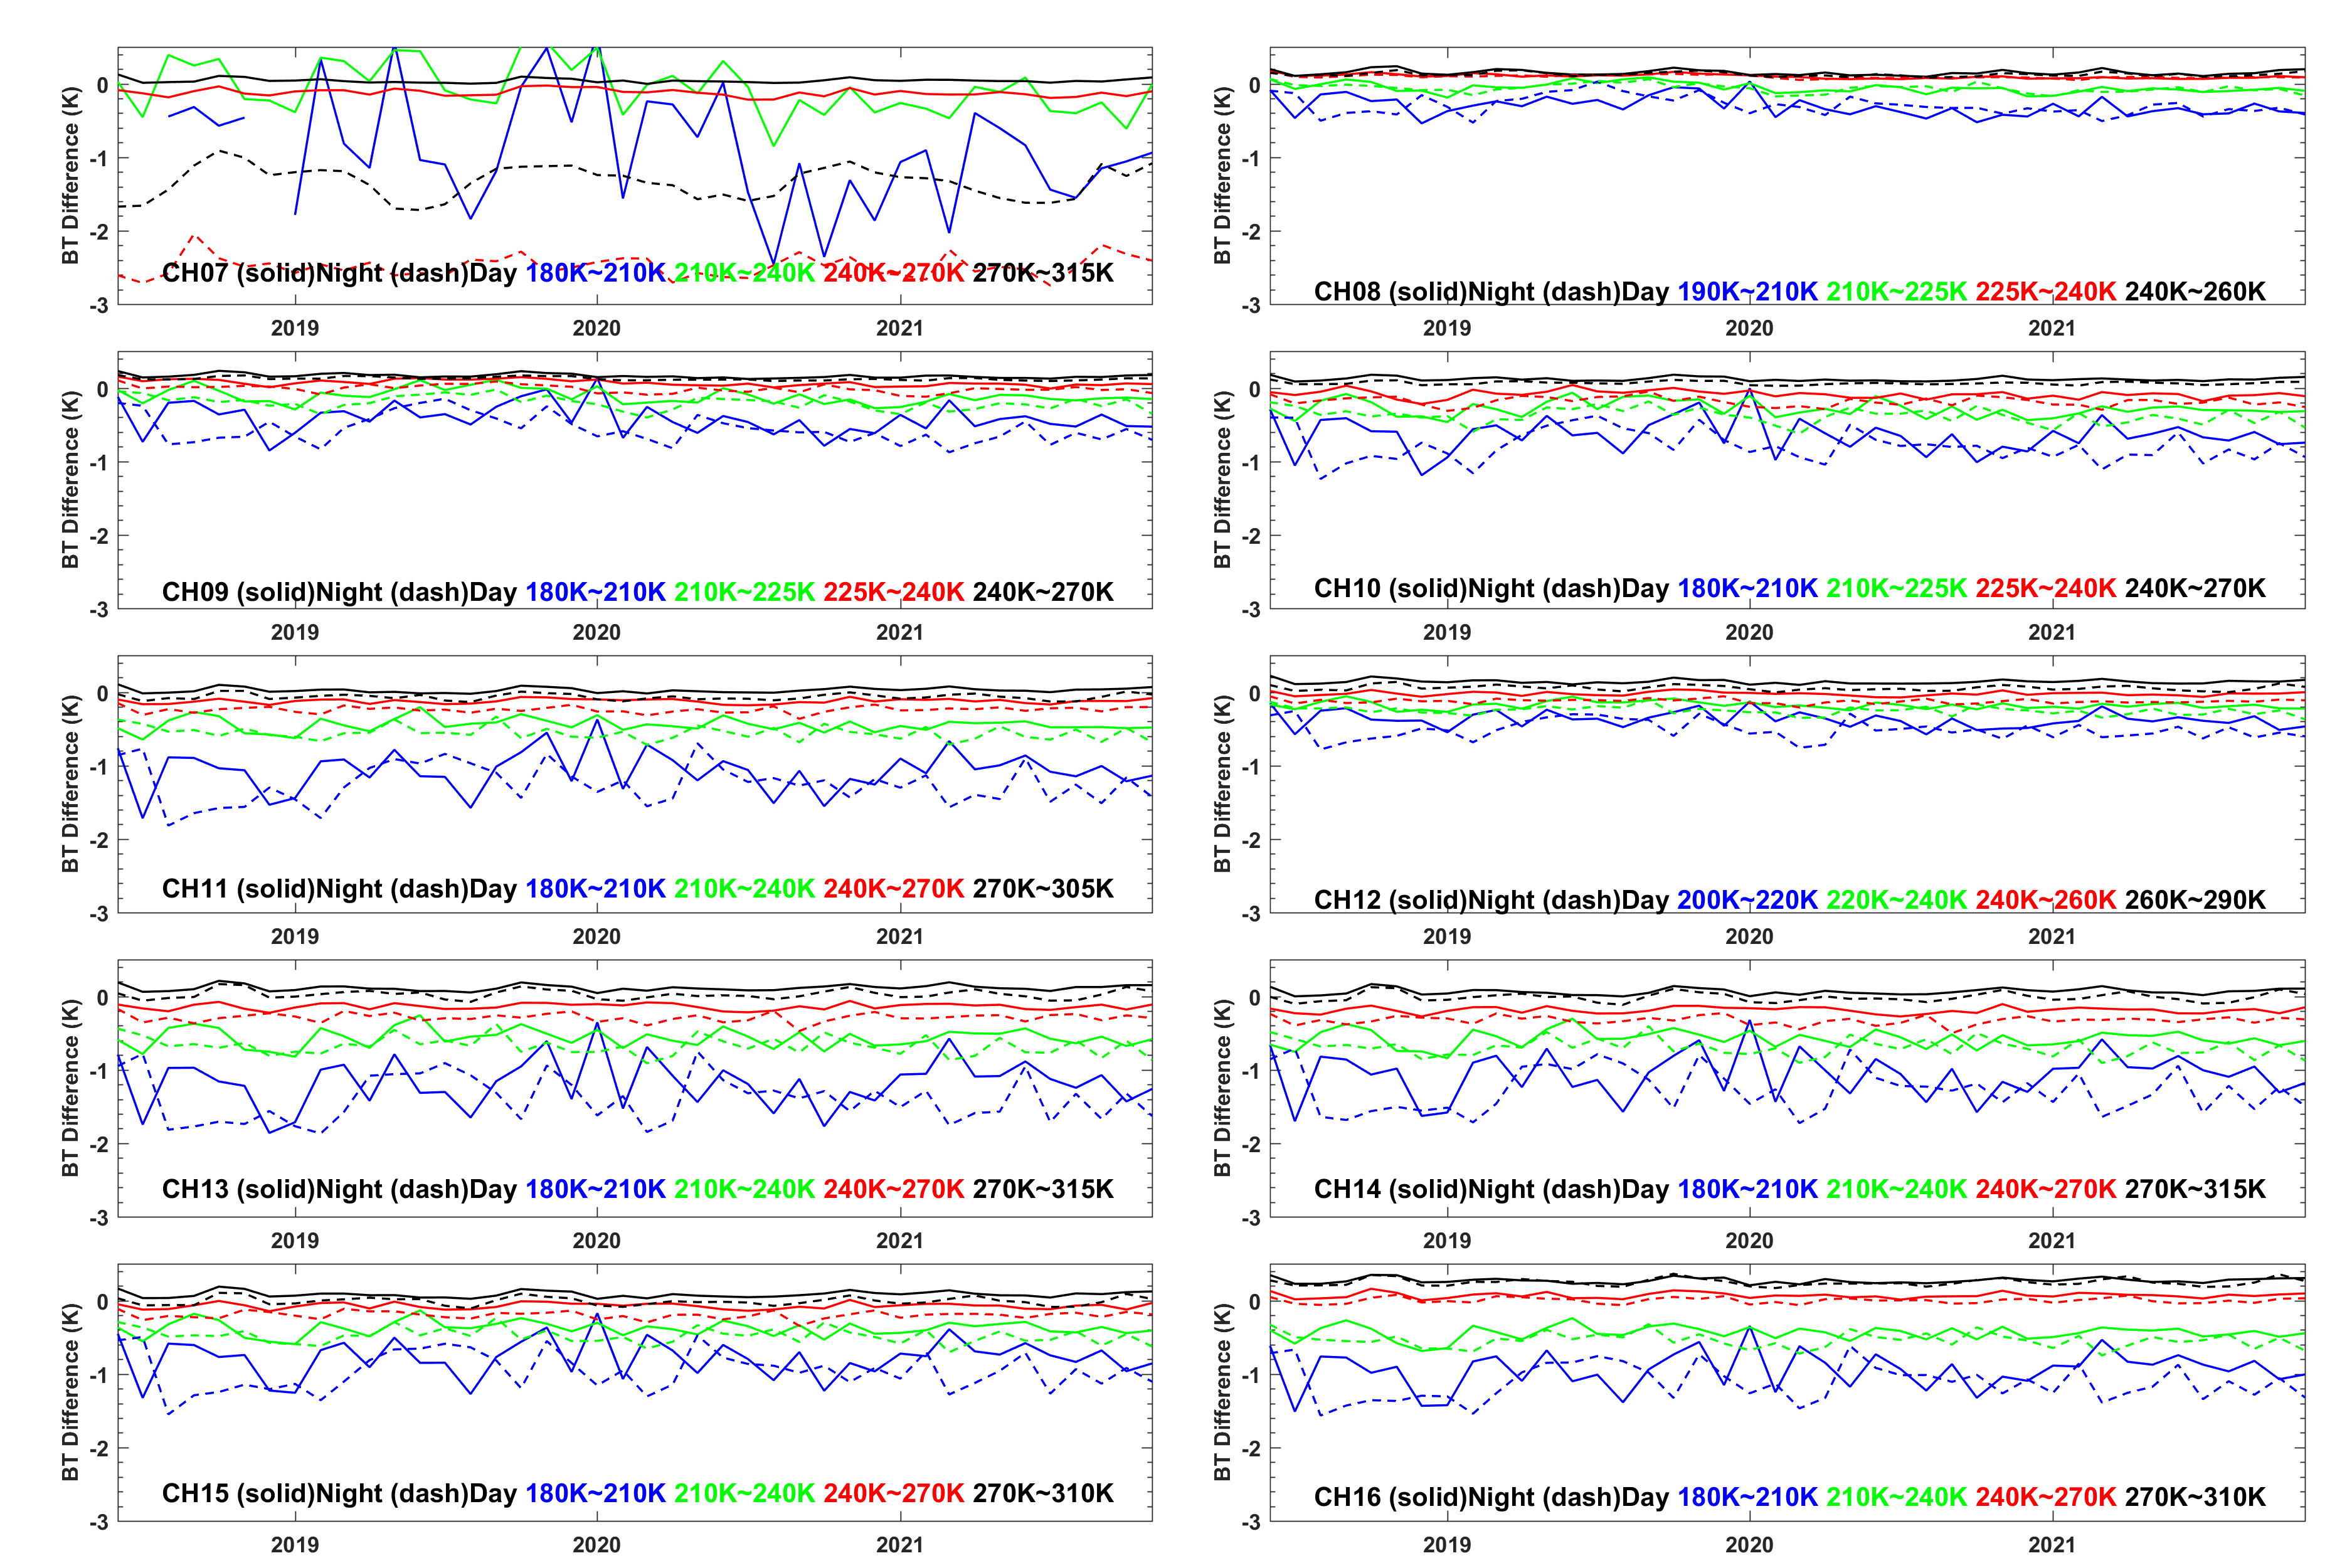
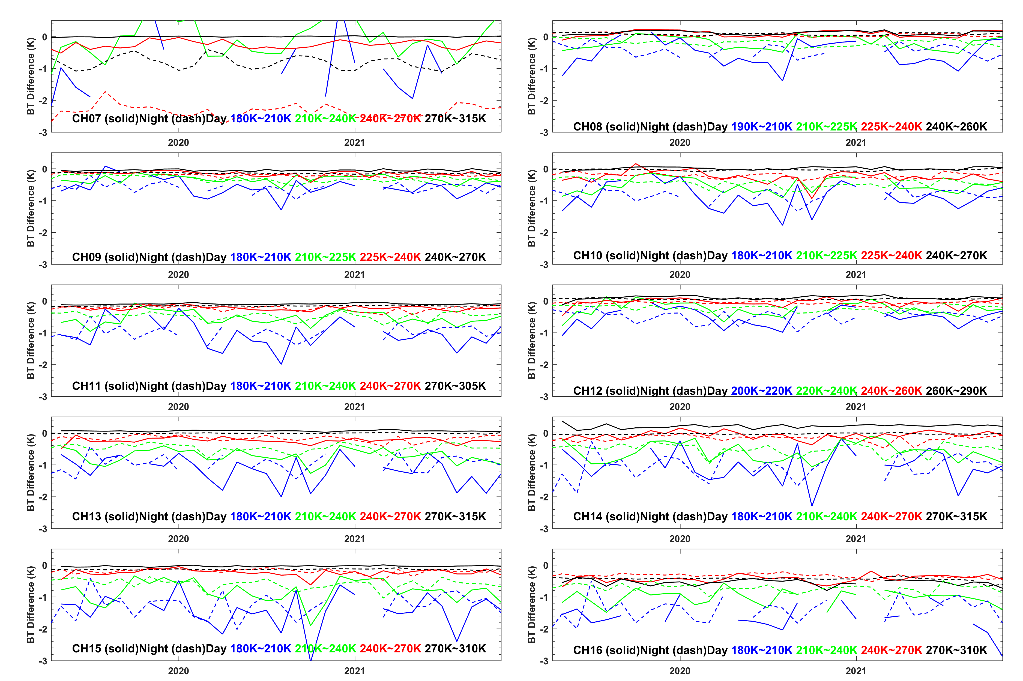
Scene Temperature Dependency Analysis:
Root Cause to Large Inter-Sensor Biases
Monthly Aggregated BT Bias Difference Time Series
(left) J01/CrIS vs G16/ABI (right) J01/CrIS vs G17/ABI
Cold scene temperature bias is one of the major root causes on the BT bias time series plots

Slide 12
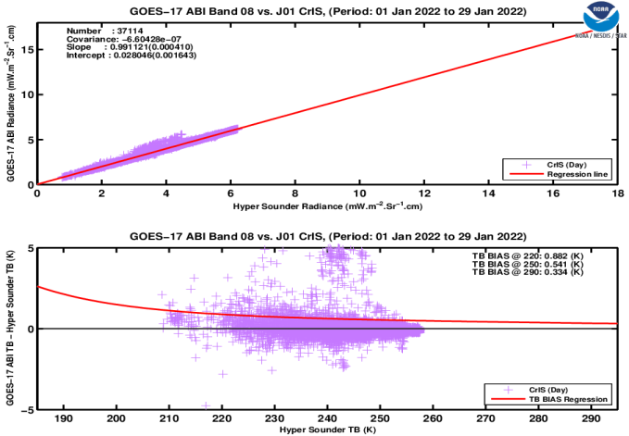
Detection of Sensor Anomaly (G17 ABI Ch08 anomaly between 01/22 and 01/31, 2022)
“G17 B08 did experience an under-performance due to bad detector #256 and it caused anomalous behaviors and striping during 01/22 - 01/31. This issue was resolved with the BDS update on 01/31, 2022 and CWG is working on reporting in our CEL”, Courtesy to Hye Lim Yoo, hyelim.yoo@noaa.gov

Slide 13
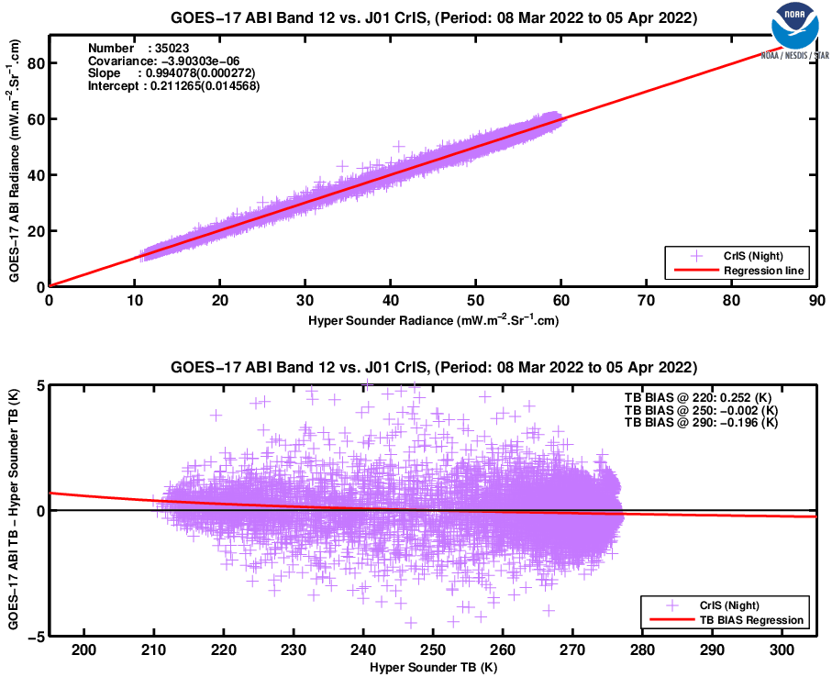
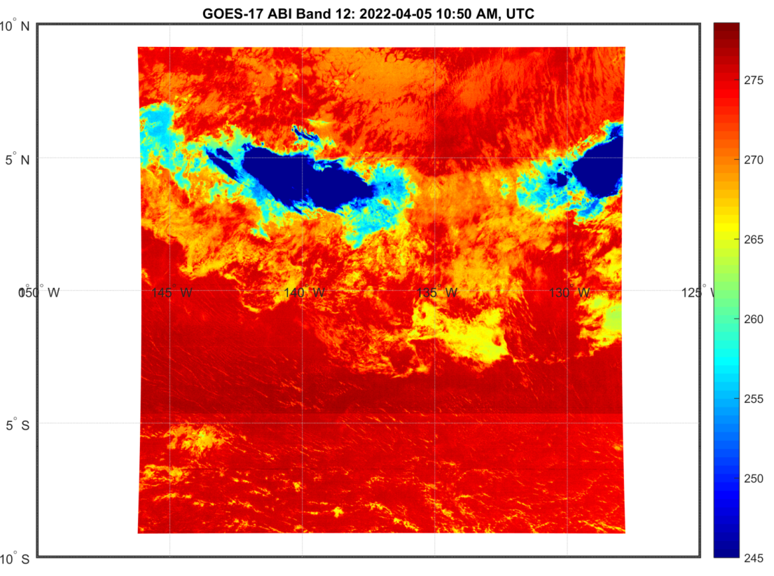
Sensor Calibration Update Detection (G17 ABI Ch12 Calibration Update on 04/05, 2022)
“The boundary you observed is due to the activation of Predictive Calibration (pCal) at 1055 UCTC on 4/5 such that the upper half of the FD image did not use pCal and the lower half did”, Courtesy to Fred Wu, xiangqian.wu@noaa.gov

Slide 14
Conclusions and Summary
A new LEO/GEO SNO method is presented, using the temporal interpolation around the SNO moment to generate a ABI dataset instead of using the nearest measurements
Pros:
Preserving as many valuable samples as possible
Reducing the uncertainty of the inter-sensor biases
Cons:
Requiring continuous ABI full disk measurements with good quality
The improved SNO method has been applied to operational LTM of CrIS and ABI inter-sensor biases via the STAR ICVS LTM system to support the SNPP and JPSS Cal/Val missions
Providing a new LTM performance monitoring method for the CrIS-ABI inter-sensor comparison with good agreement with current method
Assisting in capturing the CrIS sensor noise degradation by using the differences of the bias standard deviations between the two SNO methods.
Better understanding the root cause of large inter-sensor biases: most of the outlies in BT bias time series are caused by the scene temperature dependency feature of ABI sensors.
Demonstrating its value in detecting sensor (calibration) anomaly or update: more effectively capturing sensor calibration anomaly or calibration table update since the ‘unexpected’ (e.g., outliers) SNO pairs of the data sets are not removed.
Recommendations for operational CrIS-ABI SNO instrument performance monitoring:
Separating warm and cold scenes in monitoring CrIS and ABI inter-sensor biases
Keeping scene temperature dependency scattering plots for anomaly detection

Slide 15
Disclaimer
The presentation contents are solely the opinions of the authors and do not constitute a statement of policy, decision, or position on behalf of NOAA or the U. S. Government.
Acknowledgement
The authors would like to thank Likun Wang, Fred Wu, Fangfang Yu, and many other colleagues for valuable discussions and inspirations

Slide 16
Backup slides

Slide 17
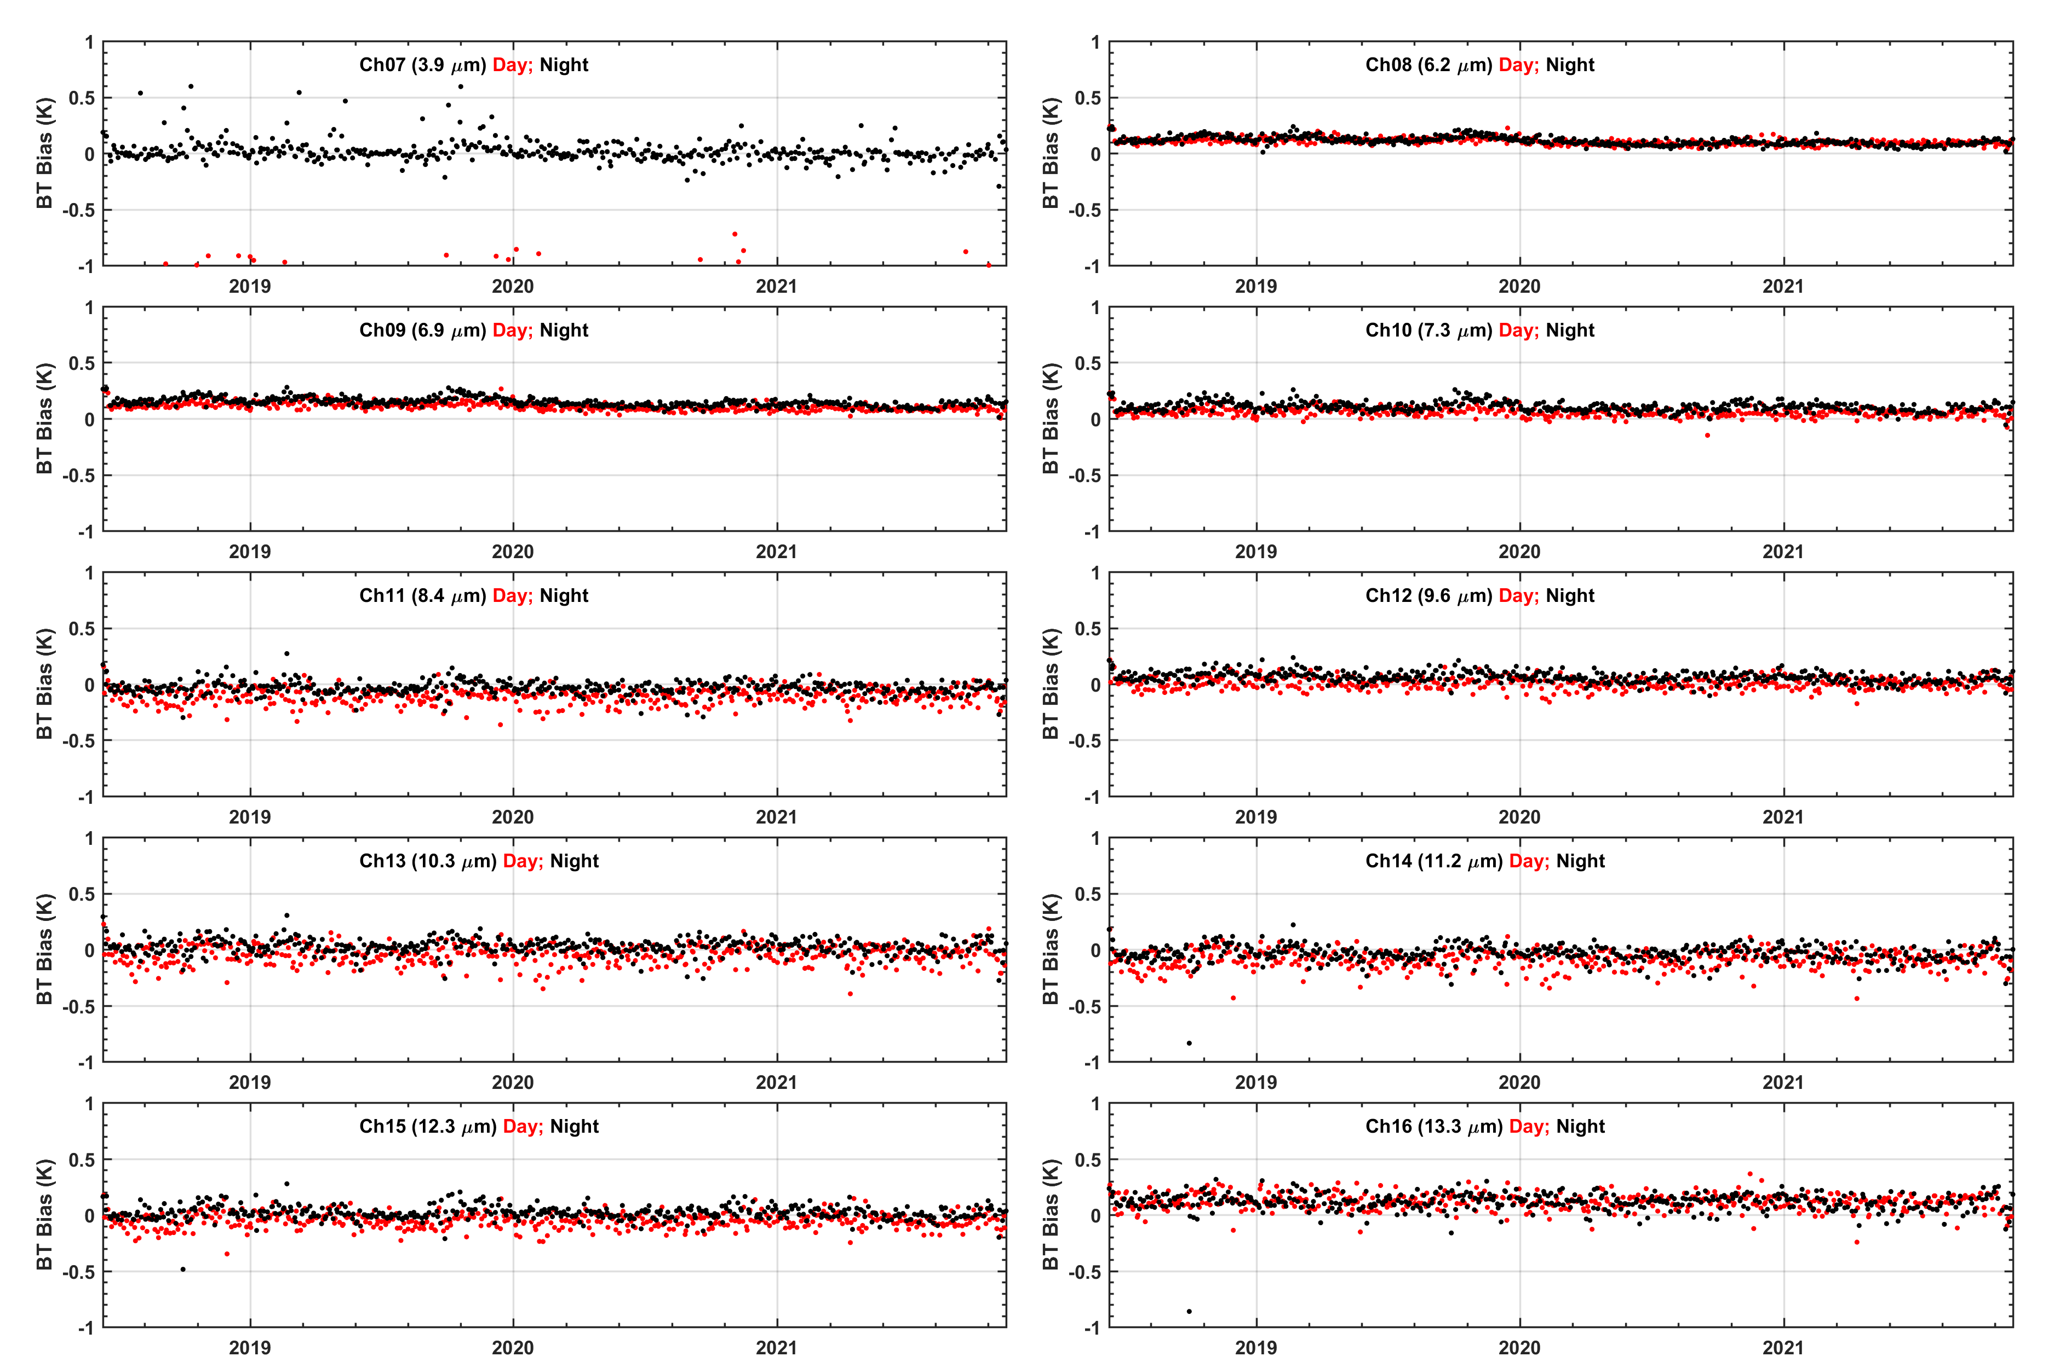
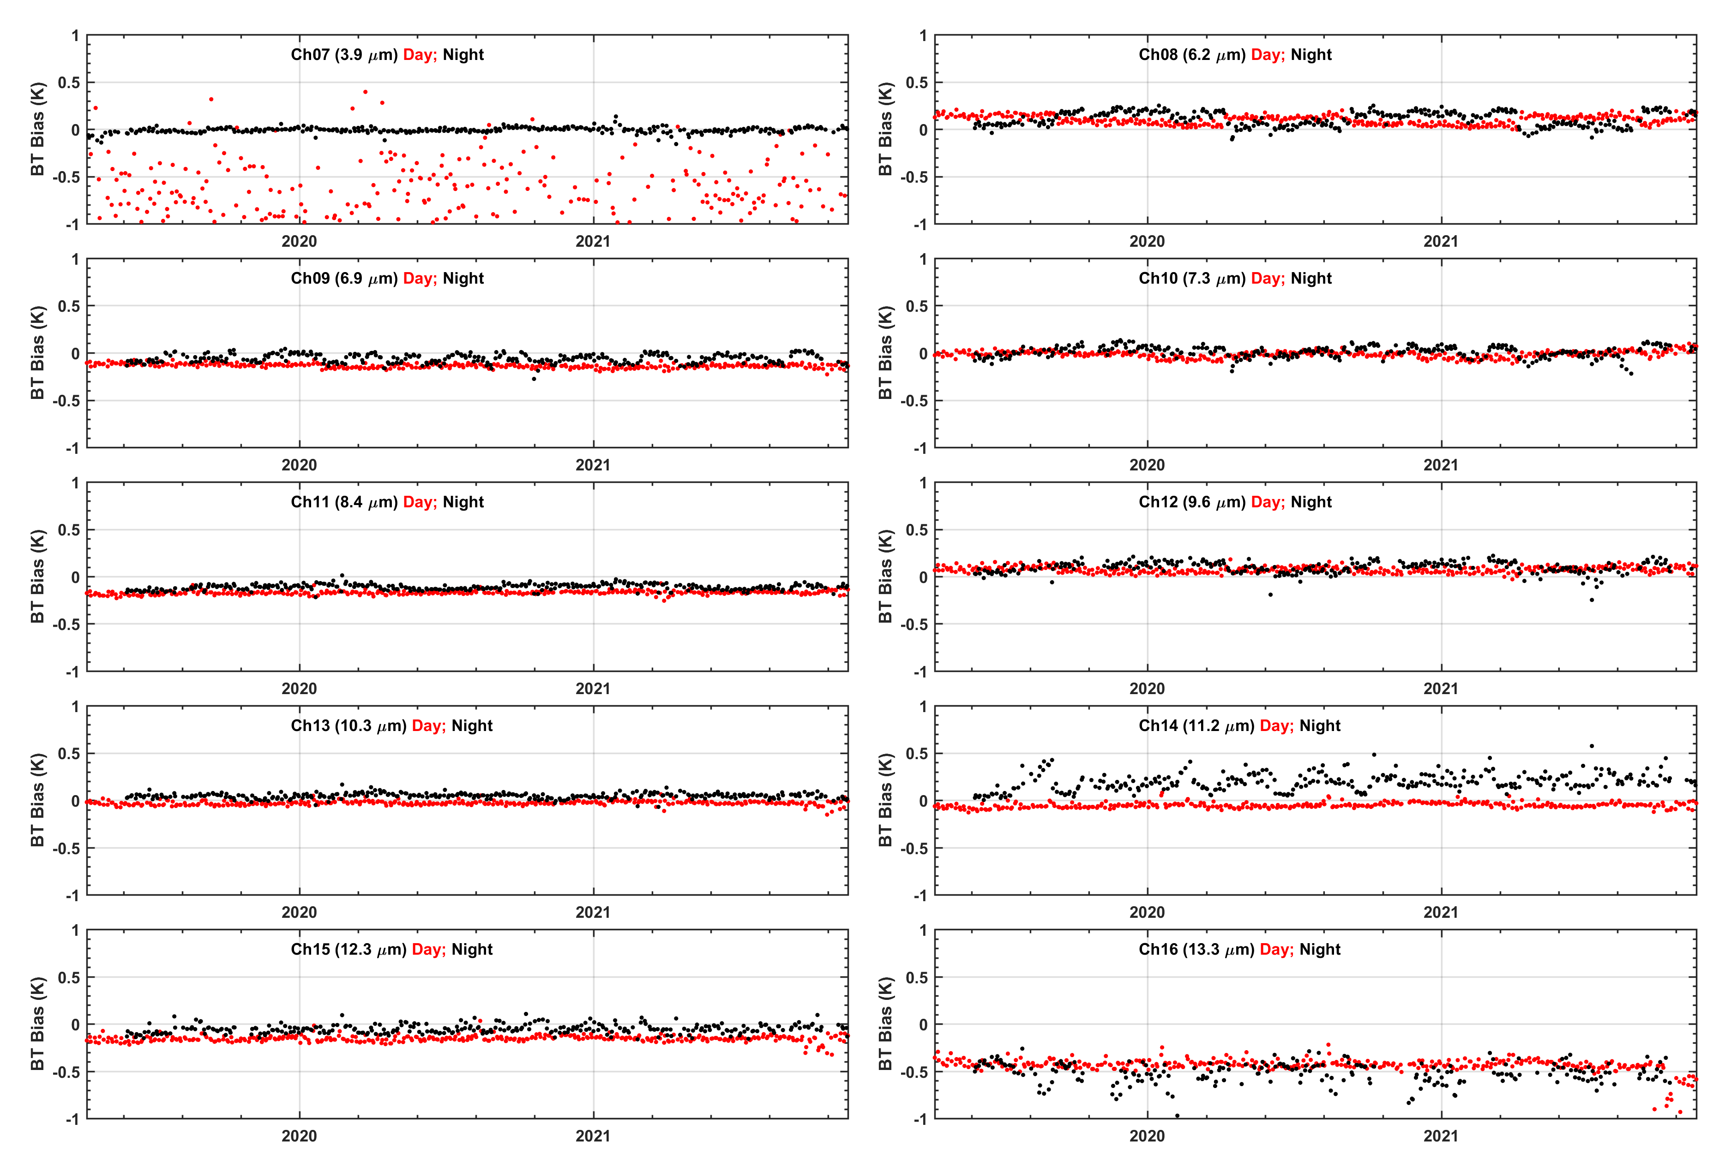
Time Series of CrIS – ABI BT Biases
J01 CrIS vs G16 ABI
Temporal interpolation
J01 CrIS vs G16 ABI
Nearest time
J01 CrIS vs G17 ABI
Temporal interpolation
J01 CrIS vs G17 ABI
Nearest time

Slide 18
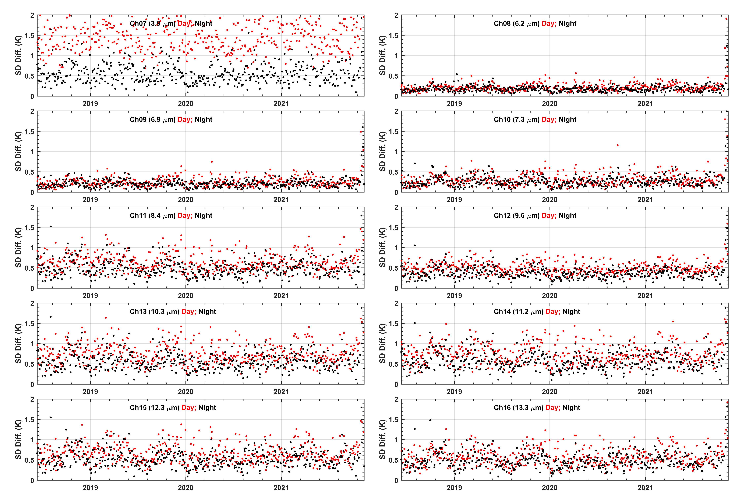
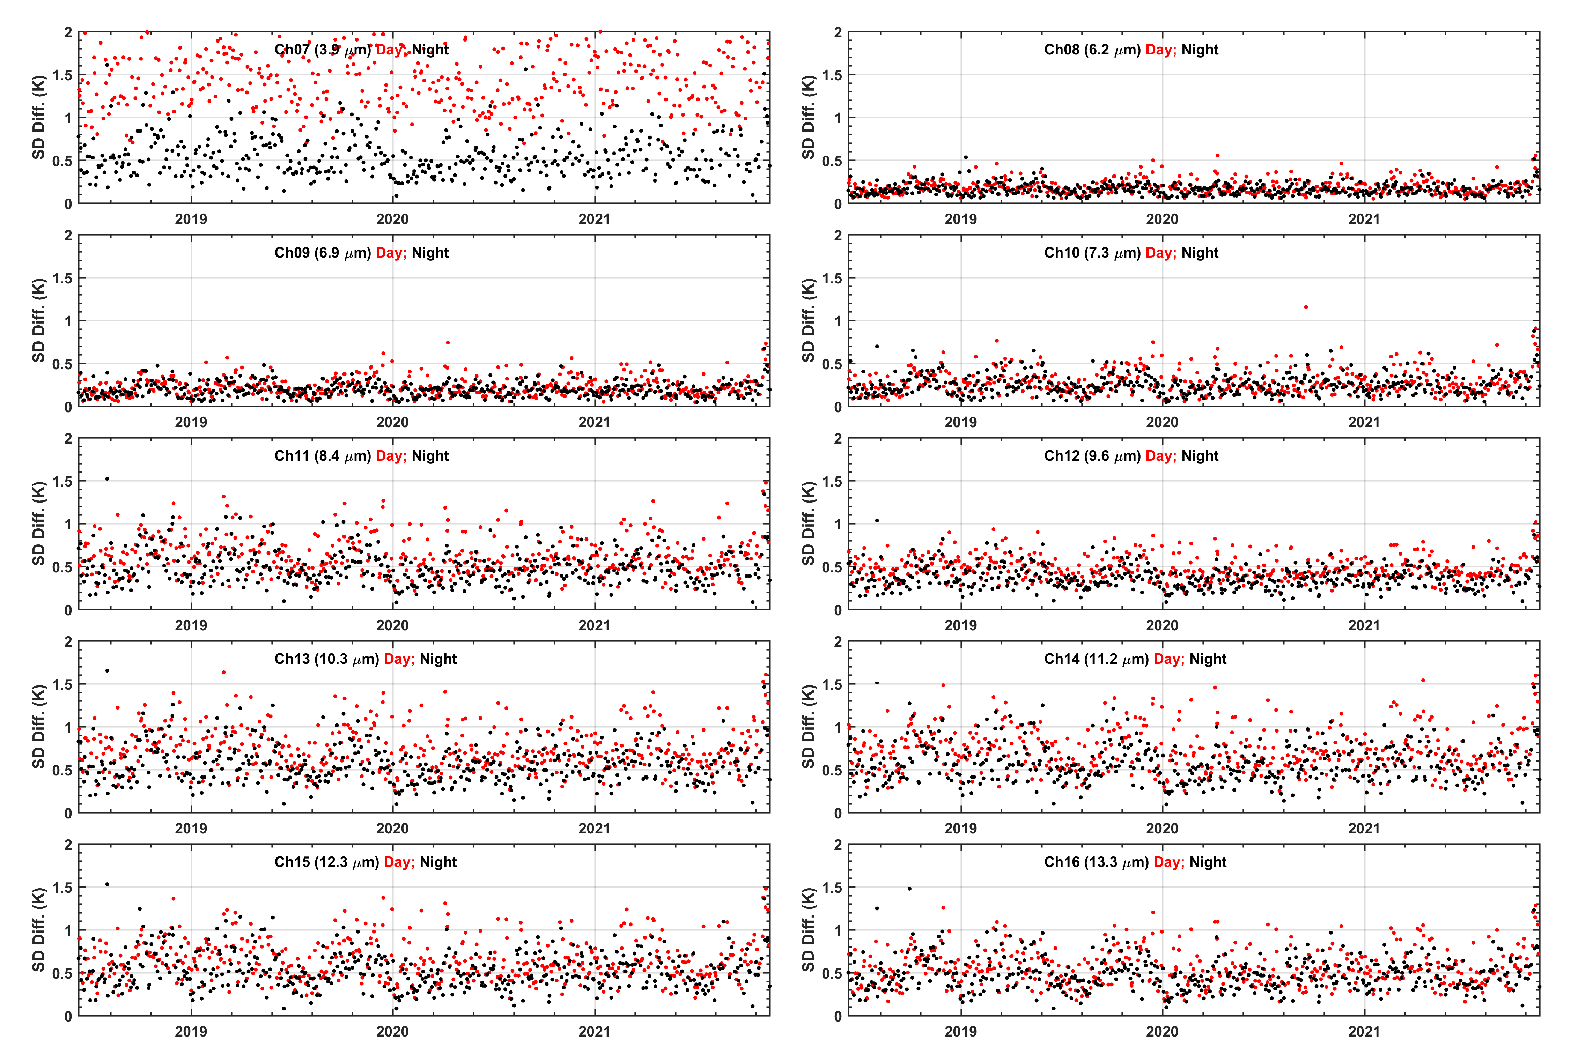
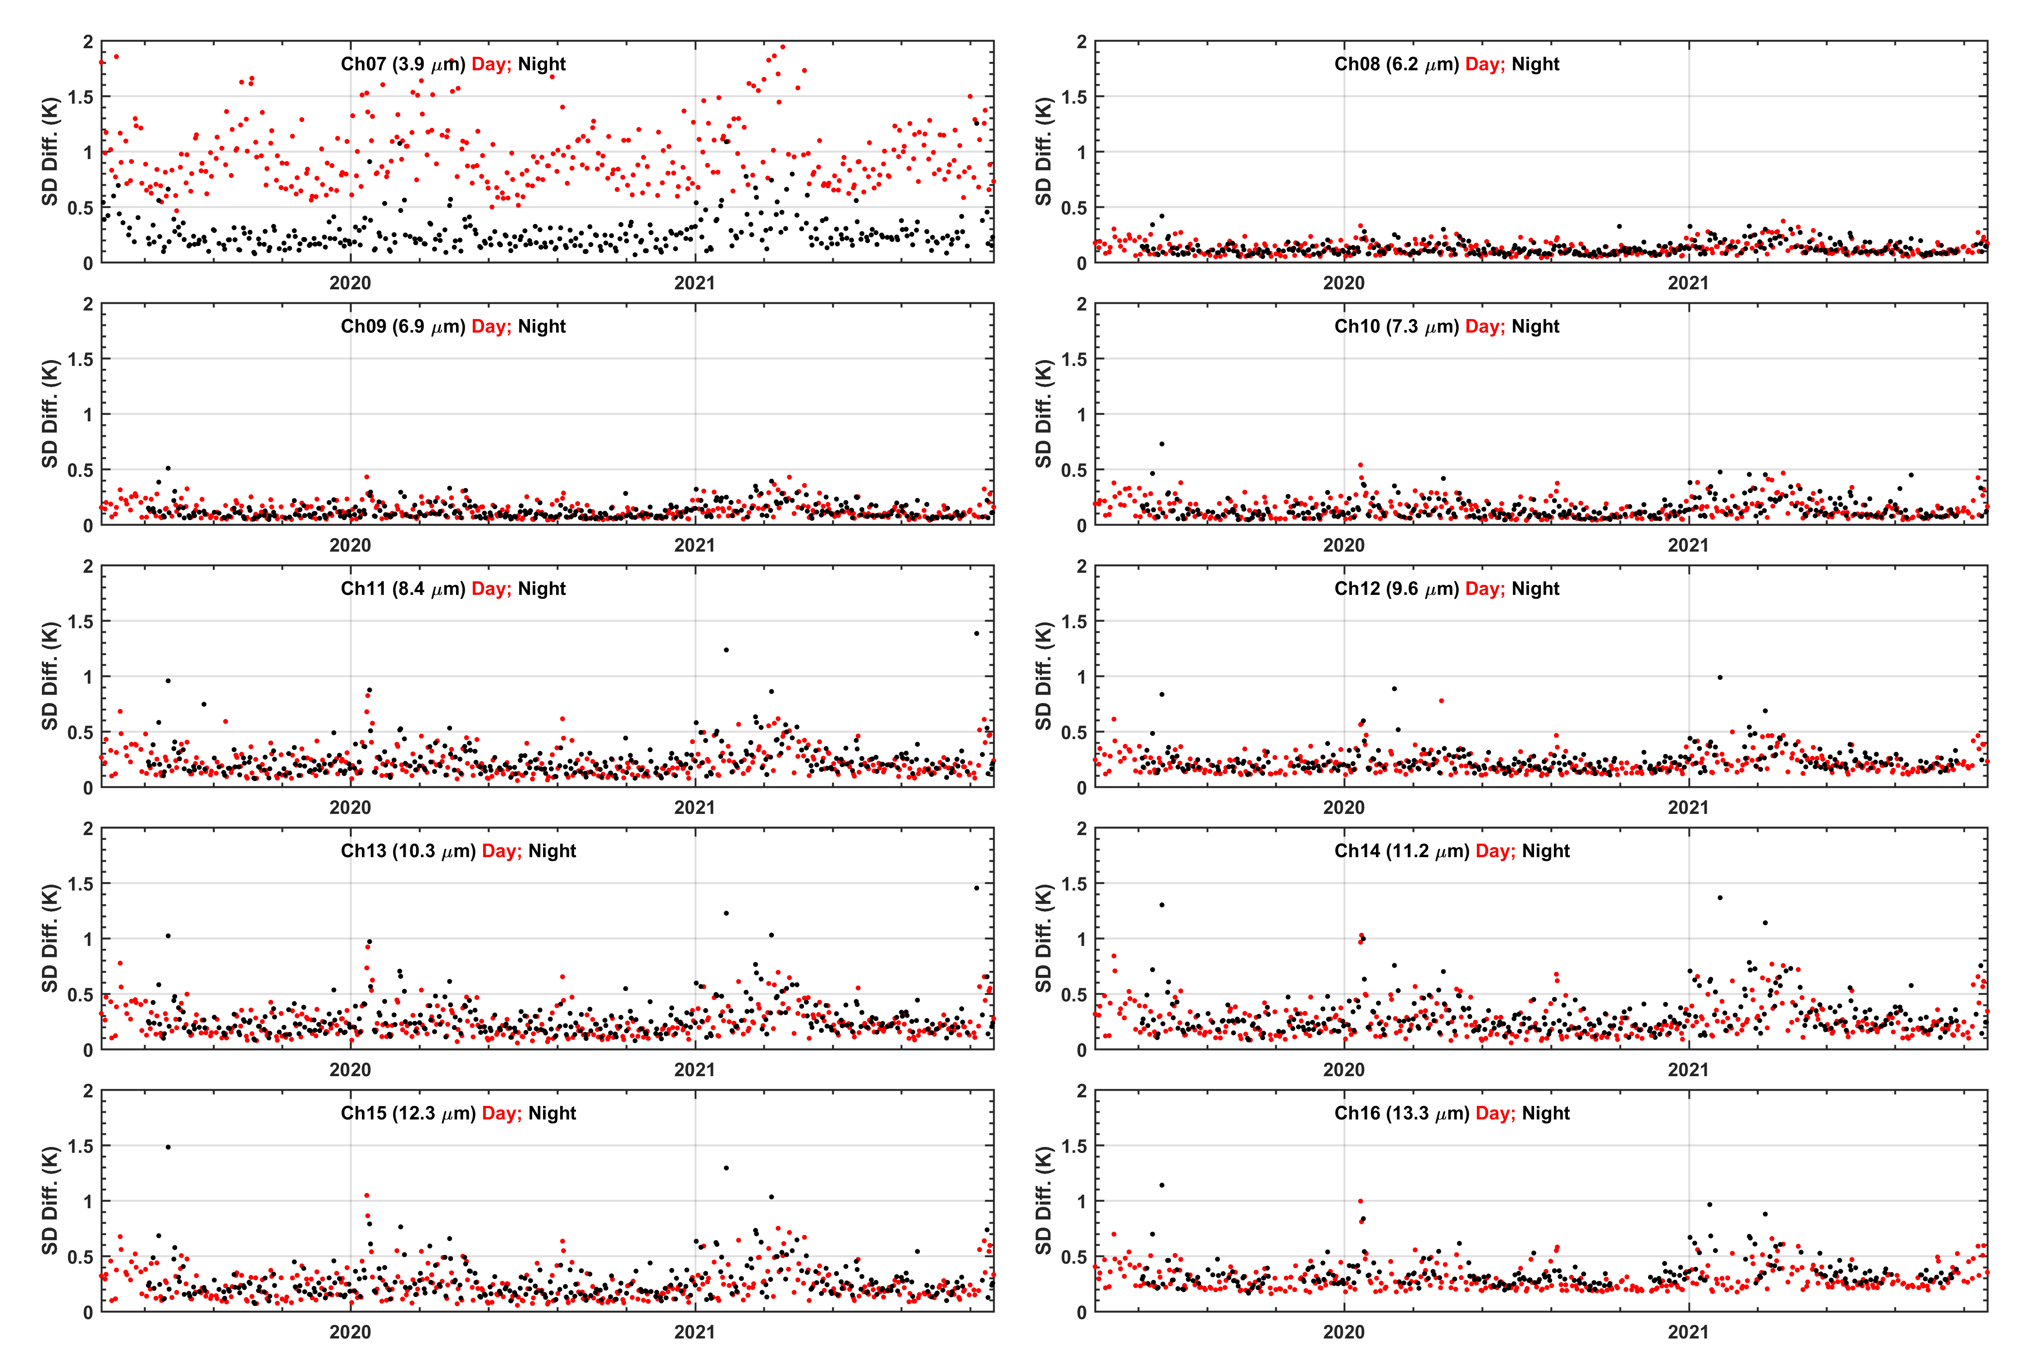
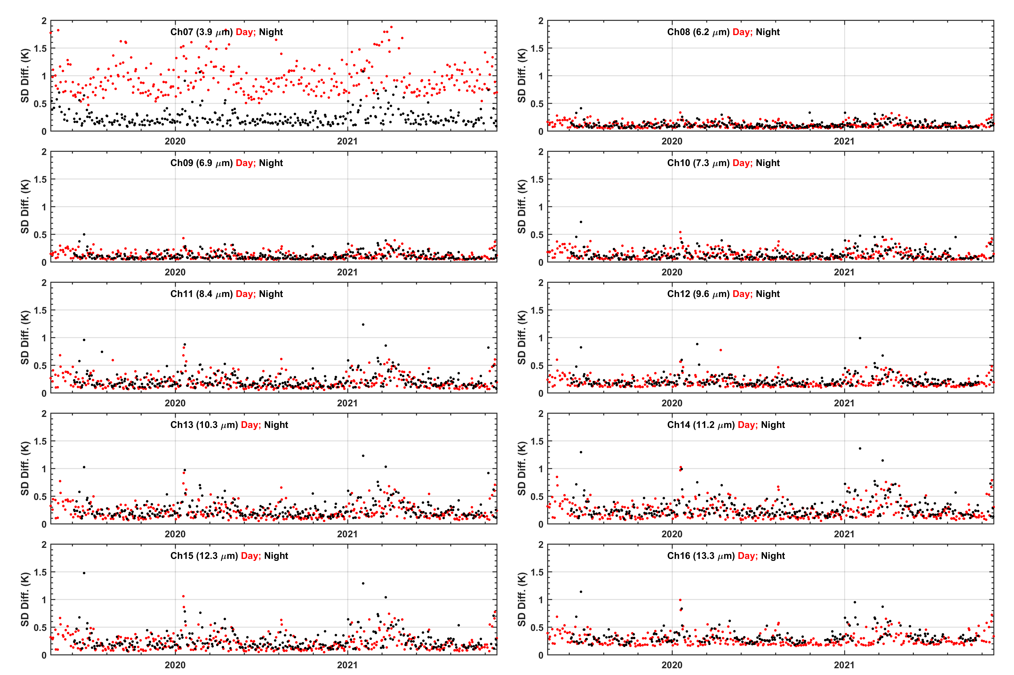
Time Series of CrIS – ABI BT StdDev
J01 CrIS vs G16 ABI
Temporal interpolation
J01 CrIS vs G16 ABI
Nearest time
J01 CrIS vs G17 ABI
Temporal interpolation
J01 CrIS vs G17 ABI
Nearest time

