Slide 1
Calibration anomalies of INSAT-3D/3DR IR channels during pre and post flip period: A case study
Munn Vinayak Shukla
Pradeep K Thapliyal
Space Applications Centre (ISRO) Ahmedabad

Slide 2
Acknowledgement
Mr. Nitesh Kaushik
Mr. Anurag Pushpkar
GD AOSG/EPSA/SAC
DD EPSA/SAC
Director SAC
GRWG (IR Subgroup)
EUMETCAST for providing IASI data
EUMETSAT for providing various tools to read bufr data
https://mosdac.gov.in
India Meteorological Department (MoES), New Delhi

Slide 3
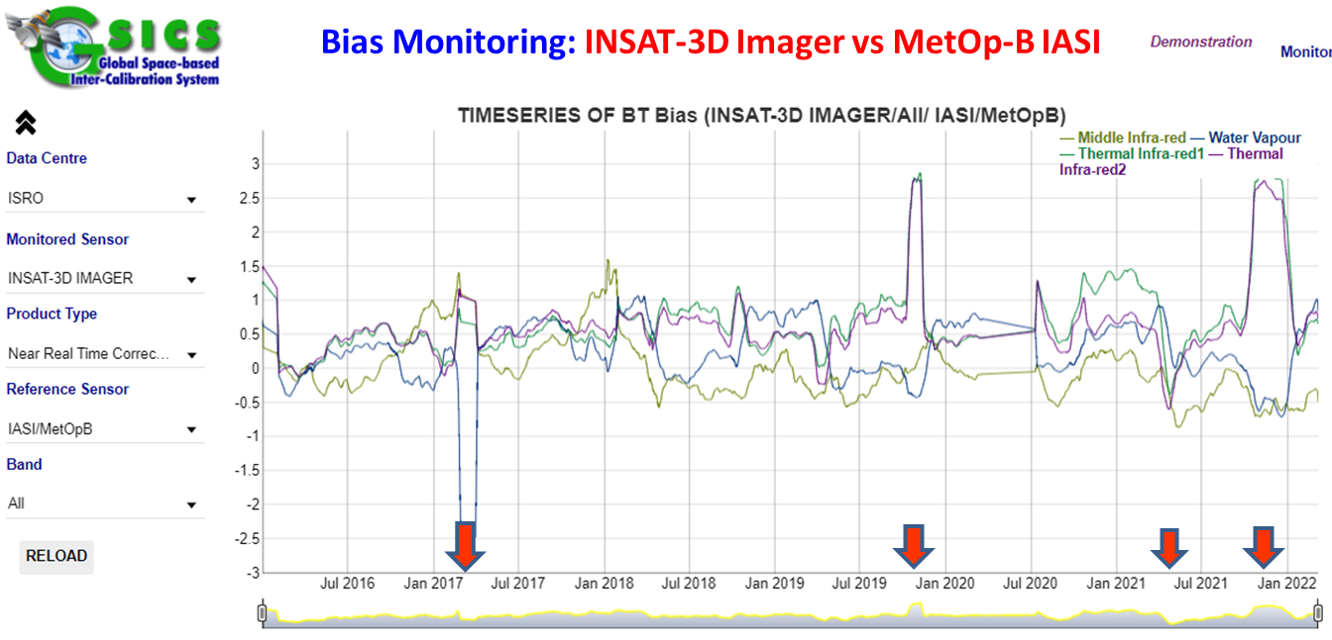
Issues with Products
Calibration anomaly in INSAT-3D/3DR IR Imager during mid-night and satellite Yaw-flip to be further investigated
Action from GRWG-2022 Meeting

Slide 4
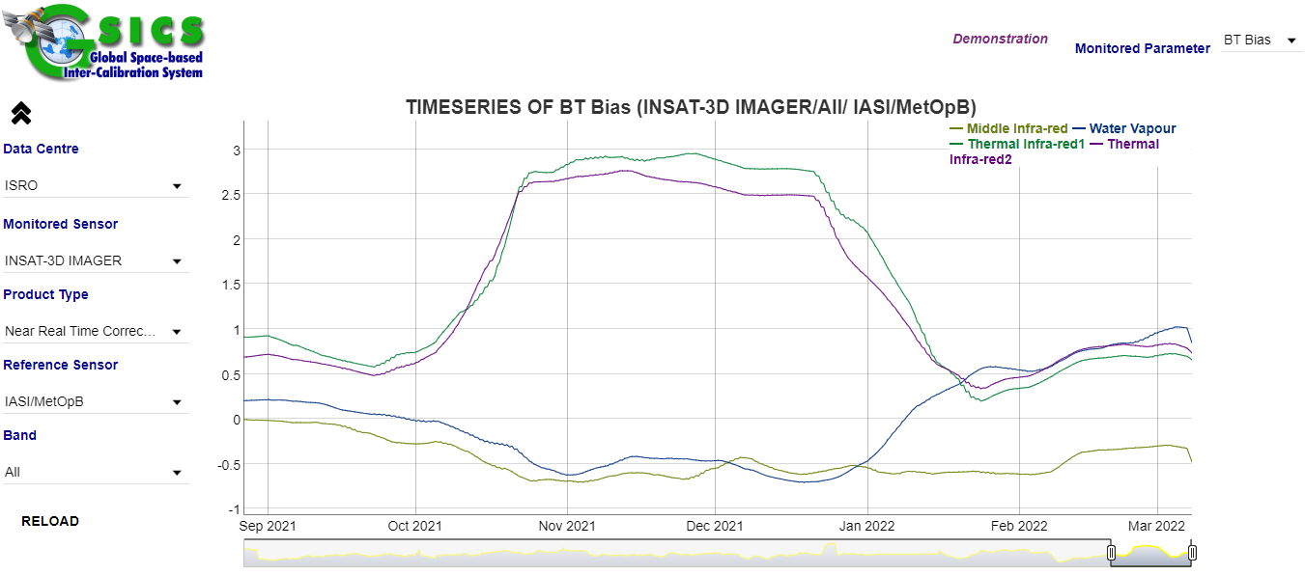

Slide 5
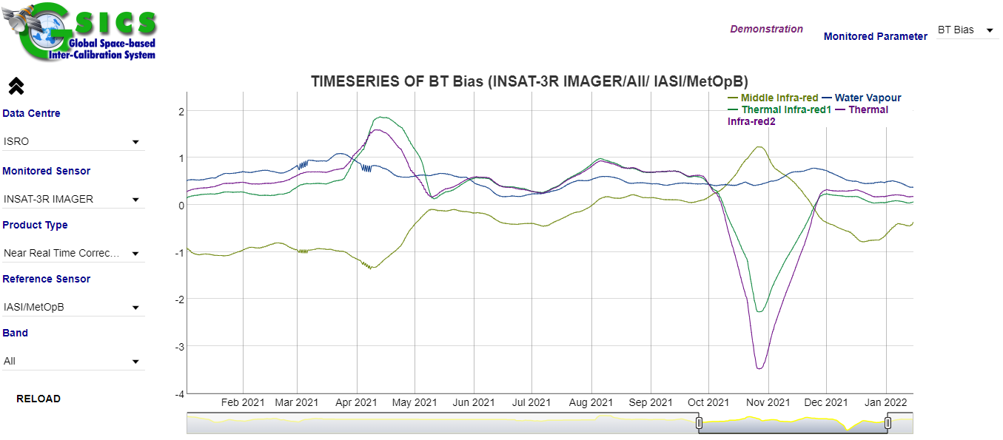

Slide 6
INSAT-3D and INSAT-3DR undergo yaw-flip twice a year
INSAT-3D: 23rd March (between 0530-0800 UTC)
22nd September (between 0530-0800 UTC)
INSAT-3DR: 24rd March (between 0545-0715 UTC)
23nd September (between 0545-0715 UTC)
System behavior changes after each flip
Empirical correction coefficients are derived for each flip duration.
Biases changes drastically if these coefficients are not applied

Slide 7
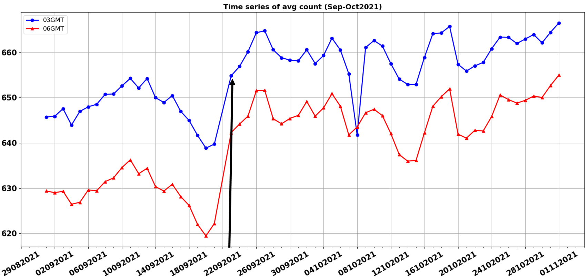
INSAT-3D
Sep-Oct 2021

Slide 8
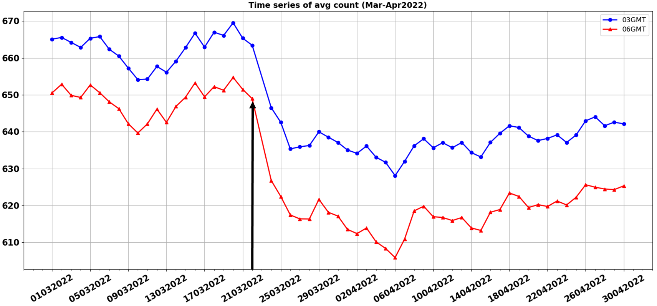
INSAT-3D
Mar-Apr2022

Slide 9
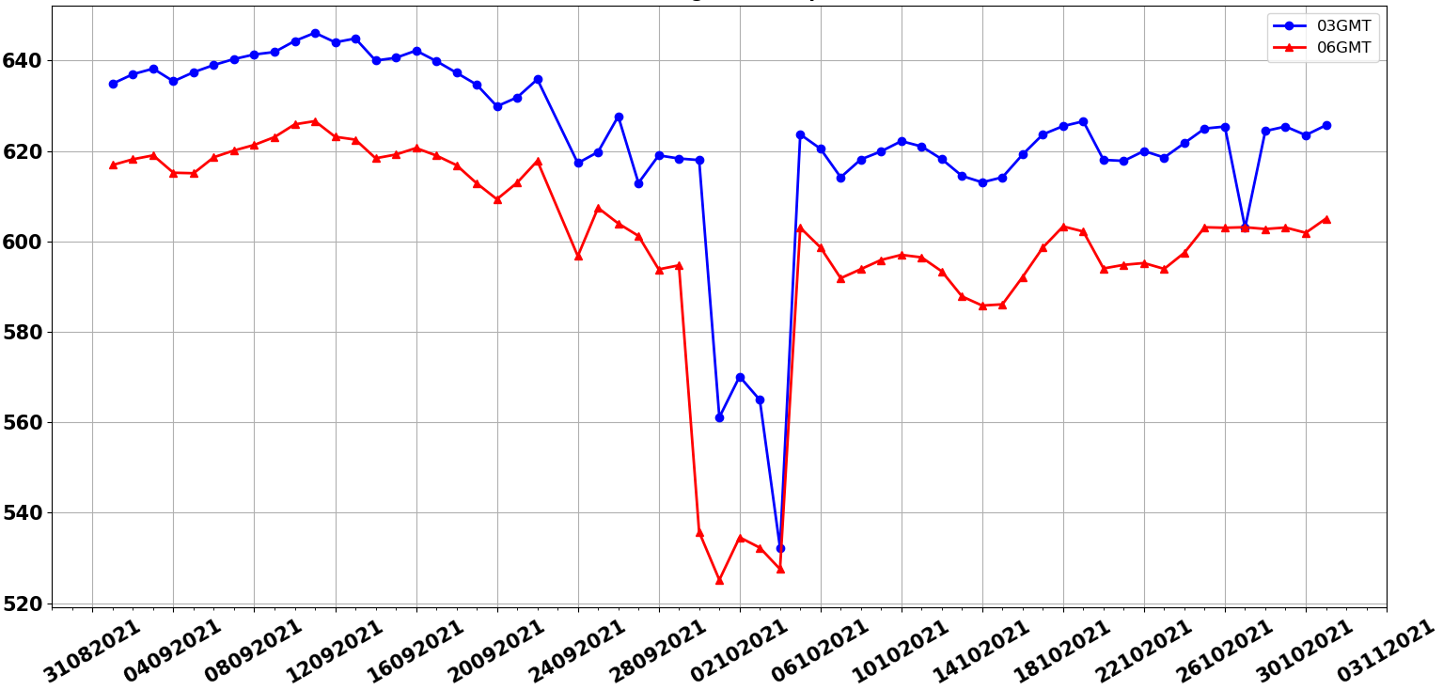
INSAT-3DR
Sep-Oct 2021

Slide 10
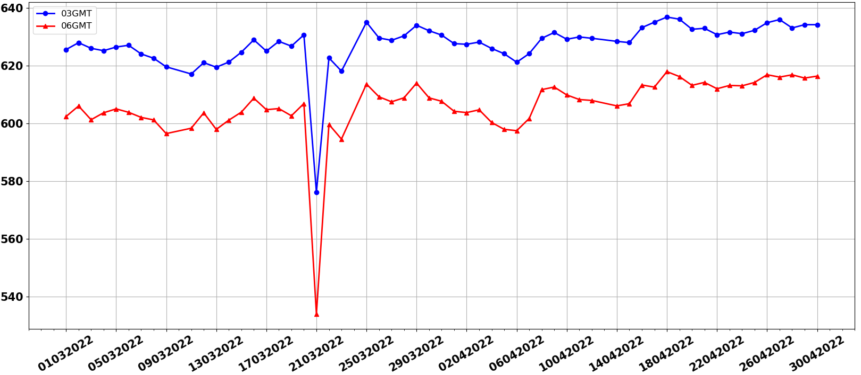
INSAT-3DR
Mar-Apr2022

Slide 11
COF01: (i) 23rd Aug 2021- 22nd Sep 2021
COF02: (ii) 24th Sep 2021 -23rd Oct 2021
COF03: (iii) 01st Jan 2022 -30th Jan 2022
COF01: (i) 21st Feb 2022- 22nd Mar 2022
COF02: (ii) 24th Mar 2022 -23rd Apr 2022
COF03: (iii) 01st Jun 2022 -30th Jun 2022
For each flip three set of experiments have been done to simulate the errors shown in operation GSICS correction coefficients.
COF01 is applied for all
COF02 is applied to (ii) and (iii)
COF03 is applied to (iii)

Slide 12
FLIP-1
 | Slope |  |  |  | Offset
EXP-1 | 0.982 |  |  |  | 2.190
EXP-2 | 1.020 |  | 0.979 |  | 2.697 |  | 2.2973102
EXP-3 | 1.029 | 0.988 |  | 0.994 | 1.866 | 1.462 |  | 0.548
FLIP-2
 | Slope |  |  |  | Offset
EXP-1 | 0.985 |  |  |  | 2.091
EXP-2 | 0.955 |  | 0.975 |  | 0.3264746 |  | 3.0075104
EXP-3 | 0.947 | 0.967 |  | 0.975 | 1.495 | 4.153 |  | 2.938

Slide 13
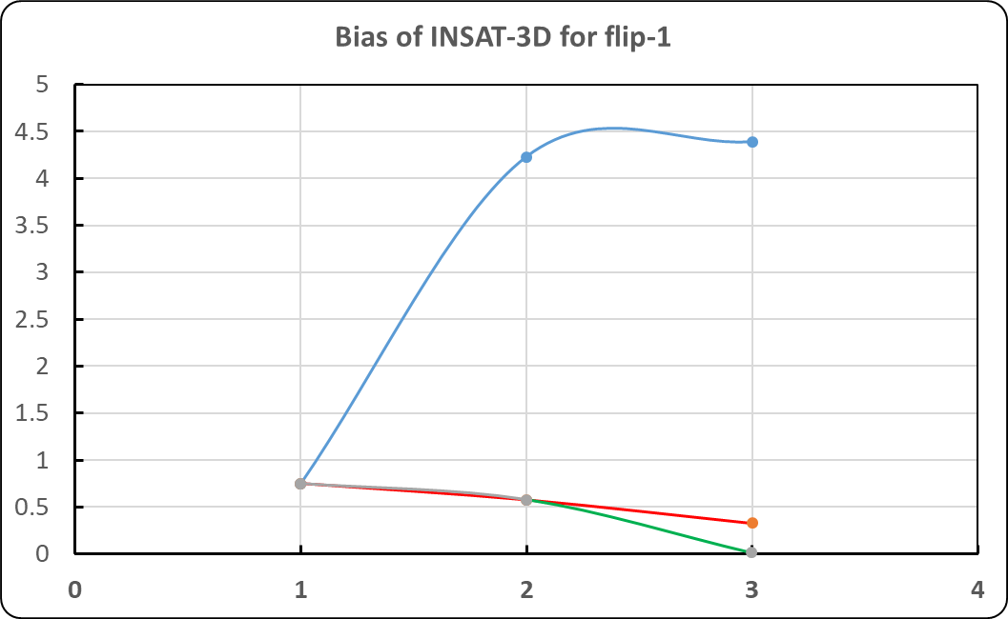
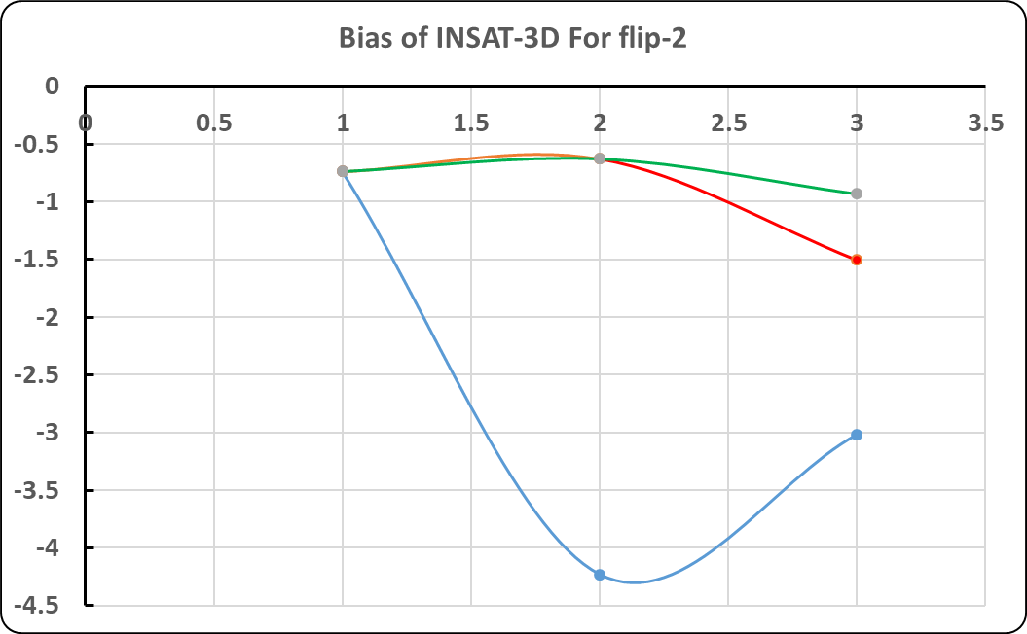

Slide 14
