Slide 1
GOES-18 ABI IR Calibration Update
Xiangqian Wu
GSICS Research Working Group Infrared Subgroup Monthly Meeting
8 December 2022

Slide 2
Introduction
GOES-18, launch on 1 March 2022, is the 3rd in the GOES-R series.
GOES-16, launched on 19 Nov 2016, is GOES-EAST since 18 Dec 2017.
GOES-17, launched on 01 Mar 2018, is GOES-WEST since 12 Feb 2019.
GOES-U is planned for launch in spring 2024.
GOES-17 ABI suffers from a cooling system anomaly, which has the worst impacts on IR calibration around equinox.
GOES-18 ABI commissioning is altered accordingly:
Drifted to the WEST position before the completion of most post-launch tests.
Reached the Provisional maturity on July 28 (faster than GOES-16/17).
Used in operation 8/1 – 9/6 and 10/13 – 11/16 via “interleaves”.
This is a summary of the calibration and validation status of GOES-18 IR channels at the Provisional maturity, and some update since then.

Slide 3
Overall performance

Slide 4
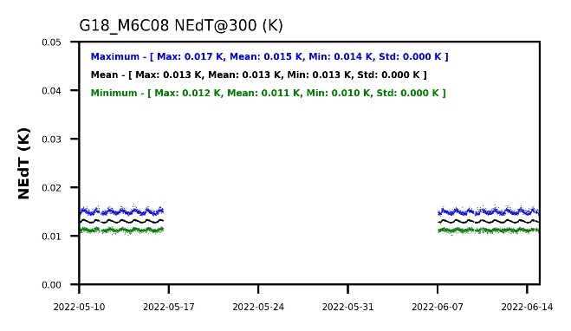
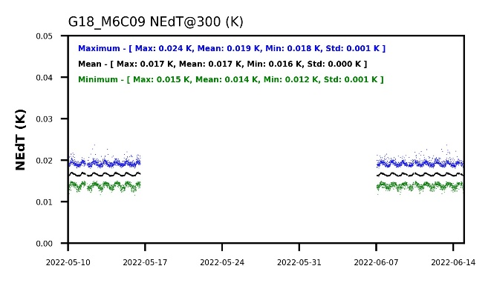
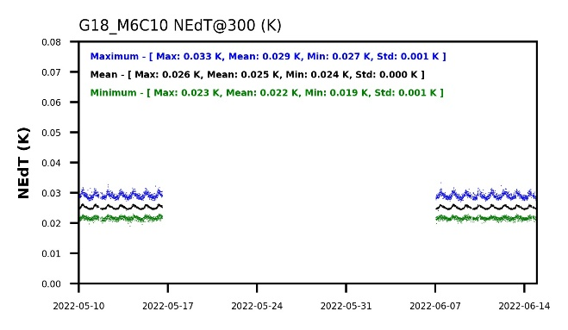
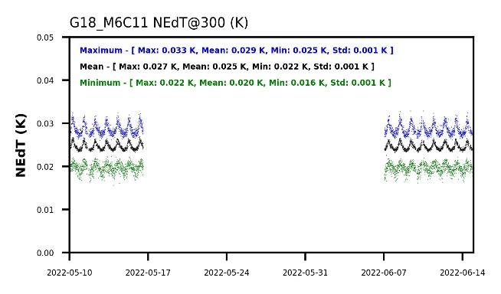
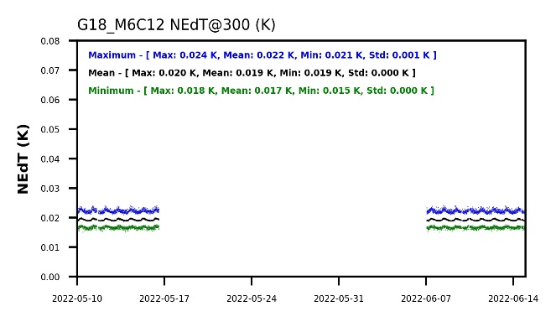
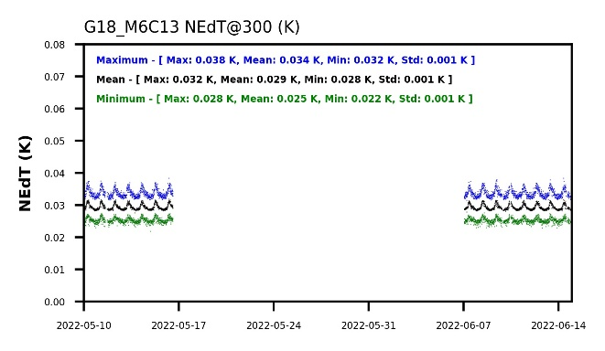
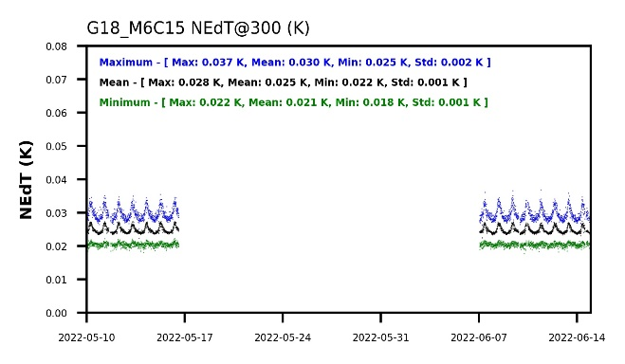
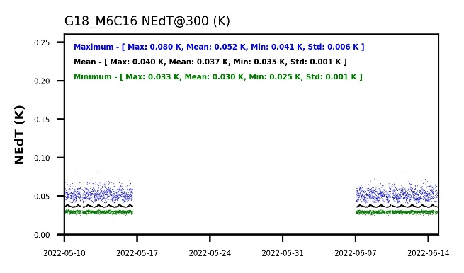
GOES-18 ABI IR Noise
The lower, the better.
NEdT is many times better than requirement, is stable, and ...

Slide 5
Comparison with GOES-16
The lower, the better.
Not compared with GOES-17 because of the LHP anomaly.
… is comparable to GOES-16.
B07 will be addressed separately later.

Slide 6
IR Radiances Are Accurate …
The closer to zero, the better.
Requirement is marked by the green lines.
Comparable to or slightly better than GOES-16/17.
An order of magnitude better than MRD.

Slide 7
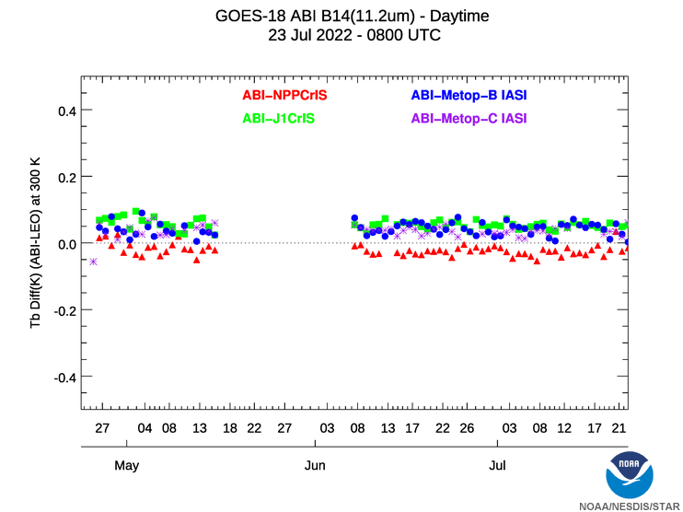
… and Stable
The closer to zero, the better.
Other channels are similar.
Nighttime is often better.
ABI accuracy is comparable to hyperspectral sounders.

Slide 8
issues

Slide 9
Periodic Infrared Calibration Anomaly (PICA)
In this animation of CONUS images by GOES-18 ABI on 15 July 2022, the “flickering” (alternating between green and orange) of IR images before ~2000 UTC indicates a Periodic (every five minutes) IR Calibration Anomaly (PICA).
It largely disappeared after ~2000 UTC when a scan mirror emissivity update eliminates the root cause of PICA.
M. Gunshor and T. Schmit
Notes:
https://cimss.ssec.wisc.edu/satellite-blog/images/2022/07/loop_16paneltimediff_2022196_GOES18R_CONUS_M6_B12345678910111213141516_0016PANELS_timediff.mp4

Slide 10
PICA and Scan Mirror Emissivity
PICA was discovered in March 2017 from GOES-16 data, and was corrected in October 2017.
Post-launch tests have since been revised for future ABI.
It was corrected for GOES-17 ABI before the data became widely available to users.
GOES-18 data was accessible before PICA was corrected, therefore rediscovered by users. It disappeared after the planned update of scan mirror emissivity.

Slide 11
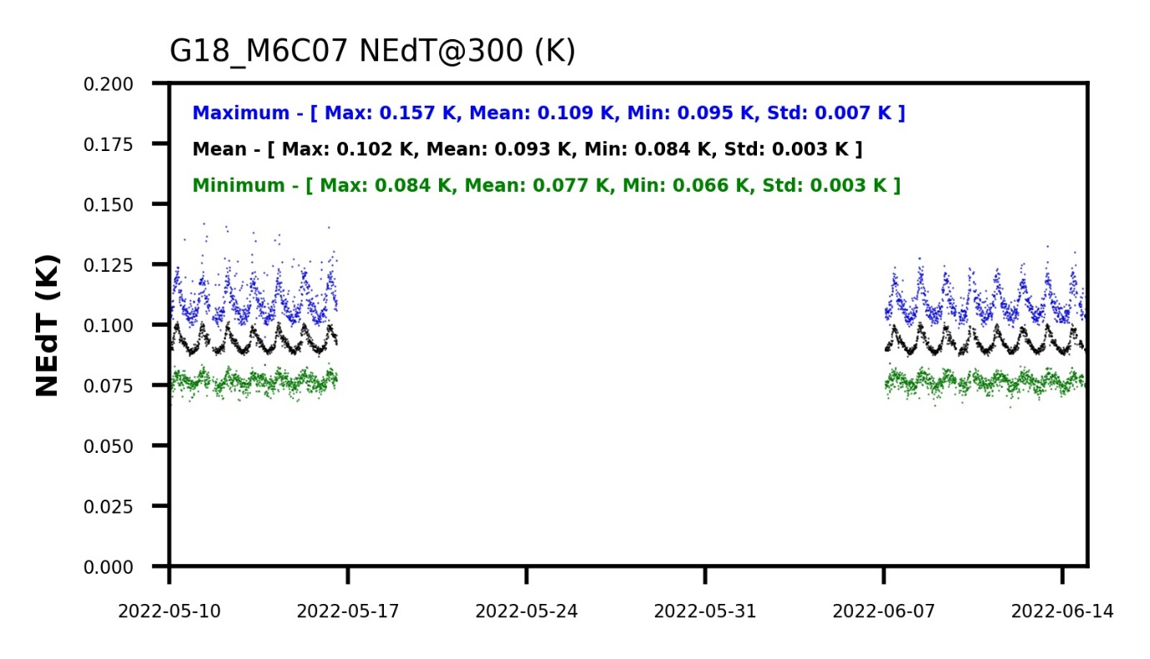
High NEdT for GOES-18 ABI Channel 7
GOES-18 ABI B07 NEdT is higher than GOES-16, higher than GOES-17 with Gain Set I and III, at all levels of maturity and for both mean and max.

Slide 12
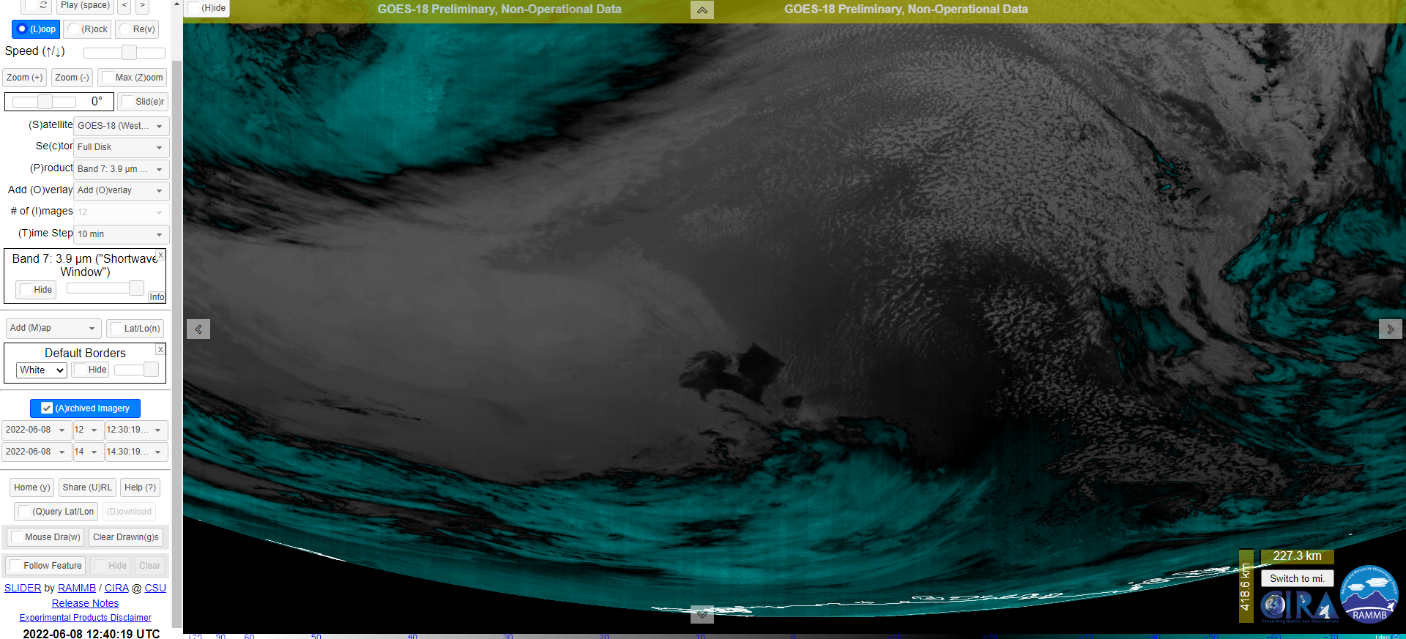
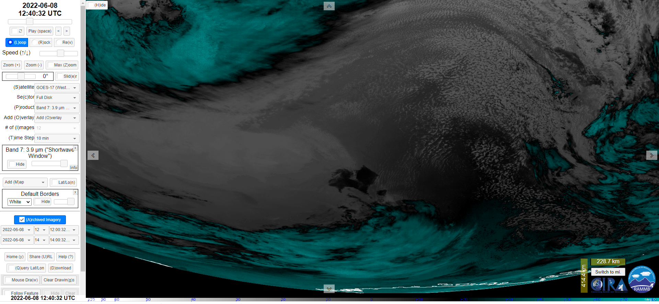
Also Found Vertical Striping
GOES-18
D. Lindsey
GOES-17

Slide 13
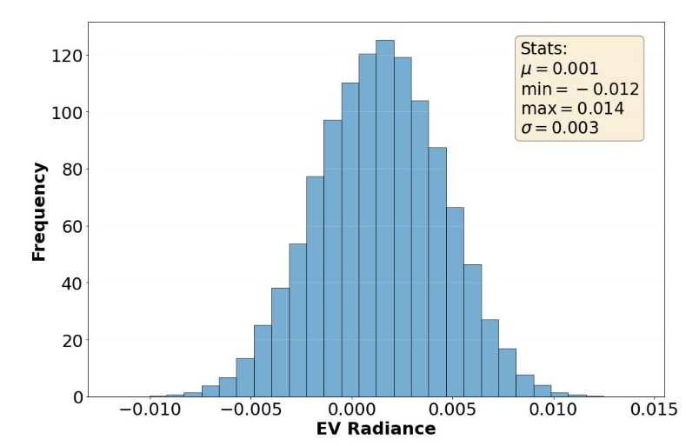
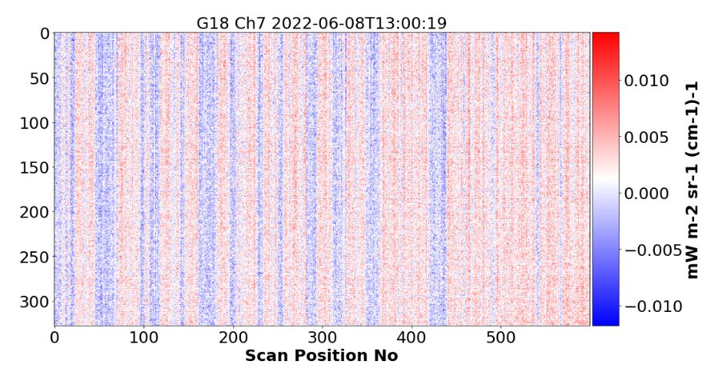
Within SPEC Noise Can Be Non-Random
Histogram: Noise is normally distributed and within spec.
Image: Part of the noise is not random in space.

Slide 14
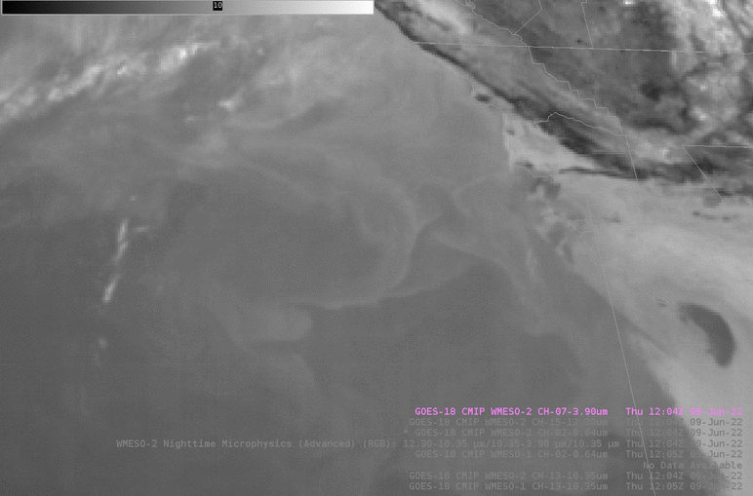
The non-random noise may contribute to the barcode artifact …
B. Line

Slide 15
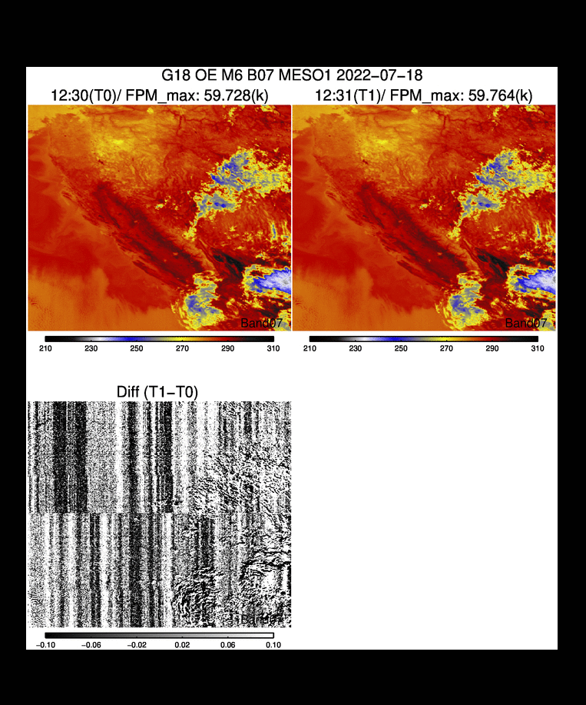
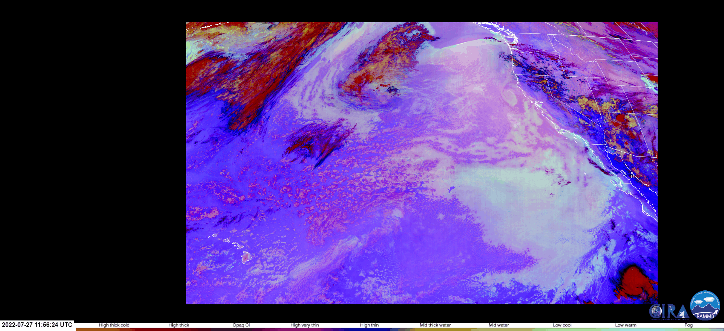
… esp. Those of Time or Channel Differences
Barcode artifact is more visible in time-difference image …
… and channel difference image.

Slide 16
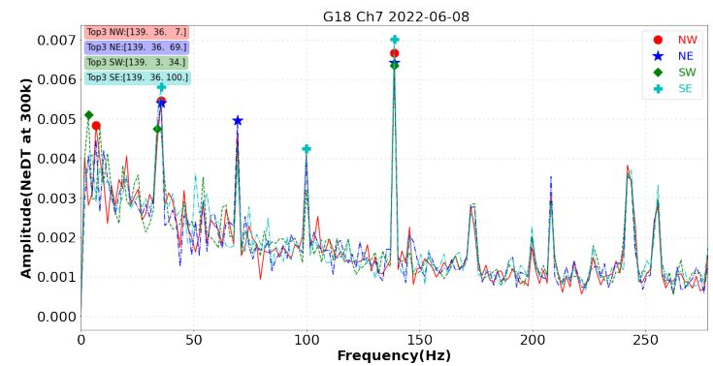
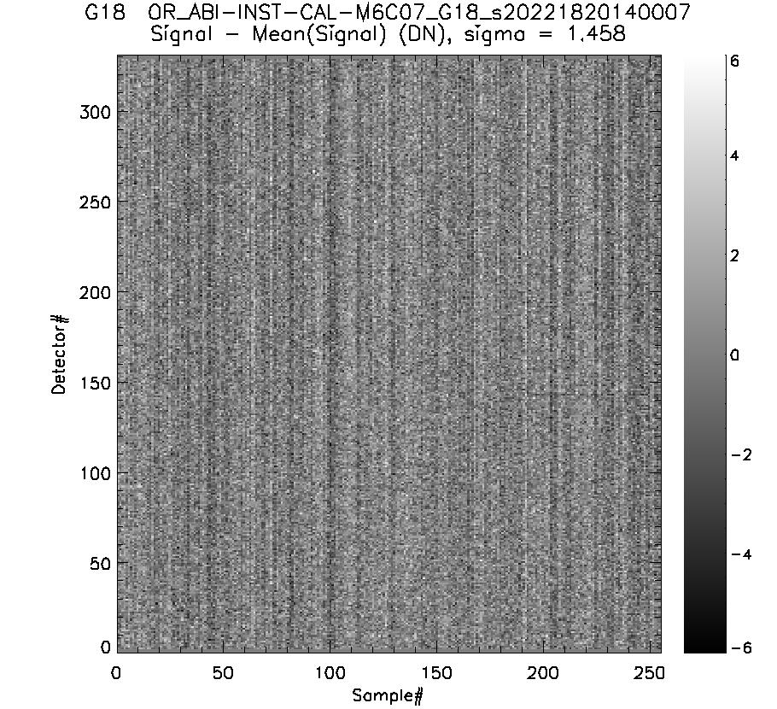
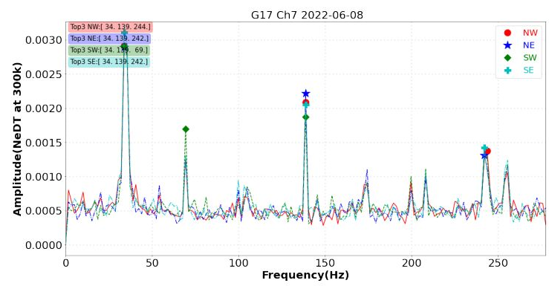
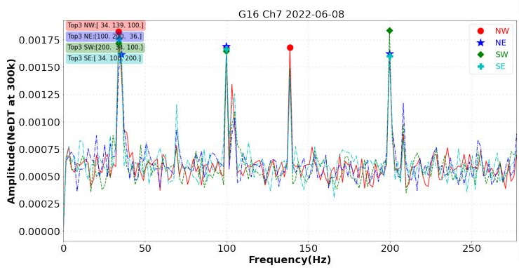
Characteristics
G18
G17
G16
B. Efremova
Found in GOES-16/17/18 and Channels 7-16, but stronger for GOES-18 and Channel 7.
No FM- & channel-unique characteristic frequency.
Did not find significant change day to day, different times in a day, or among the four corners.
Magnitude may be larger at night.
Also found in AHI-8.
May or may not be related. Confirmed with Fourier analysis
FFT: G18 ≅ 2 x G17; G17 ≅ 2 x G16
Common characteristic frequencies for three or two ABIs

Slide 17
Channel 7 Noise
GOES-18 ABI Channel 7 noise is higher than the other two ABIs in all aspects.
Part of the noise is not random, which may contribute to the “Barcode Artifact” in some images.
Especially in images of low radiance and time or channel differences.
Non-random noise exists in all IR channels of all ABIs, sharing common characteristic frequencies, but the magnitude is larger for GOES-18 ABI B07.
The characteristic frequencies are not known to change within FOR, time of day, and day to day, but the amplitude may be larger at night.
Update: The Barcode Artifact (BA) was substantially reduced since 22 September 2022.

Slide 18
Summary
Overall, GOES-18 ABI IR channels perform well in terms of precision, accuracy, and stability.
Periodic Infrared Calibration Anomaly (PICA) is a known issue that was corrected as planned.
Noise of the 3.7 µm channel, while meeting requirement, is high as compared to other channels and Flight Modules.
Part of the noise is not random, which may contribute to the “Barcode Artifact” (BA).
The BA, while occasionally annoying, does not affect qualitative nor quantitative applications of the data.
Update: The BA was substantially reduced since 22 September 2022.

