Slide 1
A Personal History of Microwave Remote Sensing
and the People Along the Way (1971-2022)
Thank you for inviting me to give a talk on the History of MW Remote Sensing.
There are hundreds of scientists and engineers who have contributed to the field over many years.
There are also many books on the subject.
For example:
Introduction to Satellite Remote Sensing:
Atmosphere, Ocean, Cryosphere and Land Applications
William Emery and Adriano Camps
I could not possibly cover this all. Rather I will present a personal history of my contributions to the Field and the remarkable scientists and engineers I met along the way.
Also, I will review some of the major milestones in the Field as I saw them.
(Literature references are available upon request.)

Slide 2
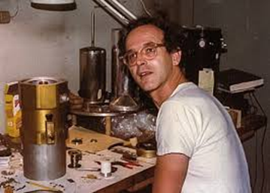
My Introduction to the Field:
Early Balloon-Flown Radiometers to Measure Cosmic Background Radiation (CBR)
My Master Thesis at MIT was on the Calculation of the Antenna Pattern for a Balloon-Flown Radiometer designed to measure the CBR in the far-infrared.
My Thesis Advisor was Prof. Rainer Weiss.
He was attempting to measure anisotropy of CBR.
It turned out the anisotropy was very small and the answer had to wait for
the Cosmic Background Explorer (COBE) in 1990.
Prof. Weiss went on to win the Nobel Prize in Physics in 2017 for Achievement of Gravity Wave Detection.
A young Ray Weiss at work
in my early days at MIT.

Slide 3
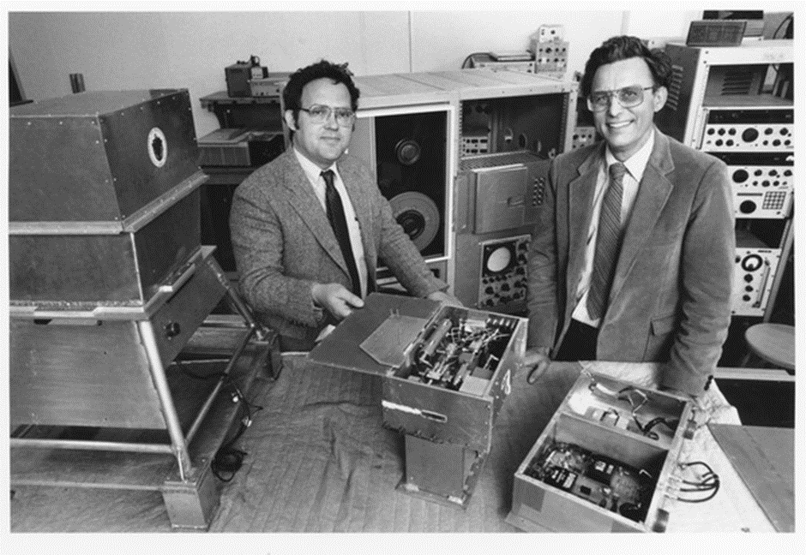
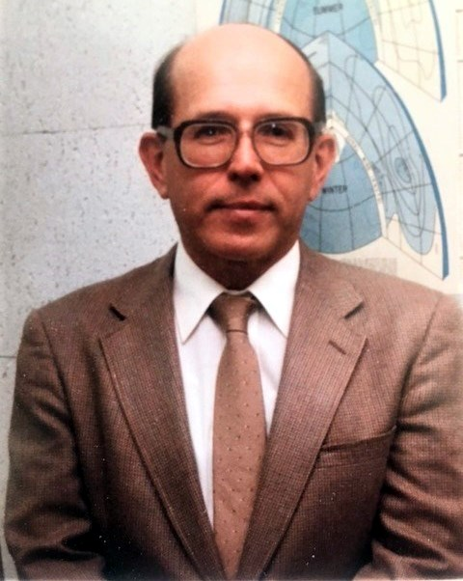
All-Weather Sea-Surface Temperatures (SST) from Space &
The Dielectric Constant of Sea Water
After graduating, I worked on a NOAA-funded project to develop methods for measuring SST through clouds using low-frequency microwave measurements.
One outcome of this study was a radiative transfer model (RTM) for the ocean and intervening atmosphere in the 1 to 100 GHz spectrum.
A key component of this study was determining the dielectric constant model for sea water in the 1 to 10 GHz range.
Drs. Calvin Swift and Alex Strogryn sponsored laboratory measurements of the dielectric constant. Cal also conducted aircraft radiometer measurements to demonstrate the feasibility of measuring both SST and Salinity from space.
Robert McIntosh (left) and Cal Swift (right) busy at work in 1973.
Alex Strogryn

Slide 4
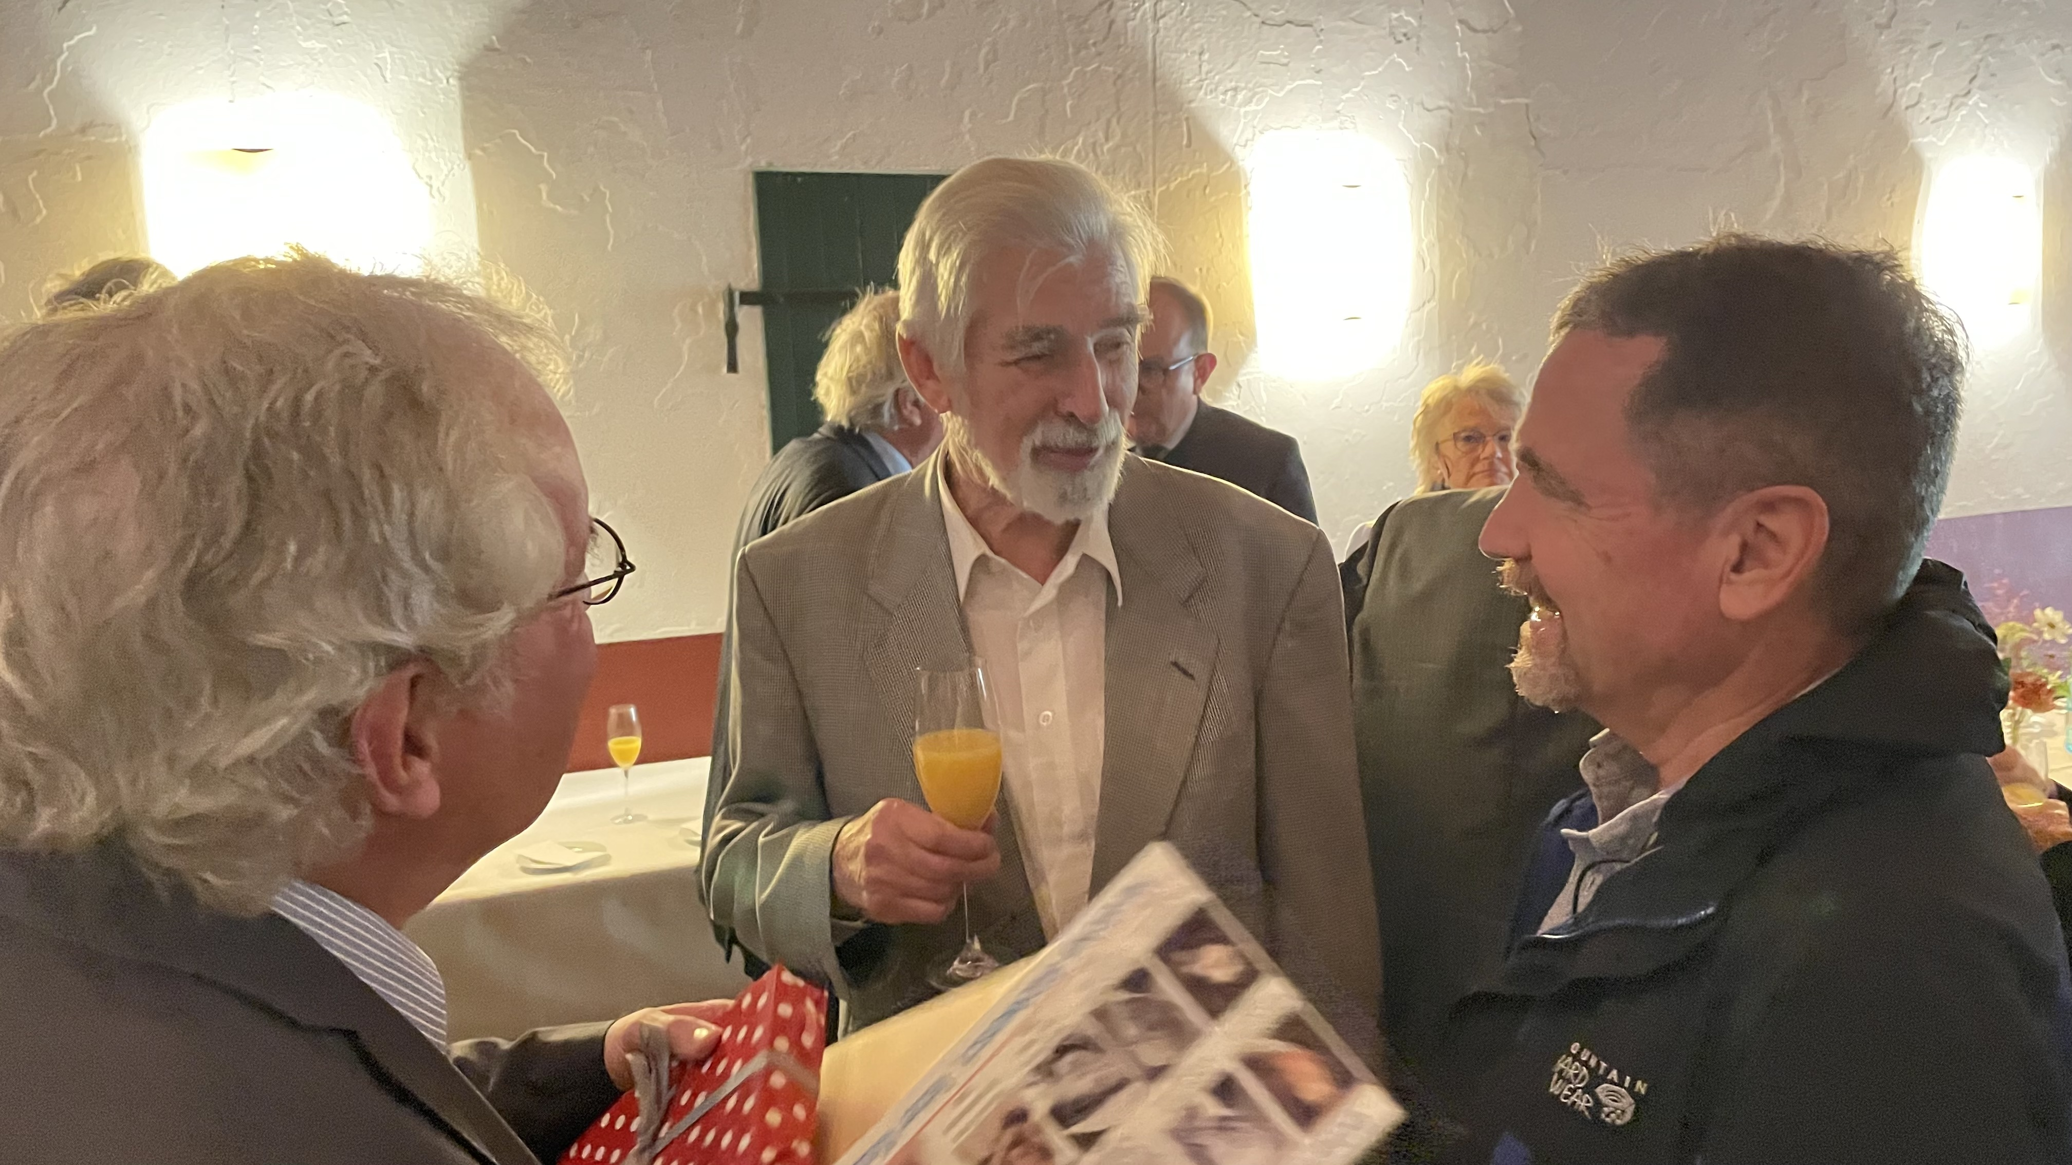
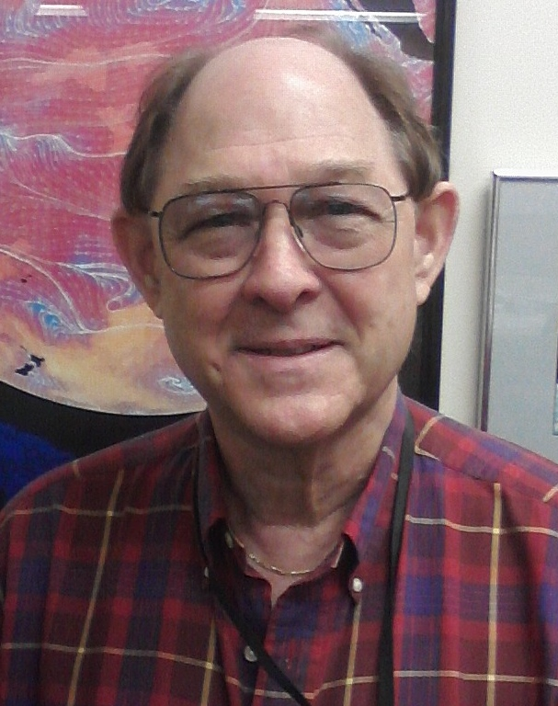
A Two-Scale Model for Microwave Scattering off the Ocean Surface &
Wind Direction from Scatterometers
In 1977, Klaus Hasselmann invited me to work at the Max Planck Institute of Meteorology for the summer.
Klaus was collaborating with NASA in the Joint North Sea Wave Project (JONSWAP).
Part of JONSWAP was the scatterometer aircraft measurements being conducted by Linwood Jones. By flying in circles, Linwood was the first to demonstrate that there is a distinctive wind direction signal in the scatterometer measurement. (Earlier fights by NRL suggested otherwise.).
I was working on the theory of two-scale scattering from a rough ocean surface to explain the JONSWAP aircraft measurements.
Klaus Hasselmann went on to win the Nobel Prize in Physics in 2021 for his work with weather versus climate systems.
Klaus Hasselmann (middle) talking with Ben Santer (right) at his 90th birthday party.
Linwood Jones

Slide 5
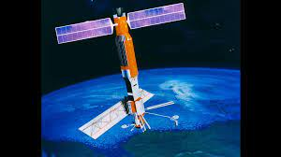
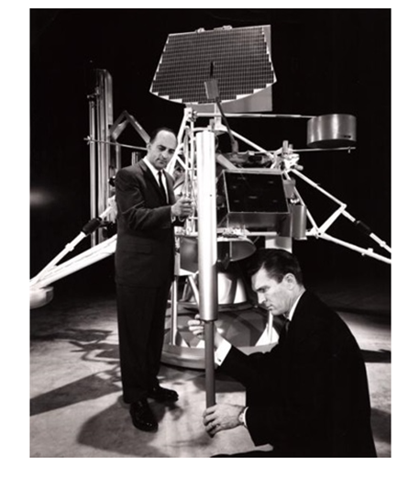
SeaSat: June 1978 to October 1978
Active and Passive Microwave Measurements from Space
SeaSat opened the door to Microwave Remote Sensing of the oceans.
The microwave sensors included:
MW Imager: Scanning Multichannel Microwave Radiometer (SMMR)
MW Scatterometer: SeaSat-A Satellite Scatterometer (SASS)
MW Altimeter
Synthetic Aperture Radar (SAR)
NASA Langley and JPL asked me to develop geophysical retrievals algorithms for both SASS and SMMR.
The algorithms were essentially Maximum Likelihood Estimators (MLE).
They were delivered to NASA in several boxes of computer cards.
They worked!
This was the beginning of Remote Sensing Systems, Inc. (RSS).
Artist rendition of SeaSat
Gene Giberson (right), SeaSat project manager, in an earlier photograph next to "Surveyor", 1960.

Slide 6
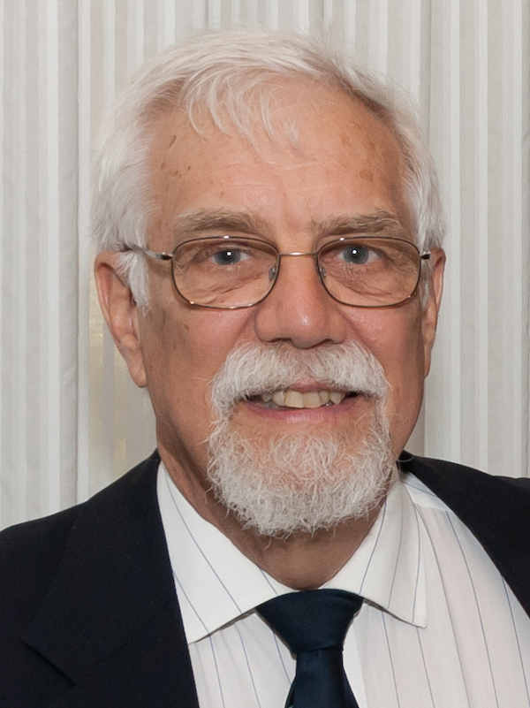
NIMBUS-7 SMMR: 1979 to 1987
A year later in 1979, the SeaSat MW imager was followed by SMMR on board NIMBUS-7.
The on-board calibration system was not the best, with some channels showing significant drifts.
The relatively small antenna (79 cm) limited the usefulness of the lower frequency channels (7 to 11 GHz).
The spinning mechanism was turned on and off every other day.
RSS does not include this as part of their Climate Data Records, but with more work possibly …
Tom Wilheit was instrumental in the development of the two SMMRs and associated rain retrieval algorithms.

Slide 7
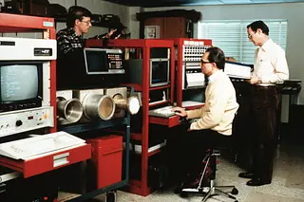
Special Sensor Microwave Imager SSMI: 1987 to 2021
DOD Begins to Invest in Satellite Microwave Radiometers
Their first SSMI was launched in 1987.
The lead scientist was Jim Hollinger.
His earlier radiometer measurements from an ocean pier were the first to clearly characterize the dependence of the ocean’s MW emission on wind speed:
The H-pol emissions increase in a linear fashion with wind speed.
In contrast, near incidence angles at 50 to 60 degrees, V-pol is insensitive to wind speed. This unique signature of H-pol versus V-pol formed the basis of wind speed retrievals from space.
Realizing the importance of SSMI to scientific and climate research, RSS took the initiative to make the SSMI data available to the broader community.
The SSMI data was being stored on 6,250 bpi tapes, 4 per day, $250 each!
Via data compression and employing Exabyte tapes,
RSS produced SSMI Compact TA Tapes.
Four 6,250-bpi tapes/day ➔ 4 Compact TA tapes/year.
The SSMI data became affordable to a wide range of users.
Jim Hollinger (center) was the lead scientist/engineer for SSMI.

Slide 8
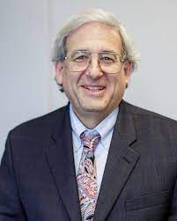
NASA Scatterometers
18 years after SeaSat, NASA’s follow-on scatterometer (NSCAT)
was launched aboard the Japanese satellite Midori. NSCAT operated for about one year (1996 to 1997). The mission was cut short by a power failure.
NSCAT’s new design of 3 antennas/side (SeaSat had only two) was based on simulation studies done by RSS. The 3-antenna design greatly mitigated the wind direction ambiguity problem.
The retrieval algorithm for NSCAT and subsequent NASA scatterometers [QuikSCAT (1999 to 2009) and RapidSCAT (2014 to 2016)] was based on the Maximum Likelihood Estimator (MLE) RSS developed for SeaSat.
The Project Scientist for NSCAT was Michael Freilich, who later became the revered Director of NASA’s Earth Science Division.
All of us at RSS are extremely grateful for the unwavering support Mike gave to our efforts to generate reliable, long-term Climate Data Records (CDRs).
Michael Freilich, Director of NASA’s Earth Science Division 2006 to 2019.

Slide 9
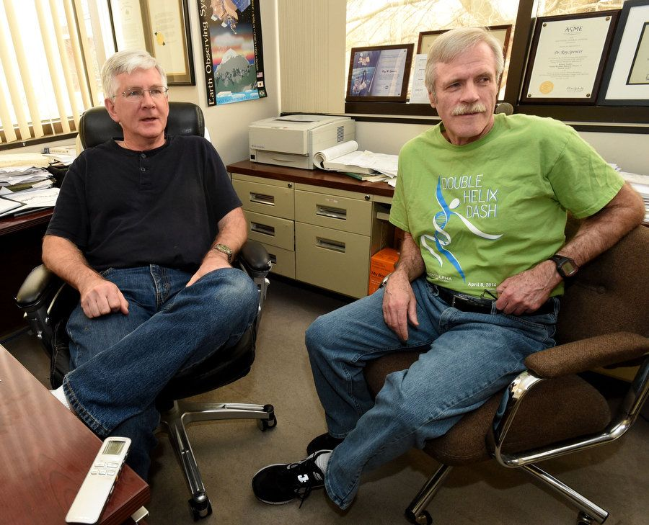
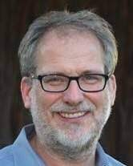
Microwave Sounders and Atmospheric Temperature Trends
During the 1990’s, John Christy and Roy Spencer were reporting the Earth’s lower atmosphere was cooling, not warming, by -0.05 K/decade. For the tropics the purported cooling was -0.11 K/decade. These results were based on the satellite Microwave Sounder Units (MSU) from 1979 to 1995.
Meanwhile, the RSS water vapor SSMI CDR was clearly showing a substantial increase in water vapor in the atmosphere.
The water vapor measurement is very precise because it is a differential measurement (22 GHz - 19 GHz).
A quick review of the Christy/Spencer methodology revealed several errors (neglect of orbital decay, wrong sign for diurnal effect, erroneous target factor), all of which produced spurious cooling.
The Earth is indeed warming.
At this point, RSS began producing atmospheric temperature CDRs based on MSU and later on the Advanced MSU (AMSU) measurements.
Carl Mears has been leading this project for 20+ years.
Roy Spencer (left) and John Christy (right) get the wrong sign for tropospheric temperature trends. The Earth is not cooling.
Carl Mears, Vice-President RSS, is responsible for our tropospheric and stratospheric temperature CDRs.

Slide 10
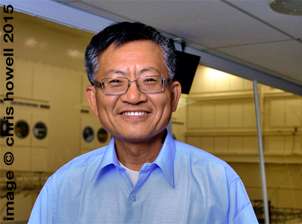
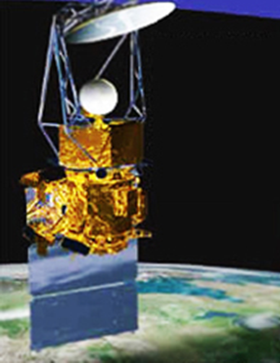
Wind Direction from Passive Microwave Observations:
The Fully Polarimetric WindSat
In 1992, I detected a wind direction signal in the SSMI observations. Heretofore, the emission of microwaves from the ocean was assumed to be essentially isotropic.
(Some earlier Russian nadir-looking aircraft measurements notwithstanding.)
Later in 1997, Simon Yueh’s aircraft observations show a wind direction signal in the 3rd and 4th Stokes emission.
These discoveries led to WindSat: the first fully polarimetric satellite radiometer. WindSat was launched in 2003 and is still operating, although the data is not being brought to the ground (what a shame).
RSS provided near-real time wind vectors (and CDRs) from WindSat to the community at large for 17 years.
Simon Yueh aircraft observations reveal a wind direction signal in the 3rd and 4th Stokes emission.
Artist rendition of WindSat

Slide 11
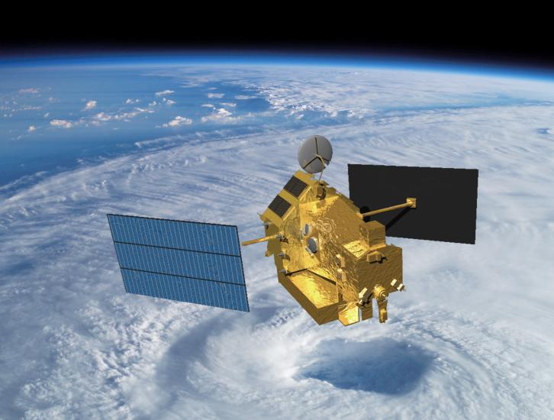
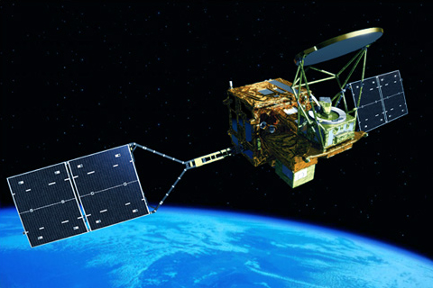
Sea-Surface Temperature Through Clouds:
TMI, WindSat, AMSR-E, and AMSR-2
After many years, my early work on All-Weather SST measurements finally came to fruition with the launches of:
TRMM Microwave Imager (TMI) (1997 to 2015)
JAXA Advanced Microwave Scanning Radiometer
AMSR-E (2002 to 2011)
AMSR-2 (2012 to present)
WindSat (2003 to 2020)
(Nimbus-7 SMMR SST capabilities were limited by a number of factors.)
The improvements for these new sensors included:
Additional low frequency channels (7 to 11 GHz) which were not on SSMI
Larger antennas (except for TMI)
Better on-board calibration
Sun-Synchronous Orbit (except for TMI)
Accurate all-weather (really just through-clouds) SST retrievals at a 50 km resolution were finally realized.
Also, more accurate wind speed retrievals were obtained.
Artist rendition of TMI
Artist rendition of AMSR-2

Slide 12
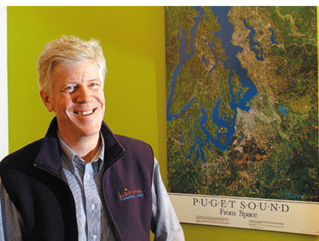
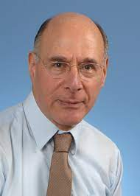
Measuring Sea-Surface Salinity from Space:
The L-Band Sensors: SMOS, Aquarius, and SMAP
The first L-band satellite radiometer to measure sea-surface salinity was the European Space Agency satellite SMOS (Soil Moisture and Ocean Salinity) launched in November 2009.
SMOS was then followed by NASA’s Aquarius instrument that operated from 2011 to 2015.
The P.I. and Deputy P.I. for Aquarius were Gary Lagerloef and David Le Vine, with whom I enjoy an enduring collaboration.
With the premature end of Aquarius, RSS focus was directed to NASA’s Soil Moisture Active Passive Mission (SMAP) that was being launched in 2015. Although SMAP was not originally intended to measure salinity, it has proven to be an excellent salinity sensor.
RSS developed and operated the Level-2 Data Processing System for both Aquarius and SMAP. Operational processing of SMAP data is on-going at RSS.
Gary Lagerloef, Aquarius P.I.
David Le Vine, Aquarius Deputy P.I.

Slide 13
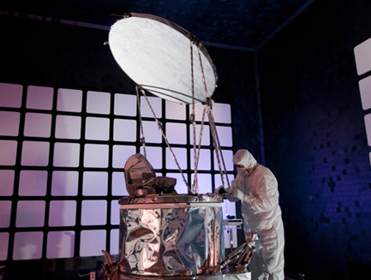
Finally! The Absolute Calibration of Satellite Microwave Imagers.
NASA’s GPM Microwave Imager (GMI)
Previous calibration of satellite microwave radiometers was based on pre-launch field and laboratory measurements and on empirical post-launch adjustments often using an Ocean-Atmosphere Radiative Transfer Model (OA-RTM) as a calibration reference.
The problem with this approach is the pre-launch measurements have errors, particularly the measurement of the fraction of received power coming from cold space (spillover). This uncertainty can be 1 K, or higher.
Secondly, the absolute accuracy of the OA-RTM is difficult to assess.
Ball Aerospace’s GMI Sensor
For the first time, NASA’s GPM Microwave Imager (GMI, 2014 to present) provided the means to measure the Earth’s upwelling radiation (brightness temperature, TB) to a known absolute accuracy. The unique feature of GMI include:
A flawless antenna coating and a hot load free of sun intrusion.
A combination of external calibration loads (hot load and cold mirror) and internal calibration noise diodes.
A direct on-orbit measurement of the sensor non-linearity.
On-orbit calibration maneuvers (cold-space view, nadir-view, pitch hold).
RSS and Ball Aerospace (myself and David Draper) collaborated to use this information to calibrate GMI in an absolute sense. The accuracy quoted in the Wentz/Draper 2016 paper is 0.10 K for TA and 0.25 K for TB.
(I think it is somewhat better).

Slide 14
Reprocessing the Entire Collection of Satellite Microwave Imagers
16 MW Imagers from 1987 to present

Slide 15
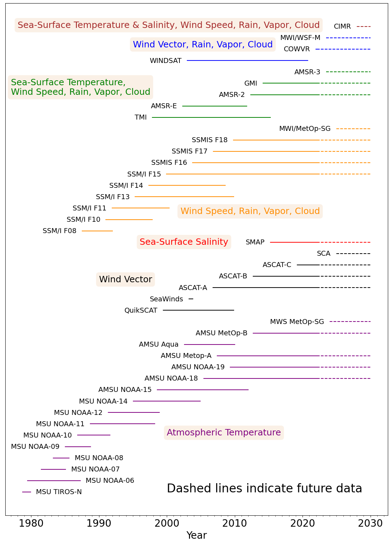
Microwave Climate Data Center (MCDC)
RSS operates the Microwave Climate Data Center (MCDC) in Santa Rosa, CA.
One of the world’s largest repositories of climate observations obtained from MW satellite sensors.
35 MW sensors dating back to 1979 (Sounders, Imagers, Scatterometers).
Consistent data processing procedures used throughout.
On-board Calibration
Geolocation
OA-RTM and associated retrieval algorithm (OA-RTM Inverse)
Quality Control
Same scientists and engineers (20+ years for some)
7,300 Registered Users
Currently operationally processing SSMIS (16, 17, 18), SMAP, GMI, AMSR-2,
ASCAT (A, B, C), AMSU (Metop-A, Metop-B, NOAA-18, NOAA-19).
Soon to be added: COWVR, MWI, AMSR-3, CIMR

Slide 16
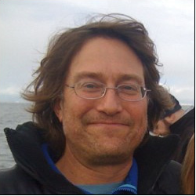
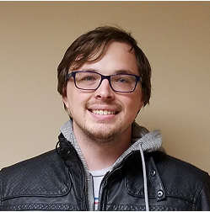
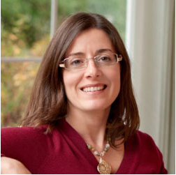
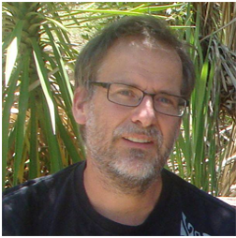
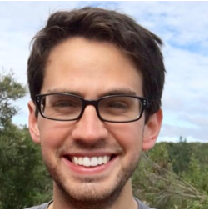
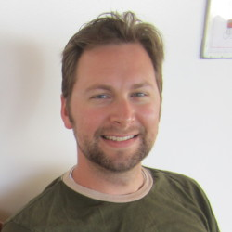
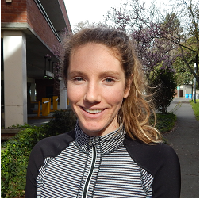
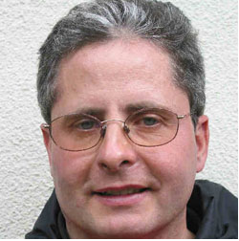
Concluding Remarks
Marty Brewer
Thank you for giving me the opportunity to meet with you, albeit remotely.
My apologies to all those remarkable scientists and engineers not mentioned herein. There are so many.
It is by virtue of their combined work over many years that I have been able to enjoy and prosper in this field of MICROWAVE REMOTE SENSING!
And thanks to scientists and engineers at RSS for their dedicated service.
Michael Densberger
Andy Manaster
Richard Lindsley
Thomas Meissner
Lucrezia Ricciardulli
Carl Mears
Katherine Wentz

