Slide 1
Microwave soundings in NWP at the Met Office: experience and suggestions for future systems
Prepared by John Eyre & Fabien Carminati
with contributions from Stefano Migliorini, Nigel Atkinson, Brett Candy & Chawn Harlow
Presented by Fabien Carminati
Met Office, UK

Slide 2
Microwave soundings in NWP at the Met Office: instruments used
AMSU-A Metop-B, -C NOAA-15, -18, -19
MHS Metop-B, -C NOAA-18, -19
ATMS Suomi-NPP NOAA-20
SSMIS DMSP-F17
AMSR-2 GCOM-W
GMI GPM
MWHS-2 FY-3C, -3D
MWTS-2 FY-3D
MWRI FY-3D

Slide 3
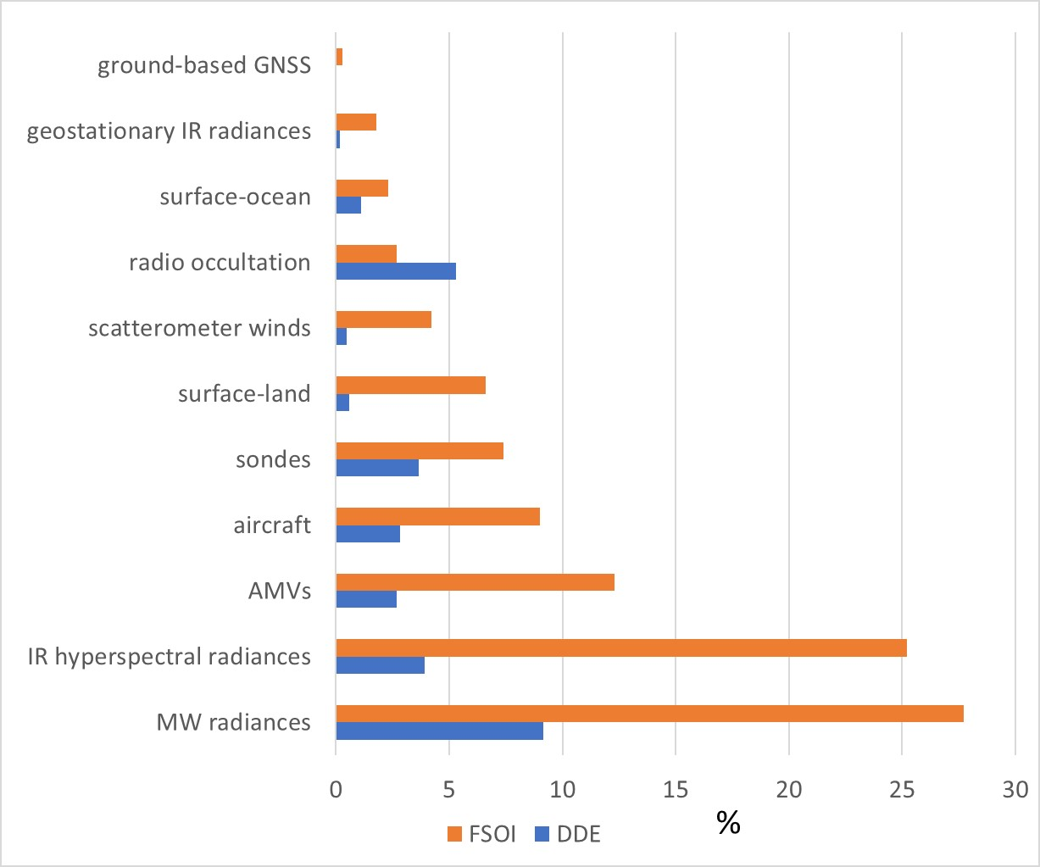
Microwave soundings in NWP at the Met Office: Impact
Data denial experiments
Aug-Oct 2019
% impact on error variance of 24h forecast
by DDE
by FSOI
Candy B et al., 2021 Met Office FRTR 641
Eyre J, 2021. QJRMS DOI: 10.1002/qj.4123

Slide 4
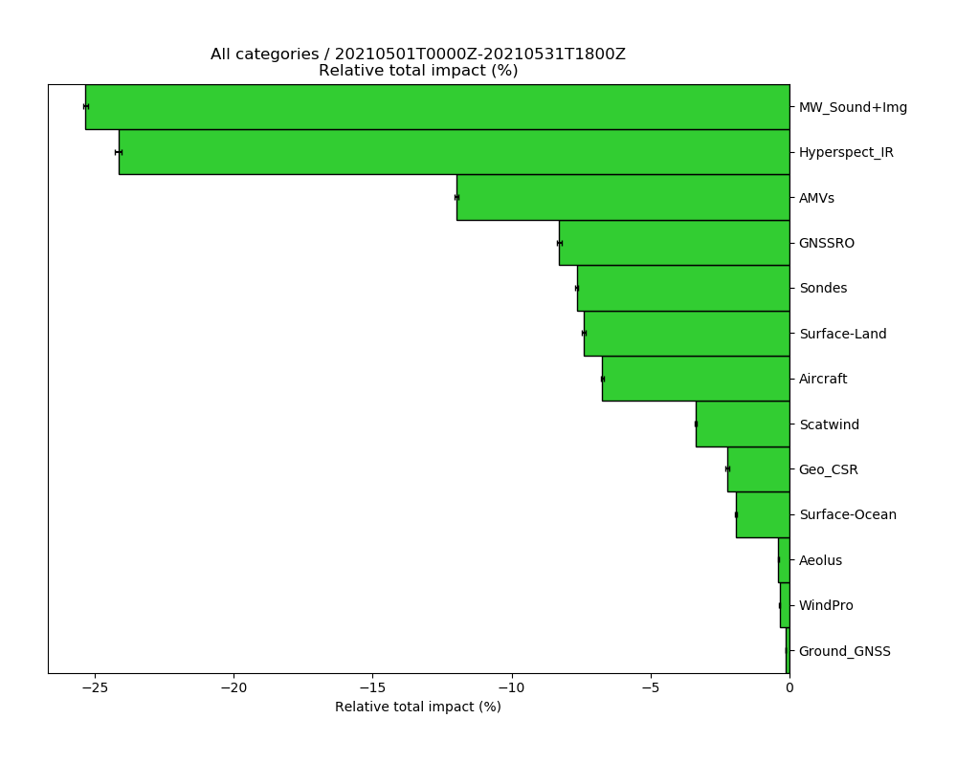
Microwave soundings in NWP at the Met Office: Impact
MW sounders and imagers
FSOI impacts by technology type as of May 2021
Note:
MWRI not included

Slide 5
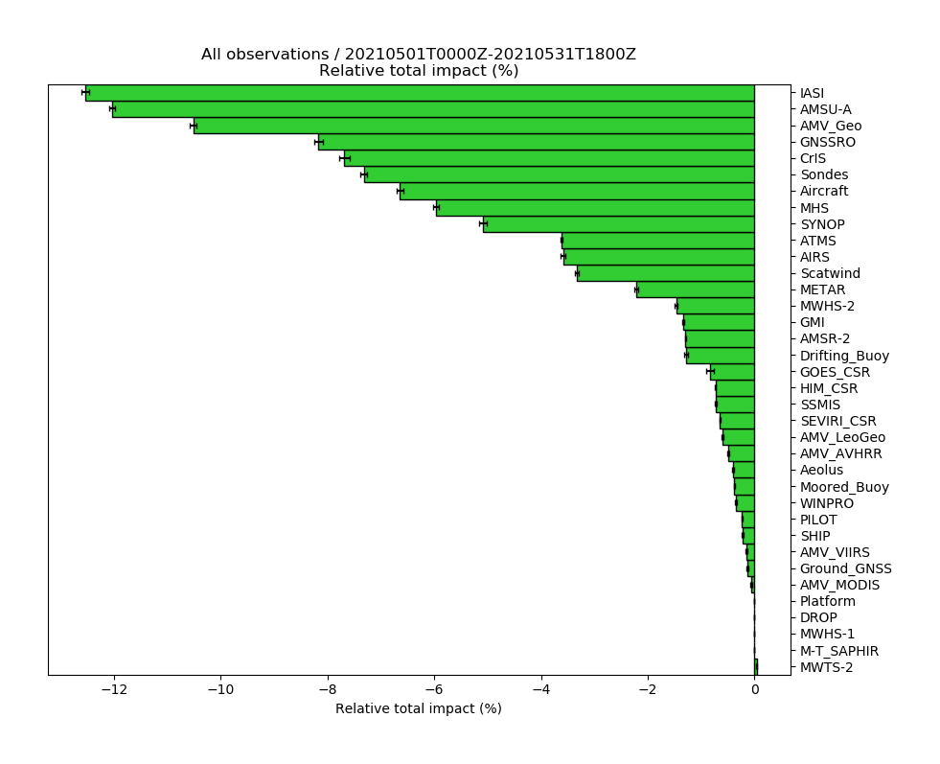
Microwave soundings in NWP at the Met Office: Impact
AMSU-A
MHS
ATMS
FSOI impacts by instrument as of May 2021
Note:
MWRI not shown
MWHS-1 no longer in use

Slide 6
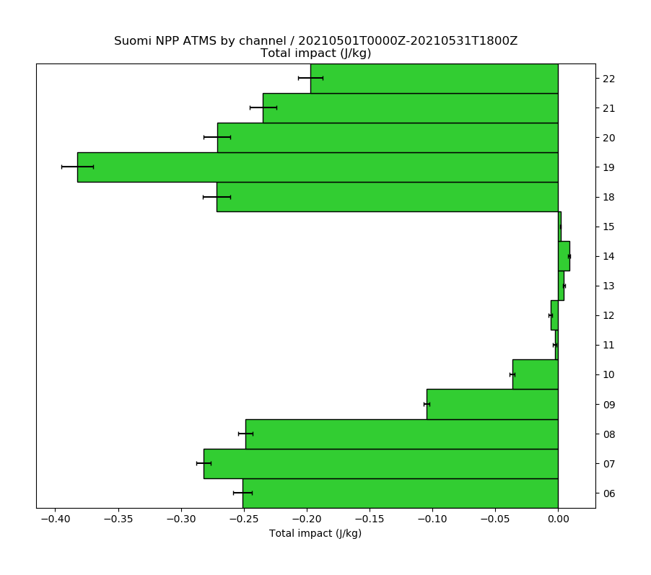
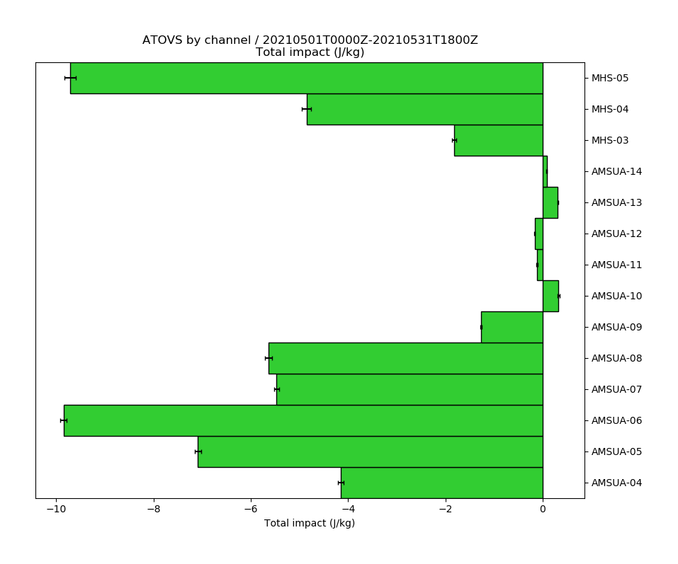
Microwave soundings in NWP at the Met Office: Impact
ch 22
ch 5
21
4
Humidity chs
20
3
19
MHS (x4)
AMSU-A (x5)
18
FSOI impacts by MW channel as of May 2021
ATMS SNPP
8
9
7
Temp. chs
8
6
7
5
6
4
-0.4
0
-10
0

Slide 7
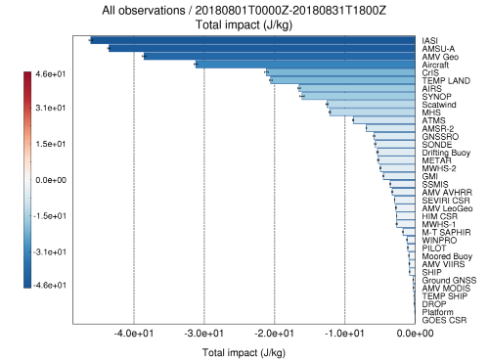
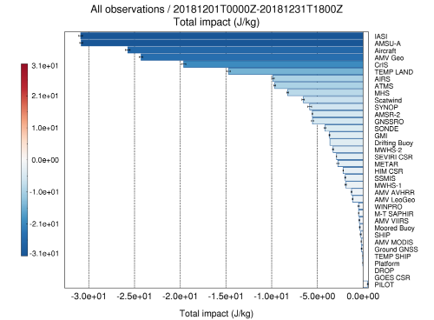
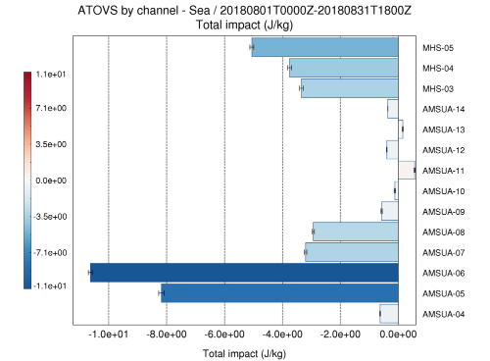
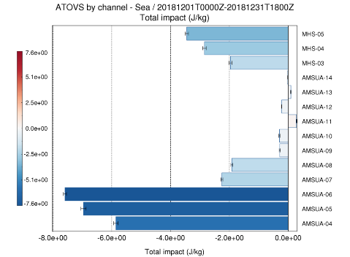
Microwave soundings in NWP at the Met Office: Impact
August 2018
December 2018
Impact from all-sky temperature sounders: AMSU-A ch 4 since 25 Sep 2018.
FSOI before and after AMSU-A all-sky:
AMSU-A joins IASI as highest-impact instrument
AMSU-A channel 4 ~6x impact increase
See IPWG for details

Slide 8
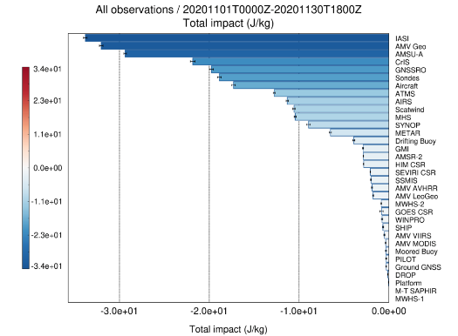
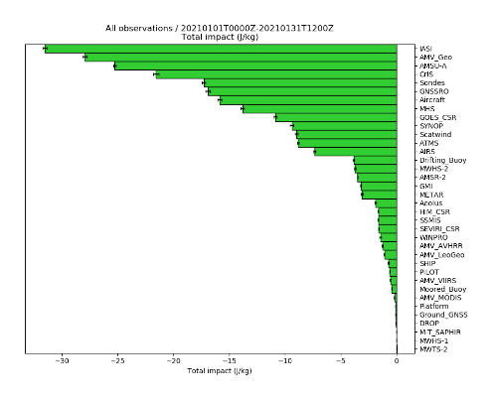
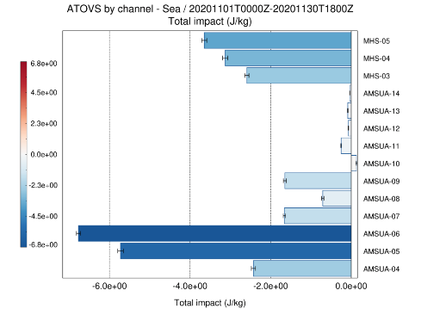
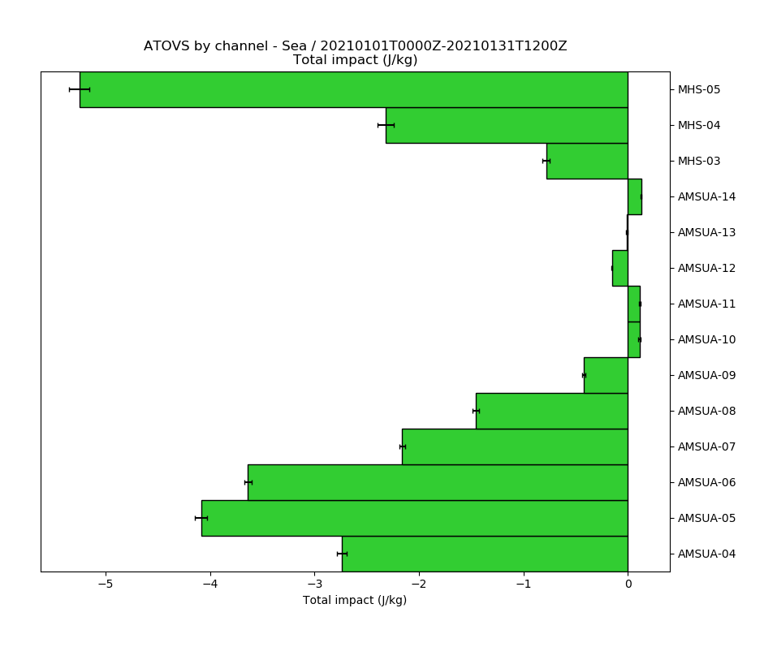
Microwave soundings in NWP at the Met Office: Impact
Impact from all-sky humidity sounders: MHS since 8 Dec 2020.
FSOI before and after MHS all-sky:
From 11th to 8th place, overtaking AIRS and ATMS
About 30% impact increase for MHS channel 5 over sea
See IPWG for details
November 2020
January 2021

Slide 9
Microwave soundings in NWP at the Met Office: Monitoring
Routine monitoring includes:
mean and standard deviation of observed-minus-forecast brightness temperatures, “O-Bs”
for each channel
for each assimilation cycle
Following data are averages for 2 weeks in June-July 2021

Slide 10
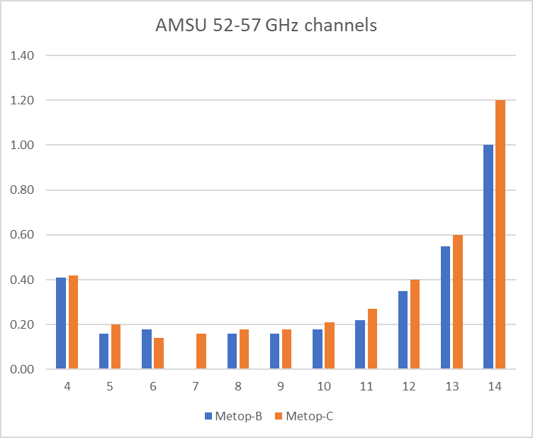
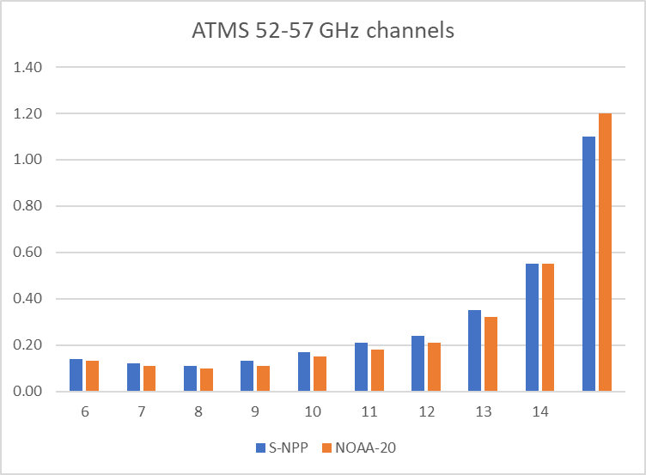
Microwave soundings in NWP at the Met Office: Monitoring
Standard deviations of O-B
(K)
(K)
***
For key tropospheric temperature sounding channels, SD of (O-B) is 0.1-0.2 K
***
ATMS
(at AMSU-A res.)
AMSU-A
Includes observation error and forecast error!

Slide 11
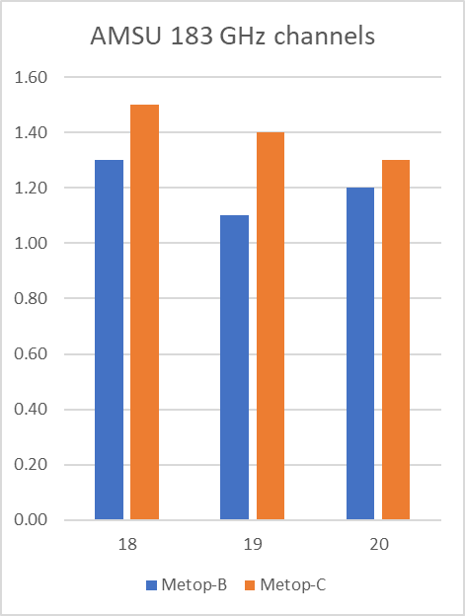
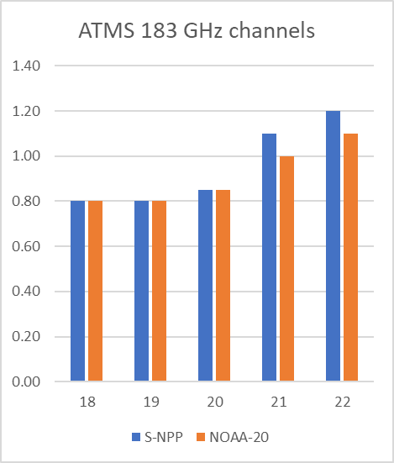
Microwave soundings in NWP at the Met Office: Monitoring
(K)
(K)
MHS
at AMSU-A res.
ATMS
***
For key tropospheric humidity sounding channels,
SD of (O-B) is 0.8-1.5 K
***
Includes observation error and forecast error!

Slide 12
Future MW sounding systems: What’s important?
Temperature sounding
Low NEdT – 0.2 K is already marginal … at 50 km (AMSU-A) resolution
NEdT spec should include 1/f noise (“striping”)
Calibration stability should be better than this … particularly around the orbit, … and over periods of 1-2 days.
NWP bias correction (VarBC) can handle changes on slower time scales, and the occasional jump
Notes:
“of marginal utility”, i.e. only just useful, but they would not be if you relaxed this requirement. Also you would expect to get more benefit if you could improve this aspect of the observing system specification.

Slide 13
Future MW sounding systems: What’s important?
Temperature sounding
Horizontal resolution – 50 km is OK!
Why? Low vertical resolution + aspect ratio of atm. features
→ can’t see horizontal features <50 km
But higher resolution useful for quality control … and for features with different structure and bigger signals, e.g. tropical cyclones
Notes:
features in the atmosphere have typical aspect ratios. For example, frontal features in mid-latitude systems tend to have a vertical:horizontal aspect ratio of 1:50 or 1:100. Also NWP model error fields will tend to have these characteristic aspect ratios. This means that if a MW sounder has a vertical resolution of only ~3 km, it will not “see” error features with a vertical scale of ~1 km, and so it will not see features with horizontal scales of corresponding aspect ratio.
There are several caveats to this:
It applies to temperature not humidity.
It probably does not apply to tropical storms, which have different aspect ratios.
It does not mean that higher horizontal resolution is not useful, e.g. for data selection and qc.

Slide 14
Future MW sounding systems: What’s important?
Temperature sounding: 52-57 GHz vs 118 GHz ?
118 GHz not preferred
Why?
Lower vertical resolution
Greater impacts of water vapour and cloud
Typical forecast errors in temperature still lead to signals of 0.1-0.2 K in BT space

Slide 15
Future MW sounding systems: What’s important?
Humidity sounding: 183 GHz
Direct sounding of humidity
Indirect sounding of wind through tracer effect
→ Tracking humidity and cloud/precip features over time
NEdT requirements more relaxed
Higher horizontal resolution more useful

Slide 16
Conclusion
Microwave sounding radiances are crucial data for operational NWP performance
Backbone of high-quality instruments will remain important – as WMO “Vision for WIGOS in 2040”
Data from many instruments currently assimilated – no sign of saturation
→ keep old satellites flying if you can!
Low NEdT (including 1/f noise) and calibration stability are crucial for temperature sounding

Slide 17
Questions?
fabien.carminati@metoffice.gov.uk
@fab_carminati

