Slide 1
Microwave FCDR Activities at EUMETSAT
Viju John, Timo Hanschmann, Paul Poli, Jörg Schulz
Ralf Giering (FastOpt)
GSICS Microwave Meeting 2022

Slide 2
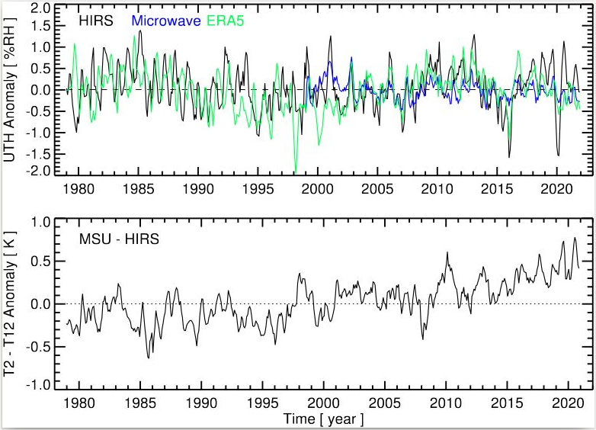
Background
FCDRs are essential for climate monitoring and for generating climate quality reanalyses:
Input to State of the climate report for UTH
Three FCDRs and one reanalyses
AMSU-B/MHS, MSU/AMSU-A, HIRS, ERA5
RH in the upper troposphere stays nearly constant over time which is consistent with our understanding
Moistening of the upper troposphere is evident from the T2 minus T12 trend

Slide 3
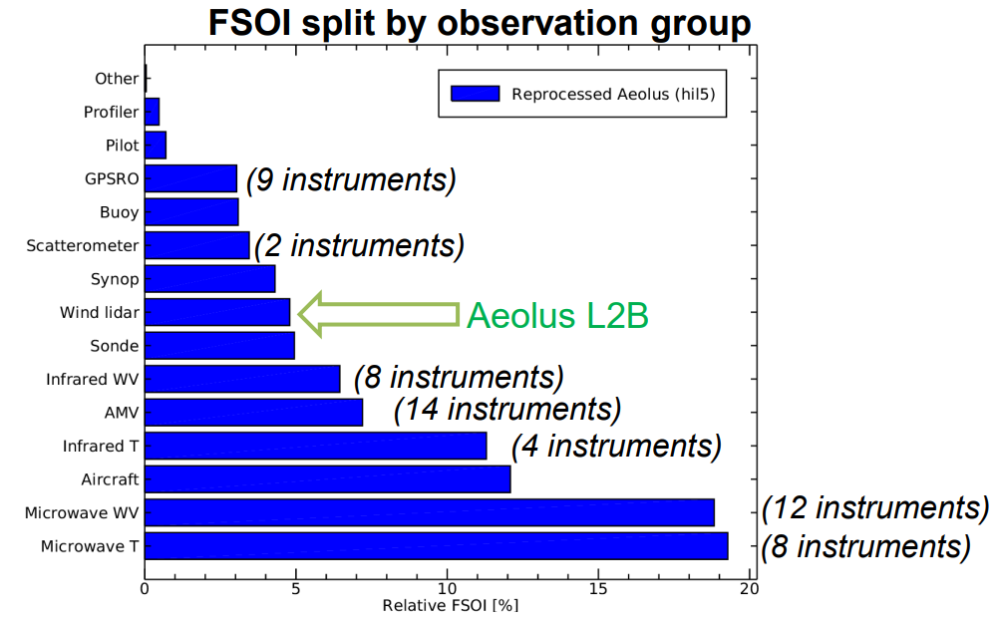
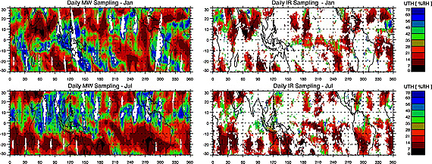
Background
Advantage of microwave measurements:
“All-sky” sampling
Figure from ECMWF

Slide 4
Background
In the past the focus was only on humidity sounding instruments, but now we are stepping into the temperature sounding instruments as well;
Already started working on SSMT data and we will start working in the coming years on MSU, AMSU-A, and ATMS temperature sounding channels

Slide 5
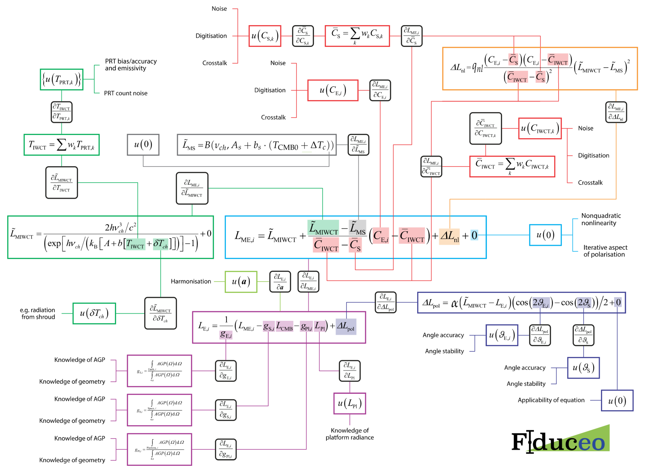
Metrology based approach
EU Horizon-2020 FIDUCEO project has developed a widely applicable metrology approach for the calibration of earth observations;
This establishes traceable, uncertainty-quantified evidence for climate and environmental change from space;
Measurement function centered analysis;
For each term in the function effects causing uncertainties have been identified and analysed;
Three types of uncertainties – independent, structured, and common
I. Hans, M. Burgdorf, S. A. Buehler, M. Prange, T. Lang, V. O. John (2019) An Uncertainty Quantified Fundamental Climate Data Record for Microwave Humidity Sounders, Remote Sens., 11, 548.

Slide 6
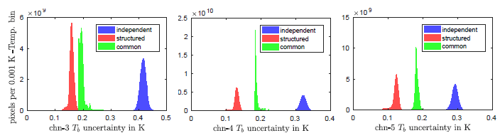
Uncertainty characterised Microwave Humidity Sounder data
FIDUCEO – their Release 1 contains data from SSM/T-2, AMSU-B, and MHS – Brightness temperatures and fully traceable uncertainties – Independent, structured, and common
I. Hans, M. Burgdorf, S. A. Buehler, M. Prange, T. Lang, V. O. John (2019) An Uncertainty Quantified Fundamental Climate Data Record for Microwave Humidity Sounders, Remote Sens., 11, 548.

Slide 7
Released datasets – Humity Sounders
Data Record | Period | Satellite | Status
Microwave
SSM/T-2 R2 | 1994 – 2005 | DMSP-11, -12, -14, -15 | Available from https://navigator.eumetsat.int/product/EO:EUM:DAT:0343
AMSU-B R1 | 1999 - 2014 | NOAA-15, -16, -17 | Available from https://navigator.eumetsat.int/product/EO:EUM:DAT:0303
MHS R2 | 2006 – 2018 | Metop-A & -B | Available from https://navigator.eumetsat.int/product/EO:EUM:DAT:0344
MWHS-1 R1 | 2008 – 2018 | FY-3A & -3B | Available from https://navigator.eumetsat.int/product/EO:EUM:DAT:0348
MWHS-2 R1 | 2013 – 2018 | FY-3C | Available from https://navigator.eumetsat.int/product/EO:EUM:DAT:0349
ATMS R1 | 2011 – 2018 | SNPP | Available from https://navigator.eumetsat.int/product/EO:EUM:DAT:0345

Slide 8
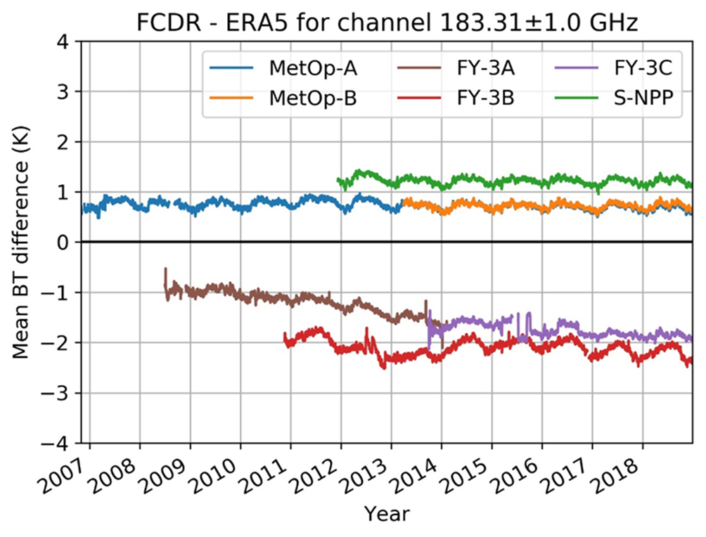
Uncertainty characterised Microwave Humidity Sounder data
We extended the FIDUCEO methods to MWHS, MWHS-2, and ATMS – only for 183 GHz channels;
Currently working on the harmonisation of these individual data records;
We look for collaborations with other agencies.

Slide 9
Harmonisation
Method was developed in the FIDUCEO project (Giering, R.; Quast, R.; Mittaz, J.P.D.; Hunt, S.E.; Harris, P.M.; Woolliams, E.R.; Merchant, C.J. A Novel Framework to Harmonise Satellite Data Series for Climate Applications. Remote Sens. 2019, 11, 1002);
Measurement equation based approach and including uncertainties, i.e., for all instruments except for the reference instrument, raw count and PRT measurements are used and calibration parameters are optimised;
Optimisation is based on collocations, both polar and warm match-ups are used;
Individual instrument characteristics are retained. E.g., differences due to central frequency differences;
A Bayesian based cost function is minimised by changing measurement equation parameters:
Usually, cold target and warm target biases and non-linearity in the measurement equations are optimised.

Slide 10
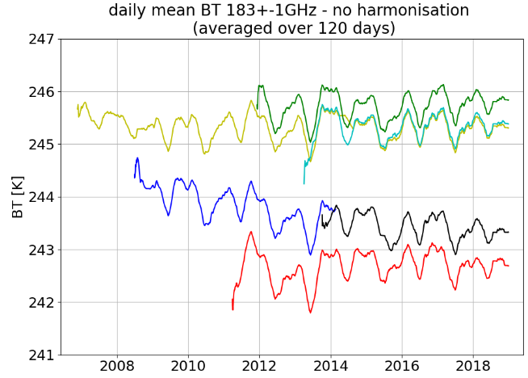
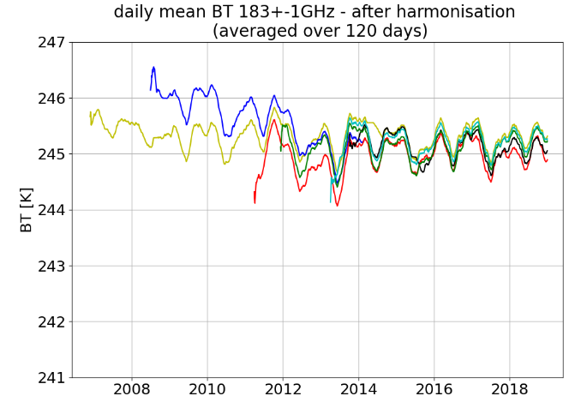
Harmonisation Results
AMSU-B and SSM/T2 are currently being incorporated and a harmonised FCDR for all the instruments will be released in Q3/2023

Slide 11
Summary
EUMETSAT continues to produce and improve microwave sounder FCDRs;
The FCDRs are provided with metrologically traceable uncertainties;
FCDRs are currently available for humidity sounders – SSM/T2, AMSU-B, MHS, MWHS, MWHS-2, and ATMS;
Harmonised FCDRs of the above sensors will be available in Q2/2023;
Started working on temperature sounders – SSMT (MSU, AMSU-A from Q3/2023).

