Slide 1
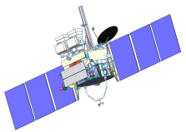
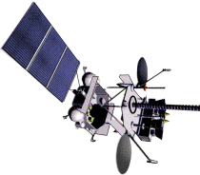
GSICS MW Subgroup Workshop, 02.03.2022
Past, Current, and Future of Russian Microwave Radiometers
A.Uspensky¹, I. Cherny ²
¹ SRC PLANETA, Moscow,
² JSC “Russian Space Systems”, Moscow
with contribution from M. Tsyrulnikov and D.Gaifulin,
Hydrometcenter of Russian Federation

Slide 2
Instrument (Satellite, Launch) | Frequency, GHz | Resolution, km | Swath Width, km | Meteorological Parameters | Type of Instrument
MSU (NOAA 6, 1979) | 50-58 | 110 | 2000 | Temperature Profile | Sounder
SSM/I (DMSP F08, 1987) | 19.3, 22.2, 37.0, 85.5 | 13-69 | 1400 | Integrated Meteoparameters | Imager
SSM/T-1 (DMSP F11, 1991) | 50.5-59.4 | 175 | 1600 | Temperature Profile | Sounder
SSM/T-2 (DMSP F11, 1991) | 91.6, 150, 183.31 | 48 | 1400 | Water Vapor Profile | Sounder
Ikar-Delta (Mir, 1996) | 22.2, 37, 100 | 5-15 | 420 | Integrated Meteoparameters | Imager
AMSU-A (NOAA-K, 1998) | 23.8, 31.4, 50-59 , 89 | 50 | 2340 | Temperature Profile | Sounder
AMSU-B (NOAA-K, 1998) | 89, 157, 183.31 | 15 | 2200 | Water Vapor Profile | Sounder
MIVZA (Meteor-3М №1, 2001) | 20, 35, 94 | 25-110 | 1500 | Integrated Meteoparameters | Imager
МТVZA (Мeteor-3М №1, 2001) | 18.7, 22.2, 33, 36.5, 42, 48 52-57 91.6, 183.31 | 16-75 | 2200 | Meteoparameters, Temperature and Water Vapor Profiles | Imager/ Sounder
AMSR (Aqua, may 2002) | 6.9, 10.6, 18.7, 23.8, 36.5, 89 | 5-75 | 1400 | Meteoparameters, SST | Imager
WindSat (DMSP Coriolis, January 2003) | 6.8, 10.7, 18.7, 23.8, 37 | 25 | 1025 | Sea Surface Wind Speed and Direction, SST | Imager
SSMIS (DMSP F16, September 2003) | 19.3, 22.2, 37.0, 50.3-59.4 91.6, 150, 183.31 | 13-75 | 1700 | Meteoparameters, Temperature and Water Vapor Profiles | Imager/ Sounder
МТVZA-GY (Meteor-M, 2009, 2014, 2019) | 6.9, 10.6, 18.7, 23.8, 31, 36.5, 42, 48, 52-57 91.6, 183.31 | 16-198 | 1500 | Meteoparameters, Temperature and Water Vapor Profiles, SST | Imager/ Sounder
AMSR 2 GCOM-W1, Май, 2012 | 6.9, 7.3, 10.6, 18.7, 23.8, 37, 89 | 5-35 | 1450 | Meteoparameters, SST | Imager
ATMS, JPSS Suomi NPP, 2011, NOAA 20, 2017 | 23.8, 31.4, 50-57 , 89, 166, 183.31 | 16-74 | 2450 | Temperature and Water Vapor Profiles | Sounde
МТVZA-GY-MP (Meteor-MP, after 2025) | 6.9, 7.3, 10.6, 18.7, 23.8, 31, 36.5, 42, 48, 52-57 91.6, 166, 183.31 | 9-160 | 2200 | Meteoparameters, Temperature and Water Vapor Profiles, SST | Imager/ Sounder

Slide 3
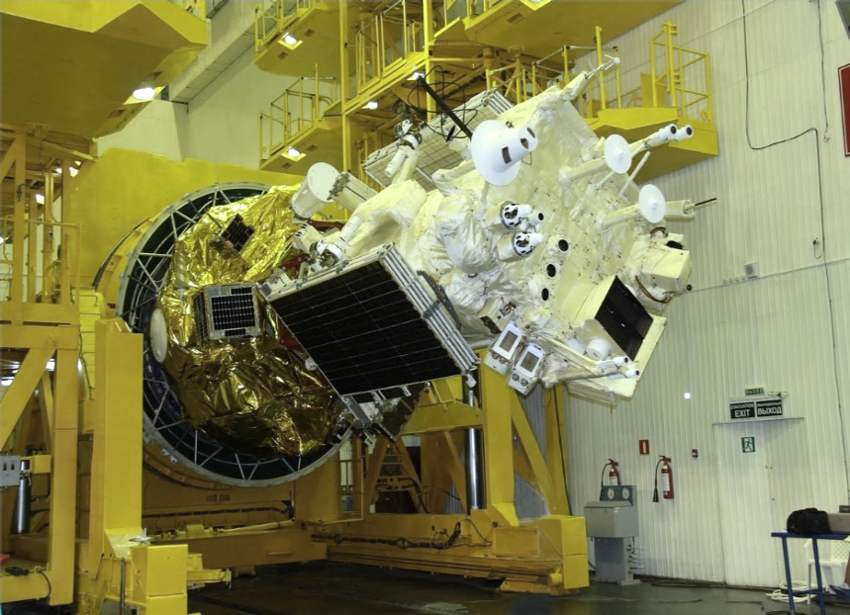
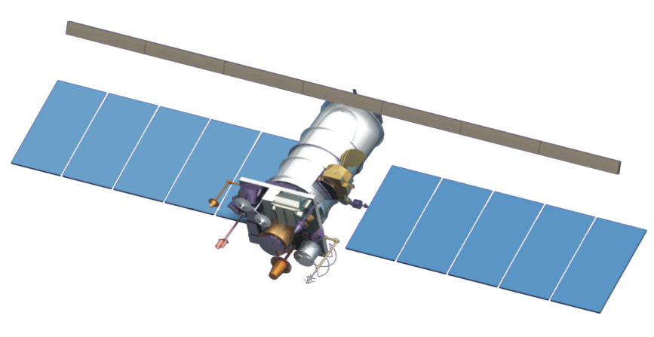
METEOR-M General Design
In-orbit mass – 2700 kg
Payload mass – 1200 kg
Lifetime – 5 years
Orbit – Sun-synchronous
Altitude – 830 km
Data dissemination format – HRPT/LRPT
Russian meteorological satellite Meteor-М N2 was launched
on July 8, 2014

Slide 4
Meteor-M №№ 2, 2-2, 2-3, 2-4, 2-5
Basic Instruments Specifications
Instrument | Application | Spectral band | Swath-width (km) | Resolution (km)
MSU-MR Low-resolution multi-channel scanning unit | Global and regional cloud cover mapping, ice and snow cover observation, forest fire monitoring… | 0,5 – 12,5μm (6 channels) | 3000 | 1 x 1
KMSS Visible spectrum scanning imager | Earth surface monitoring for various tasks (floods, soil and vegetation cover state, ice cover) | 0,4-0,9 μm (3+3 channels) | 450/900 | 0,05/0,1
MTVZA-GY Imager-sounder (module for temperature and humidity sounding of the atmosphere) | Atmospheric temperature and humidity profiles, sea surface wind | 10,6-183,3 GHz (26 channels) | 2600 | 12 – 75
IRFS-2 Advanced IR sounder (infrared Fourier-spectrometer) | Atmospheric temperature and humidity profiles | 5-15 μm | 2000 | 35
“Severjanin-M” Synthetic aperture radar | All-weather Ice coverage monitoring | 9500-9700 MHz | 600 | 0,4 x 0,5
GGAK-M Heliogeophysical instrument suite | Heliogeophysical data providing
BRK SSPD Data Collection System | Data retransmission from DCP

Slide 5
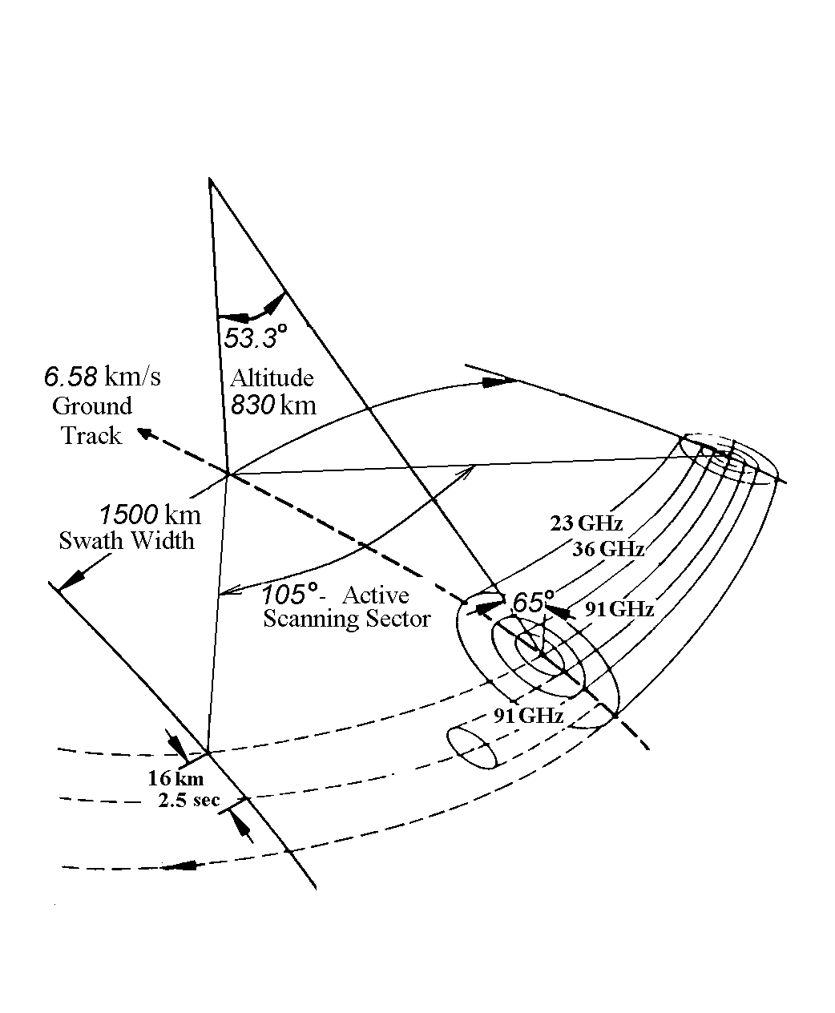
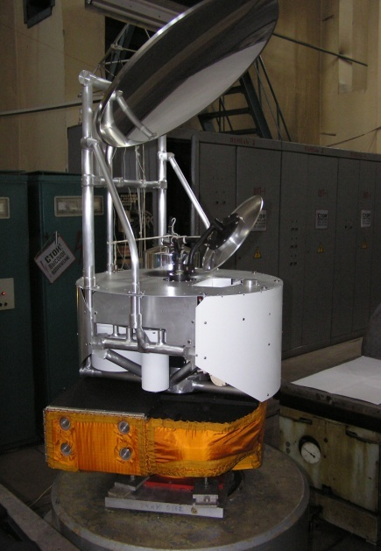
Microwave Imager/Sounder MTVZA-GY
Parameter | Value
Frequencies, GHz | 10.6, 18.7, 23.8, 36.5, 52-57, 91, 183.31
Channels | 29
Antenna Aperture, cm | 65
Spatial Resolution, km | 16-198
Sensitivity, K/pixel | 0.3-1.7
Calibration Accuracy, K | < 1
Swath Width, km | 1800
Conical Scanning Period, s | 2.5
Data Rate, Kbit/s | 35
Mass, kg | 94
Power , W | 80
Scheme of scanning
Instrument MTVZA-GY

Slide 6
MTVZA GY Sensor Characteristics

Slide 7
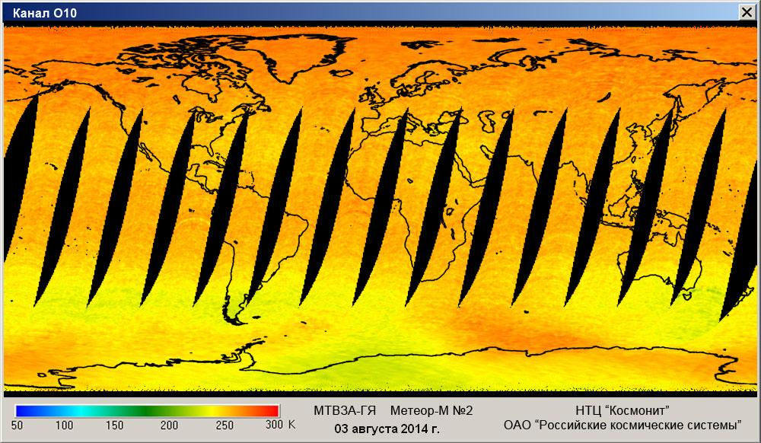
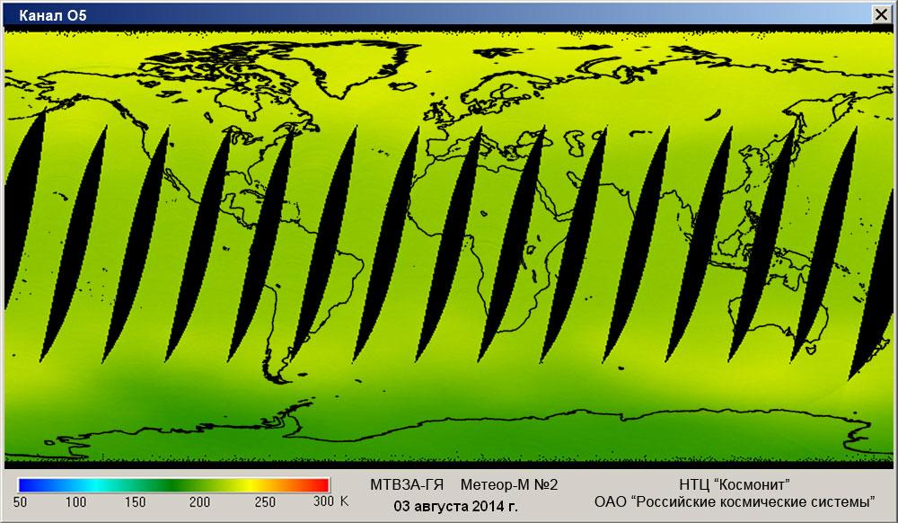
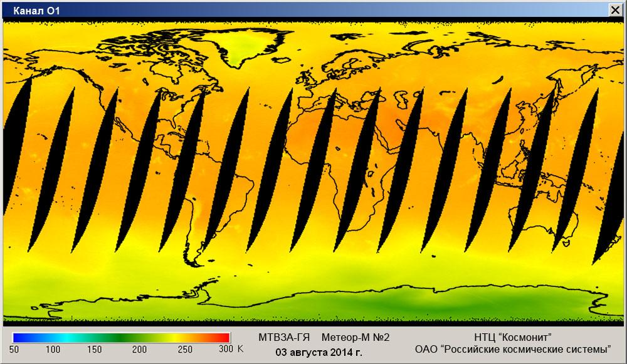
MTVZA-GY measurements in 52-57 GHz channel. «Meteor-M» №2-2, 30.09.2019.
57.2903 ± 0.3222 ± 0.005 ГГц
42 км
55.63 ГГц
14 км
2 км
52.80 ГГц

Slide 8
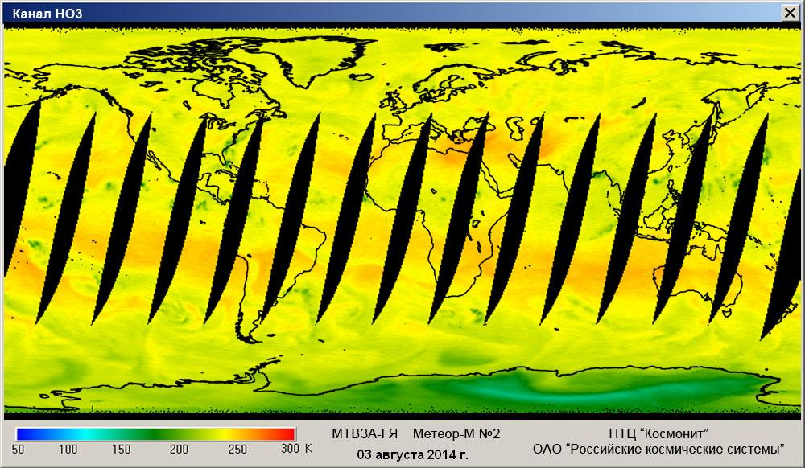
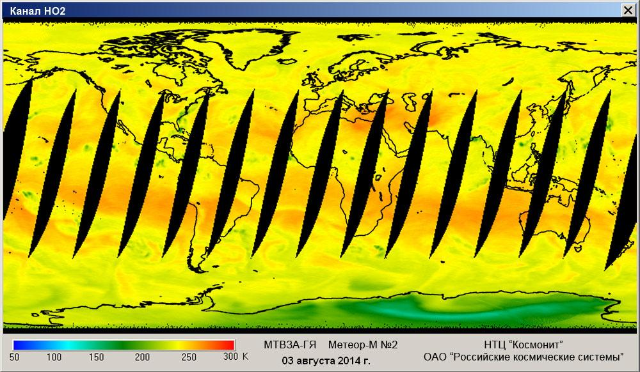
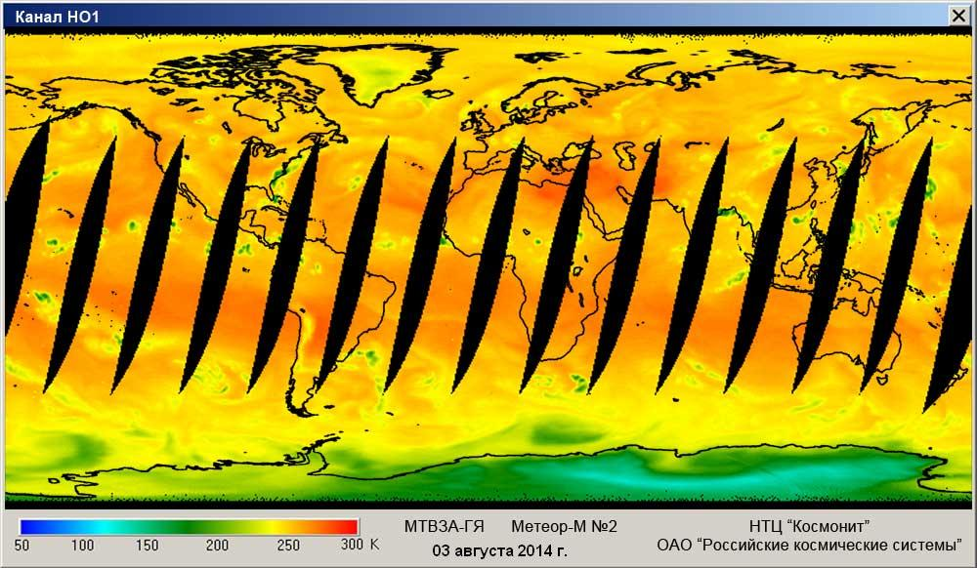
MTVZA-GY measurements in 183.31 GHz channels. «Meteor-M» №2-2, 30.09.2019.
183.31±1.00 ГГц
183.31±1.40 ГГц
183.31±3.00 ГГц
183.31±7.00 ГГц

Slide 9
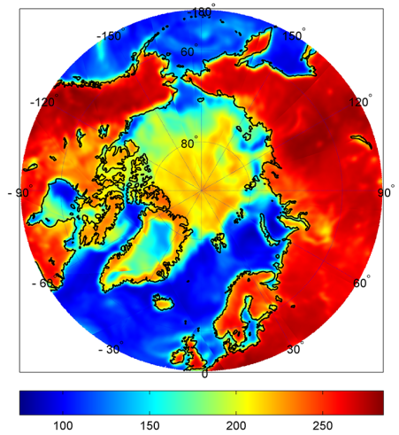
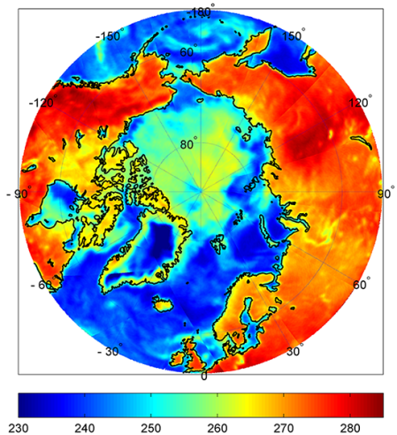
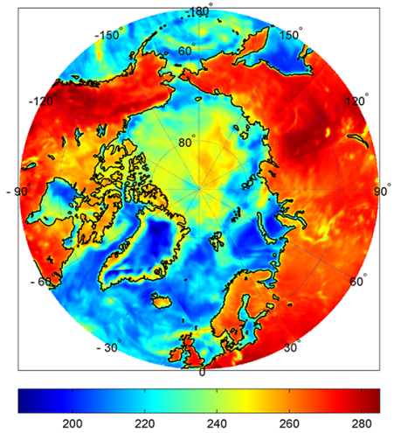
MTVZA-GY measurements in 18.7, 31.5 and 48.0 GHz channels for Arctic region. «Meteor-M» №2-2, 30.09.

Slide 10
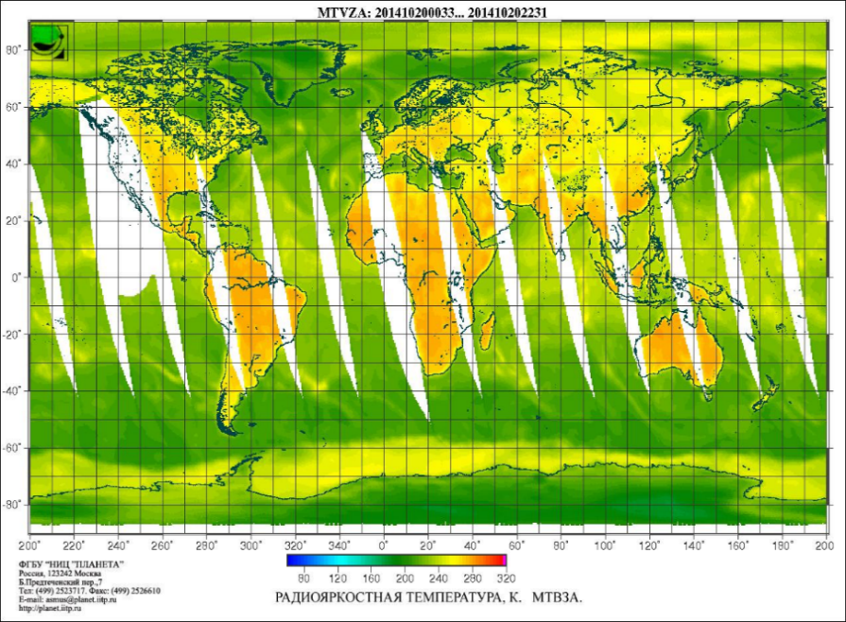
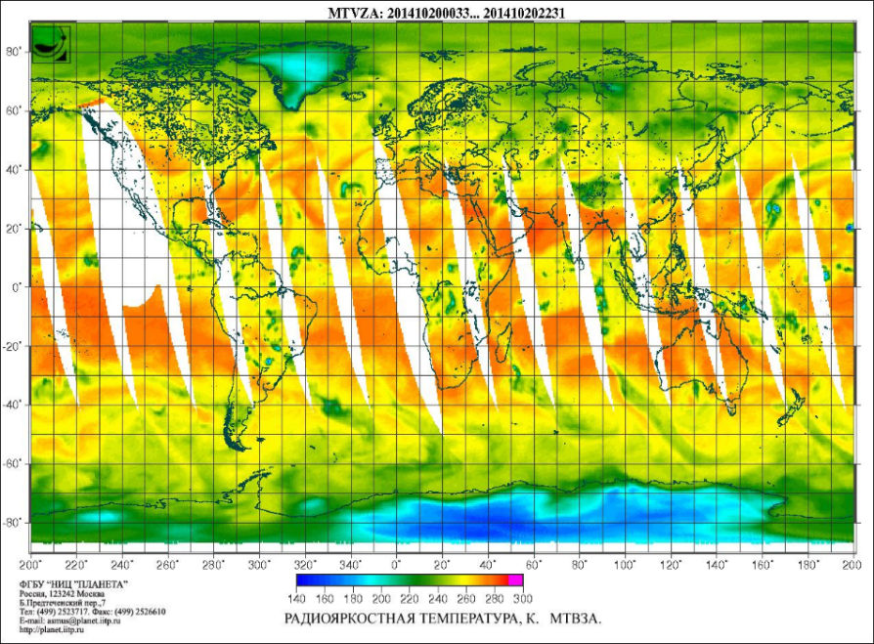
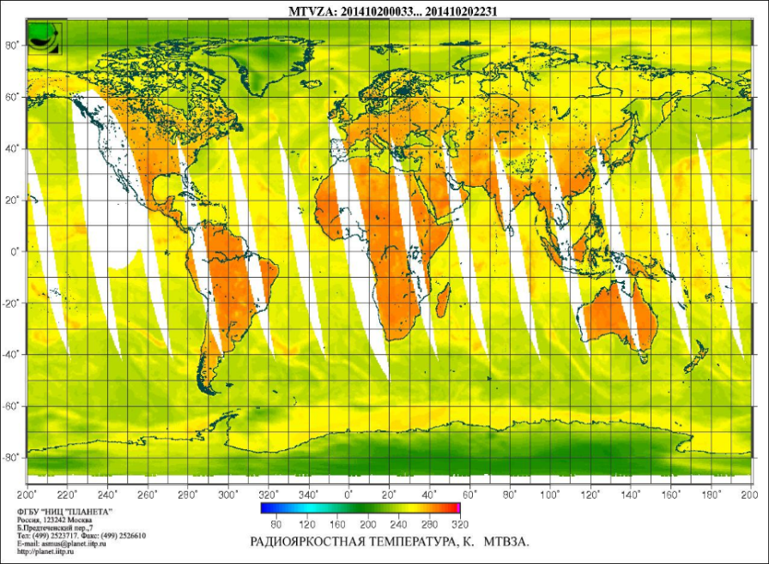
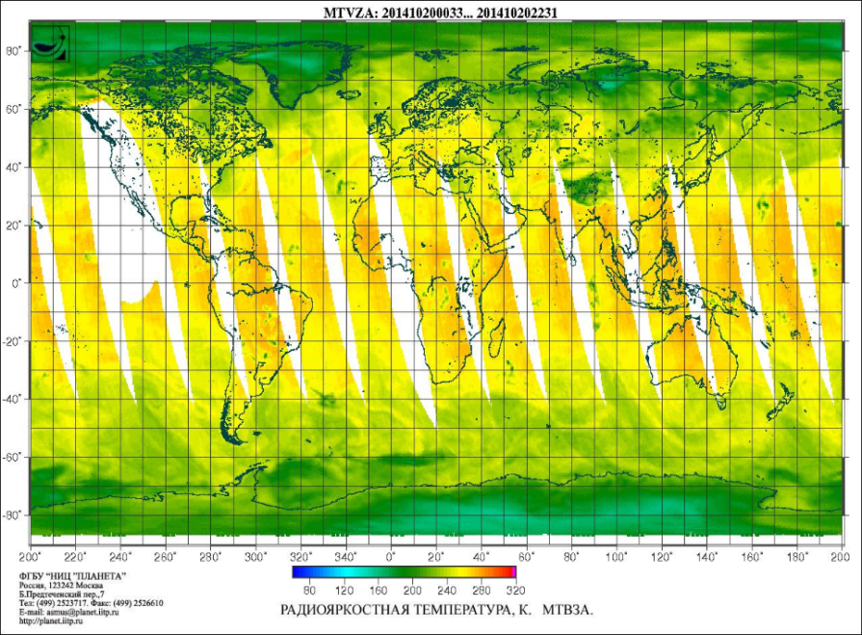
MTVZA-GY global data in channels 18.7v, 36.5v, 52.8v, 183.31±7h GHz

Slide 11
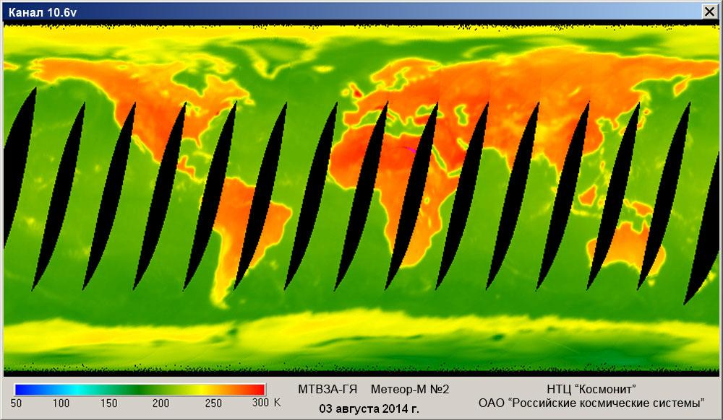
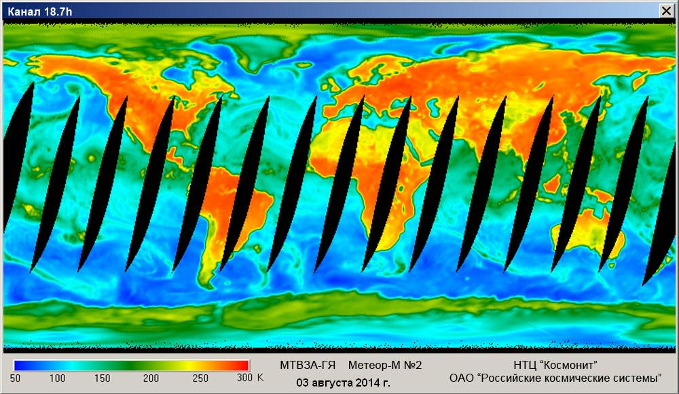
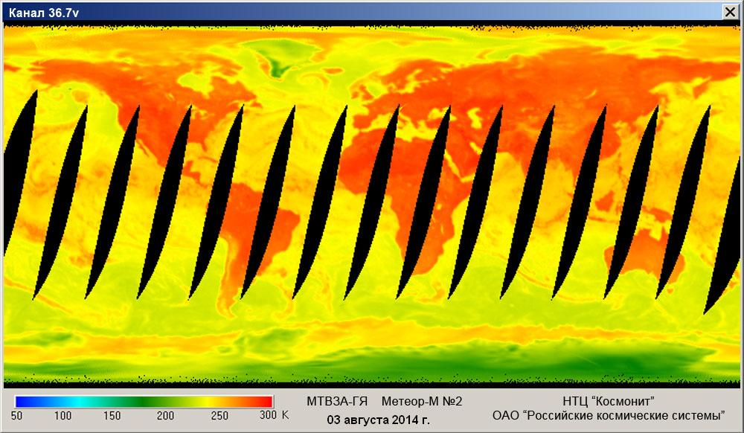
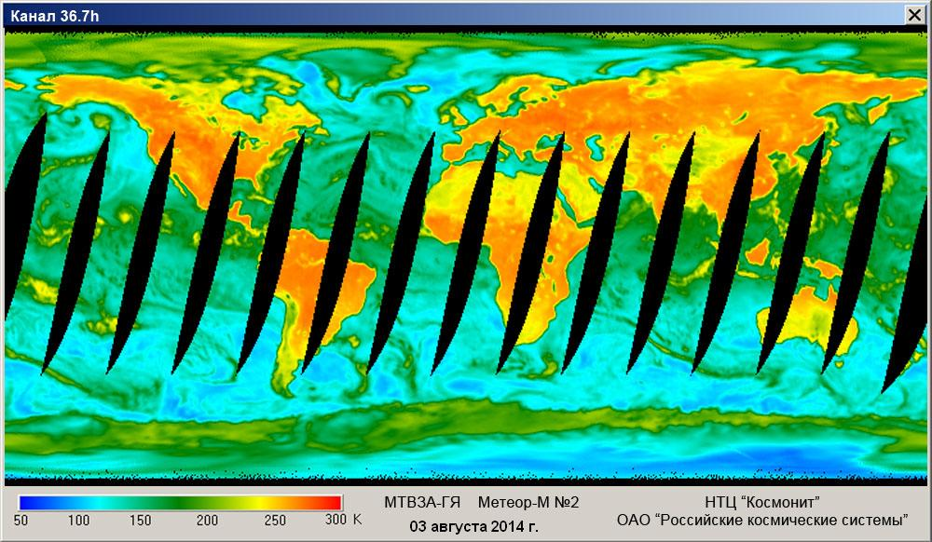
MTVZA-GY measurements in 10.6 GHz (V), 18.7 GHz (H), 36.5 GHz (V) и 36.5 GHz (H) channels. «Meteor-M» №2-2, 30.09.2019.

Slide 12
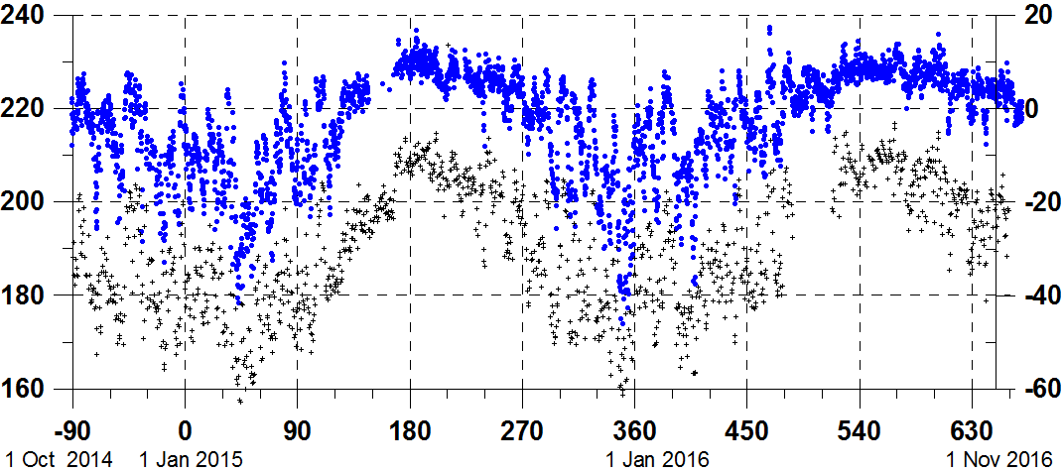
Time series of the MTVZA-GY observations at 183.31 ± 3.0 GHz (the blue dots) over the Greenland Summit station from October 1, 2014 to November 1, 2016. The dark dots are the air surface temperature.

Slide 13
Meteor-M N2 Data Dissemination
1. Direct broadcast MSU-MR and MTVZA-GY data are currently being disseminated at 1.7 GHz band in direct broadcast mode (HRPT-like). Data format description is available at SRC Planeta WEB-site http://planet.iitp.ru/english/spacecraft/meteor_m_n2_structure_eng.htm
2. Global data access MTVZA instrument data, declared as Essential according to Roshydromet-EUMETSAT bilateral Agreement, is available in HDF format to EUMETSAT third party service in near-real time via FTP channel, free to be redistributed to all interested parties.
3. L2 products access Some L2 products are regularly generated by SRC Planeta and can be accessed via SRC Planeta WEB-site.

Slide 14
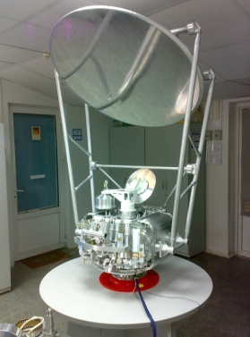
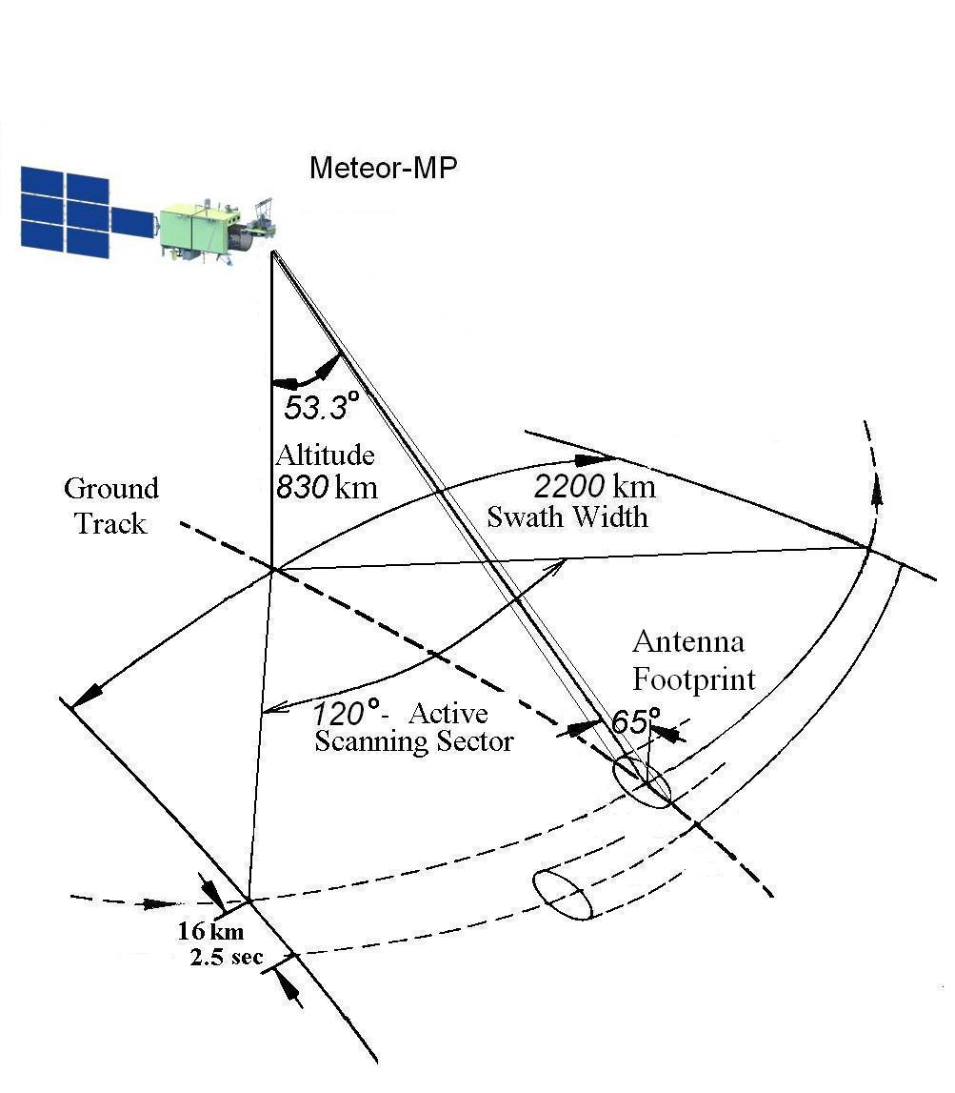
MTVZA-GY-MP scanning geometry
The advanced microwave radiometer MTVZA-GY-MP onboard the new Russian meteorological satellite Meteor-MP will provide the
quantitative information about characteristics of the land surface, ocean, troposphere and lower stratosphere within the swath width 2200 km.
The advanced microwave radiometer MTVZA-GY-MP onboard the new Russian meteorological satellite Meteor-MP will provide the quantitative information about characteristics of the land surface, ocean, troposphere and lower stratosphere within the swath width 2200 km.

Slide 15
MTVZA-GY-MP performance characteristics
Frequencies (GHz) | 6.925, 7.3, 10.6, 18.7, 23.8, 31.5, 36.5, 42.0, 48.0, 52.8-57.3, 91.65, 165.5, 183.31
Spatial Resolution (km) | 9-160
Swath Width (km) | 2200
Conical Scanning Period (sec) | 2.5
Instability of Scanning Period | 10⁻⁴
Mass (kg) | 120
Power Consumed (W) | 95
The advanced microwave radiometer MTVZA-GY-MP onboard the new Russian meteorological satellite Meteor-MP will provide the quantitative information about characteristics of the land surface, ocean, troposphere and lower stratosphere within the swath width 2200 km.

Slide 16
Forty radiometric channels of MTVZA-GY-MP have operating frequencies in the atmospheric windows of 6.9, 7.3, 10.6, 18.7, 23.8, 31, 36.5, 42.0, 48.0, 91, and 165 GHz, as well as in the oxygen absorption band (52–57 GHz) and close to the water vapor absorption line 183.31 GHz. The instrument antenna aperture is 1.0 m, which allows improving the horizontal spatial resolution by 1.5 times as compared to MTVZA-GYa. The MTVZA-GYa-MP band will be equal to 2500 km from the orbit at the altitude of 830 km.

Slide 17
The MTVZA-GYa-MP combines functions of the imager, atmospheric sounder, and polarimeter (the third Stokes parameter is measured at the frequencies of 18.7 and 36.5 GHz). Polarimetric measurements are intended for retrieving the speed and direction of sea surface wind. An essential feature of MTVZA-GYa-MP is an increase in the number of channels for the humidity sounder from three in MTVZA-GYa to six in the range of 165–190 GHz, which should improve the accuracy and vertical resolu- tion of estimated air humidity profiles. The additional channel with a frequency of 6.9 GHz was introduced for more accurate estimation of sea surface temperature and soil moisture. The introduction of the channel with a frequency of 7.3 GHz will provide the estimation of sea surface temperature in case of data noise in the channel of 6.9 GHz due to radio frequency interference.

Slide 18
MTVZA-GY-MP microwave frequency channel characteristics
Center Frequency (GHz) | Polarization | Bandwidth (MHz) | Antenna Footprint (kmxkm) | Imagery Pixel size (kmxkm) | Sensitivity (K/pixel)
6.925 | V, H | 350 | 73х160 | 32х32 | 0.3
7.3 | V, H | 350 | 73х160 | 32х32 | 0.3
10.65 | V, H | 100 | 58x129 | 32х32 | 0.5
18.7 | V, H, V-45º, V+45º | 200 | 34x75 | 32х32 | 0.4
23.8 | V, H | 400 | 28x62 | 32х32 | 0.3
31.5 | V, H | 1000 | 23x49 | 32х32 | 0.3
36.5 | V, H, V-45º, V+45º | 1000 | 20x44 | 32х32 | 0.3
42 | V, H | 1000 | 17x39 | 32х32 | 0.4
48 | V, H | 1000 | 16x38 | 32х32 | 0.4
91.655 | V, H | 2000 | 9x19 | 16x16 | 0.6
52.80 | V | 400 | 14x31 | 32х32 | 0.4
53.30 | V | 400 | 14x31 | 32х32 | 0.4
53.80 | V | 400 | 14x31 | 32х32 | 0.4
54.64 | V | 400 | 14x31 | 32х32 | 0.4
55.63 | V | 400 | 14x31 | 32х32 | 0.4
F₀±0.1 | H | 50 | 14x31 | 48x48 | 0.4
F₀±0.05 | H | 20 | 14x31 | 48x48 | 0.7
F₀±0.025 | H | 10 | 14x31 | 48x48 | 0.9
F₀±0.01 | H | 5 | 14x31 | 48x48 | 1.3
F₀±0.005 | H | 3 | 14x31 | 48x48 | 1.7
165.5 | V | 3000 | 9x19 | 32х32 | 0.6
183.31 ± 1.0 | V | 500 | 9x19 | 32х32 | 0.8
183.31 ± 1.8 | V | 1000 | 9x19 | 32х32 | 0.6
183.31 ± 3.0 | V | 1000 | 9x19 | 32х32 | 0.6
183.31 ± 4.5 | V | 2000 | 9x19 | 32х32 | 0.5
183.31 ± 7.0 | V | 2000 | 9x19 | 32х32 | 0.5

Slide 19
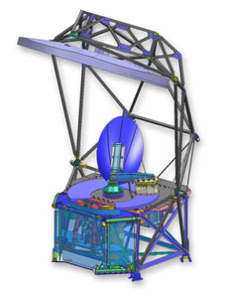
Future MTVZA-GY-MP instrument and MIS
MTVZA-GY-MP (Meteor-MP) | MIS (DWSS), USA

Slide 20
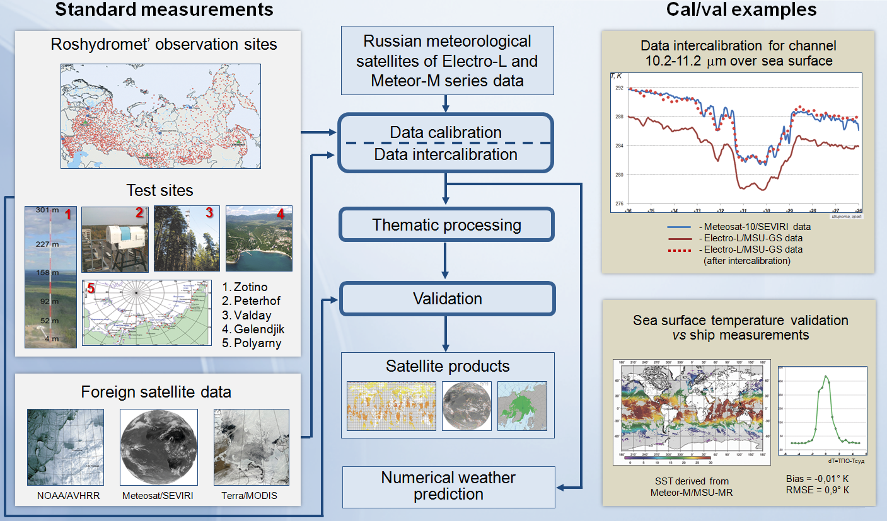
CAL/VAL System for Satellite Data and Products

Slide 21
Channel numbering in MTVZA-GY HDF data sets and RTTOV v12
Channel no in MTVZA-GY data file (HDF) | Channel no in RTTOV coefficient’s file | Central frequency and polarisation, GHz | Channel name (atmospheric sounding channels)
1 | 1 | 10.6V
2 | 2 | 10.6H
3 | 3 | 18.7V
4 | 4 | 18.7H
5 | 5 | 23.8V
6 | 6 | 23.8H
7 | 9 | 36.7V
8 | 10 | 36.7H
9 | 25 | 91.65V
10 (unavailable) | 26 | 91.65H
11 | 15 | 52.80V | O1
12 | 16 | 53.30V | O2
13 | 17 | 53.80V | O3
14 | 18 | 54.64V | O4
15 | 19 | 55.63V | O5
16 | 20 | 57+0.32± 0.1H | O6
17 | 21 | 57+0.32± 0.05H | O7
18 | 22 | 57+0.32± 0.025H | O8
19 | 23 | 57+0.32± 0.01H | O9
20 | 24 | 57+0.32± 0.005H | O10
21 | 29 | 183.31±1.4 | HO3
22 | 27 | 183.31±7.0 | HO1
23 | 28 | 183.31±3.0 | HO2
24 (unavailable) | - | -
25 (unavailable) | - | -
26 | 7 | 31.5V
27 | 8 | 31.5H
28 (unavailable) | - | -
29 (unavailable) | - | -

Slide 22
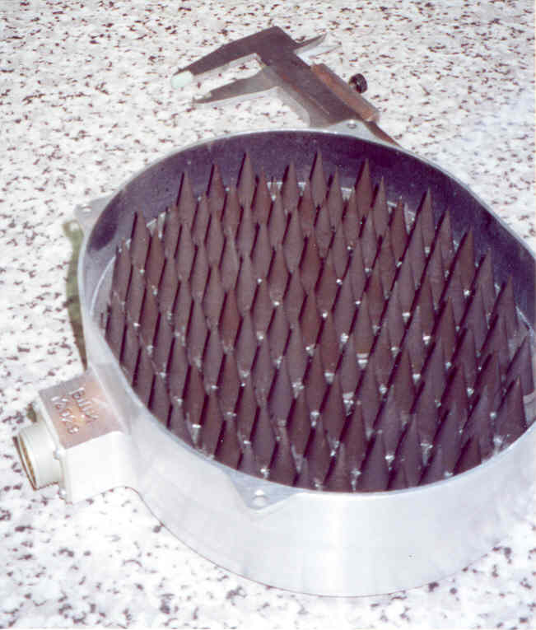
Onboard calibration (signal to TDR)
Two-point calibration scheme: warm load and space
r < 0.0001
δr = ±0.000001
Microwave
Radiometer
ε = 1 – r = 0.9999…
Т₀ =300 К
Т_{b} = εТ₀
ΔТ_{b}≤0.05 К
Space
Т_{b}=(2.725±0.006) К
Microwave
Radiometer

Slide 23
Post-launch radiometric calibration and validation of MTVZA-GY channels
Post-launch absolute calibration algorithm is based on comparison between observed radiances (antenna brightness temperatures) and RTTOV-simulated radiances (sensor brightness temperatures), and linear regression.
The calibration models (three in total) convert the antenna temperature Ta into the brightness temperature TB using a regression. The two regression coefficients a and b are being treated as functions of two arguments: solar zenith angle and solar azimuth angle.
23

Slide 24
Calibration techniques
2) TB = a(t)Ta + b(t)- evolving in time but constant in space coefficients a, b. This approach uses temporal “on-line" smoothing of the a and b coefficients for each of the 6-hours time spacing intervals.
3) TB = a(α;ζ ) Ta + b(α;ζ ) - evolving in time and in space coefficients a, b.
α, ζ- solar azimuth and zenith angles (Solar Angle Correction). The fields a(α;ζ) and b(α;ζ) are defined on a grid in the α- ζ plane. The coefficients are cyclically updated every 6 hours using deviations of the antenna temperatures from the reference as observations.
1) TB = aTa + b, where a=const and b=const are the regression coefficients estimated using least squares from a training sample of the observed Ta's and the collocated reference Tb's computed by the RTTOV from 6h GFS NCEP forecast fields (simplest approach );

Slide 25
Operational quality monitoring and control of calibration
The operation of the MTVZA-GYa on board the Meteor-M spacecraft No. 2 (July 2014 – August 2017) and No. 2-2 (July 2019 - present) revealed the need to correct the measured antenna temperatures Ta, obtained after on-board radiometric calibration, when switching to the T_{B} brightness temperature scale. In this regard, a system (methodology and numerical scheme) of MTVZA-GYa measurements operational quality monitoring and control of calibration (in terms of T_{B}) has been developed. To determine the desired T_{B}, the linear regression model T_{B} = a Ta + b is applied in which the regression (calibration) coefficients a, b are estimated using the regularized least squares method and a training sample of spatially combined and synchronous pairs (Ta, reference T_{B}). The training sample is formed for a set of pixels covering natural polygons – the waters of the World Ocean in the latitude zone of ± 60°, and filtered out scenes with heavy clouds and precipitation in the instrument field of view. The radiative transfer model RTTOV (v. 11) together with the 6h GFS NCEP forecasts model as input data (temperature/humidity fields with the resolution 0.25 deg. and the upper level of 1 hPa) is used to calculate the reference T_{B}.

Slide 26
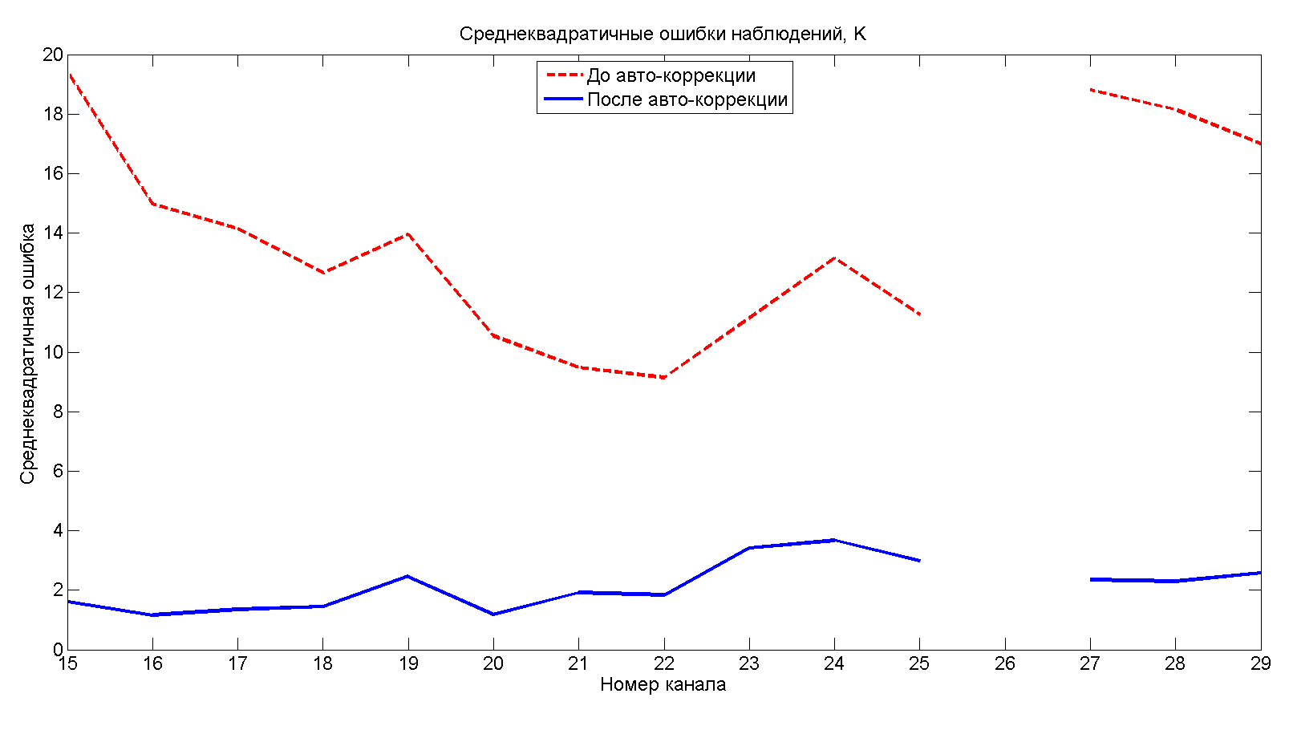
The root-mean-square error of brightness temperature determination in atmospheric channels ( red) before and ( blue) after autocorrection.

Slide 27
The standard deviation of the error in brightness temperature in imaging channels after autocorrection: (1) without the quality control and rejection in the presence of clouds; (2) after the rejection of observations under strong surface wind conditions over sea; (3) after the rejection of observations under strong surface wind conditions over sea and after the rejection using scattering index; ( 4) after the rejection of observations un der strong surface wind conditions over sea, using scattering index, and using polariza tion difference .

Slide 28
Biases and standard deviations of BTs in atmospheric sounding
channels after the last on-orbit calibration
Channel Index | Center Frequency (GHz)& polarization | 19.03.2021 |  | 24.03.2021 |  | 29.03.2021 |  | 03.04.2021 |  | 08.04.2021 |  | 14.04.2021
 |  | Bias | St.dev | Bias | St.dev | Bias | St.dev | Bias | St.dev | Bias | St.dev | Bias | St.dev
15 | 52.8V | 0.18 | 1.41 | 0.21 | 1.42 | 0.09 | 1.37 | 0.03 | 1.41 | -0.02 | 1.35 | 0.30 | 1.41
16 | 53.3V | 0.16 | 1.07 | 0.25 | 1.04 | 0.11 | 0.97 | 0.03 | 1.01 | -0.01 | 1.00 | 0.27 | 1.05
17 | 53.8V | -0.11 | 1.06 | -0.07 | 1.00 | -0.02 | 0.97 | -0.09 | 0.96 | -0.11 | 0.96 | -0.08 | 1.05
18 | 54.64V | 0.04 | 1.31 | 0.18 | 1.39 | -0.01 | 1.34 | -0.08 | 1.34 | 0.01 | 1.18 | 0.05 | 1.05
19 | 55.63V | 0.24 | 1.43 | 0.12 | 1.26 | 0.04 | 1.13 | -0.06 | 1.03 | 0.06 | 1.26 | 0.20 | 1.21
23 | 57±0.1H | 0.11 | 1.17 | 0.18 | 1.17 | 0.01 | 1.15 | 0.00 | 1.12 | 0.03 | 1.24 | 0.12 | 1.12
27 | 183±7V | 0.20 | 2.69 | 0.03 | 2.64 | -0.28 | 2.61 | -0.05 | 2.73 | -0.15 | 2.61 | 0.22 | 2.65
28 | 183±3V | -0.05 | 2.38 | -0.02 | 2.39 | -0.16 | 2.31 | -0.04 | 2.41 | 0.03 | 2.29 | 0.29 | 2.40
29 | 183±1.4V | -0.10 | 2.31 | -0.15 | 2.33 | -0.14 | 2.32 | -0.11 | 2.41 | -0.01 | 2.38 | 0.24 | 2.41

Slide 29
Biases and standard deviations of BTs in atmospheric sounding
channels

Slide 30
Conclusion
Post-launch calibration was explored using RTM calculations and GFS NCEP data.
The results for MTVZA-GY are similar to early results from the SSMIS instruments on DMSP.
MTVZA-GY instrument performance proved to be stable and is according to specs.
For the most channels there were large air-mass dependent biases. After the post-launch calibration the biases are within limits except for the stratospheric channels (O7-O10). Bias distribution now became more like normal Gaussian type for most channels.
The stripping noise in most channels was also detected, especially for the humidity sounding channels.
30

Slide 31
REFERENCES
I. A. Barsukov, V. V. Boldyrev, M. I. Gavrilov, et al. Satellite Microwave Radiometry for Earth Remote Sensing,” Raketno-kosmicheskoe Priborostroenie i Informatsionnye Sistemy, No. 1, 8 (2021) [in Russian].
D. R. Gayfulin, M. D. Tsyrulnikov, A. B. Uspensky, et al. The Usage of MTVZA-GYa Satellite Microwave Radiometer Observations in the Data Assimilation System of the Hydrometcenter of Russia, Meteorol. Gidrol., No. 9 (2017) [Russ. Meteorol. Hydrol., No. 9, 42 (2017)].
M. D. Tsyrulnikov, D. R. Gayfulin, P. I. Svirenko, and A. B. Uspensky. Assimilation of Observation from Meteorological Satellites in the Hydrometcenter of Russia. ISSN 1068-3739, Russian Meteorology and Hydrology, 2021, Vol. 46, No. 12, pp. 856–865.
A. B. Uspensky, V. V. Asmus, A. A. Kozlov, et al. Absolute Calibration of MTVZA-GYa Satellite Microwave Radiometer Atmospheric Sounding Channels, Issled. Zemli iz Kosmosa, No. 5 (2016).
A. B. Uspensky, Yu. M. Timofeev, D. A. Kozlov, and I. V. Cherny. Development of Methods and Instruments for Remote Temperature and Humidity Sensing of the Earth’s Atmosphere. Russian Meteorology and Hydrology, 2021, Vol. 46, No. 12, pp. 821–829.
D. Gayfulin, M. Tsyrulnikov, and A. Uspensky. Assessment and Adaptive Correction of Observations in Atmospheric Sounding Channels of the Satellite Microwave Radiometer MTVZA-GY, Pure and Appl. Geophys., 175 (2018).
I.V. Cherny, L.M. Mitnik, M.L. Mitnik, et al. Оn-orbit calibration of the “METEOR-M” Microwave Imager/Sounder, The IEEE Intern. Geosci. and Rem. Sens. Symposium (IGARSS 2010), Honolulu, Hawaii, Proc. IGARSS 2010, pp. 558-561. 2010.
I. Barsukov, G. Cherniavsky, I. Cherny, et al. New Russian meteorological satellite Meteor-M N 2: Sensing of the subsurface, surface and atmospheric characteristics by MTVZA-GY microwave imager/sounder, The IEEE Intern. Geosci. and Rem.Sens. Symposium (IGARSS 2016), Proc. IGARSS 2016, pp. 5528-5531, 2016.
Rublev, A., Ju. Kiseleva, A. Uspensky, et al. On-orbit calibration of Russian satellite instruments: New issues. GSICS Quarterly Spring Issue 2021, Volume 15, No. 1, 2021.

Slide 32
Thank you!

