Slide 1
Inter-calibration of Geostationary Imager Infrared Bands
Using a Hyperspectral Sounder on the Same Platform
Di Di^{1,3} , Jun Li² and Zhenglong Li³
¹School of Atmospheric Physics, Nanjing University of Information Science and Technology, Nanjing, China
²National Satellite Meteorological Center, China Meteorological Administration, Beijing, China
³Cooperative Institute for Meteorological Satellite Studies,
University of Wisconsin-Madison, Madison, WI, USA
References:
Di, D., Liu, Y., Li, J.*, Zhou, R., Li, Z., & Gong, X. (2023). Inter-calibration of geostationary imager infrared bands using a hyperspectral sounder on the same platform. Geophysical Research Letters, 50, e2022GL101628. https://doi.org/10.1029/2022GL101628

Slide 2
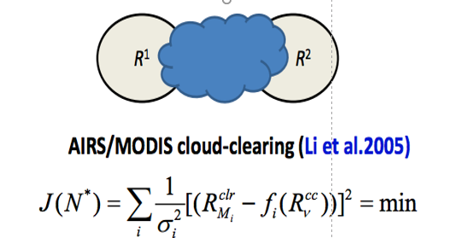
Motivation
GEO-GEO inter-calibrations have advantages
almost cover all scenes(e.g. all angles, large coverage, continuous time), enables users to identify possible scene dependency of calibration uncertainty
Interested in joint application of hyperspectral sounder and imager
have a hyperspectral sounder (GIIRS) and imager (AGRI) on Fengyun-4A satellite
Provide an opportunity for joint application, like cloud-clearing radiance for hyperspectral sounder used in the assimilation (Wang P. et al., 2017; 2019).
It requires the clear radiance components from the hyperspectral sounder are close to that of imager.
Curious about the 'true' accuracies/consistency of GIIRS & AGRI
Lots of assessment work on GIIRS/AGRI using observation and simulation (OMB) from Numerical Weather Prediction Model, like GRAPES –an operational model in CMA and WRF model
Goal: the radiance consistency between the AGRI and GIIRS under different scenes

Slide 3
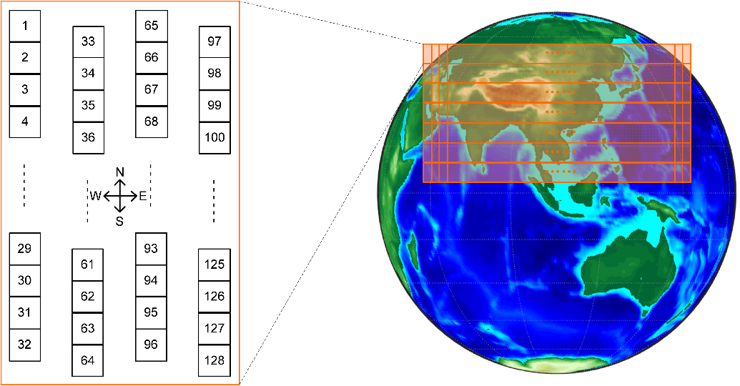
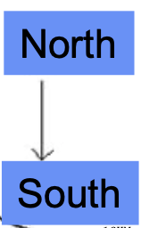
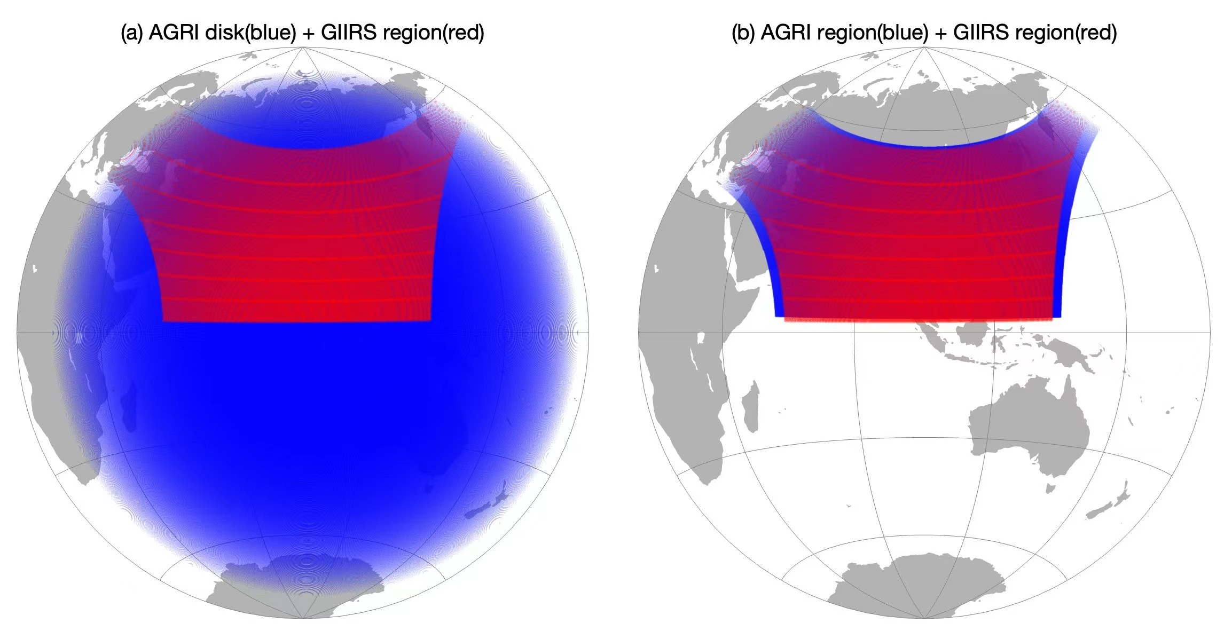
Background
GIIRS/FY-4A detector array, observation coverage and period
GIIRS (Geostationary Interferometric Infrared Sounder)
128 detectors
~ 2 hr for whole region scan
~ 15 min for each horizontal area
including Earth scene (ES), deep space (DS), blackbody (BB), and star sensing
(Guo et al., 2021)
AGRI/FY-4A observation coverage and period
AGRI (Advanced Geosynchronous Radiation Imager)
~ 15 min for full-disk mode
~ 5 min for region mode

Slide 4
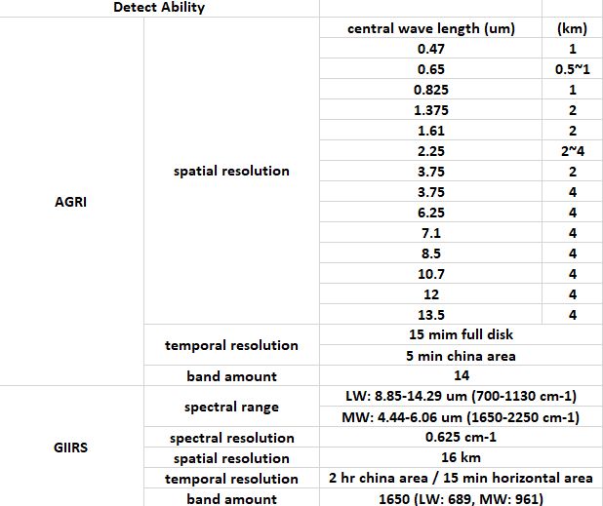
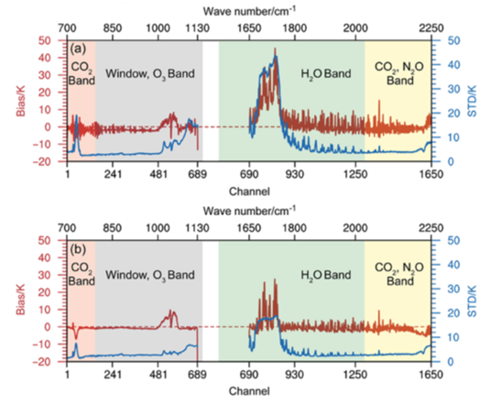
Background
Spectral information of AGRI and GIIRS
OMB results for the GIIRS/FY4A
OMB from WRF
Jun, in 2019
Aug, in 2020
large noise or calibration uncertainty
around 730 cm⁻¹ for the GIIRS
Spectral collocated bands:
One CO₂ absorption band + Two window bands
Tip: The calibration coefficients had been revised in August, October and November of 2019, respectively (Guo et al., 2021).

Slide 5
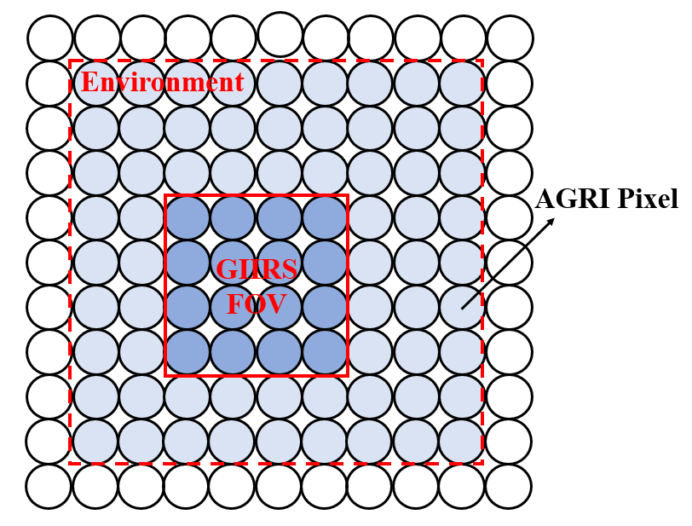
Algorithm
Collocation and Filter for the AGRI/GIIRS inter-calibration pairs
Filter/Constraint | Criteria/Threshold
Collocation in Space | Line-of-Sight (LOS) method (Wang L. et al., 2016)
Concurrent in Time | < 15 min
Collocation in spectrum | Band12 & 13
View geometry | No additional limitation
Scene uniformity | STD/mean BT < 0.02 (Environment: 9 × 9 AGRI pixel) (Hewison et al.,2013)
No additional limitation on viewing geometry
Local Zenith Angle differences between spatial collocated AGRI and GIIRS

Slide 6
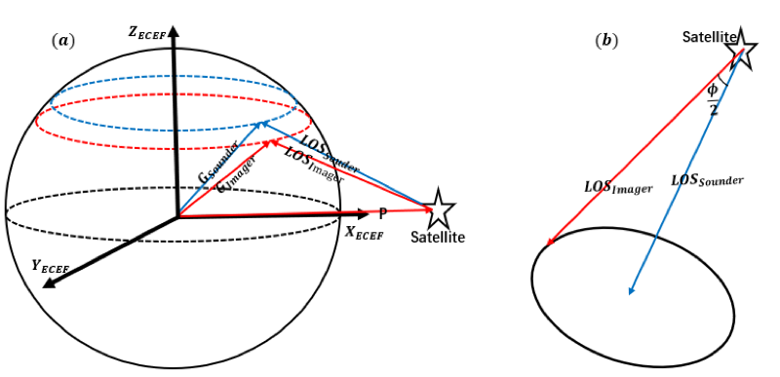
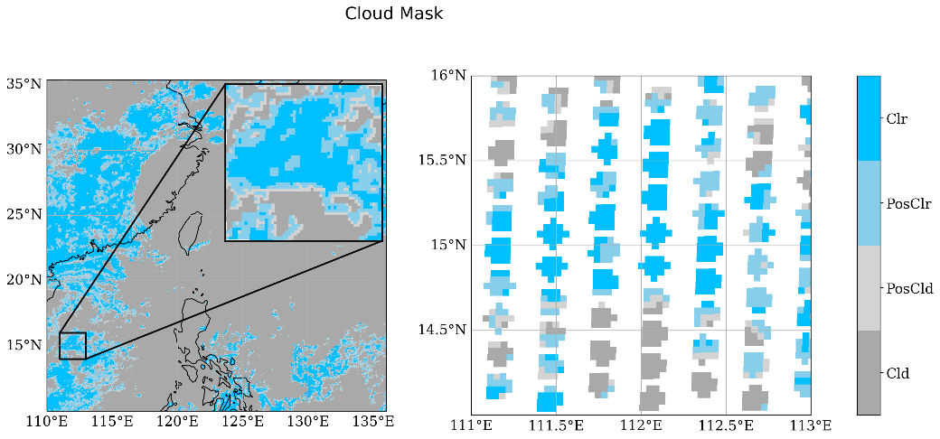
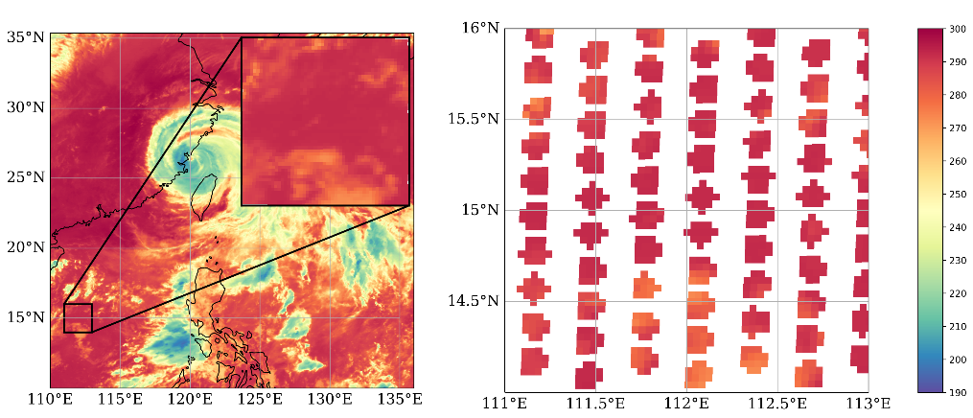
Algorithm
LOS Method – Spatial Collocation
Criteria:
LOS vector difference between the AGRI and GIIRS < GIIRS FOV size angle
AGRI cloud mask
at AGRI pixel (4 km)
AGRI cloud mask
at GIIRS FOV (16 km)
AGRI band 12 BT
at AGRI pixel
AGRI band 12 BT
at GIIRS FOV

Slide 7
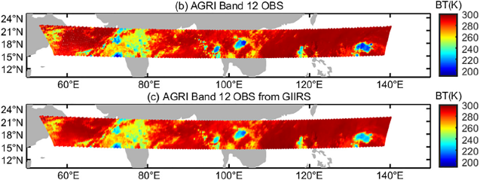
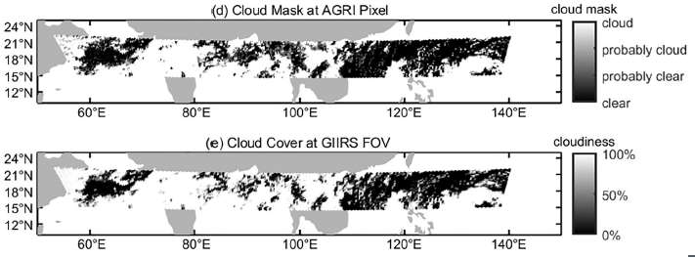
Data
GIIRS & AGRI Level 1b radiance measurements
Time: from 01 to 07 July 2020
AGRI Level 2 product to determine the cloudy scene for the GIIRS FOV

Slide 8
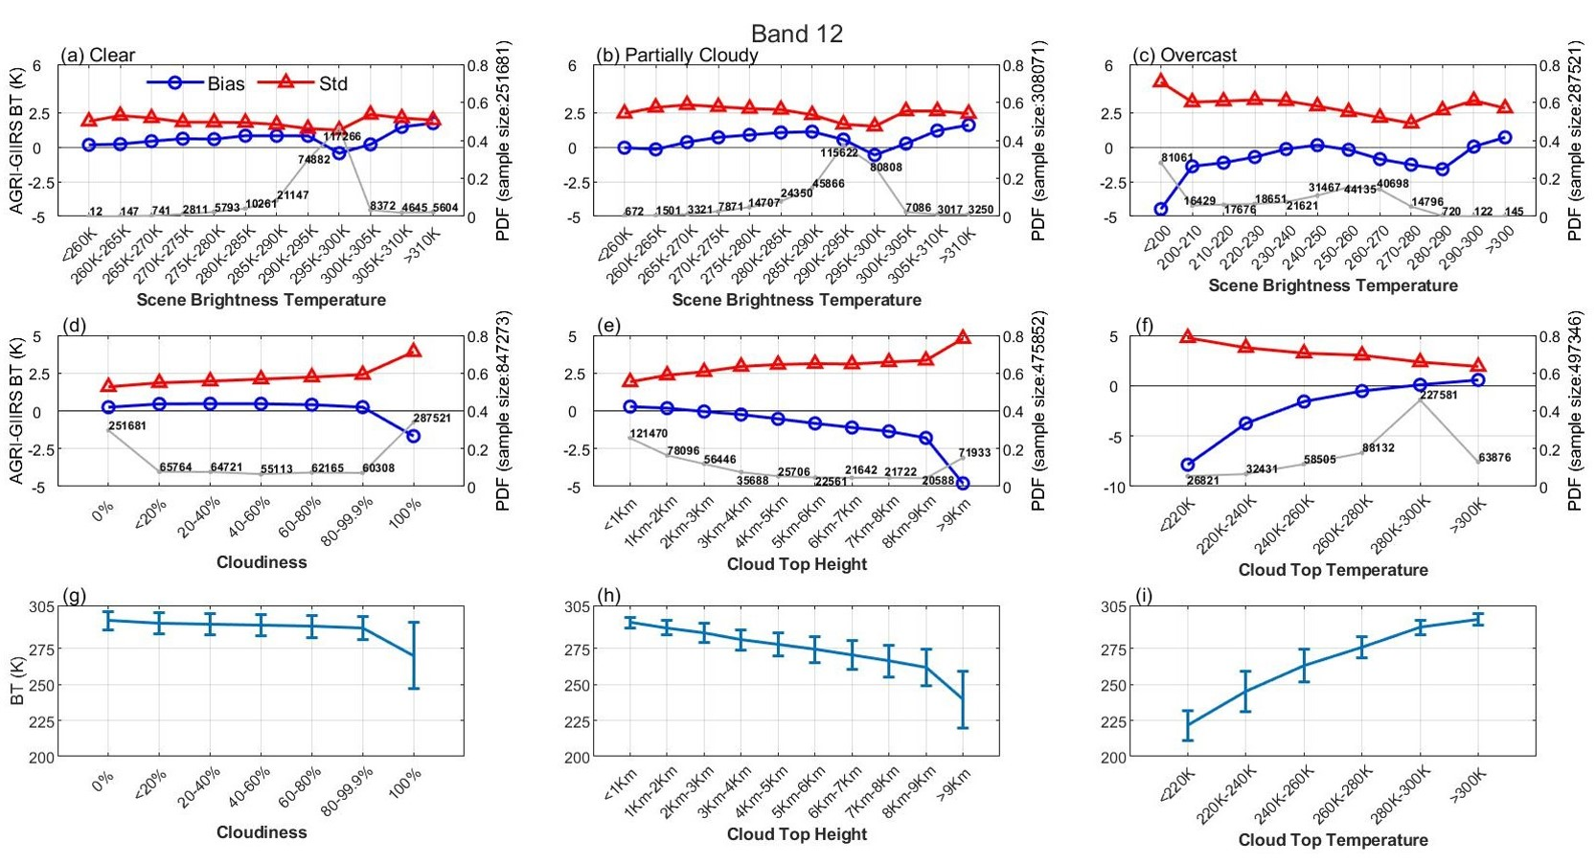
Results
Bias and STD in space of Brightness Temperature (unit: K)
Scene BT
dependency
Cloud Scene dependency
GIIRS Scene BT
Clear skies: less scene/target BT dependence; Cloudy situations: significant scene BT dependence;
BIAS and STD are more influenced by scene brightness temperature than the “presence” of clouds
Why Larger calibration uncertainty in low temperature scenes?
Guess: Might partly caused by larger nonlinearity of the Planck function in low temperature scenes.

Slide 9
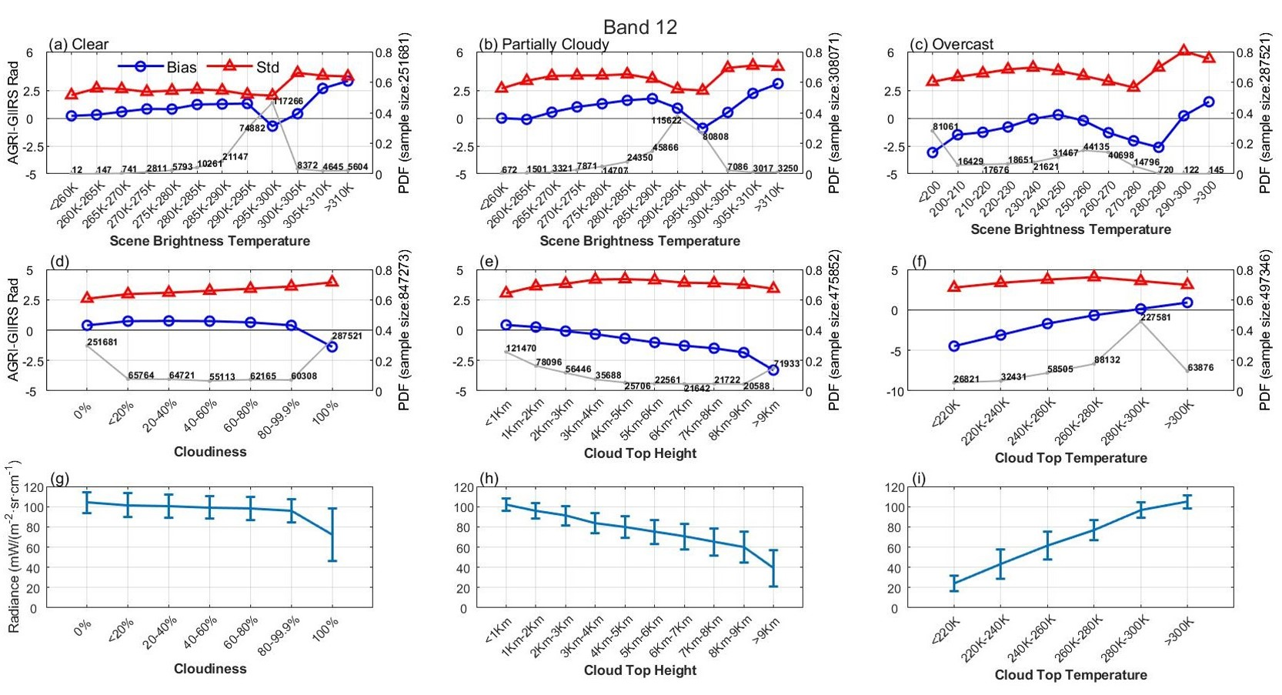
Results
Bias and STD in space of Radiance (unit: mw/(m⁻² sr cm⁻¹))
Scene BT
dependency
Cloud Scene dependency
GIIRS Scene Rad
For the cold scene, the bias decrease fast (more nonlinear) in BT than the bias in radiance (less nonlinear).
It proves the nonlinearity of Planck function makes some contributions to the larger biases for cold scenes.

Slide 10
Results
Why adopt scene BT dependence correction
Considering BIAS between AGRI/GIIRS has significant scene BT dependence.
In order to better analyze bias dependency on cloud cover, land/sea dependence, and scan angle without the obvious influence of the scene BT.
How to do scene BT dependence correction
It is based on the linear fitting method, and is done under clear sky, partially cloudy sky and overcast, as well as different scene BT segments, respectively.
Step 1. Get the relationship between AGRI-GIIRS BT differences (BTDs) and scene BTs using linear fitting method.
Step 2. Correcting BTD use the fitting coefficients from Step1 for each BT Scenes.

Slide 11
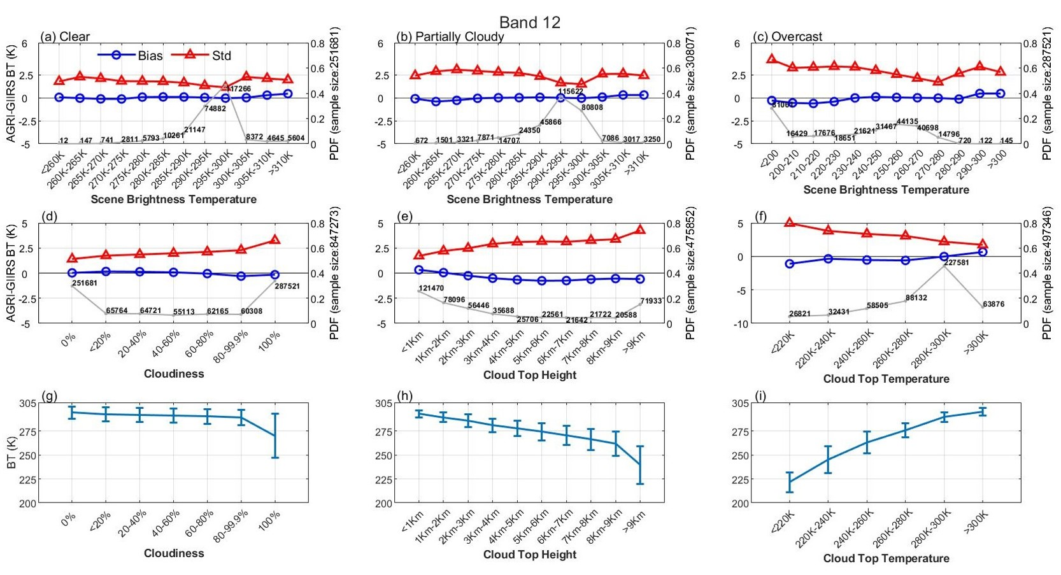
Results
After scene BT dependence correction
Scene BT
dependency
Cloud Scene dependency
GIIRS Scene BT
It proves that BIAS is almost insensitive to the cloudiness, CTH or CTT after radiance scene dependency correction.

Slide 12
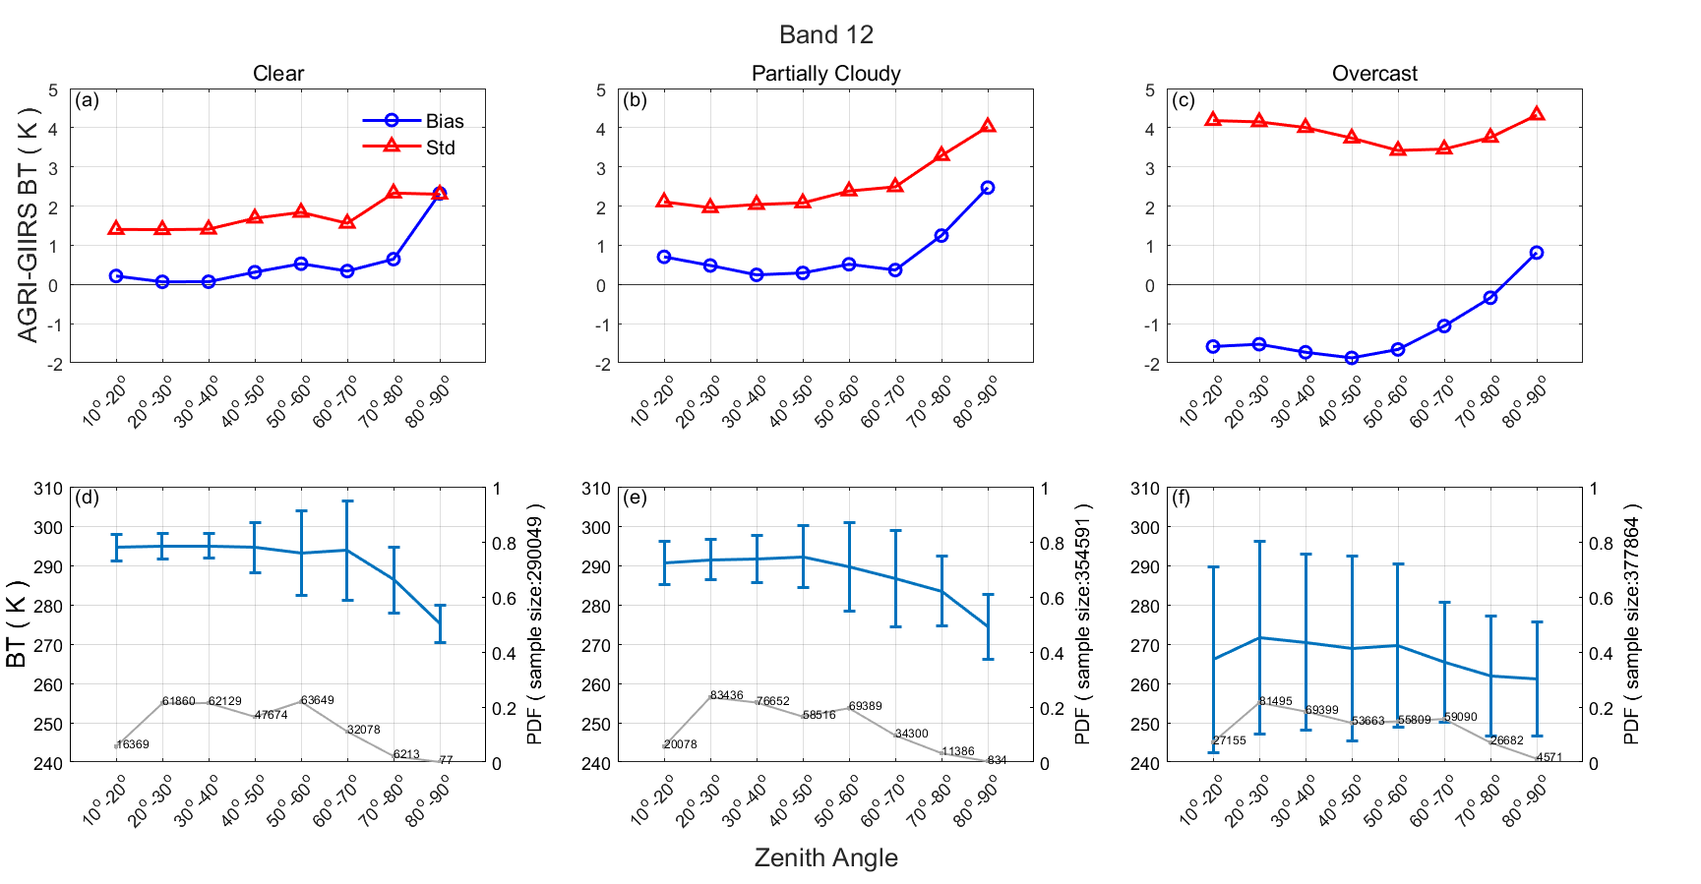
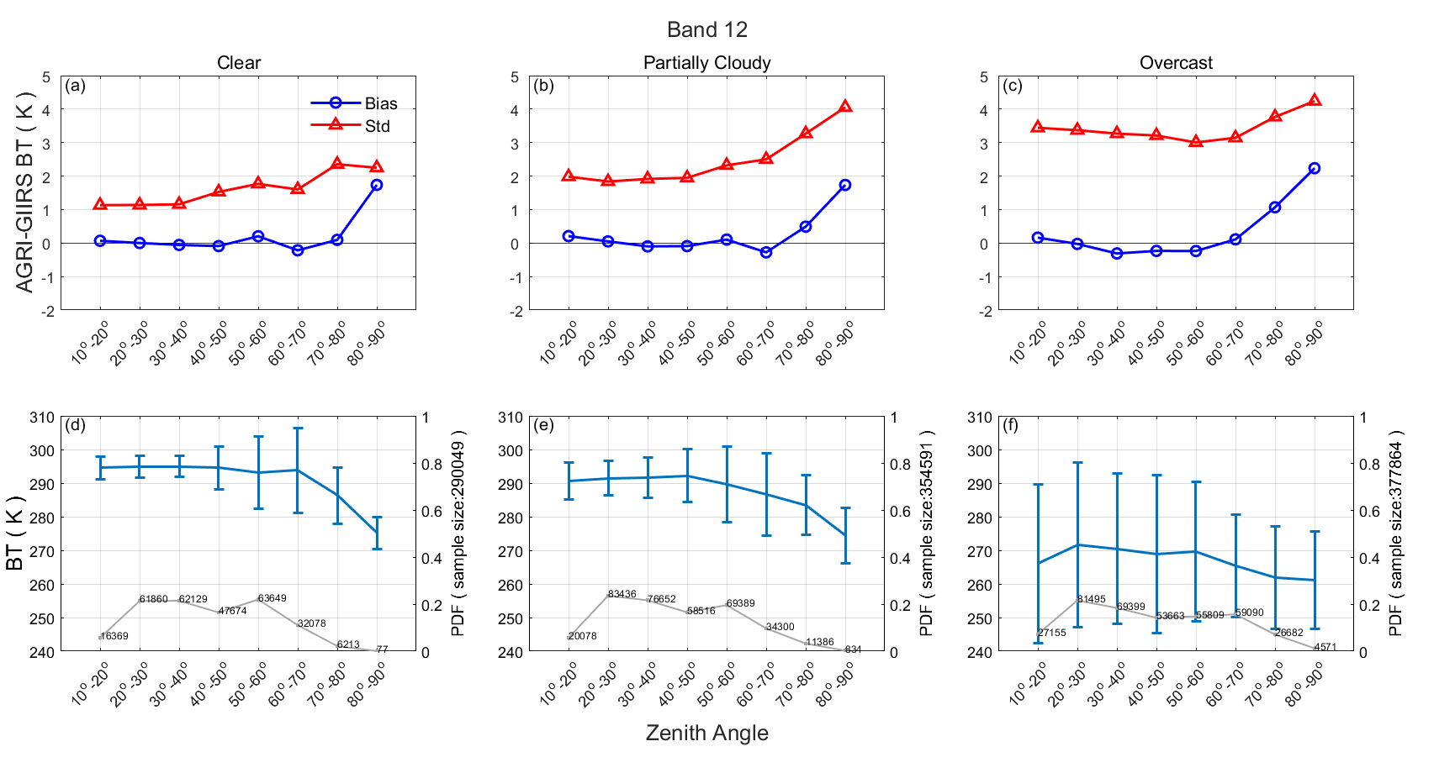
Results
Local zenith angle(LZA) dependence
Before scene BT dependence correction
After scene BT dependence correction
No obvious angle dependence when the LZA is less than 70° under both clear and partially cloudy situations; when LZA is less than 60 ° under overcast situations;
Why Larger calibration uncertainty in larger LZA?
Possible reason
Low temperature Scene? Uniformity test?
Low Spatial collocation accuracy?
Small sample size?
BIAS and STD still increase fast when LZA over
60 – 70 degree, although the bias is smaller after the correction

Slide 13
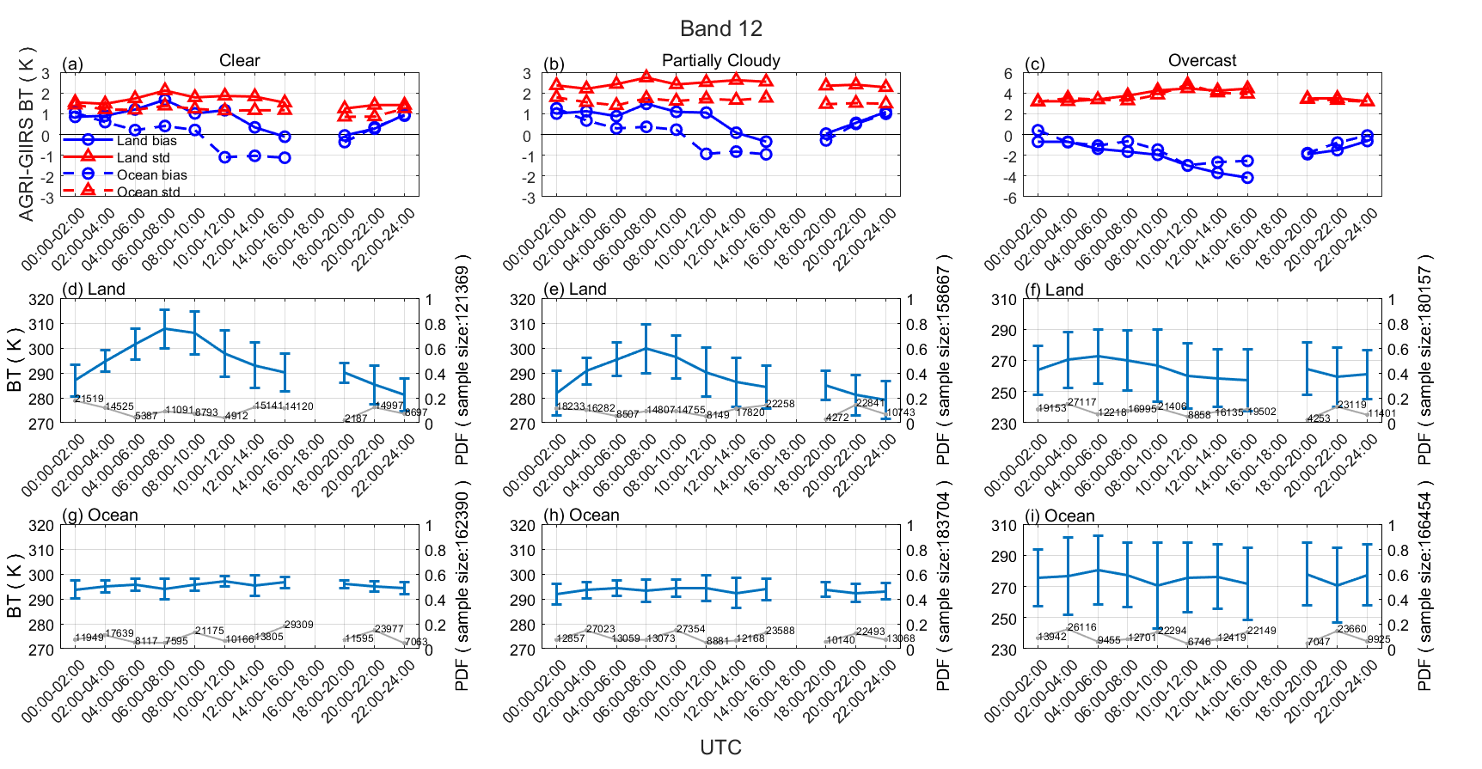
Results
Diurnal variation (with LZA less than 60° )
Land scene BT
Ocean scene BT
Note: the GIIRS sensor does not operate between 1600 and 1800 UTC
For BIAS : Significant BIAS diurnal characteristics; Over land is significant than over ocean under clear/cloudy;
For STD : Relatively stable STD (<0.5 K) under clear and partially cloudy but STD over 2K under on overcast;

Slide 14
Conclusions
Based on the comparison of collocated AGRI band 12 and band 13 with GIIRS measurements from 01 to 07 July 2020 to addresses GEO imager specific calibration questions such as viewing angle dependence, scene (clouds, etc.) depedence, and diurnal characteristics, it is found that:
1. the BT inconsistencies are less scene/target temperature dependent under clear and partially cloudy situations, while under overcast cloudy situations, the scene temperature dependence is significant. The imager calibration uncertainty is more relevant to the temperature of the scene, and the BT inconsistency between AGRI and GIIRS is more noticeable in low temperature scenes (e.g., overcast, high cloud situations).
2. the BT inconsistencies are less dependent on the angle when the LZA is less than 70° under both clear and partially cloudy situations. While under overcast situations, BT inconsistencies increase significantly when the LZA is over 60°.
3. Significant BIAS diurnal characteristics and relatively stable STD under clear and partially cloudy situations; even larger diurnal variations in BIAS and STD under overcast situations

Slide 15
References
Guo, Q., Yang, J., Wei, C., Chen, B., Wang, X., Han, C., et al. (2021). Spectrum calibration of the first hyperspectral infrared measurements from a geostationary platform: Method and preliminary assessment. Quarterly Journal of the Royal Meteorological Society, 147(736), 1562–1583. https://doi.org/10.1002/qj.3981
Hewison, T. J., Wu, X., Yu, F., Tahara, Y., Hu, X., Kim, D., & Koenig, M. (2013). GSICS Inter-Calibration of Infrared Channels of Geostationary Imagers Using Metop/IASI. IEEE Transactions on Geoscience and Remote Sensing, 51(3), 1160–1170. https://doi.org/10.1109/TGRS.2013.2238544
Li, J., Liu, C. Y., Huang, H. L., Schmit, T. J., Wu, X., Menzel, W. P., & Gurka, J. J. (2005). Optimal cloud-clearing for AIRS radiances using MODIS. IEEE Transactions on Geoscience and Remote Sensing, 43(6), 1266-1278.
Wang, L., Cao, C., & Goldberg, M. (2009). Intercalibration of GOES-11 and GOES-12 water vapor channels with MetOp IASI hyperspectral measurements. Journal of Atmospheric and Oceanic Technology, 26(9), 1843-1855.
Wang, L., Tremblay, D., Zhang, B., & Han, Y. (2016). Fast and accurate collocation of the visible infrared imaging radiometer suite measurements with cross-track infrared sounder. Remote Sensing, 8(1), 76.
Wang, P., Li, J., Li, Z., Lim, A. H., Li, J., Schmit, T. J., & Goldberg, M. D. (2017). The impact of Cross-track Infrared Sounder (CrIS) cloud- cleared radiances on Hurricane Joaquin (2015) and Matthew (2016) forecasts. Journal of Geophysical Research: Atmospheres, 122(24), 13201–13218. https://doi.org/10.1002/2017jd027515
Yin, R., Han, W., Gao, Z., & Di, D. (2020). The evaluation of FY4A’s Geostationary Interferometric Infrared Sounder (GIIRS) long-wave temper- ature sounding channels using the GRAPES global 4D-Var. Quarterly Journal of the Royal Meteorological Society, 146(728), 1459–1476. https://doi.org/10.1002/qj.3746

