Slide 1
Angle effects on collocation related to the algorithm improvements
Likun Wang
Univ. of Maryland, College Park, MD; wlikun@umd.edu
2023 GSICS Web Meeting; March 20 2018

Slide 2
Background
A presentation was given by Tim Hewison to improve current GEO-LEO inter-calibration algorithm by resolving several remained issues.
One of the actions is to investigate parallax effects
A.GIR.20230301.1: Likun Wang (NOAA) will investigate parallax effects for GEO-LEO IR v2 algorithm and report back to the IR group in early May 2023.
This study will try to explore a resolution to avoid parallax effects, especially at high view angles.

Slide 3
Content
What are parallax effects?
Review of current GSICS algorithms.
Collocation doing on the earth surface based on latitude and longitude
Use satellite view zenith angle as constrains
Resolution:
More collocated observations
Less parallax effects

Slide 4
Parallax Effects for Inter-calibration on Different Platforms
Both satellites view the targets off nadir
One will see the same target displacement when play two images due to perspective change
Clouds
Terrain
The displacement is determined by view perspective (known) and target altitude (unknow)
Wrong collocation if only use latitude and longitude collocation, especially at cloud edge: one see cloud target and another see surface target
Merucci, L.; Zakšek, K.; Carboni, E.; Corradini, S. Stereoscopic Estimation of Volcanic Ash Cloud-Top Height from Two Geostationary Satellites. Remote Sens. 2016, 8, 206.

Slide 5
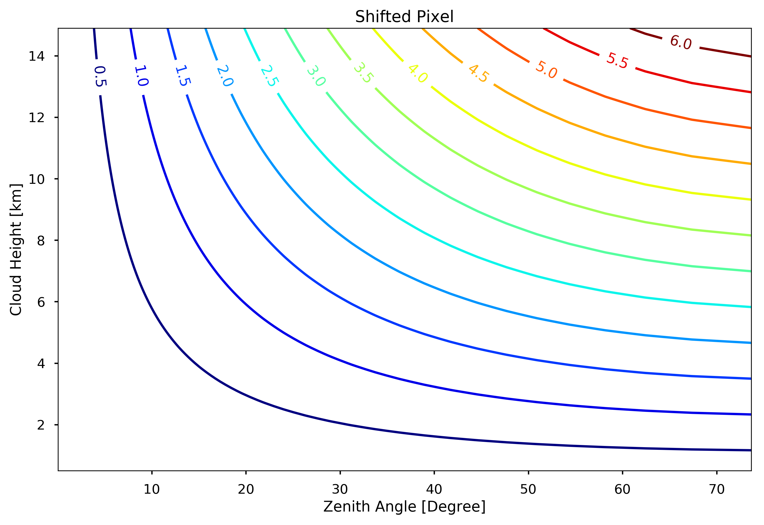
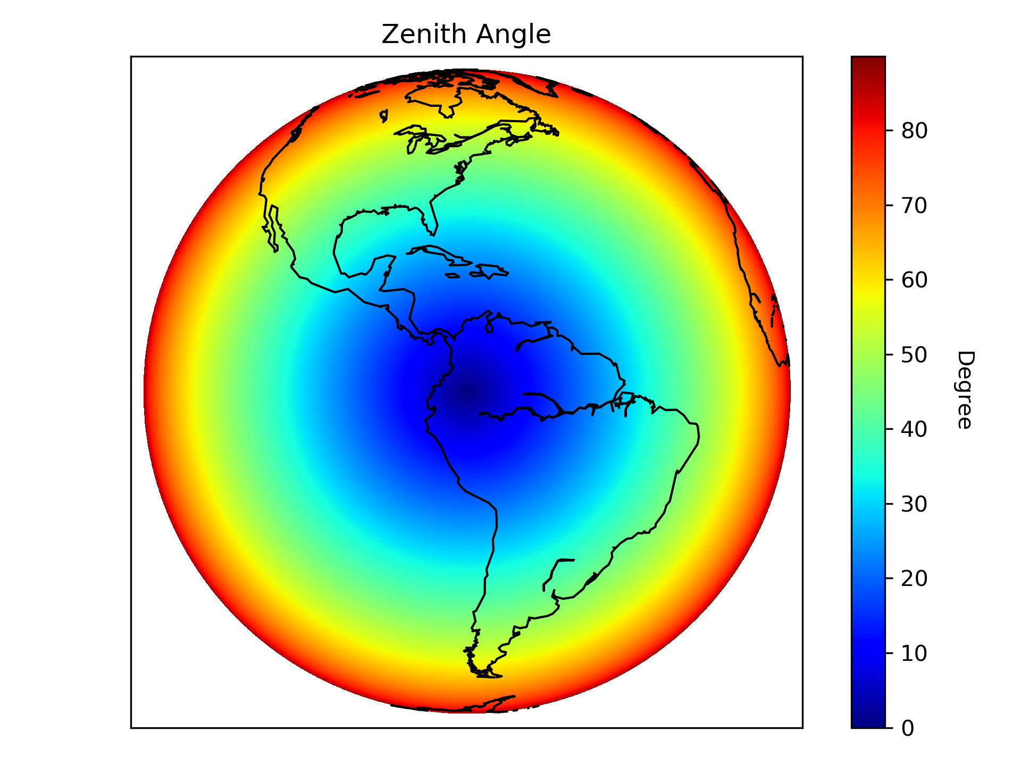
Effects for Parallax Effects
CrIS Zenith Angles
Most of GEO-LEO collocated observations are off-nadir and thus
parallax effects are unavoidable.
GOES Zenith Angles

Slide 6
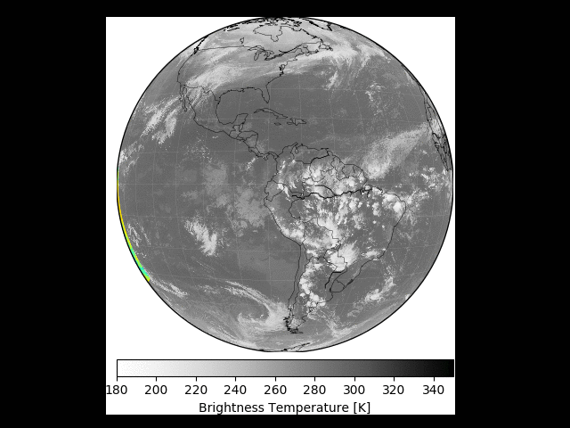
Collocation Procedures
Using time constrains to find the matched GEO and LEO files (5 minutes)
Using latitude and longitude from both GEO and LEO to find the collocated pixels
Can speed up using K-D tree
Using zenith angle relative difference as a constrain for angle match.
Other constrains: not discussed here

Slide 7
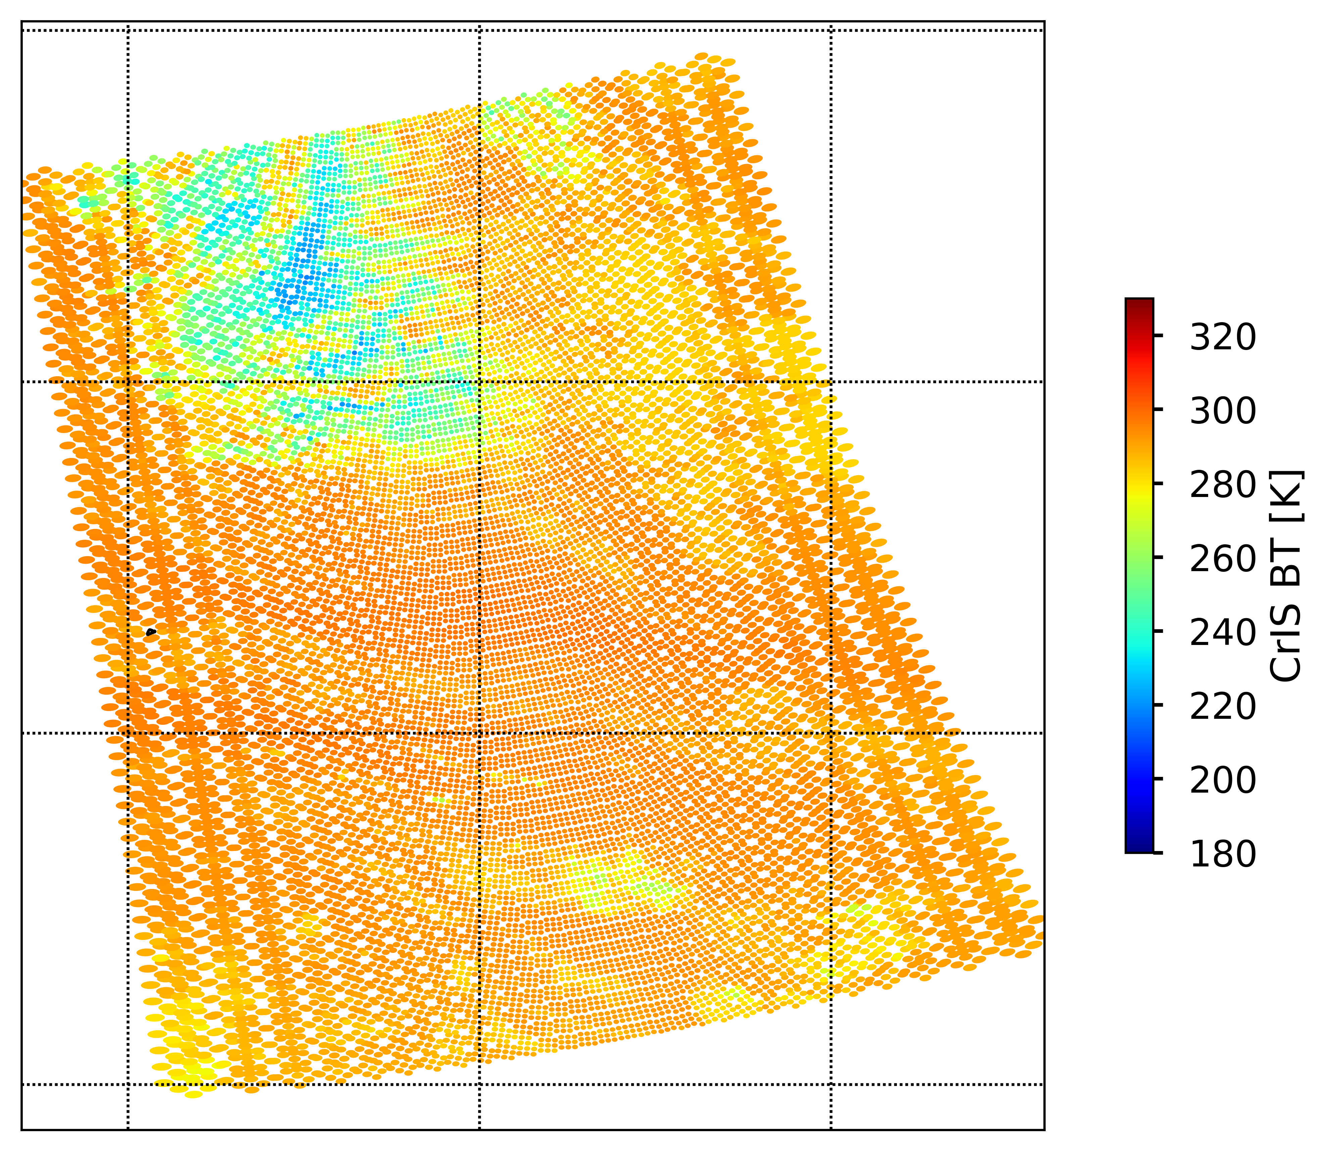
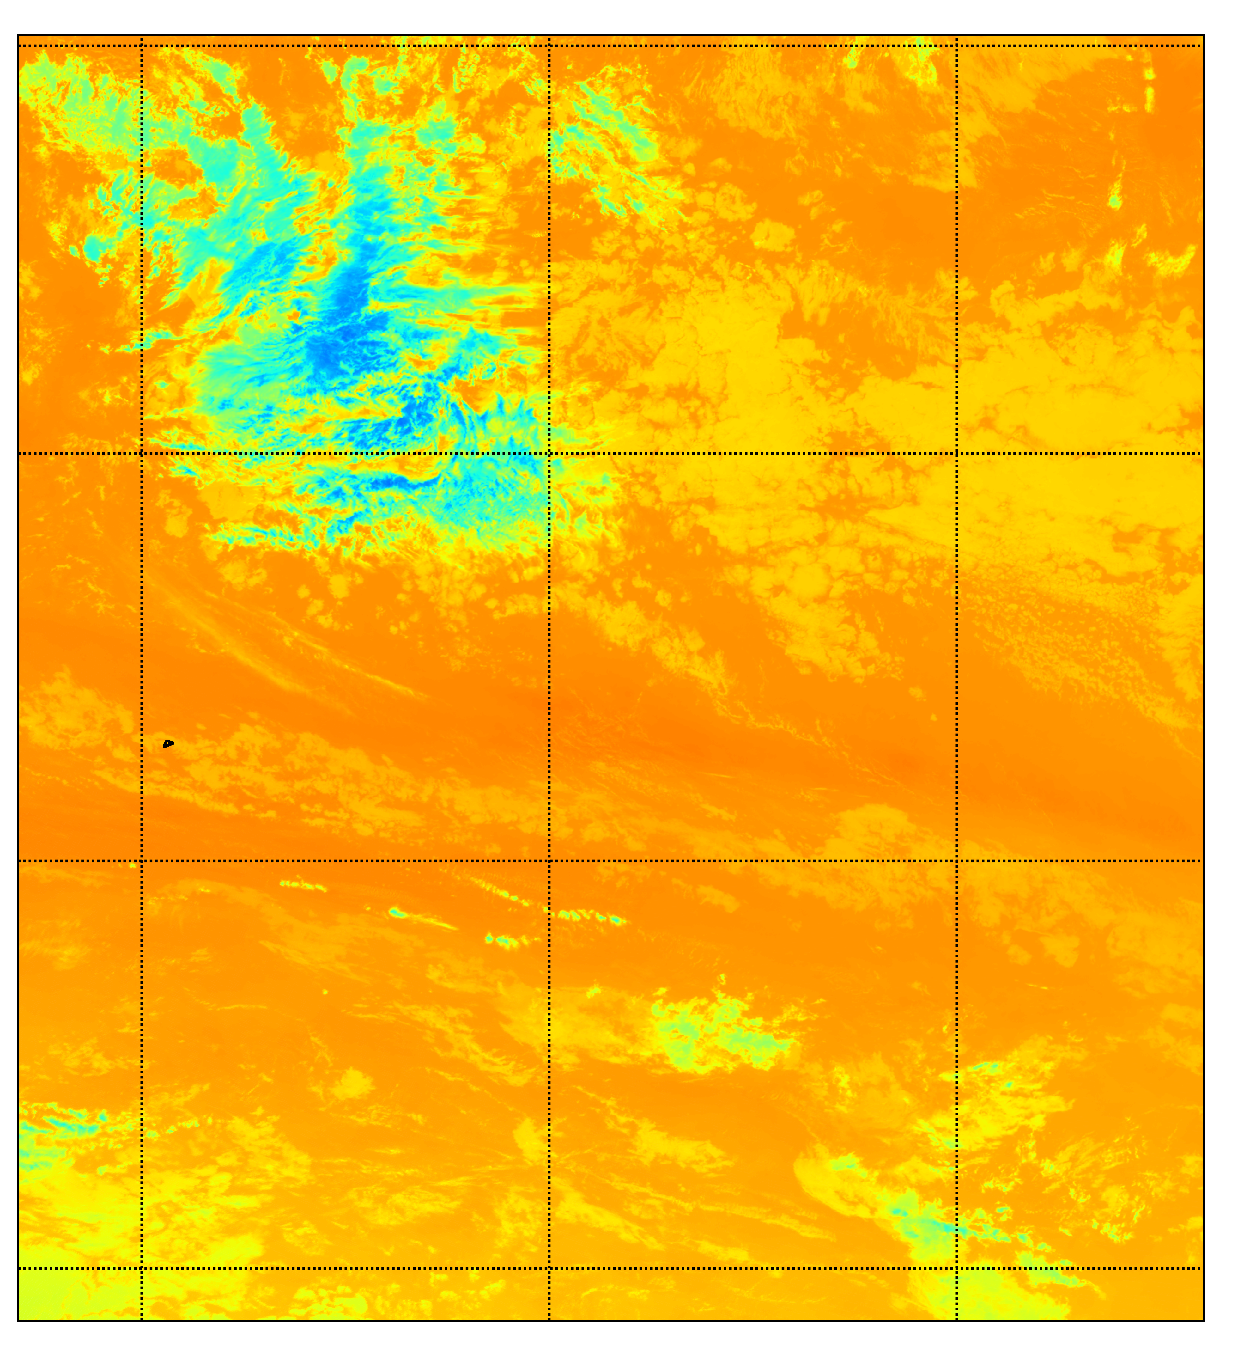
Example : CrIS and ABI Collocation (away from nadir)
CrIS
GOES ABI

Slide 8
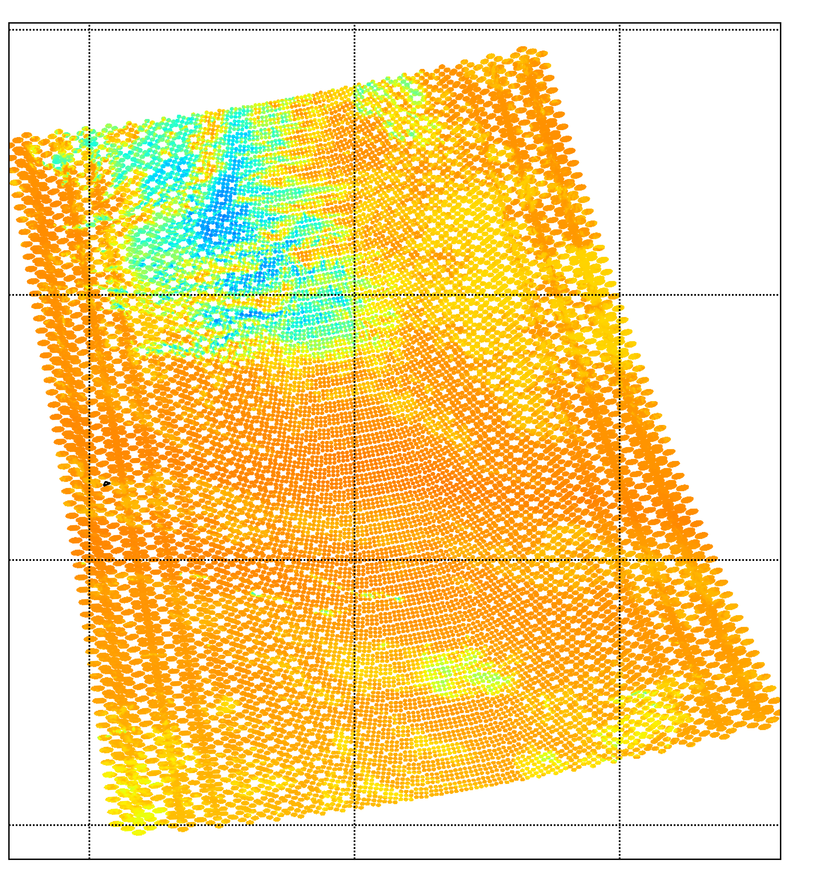
Example : CrIS and ABI Collocation (away from nadir)
CrIS
Collocated ABI

Slide 9
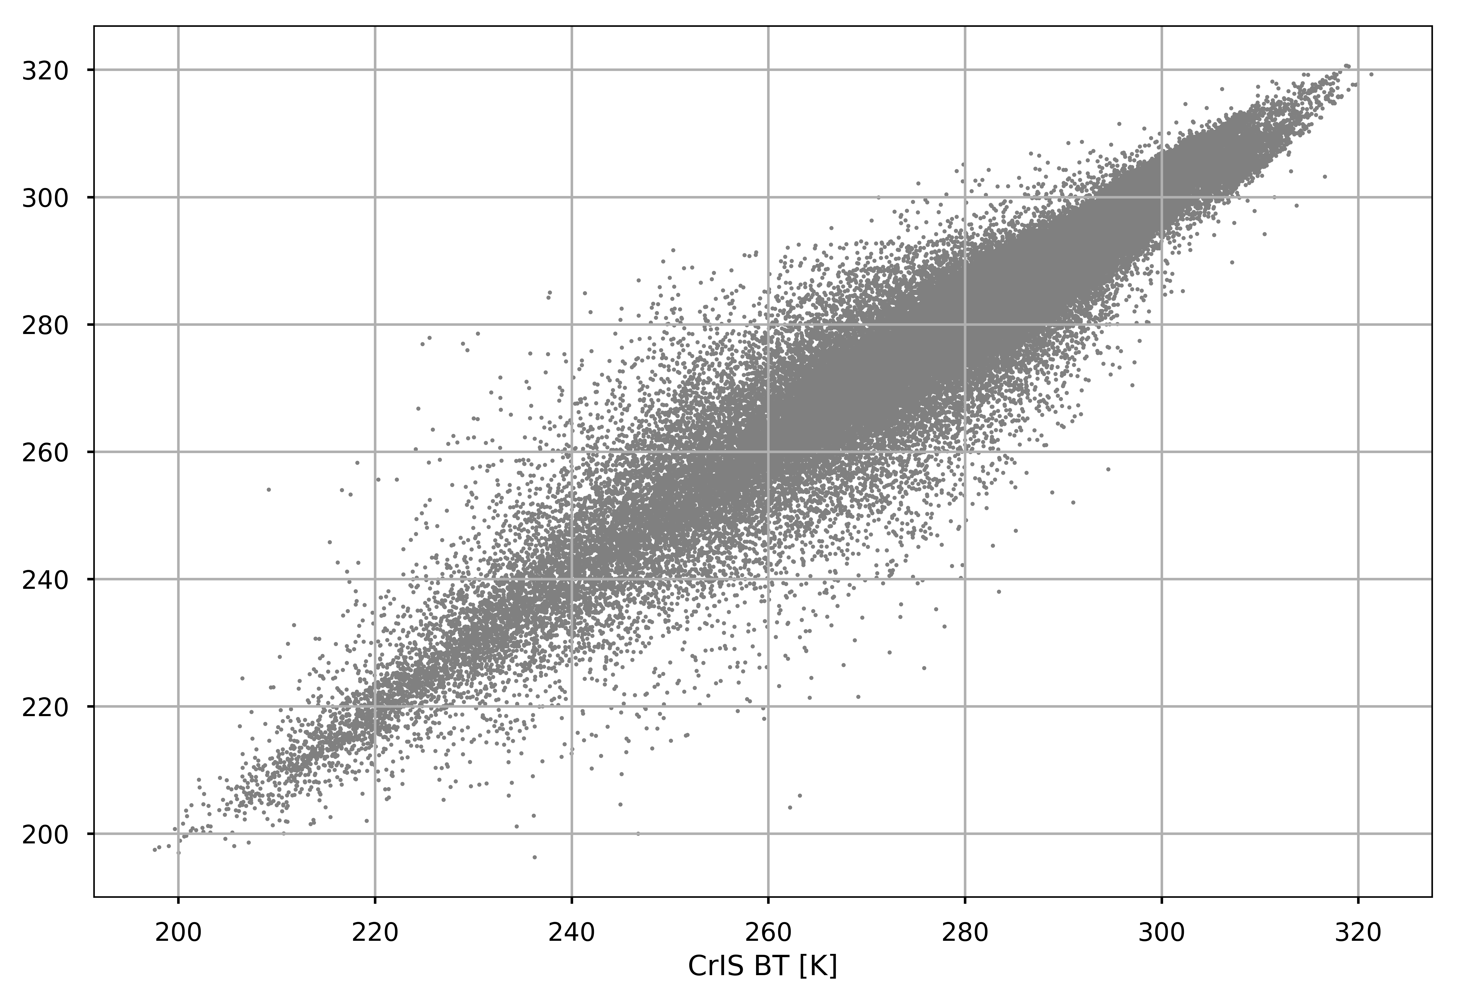
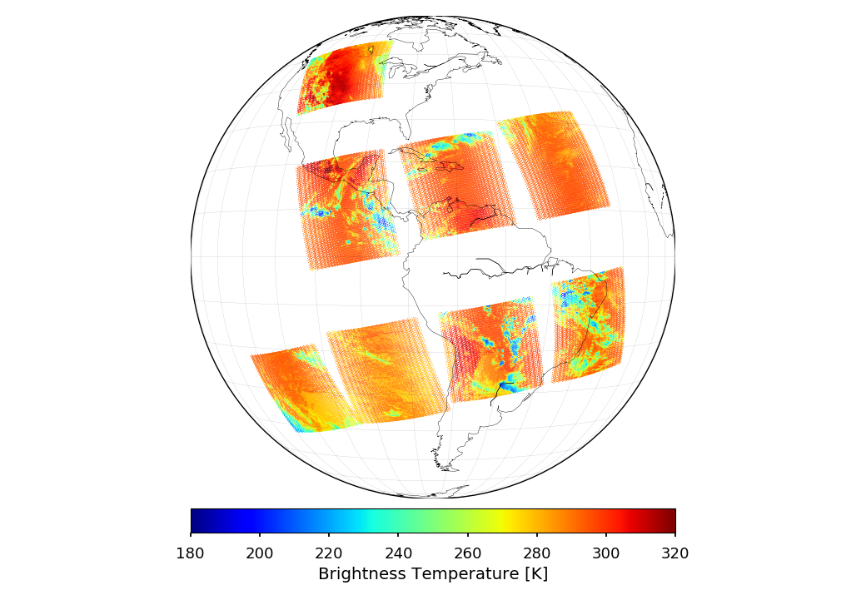
Collocated Observations
Night time
CrIS BT [K]
GOES BT [K]
Day time
For one day’s data: 185760 samples

Slide 10
Applying Angle Constrains
|COS(zenith1)/COS(zenith2) -1| < 0.01, only 3% (5763) data are saved for one day’s collocations

Slide 11
Break down with Azimuth Angle Difference
We should only use the data from the small azimuth angle difference (from close view perspective). Otherwise, parallax
effects will bring into uncertainties into the data.

Slide 12
Further constrain Azimuth Angle Difference (less 50 degree)
Only 1738 (of 5763) observations are left.

Slide 13
Using LOS vectors instead of Angles
Azimuth and Zenith angles are used to characterize the LOS vectors.
The LOS vectors can be computed from both LEO and GEO.
How about directly constraining Line of Sight (LOS) Vectors from GEO and LEO?
Check the angles of two LOS vectors.
LEO
LOS
LOS
GEO

Slide 14
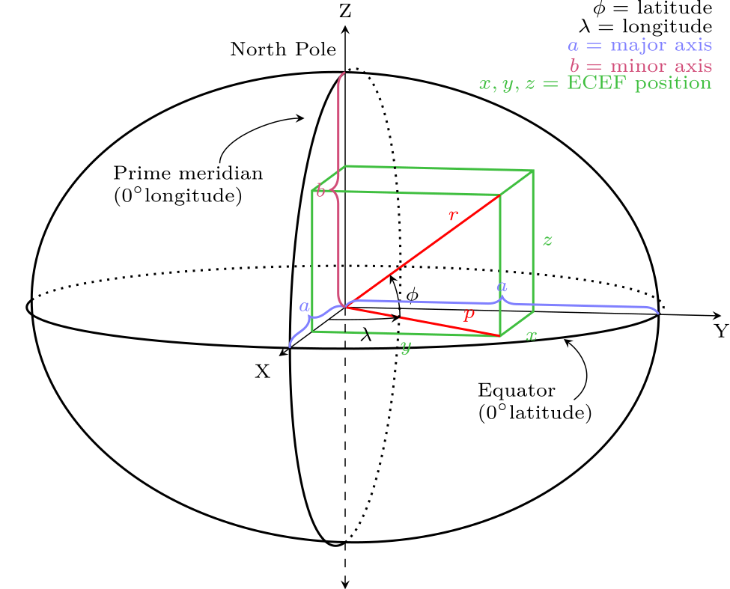
From LLA (lon, lat, 0) to ECEF (x, y, z)
By Krishnavedala - Own work, CC BY-SA 3.0, https://commons.wikimedia.org/w/index.php?curid=37182608
The transformation is invertible linear map between LLA and ECEF.
In ECEF, it avoid ambiguity in the Polar regions using LLA coordinate.

Slide 15
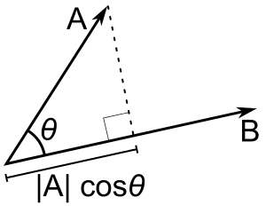
Cosine Distance
Cosine Distance is equivalent to Euclidean Distance for a pair of normalized vectors.

Slide 16
Angle Between LOS vectors less than 15 degree
Break down with Azimuth Angle Difference
Break down with Zenith Angle Difference
GOES BT [K]
A total of 10646 samples are kept.

Slide 17
Final Remarks
Parallax effects should be addressed for GEO-LEO inter-calibration because they mostly deal with off-nadir collocated pixels on different platforms.
Current algorithm only checks the zenith angle difference. The azimuth angle differences should also be constrained.
Another easy way is to constrain the angles between the GEO and LEO LOS vectors.

