Slide 1
Collocation VIIRS with CrIS only using Terrain Correction Geolocation Datasets
Likun Wang
ESSIC/Univ. of Maryland, College Park, MD
wlikun@umd.edu

Slide 2
Background
VIIRS has two different types of geolocation datasets
Geolocation on ellipsoid (GMODO, GIMGO): Non-TC geolocation
Geolocation with terrain correction (GMTCO, GITCO): TC geolocation
VIIRS geolocation dataset on ellipsoid will be turned off in the future and only terrain correction geolocation dataset will be generated.
CrIS only has geolocation dataset on ellipsoid (GCRSO)
For data fusion (e.g., VIIRS cluster analysis) and inter-calibration (VIIRS and CrIS), it is needed to accurately collocate VIIRS and CrIS data.
In this study, we evaluate the impacts of collocating VIIRS with CrIS only using VIIRS terrain correction geolocation dataset. We also propose the collocation method to minimize this effects.

Slide 3
VIIRS Terrain Correction
Using TC and Non-TC geolocation datasets to make VIIRS images
Image shift due to TC
Light of Sight
The image shifts happen at off-nadir regions with Complex Terrain
Non-TC geolocation
TC geolocation

Slide 4
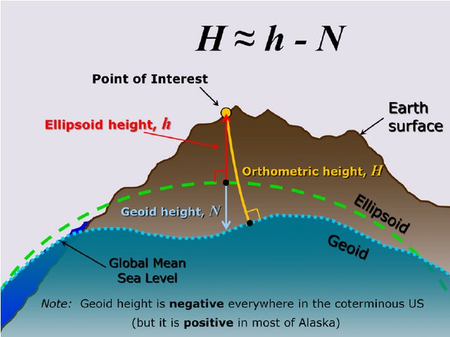
Relationship between Orthometric height, Ellipsoid height, and Geoid height
Ellipsoid height is needed to derive the line-of-sight vector at latitude and longitude
It can be calculated from Geoid height and Orthometric height (height above the sea level)
Geoid height can be negative and positive values.
Light of sight
https://www.researchgate.net/publication/273133676_Evolution_of_NAD_83_in_the_United_States_Journey_from_2D_toward_4D/figures?lo=1

Slide 5
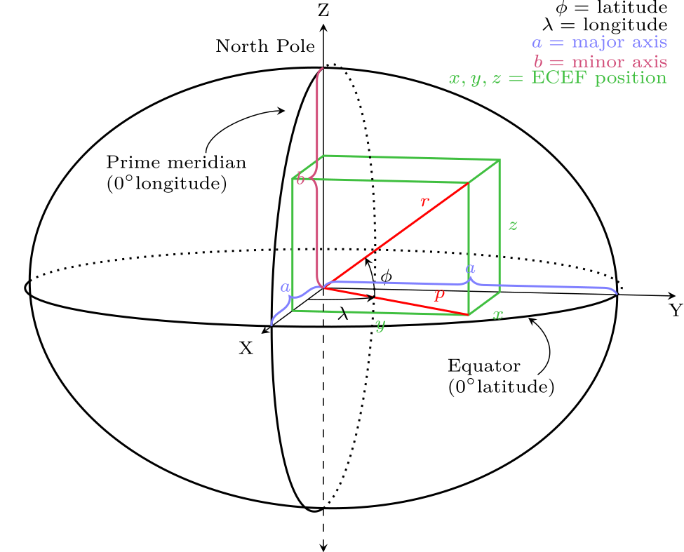
From LLA (lon, lat, h) to ECEF (x, y, z)
h: Geoid height + Terrain height
Geoid height: static Dataset
Terrain height: saved in the data
By Krishnavedala - Own work, CC BY-SA 3.0, https://commons.wikimedia.org/w/index.php?curid=37182608

Slide 6
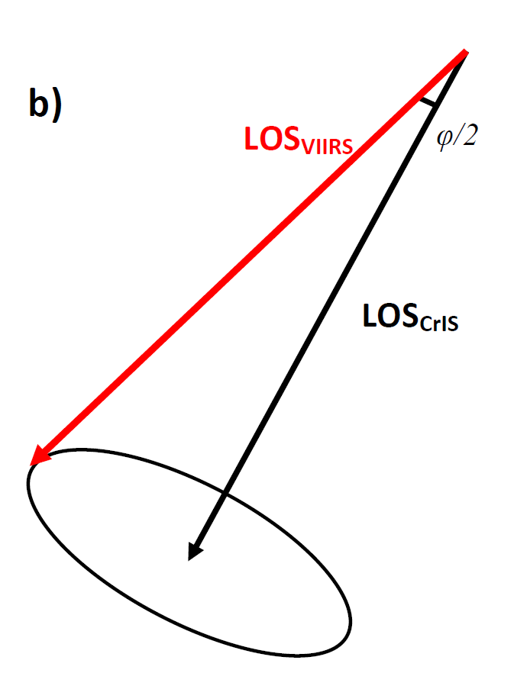
Collocation of CrIS with VIIRS Control Run and Method One Use the Same Method but different inputs
It is better to collocate sounder and imager in space instead of on the Earth Surface
No worry about FOV distortion
Retrieving line-of-sight vector of sounder from (lon, lat, satellite zenith, azimuth angles , and range)
The satellite position for sounder can be computed as:
G_s = P_s + LOS_s
The imager LOS vector viewing from the sounder can expressed as:
LOS_i = G_i – P_s
The collocation of imager and sounder can be simplified as examining the angles between two vectors, i.e. LOS_i and LOS_s

Slide 7
Collocation of VIIRS within CrIS
Control Run: collocating VIIRS Radiances with CrIS FOVs using VIIRS Non-TC latitude and longitude as inputs (no height)
Method One: Same as the control one, but using VIIRS TC latitude and longitude as inputs (no height)
Method Two: Collocation method using TC latitude, longitude, and ellipsoid heights as inputs

Slide 8
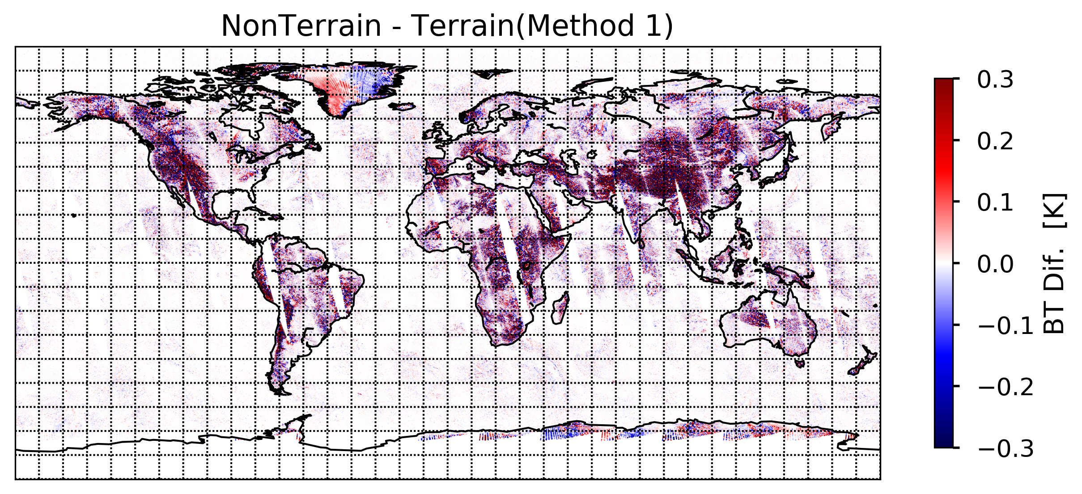
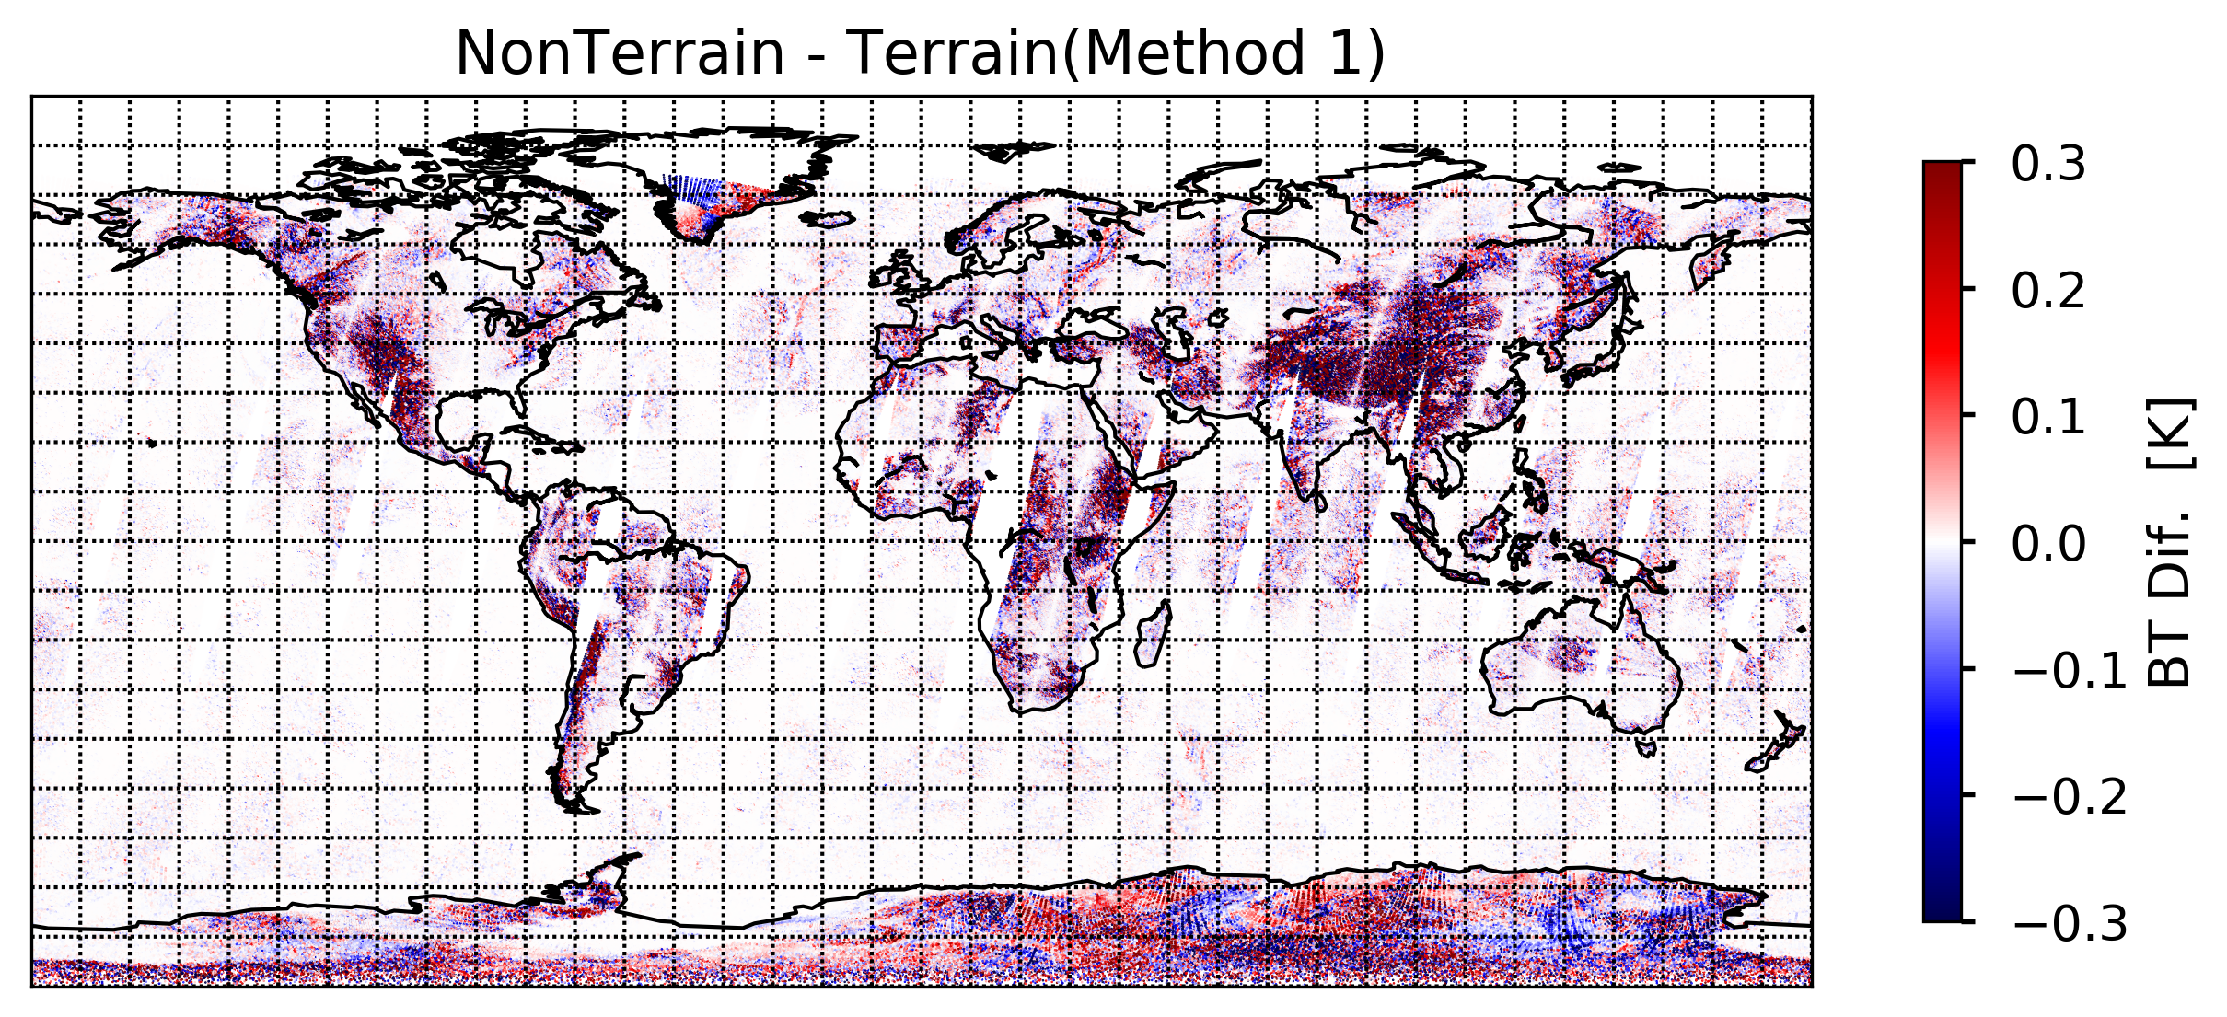
Control Run minus Method One
Control Run and Method One use the same collocation method but with different VIIRS geolocation datasets.
It clearly shows the large difference if one does not account for terrain effects.

Slide 9
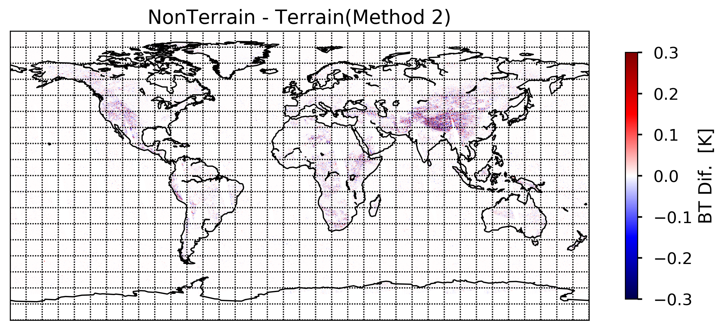
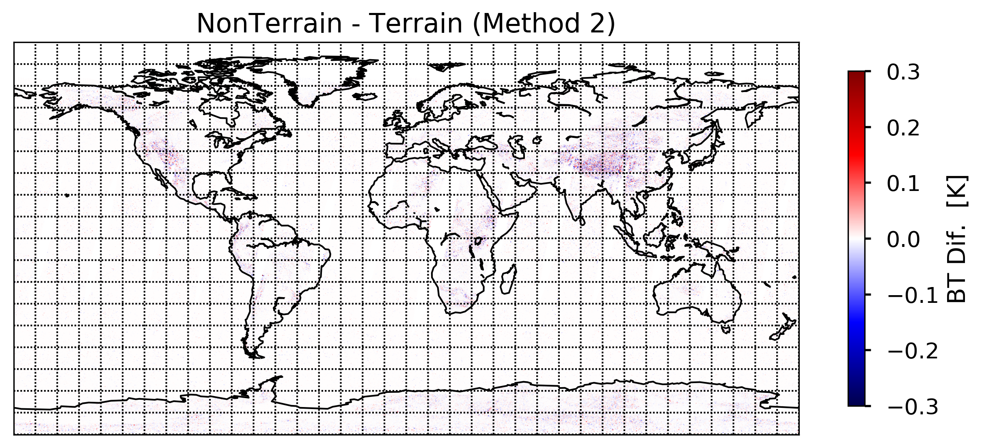
Control Run minus Method Two
Method Two uses the new collocation method with TC geolocation data as inputs. Control Run uses the old colocation method with Non-TC geolocation as inputs. The difference between Method Two and Control Run
Is very small.

Slide 10
Scatter Plot Method 1 or 2 versus Control Run

Slide 11
Histogram of Method 1 or 2 – Control Run

Slide 12
Method 1 or 2 – Control Run Varying Zenith Angle

Slide 13
Conclusion
If one does not account for TC effects but only simply collocate VIIRS with CrIS (or other sensors) using latitude and longitude, it will result in large difference between TC and Non-TC datasets.
By adding geoid height (static dataset) and Terrain height (already saved in VIIRS geolocation data), we can modify the collocation method and achieve the similar results. The differences are very small.
For data fusion and inter-calibration application (e.g. VIIRS cluster analysis with CrIS), we can use only TC geolocation data to get the similar results with Non-TC data. However, the collocation method must account for terrain effects.

