Slide 1
GEO-LEO & LEO-LEO IR
Hot land Analysis
Importance of Collocations’ Symmetric Time Difference
Tim Hewison, Vincent Debaecker, Ali Mousivand
(EUMETSAT)
GSICS Web meeting 2023-07-06
Notes:
TJH: Change title

Slide 2
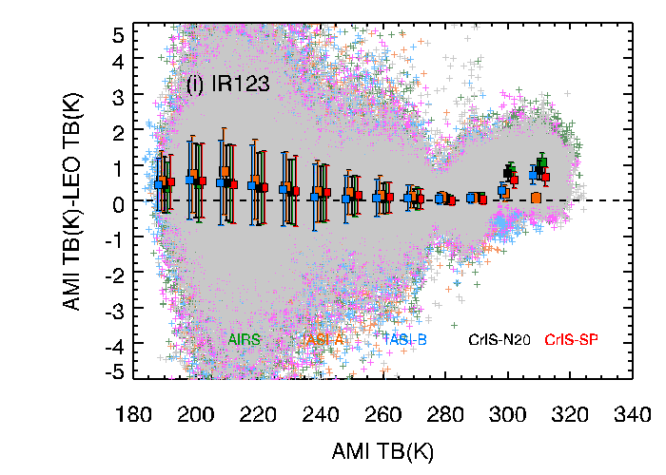
Review: Issues with current GSICS GEO-LEO IR algorithm
Formulation not user friendly
Need to invert function to apply – complicates error propagation
Performance at the Cold End
Large biases – especially in Brightness temperature
Biases should tend to zero for zero radiance
High IASI shortwave channels' noise and uncertain calibration
Hot Land Bias issue - unresolved – for now, focus only on night-time data
First reported by KMA ➔
Add CrIS as reference instrument to include collocations around 01:00/13:00 LST
Restrict RAA? geographic domain? radiometric range?
Meanwhile, mask out hot land in v2a
focus first on cold end issue - primarily a meteorological imager
Impact of high viewing angles
Inconsistent results from Full Disc and Rapid Scan Service
e.g. due to cloud parallax issues
repeating VZA dependence analyse for MSG3-IASIC
Diurnal variation
Need to handle multiple references - including IASI, CrIS, HIRAS, …
Prime GSICS Correction - merging multiple reference instruments through double-differences
Shown abnormal large biases at high temperature (>300K, Australian desert) scene in window channels during the daytime.

Slide 3
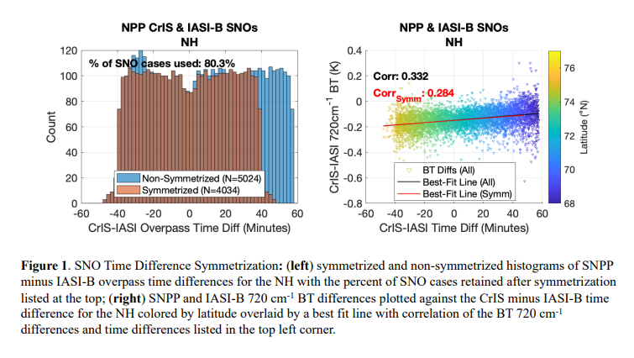
TLDR: Ensuring Symmetric Time Sampling critical for daytime!
Dave Tobin’s presentation at 2023 annual GSICS meeting:
5h_GSICS_Annual_2023_Tobin_20230223.pdf
Highlighted importance of symmetric time sampling
Even more critical over arid land surfaces in daytime
Should be straightforward for GEO-LEO inter-cal …
But still need to be careful!

Slide 4
Hot land issue in GEO-LEO and LEO-LEO
GEO-LEO
SEVIRI - MSG4

Slide 5
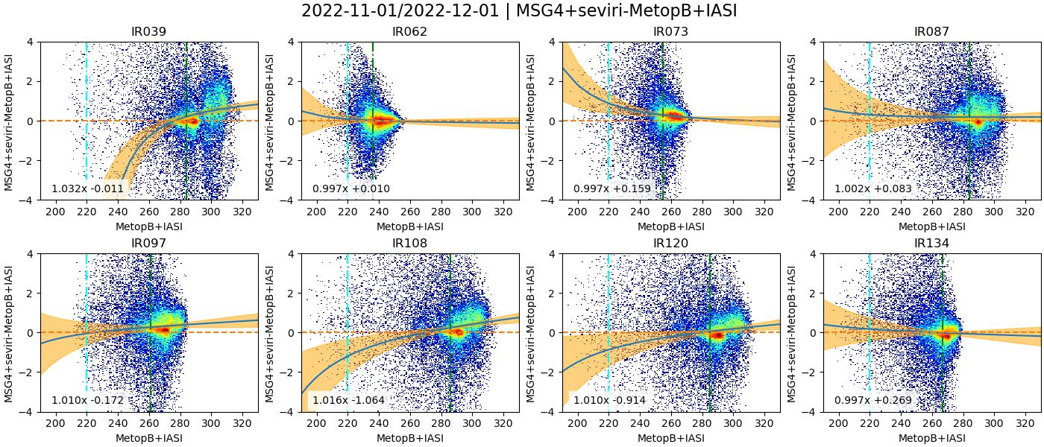
SEVIRI / IASI – COLT module (before)
Land only
Ignore the fitted lines and uncertainty bars
- Based on current GEO-LEO IR v1 (linear regression)
Cluster of collocations with out-of-family biases
Over hot land scenes

Slide 6
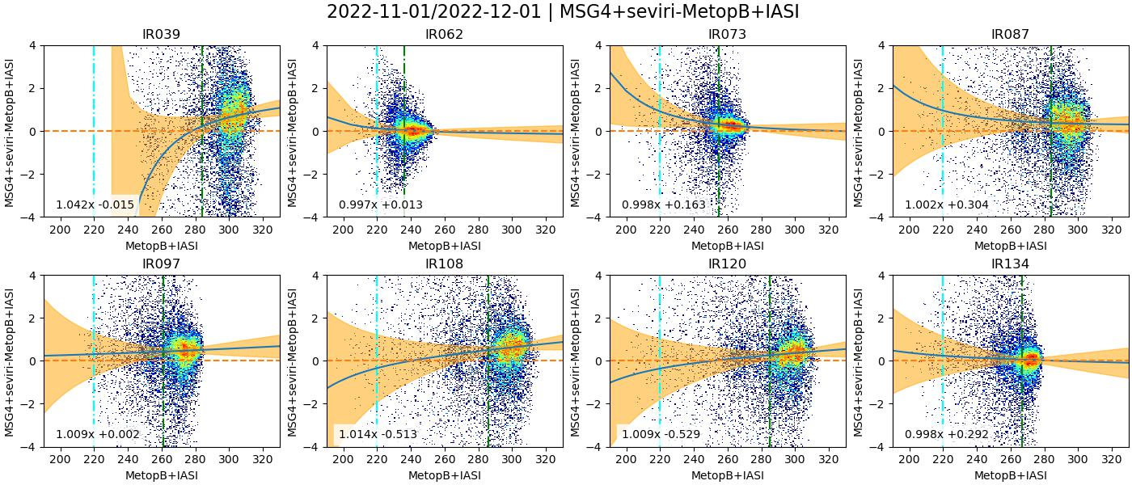
SEVIRI / IASI – COLT module (before)
Land only
Daytime
Cluster of collocations with out-of-family biases
Over hot land scenes – all in day-time only

Slide 7
Progress
Fixed Bug in time calculation
Highlighted importance of symmetric time differences distribution of collocations
Aliasing diurnal variations
GEO-LEO case:
uniform distribution of Δt
More important in daytime
Max dTb/dt ~ 08:00 LST
Meteosat 0°E FoR covers lots of hot arid land
Time series of mean rate of change of radiances calculated from Meteosat-9 observations on 2009-09-20 Average over (30°W-30°E)x(30°S-30°N) Area – Land+Sea, Cloud+Clear
[1mW/m2/st/cm⁻¹/hr ~ 1K/hr]
2.278mW/m2/st/cm⁻¹/hr ~ 0.08K/min over all land
From Hewison, 2011 EUMETSAT Conference
Notes:
Tim to add plot
Check for anything from workshop on diurnal variations

Slide 8
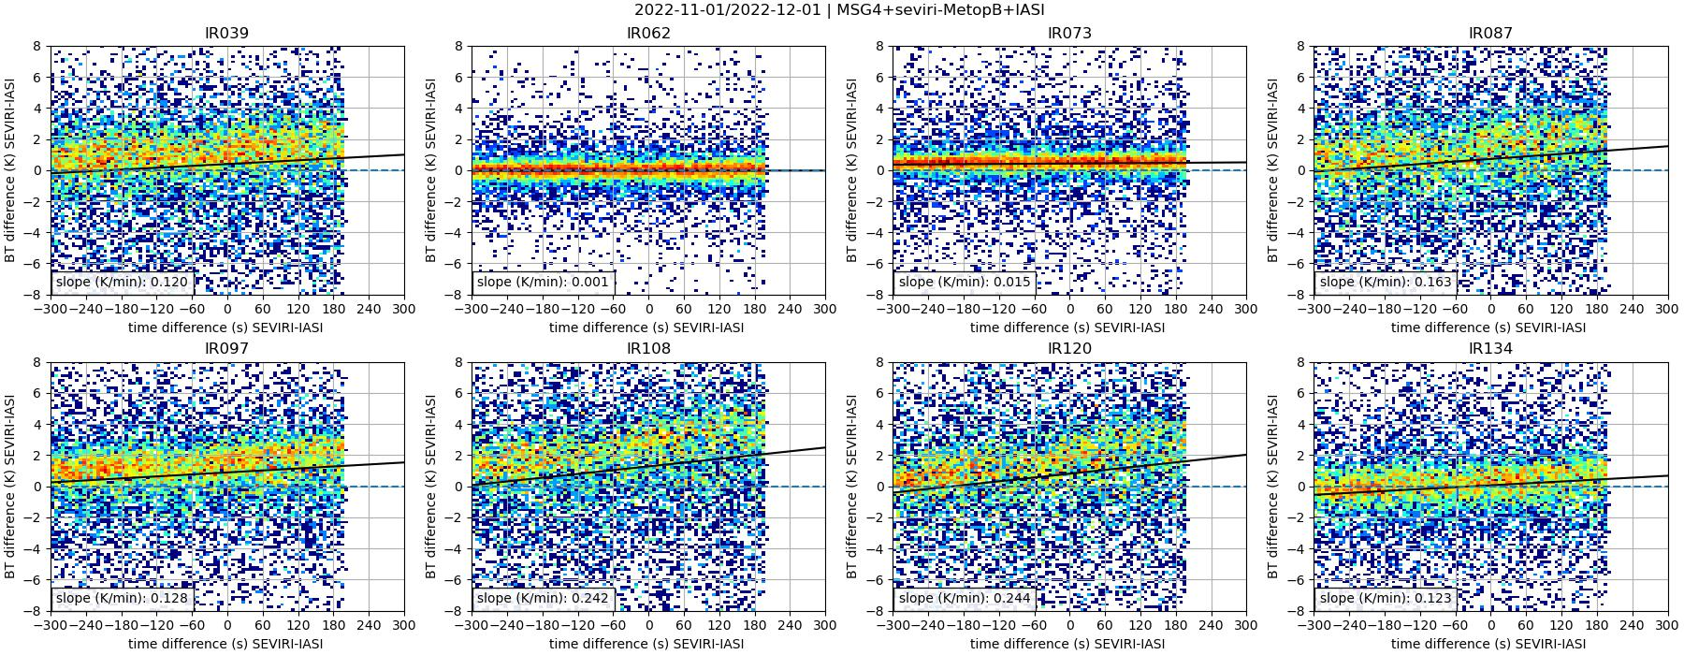
SEVIRI / IASI – BT bias function of Time-Difference
Land only
Daytime
Old Version
Note: missing data in range of Δt=+200 to +300s

Slide 9
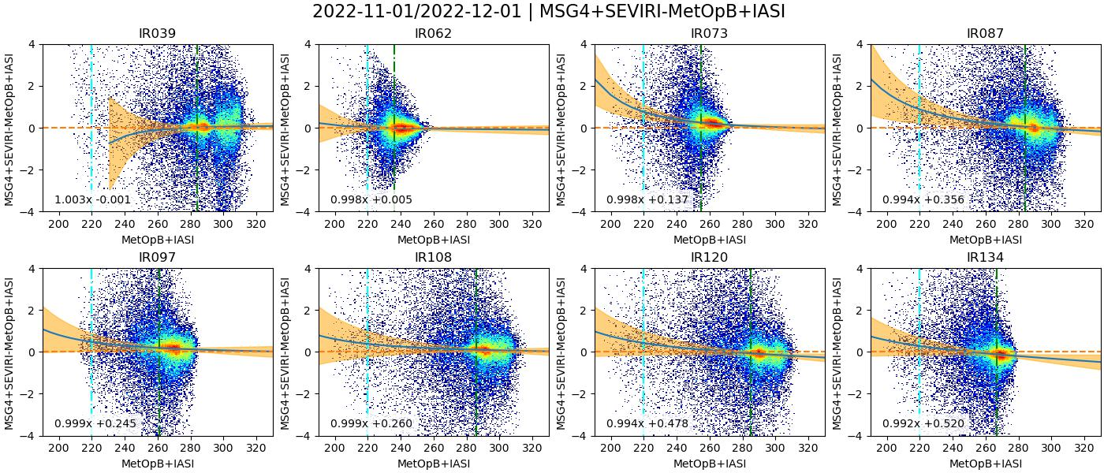
SEVIRI / IASI – improvement of COLT module
Land only
Cluster of collocations now in-family
Over hot land scenes – all in day-time only

Slide 10
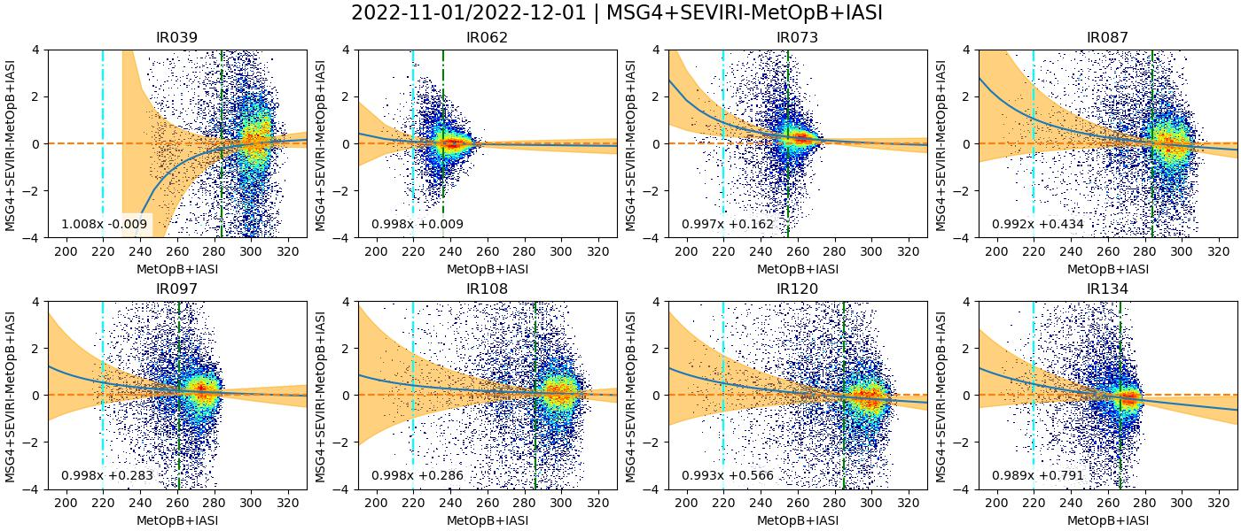
SEVIRI / IASI – improvement of COLT module
Land only
Daytime
Window channels were worst – now OK – even IR3.9
Cluster of collocations now in-family
- Even for hot land scenes in the daytime

Slide 11
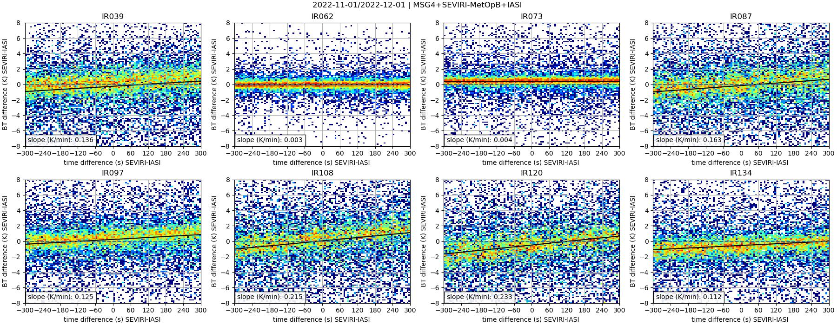
SEVIRI / IASI – BT bias function of Time-Difference
Land only
Daytime
New COLT Version
Note: no missing data in range of Δt=-300 to +300s
Black line fitted by eye to illustrate mean dΔTb/dt~0.2K/min in 10.8µm channel
~0.1K/min in 3.9, 13.4µm ~0.0K/min in WV channels

Slide 12
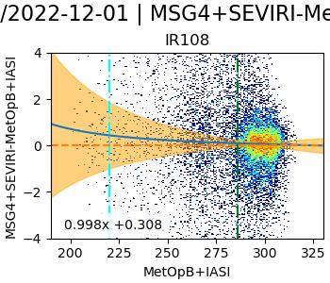
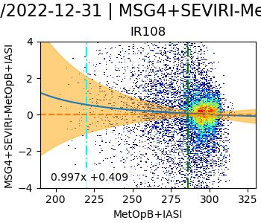
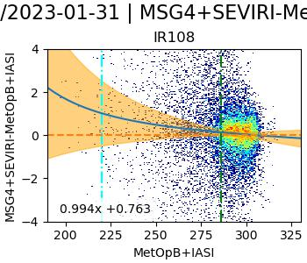
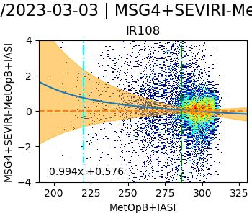
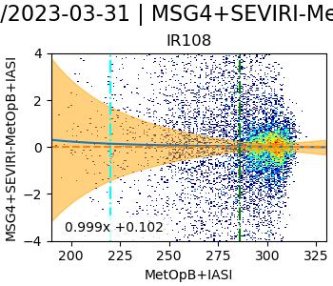
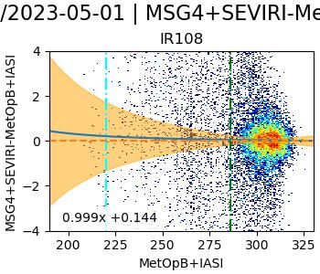
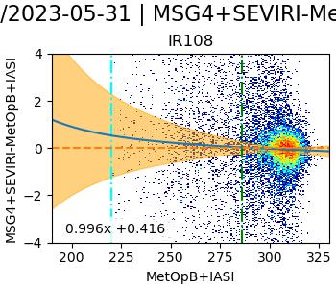
SEVIRI / IASI – Results for 10.8µm month-by-month
Land only
Daytime
IR10.8
Nov 2022
Dec 2022
Jan 2023
Feb 2023
Mar 2022
Apr 2022
May 2023
Note:
Max Tb higher in Spring
Biases still on the line

Slide 13
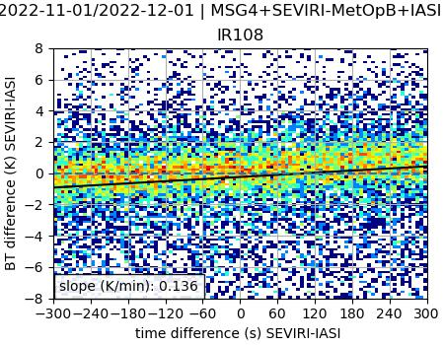
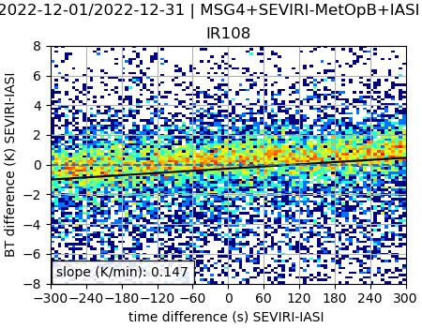
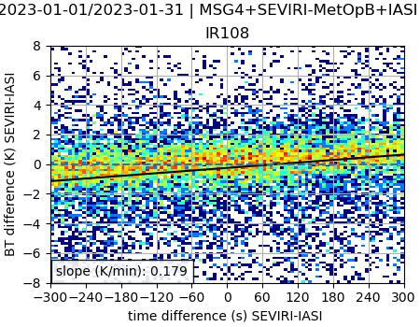
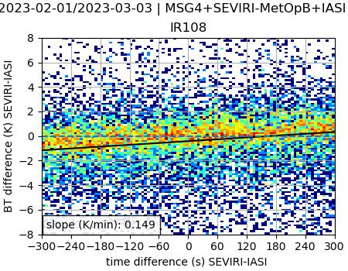
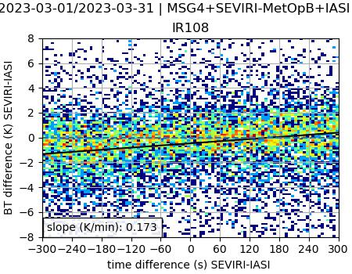
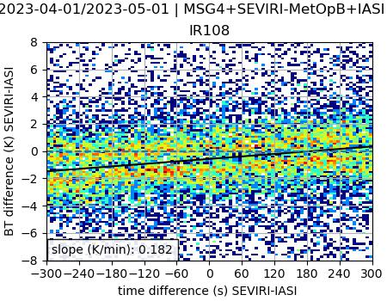
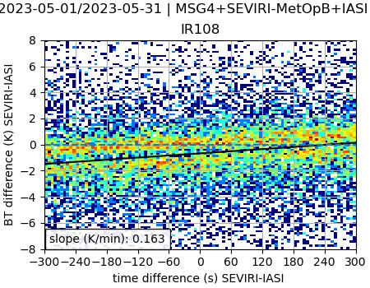
SEVIRI / IASI – improvement of COLT module
Land only
Daytime
IR10.8
Nov 2022
Dec 2022
Jan 2023
Feb 2023
Mar 2022
Apr 2022
May 2023

Slide 14
Hot land issue in GEO-LEO and LEO-LEO
LEO-LEO
SLSTR

Slide 15
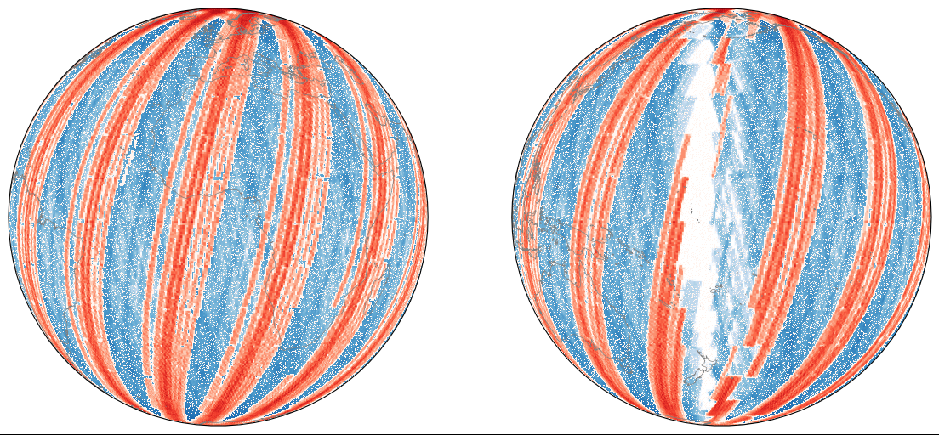
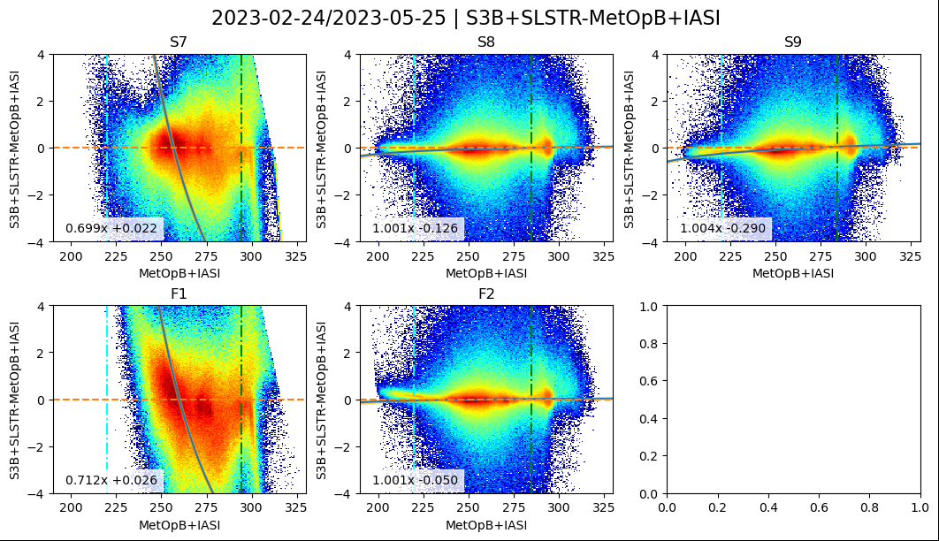
SLSTR / IASI – hot land analysis
Daytime
3 month period: March – May 2023
3.7µm
10.8µm
12.0µm
Normal Channels
|time_diff| < 300s
|zen_diff_sec| < 0.1
sun_zen < 90
S7 = 3.7µm
S8 = 10.8µm
S9 = 12.0µm
S7 results included, but complicated by solar contribution
- S7 saturates
F1 does not
3.7µm
10.8µm
Fire Channels

Slide 16
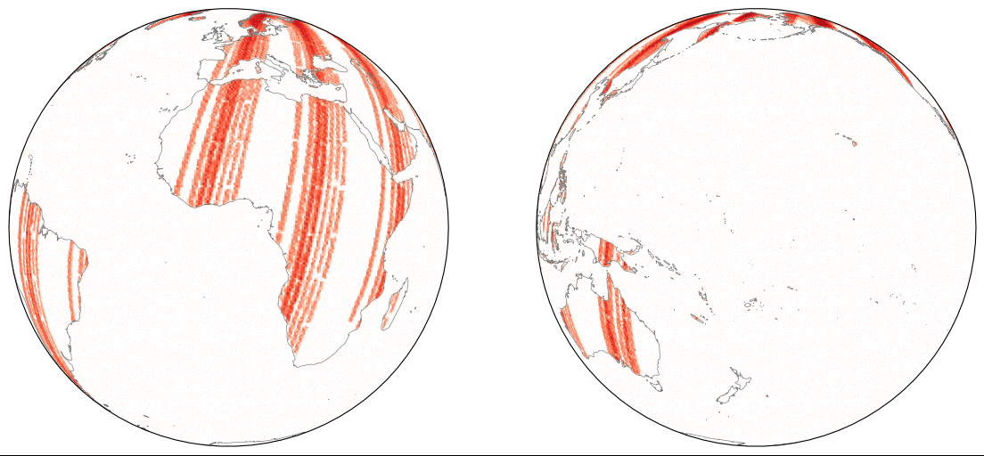
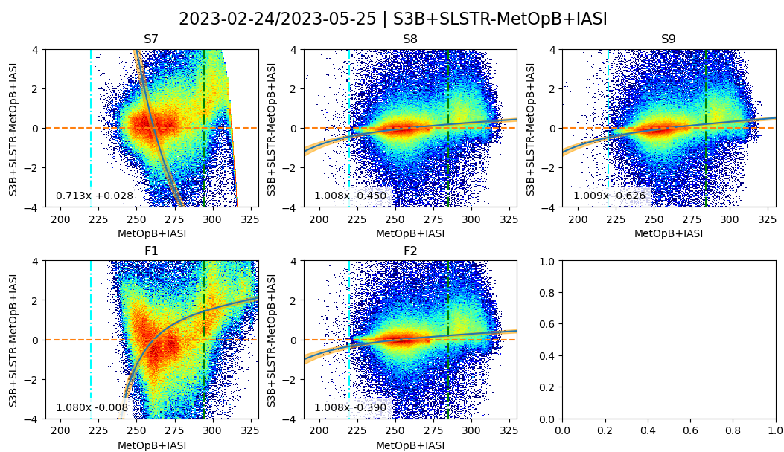
SLSTR / IASI – hot land analysis
Daytime
& land only
3-month period: March – May 2023
3.7µm
10.8µm
12.0µm
Normal Channels
|time_diff| < 300s
|zen_diff_sec| < 0.1
sun_zen < 90
land_mask
S7 = 3.7µm
S8 = 10.8µm
S9 = 12.0µm
S7 results included, but complicated by solar contribution
- S7 saturates
F1 does not
3.7µm
10.8µm
Fire Channels

Slide 17
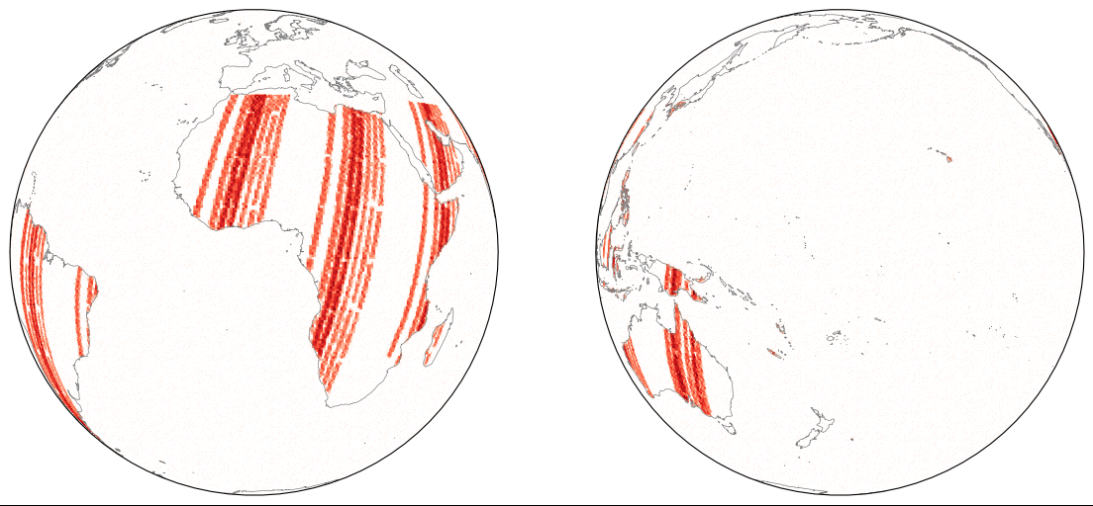
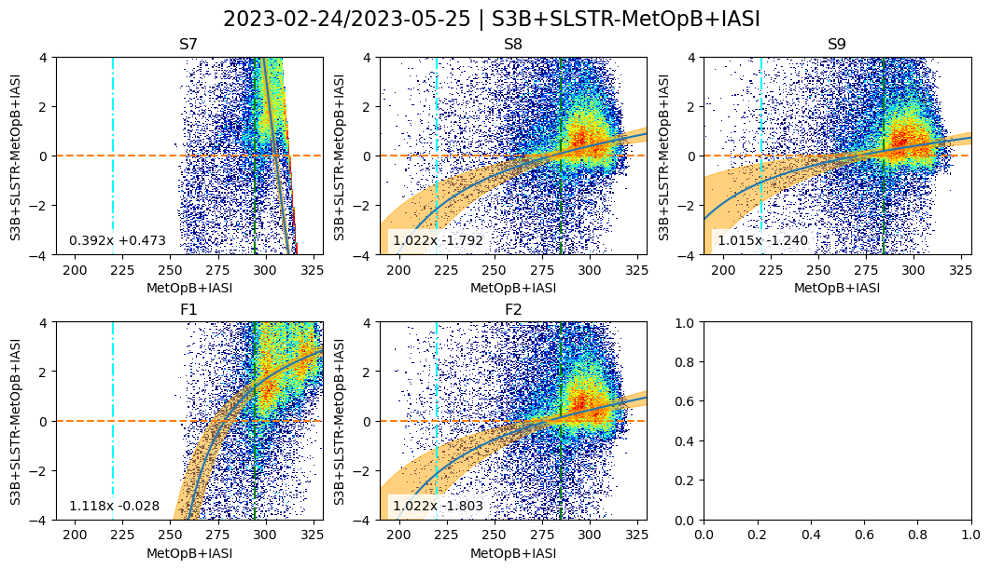
SLSTR / IASI – hot land analysis – low lat
Daytime
& land only
& |lat| < 35°
Period: March – May 2023
3.7µm
10.8µm
12.0µm
Normal Channels
|time_diff| < 300s
|zen_diff_sec| < 0.1
sun_zen < 90
land_mask
|lat| < 35°
S7 = 3.7µm
S8 = 10.8µm
S9 = 12.0µm
S7 results included, but complicated by solar contribution
- S7 saturates
F1 does not
3.7µm
10.8µm
Fire Channels

Slide 18
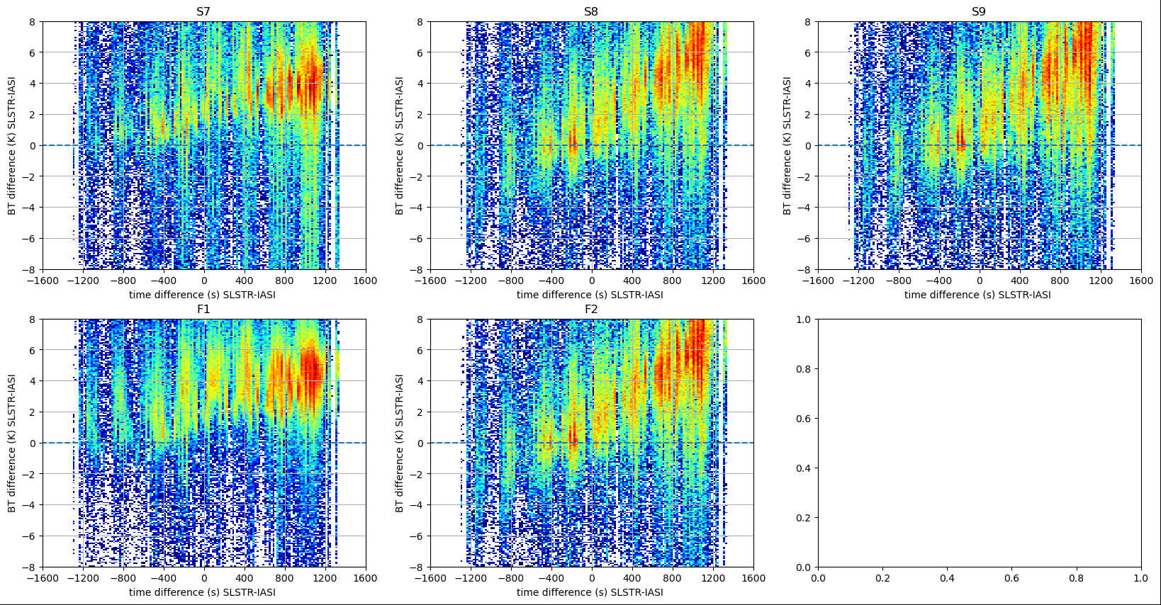
SLSTR / IASI – hot land analysis
Daytime & land only & |lat| < 35°
Period: March – May 2023
time_diff" filter disabled

Slide 19
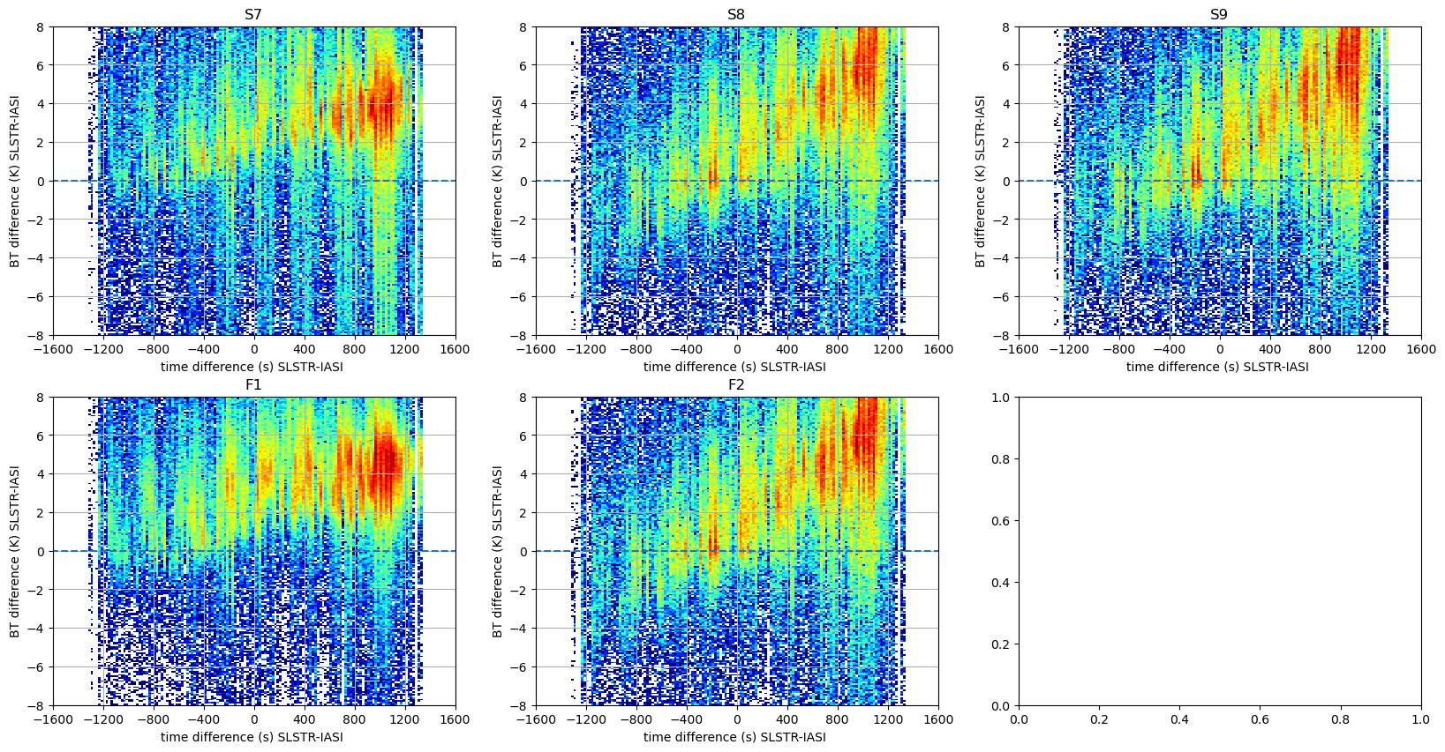
SLSTR / IASI – hot land analysis
Daytime & land only & |lat| < 35°
Period: Extended to 7 Months
time_diff" filter disabled
Black line = +0.25K/min
- added manually
Same slope for all channels
±300s window = current algorithm
But collocations not symmetrically distributed
Due to orbital differences ~30min
Need to check histogram of Δt

Slide 20
Hot land issue in GEO-LEO and LEO-LEO
LEO-LEO
AVHRR

Slide 21
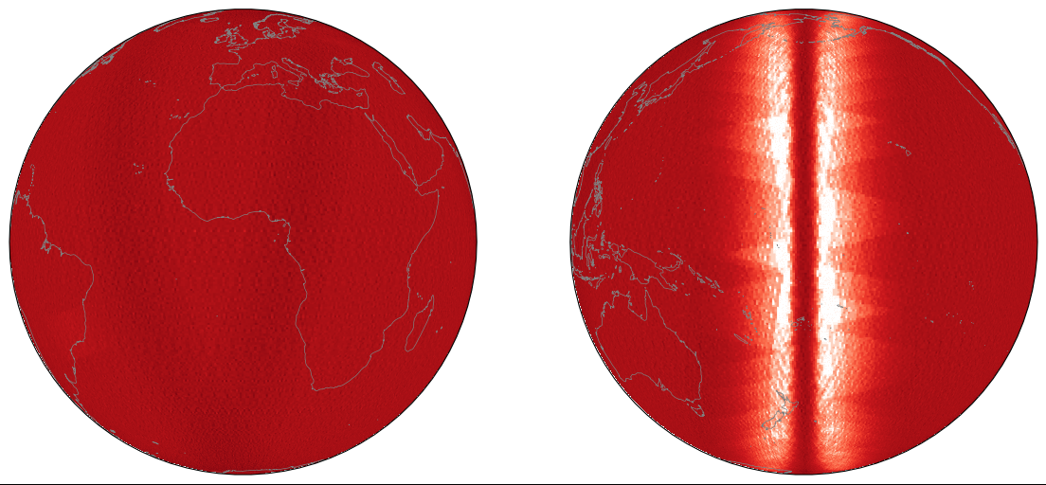
AVHRR / IASI – hot land analysis
Global
May 2023
3.7µm
10.8µm
12.0µm
Lots of collocations!
No time difference
No azimuth angle difference
No obvious difference over hot land
Metop-C <>B
MetopB
MetopC

Slide 22
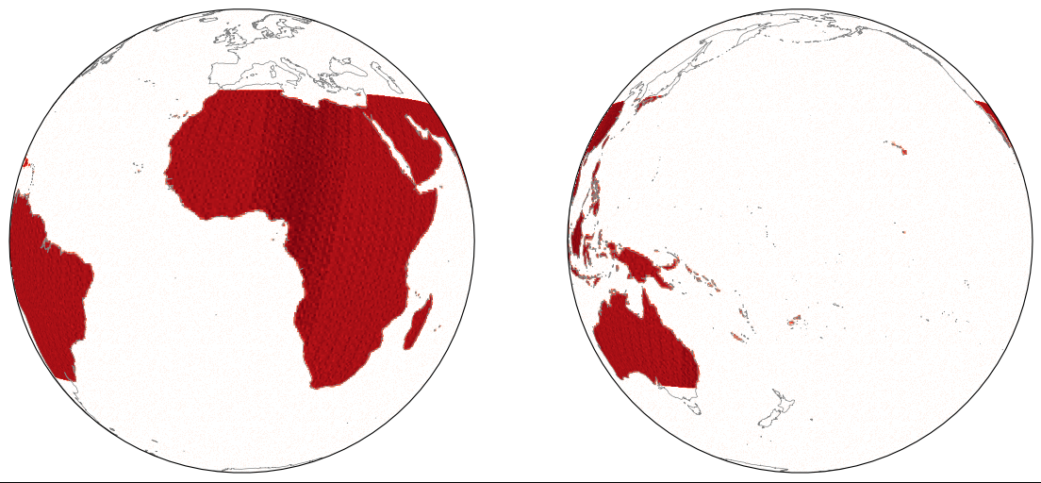
AVHRR / IASI – hot land analysis
Daytime
& land only
& |lat| < 35°
May 2023
MetopB
sun_zen < 90
land_mask
|lat| < 35°
MetopC

Slide 23
AVHRR / IASI – hot land analysis
Daytime
& land only
& |lat| < 35°
May 2023
MetopB
|time_diff| < 300s
|zen_diff_sec| < 0.01
sun_zen < 90
land_mask
|lat| < 35°

Slide 24
GEO-LEO using GEO before/after LEO
Temporal Variability/Mismatch is a dominant uncertainty source in GEO-LEO IR GSICS products
Possible component of GEO-LEO IR v2 algorithm:
Compare GEO image before/after LEO data
Include collocations with both
to cancel asymmetric time differences?
and double the # collocations!
Or interpolate in time?
Means modifying data!
Or include collocations before/after IASI
Weighting each according to time difference
# Collocations
-300s 0 +300s
Time Difference
# Collocations
-300s 0 +300s
Time Difference

Slide 25
Conclusions
Diurnal Variations can be aliased into inter-calibration biases
if collocations’ time difference are not symmetrically distributed
Much worse over land
Worse in morning than evening
Important to check histogram of Δt
Ideas for how to ensure symmetric distribution?
Could filter out data at random?
Boot-strapping with different subsets?
Down-weighting collocations in common Δt bins?
(Could use similar technique to check distribution of Tb)
GPRCs are advised to check their algorithms!
Meanwhile, EUMETSAT will compare GEO image before/after LEO

Slide 26
Cooperative further IR inter-calibration algorithm development
GPRCs operating GEO imagers to implement proposed algorithm for GEO-LEO IR v2:
CMA, EUMETSAT, ISRO/IMD, JMA, KMA, NOAA
Volunteers agreed to investigate further improvements and report by 2024 meeting:
3.9µm channel issue – already addressed (summarised by Likun Wang)
Parallax mask – reject high VZA + low BT combinations - Likun Wang (NOAA) – 2023-05-04
Detect and Filter collocations affected by Hot Land issue – KMA + EUM
Formulation of regression algorithm - Fred Wu (NOAA)
Using multiple GEO imagers per LEO overpass – Vincent Debaecker (EUMETSAT) – new!
Multiple References/Diurnal Variations - Pradeep Thapliyal (ISRO), Chengli Qi (CMA)
CMA also to cover in hyperspectral-hyperspectral comparisons
Define Standard Scene Tbs: e.g. 205K, Tb_std, 305K? - Pradeep Thapliyal (ISRO)
Uncertainty Analysis - Tim Hewison (EUMETSAT) – as part of MTG-I1/FCI commissioning
Follow-up web meeting 2023-09-07?
First results from MTG/FCI-IASI + Uncertainty analysis – Tim Hewison (EUMETSAT)
Others?

