Slide 1
Inter-Comparison of NOAA-21 VIIRS and CrIS
-Preliminary Results Using CrIS Gap-Filled Spectra
Wenhui Wang
CISESS/University of Maryland – College Park
GSICS IR Subgroup Web Meeting, July 6 2023
Acknowledgement: Dr. Changyong Cao (NOAA/STAR VIIRS SDR team lead) and NOAA STAR VIIRS radiance team

Slide 2
Outline
Background
GSICS IR Subgroup CrIS Gap-Filled Coefficients
Procedures for VIIRS-CrIS Inter-Comparison
Impacts of CrIS gap-filled spectra on NOAAA-21 VIIRS thermal bands calibration evaluation.
Summary

Slide 3
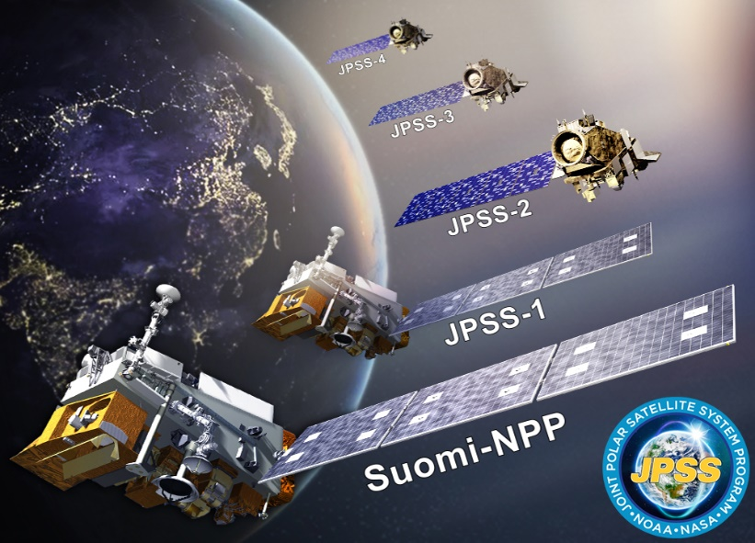
Background
Visible Infrared Imaging Radiometer Suite (VIIRS) and Cross-track Infrared Sounder (CrIS) are both on the S-NPP/NOAA-20/NOAA-21 satellites.
NOAA STAR VIIRS radiance team has been using CrIS data for evaluating VIIRS thermal bands calibration performance.
  CrIS L1B data are well calibrated (uncertainty ~0.2-0.3 K), major calibration anomalies/updated are well communicated to the users.
  There are plenty of co-located VIIRS-CrIS observations at a wide range of scene temperatures (~220 – 310 K).
  Covering a wide range of VIIRS scan angles: ±48.3°
  I5, M13, and M15-M14 are covered by the CrIS observed spectra.

Slide 4
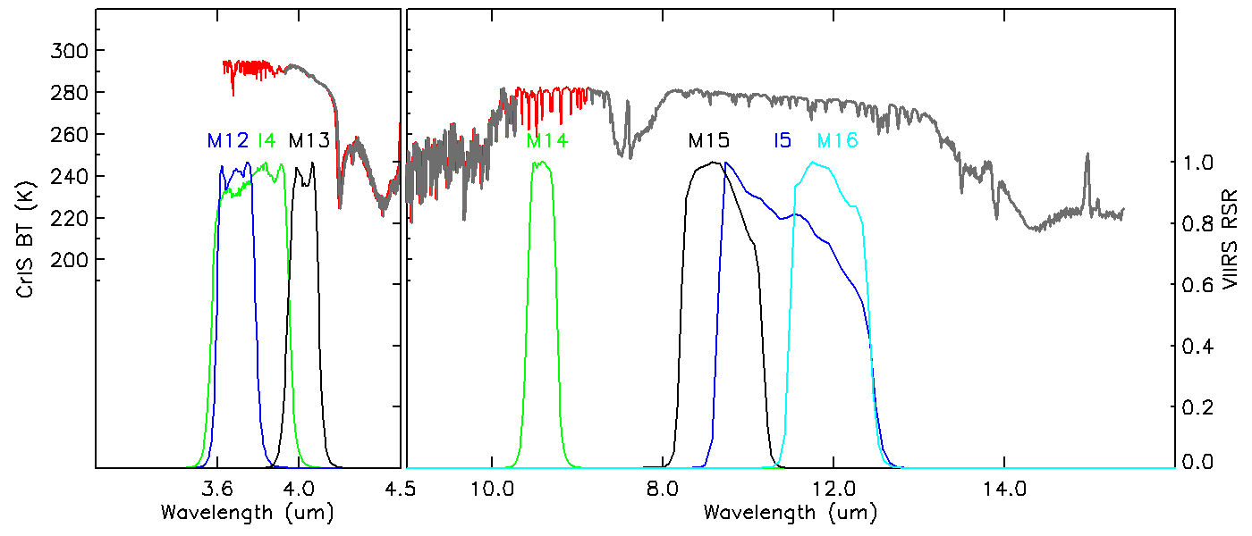
GSICS IR Subgroup CrIS Gap-Filled Coefficients
CrIS gap-filling method was developed by Dr. Hui Xu using IASI data (Xu et al 2018).
  http://gsics.atmos.umd.edu/bin/view/Development/20180605
Spectral Coverage for NOAA-21 VIIRS:
I5,M15-M14: >99.4%
M14: 99.7% covered.
M13: improved spectral coverage (96.7% → 99.8%)
I4: 82.3% covered.
M12: 78.6% covered
This study focuses on study the impact of using CrIS gap-filled spectra for evaluating NOAA-21 VIIRS thermal bands, especially I4, M12-M14.

Slide 5
Procedures for VIIRS-CrIS Inter-Comparison
Co-locate CrIS field of views (FOV) with VIIRS pixels (Wang, L. et al. 2016).
Spatially average co-located VIIRS pixel radiances within CrIS FOVs;
Calculate CrIS gap-filled spectra using observed spectra and GSICS gap-filling coefficients.
Spectrally integrate co-located CrIS observed and gap-filled spectra using VIIRS band-averaged RSRs to calculate VIIRS equivalent radiances;
Select spatially homogeneous CrIS FOVs;
Convert averaged VIIRS radiances and integrated CrIS radiances to BTs;
Compute and analyze VIIRS and CrIS BT differences.

Slide 6
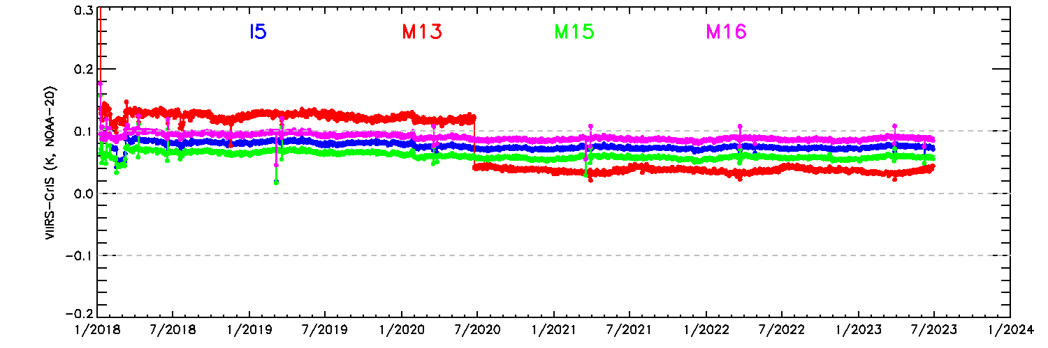
VIIRS-CrIS Daily Averaged BT Bias Time Series
(Using CrIS measured spectra)
The long-term calibration stability of biases of NOAA-21/NOAA-20/S-NPP VIIRS TEBs are monitoring using daily averaged BT bias time series.
NOAA-20 VIIRS agree with CrIS within 0.1 K at nadir.
VIIRS calibration biases during WUCD events
Switched to CrIS full spectra.

Slide 7
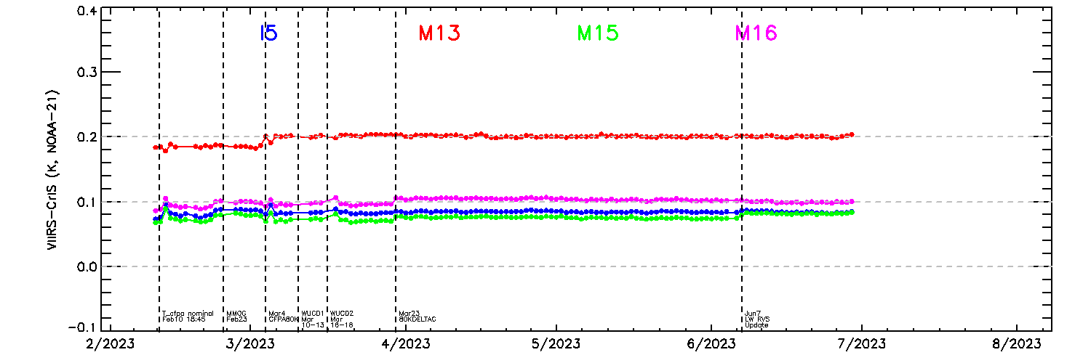
VIIRS-CrIS Daily Averaged BT Bias Time Series
(Using CrIS measured spectra)
NOAA-21 VIIRS I5 and M15-M16 agree with CrIS within 0.1 K.
M13 shows larger bias: ~0.2 K.
Small changes are mainly due to VIIRS instrument/calibration changes during the post-launch test period.
Nominal operations only

Slide 8
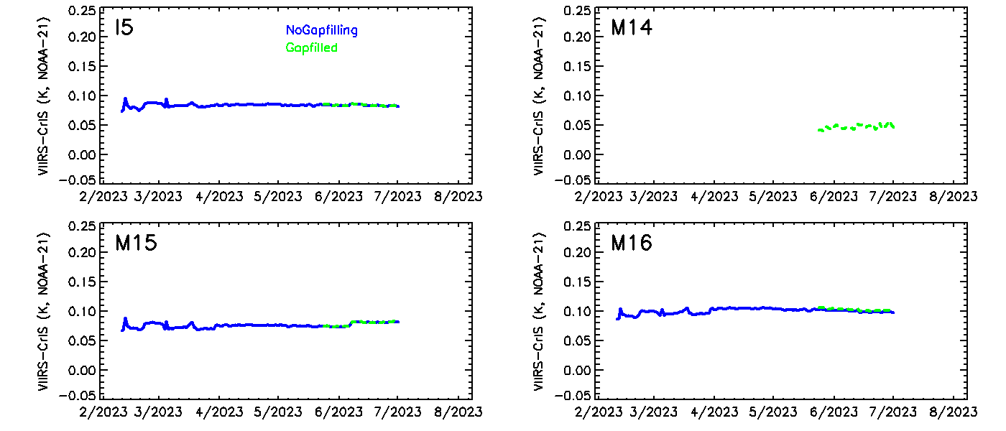
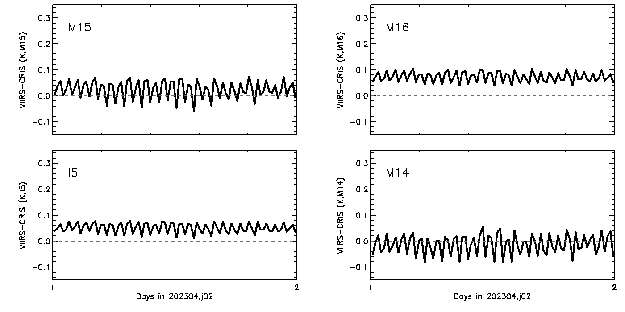
Measured vs Gap-Filled Spectra
(NOAA-21, LWIR, Nadir)
Time Period: May 24 – June 30, 2023
I5 and M15-M16: the differences are very small (within 0.01 K).
M14 daily BT bias time series (for gap-filled spectra only) are very promising.
  BT biases are reasonable.
  Orbital variations are similar to M15.

Slide 9
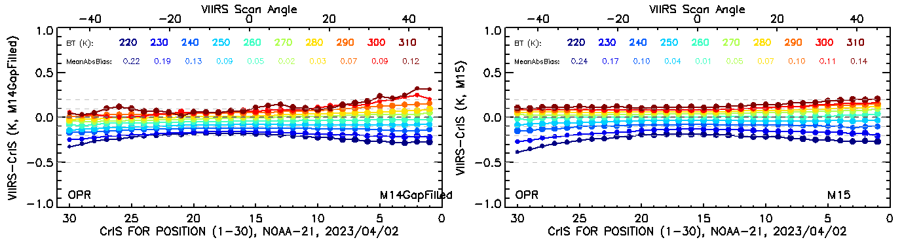
NOAA-21 VIIRS LWIR Scan Angle and Scene Temperature Dependent Biases
Consistent larger than expected scan angle and scene temperature dependent biases were observed in NOAA-21 LWIR SDRs.
CrIS gap-filled spectra are very useful for charactering the M14 biases.
M14, April 2
M15, April 2
Before the operational correction of scan angle and scene temperature dependent biases

Slide 10
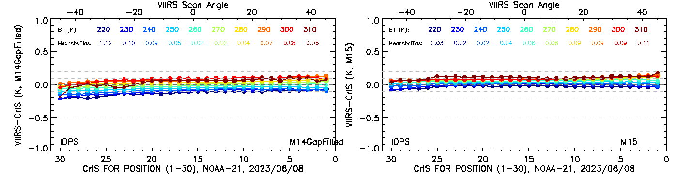
NOAA-21 VIIRS LWIR Scan Angle and Scene Temperature Dependent Biases
VIIRS on-orbit pitch maneuver data derived calibration parameters was applied to NOAA-21 LWIR calibration since June 7, 2023.
  I5, M14-M16 biases were reduced within ~±0.15K.
CrIS gap-filled spectra provide in-dependent validation of the M14 calibration update.
M14, June 8
M15, June 8

Slide 11
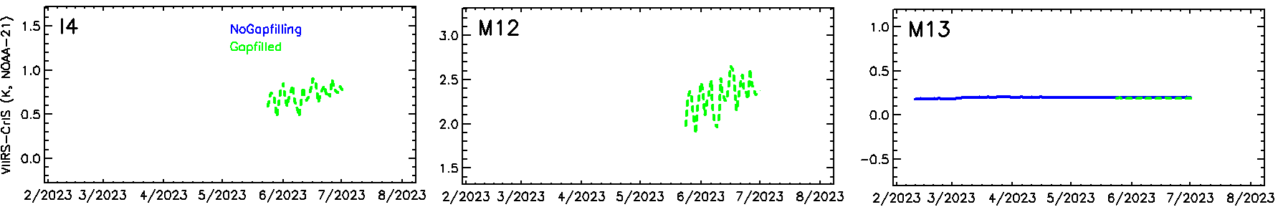
Measured vs Gap-Filled Spectra
(NOAA-21, MWIR, Nadir)
M13 BT Biases are similar to those derived using measured spectra.
  Differences within 0.01 K.
  Spectral coverage was improved: 96.7% → 99.8%
I4 and M12 show much larges BT biases (~0.7 K and 2.2K):
  Daily time series seem not stable over time.
  Requiring further analysis with more data.

Slide 12
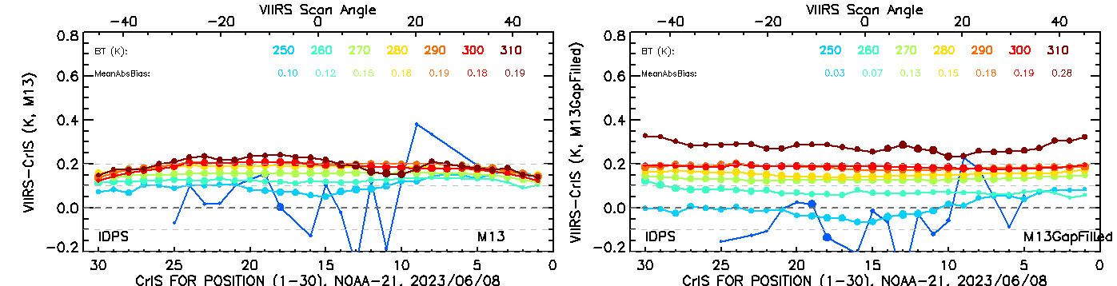
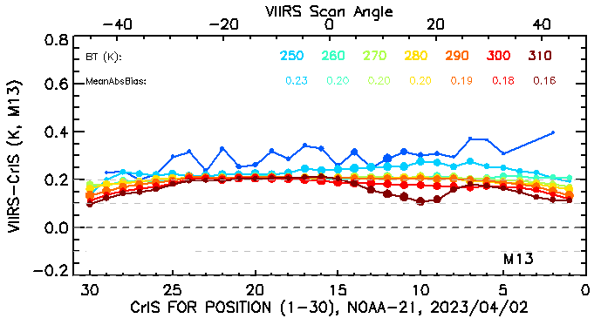
Scan Angle and Scene Temperature Dependent Biases
(M13)
VIIRS - CrIS_{observed}
VIIRS – CrIS_{gap-filled}
M13 exhibit different bias patterns for the measured and gap-filled CrIS spectra.
Independent VIIRS pitch maneuver data analysis results indicate:
  The scan angle dependent biases are likely caused the gap in the CrIS measured spectra.
  CrIS gap-filled spectra may introduce additional VIIRS-CrIS BT biases.
  Will be further studied.
VIIRS - CrIS_{observed}
After applying pitch maneuver data derived cal. Parameters (reprocessed).

Slide 13
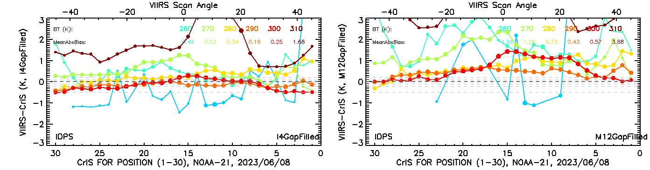
I4 and M12 (NOAA-21)
I4 and M12 show much larger BT Biases compared to other bands.
  VIIRS RSRs are only ~80% covered by CrIS gap-filled spectra.
  Signals are small, stricter quality control may be required.
  Larger uncertainty may exist in the CrIS gap-filled spectra.
  Will be further studied.

Slide 14
Summary
The impacts of CrIS gap-filled spectra on NOAA-21 VIIRS on-orbit calibration evaluation were studied.
Preliminary results indicate:
  The impacts of gap-filling on I5 and M15-M16 are small (within ±0.01 K).
  CrIS gap filled spectra are valuable for validating VIIRS M14 and M13 calibration.
  Further analysis are needed for the I2, M12-M13 results. larger uncertainty may exist in the CrIS gap-filled spectra.
Thanks GSICS IR subgroup for developing and sharing the CrIS gap-filling method!

Slide 15
Funding and Disclaimer
Funding: This study was supported by NOAA grant NA19NES4320002 (Cooperative Institute for Satellite Earth System Studies—CISESS) at the University of Maryland/ESSIC.
Disclaimer: The scientific results and conclusions, as well as any views or opinions expressed herein, are those of the author(s) and do not necessarily reflect those of NOAA or the Department of Commerce.

Slide 16
Backups

Slide 17
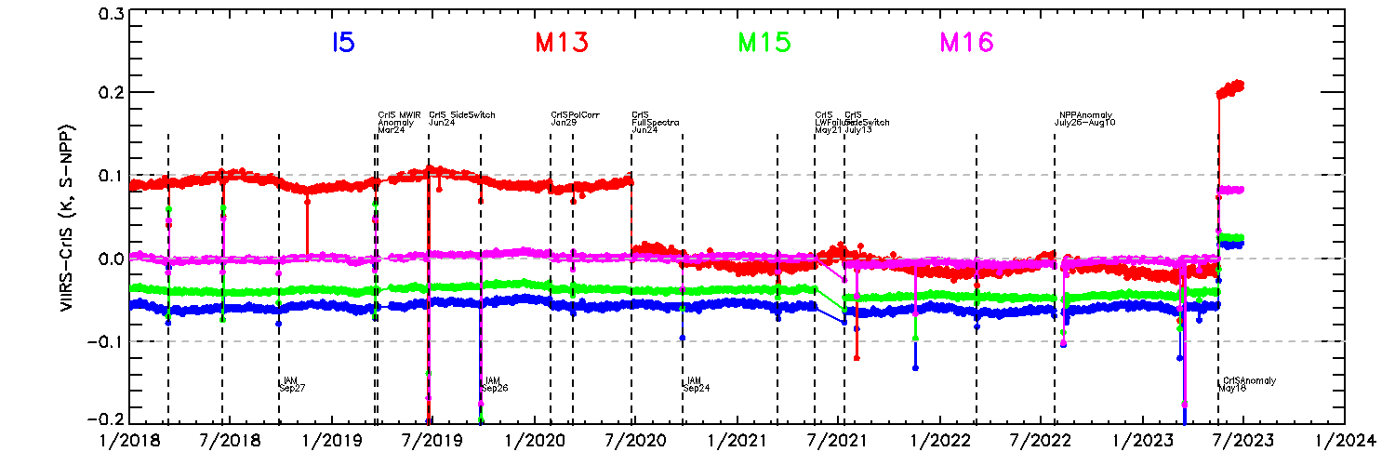
S-NPP/NOAA-20 VIIRS-CrIS Results
Findings: The long-term calibration of S-NPP I5 has been very stable relative to the co-located CrIS observations (trend: ~0.5 mK/year, or 0.0005 K/year).

Slide 18
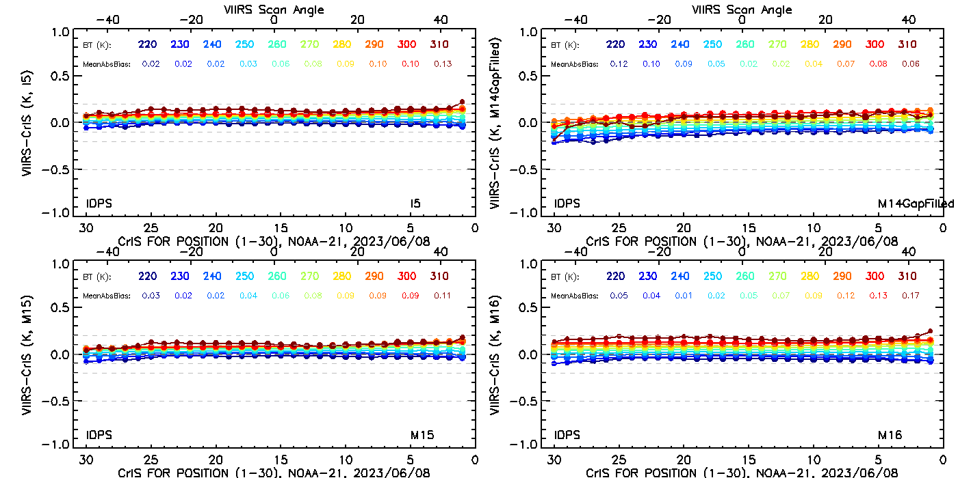
NOAA-21 I5, M14-M16 (June 8)

