Slide 1
Uncertainty Analysis for GEO-LEO IR v2
– and other GSICS products
Tim Hewison
For Discussion at GSICS

Slide 2
Introduction
Uncertainties of different effects can be analysed by different methods:
  (A) Analytically
    May be of limited applicability due to difficulty of propagation through any regression
  (I) Inherent propagation through measurement model
    as uncertainties input radiances in ODR regression
    May be most useful for random uncertainty components
    but care needed in ODR algorithm implementation
  (M) Monte Carlo
    may be most useful for common (“systematic”) uncertainty components
By evaluating:
  Sensitivity of resulting bias to each effect's variable
  Range of each effect's variable
Diagnosing the impact on
  (R) Random components
  (C) Common components ("systematic")
  (S) Structure components
In different modes:
  (N) Near Real-Time
  (T) Using samples of Typical condition

Slide 3
Basic Method
Re-consider these components in turn, and whether they could be analysed
  (A) Analytically
  (I) Inherent propagation through measurement model (as weighting in regression)
  (M) Monte Carlo
How the effect could quantified?
  Identify range of Perturbations
  Quantify Sensitivity of end bias to perturbations
Could Random components be validated using repeated independent evaluations – time series analysis
  Yes – see discussion with Jon Mittaz
How a structured component of the uncertainty could be considered?
How this could be extended to account for inter-channel correlations?

Slide 4
After discussion with Jon Mittaz
Use regression algorithm to propagate realistic estimates of input radiances’ uncertainties
  due to any effects that we can characterise
  Either from the data itself, or a priori information
To provide realistic estimates of the covariance of the fitted coefficients’ uncertainties
  Could be used to evaluate uncertainty on any radiances corrected by them
Could be validated by comparison with variance of time series of resulting biases
  At least for the random components of the uncertainty
  Assuming the instruments’ calibration to be stable
Systematic components may need a Monte Carlo approach
  Which may only be possible less frequently
  i.e. a one-off – or on a monthly basis, depending on the likely nature of the components
  May also be necessary to assume effects are fully uncorrelated as a worst case

Slide 5


Previously …
T. J. Hewison, "An Evaluation of the Uncertainty of the GSICS SEVIRI-IASI Intercalibration Products,"
  in IEEE Transactions on Geoscience and Remote Sensing, vol. 51, no. 3, pp. 1171-1181, March 2013, doi:10.1109/TGRS.2012.2236330.
For Range of different effects, j
Systematic Components:
  Perturbed collocated radiances by (perturbation, Δx) * (sensitivity, ∂L/∂x)
Random Components:
  Monte-Carlo approach: Perturbed collocated radiances by (random number, z_{i}) * (perturbation, Δx) * (sensitivity, ∂L/∂x)
Both used one-off analysis using example set of collocations
  Not dynamic
Structured Components were not considered in that analysis
Sorted in order of dominance for IR13.4 channel, the effects considered were:
  Spatial Variability (R) - lat and lon + parallax
  Temporal Variability (R)
  Temporal Mismatch (C)
  Spatial Mismatch (C) - lat then lon + parallax
  Geometric Mismatch (C )
  Radiometric Noise GEO (R)
  Geometric Variability (R )
  Radiometric Noise LEO (R)
  Spectral Variability (R)
  Spectral Mismatch (C ) - SRF interpolation + gap-filling or SBAF application
  Spectral Calibration (C )
Notes:
(perturbation, Δx) * (sensitivity, ∂L/∂x)

Slide 6
Proposed New Approach
Evaluate uncertainties on all collocated radiances, x_{i}, y_{i} : ux_{i}, uy_{i} (where i is collocation target)
Input collocated radiances and uncertainties as weighting in regression (e.g. ODR): y_{i} = ƒ(x_{i}+ ux_{i} ; β) - uy_{i}
  Where ux_{i} and uy_{i} are uncertainties (with assumed variance, S_{x} and S_{y})
  ux_{i} and uy_{i} are made up of various contributions, ux^{r}_{i,j} and uy^{r}_{i,j} (random) and ux^{s}_{i,j} and uy^{s}_{i,j} (systematic) from effect j
Use regression to propagate uncertainties on inputs into uncertainty of GSICS Correction coefficients, S_{β}
Use these to evaluate uncertainty on any radiances corrected for them, y = ƒ(x; β); S_{y}=ƒ’(x; β; S_{β})
Need to repeat to evaluate uncertainty on corrected radiances due to each source of uncertainty of collocated radiances
Approach expected to work for random components – typically due to scene variability
  Could also be validated by analysis of repeated independent evaluations in a time series
But Systematic Components? – typically due to scene mismatches
  Could be included with random components
  Or could be done as before - Perturbed collocated radiances by (perturbation, Δx) * (sensitivity, ∂L/∂x)
  Is it useful to provide this information separately to the users dynamically?
  Is the systematic component expected to vary significantly with time?

Slide 7
Discussion
Discuss proposed approach in general terms…
Then we go through some effects
to illustrate examples of how they could be evaluated
considering the magnitude of likely perturbations
and sensitivity in radiance-space

Slide 8

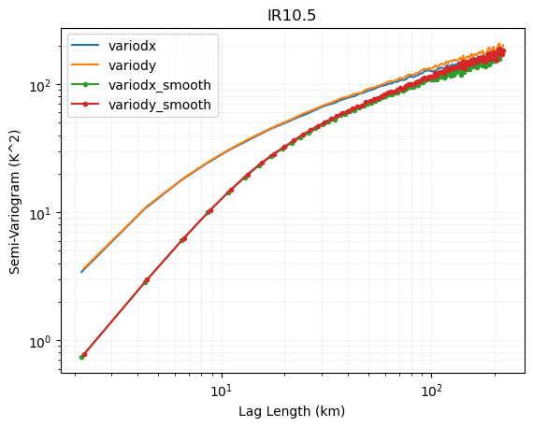
Spatial Variability/Mismatch - latitudinal and longitudinal
Perturbations
  Actual collocations’ spatial separations (if available)
  Histogram of collocations’ spatial separations
  Assume uniform distribution within collocation criteria ±0.5 GEO pixels
  Add random part of geolocation uncertainty of MON + REF
    E.g. IASI 1-2km, CrIS ~0.25km, HIRAS ~3km
Sensitivity
  from variogram
    Similar to Allan Variance – or Structure Functions
    after smoothing equivalent to averaging over LEO FOV
  only need shortest interval – 1 GEO pixel – quick and easy calculation
  Scale by perturbation, according to pre-fitted function – e.g. γ^{5/3}
  Provides reasonable fit for scales <~10km
  (Within inertial sub-range
  Following Kolmogorov turbulence cascade)

Slide 9
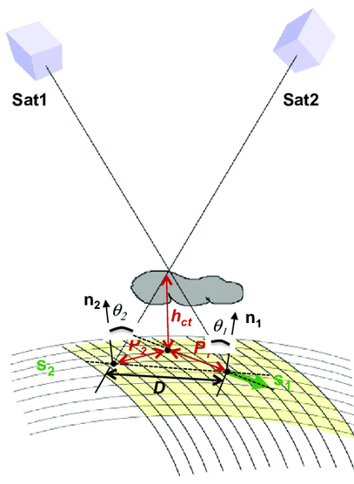

Spatial Variability/Mismatch – Parallax
Equivalent to spatial offset
Geometrically-defined formula
  Eqn (7) in Hewison, 2013
  Simple Cloud Top Height parameterisation:
    If no CTH retrieval readily available
  CTH = (Tsurf – CTT) / ALR, where
    Tsurf = max (Tb) in surrounding environment
    CTT = Tb(10.8µm) = Cloud Top Temperature
    ALR = Adiabatic Lapse Rate,
      typically -6.5K/km at low latitudes [DOI:10.1134/S0001433806040037]
    For a better model see https://doi.org/10.3390/atmos12020173
Corradini et al. (2016). A Multi-Sensor Approach for Volcanic Ash Cloud Retrieval and Eruption Characterization: The 23 November 2013 Etna Lava Fountain. Remote Sensing. 8. 58. 10.3390/rs8010058.

Slide 10
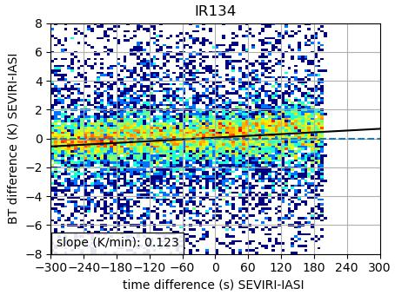
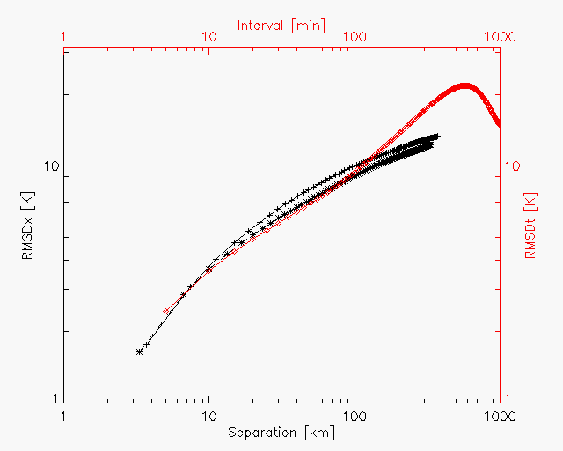
Temporal Variability
Perturbations
  Actual time inter-sensor time difference
  Histogram of time differences
  Assume uniform distribution within collocation criteria
Sensitivity
  from variogram from successive GEO images
Structured component
  ?
Inter-Channel Correction
  ?
Contribution to time series validation
  Random only
Note: missing data in range of Δt=+200 to +300s
Dangerous to assume distributions are symmetric!
R.M.S. differences in Meteosat-8 10.8 μm brightness temperatures with time intervals from Rapid Scanning Meteosat data (red diamonds)

Slide 11
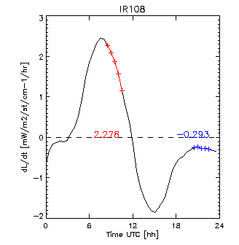
Temporal Mismatch
Perturbations
  Actual time inter-sensor time difference
  Histogram of time differences
  Assume uniform distribution within collocation criteria
Sensitivity
  mean rate of change
  Difference between successive GEO images before/after LEO
Structured component
  ?
Inter-Channel Correction
  ?
Contribution to time series validation
  Random only
Note: missing data in range of Δt=+200 to +300s
Dangerous to assume distributions are symmetric!
Time series of mean rate of change of radiances calculated from Meteosat-9 observations on 2009-09-20
Average over (30°W-30°E)x(30°S-30°N) Area – Land+Sea, Cloud+Clear
[1mW/m2/st/cm⁻¹/hr ~ 1K/hr] 2.278mW/m2/st/cm⁻¹/hr ~ 0.08K/min
From Hewison, 2011 EUMETSAT Conference

Slide 12
GEO-LEO using GEO before/after LEO
Temporal Variability/Mismatch is a dominant uncertainty source in GEO-LEO IR GSICS products
Possible component of GEO-LEO IR v2 algorithm:
  Compare GEO image before/after LEO data
Include collocations with both
  to cancel asymmetric time differences?
  and double the # collocations!
Or interpolate in time?
  Means modifying data!
Or include collocations before/after IASI
  Weighting each according to time difference
# Collocations
-300s 0 +300s
Time Difference
# Collocations
-300s 0 +300s
Time Difference

Slide 13
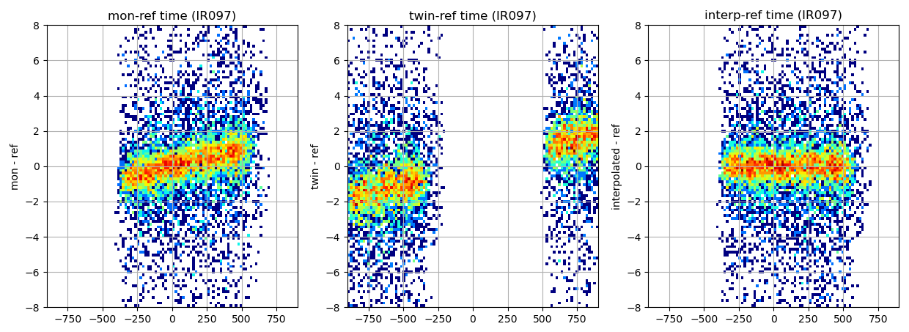
Temporal interpolation between GEO images
Left panel = Closes GEO image to IASI Mid panel = GEO image before/after Right panel=Interpolated in time
X axis = time difference between SEVIRI IR9.7-IASI, Y axis = brightness temperature difference

Slide 14
Geometric Variability/Mismatch
Perturbations
  Actual VZA differences
  Histogram of VZA differences
  Assume uniform distribution within collocation criteria
Sensitivity
  From RTM over range of conditions at VZA=30°/31°
  dsec(theta)=0.012 (0.010 for 15°/17°)
Structured component
  ?
Inter-Channel Correction
  yes
Contribution to time series validation
  Yes - inherently - Random part only
Calculated Offline
Same profiles as for gap-filling/SBAF?

Slide 15
Radiometric Noise - GEO
Perturbations
  NEdT
  Reduced by sqrt(#pixels/collocation)
Sensitivity
  1:1
Structured component
  No
Inter-Channel Correction
  yes
Contribution to time series validation
  Yes - inherently - Random part only

Slide 16
Radiometric Noise - LEO
Perturbations
  NEdT
  Reduced by sqrt(#channels/collocation)
Sensitivity
  1:1
Structured component
  No
Inter-Channel Correction
  yes
Contribution to time series validation
  Yes - inherently - Random part only

Slide 17
Spectral Variability/Mismatch
Perturbations
  Different Spectral interpolation/convolution methods
  Gap-filling method
Sensitivity
  Was negligible for SEVIRI-IASI – no need to re-calculate?
  Can check by halving spectral resolution
  Gap-filling method
Structured component
  No
Inter-Channel Correction
  No
Contribution to time series validation
  Negligible

Slide 18
Spectral Calibration
Perturbations
  IASI Spectral Calibration shift
  Was negligible for SEVIRI-IASI – no need to re-calculate
  Update from Pierre Dussarrat : “CrIS and IASI both good to ~1ppm”
Sensitivity
  Shift SRF before spectral convolution
Structured component
  No
Inter-Channel Correction
  yes
Contribution to time series validation
  No – systematic only

Slide 19
Statistical Breakdown
Using data for full range of conditions used in inter-calibration
  Spatial domain (Lat, Lon)
  Temporal domain (overpass times)
  Time Difference
  VZA and VZA difference
  RAA
Can breakdown statistics by:
  Day and Night
  Land and Water
  Clear and Cloudy
Above is analysed independently for each channel
  Should also consider how to characterise full covariance,
  accounting for inter-channel correlations
Analysis of the results can help refine the inter-calibration algorithm and thresholds

Slide 20
Extension to Inter-Channel
“Just do everything as matrices”
  big!
Or look at differences of channel pairs
Question:
  If we correct each channel independently,
  Or if we correct some channels and not others,
  Do we risk losing something? Or degrading the data?
  e.g. for retrieval algorithms based on inter-channel differences

Slide 21
Defining Structured Uncertainties
“Systematic” terms that aren’t exactly constant
  long-term drifts – seasonal cycles, between decontaminations, …
  Radiance-dependence? – difficult to see how!
May be relevant for some users
  Who?

Slide 22
Application to LEO-LEO IR
Multispectral – Multispectral instead of multispectral-hyperspectral
  SBAF instead of Gap-filling
Time Differences more likely to be asymmetric
  Need greater care to select symmetrically distributed collocations
  Or develop a correction?
More difficult to characterise sensitivity to time differences
  Calculate spatial differences from either LEO data
  Assume spatial & temporal variograms follow same pattern as GEO-LEO
May need to extend time difference threshold
  May need to filter to more stable targets (clear sky/ocean/night, …)

Slide 23
Thank you!
Questions are welcome.

Slide 24
Extension for Microwave inter-cal

Slide 25
Application to LEO-LEO Microwave
As LEO-LEO IR (see previous section), plus :
Gaussian beams
  Account for overlap – esp in fwd/bwd view of conical scanners
Polarisation sensitivity: - new for microwave
  Cross-track Sounders – select only pixels close to nadir
  Characterise sensitivity using RTM over wider range
  Define perturbations based on pre-launch test results
Scan-angle dependence (due to mirror reflectivity and side-lobes): - similar to IR
  Cross-track Sounders – select only pixels close to nadir,
  but characterise sensitivity over wider range
  Conical Imagers – account for different view angles – using RTM - as SBAF
Precipitation screening: - new for microwave
  May be necessary part of filtering for microwave instruments’
  Strong scattering gives highly inhomogeneous signal in space and time
  Outlier detection to remove collocations with highly non-Gaussian differences
  Could also be analysed after
Radio Frequency Interference: - new for microwave
  Strong non-Gaussian error characteristics
  Strictly detection and filtering needed
Ascending/Descending Node
  Not just day/night
  Changes in instruments’ thermal environment
Non-linearity?
…
}
Residuals after filtering treated in same way as spatial variability

Slide 26
Introduction - same
Uncertainties of different effects can be analysed by different methods:
  (A) Analytically
    May be of limited applicability due to difficulty of propagation through any regression
  (I) Inherent propagation through measurement model
    as uncertainties input radiances in ODR regression
    May be most useful for random uncertainty components
    but care needed in ODR algorithm implementation
  (M) Monte Carlo
    may be most useful for common (“systematic”) uncertainty components
By evaluating:
  Sensitivity of resulting bias to each effect's variable
  Range of each effect's variable
Diagnosing the impact on
  (R) Random components
  (C) Common components ("systematic")
  (S) Structure components
    In time
    In radiance
In different modes:
  (N) Near Real-Time
  (T) Using samples of Typical condition

Slide 27
After discussion with Jon Mittaz - same
Use regression algorithm to propagate realistic estimates of input radiances’ uncertainties
  due to any effects that we can characterise
  Either from the data itself, or a priori information
To provide realistic estimates of the covariance of the fitted coefficients’ uncertainties
  could evaluate uncertainty on any radiances corrected for them
At least for the random components of the uncertainty
Could be validated by comparison with variance of time series of resulting biases
  Assuming the instruments’ calibration to be stable
Systematic components may need a Monte Carlo approach
  Which may only be possible less frequently
  i.e. a one-off – or on a monthly basis, depending on the likely nature of the components
  May also be necessary to assume effects are fully uncorrelated as a worst case

Slide 28
Basic Method - same
Re-consider these components in turn, and whether they could be analysed
  (A) Analytically
  (I) Inherent propagation through measurement model (as weighting in regression)
  (M) Monte Carlo
How the effect could quantified?
  Identify range of Perturbations
  Quantify Sensitivity of end bias to perturbations
How a structured component of the uncertainty could be considered?
How this could be extended to account for inter-channel correlations?
Could Random components be validated using repeated independent evaluations – time series analysis

Slide 29
Previously … - update with MW
T. J. Hewison, "An Evaluation of the Uncertainty of the GSICS SEVIRI-IASI Intercalibration Products," in IEEE Transactions on Geoscience and Remote Sensing, vol. 51, no. 3, pp. 1171-1181, March 2013, doi:10.1109/TGRS.2012.2236330.
Sorted in order of dominance for IR13.4 channel, the effects considered were:
  Spatial Variability (R) - lat and lon + parallax
  Temporal Variability (R)
  Temporal Mismatch (C)
  Spatial Mismatch (C) - lat then lon + parallax
  Geometric Mismatch (C )
  Radiometric Noise GEO (R)
  Geometric Variability (R )
  Radiometric Noise LEO (R)
  Spectral Variability (R)
  Spectral Mismatch (C ) - SRF interpolation + gap-filling or SBAF application
  Spectral Calibration (C )
Parallax may be dominant source of uncertainty in some conditions, it was not analysed in the same rigour.
Structured Components were not considered in that analysis.

Slide 30
Statistical Breakdown – MW updates
Using data for full range of conditions used in inter-calibration
  Spatial domain (Lat, Lon)
  Temporal domain (overpass times)
  Time Difference
  VZA and VZA difference
  RAA
  Polarisation
Can breakdown statistics by:
  Day and Night
  Land and Water, Sea Ice, Land Ice
  Clear and Cloudy
Above is analysed independently for each channel
  Should also consider how to characterise full covariance,
  accounting for inter-channel correlations
Analysis of the results can help refine the inter-calibration algorithm and thresholds

Slide 31
Spatial Variability/Mismatch - latitudinal and longitudinal
Perturbations
  Actual collocations’ spatial separations
  Histogram of collocations’ spatial separations
  Assume uniform distribution within collocation criteria
  How to handle Gaussian FOV?
Sensitivity
  from variogram - I, A, M
    after smoothing equivalent to averaging over collocation target area
  Only need to calculate for 1 interval - TBD which - quick and easy!
Structured component
  Maybe in radiance-space?
Inter-Channel Correction
  Variogram would be complicated!
Contribution to time series validation
  Yes - inherently - Random part only

Slide 32
Spatial Variability/Mismatch – Parallax
Perturbations
  CTH (proxy from Tb) - N/A to MW! From ICI/MWI WV diffs
  VZA
  RAA
Sensitivity
  Geometrically-defined formula - Eqn (7) in Hewison, 2013
  Equivalent to spatial offset
Structured component
  ?
Inter-Channel Correction
  ?
Contribution to time series validation
  Yes - inherently - Random part only
Cloud Parallax – Application to Microwave : N/A or difficult? – no CTH
Corradini et al. (2016). A Multi-Sensor Approach for Volcanic Ash Cloud Retrieval and Eruption Characterization: The 23 November 2013 Etna Lava Fountain. Remote Sensing. 8. 58. 10.3390/rs8010058.

Slide 33
Temporal Variability
Perturbations
  Actual time inter-sensor time difference
  Histogram of time differences
  Assume uniform distribution within collocation criteria
Sensitivity
  N/A for most MW – for Δt<12h
  WV: Proxy to IR WV channels
  Assume same correlation with spatial variability as IR?
  NWP+RTM
Structured component
  ?
Inter-Channel Correction
  ?
Contribution to time series validation
  Random component only
Note: missing data in range of Δt=+200 to +300s
Dangerous to assume distributions are symmetric!
R.M.S. differences in Meteosat-8 10.8 μm brightness temperatures with time intervals from Rapid Scanning Meteosat data (red diamonds)

Slide 34
Temporal Mismatch
Perturbations
  Actual time inter-sensor time difference
  Histogram of time differences
  Assume uniform distribution within collocation criteria
Sensitivity
  N/A for most MW – for Δt<12h
  WV: Proxy to IR WV channels
  Assume same correlation with spatial variability as IR?
  NWP+RTM
Structured component
  ?
Inter-Channel Correction
  ?
Contribution to time series validation
  Random component only
Note: missing data in range of Δt=+200 to +300s
Dangerous to assume distributions are symmetric!
Time series of mean rate of change of radiances calculated from Meteosat-9 observations on 2009-09-20
Average over (30°W-30°E)x(30°S-30°N) Area – Land+Sea, Cloud+Clear
[1mW/m2/st/cm⁻¹/hr ~ 1K/hr] 2.278mW/m2/st/cm⁻¹/hr ~ 0.08K/min
From Hewison, 2011 EUMETSAT Conference

Slide 35
Geometric Variability/Mismatch
Perturbations
  Actual VZA differences
  Histogram of VZA differences
  Assume uniform distribution within collocation criteria
Sensitivity
  From RTM over range of conditions at VZA=30°/31°
  dsec(theta)=0.012 (0.010 for 15°/17°)
Structured component
  ?
Inter-Channel Correction
  yes
Contribution to time series validation
  Yes - inherently - Random part only
Calculated Offline
Same profiles as for gap-filling/SBAF?

Slide 36
Polarisation Variability/Mismatch – Microwave only
Perturbations
  Difficult to assess from in-orbit data?
  Based on pre-launch characterisation?
Sensitivity
  From RTM over range of conditions near nadir
Structured component
  ?
Inter-Channel Correction
  yes
Contribution to time series validation
  Yes - inherently - Random part only
Calculated Offline
Same profiles as for gap-filling/SBAF?

Slide 37
Radiometric Noise – Microwave
Perturbations
  NEdT
  Reduced by sqrt(#FOVs/collocation)
Sensitivity
  1:1
Structured component
  No
Inter-Channel Correction
  yes
Contribution to time series validation
  Yes - inherently - Random part only

Slide 38
Spectral Variability/Mismatch - microwave
Perturbations
  From SBAF tool
Sensitivity
  From SBAF tool
Structured component
  No
Inter-Channel Correction
  No
Contribution to time series validation
  Negligible

Slide 39
Extension to Inter-Channel – same as IR
“Just do everything as matrices”
  big!
Or look at differences of channel pairs
Question:
  If we correct each channel independently,
  Or if we correct some channels and not others,
  Do we risk losing something? Or degrading the data?
  e.g. for retrieval algorithms based on inter-channel differences

